Slide 1
New 5 MeV Dipole Magnet
(“DL”)
Planning Meeting
May 23, 2014

Slide 2
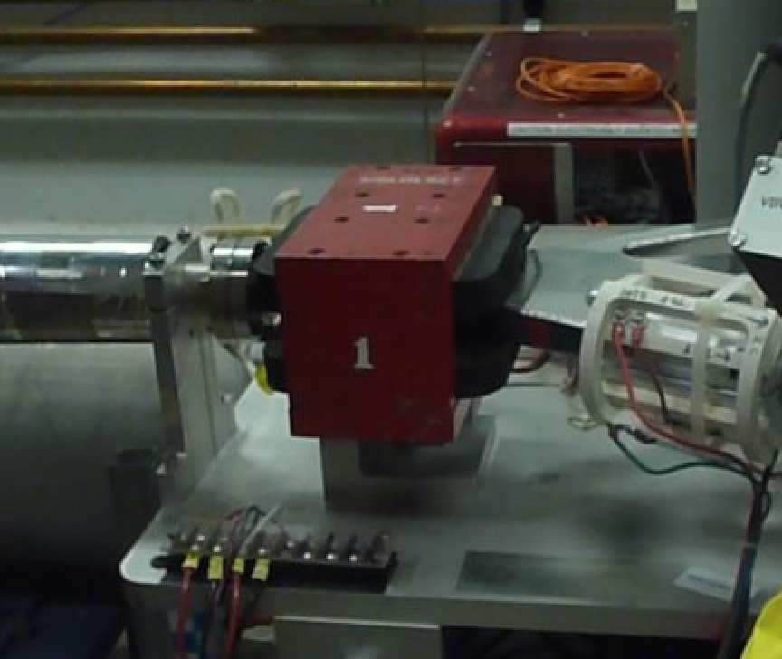
We’re replacing existing 5MeV Dipole Magnet: MBV0L02

Slide 3
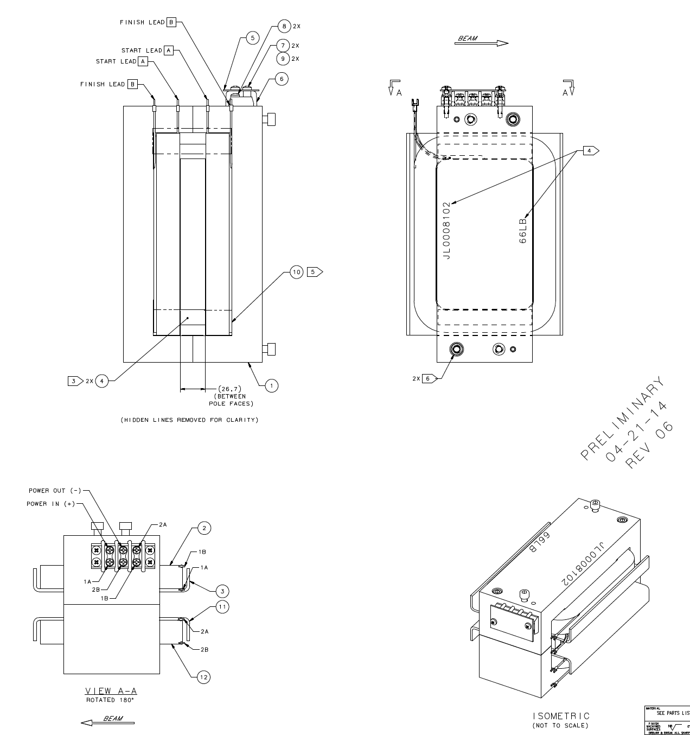
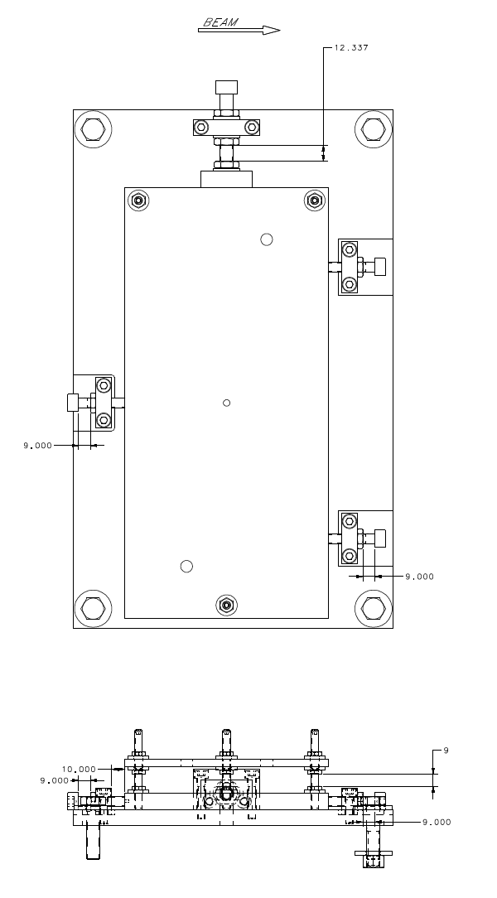
Fixture plate
4” wide
5.8” wide
1.05” gap

Slide 4
Magnet
Design
(Benesch)
Magnet Drawings
(Gregory)
Fixture Design/Drawings
(Gregory)
Specify Magnet Probe
(Benesch)
Fabricate
Magnet
(Shop/Vendor)
Fabricate Fixture
(Shop)
Purchase Magnet Probe
(Suleiman)
Measure
Magnet
(Meyers)
?
Magnet Probe Software
(Croke)
Install
Magnet
(EGG)
Install @ Tunnel
(Croke?)
Update Controls
(Croke?)
Update CED & Songsheet
(Grames)
Align
Magnet
(S&A)

Slide 5
Details of our To-Do List
Magnet + Fixture
Grames will monitor and do best to get this here by August 1st
Precision Hall Probe + Controller
Where?
Installed in CEBAF injector near experiment
Maybe used at MagTest during measurement?
What?
Remote configuration control
Monitoring of magnetic field (and temperature?) into Archiver
When?
Before August 1st … can we shoot for July 15th?
Magnetic Measurements (Jay’s wish list)
Two magnets – twice the opportunity
Power Supply – standard 10A trim (possibly some tests w/ 20A trim)
Stretched wire – 1A intervals between max/min on loop
Hall Probe – Mid-plane @ 5.5A
NMR – 21 positions @ 5.5A
Jay & Sarin like to measure AC/DC to evaluate role of copper

Slide 6
This page intentionally not left blank.

