Slide 1
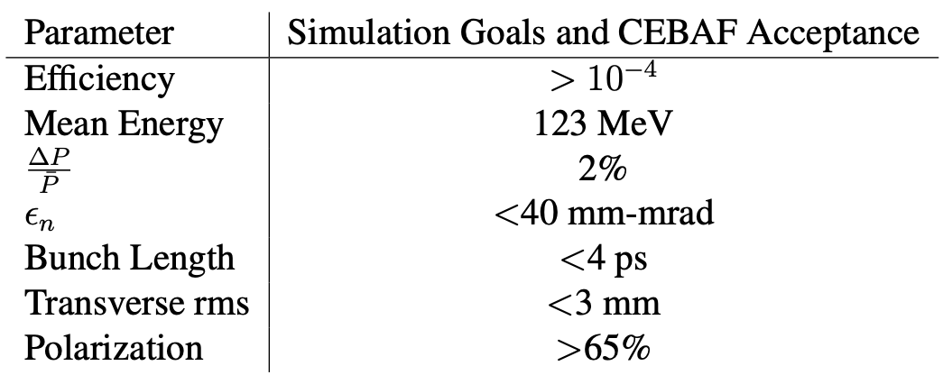
Positron Capture Beam Parameters
Ideally, two modes of operation will be possible
-Delivery of polarized positrons with an efficiency of 10e-4
-Delivery of unpolarized positrons with an efficiency of 10e-3
CEBAF North Linac acceptance values are based on simulation work done by Yves Roblin

Slide 2
Current “Best” Approach
X4
Polarized Beamline
Legend
Target
Conical Solenoid
Solenoid
Quadrupole
Dipole
Collimator/dump
RF Cavity
Unpolarized Beamline
(Additional bunching cavity)
X4

Slide 3
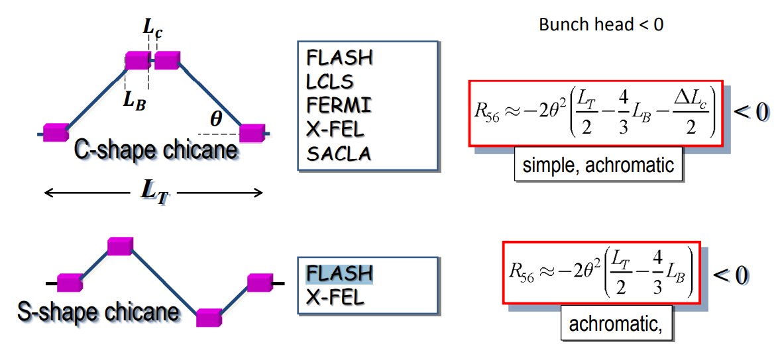
Looked at C and S chicane

Slide 4
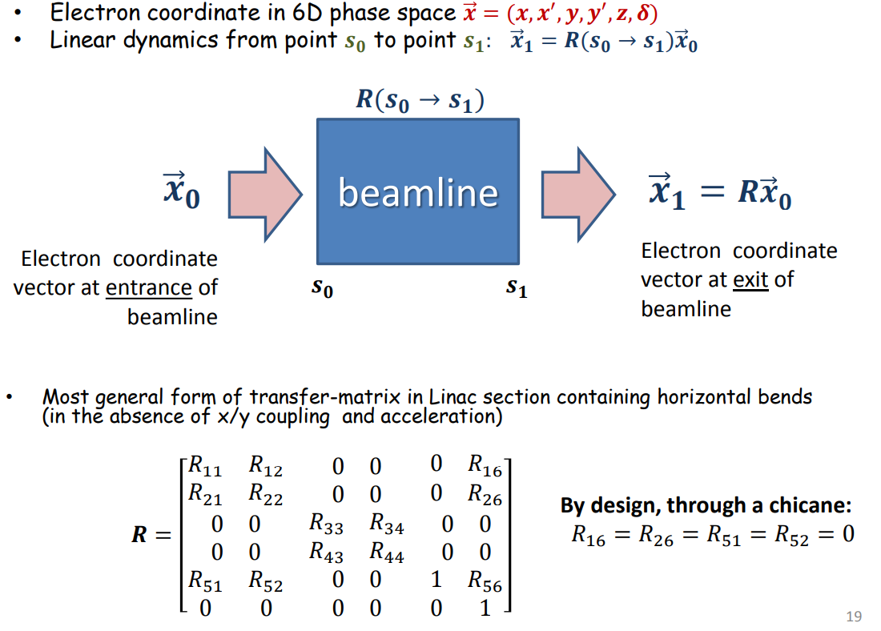
Transfer Matrix R56

Slide 5
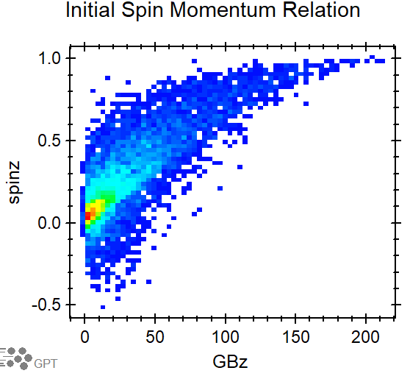
Unpolarized Beamline (Past Approach)
Solenoids vs Quads (efficiency)
Emittance controlled by collimation (energy, emit. effciency)
Initial dipole isolates particles species
Drift reduces efficiency, buncher helps to minimize effect
Chicane carried over form polarized concept
Subsequent acceleration to 123 MeV

Slide 6
Unpolarized Beamline Change
Reduce initial collimation
Trying 500 MHZ bunching cavity (larger bore)
Stronger Solenoids
Take a larger bite of momentum
Chicane has more phase space to exchange
Then increase collimation to bring Emittance down
Subsequent acceleration to 123 MeV

Slide 7
Larger Population to Pass Through This Transformation

Slide 8
Unpolarized Beamline Capture
Will likely need to extend the back end to include more optics and collimation to reduce emittance before acceleration.
Improve chicane design return to quads

