Slide 1
NPS DAQ equipement

Slide 2
DAQ talk 2013 by Brad
NPS: 1116 PbWO4 blocks
→ Energy / ADC:
≫ 70x FADCs
≫ 5x VXS crates
≫ 5x SD + TI + Linux SBC / ROC
→ If fully-piplelined NPS trigger (formed in firmware), then add
≫ 1 VXS crate, 1 TI, 1 Linux SBC
≫ 5x CTP, 1x SSP, (no GTP needed, I think...)
→ Timing / TDC (resolution?)
≫ ~ 1 ns OK: FADCs (no cost)
≫ ~0.1 ns
10x VME CAEN 1190 TDCs (100ps/bin)
Splitters (build into active bases?)
Discriminators
→ HV (-1.6kV @ 1—2 mA base draw?)
≫ want independent channels?
– ie. is HV gain matching a “like” or a “must”?
≫ or multiplex:
– ~ 2x available HW channels (current limited)
https://wiki.jlab.org/cuawiki/images/e/e1/NPS_HallC_DAQ_summary.pdf

Slide 4
Cost estimates total
 | Number needed | Unit price K$
FADC | 70 | 4 | 280
VXS | 5 | 15 | 75
SD | 5 | 4 | 20
TI | 5 | 4 | 20
CPU | 5 | 4 | 20
VTP | 5 | 7 | 35
 |  | Total | 450 | No FADC cost | 170

Slide 5
Cost estimates total reuse SHMS
 | Number needed | Unit price K$
FADC | 43 | 4 | 172
VXS | 3 | 15 | 45
SD | 3 | 4 | 12
TI | 3 | 4 | 12
CPU | 3 | 4 | 12
VTP | 3 | 7 | 21
 |  |  | 274 | No FADC cost | 102
 |  |  |  | No trigger | 81

Slide 6
FADC VTP trigger progress
SBS HCal
Marco helping
VXS Trigger Processor : new Hall B trigger processor module with larger FPGA
VTP readout
VME backplane limited to 100 MB/s
Development of parallel readout of FADC through serial link = 16x 125 MB/s
good option for cluster readout ( read all FADC and only transfer clusters )

Slide 7
Coincidence trigger
 |  |  |  |  |  |  |  | 1 GeV | 300 MeV | Accidental calo 1 GeV
Kin | SIDIS | k ( GeV ) | Q2 | x | Days | DIS rate(Hz) | Coinc gate | Calo rate (MHz) | Calo rate (MHz) |  | coinc rate(Hz)
0 |  | 6.6 | 3 | xBj=0.36 | 1 | 730 | 5.00E-08 | 27 | 115 | 1.35E+00
1 |  | 8.8 | 3 | xBj=0.36 | 2 | 4400 | 5.00E-08 | 11 | 68 | 5.50E-01 | 2420
2 | B | 11 | 3 | xBj=0.36 | 1 | 13000 | 5.00E-08 | 7 | 52 | 3.50E-01 | 4550
3 |  | 8.8 | 4 | xBj=0.36 | 1 | 1200 | 5.00E-08 | 41 | 145 | 2.05E+00
4 | C | 11 | 4 | xBj=0.36 | 3 | 2900 | 5.00E-08 | 22 | 100 | 1.10E+00
5 |  | 8.8 | 3.4 | xBj=0.50 | 3 | 3300 | 5.00E-08 | 2 | 26 | 1.00E-01 | 330
6 |  | 11 | 3.4 | xBj=0.50 | 2 | 9000 | 5.00E-08 | 1.3 | 20 | 6.50E-02 | 585
7 | E | 11 | 4.8 | xBj=0.50 | 5 | 1700 | 5.00E-08 | 6.1 | 48 | 3.05E-01 | 518.5
8 |  | 6.6 | 5.1 | xBj=0.60 | 5 | 53 | 5.00E-08 | 14 | 79 | 7.00E-01 | 37.1
9 |  | 8.8 | 5.1 | xBj=0.60 | 1 | 340 | 5.00E-08 | 4.2 | 39 | 2.10E-01 | 71.4
10 |  | 11 | 5.1 | xBj=0.60 | 5 | 1100 | 5.00E-08 | 2.2 | 27 | 1.10E-01 | 121
11 | F | 11 | 6 | xBj=0.60 | 10 | 450 | 5.00E-08 | 5 | 43 | 2.50E-01 | 112.5
12 |  | 6.6 | 2 | xBj=0.20 | 1 | 260 | 5.00E-08 | 14 | 30 | 7.00E-01 | 182
13 |  | 8.8 | 2 | xBj=0.20 | 1 | 1300 | 5.00E-08 | 5.9 | 18 | 2.95E-01 | 383.5
14 | A | 11 | 2 | xBj=0.20 | 1 | 9400 | 5.00E-08 | 8 | 28 | 4.00E-01 | 3760
15 |  | 11 | 3 | xBj=0.20 | 1 | 700 | 5.00E-08 | 14 | 30 | 7.00E-01 | 490
16 | D | 11 | 5.5 | xBj=0.36 | 5 | 530 | 5.00E-08 | 86 | 222 | 4.30E+00
17 |  | 11 | 8.1 | xBj=0.50 | 5 | 72 | 5.00E-08 | 84 | 220 | 4.20E+00
18 |  | 11 | 10 | xBj=0.60 | 12 | 17 | 5.00E-08 | 85 | 220 | 4.25E+00
For some kinematics does not help unless higher threshold on calorimeter
Might be useful for high rates kinematics
Might need to recheck calorimeter single rates estimates

Slide 8
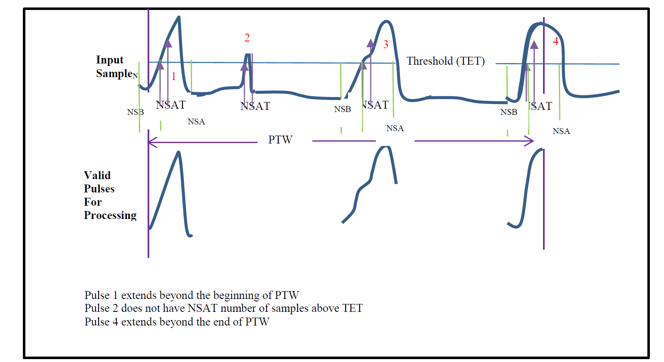
Integral + time
FADC can record up to 4 pulses in time window
Data about 10 times smaller if reading 25 samples

Slide 9
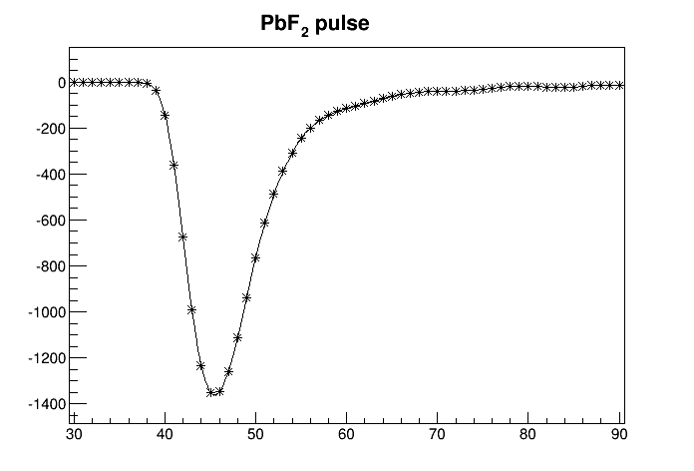
Waveform
Hall A DVCS recorded full waveform 128 samples

Slide 10
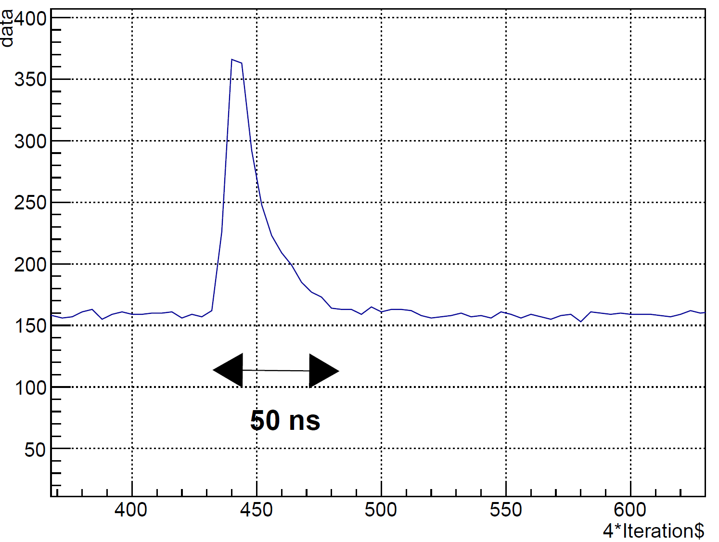
Waveform
NPS pulse fairly fast, need to check with final base and cable length

Slide 11
Data rates
DIS from 1 KHz to 13 KHz
Kin | SIDIS | k ( GeV ) | Q2 | x | Days | DIS rate(Hz) | All calo (KB) | ( MB/s) | Nb blocks | N blocks firing : ev size KB | Calo rate ( MB/s)
0 |  | 6.6 | 3 | xBj=0.36 | 1 | 730 | 71.424 | 52.13952 | 75 | 4.8 | 3.504
1 |  | 8.8 | 3 | xBj=0.36 | 2 | 4400 | 71.424 | 314.2656 | 75 | 4.8 | 21.12
2 | B | 11 | 3 | xBj=0.36 | 1 | 13000 | 71.424 | 928.512 | 75 | 4.8 | 62.4
3 |  | 8.8 | 4 | xBj=0.36 | 1 | 1200 | 71.424 | 85.7088 | 75 | 4.8 | 5.76
4 | C | 11 | 4 | xBj=0.36 | 3 | 2900 | 71.424 | 207.1296 | 75 | 4.8 | 13.92
5 |  | 8.8 | 3.4 | xBj=0.50 | 3 | 3300 | 71.424 | 235.6992 | 75 | 4.8 | 15.84
6 |  | 11 | 3.4 | xBj=0.50 | 2 | 9000 | 71.424 | 642.816 | 75 | 4.8 | 43.2
7 | E | 11 | 4.8 | xBj=0.50 | 5 | 1700 | 71.424 | 121.4208 | 75 | 4.8 | 8.16
8 |  | 6.6 | 5.1 | xBj=0.60 | 5 | 53 | 71.424 | 3.785472 | 75 | 4.8 | 0.2544
9 |  | 8.8 | 5.1 | xBj=0.60 | 1 | 340 | 71.424 | 24.28416 | 75 | 4.8 | 1.632
10 |  | 11 | 5.1 | xBj=0.60 | 5 | 1100 | 71.424 | 78.5664 | 75 | 4.8 | 5.28
11 | F | 11 | 6 | xBj=0.60 | 10 | 450 | 71.424 | 32.1408 | 75 | 4.8 | 2.16
12 |  | 6.6 | 2 | xBj=0.20 | 1 | 260 | 71.424 | 18.57024 | 75 | 4.8 | 1.248
13 |  | 8.8 | 2 | xBj=0.20 | 1 | 1300 | 71.424 | 92.8512 | 75 | 4.8 | 6.24
14 | A | 11 | 2 | xBj=0.20 | 1 | 9400 | 71.424 | 671.3856 | 75 | 4.8 | 45.12
15 |  | 11 | 3 | xBj=0.20 | 1 | 700 | 71.424 | 49.9968 | 75 | 4.8 | 3.36
16 | D | 11 | 5.5 | xBj=0.36 | 5 | 530 | 71.424 | 37.85472 | 75 | 4.8 | 2.544
17 |  | 11 | 8.1 | xBj=0.50 | 5 | 72 | 71.424 | 5.142528 | 75 | 4.8 | 0.3456
18 |  | 11 | 10 | xBj=0.60 | 12 | 17 | 71.424 | 1.214208 | 75 | 4.8 | 0.0816
If all blocks read with waveform, large amount of data

Slide 12
Data rate, time and amplitude
Kin | SIDIS | k ( GeV ) | Q2 | x | Days | DIS rate(Hz) | calo angle (degrees ) | All calo (KB) | ( MB/s) | Nb blocks | N blocks firing : ev size KB | Calo rate ( MB/s)
0 |  | 6.6 | 3 | xBj=0.36 | 1 | 7.30E+02 | 11.7 | 17.856 | 13.03488 | 75 | 1.2 | 0.876
1 |  | 8.8 | 3 | xBj=0.36 | 2 | 4.40E+03 | 14.7 | 17.856 | 78.5664 | 75 | 1.2 | 5.28
2 | B | 11 | 3 | xBj=0.36 | 1 | 1.30E+04 | 16.2 | 17.856 | 232.128 | 75 | 1.2 | 15.6
3 |  | 8.8 | 4 | xBj=0.36 | 1 | 1.20E+03 | 10.3 | 17.856 | 21.4272 | 75 | 1.2 | 1.44
4 | C | 11 | 4 | xBj=0.36 | 3 | 2.90E+03 | 12.4 | 17.856 | 51.7824 | 75 | 1.2 | 3.48
5 |  | 8.8 | 3.4 | xBj=0.50 | 3 | 3.30E+03 | 20.2 | 17.856 | 58.9248 | 75 | 1.2 | 3.96
6 |  | 11 | 3.4 | xBj=0.50 | 2 | 9.00E+03 | 21.7 | 17.856 | 160.704 | 75 | 1.2 | 10.8
7 | E | 11 | 4.8 | xBj=0.50 | 5 | 1.70E+03 | 16.6 | 17.856 | 30.3552 | 75 | 1.2 | 2.04
8 |  | 6.6 | 5.1 | xBj=0.60 | 5 | 53 | 13.8 | 17.856 | 0.946368 | 75 | 1.2 | 0.0636
9 |  | 8.8 | 5.1 | xBj=0.60 | 1 | 3.40E+02 | 17.8 | 17.856 | 6.07104 | 75 | 1.2 | 0.408
10 |  | 11 | 5.1 | xBj=0.60 | 5 | 1.10E+03 | 19.8 | 17.856 | 19.6416 | 75 | 1.2 | 1.32
11 | F | 11 | 6 | xBj=0.60 | 10 | 4.50E+02 | 17.2 | 17.856 | 8.0352 | 75 | 1.2 | 0.54
12 |  | 6.6 | 2 | xBj=0.20 | 1 | 2.60E+02 | 6.3 | 17.856 | 4.64256 | 75 | 1.2 | 0.312
13 |  | 8.8 | 2 | xBj=0.20 | 1 | 1.30E+03 | 9.2 | 17.856 | 23.2128 | 75 | 1.2 | 1.56
14 | A | 11 | 2 | xBj=0.20 | 1 | 9.40E+03 | 10.6 | 17.856 | 167.8464 | 75 | 1.2 | 11.28
15 |  | 11 | 3 | xBj=0.20 | 1 | 7.00E+02 | 6.3 | 17.856 | 12.4992 | 75 | 1.2 | 0.84
16 | D | 11 | 5.5 | xBj=0.36 | 5 | 5.30E+02 | 7.9 | 17.856 | 9.46368 | 75 | 1.2 | 0.636
17 |  | 11 | 8.1 | xBj=0.50 | 5 | 72 | 8 | 17.856 | 1.285632 | 75 | 1.2 | 0.0864
18 |  | 11 | 10 | xBj=0.60 | 12 | 17 | 8 | 17.856 | 0.303552 | 75 | 1.2 | 0.0204
Data rate more manageable
need to check zero suppression ( indvidual FADC channel threhsold)
Pile-up

Slide 13
Test setup SHMS
1 FADC and VME64X crate : 16 channels ( Free )
VXS crate, 1 VTP, 1 SD, 1 TI , 1 CPU : self trigger on FADC and test trigger , no NIM ! about 34 K$
Could have small scale permanent setup
Test background though no magnet ( GEM in front of calorimeter, veto ? )
Is pile-up an issue ?

Slide 14
Cables
1116 cables from patch to SHMS hut
Need to evaluate cost
Steve will ask an estimate to Joe

Slide 15
Conclusion
A few pieces of hardware required for running
get a bit every year
or make large order
3 x (VXS crates+CPU+TI+SD)
If want calorimeter trigger
order VTP : additionnal cost possibility of fast readout
reuse old CTP,GTP ( Hall D, Hall B might upgrade to VTP)
order of VTP coming up soon
Test / simulation
occupancies
effect of pile-up
HV ?

