Slide 1
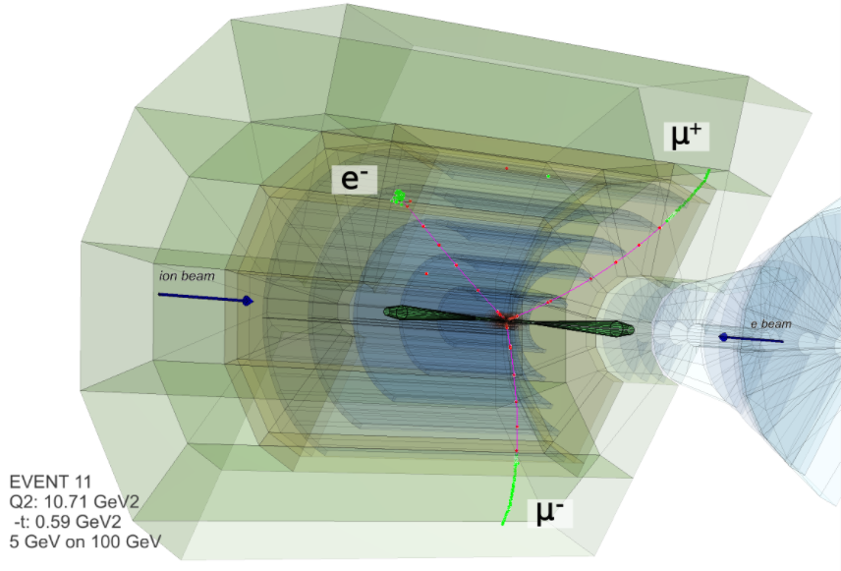
Particle Identification with Silicon
José Repond
Argonne National Laboratory
EIC Users Group Meeting
Catholic University of America
Washington D.C.
July 30 – August 2, 2018

Slide 2
● To achieve the EIC physics goals we need
100% acceptance for all particles produced (acceptance is luminosity!)
Excellent momentum/energy resolution
PID for all particles
→ This requires full integration of the central, forward detectors and the beamline
● Particle list at MC hadron level
● Detector output
We want a detector which provides the same type of information
Particle ID | P_{x} | P_{y} | P_{z}
11 (e⁻) | -0.743 | -0.636 | -4.842
321 (K⁺) | 0.125 | 0.798 | 6.618
-211 (π⁻) | 0.232 | 0.008 | 3.776
-211 (π⁻) | 0.151 | -0.007 | 4.421
211 (π⁺) | 0.046 | 0.410 | 2.995
111 (π⁰) | -0.093 | 0.048 | 1.498
2112 (p) | 0.115 | -0.337 | 31.029
211 (π⁺) | 0.258 | 0.145 | 6.336
310 (K_{S}⁰) | 0.385 | -0.408 | 3.226
DIS event
E_{e} = 5 GeV
E_{p} = 60 GeV

Slide 3
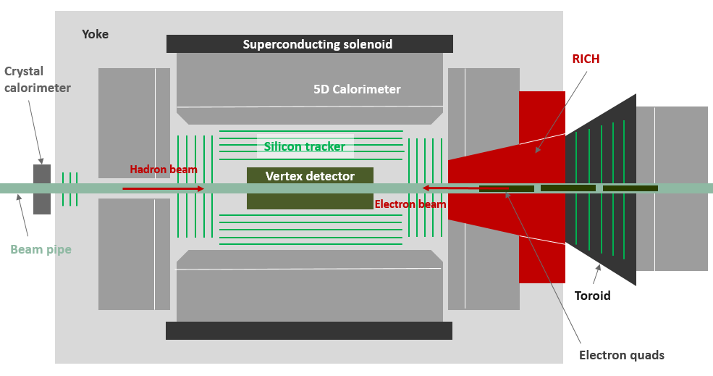
TOPSiDE: Concept of an EIC Detector
TOPSiDE
5D Concept
Energy E
Position x,y,z
Time t
Salient features
4π detector (hermetic coverage)
Multi-purpose detector (don’t need another specialized detector)
Mostly based on silicon sensors (tracker, electromagnetic calorimeter)
Each particle measured individually (optimized for Particle Flow Algorithms)
Particle identification (pion-kaon separation) performed by TOF (tracker and calorimeter)
Imaging calorimetry (tens of millions of readout channels)
Coil on the outside (not to disturb calorimetric measurements)
Dipole/Toroid in the forward direction (to obtain a momentum measurement)
Special detectors in the forward direction (Ring Imaging Cerenkov for Particle ID, debris taggers)
No need for additional TOFs, TRDs, Čerenkovs (in front of calorimeters), muon chambers

Slide 4
TOPSiDE needs
Imaging calorimetry
Ultra-fast silicon ← Emphasis of this talk
Ring Imaging Čerenkov detector
Large solenoid

Slide 5
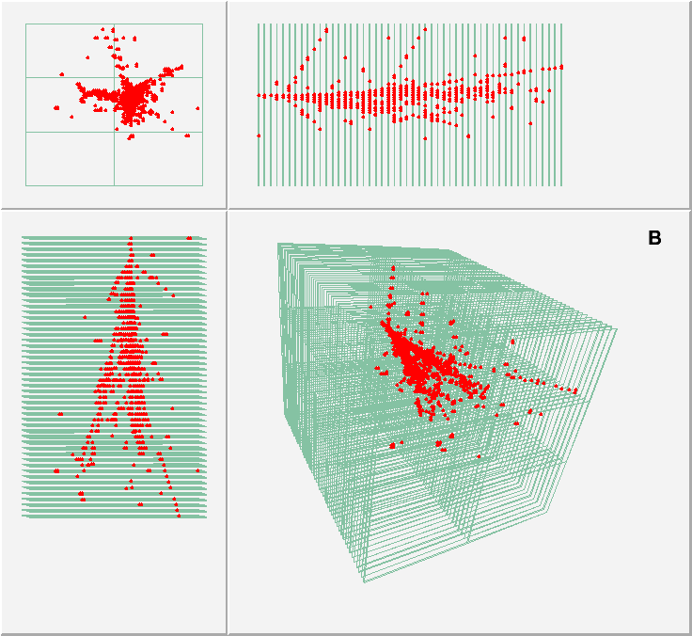

Imaging Calorimetry
Very fine granularity
0.16 – 1.00 cm² readout cells
Cells in every layer read out individually
Entire calorimeter several 10⁷ readout channels
Advantages
Particle ID (photons, electrons, muons, neutral and charged hadrons)
Software compensation (improves hadronic resolution)
Leakage corrections (improves hadronic resolution)
Particle Flow Algorithms (improves jet energy resolution)
Track segment identification (monitors gain/response)
Technologies studied and validated
Silicon and scintillator ECAL with Tungsten absorbers
Scintillator and Resistive Plate Chamber (RPC) HCAL with steel absorbers

Slide 6
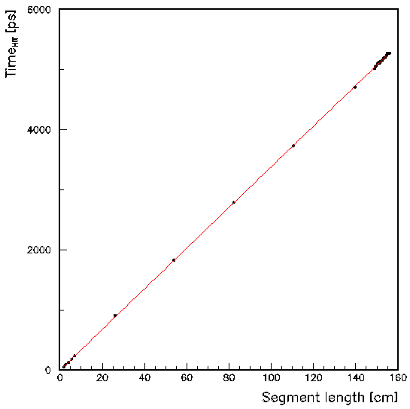
Study of Timing Requirements for PID
Generation of single particles into the barrel (full detector simulation and reconstruction)
Electrons, pions, kaons, protons with E < 10 GeV/c
Reconstruction of track parameters
Calculation of track length up to a given sensor
Linear fit
Timing in sensor versus track length
Assumption track starts at (0,0)
Study of timing resolution
Smearing of times by Gaussian with a fixed width
ECAL
σ = 10 ps
Vertex detector
Outer tracker

Slide 7
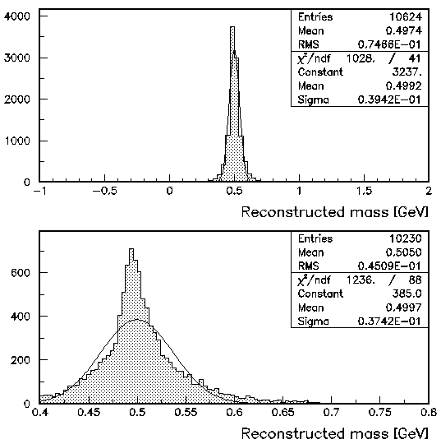
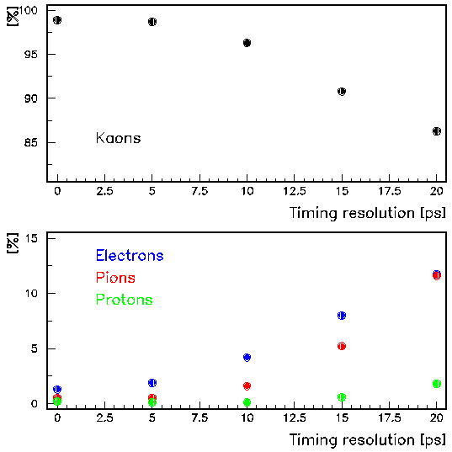
K⁻ sample
σ = 10 ps
Requirement
At least 20 hits (in trackers + cal)
→ Improves resolution
Mass reconstruction
Fit provides c (inverse speed)
Calculate β of track
Calculate mass of particle
Take care of tachions
Define Kaons
0.4 < mass < 0.8 GeV window

Slide 8
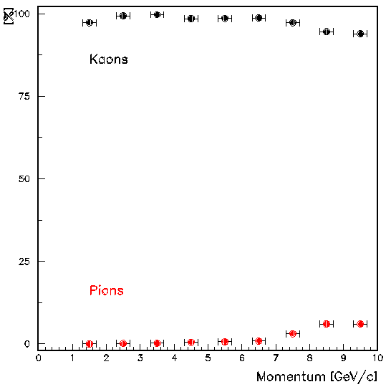
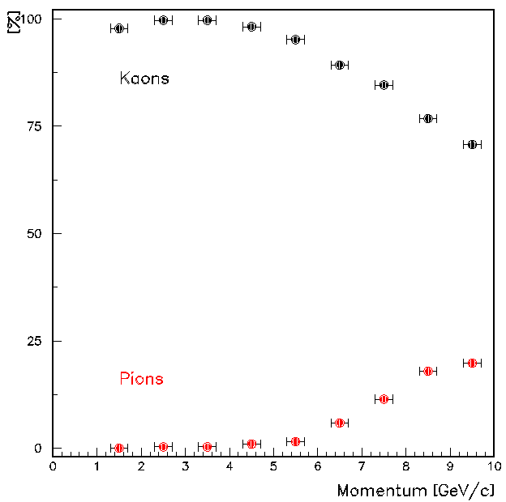
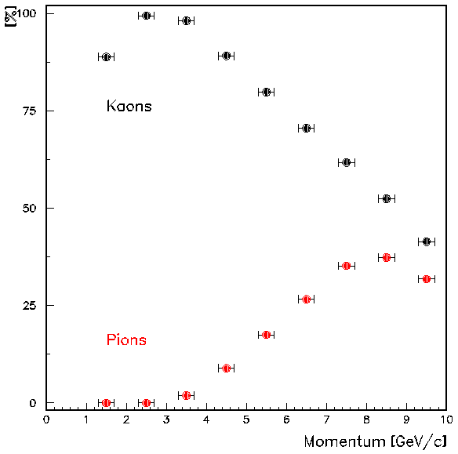
Performance as function of momentum
With the (0,0) constraint
(fit event vertex using all tracks: not entirely unrealistic)
σ = 5.0 ps 10.0 ps 20.0 ps
Excellent pion/kaon separation for p < 7 GeV/c
10 ps timing resolution desirable
Separation of electrons/kaons/protons easy

Slide 9
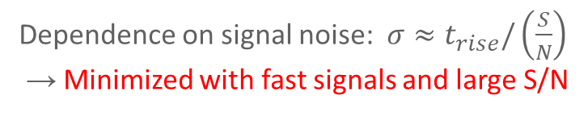
Time resolution of silicon sensors
Taken from Hartmut F-W Sadrozinski et al 2018 Rep. Prog. Phys. 81 026101
Contribution from RO electronics
→ Minimized with careful design
Dependence on signal noise: $σ≈t_{rise}/\left(\frac{S}{N}\right)$
→ Minimized with fast signals and large S/N
Dependence on drift velocity
→ Minimize with uniform electric fields
Dependence on uniformity of ehp production
→ Minimized by decreasing sensor thickness
Dependence on signal size
→ Minimize using e.g. constant fraction discriminators

Slide 10
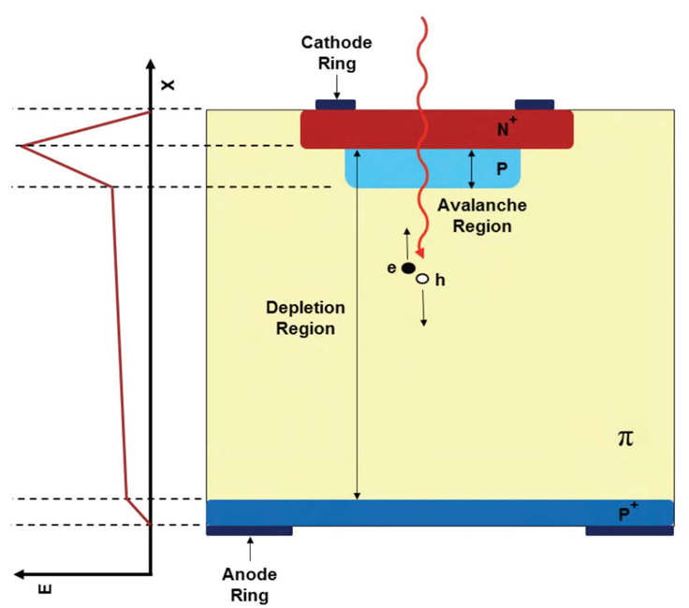
Low-Gain Avalanche Diode (LGAD) Sensors
Additional thin p-layer
Through Boron/Gallium implantation
Increases E-field
Charge multiplication with moderate gain 10 – 50
Amplification of electrons close to pixel (minimal drift)
→ Improved time resolution
Four manufacturers
CNM Barcelona (RD50, ATLAS HGTD)
HPK Hamamatsu
FBK Trento (Italy)

Slide 11
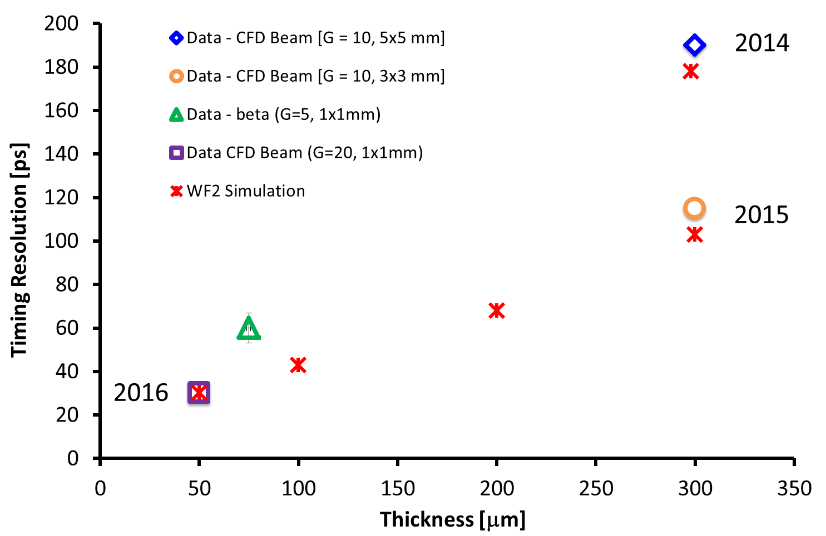
Time Resolution versus Time
H Sadrozinski at the Pico-second Timing Workshop, Torino, Italy, 2018
https://agenda.infn.it/conferenceTimeTable.py?confId=15031
Smaller C
Low noise
Thin sensors
2018
To date best results ~18 picosecond with 35 μm sensors
→ Results with 20 μm sensors imminent

Slide 12
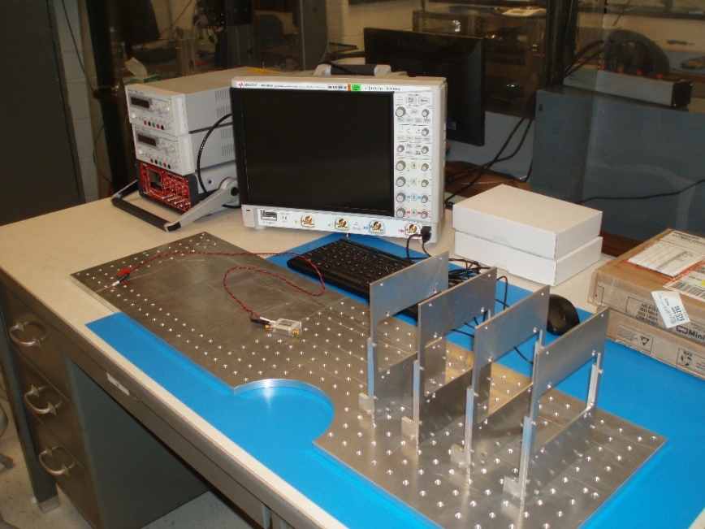
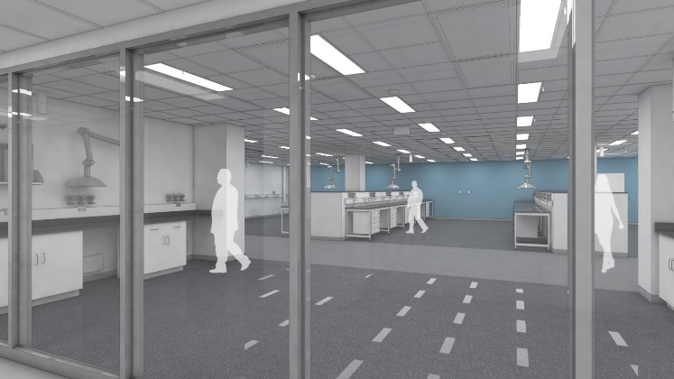
UFSD Test Bench at Argonne
Hardware
Assembly started a few months ago
Almost everything in hand
Scope: Keysight, 2GHz, 4 channels, 20 Gsa/s, 10 bits
LV power supplies: Keysight
HV power supply: CAEN
Environmental chamber
Argonne Micro Assembly Facility AMAF
Being constructed
To be finished by the end of the year
Will be equipped with all possible tools and gadgets
Scopes
Microscopes
Wire bonder
Environmental chambers
Probe stations
Flip chip machine
…
Collaboration with
Argonne HEP (ATLAS), Geneva, Santa Cruz, Fermilab, (Kansas)…

Slide 13
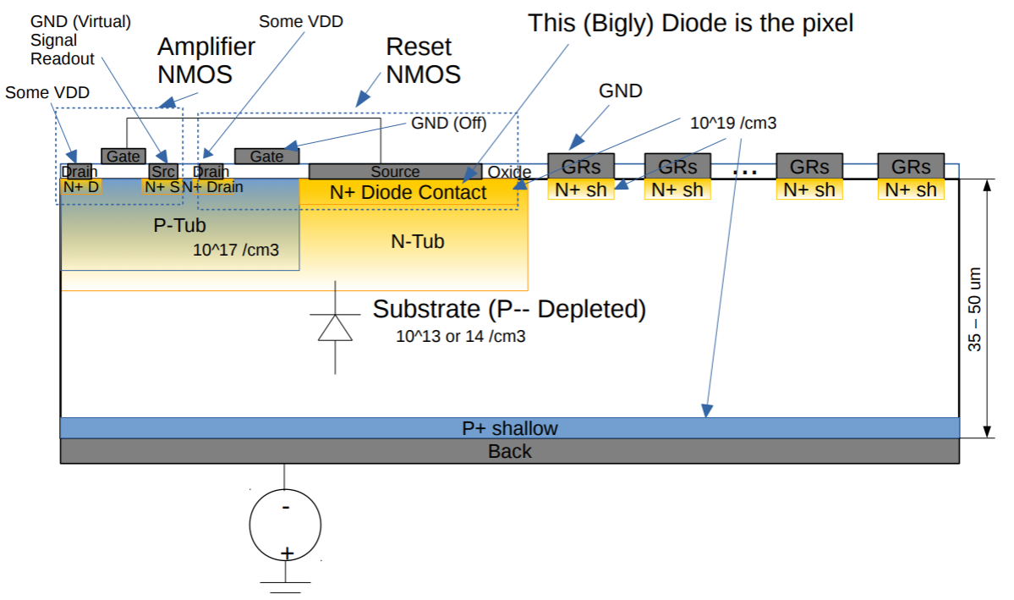
Simulating Sensors at Argonne
Only started recently
Using Silvaco software (actual design)
Using Weightfield2 (developed by Torino)
Study of guard rings
To prevent breakdowns at edges

Slide 14
Simulating Sensors at Argonne
Investigating temperature dependence
-20 ⁰C reduces the leakage current by 2 orders of magnitude
Dependence on doping concentration
Increases both leakage and signal current
Leakage current [A]
Temperature [⁰K]

Slide 15
Simulating Sensors at Argonne
Signal versus time
No Landau fluctuations, no noise (jitter, readout) yet
Next steps
Implementation of readout circuit (HVCMOS)
Study of effects of Landau fluctuations, noise on timing

Slide 16
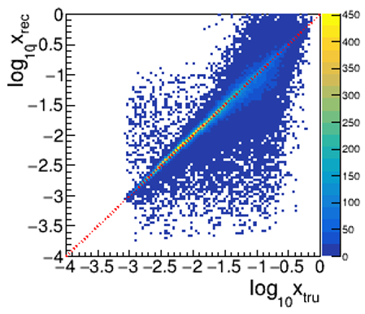
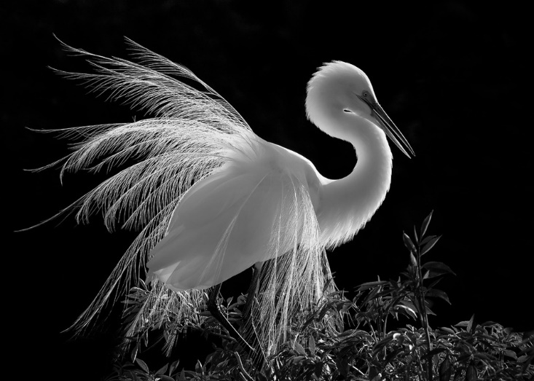
Conclusions
Electron Method
TOPSiDE
Based on silicon
Features ultra-fast silicon, imaging calorimetry → 5D concept
Completely hermetic
Advantages of TOPSiDE
Simplicity of design (limited number of subsystems)
Based on silicon, which is robust (no gas/high voltages, stable operation, radiation hardness)
Excellent kinematic reconstruction
Excellent background rejection (hermeticity)
Minimal ‘dead’ material in front of calorimeters
No additional TOF, TRD, Čerenkov, muon system
Provides list of particles, similar to hadron level MC
Development of Ultra-Fast Silicon detectors
Worldwide interest in this
Argonne constructing a Micro Assembly Facility
Test bench for silicon sensors at Argonne
Simulation studies of sensor designed started at Argonne

Slide 17
Backup Slides

Slide 18
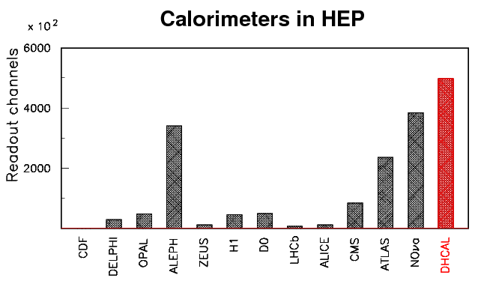
Number of channels
ECAL
Silicon pixels with an area of 0.25 cm²
Total area about 1,400 m²
→ 51M channels
→ Resolution per pixel ~14-bit
HCAL
Scintillator pads with an area of 3 x 3 cm² with 14-bit/pad resolution or
RPCs with 1 x 1 cm² readout pads with 1-bit/pad resolution
Total area about m²
→ 3M (Scintillator) -> 26M (RPC) channels
Tracker/RICH
→ <3M channels
Total
Of the order of 57 – 82 M channels
This is only a prototype

