Slide 1
NPS cooling system
01/10/2021

Slide 2
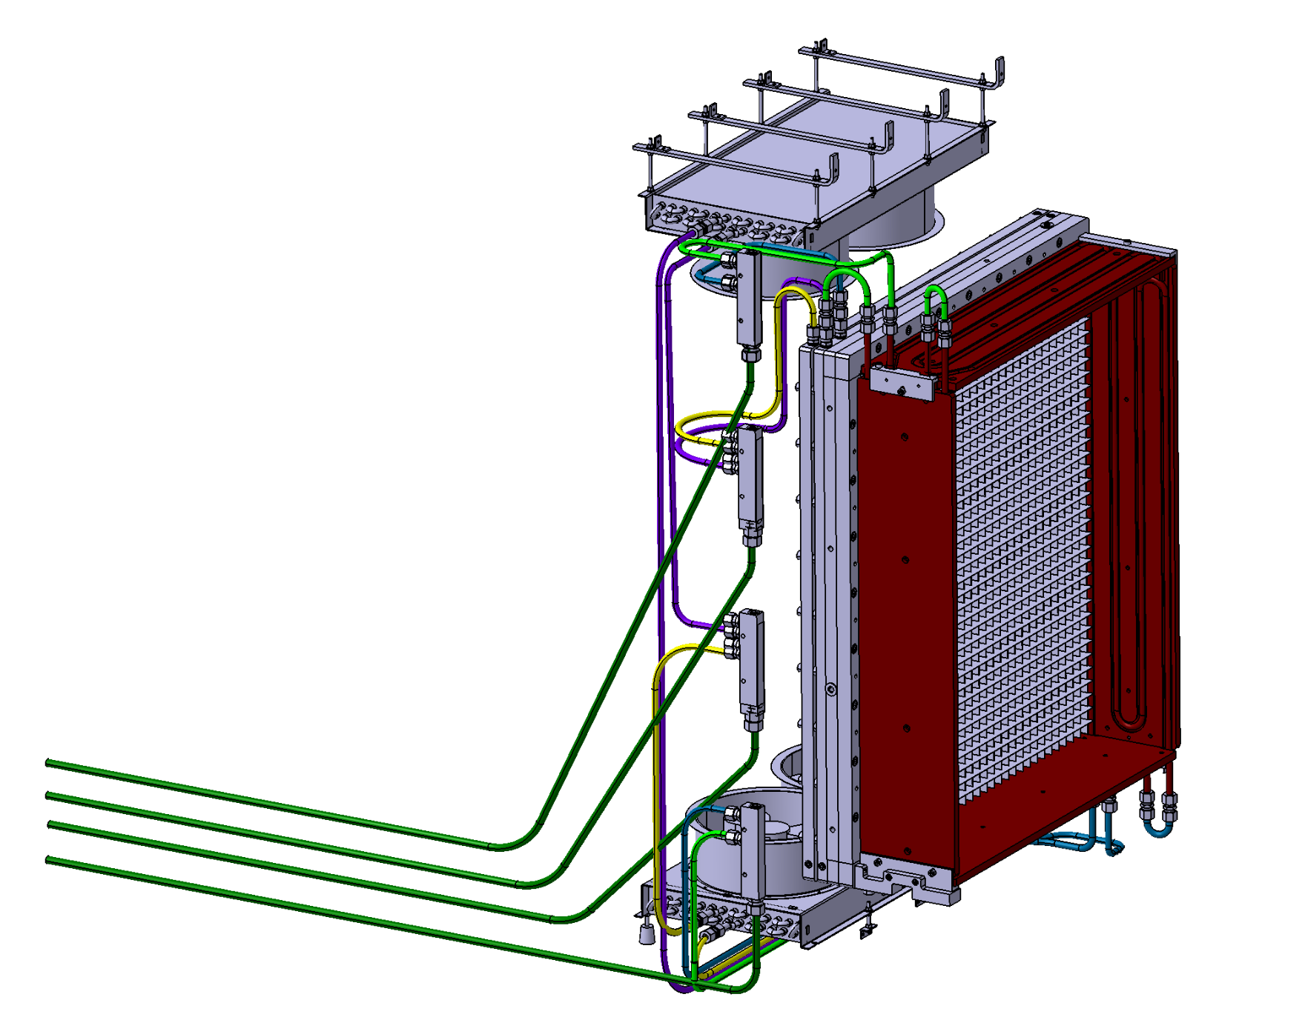
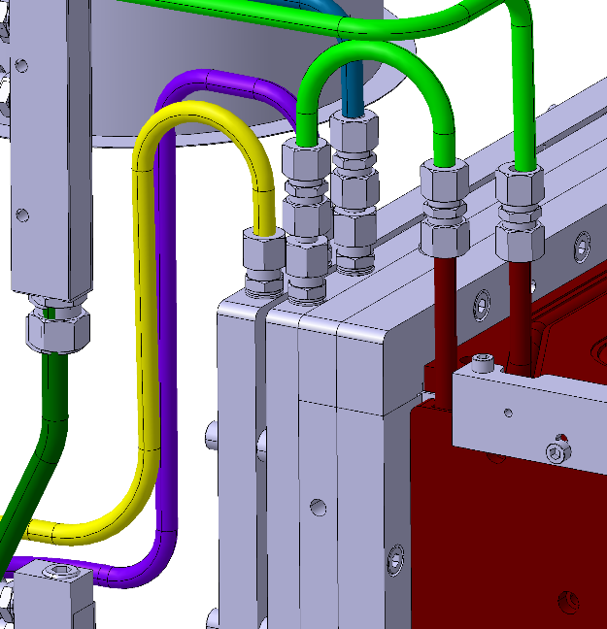
Total cooling (side crystals + side electronic)
Support PMt plate
detail
Reference plate
Connected to 2 chillers

Slide 3
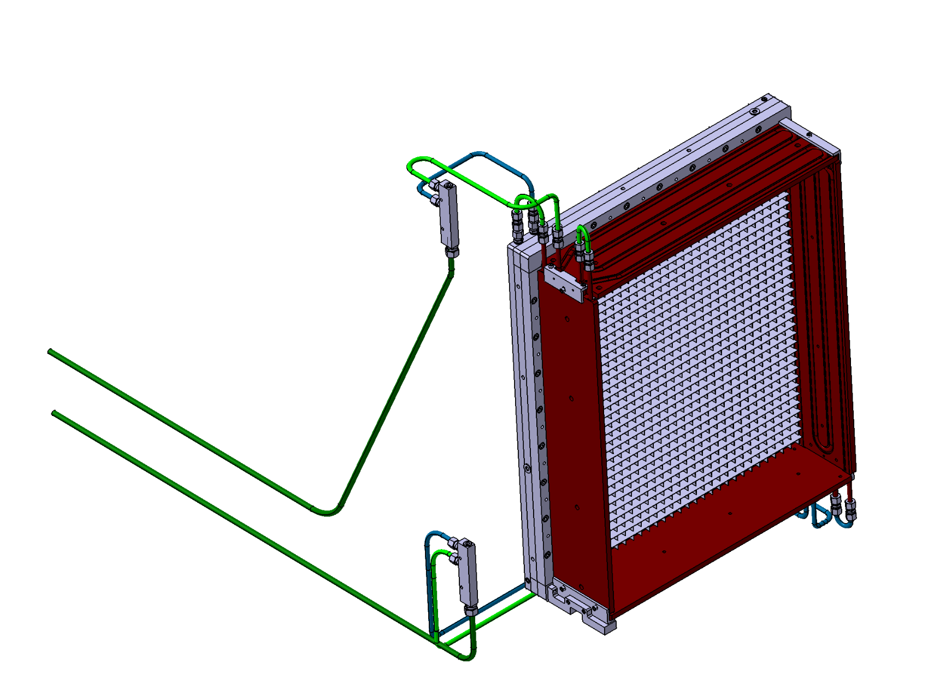
Front cooling (side crystals )
Second branch cooling : 2 copper plates + half reference aluminum plate (cf slide 4)
Divided in 2 branches ( copper tubes D10 ,d8)
Connected to chiller n°1 Kodiak RC006G03BG3
2,3 GPM (Gallons / minute)
Inlet (copper tube D12, d10)
Return (copper tube D12, d10)
Thirst branch cooling : 2 copper plates + half reference aluminum plate (cf slide 4)

Slide 4
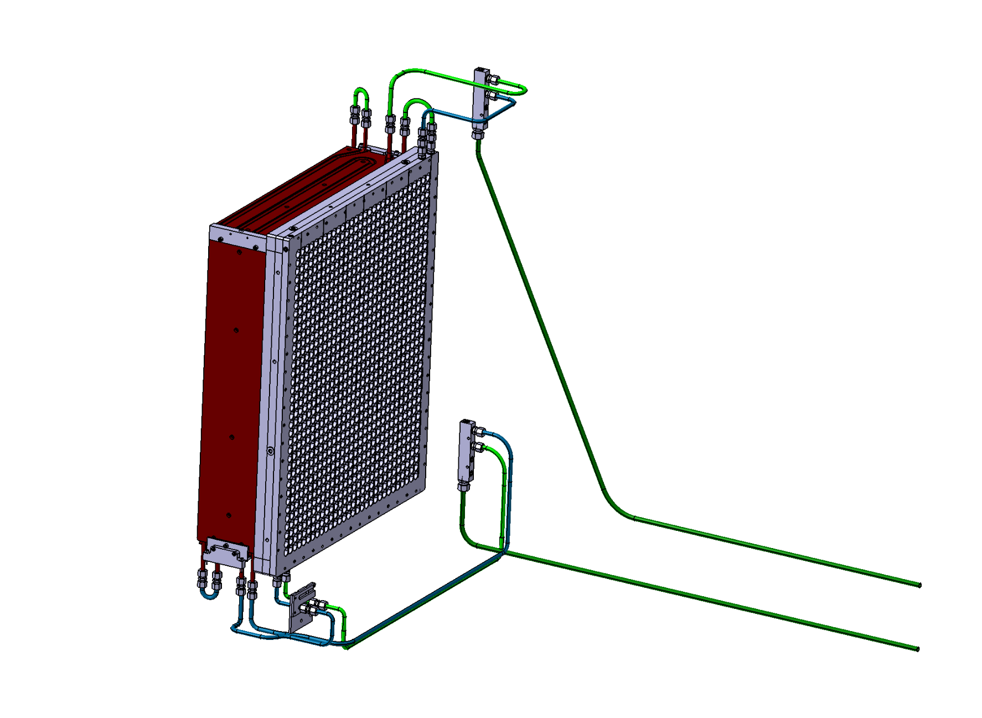
Front cooling (crystals )
Dividers:
1 inlet ;4 outlets
2 of them are used
Possibility if necessary to connect 2 other tubes

Slide 5
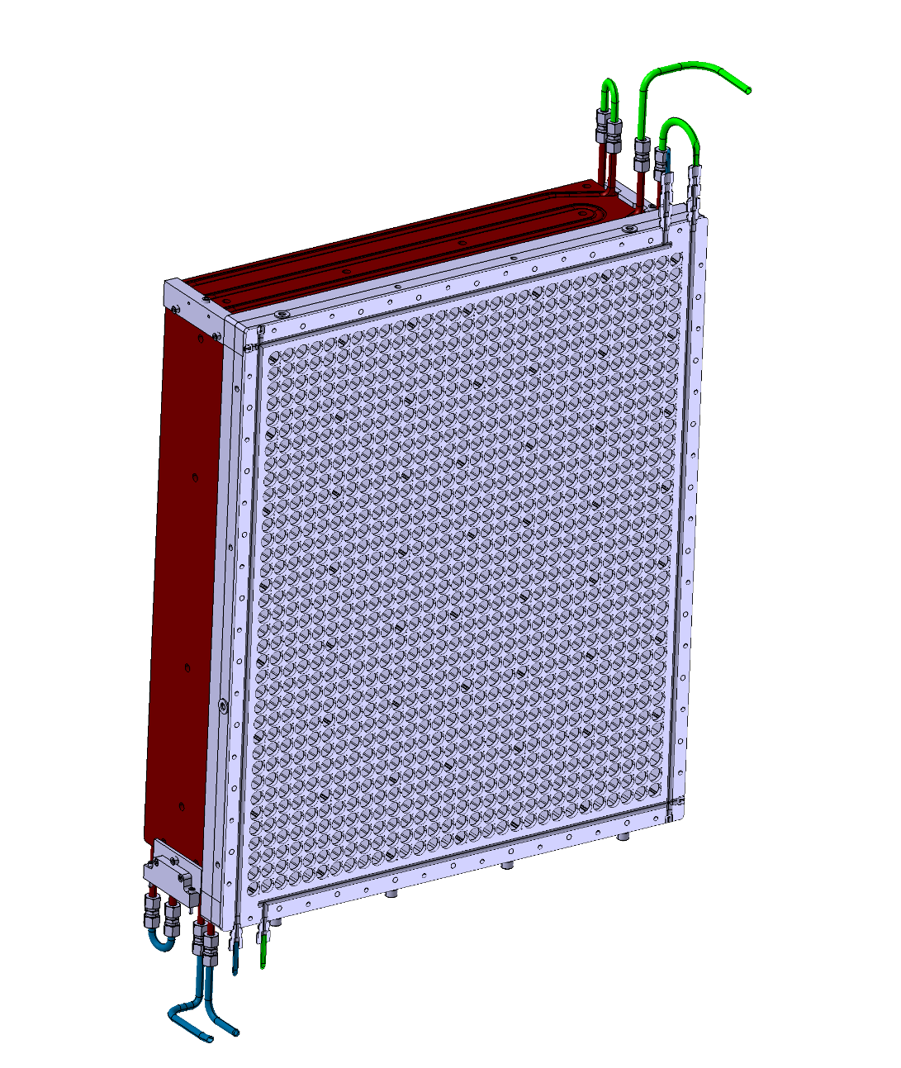
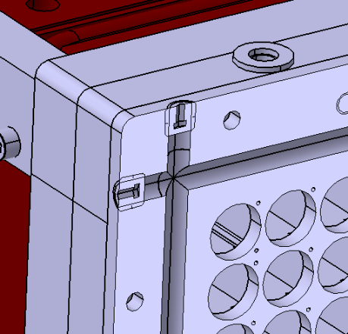
Cooling edge of the reference plate (cut view)
1st branch
2nd branch

Slide 6
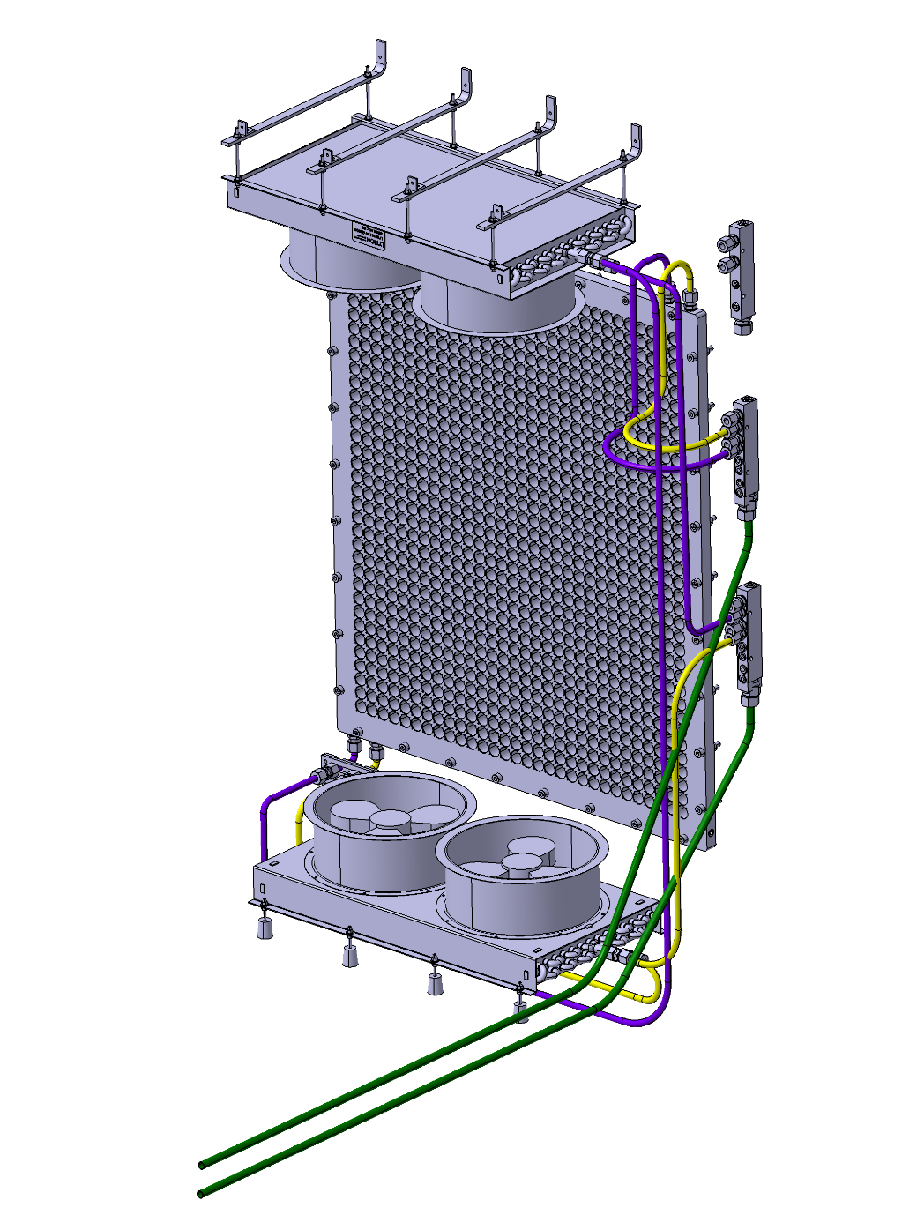
Rear cooling (electronic )
Thirst branch cooling : Top heat exchanger + half support PMt aluminum plate (cf slide 6)
2 heat exchangers Lytron 6320G3SB with funs 10 ’’
Divided in 2 branches ( copper tubes D10 ,d8)
Inlet (copper tube D12, d10)
2nd branch cooling : Bottom heat exchanger + half support PMt aluminum plate (cf slide 7)
Connected to chiller n°2 Kodiak RC011G03BG3
4,3 GPM (Gallons / minute)
Return (copper tube D12, d10)

Slide 7
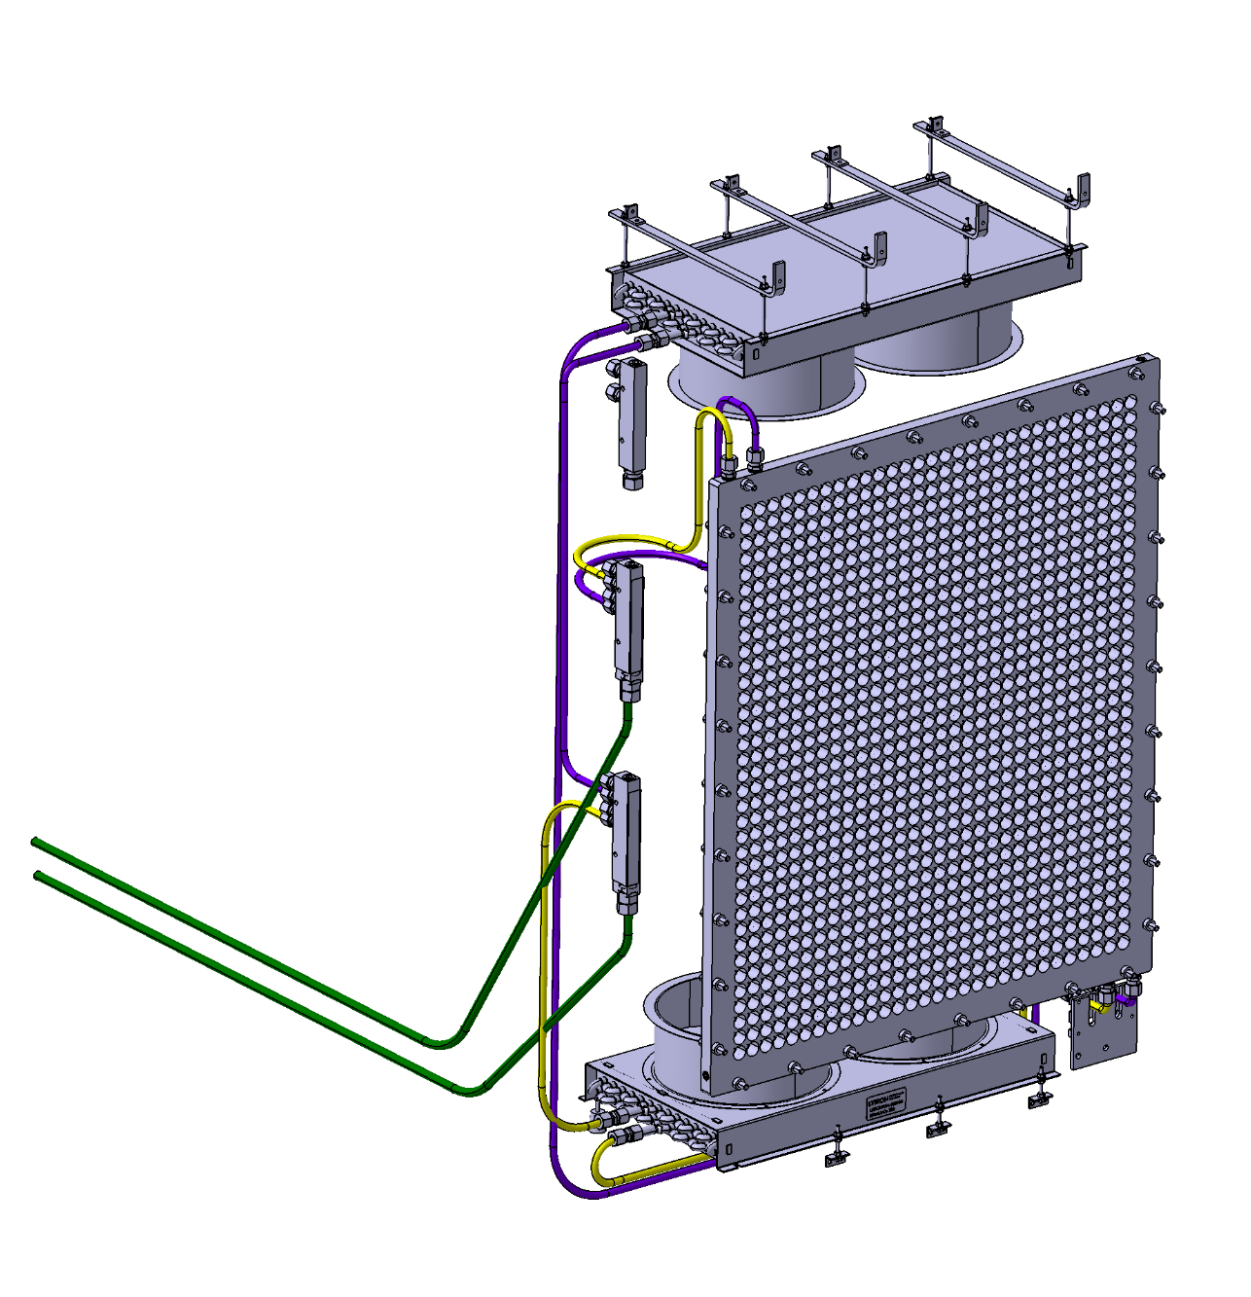
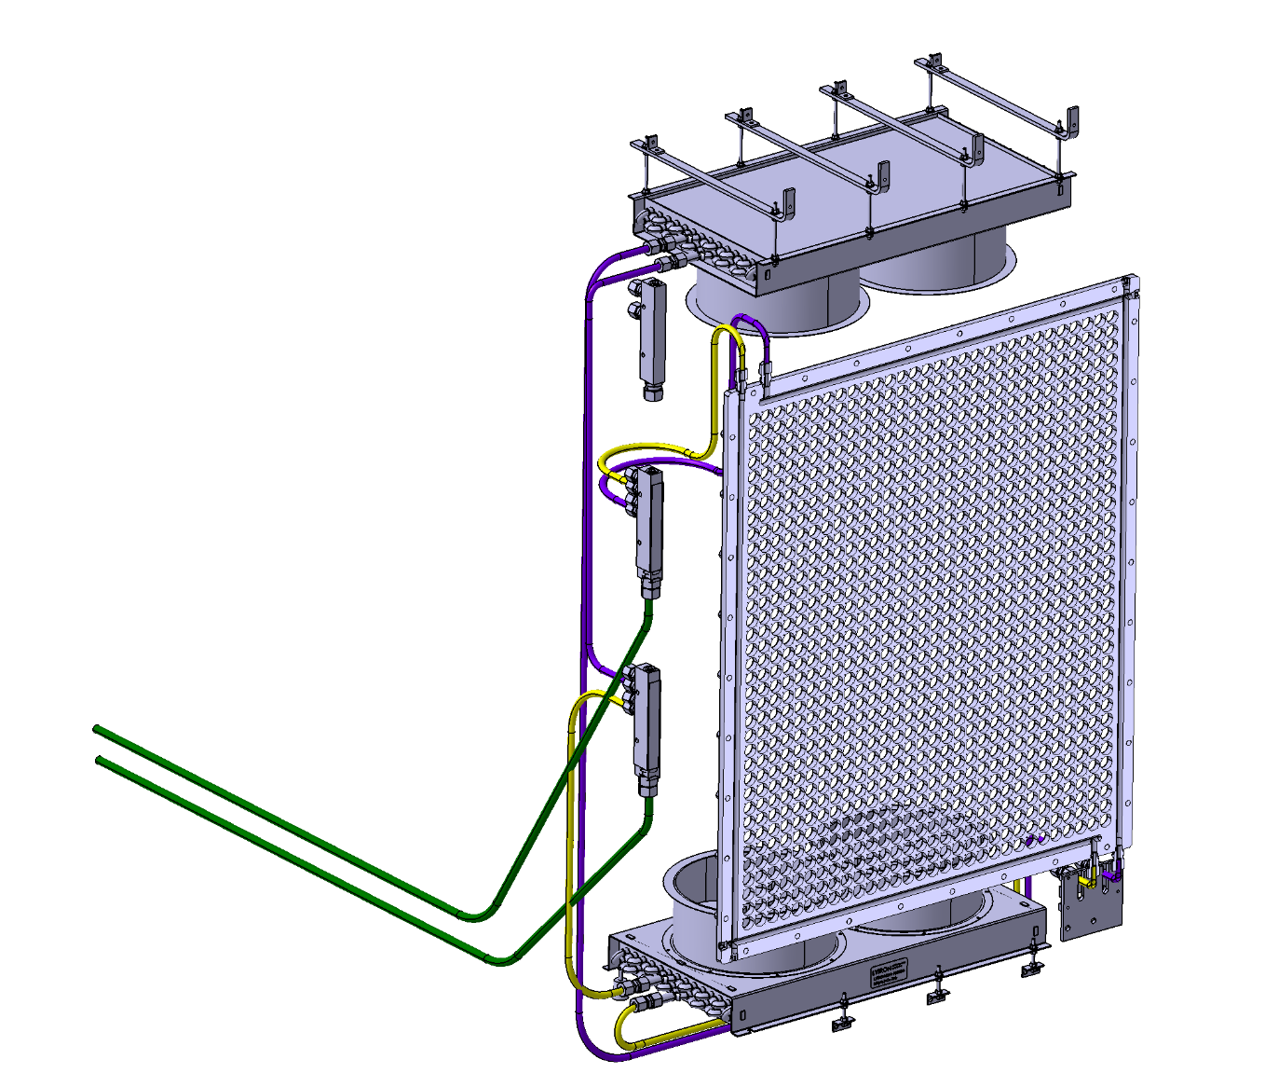
Rear cooling (electronic )
2 heat exchangers Lytron 6320G3SB with funs 10 ’’
1st branch
Inlet (copper tube D12, d10)
2nd branch
Return (copper tube D12, d10)
Cut view

Slide 8
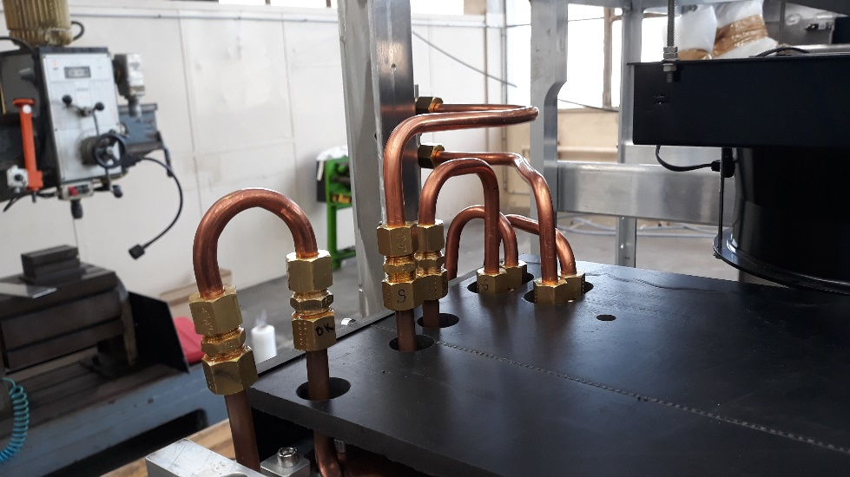
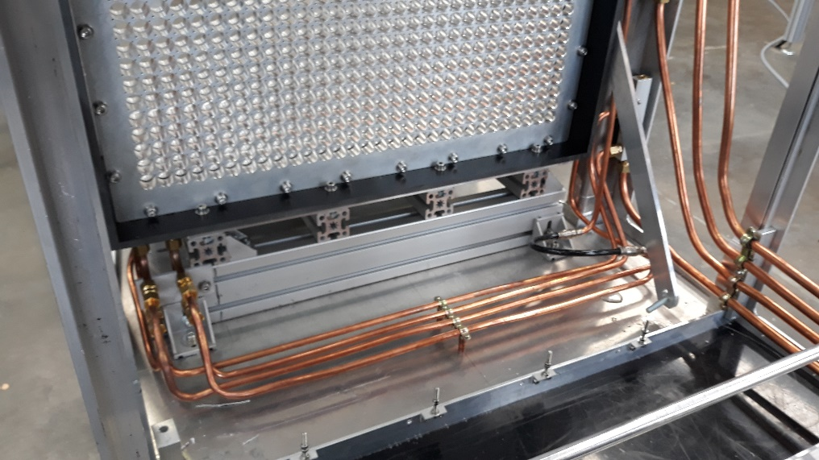
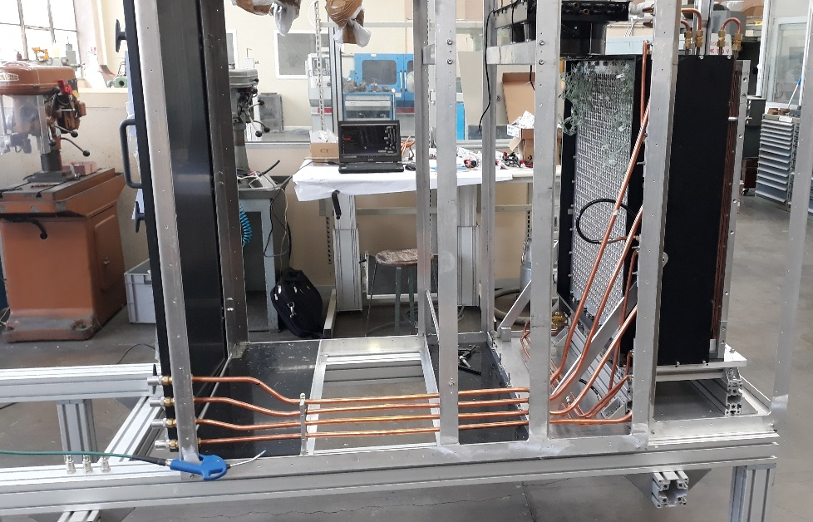
Pictures
Copper tubes and brass connectors for radiation resistance

Slide 9
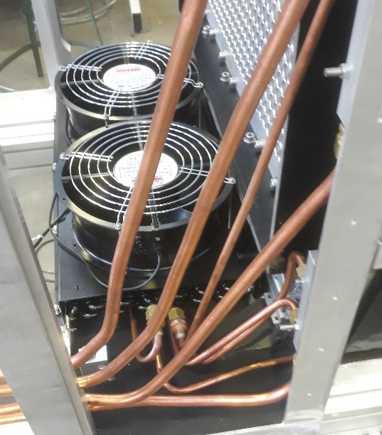
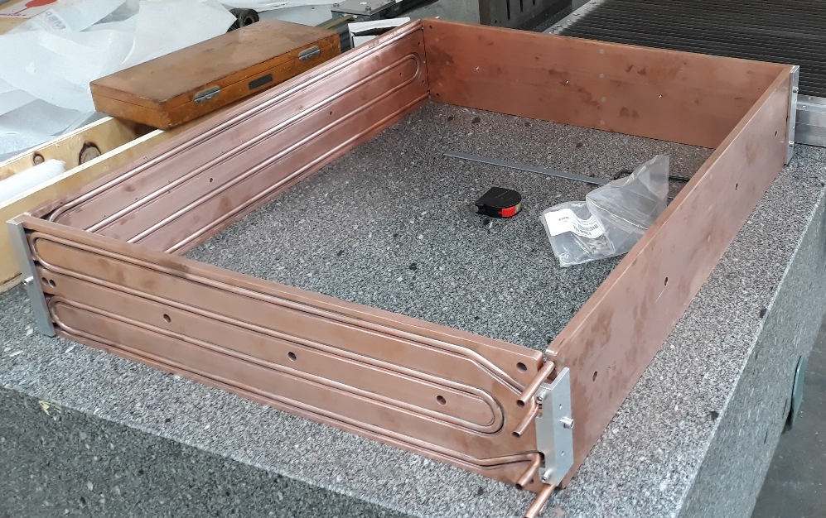
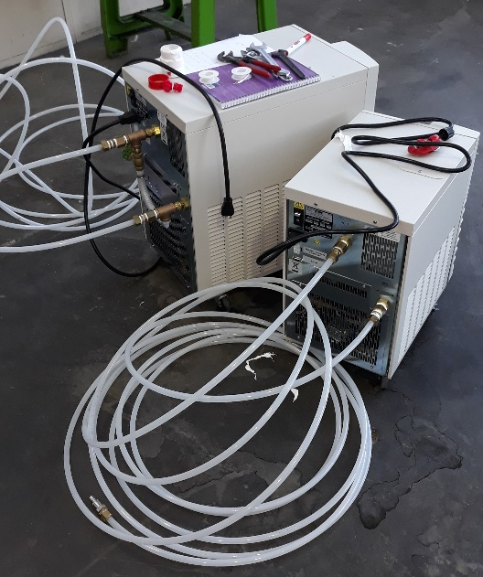
Pictures
Staubli connectors outside the box
Heat exchanger
2 chillers
Copper plates

Slide 10
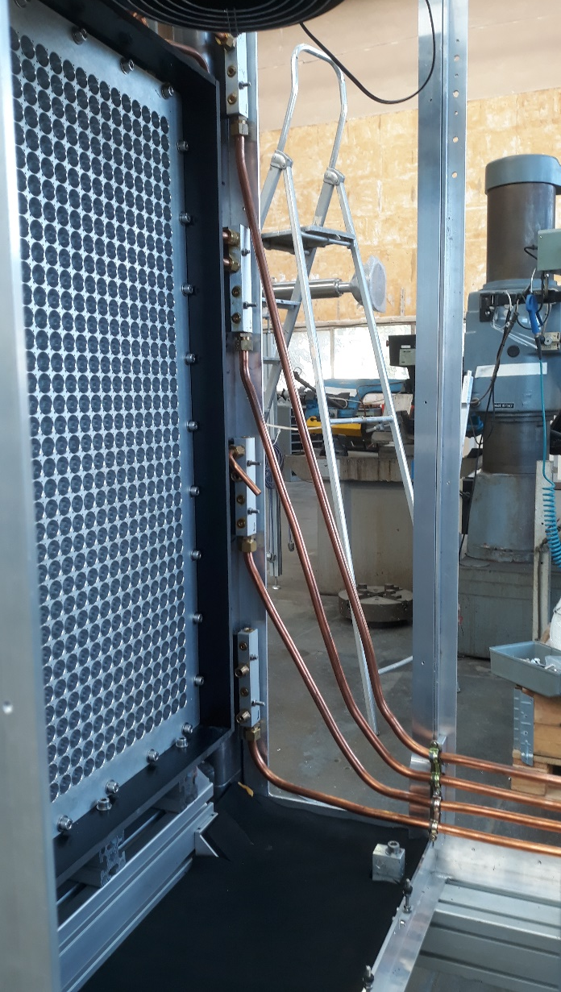
Pictures
Dividers

Slide 11
Connectors reference and device list
1 Chillers n°1 : KODIAK RC006G03BG3 (2,3 GPM)
1 Chillers n°2 : KODIAK RC011G03BG3 ( 4,3 GPM)
2 Heat exchangers LYTRON 6320G3SB with fans 10’’ (100236-11)
Copper tube D12- d10
Copper tube D10- d8
Connectors Parker (brass)
https://www.parker.com/literature/Switzerland/Swiss%20PDF%20Files/Catalogue%20Parker%20Legris%20-%20F.pdf
Page 246
List of device in pdf files

Slide 12
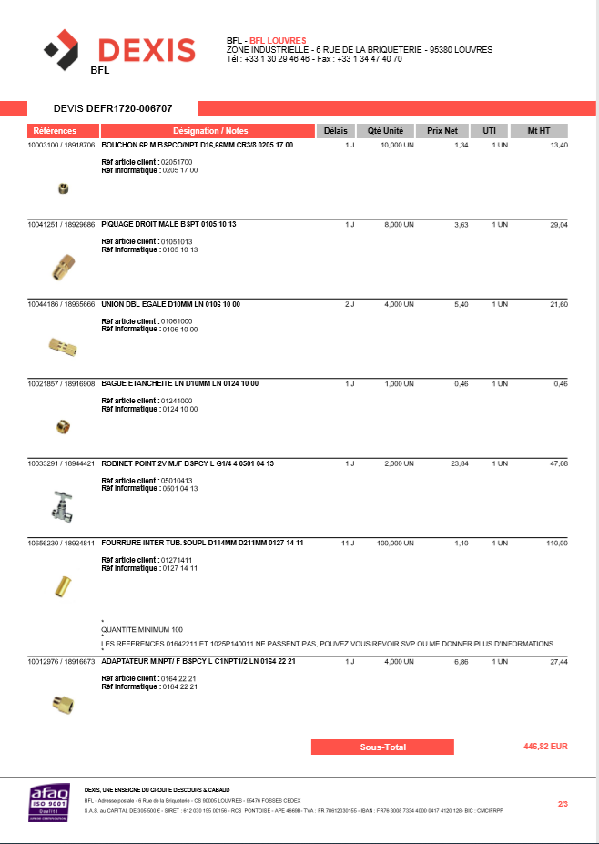
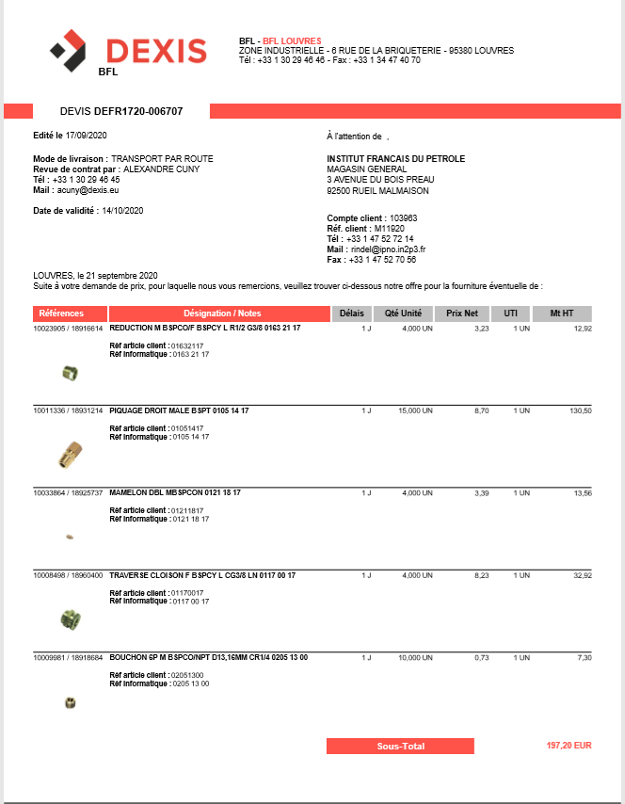
Connectors reference and device list

Slide 13
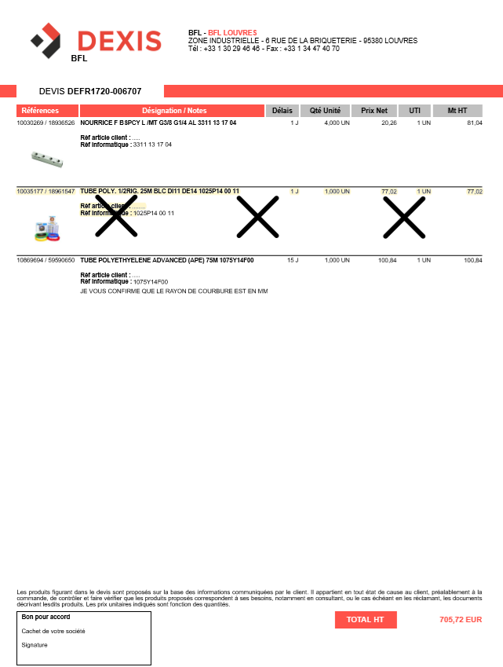
Connectors reference and device list

