Slide 1
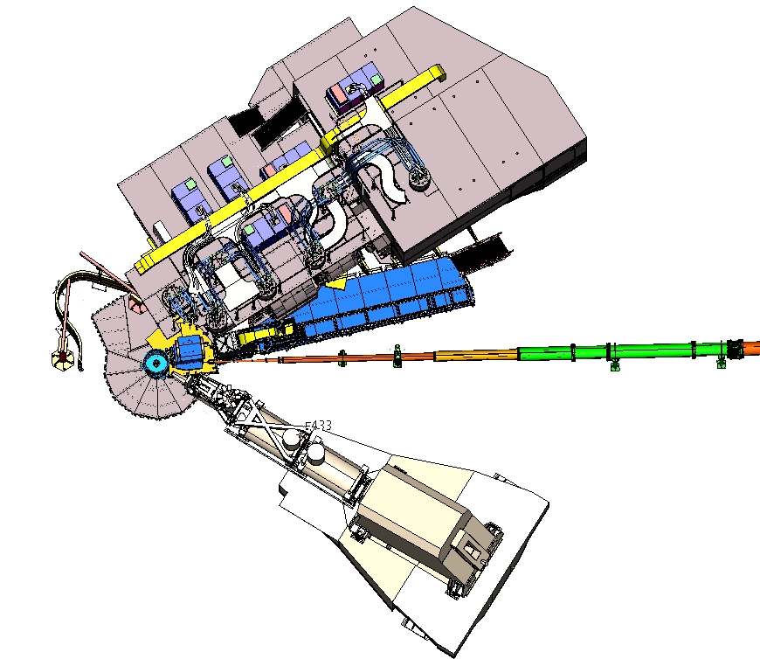
Status of the NPS calorimeter assembly
06/09/2022
NPS assembly
1

Slide 2
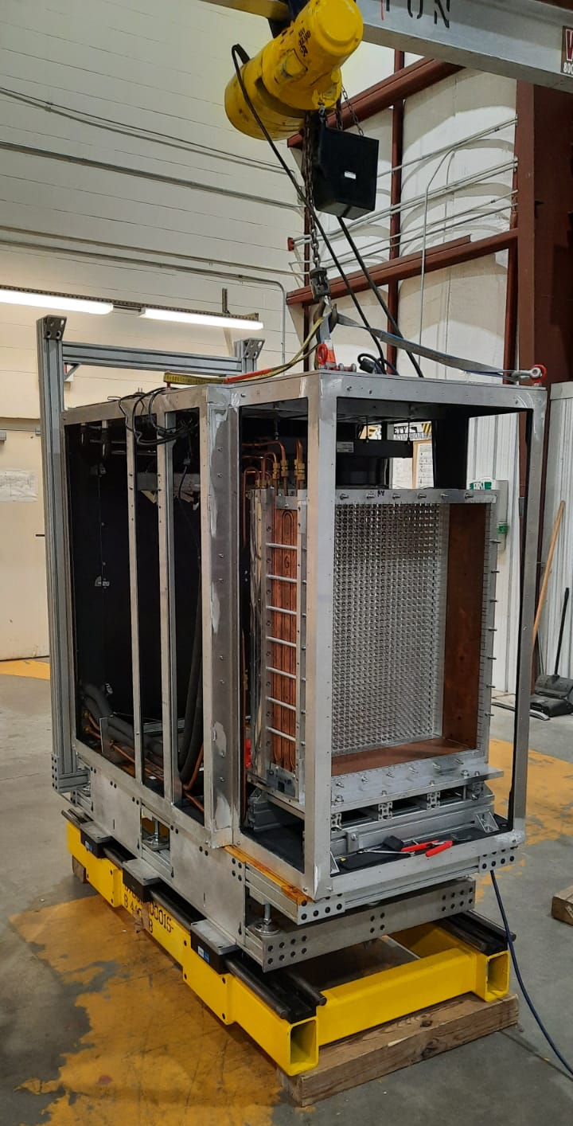
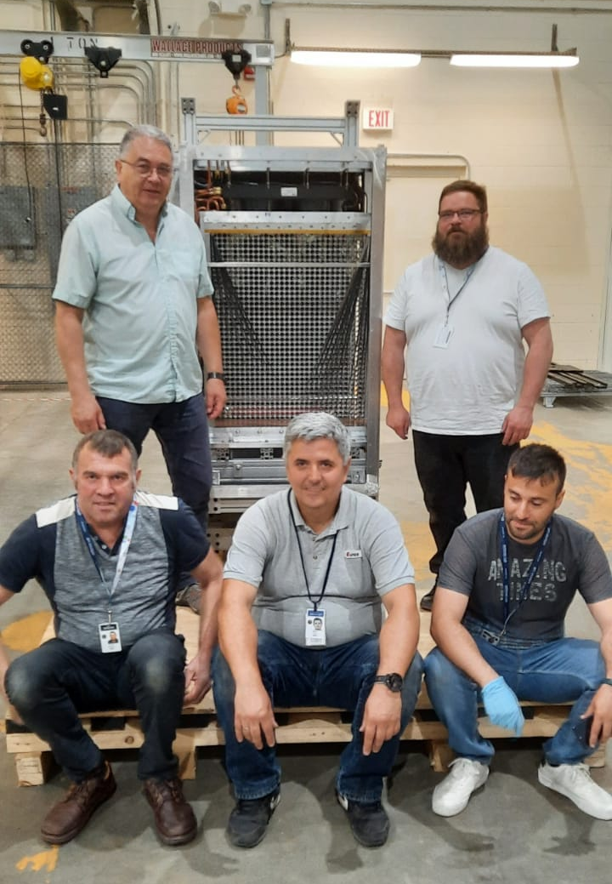
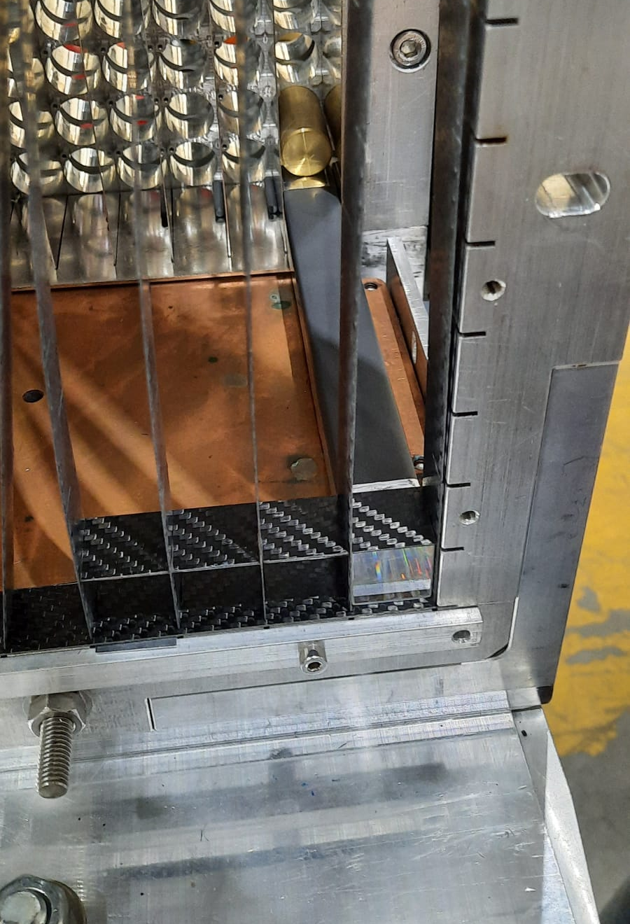
Box onto support frame
06/09/2022
NPS assembly
1

Slide 3
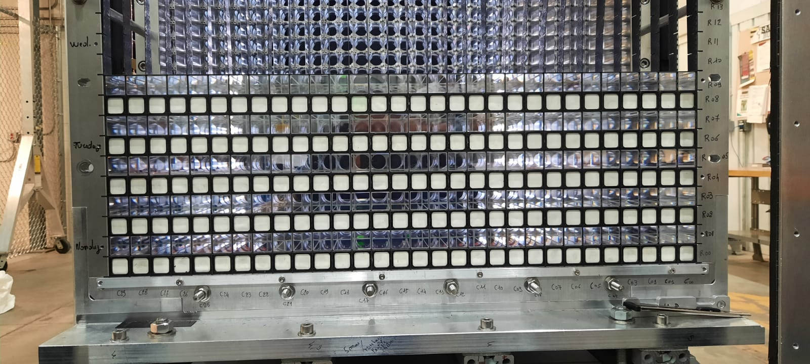
Crystal stacking
06/09/2022
NPS assembly
1

Slide 4
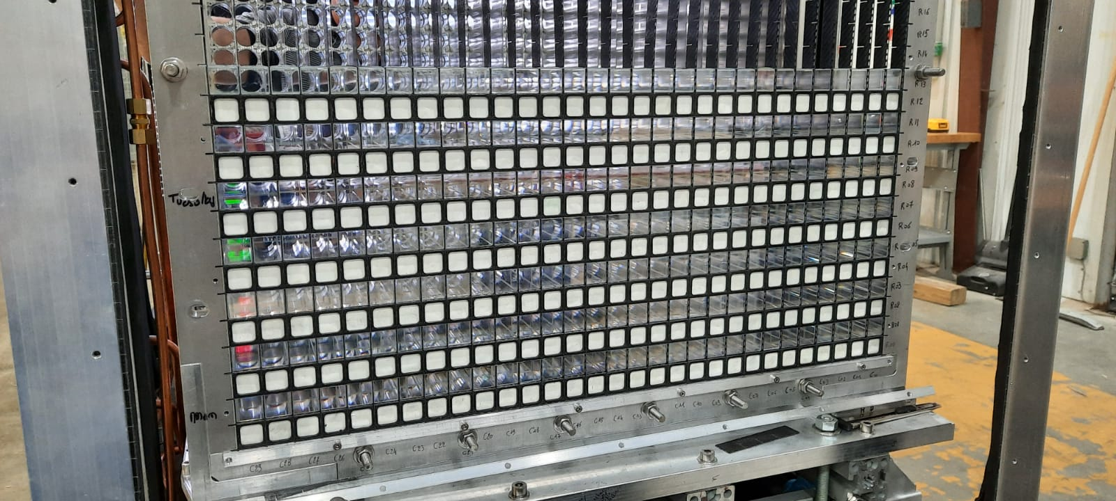
Crystal stacking
06/09/2022
NPS assembly
1

Slide 5
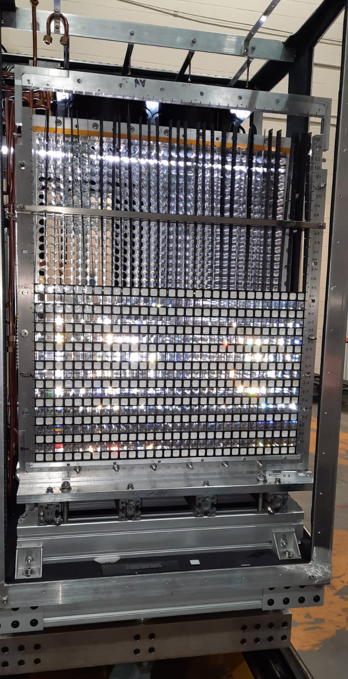
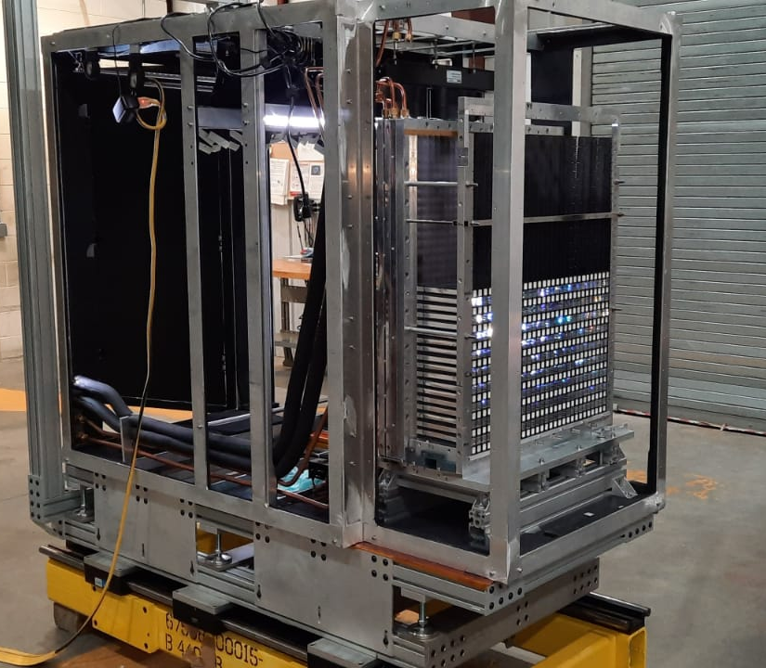
Crystal stacking
06/09/2022
nDVCS with NPS
1

Slide 6
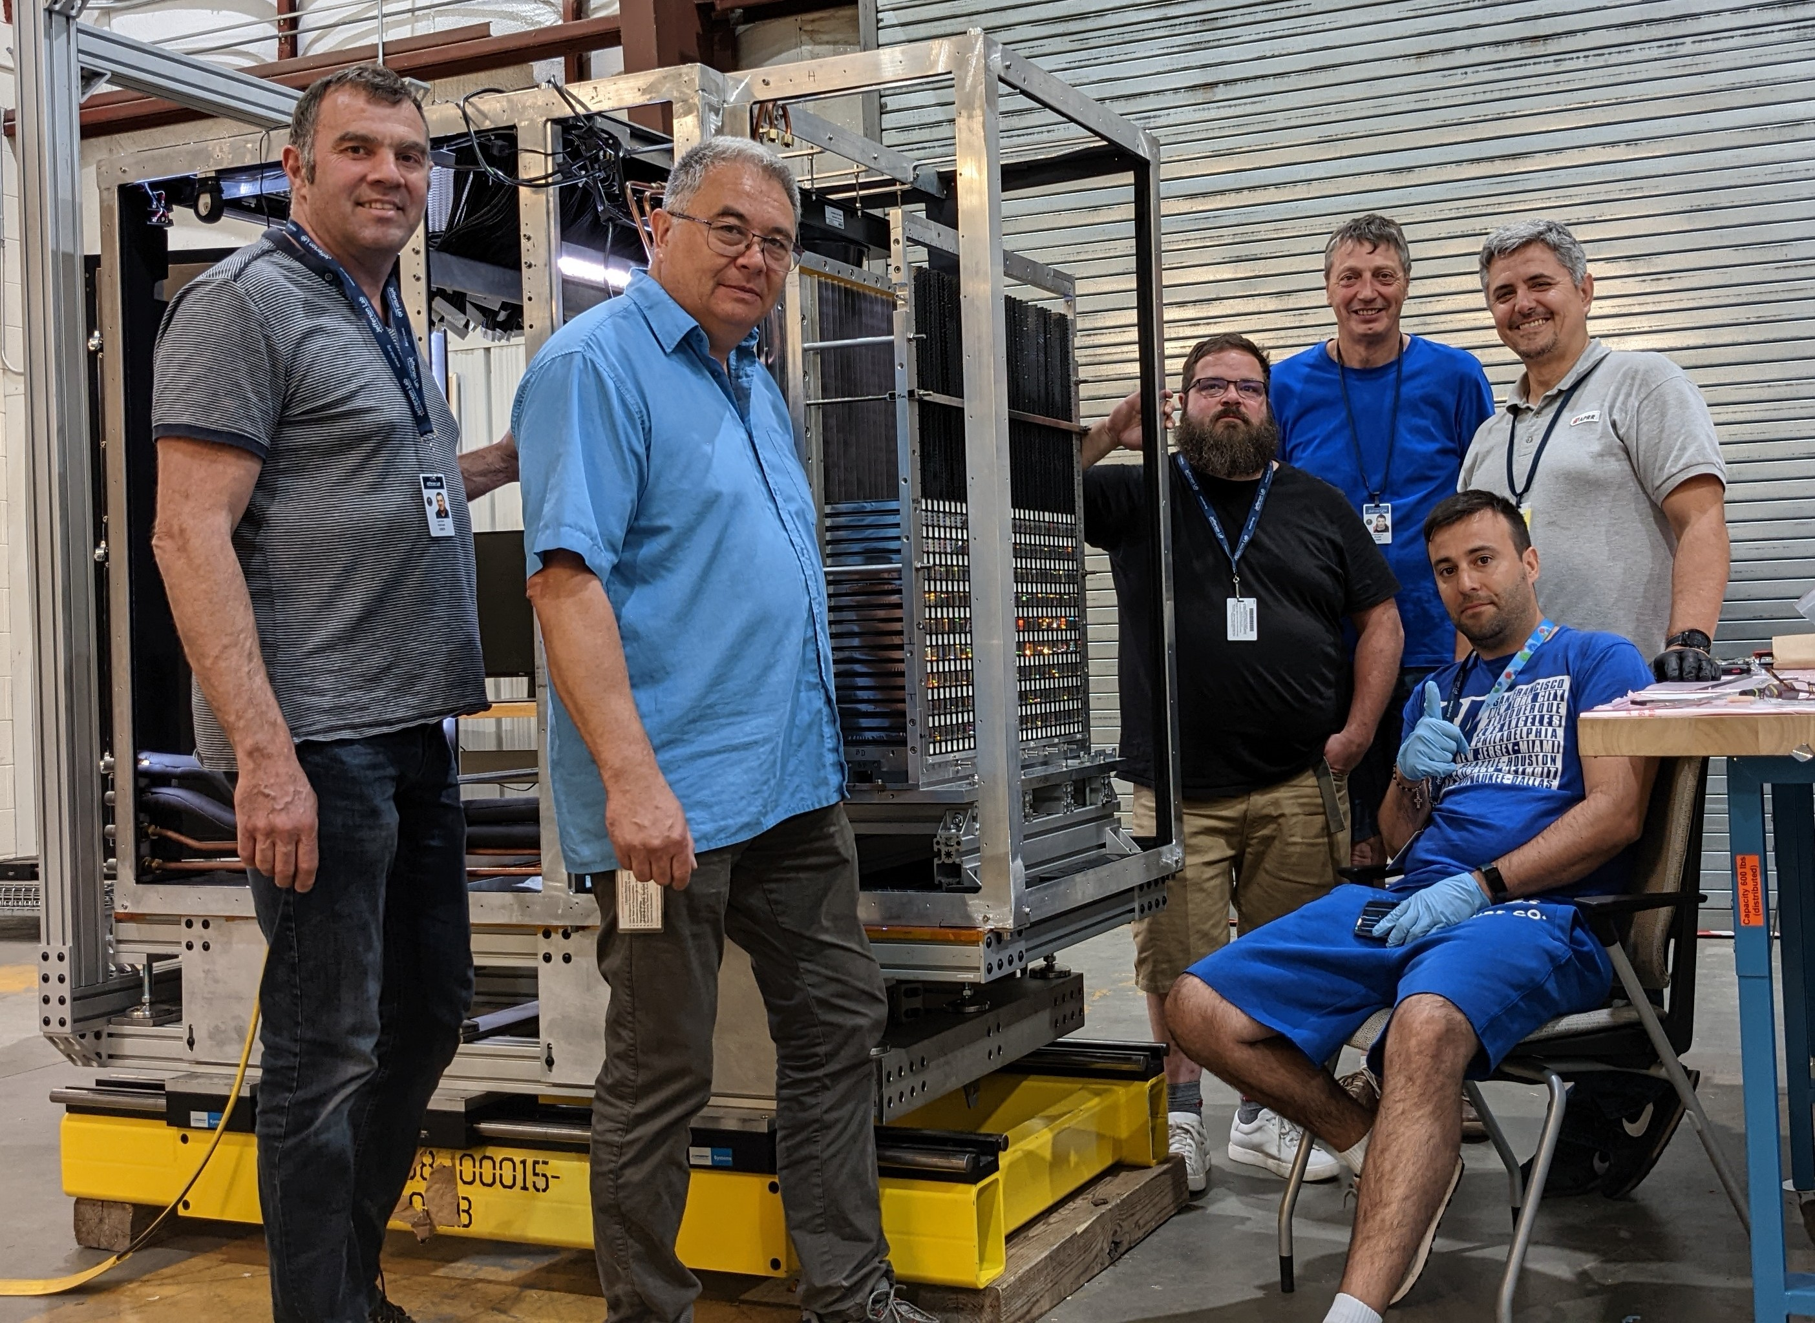
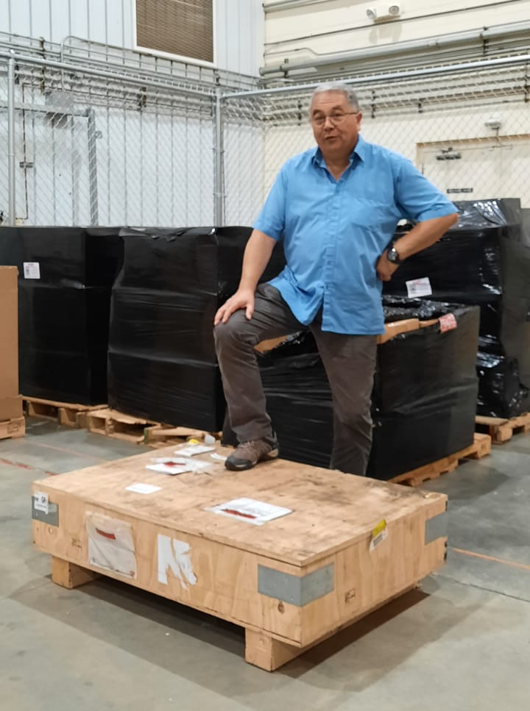
LV crate (very late) arrival (June 8)
06/09/2022
NPS assembly
1

Slide 7
Status summary
Stacking will be completed by Friday afternoon
PMT blocks assembly can start now and continue through next week
Next week: start cabling
Most likely a few columns will be cabled before the end of next week
(Orsay group departure)
Tests can be performed at that time or continue cabling
Orsay group can return in September to finish cabling or for further tests
(cooling, electronics, etc)
06/09/2022
NPS assembly
1

