Slide 1
CPS Update
Jan 14, 2022

Slide 2
Activities
Coil discussions with potential vendor NEC/Tokin. Preparing material for review by Robin and Probir’s magnet support group.
Prototype drawings being checked/signed off for fabrication
Design work starting on CPS/shielding platform
44 80W20Cu blocks moved to Physics storage and one crate opened for inspection.

Slide 3
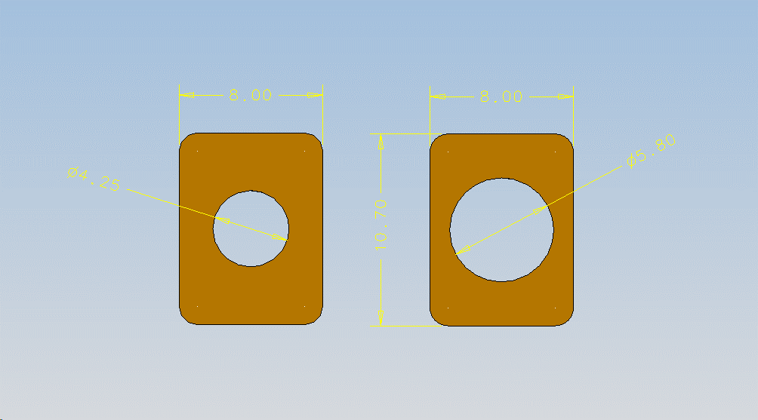
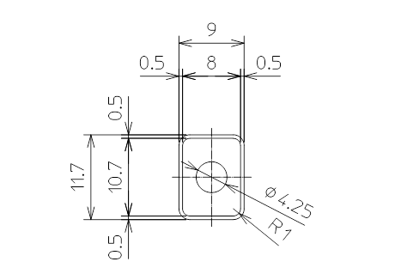
CPS Magnet Coil
4 Pancake Option Lower LCW Pressure Drop and Temperature
Continuous Wound Option Less splices/joints
 | #8372 | #8133
Power (kW) Magnet | 27.6 | 33.4
Voltage Magnet | 36.8 | 44.6
Cooling Diameter (mm) | 4.25 | 8.00

Slide 5
Prototype parts drawings

Slide 6
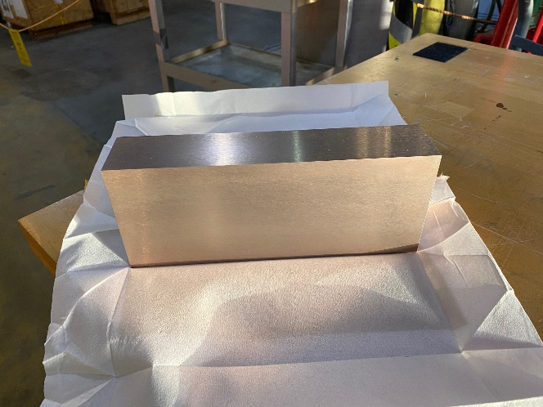
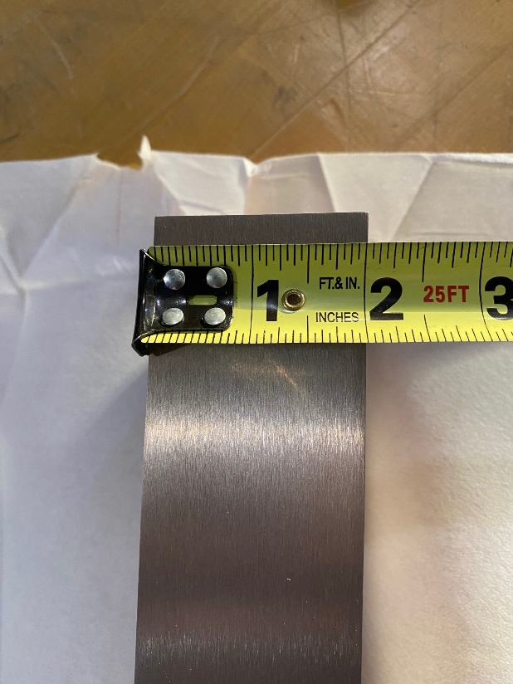
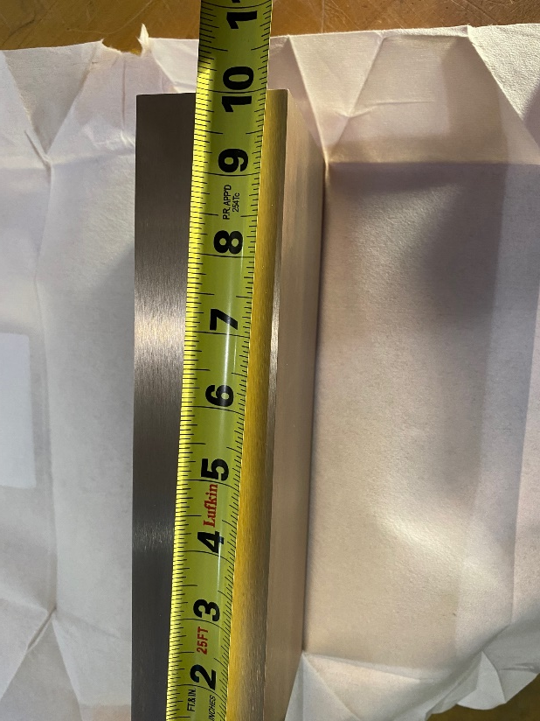
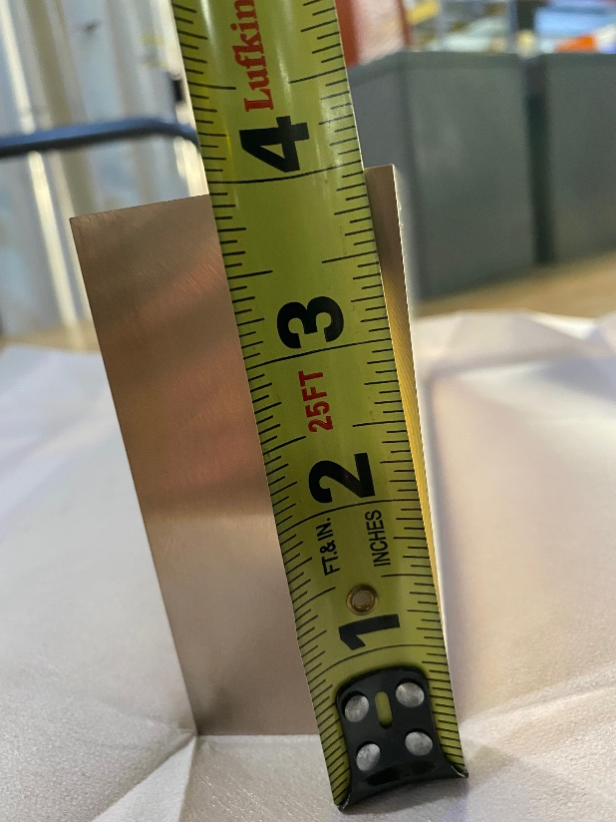
80W20Cu Blocks 44 blocks in Physics Storage Building

Slide 7
Topics to address
LCW coolant method – check on activation of LCW – Is a closed loop circuit needed or activation be low enough for Hall C’s LCW coolant. Long term deadheaded LCW may lead to unacceptable trapped LCW activation.
Increase current lead flags to extend connections outside of shielding. Longer leads more susceptible to damage during handling and installation but makes for cleaner shielding and access for PSU and LCW connections.
Check proposed PSU voltage against continuous would coil voltages. Impacts conductor choices or different PSU choice.

