Slide 1

NPS Sweep Magnet Field-Mapping
Charles Hyde, Tom Hartlove
6 September 2018

Slide 2
Velmex
Travel:
X (long) = 80”
Y (trans) = 12”
Z (vert) = 6”
Labview readout of positioning.
Measure field in gap and (separately) along beam-line
Only long track is in magnet gap.
  Revising P.O. with Velmex to replace Stainless Steel drive screw with (mostly) non ferrous belt-drive
Hall Probe sensor required
Notes:
Check with Bogdan, Jack re: Hall Probe. What is minimum field/precision. +- 2 Gauss

Slide 3
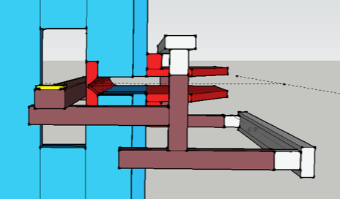
Mapper in Magnet
Mapper, support structure, and magnet

Slide 4
Mapping Strategy
Develop Lab View app to control sensor and record Hall probe readings.
Install mapper in main gap
Power magnet at full Test-Lab current.
  Repeat at 50% current for linearity test.
  De-Gauss procedure? Can we reverse polarity?
Record transverse field in 1 cm steps in X,Y,Z
  Repeat 3 times for reproducibility
  Longitudinal field as cross check?
Install mapper in beam-line area
  Map transverse field in midline plane (Y=0) in 1 cm steps in X and Z
Repeat in Hall-C at full power when available.

Slide 5
Anticipated Timeline
Mechanical assembly available Oct 1.
Software operational mid-Nov.
1 week for mapping

