Slide 1
NSF MSRI EEEMCAL Science Case
Science Case: Inclusive saturation - access to gluon distribution and gluon helicity (by adding polarization.
  With additional opportunities at low-x
  All these are tied together by the measurement of the energy dependence of the cross section which requires access to a wide range of kinematic phase space.
  The Rosenbluth separation is also needed for the exclusive meson production channels and DVCS.
Weakness (Achilles heel?): How to best balance the science case for EEEMCAL with the overall need for electron detection/identification at an EIC?
  Note: in the discussion DOE-NSF-EICPM it was mentioned that DOE is counting on in-kind contributions and EEEMCAL could be an impactful one for the NSF.
  Action item: ask NSF for advice in anticipated strategy meeting in October.

Slide 2
NSF MSRI EEEMCAL Science Case and Team
Need to convince non-experts that have expertise for these physics channels. Examples:
  (WG Convener Inclusive (Renee), EICUG Chair (Renee, Richard)
  YR Physics Convener (Carlos)
  ECCE Physics Convener (Rosi)
  HERA inclusive, spokesperson HERMES? (Richard)
  exclusive mesons (Tanja, Gabriel, Hamlet)
  Detector WG Convener (Tanja), exclusive DVCS/pi0 spokespeople (Julie, Carlos))
  …

Slide 3
NSF MSRI EEEMCAL – preparations for Preproposal
Science Case
  Updated plots (FL, DVCS,…)
  Generate 1-2 paragraphs for motivation/science case
    Gluon case (Renee)
    DVCS/exclusive mesons (Richard)
Broader Impacts (Rosi et al.)
  Take into account training of people for Project management – this is different from regular research proposal
Budget (Tanja) – technology readiness level vs. contingency etc.
Detector (Tanja….)
Team – responsibilities etc. (Tanja)
  Action item: prepare slides for meeting with NSF (science case, broader impacts)

Slide 4
NSF MSRI EEEMCAL Science Case: Intro
Renee

Slide 5
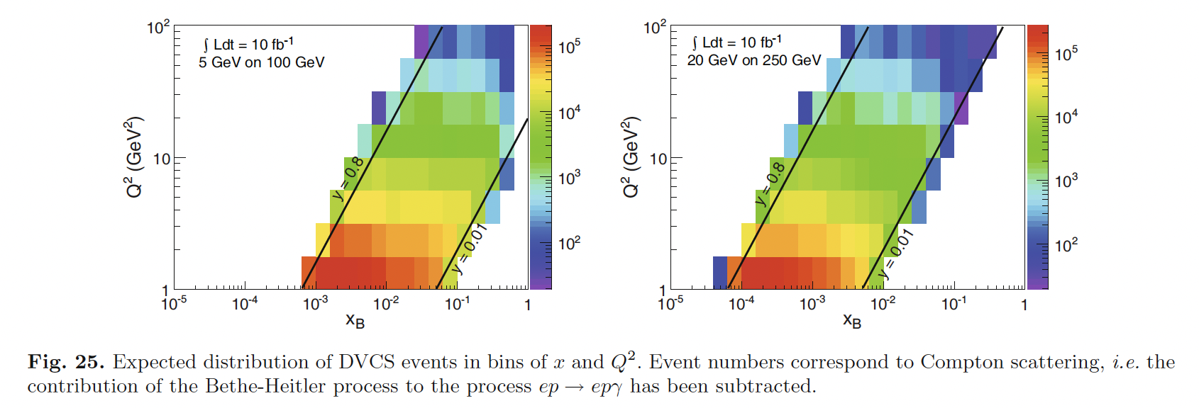
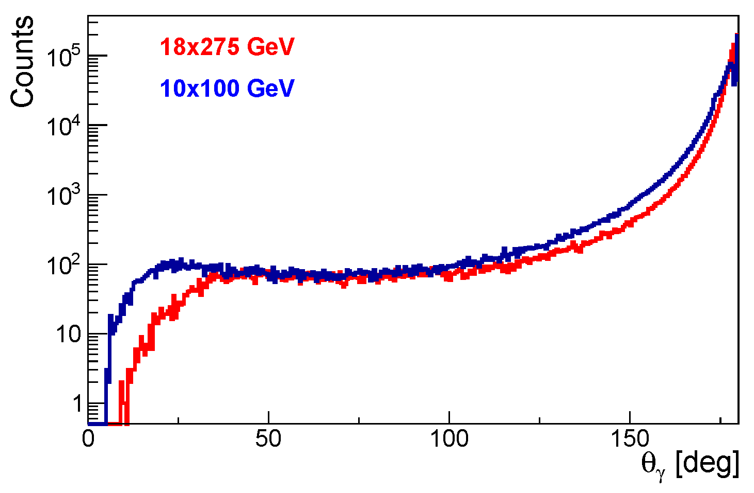
NSF MSRI EEEMCAL Science Case: DVCS
Richard
Determination of new, more general parton distributions in the nucleon and nuclei, particularly for sea quarks and gluons, is a major scientific goal of EIC. It is widely recognized that the Deeply Virtual Compton Scattering (DVCS) process is one of the most important and effective measurements to reach this goal. For example, the DVCS data can be directly used to make a determination of the gravitational form factors and to show that the mechanical pressure inside a proton exceeds that in a neutron star.
In the measurement of DVCS, the electron scatters from the nucleon (or nucleus) and the final-state consists of the scattered electron, the intact target and a real photon, which must all be detected simultaneously. The real photon is detected in an electromagnetic calorimeter over a wide angular range. In addition, the major source of background is 0 production followed by decay to two photons where one of the photons goes undetected. Thus, the electromagnetic calorimeter must cover the complete angular range, be hermetic and operate with high efficiency and good resolution.

