Slide 1
CAEN
Tools for Discovery
Overview of CAEN HV Power Supply
NPS/CPS Collaboration Meeting (JLab, 2/1/19)
Gianni Di Maio
g.dimaio@caen.it
www.caen.it
Notes:
1

Slide 2
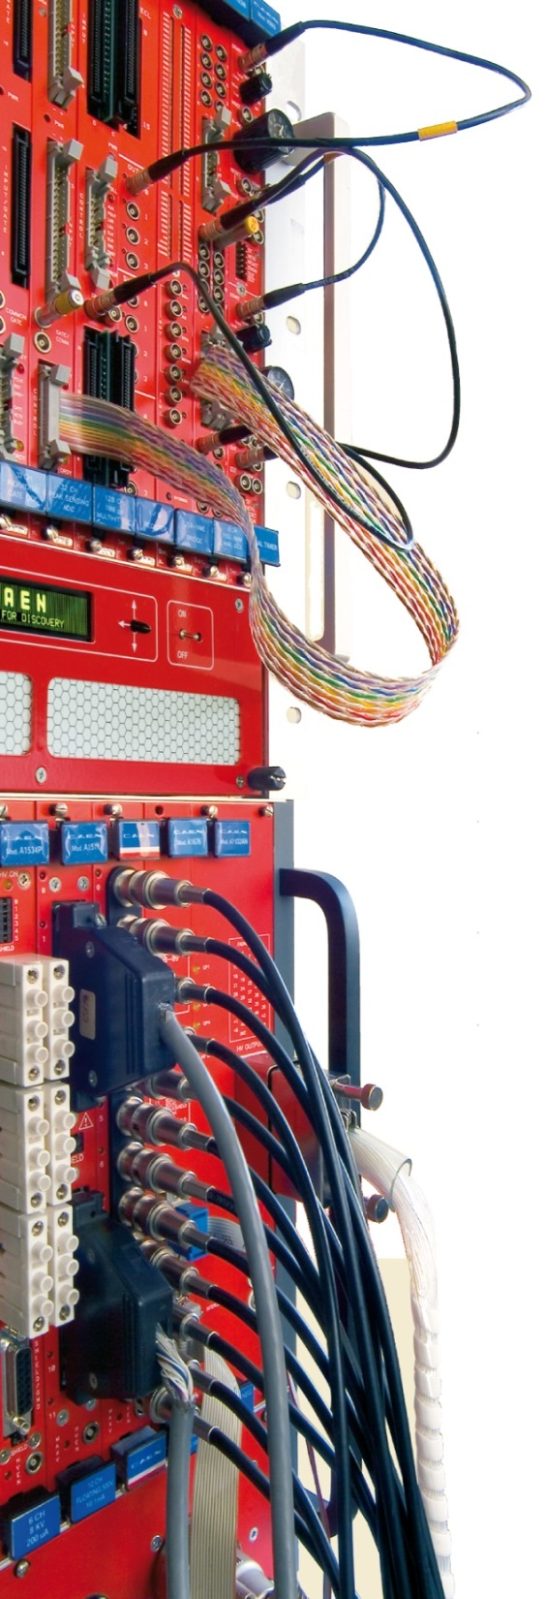
Introduction
Founded in 1979, for almost 40 years CAEN has been providing Scientists and Engineers with the most advanced electronic instrumentation designed for radiation & low light detectors
Strong of an extremely close collaboration with the world major research laboratories CAEN is proud to produce the best tools for:
High Energy Physics
Nuclear Physics
Neutrino Physics
Astrophysics
Dark Matter Investigation
Educational
Medical Applications
Homeland Security
Industrial Applications
and more …
Reproduction, transfer, distribution of part or all of the contents in this document in any form without prior written permission of CAEN S.p.A. is prohibited
Notes:
2

Slide 3
0
CAEN Network
Safety
Security
Laboratories
UHF RFID Readers
RFID Tags
Magnet Power Supplies
Precision Current Measurement
DCCTs
Beamline Electronic Instrumentation
FMC and mTCA.4
Information Security
Managed Security Services
Technologies Consulting
Risk Assessment & Vulnerability
Compliance Consulting
Notes:
3

Slide 4
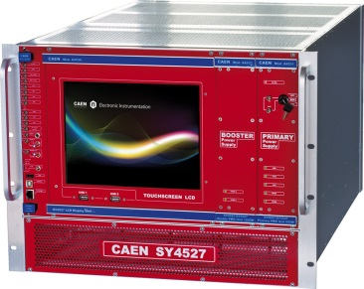
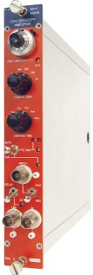
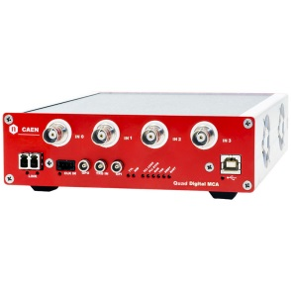
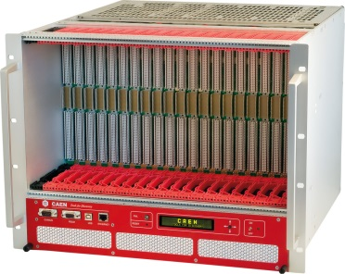
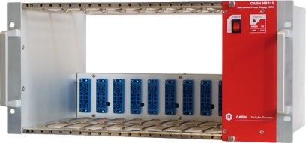
CAEN Catalog Products
High Voltage & Low Voltage Power Supplies
Multi-Channel CAEN Systems
Multi-Channel NIM and VME Modules
Stand-alone Power Supplies
PCB mountable HV DC-DC converters
Signal Conditioning & Read-out Electronics
Waveform Digitizers & Digital Pulse Processing
Digital MCA and instrumented PMT bases
NIM and VME traditional electronics
WEEROC ASICs
Powered Crates and Chassis
Low Ripple Linear NIM powered Crates
New Hi-End VME64/VME64x Crates
Educational Kit
Partnership with WEEROC
CAEN catalog includes more than 300 product categories (~1000 items)
Reproduction, transfer, distribution of part or all of the contents in this document in any form without prior written permission of CAEN S.p.A. is prohibited

Slide 5
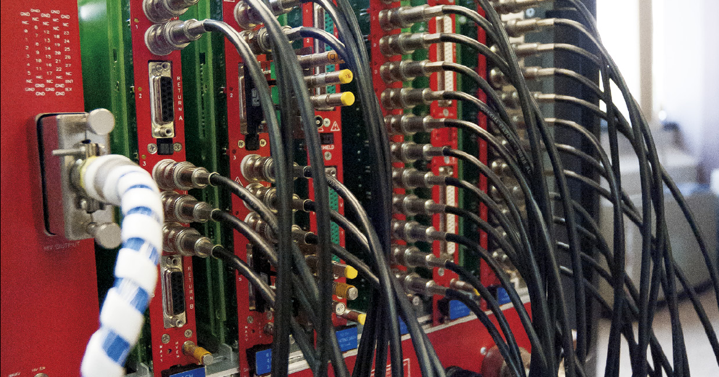
Power Supplies
CAEN Power Supplies: a perfect blend of
tradition and innovation
Reproduction, transfer, distribution of part or all of the contents in this document in any form without prior written permission of CAEN S.p.A. is prohibited
Notes:
5

Slide 6
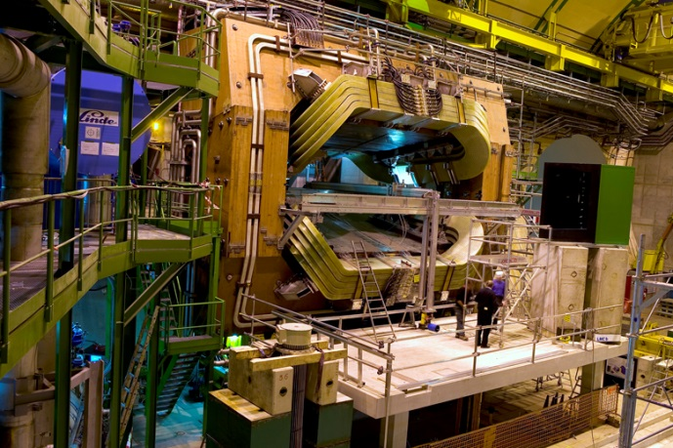
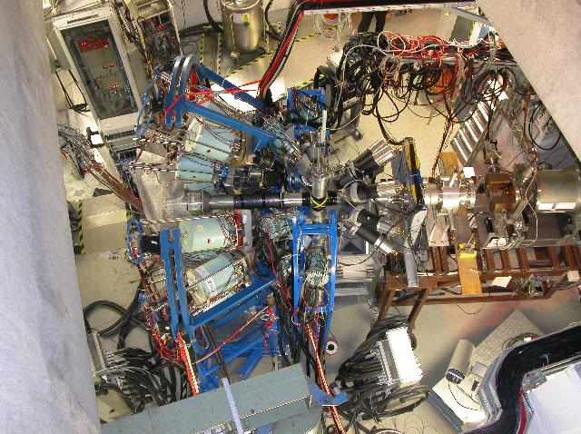
The idea behind our Multichannel System
MEDIUM EXPERIMENTS
BIG LABS / TEST BEAMS
BIG EXPERIMENTS
Each subdetector has a big number of channels
You don’t need just HV/LV channels…. You need a HV/LV infrastructure!
Modularity is a strong need (spare parts management, maintenability, …)
Simple integration in the DCS of the experiment
The number of channel for each detector can sweep from one to many
The possibility to have different channels in the same box is a plus
A unique power supply system simplifies the software development and the management of the setup

Slide 7
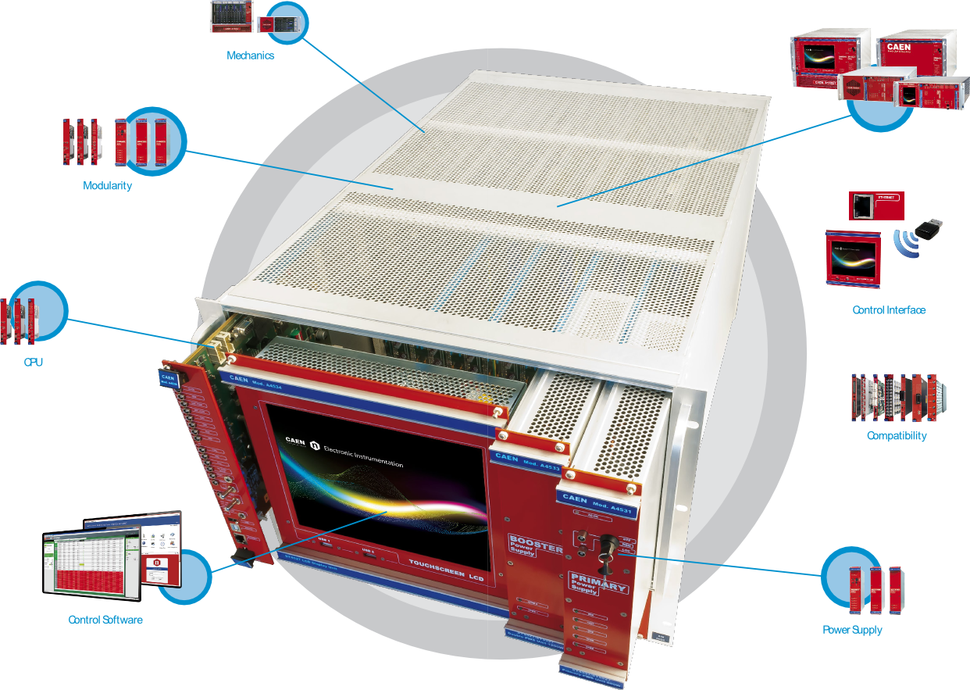
Universal Multichannel System

Slide 8
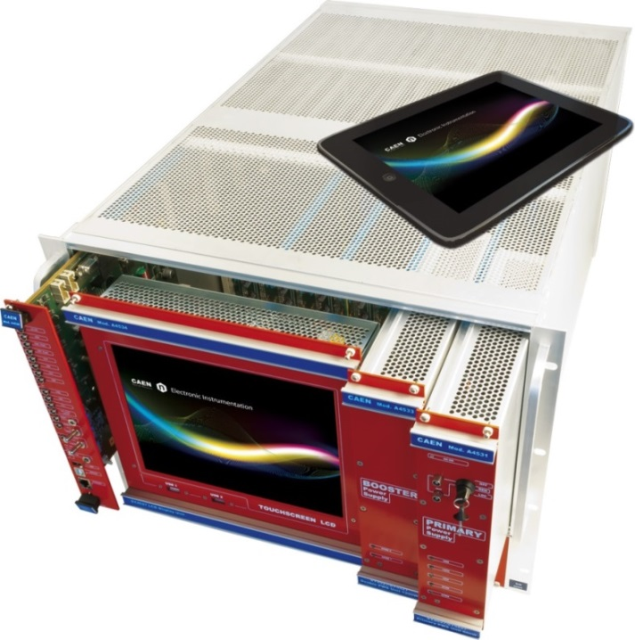
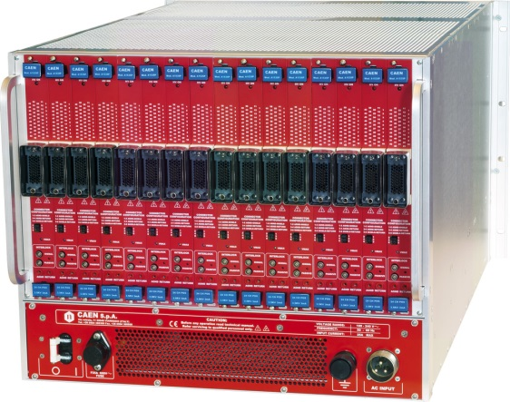
System Philosophy
Modularity
Chassis: SY4527, SY5527, SY4527LC, SY5527LC
CPU Units: Basic, Advanced, Full
Power Units: Primary, Boosters
Accessories: LCD Touchscreen, Wi-Fi, Advanced SW
Connectivity
Control based on CPU modules either Remote via Ethernet and Wi-Fi or Local via touchscreen LCD
Usability
GECO 2020 Software tools designed to set and monitor all the parameters. Advanced features for Alarming, Logging and Scripting
Compatibility
The new backplane is fully compatible with SY1527/2527 HV/LV Boards and Branch Controllers
Available in a Low Cost Version for Smaller Setups

Slide 9
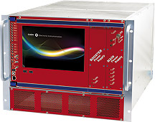
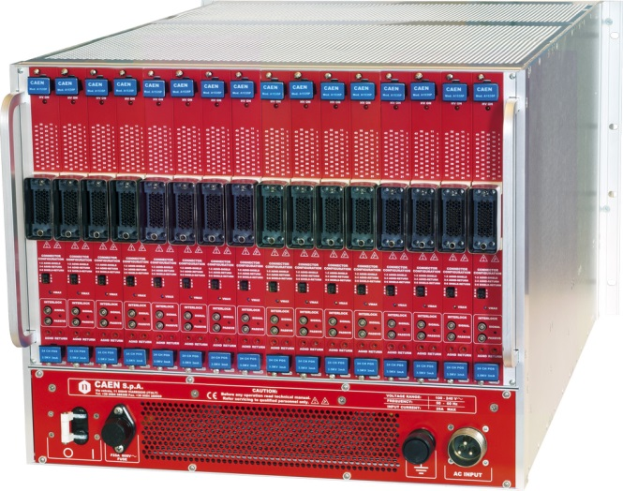
SY4527 Highlights
Fully equipped experiment version
19" wide, 8U-high Euro-mechanics rack; depth: 720 mm, weight : 13kg
16 slots to house boards, distributors and branch controller
Communications via Gigabit Ethernet and via Wi-Fi (optional)
Local control via 10.4" color touchscreen LCD (optional)
Fast, accurate setting and monitoring of channel parameters
Modular and expandable power supply (up to 4 kW)
Forced air cooling
Reproduction, transfer, distribution of part or all of the contents in this document in any form without prior written permission of CAEN S.p.A. is prohibited
Notes:
9

Slide 10
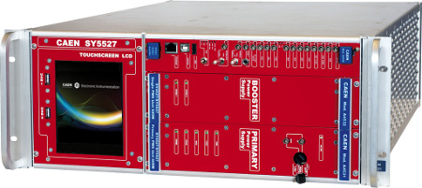
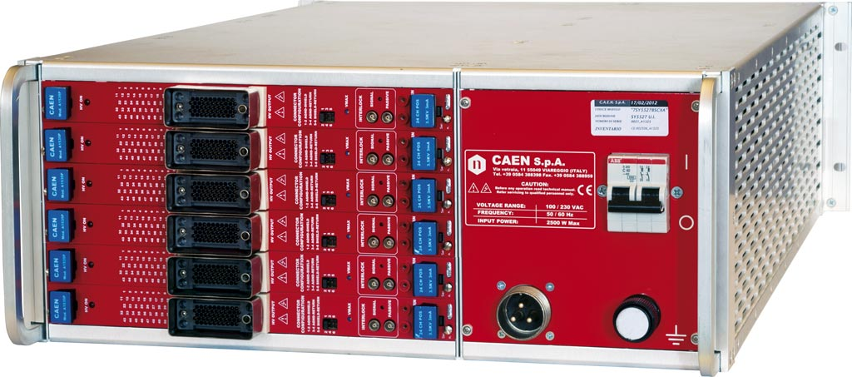
SY5527 Highlights
Small scale experiment and laboratory version
19" wide, 4U-high Euro-mechanics rack; depth: 700 mm
6 slots to house boards, distributors and branch controller
Communications via Gigabit Ethernet and via Wi-Fi (optional)
Local control via 5.7" colour touchscreen LCD (optional)
Fast, accurate setting and monitoring of channel parameters
Modular and expandable power supply (up to 1800 W)
Forced air cooling

Slide 11
Universal Multichannel Systems - New Multichannel Boards
A new categorization of CAEN Multichannel Power Supply Boards introduced to guide the users in finding the best solution for their applications
The Boards have been divided by:
Maximum Output Voltage
Low Voltage
Up to 100 V Family
Up to 500 V Family
Up to 1.5 KV Family
Up to 3.5 kV Family
Up to 8 kV Family
Up to 15 kV Family
Channel Grounding
Common Ground
Common Floating Return
Individual Floating Channel
Channel Architecture
Independent Channel
Independent Dual Range Channel
Board for Specific Application
NO DISTRIBUTORS ANYMORE !!!

Slide 12
NPS/CPS HV PMT requirements
1. HV up to -1.1 kV per channel
2. Current < 430 uA per channel
3. Number of channels required up to 1248 ( include spares)
Proposed Boards for this application.
A7030 family 12/24/36/48 Channel 3 kV/1 mA (1.5W) Common Floating
A7236 family 12/24/32 Channel 3.5 kV, 1.5/0.15 mA (4W) Common Floating Return Dual Range Boards
The basic Low Voltage power supply provides 600W.
Power requirements for Main Low Voltages for each Main Frame with 13 boards is 600W
To work in safe and maximize life cycle need add a 600W booster ( A4532) for each Main Frame.

Slide 13
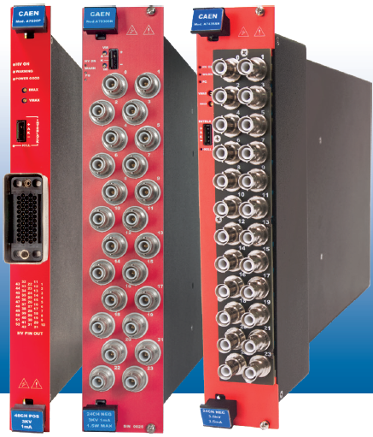
Universal Multichannel Systems - Multichannel Boards
Solutions for photomultiplier array: A7030/A7236 /A7435
12/24/32 /36/48 channels, up to 3.5 KV, 3.5 mA HV power supply
Main Features
• From 12 to 48 independently controllable High Voltage channels
• 0 ÷ 3.5 kV output voltage
• Maximum Current 3.5 mA
• Up to 10 nA / 500 pA current set / monitor resolution
• Up to 5 mV voltage set / monitor resolution
• Very Low ripple, down to < 5 mVpp
Reproduction, transfer, distribution of part or all of the contents in this document in any form without prior written permission of CAEN S.p.A. is prohibited
Notes:
13

Slide 14
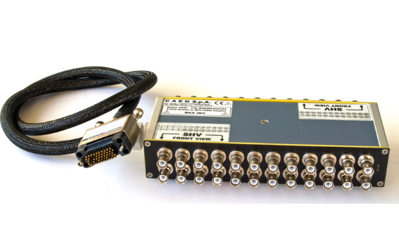
Universal Multichannel Systems – RADIALL to SHV adapters
R648 48 Channel Radiall to SHV connector Adapter (Max: 3kV - 19' Rack)
A648 Radiall to SHV Adapter for A7030 family
Reproduction, transfer, distribution of part or all of the contents in this document in any form without prior written permission of CAEN S.p.A. is prohibited
Notes:
14

Slide 15
VME, NIM and Standalone solution

Slide 16
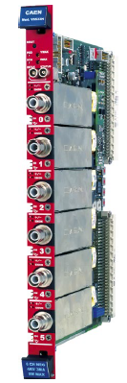
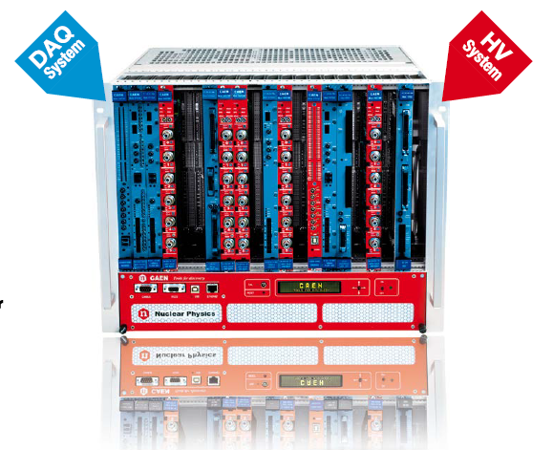
Modular VME power supplies
VME HV Boards Family
V6519, V6533, V6534, V6521, V6521H
Overview
6 channels in 1 VME Unit
From 500 to 6 kV, from 20 µA to 3 mA
Common Floating Return
SHV connectors
Voltage ripple < 3 mVpp
Internal Hardware protections
Available with positive, negative or mixed polarity
Thanks to the GECO2020 control software and the multimaster capabiity of CAEN VME Bridges, CAEN VME HV power supplies become a System:
DAQ and HV in the same VME crate independently controlled!
Reproduction, transfer, distribution of part or all of the contents in this document in any form without prior written permission of CAEN S.p.A. is prohibited
Notes:
16

Slide 17
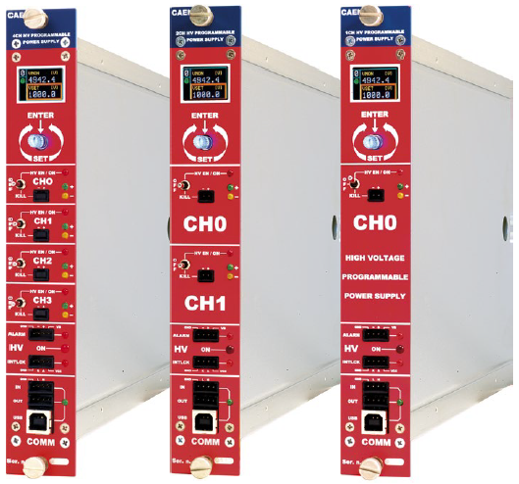
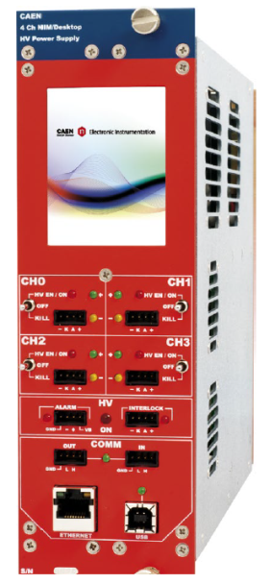
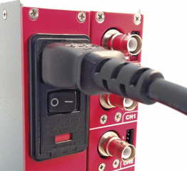
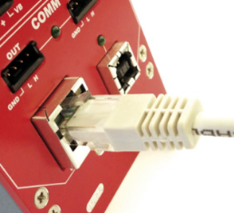
NIM-NDT High Voltage Power Supplies
NIM and NDT HV Boards Family
N14xx, NDT14xx and N14xxET
Overview:
8/4/2/1 channles in 1 or 2 NIM Unit
From 500 to 15 kV, from 20 µA to 3 mA
Common Floating Return
SHV connectors
Voltage ripple < 5 mVpp
Internal Hardware protections
Independently selectable channel polarity
Local and Remote control
Now also with Ethernet connection!
2.8’’ color touch screen display (only NDT)
110-220 Vac plug for desktop operation (Only NDT)
Reproduction, transfer, distribution of part or all of the contents in this document in any form without prior written permission of CAEN S.p.A. is prohibited
Notes:
17

Slide 18
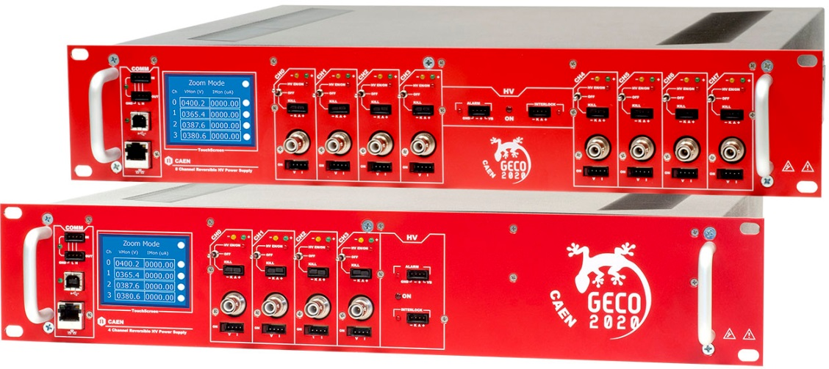
Rack-mountable High Voltage Power Supplies
Rack-mountable HV Boards Family
R1419ET, R1470ET, R1471ET, R1471HET
Overview:
1/4/8/16 channles in 2U, 19’’ rack unit
2.8’’ color touch screen display
110-220 Vac plug for desktop operation
from 500 to 8 kV, from 20 µA to 3 mA
Common Floating Return
SHV connectors
Internal Hardware protections
Independently selectable channel polarity
Local and Remote control (USB/Ethernet)
Reproduction, transfer, distribution of part or all of the contents in this document in any form without prior written permission of CAEN S.p.A. is prohibited
Notes:
18

Slide 19
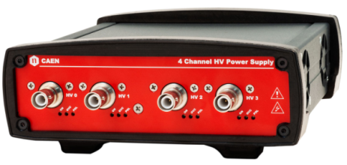
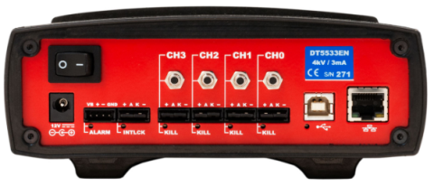
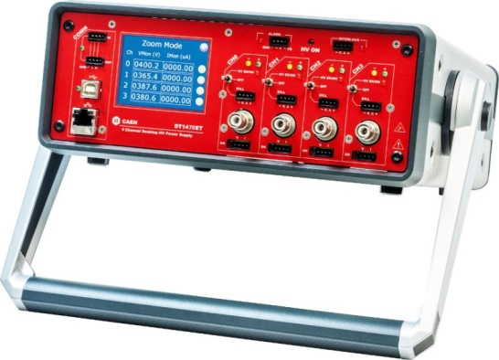
Desktop High Voltage Power Supplies
Solution for small setups: Desktop HV Boards Families
DT55xxE, DT14xxET, DT547x
Overview:
4/8 channels in desktop module
from 500 to 6 kV, from 20 µA to 3 mA (DT55xxE)
from 500 to 8 kV, from 20 µA to 3 mA (DT14xxET)
Common Floating or independent Floating return
SHV connectors
Available with positive, negative or mixed polarity
Local and Remote control (USB/Ethernet)
Individual channel enable
2.8’’ color touch screen display (DT14xxET)
110-220 Vac plug for desktop operation (DT14xxET)
Independently selectable channel polarity (DT14xxET)
Overview:
Local and Remote control (USB/Ethernet)
Reproduction, transfer, distribution of part or all of the contents in this document in any form without prior written permission of CAEN S.p.A. is prohibited
Notes:
19

Slide 20
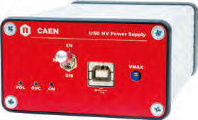
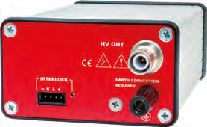
Desktop High Voltage Power Supplies
Solution for small setups: Single Channel USB Desktop HV Boards Family
DT547x
Overview:
Single Desktop HV channel powered and controlled by USB
Channel Enable/Disable via front panel switch
Available with positive or negative polarity
SHV coaxial output connector
From 500 V to 5 kV, 1 W maximum power
Imon Zoom (x10)
Remote control through USB 2.0
LabVIEW Instrument Driver
High Voltage power supplies now available in a compact, easy and handy device

Slide 21
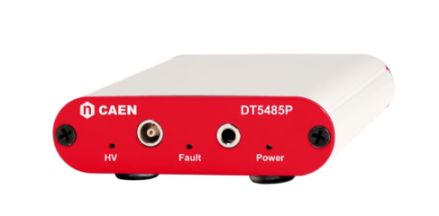
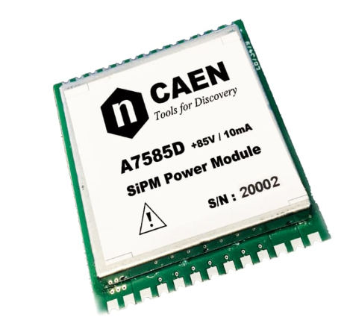
Desktop High Voltage Power Supplies
DT5485P and A7585D:
Single Channel 85 V/10 mA USB Power Supply Module for SiPM
Overview:
USB interface & power supply
Output voltage: 20÷85V with 1 mV/step
LEMO 00 output connector
Hight output current: up to 10mA, suited for large SiPM matrix
Programmable temperature compensation
3.5mm audio socket for temperature probe input
Ultra low ripple on output signal: 0.1 mVpp
Accurate voltage and current monitor: 10mV / 60nA
Free ZEUS Windows software to control multiple modules
Compact enclosure

Slide 22
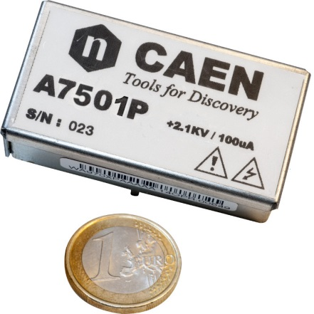
PCB mountable HV DC-DC converters
PCB High Voltage Power Supply
A7501, A7504, A7505, A7508
Single High Voltage Channel in a PCB mount architecture
Compact package 29x54x16 mm³ (WxLxH)
High Efficiency and low power consumption
Four Models available:
A7501 (2100 V / 100 μA)
A7504 (4000 V / 100 μA)
A7505 (1600 V / 500 μA)
A7508 (800V / 50 uA)
Analog voltage and current Set/Monitor
Ripple/noise: < 5mVpp typ
Excellent stability
High operating temperature range
PCB Double polarity High Voltage Power Supply
A7560
Compact package 49x49x23 mm³ (WxLxH)
High efficiency ± 6kV/10 µA output ranges
Power requirement: < 500mW @ full power
Ripple/noise: < 10mVpp typ
Setting DAC: 16bit, Monitor ADC: 20bit
Serial Line: USART (TX, RX)
Digital control loop with resident parameters and calibration
Works in magnetic field up to 1 kGauss
Reproduction, transfer, distribution of part or all of the contents in this document in any form without prior written permission of CAEN S.p.A. is prohibited
Notes:
22

Slide 23
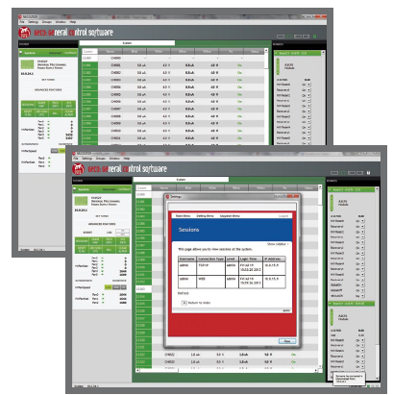
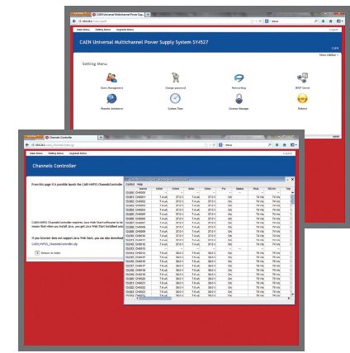
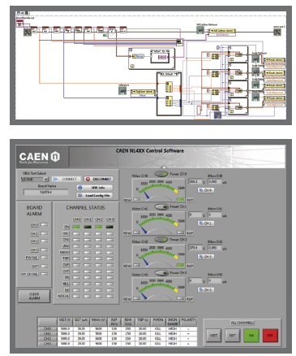
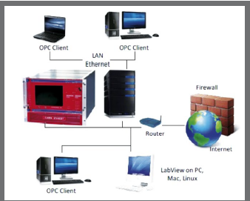
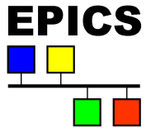
Power Supply Control Software
CAEN provides a wide family of software tools to easily configure and control its Power Supplies:
GECO2020 (General Control Software for CAEN HV Power Supplies)
HiVoCS (Web based control software for SY4527/5527 Systems)
CAEN HV Wrapper (Library for CAEN Power Supply Control)
N14xx LabVIEW Instrument Driver (for NIM and NDT only)
OPC Server
EPICS Input/Output Controller (for SY4527/5527 Systems only)
Reproduction, transfer, distribution of part or all of the contents in this document in any form without prior written permission of CAEN S.p.A. is prohibited
Notes:
23

Slide 24
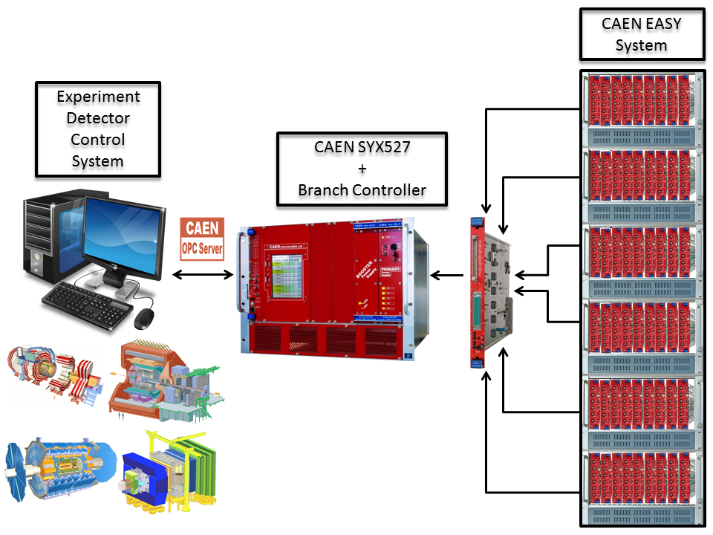
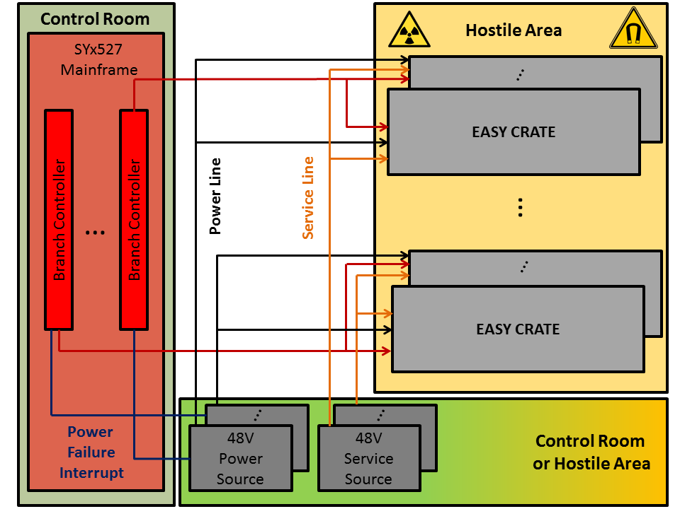
CAEN EASY Power Supplies
EASY (Embedded Assembly SYstem)
Solution to be used every time the residual magnetic field and radiation become a problem.
The EASY power supply is located directly in the hostile area while the control of the system can be done remotely using a Branch Controller plugged in a SYX527 mainframe located in the control room.
Tolerances
• Magnetic field: up to 2 kGauss
• Radiation:
- up to 1·10¹¹ p/cm² Total Dose
- up to 2·10¹² n/cm² Total Dose
- up to 15 kRad Total Integrated Dose
The best solution for hostile environment!

Slide 25
Thank You

Slide 26
BackUp Slides

Slide 27
SYx527 Multichannel System

Slide 28
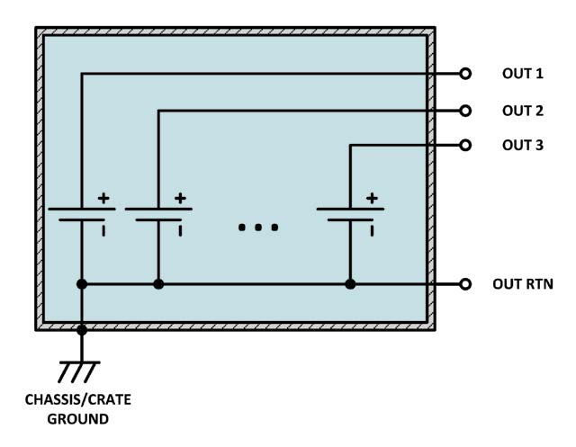
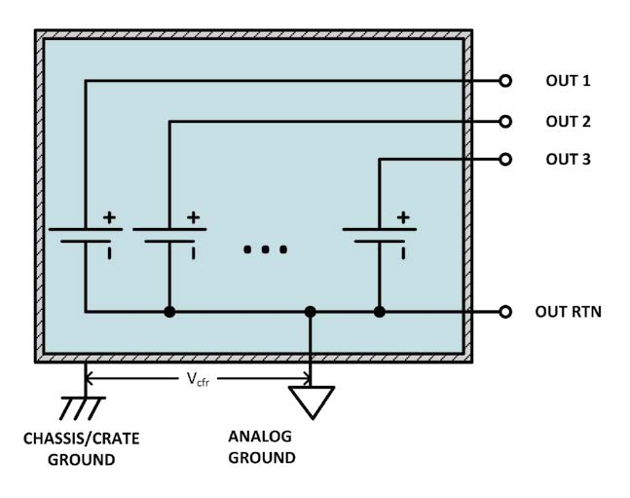
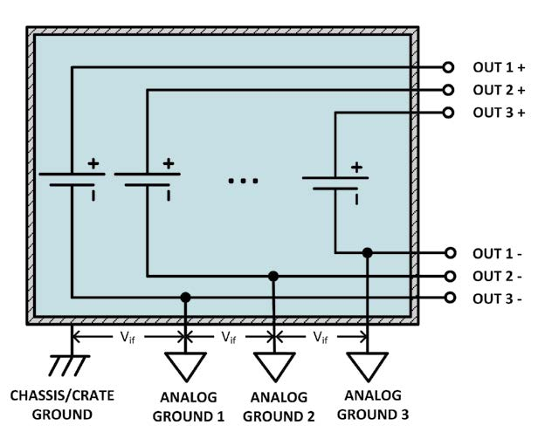
FAQ n. 1 Grounding
COMMON GROUND
COMMON FLOATING RETURN
INDIVIDUAL FLOATING
Power supplies of this kind have the channel voltage reference hardwired to the chassis/crate ground.
Generally the common floating return is insulated from chassis /crate ground up to few tens of volts.
In this configuration each channel behave exactly like a battery: by grounding the + terminal, it’s possible to get a negative voltage and by grounding the - terminal, it’s possible to get a positive voltage (and it is also possible to mix positive and negative polarity outputs).

Slide 29
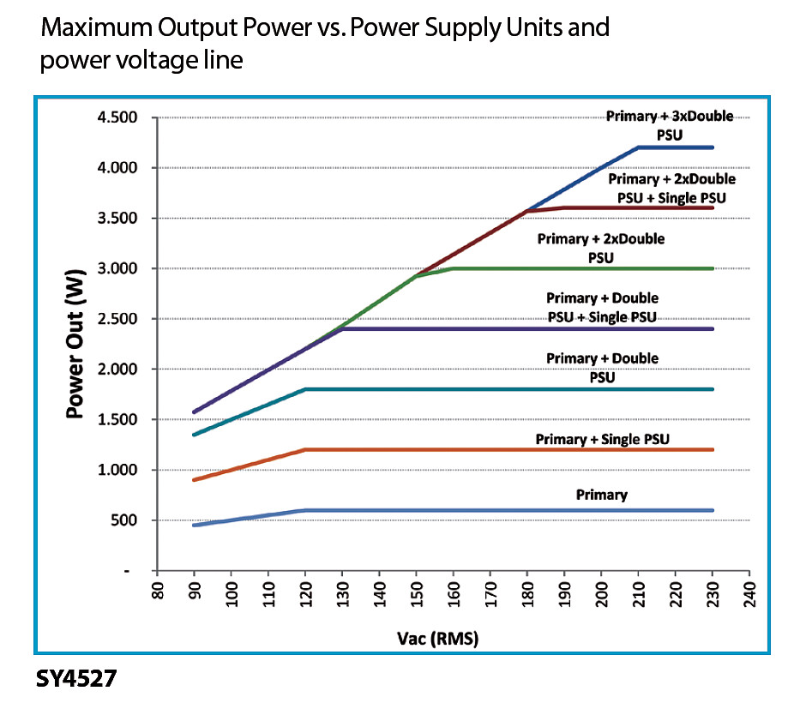
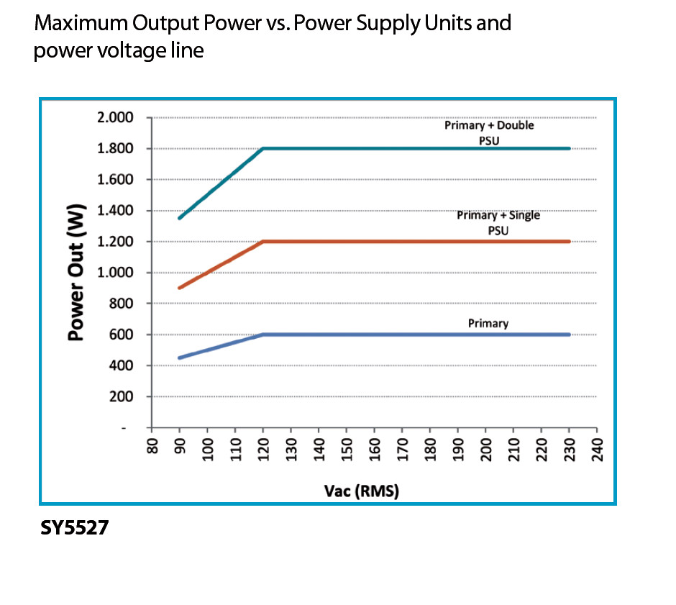
FAQ n. 2 Power Limitation

Slide 30
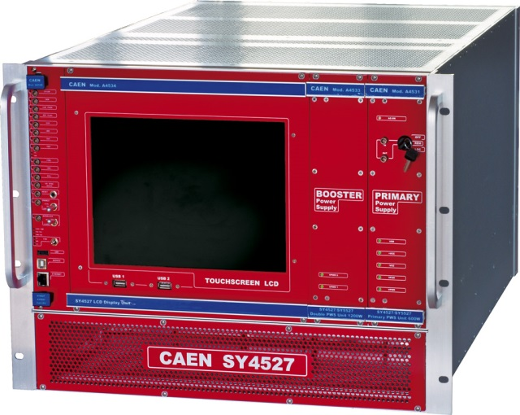
Modularity
All the systems share the same Primary Power Supply, the same Boosters and the same CPUs
Reproduction, transfer, distribution of part or all of the contents in this document in any form without prior written permission of CAEN S.p.A. is prohibited
Notes:
30

Slide 31
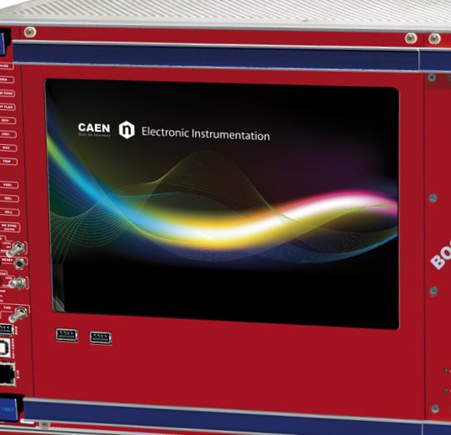
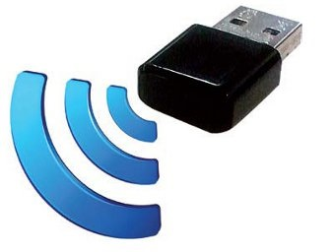
Connectivity
A4528 Built-in industrial PCs
Ethernet (TCP/IP) connection
Wireless connection through Wi-Fi USB dongle
Local control via Touchscreen LDC
Control software for Linux, Windows and Tablet PC
User profiles & View Customization
Reproduction, transfer, distribution of part or all of the contents in this document in any form without prior written permission of CAEN S.p.A. is prohibited
Notes:
31

Slide 32
A4528 CPU: available versions
Basic version
communication interfaces
RESET control
INTERLOCK control
Status LEDs
Advanced version adds:
beam handshake management connectors (CH-ON, GEN, VSEL, ISEL)
Full version adds:
complete set of panel connectors
ENABLE control section
Front panel Fan speed control.

Slide 33
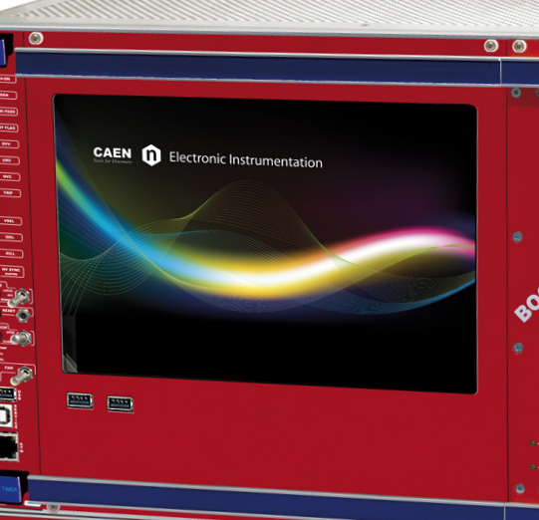
LCD Display
An optional LCD touchscreen can be provided to control both the systems locally running a dedicated control software
10.4” display for SY4527
5.7” display for SY5527
The display is also provided with two USB connectors for keyboard, mouse and pen drive to properly log the status of the boards plugged in the system and their channels
Notes:
33

Slide 34
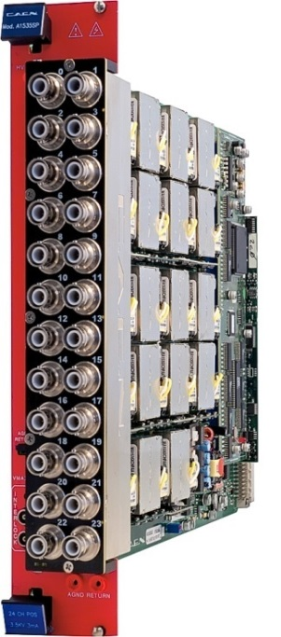
Compatibility
100% Compatible with all the power supply boards developed for the previous generation mainframes SY1527/SY2527
A1520P
A1533D
A2932
A1526
A1534
A1535 & A1550
A1510-A1511B
A1512-A1514B-A1519B
Reproduction, transfer, distribution of part or all of the contents in this document in any form without prior written permission of CAEN S.p.A. is prohibited
Notes:
34

Slide 35
SY4527 Low Cost
Houses up to 10 boards
More compact and handy
~20 cm shorter than the standard version
Both PS channels and controls on the front side
Communications via Gigabit Ethernet
Communications via Wi-Fi (optional)
Fast, accurate setting and monitoring of channel parameters
Live insertion of boards
Advanced Trip handling
Reproduction, transfer, distribution of part or all of the contents in this document in any form without prior written permission of CAEN S.p.A. is prohibited
Notes:
35

Slide 36
SY5527 Low Cost
Houses up to 4 boards
More compact and handy
~20 cm shorter than the standard version
Both PS channels and controls on the front side
Communications via Gigabit Ethernet
Communications via Wi-Fi (optional)
Fast, accurate setting and monitoring of channel parameters
Live insertion of boards
Advanced Trip handling

