Slide 1
CPS Engineering Status March 25, 2022
Steven Lassiter

Slide 2
1. Prototyping development
2. CPS magnet coils updates
3. FLEUNT licensing issues at JLAB
4. W block shipments / remaining job list / updates

Slide 3
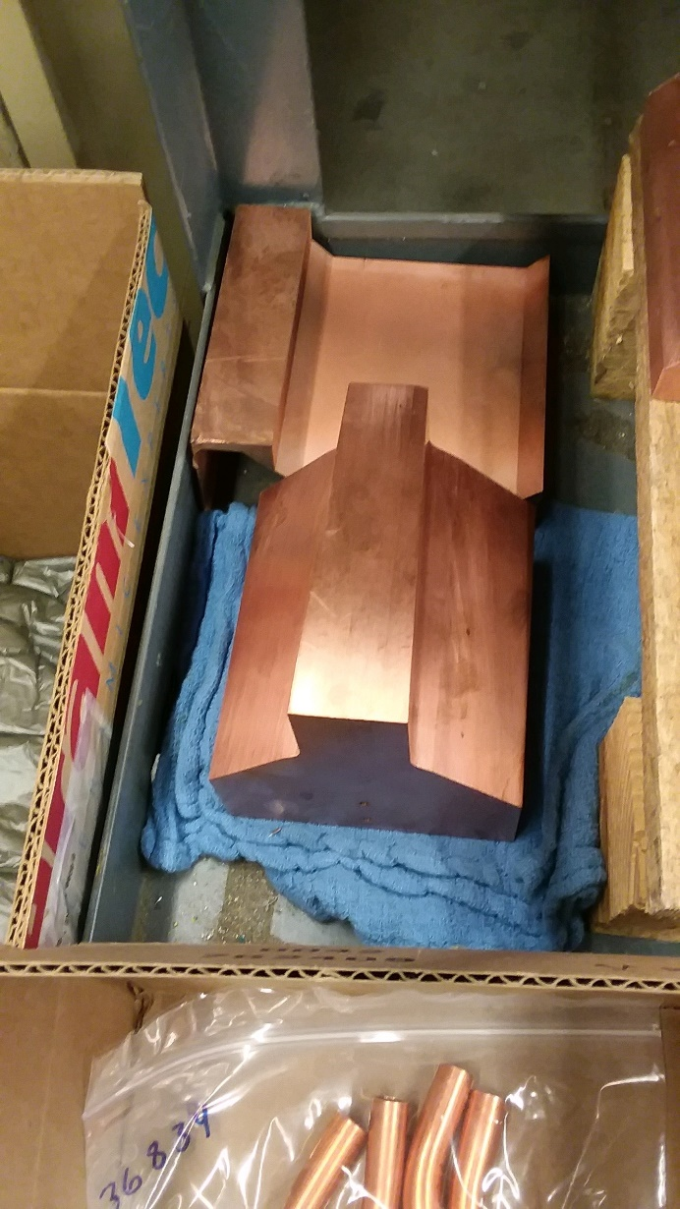
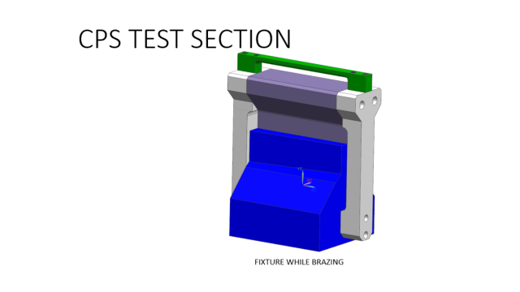
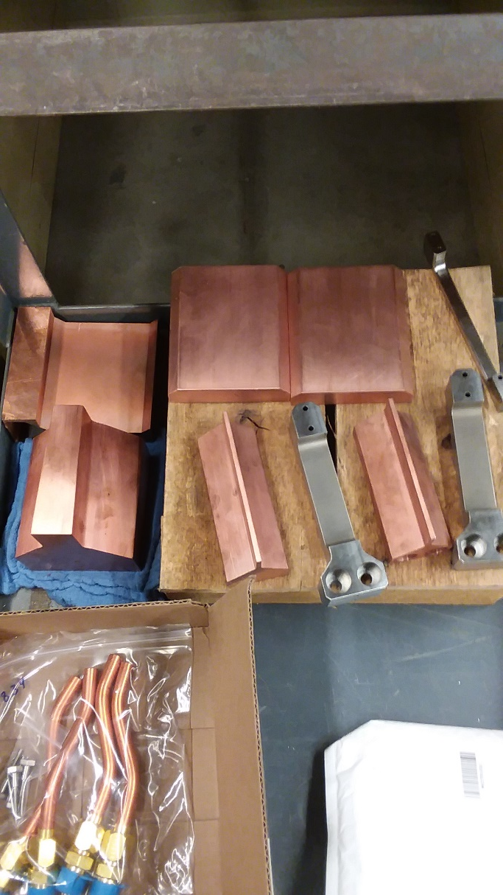
CPS Prototype
Parts in JLAB’s Machine shop being fabricated

Slide 4
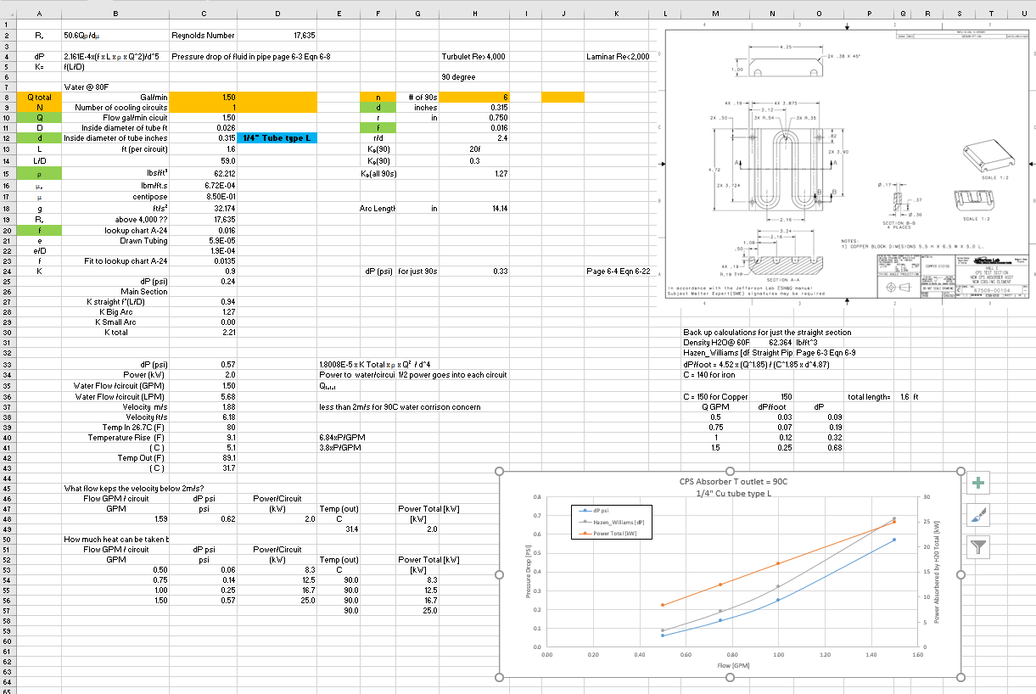
Prototype Base Cooling Element Redesigned

Slide 5
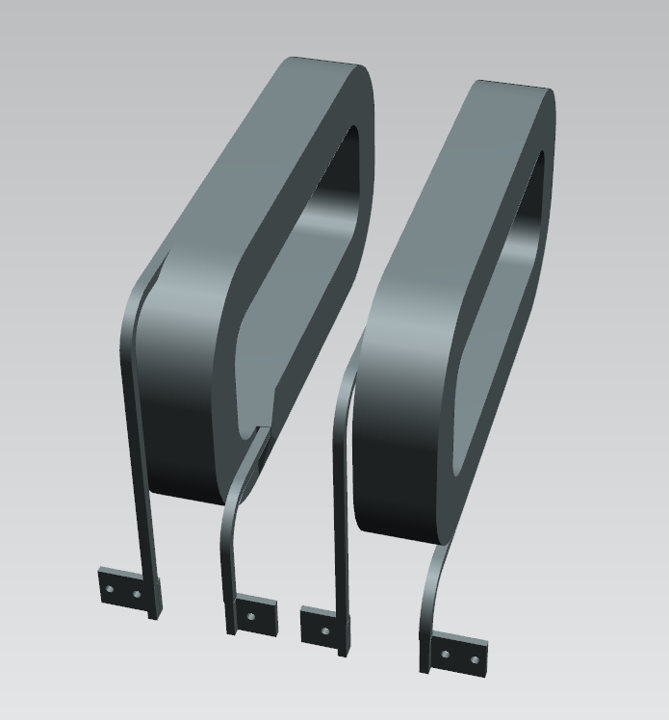
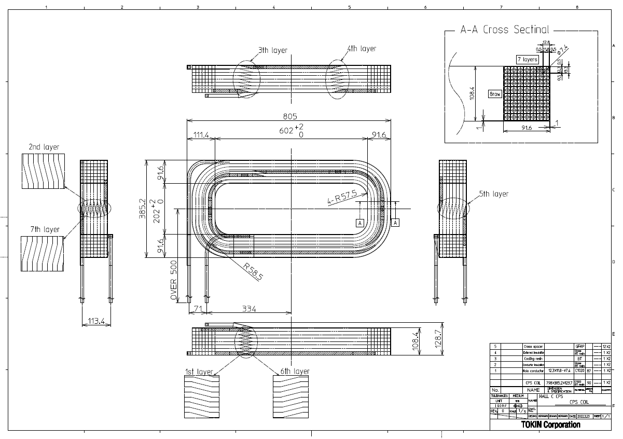
CPS Magnet Coils
Just received latest updated drawing from TOKIN on single wound coils.
Bert is updating 3D model – See JT model

Slide 6
CPS Coils Cooling Calcuations

Slide 7
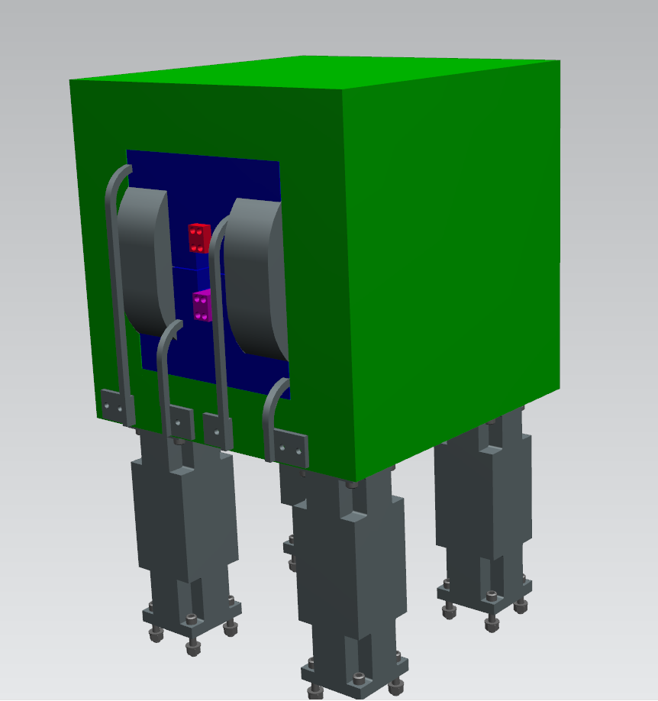
CPS Magnet JT

Slide 8
FLEUNT Modeling
Todd Coates was able to obtain 5 additional temporary licenses of FLEUNT until the end of April.
BUT upgrades to the ANSYS license file, (new date stamp on the main file) resulted in the temp license files not working any more, (older date stamp). He is working on getting them re-issued.
Amy has been able to work on a simplified model on a very limited basis. See her report.

Slide 9
280 W blocks out of 440 have been delivered from ELMET
Job List and considerations
Finish magnet design and drawings for procurement
Prototype testing
Shielding layout in CAD – both internal and external
External W Shielding in boxes for ease of handling
Raster layout
Radiator design
Beamlines with Be windows
N2 purge within magnet to reduce corrosive gases
Absorber final design
Sandesh of the Magnet support group is also working on cooling calculations for the prototype and absorber using FLEUNT, independent review.
LCW cooling of the Absorber and coils is likely as the heating load is 30kW. Still waiting on Radcon’s approval.

