Slide 1
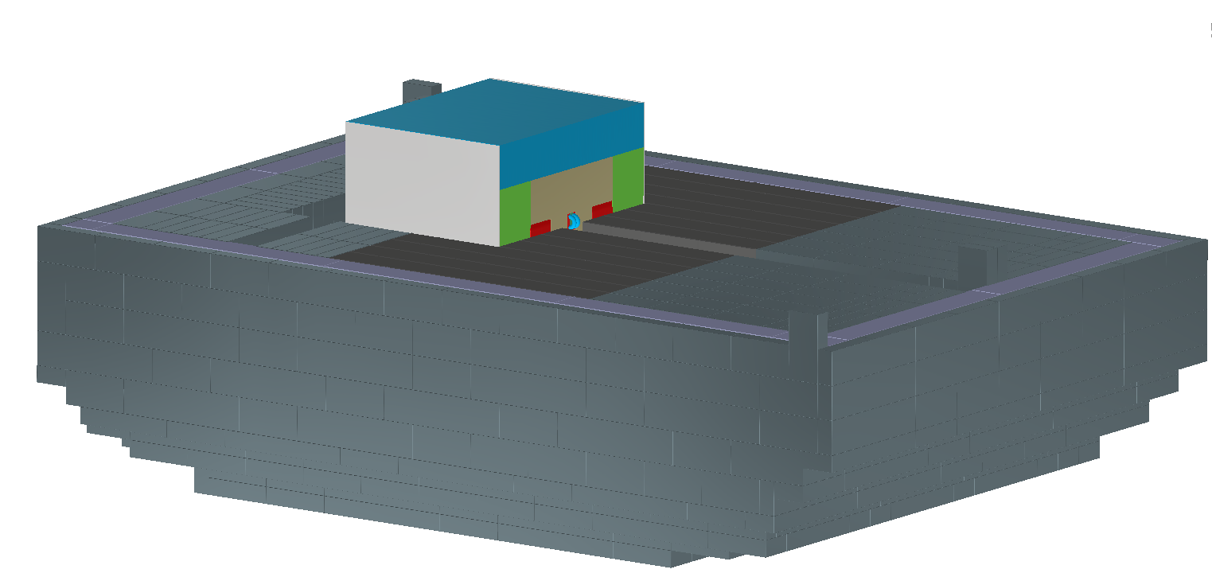
Latest Stacking Level
Last level before beam pipe installation required.

Slide 2
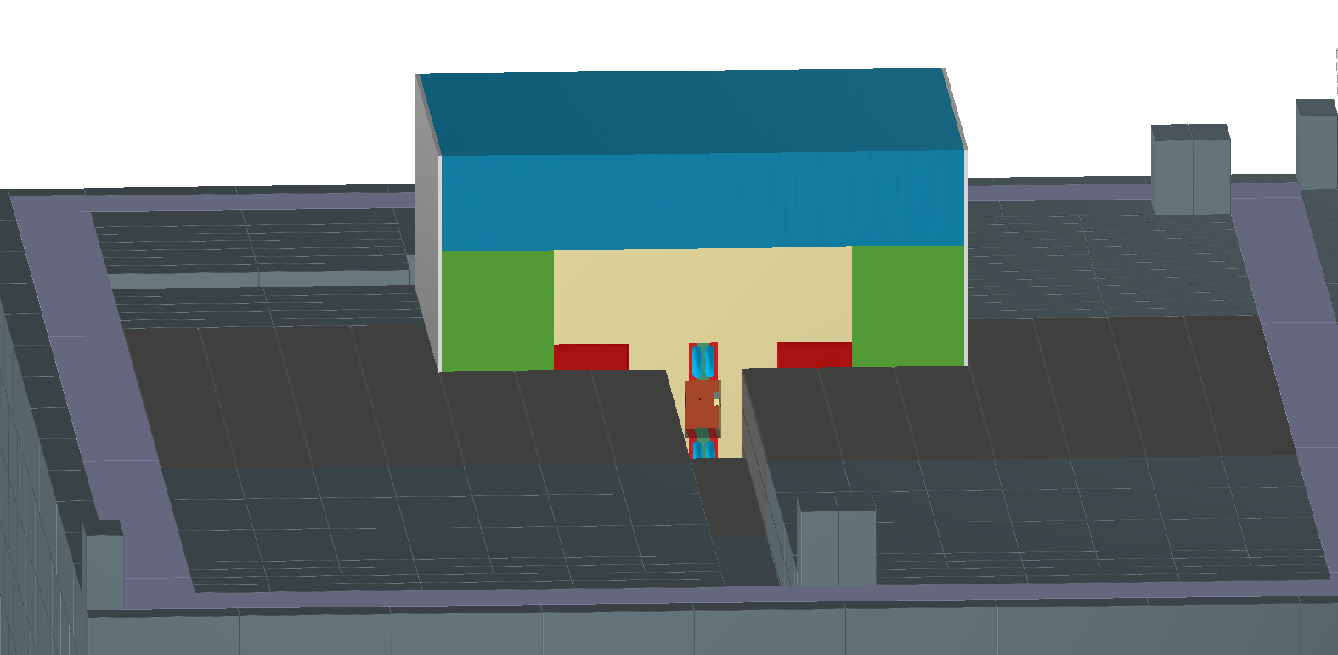
Beam Pipe Channel
Beam channel is made by excluding a row of bricks along the midline.
Structure.
Material.
Cooling.

Slide 3
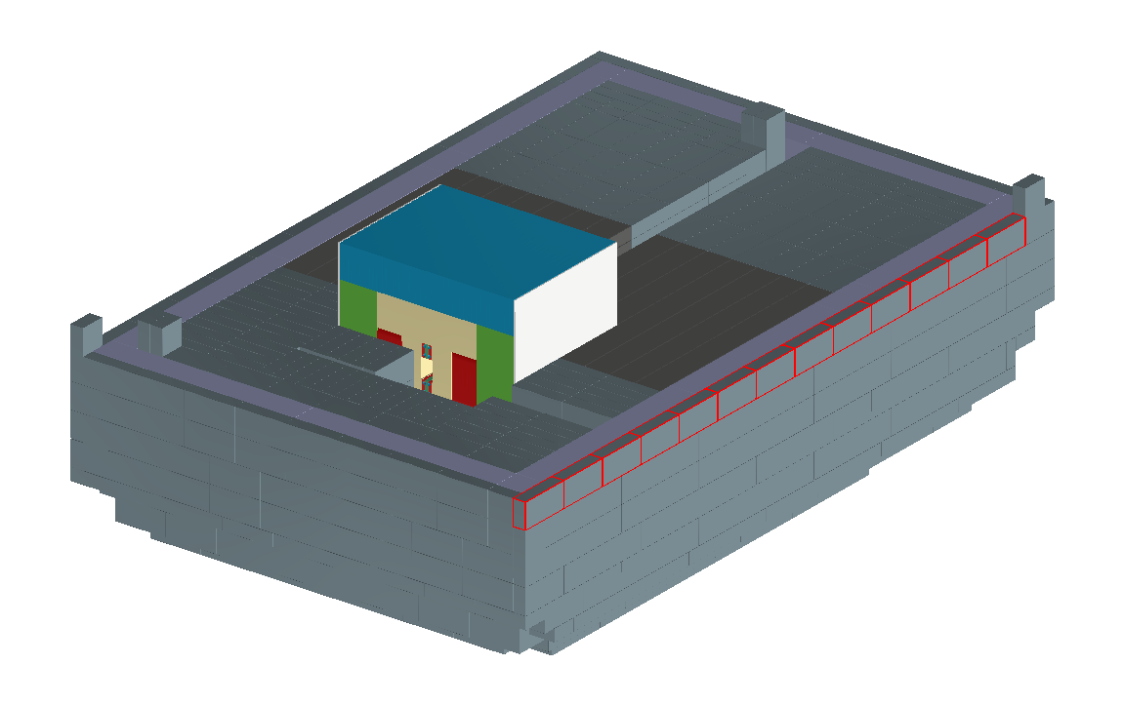
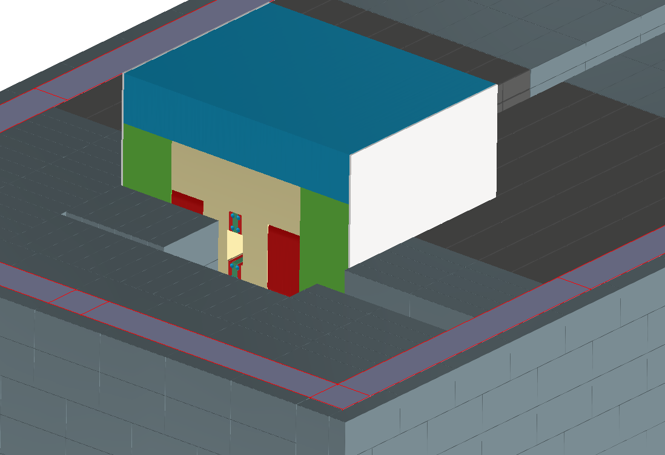
Cooling Feed.

Slide 4
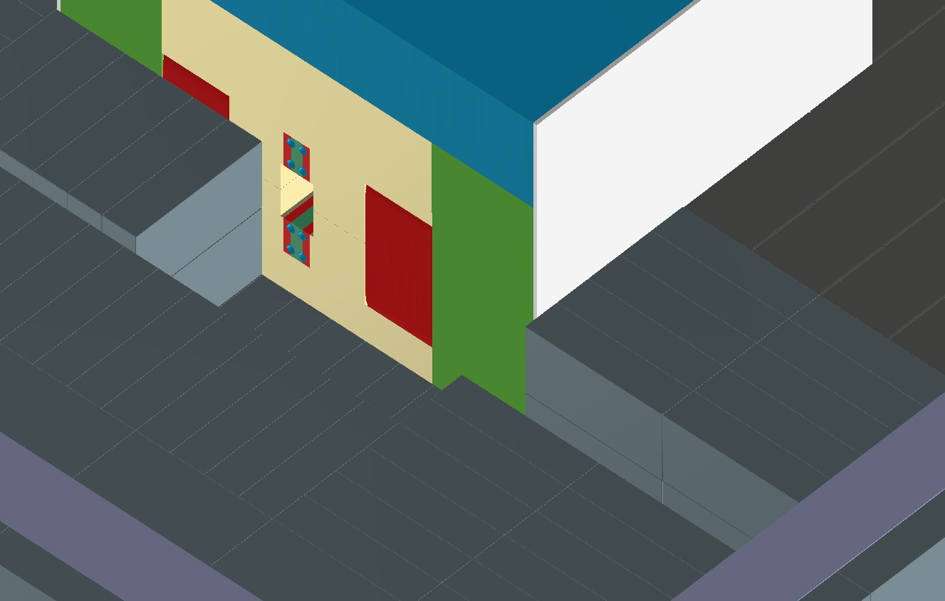
Beam Pipe Channel
Cooling feed lines.
Fed into shield from side or above
Shielding labyrinth.

Slide 5
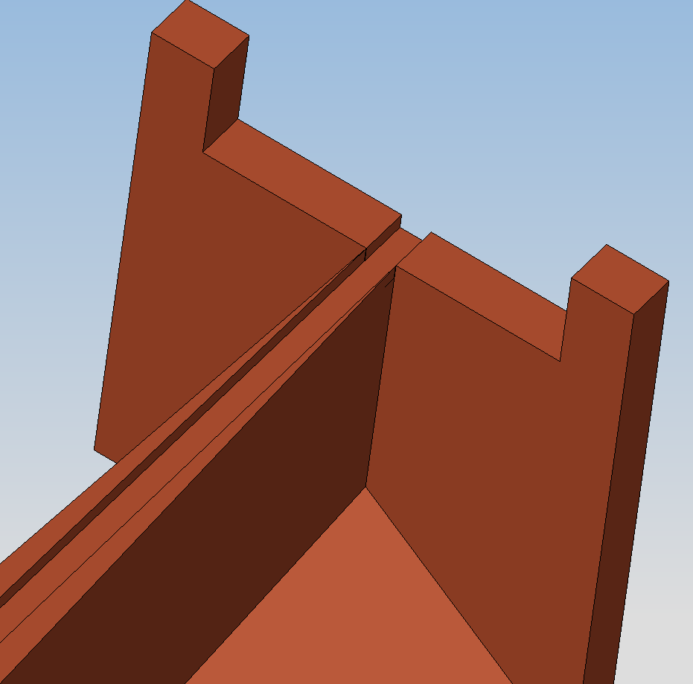
Cu Core Machining Questions
Thicken core walls at the at downstream end of Cu Core.
Adjust shape of Fe Poles.
Change spacing of Fe Poles.
Potential changes to magnetic field strength?
Sharp Tapering to zero thickness
Compound corners need radius to machine

