Slide 1
NPS Collaboration FJ Barbosa HV Divider Optimization & Results
PMT HV Dividers for NPS/CPS/COMCAL/FCAL II
F.J. Barbosa, V. Berdnikov, V. Popov, A. Somov, C. Stanislav
Divider
Bench & Hall D Beam Tests
Summary and Next Steps
3 February 2020

Slide 2
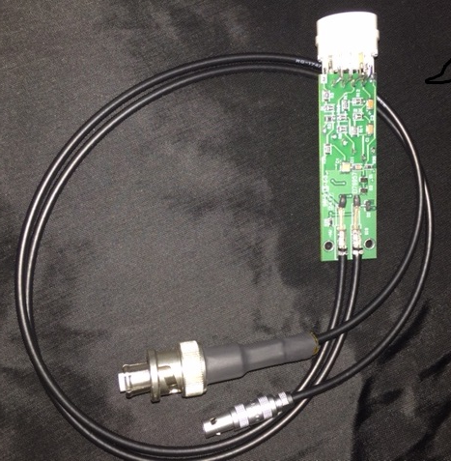
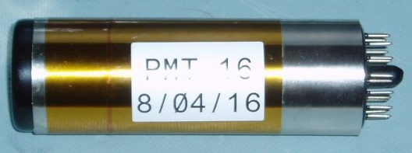
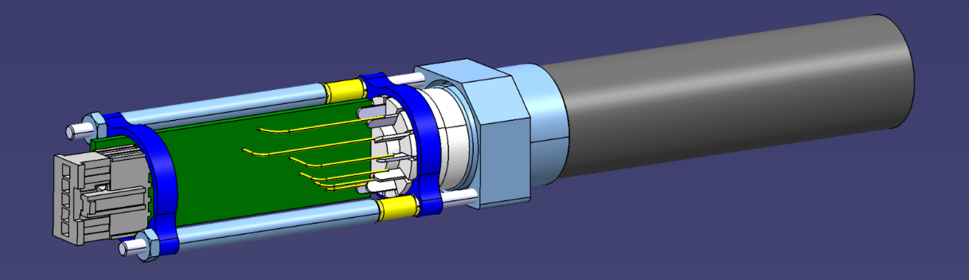
NPS Collaboration FJ Barbosa HV Divider Optimization & Results
1. Divider
Crystal
PMT
# Channels:
NPS/CPS = 1156
COMCAL = 96 (Operational)
FCAL II = 1596.
PMT: Hamamatsu R4125 PMT.
HV Divider:
Active.
Based on an earlier design by V. Popov, H. Mkrtchyan (2012).
Updated design for reliability, component and production optimization.
Optimization is ongoing.
New HV Divider (Active)
NPS PMT & Divider Assembly
(E. Rindel, IPNO, 1/31/2019)
3 February 2020

Slide 3
NPS Collaboration FJ Barbosa HV Divider Optimization & Results
Typical R4125 PMT Characteristics
Diameter 19 mm
Spectral Sensitivity 300 nm – 650 nm (Borosilicate, Bialkali)
Stages 10 stage
Cathode Luminous Sensitivity 115 uA/lm
Anode Luminous Sensitivity 100 A/lm
Dark Current 10 nA
QE 27 %
Rise Time 2.5 ns
Transit Time 16 ns
T.T.S. (Jitter) FWHM 0.85 ns
Pulse Height Resolution 7.8 %
Long Term Stability 1 %
Average Anode Current (max) 100 µA
Pulse Linearity +/- 2 % @ 100 mA
Gain 10⁵ @ 1.1 kV --- 10⁶ @ 1.5 kV
3 February 2020

Slide 4
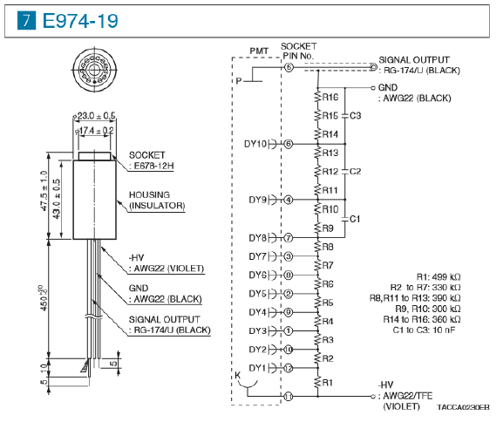
NPS Collaboration FJ Barbosa HV Divider Optimization & Results
Hamamatsu R4125 PMT Passive HV Divider
Anode Current
For improved linearity, divider current >> average anode current.
Installing transistor regulation on the last two dynodes improves performance at high rates.
Divider ratios affect PMT performance (e.g. gain, linearity) – need careful tests.
Ratios below result in half the gain for the active divider.
Divider Current
3 February 2020

Slide 5
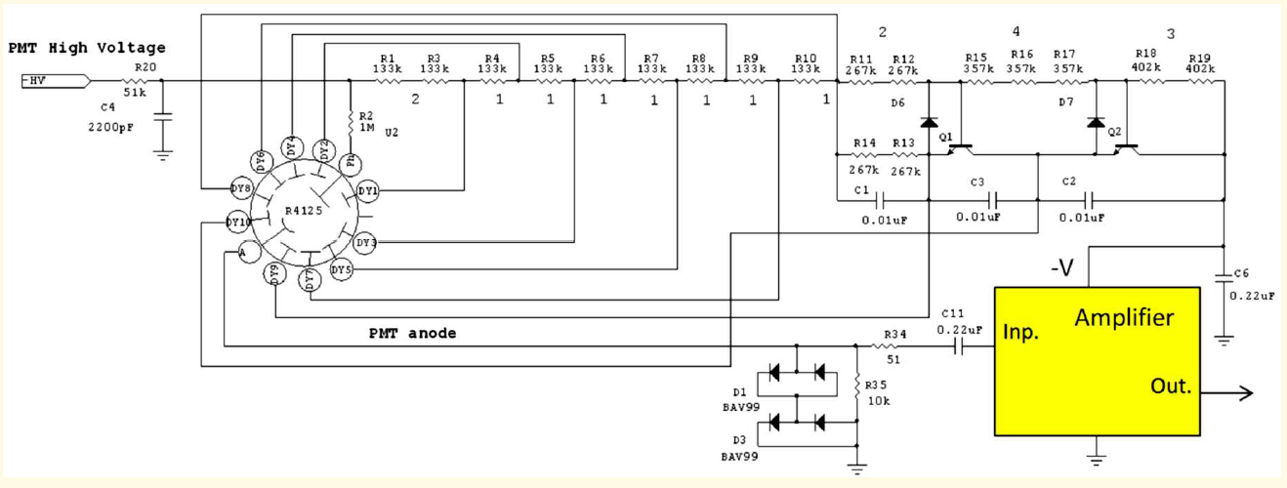
NPS Collaboration FJ Barbosa HV Divider Optimization & Results
Why an Active HV Divider?
Regulation on the last two dynodes provides for excellent stability and linearity at high rates, large dynamic range.
Operating the PMT at lower gain → lower anode current → longer PMT life.
Dynode
Regulation
Zener Regulated
CB Input
PNP-NPN Driver
Shaper
Gain – set by 1 resistor
2012 IEEE NSS/MIC – V.Popov, H. Mkrtchyan
Preamp is powered from HV supply, eliminating LV supply, connectors, controls, etc.
Divider Current: 430 uA (Active) vs. 170 uA (Hamamatsu passive).
Divider Ratios & Anode Current: Active = 1/2 Passive.
Goal: decrease anode Current, attain good linearity.
3 February 2020

Slide 6
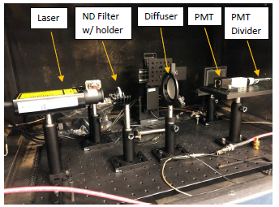
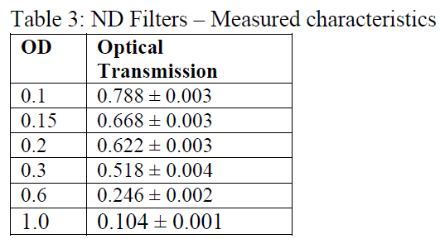
NPS Collaboration FJ Barbosa HV Divider Optimization & Results
2. Bench & Hall D Beam Tests
Wavelength 405 nm
Pulse Width 70 ps
Rate Adjustable
Up to 100 MHz
Intensity Adjustable
Class 3B
PMT R4125
HV Divider Passive & Active
Intensity was adjusted by employing neutral density filters (UV – visible) only:
3 February 2020

Slide 7
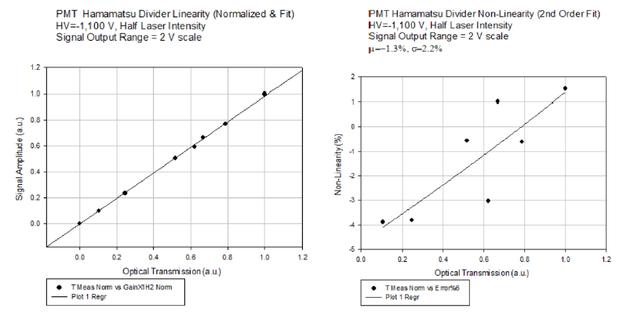
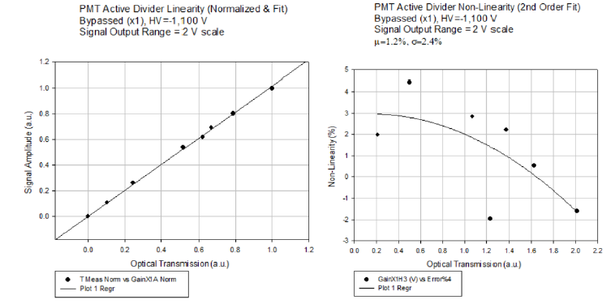
NPS Collaboration FJ Barbosa HV Divider Optimization & Results
Hamamatsu Passive:
Non-linearity = ±2.2%.
Active, bypassed*:
Non-linearity = ±2.4%.
Similar characteristics.
*bypassed – no preamp, signal taken from anode.
3 February 2020

Slide 8
NPS Collaboration FJ Barbosa HV Divider Optimization & Results
Bench Tests (May 2019):
Preamp Gain | Amplitude Scale (V) | HV Setting (V) | Divider Current (µA) | Non-Linearity (±%) | Pulse Rate Max (MHz), -3 db
Bypassed | 2 | -1,100 | 432 | 2.3 | 1.3
Bypassed | 1 | -1,012 | 396 | 1.5 | 2.5
Bypassed | 0.5 | -933 | 365 | 1.9 | 5.1
3 | 2 | -972 | 380 | 3.6 | 3.8
3 | 1 | -900 | 352 | 6.5 | 7.6
3 | 0.5 | -835 | 326 | 10.5 | 15
*fADC250 has three amplitude scales: 0.5 V, 1 V, 2 V.
Observations:
Non-linearity increases with decreasing amplitude scale for x3 preamp.
Higher rate capability with lower gain.
Anode Current Estimate:
Preamp (x3), 2V scale ~ 1/3 anode current of Hamamatsu passive divider.
3 February 2020

Slide 9
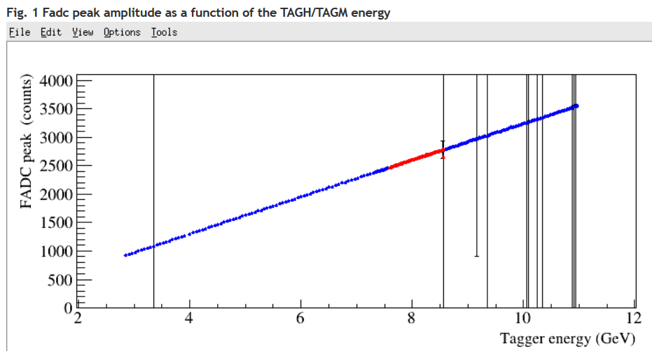
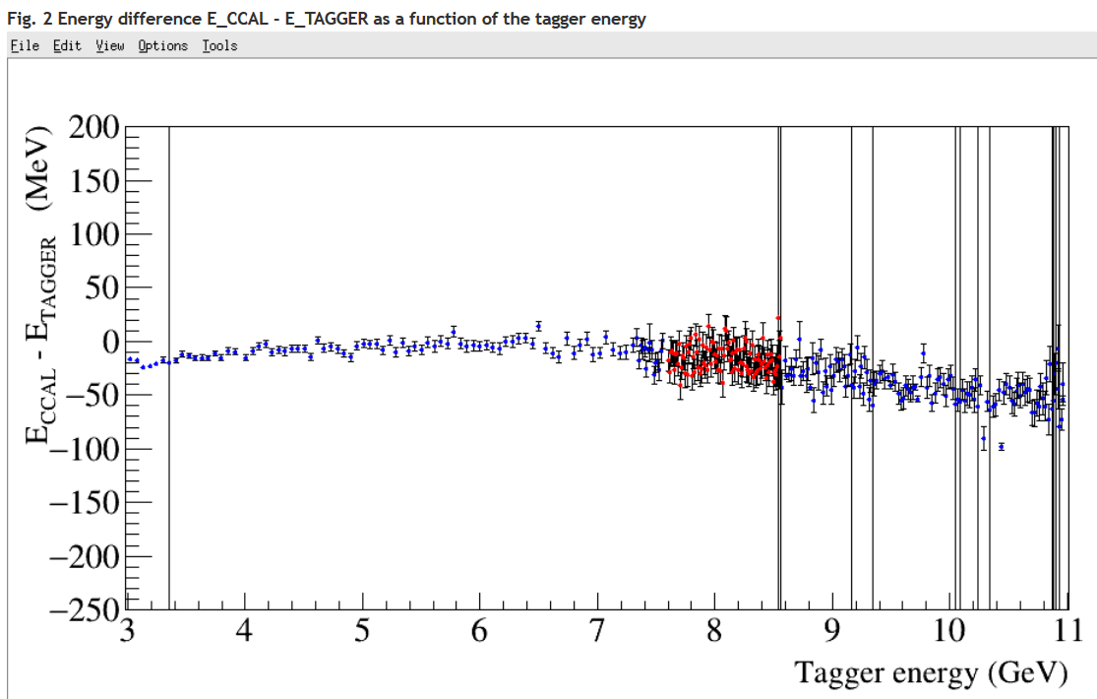
NPS Collaboration FJ Barbosa HV Divider Optimization & Results
Hall D Beam Tests (January2020):
Preamp Gain | HV Setting (V) | Divider Current (µA) | Non-Linearity (±%) | Notes
24 | -650 |  | 6 | Original
Bypassed | -1,000 | ~400 | 1 - 2
6 | -800 |  | 2 - 3
3 | -800 |  | 2 - 3
6 | -850 | ~800 | 1 – 2 | Vlad_P_Mod_1
6 | -850 | ~800 | 1 – 2 | Vlad_P_Mod_2
6 | -850 | ~800 | 1 - 2 | Vlad_P_Mod_3
Observations:
Modifications with 6x and HV resistor chain.
Divider current ~2x higher – Good linearity.
Gain x3 may be sufficient.
Anode Current:
Measurements are being analyzed.
3 February 2020

Slide 10
Hall C Collaboration FJ Barbosa Electronics
6. Summary & …
Active HV dividers for the Hamamatsu R4125 PMT have been developed, assembled and tested:
Good performance characteristics after a few modifications.
Allows operation of the PMT at lower gain, extending its useful life, and with good linearity.
The NPS/CPS detector infrastructure is under development
Choice of connectors, patch panels, … is it finalized?
HV dividers were produced sometime ago but modifications will be needed due to new modifications.
We will need to assess impact after current tests and specifications are better understood – Anode current requirements.
The COMCAL is operational. FCAL II is under development.
Next Steps
Finalize NPS Requirements.
Finalize beam tests and data analysis.
Assess and implement modifications on NPS/CPS divider.
Finalize design of FCAL II divider.
23 January 2018

