Slide 1
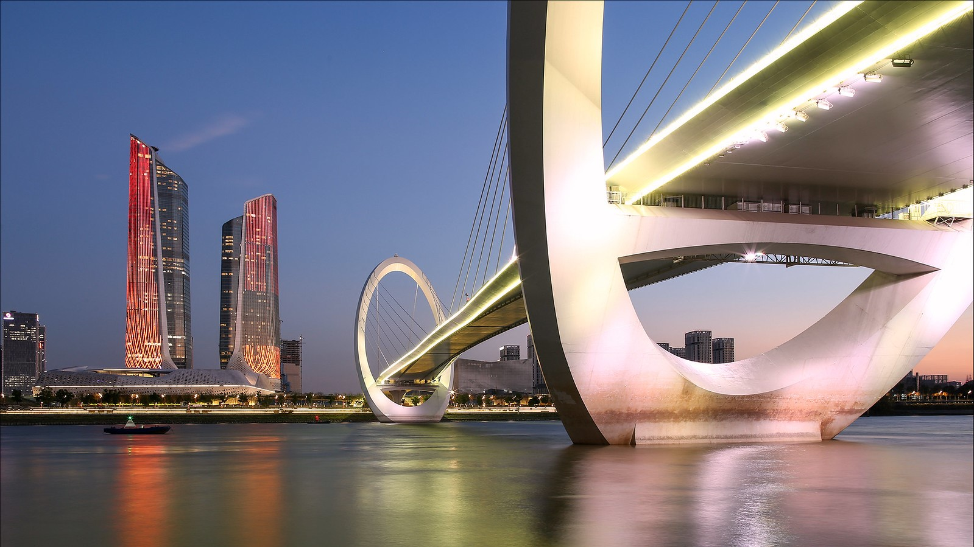
Grant no. 12135007
Craig Roberts … http://inp.nju.edu.cn/
$π, K, N$ Electromagnetic
& Gravitational Form Factors
Notes:
25+5

Slide 2
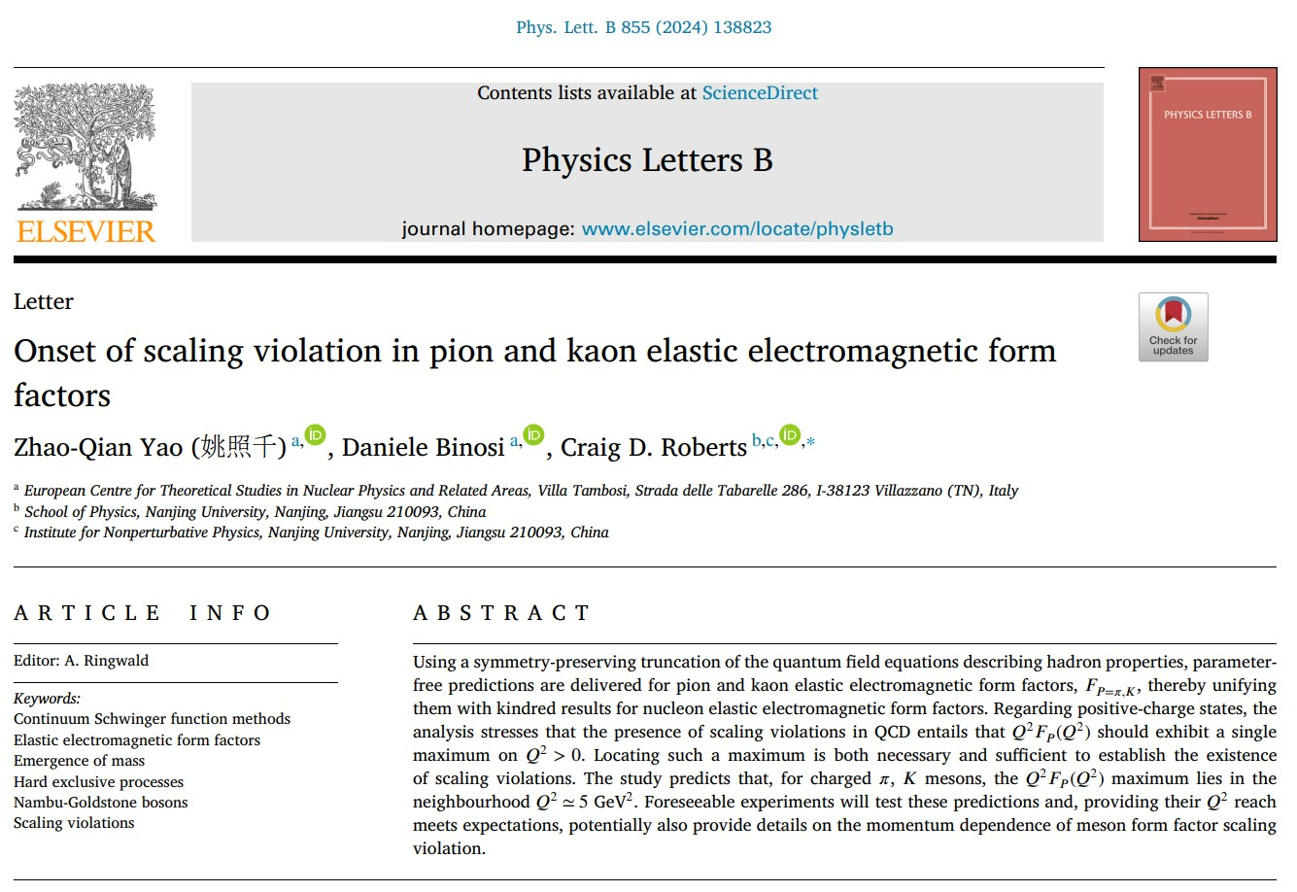

Slide 3
Contrasts – $π, K, N$
Ab initio predictions for pion and kaon electromagnetic form factors
Benchmark the continuum Schwinger function methods used to deliver predictions of nucleon form factors
Important in their own right … as noted previously …
Pions and kaons are Nature's most fundamental Nambu-Goldstone bosons
Bound-states seeded by light degrees of freedom – like nucleon
But anomalously light … pion has $μ$-lepton-like mass
These features are an
expression of emergent hadron mass (EHM) within the Standard Model
accident of Nature, which sees Higgs boson couplings into QCD produce $u, d$ quark masses that are just 4-8 times the electron mass
Such contrasts between $π, K, N$ raise many questions, particularly concerning what impressions they leave on the internal structure of these states

Slide 4
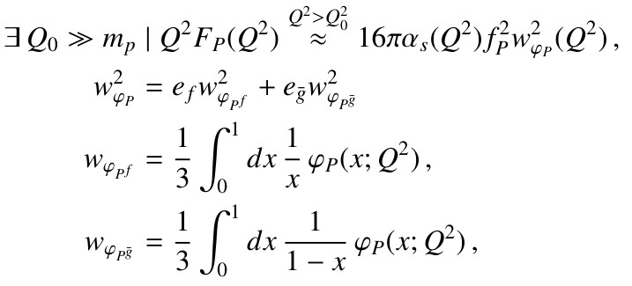
Hard QCD Prediction
Delivered more than 40 years ago … positive-charge pseudoscalar meson $P$, constituted from valence $f, \overline{g}$ quarks:
$α_{s}(Q^{2})$ is QCD running coupling
$f_{P}$ is pseudoscalar meson's leptonic decay constant
$φ_{P}(x;Q^{2})$ is meson’s leading parton distribution amplitude (DA) evaluated at the hard scale of the interaction

Slide 5
Hard QCD Prediction
Hard QCD prediction is remarkable.
beyond some momentum scale, the meson form factor is precisely known
magnitude (normalisation) is set by meson leptonic decay constant, which is an order parameter for dynamical chiral symmetry breaking (DCSB) – a corollary of EHM
and scaling violations are apparent, with $Q^{2}$ dependence determined by that of the running coupling and evolution of the DA
Analogous proton equation – magnitude (normalization) is not known
On domain ${m_{p}^{2}}/{Q^{2}}≃0⇒φ_{P=π,K}\left(x\right)=6 x(1−x)$ and right-hand side $⇒16πα_{s}\left(Q^{2}\right)f_{P}^{2}$
Two outstanding issues:
what is value of $Q_{0}$for which scaling violations become apparent?
and what is pointwise form of $φ_{P}(x;Q^{2})$at scales for which terrestrial experiments are possible?
These questions can only be answered using a nonperturbative approach to QCD.

Slide 6
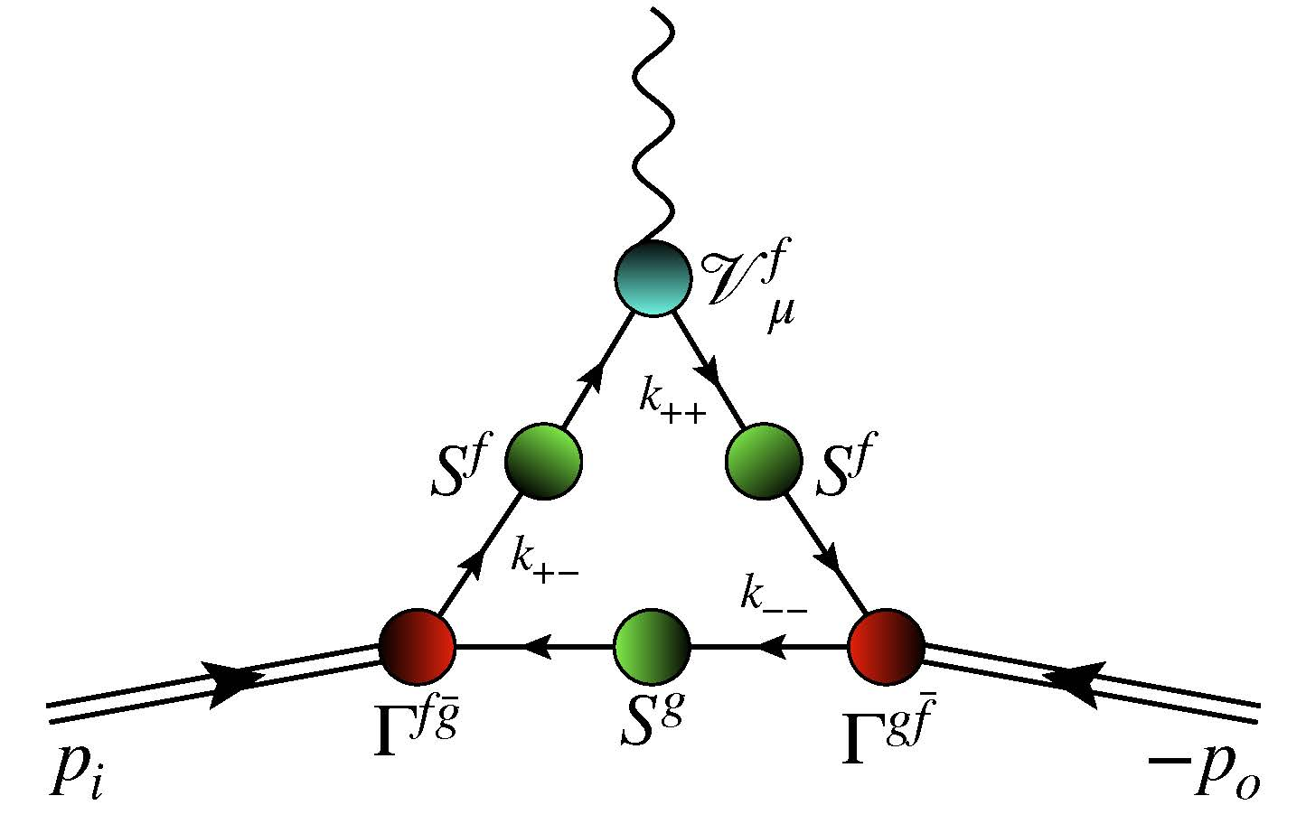
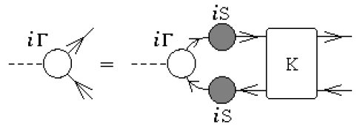
CSM Predictions for Meson Form Factors - approximation
Rainbow-ladder (RL) truncation
Leading-order in a symmetry-preserving, systematically-improvable truncation of all quantum field equations which appear in photon + meson current
This five-point Schwinger function
RL truncation specified by kernel of Bethe-Salpeter equation (analogue of Schrödinger equation in quantum field theory)
$S$ = dressed quark propagator
$Γ$ = meson Bethe-Salpeter amplitude
$V$ = dressed photon + quark vertex
Every element calculated in RL truncation

Slide 7
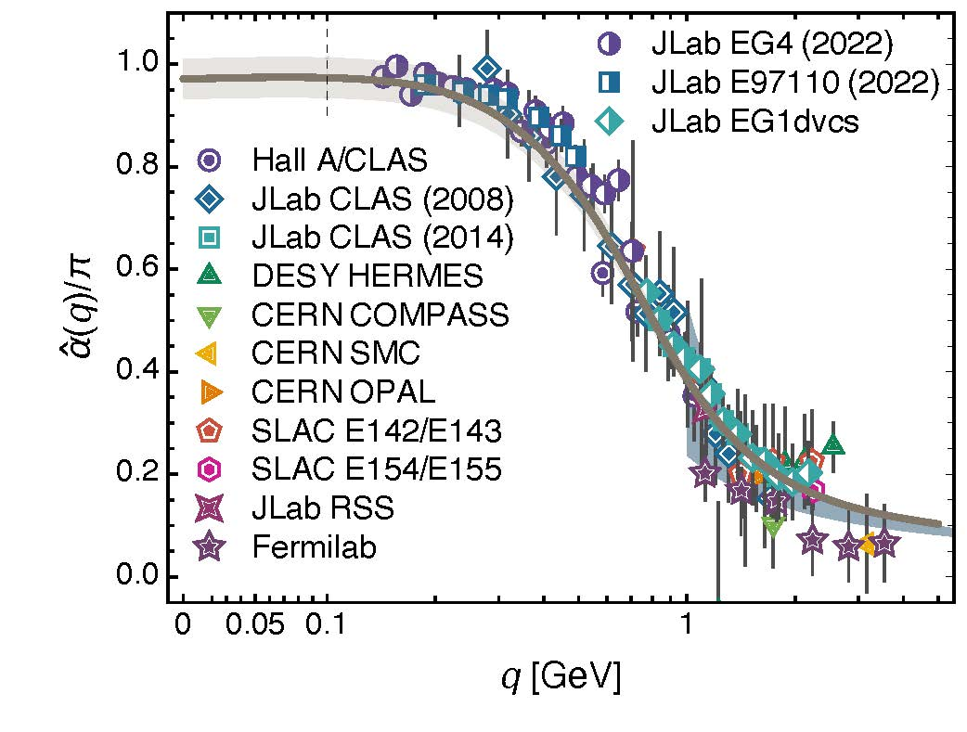
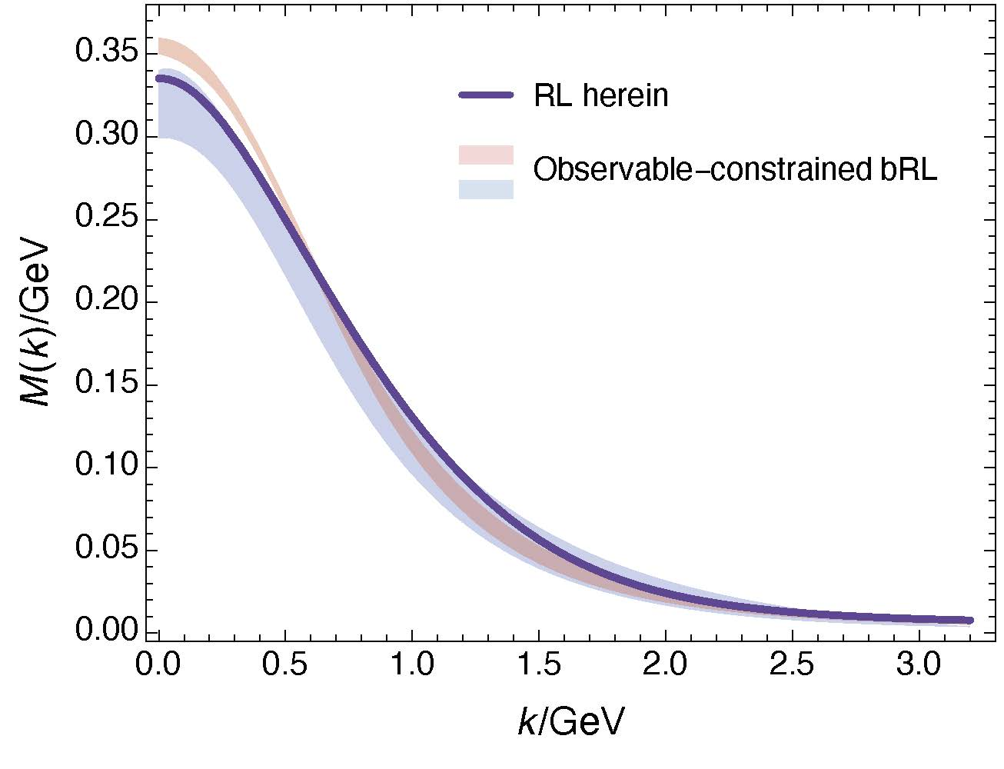
CSM Predictions for Meson Form Factors
Interaction $\tilde{G}(y)=\frac{4π\hat{α}\left(y\right)}{\left[y+m_{G}^{2}\right]}$
QCD prediction: $\frac{\hat{α}\left(0\right)}{π}=0.97(4)$ & $m_{G}=0.45(1)$ GeV
& $\frac{\hat{α}\left(0\right)}{πm_{G}^{2}}=4.8(2)$/Ge$V^{2}$
Modern RL values constrained by $m_{π}, f_{π}, m_{N}$
$\frac{\hat{α}\left(0\right)}{π}=1.45$ & $m_{G}=0.54$ GeV & $\frac{\hat{α}\left(0\right)}{πm_{G}^{2}}=5.0$/Ge$V^{2}$
Fair match with QCD values
Further highlighted by mass function
Falls comfortably within solution range determined by solving gap equation with sophisticated symmetry-preserving, nonperturbative beyond-RL truncation
Effective charge from lattice QCD, Z-F. Cui, J.-L. Zhang et al.,
arXiv:1912.08232 [hep-ph], Chin. Phys. C 44 (2020) 083102/1-10
Natural constraints on the gluon-quark vertex, D. Binosi et al.,
arXiv:1609.02568 [nucl-th], Phys. Rev. D 95 (2017) 031501(R)/1-7

Slide 8
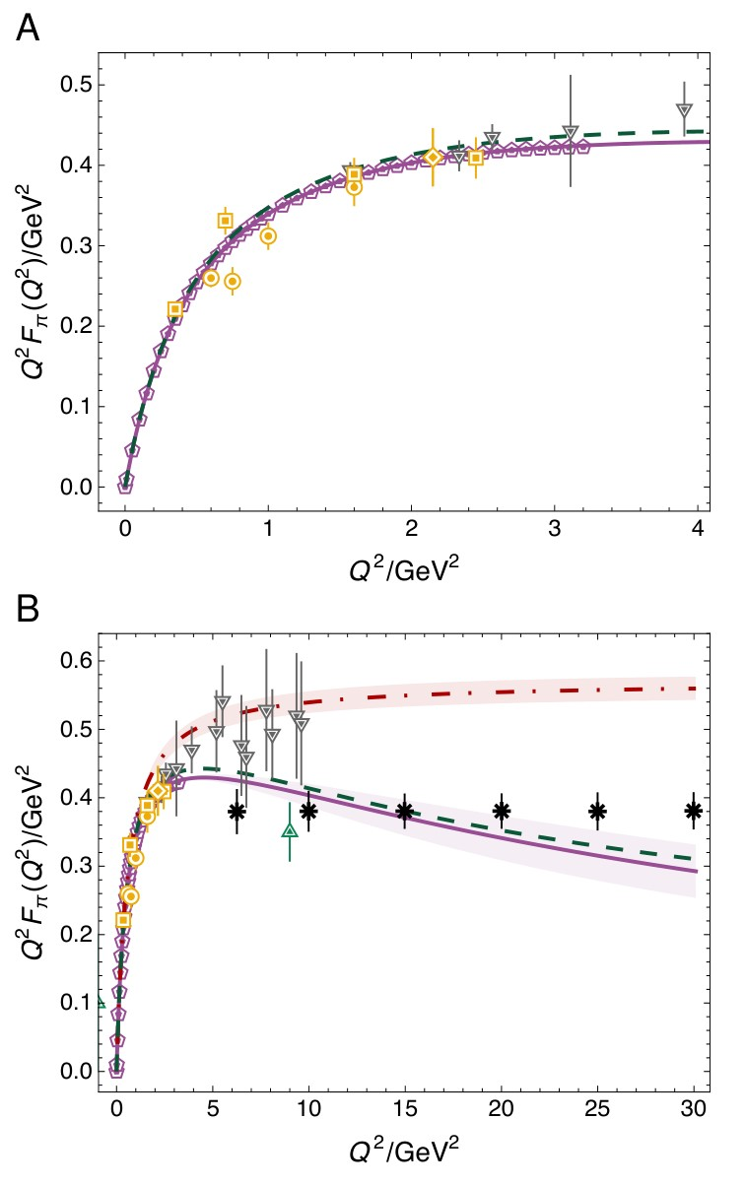
Pion Form Factor
CSM predictions for $Q^{2}F_{π}\left(Q^{2}\right)$ – purple curve
Charge radius agrees with experiment: $0.67$ fm
$Q^{2}$dependence matches that suggested by JLab precision measurements [Horn:2007ug, Huber:2008id] (gold symbols)
$Q^{2}>4GeV^{2}$
cf. vector meson dominance (VMD) result = dot-dashed red
this curve begins to deviate significantly from data and CSM prediction at upper bound of available JLab measurements
Notably, precision of lQCD (grey points) is insufficient to distinguish between VMD estimate and CSM prediction

Slide 9
Pion Form Factor
Salient feature of CSM predictions is existence of maximum in $Q^{2}F_{π}\left(Q^{2}\right)$, which occurs on $Q^{2}≃4.6\left(5\right)GeV^{2}$
Thereafter, scaling violation apparent,
$Q^{2}F_{π}\left(Q^{2}\right)$ falls steadily toward zero as
$≈{\left(1/ln⁡Q^{2}\right)}^{γ_{F}}$, $γ_{F}≈1.1$
consistent with hard QCD prediction
N.B. Any model that expresses VMD must exhibit opposite trend, viz. result for $Q^{2}F_{π}\left(Q^{2}\right)$ which rises steadily with increasing $Q^{2}$, without inflection, toward finite ultraviolet limit.
lQCD reach and precision are inadequate to see breakaway from VMD and scaling violation
green point farthest reach of anticipated JLab data
JLab is potentially capable of seeing breakaway from VMD
black asterisks – anticipated EIC will see scaling violation

Slide 10
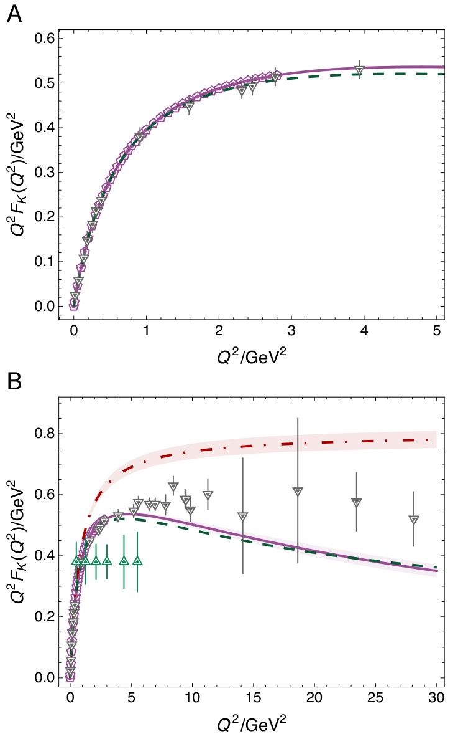
Charged kaon form factor
CSM predictions for $Q^{2}F_{K}\left(Q^{2}\right)$ – purple curve
Precise $F_{K}\left(Q^{2}\right)$data are lacking, so no comparison with experiment is made
Predicted charge radius is commensurate with available empirical estimates: $r_{K}=0.6$fm
$Q^{2}F_{K}\left(Q^{2}\right)$exhibits maximum on $Q^{2}≃4.8\left(5\right)GeV^{2}$
$Q^{2}F_{K}\left(Q^{2}\right)$ falls steadily toward zero as
$≈{\left(1/ln⁡Q^{2}\right)}^{γ_{F}}$, $γ_{F}≈1.1$
consistent with hard QCD prediction

Slide 11
Charged kaon form factor
VMD result = dot-dashed red
Comparing $F_{π,K}$, notable that, with increasing mass of the meson involved, position at which VMD curve separates from CSM prediction moves to smaller $Q^{2}$
Considering anticipated $Q^{2}$ reach (green points), JLab experiments [E12-09-011] may be expected to confirm this breakaway
On the other hand, discovery of scaling violation in charged kaon form factor may require a machine with EIC capabilities.
Analyses suggest that EicC may be better tuned to this task (EicC CDR, in preparation)
Existing lQCD results are insensitive to scaling violation in $F_{K}\left(Q^{2}\right)$: on $Q^{2}>5 GeV^{2}$, lQCD results are consistent with $Q^{2}F_{K}\left(Q^{2}\right)=$constant.

Slide 12
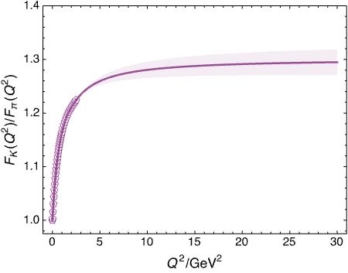
$$F_{K}(Q^{2})/F_{π}\left(Q^{2}\right)$$
Asymptotic limit $f_{K}^{2}/f_{π}^{2}$ $=1.43$
Approached as small power of $\ln{Q^{2}}$
Slightly different rate of $\ln{Q^{2}}$evolution for kaon and pion distribution amplitudes
CSM prediction
Achievable experiments will see
$f_{K}^{2}/f_{π}^{2}$ $≈1.28$

Slide 13
Summary $F_{π}\left(Q^{2}\right)$ & $F_{K}\left(Q^{2}\right)$
Onset of scaling violation in pion and kaon elastic electromagnetic form factors
Zhao-Qian Yao (姚照千), Daniele Binosi and Craig D. Roberts, NJU-INP 087/24
e-Print: 2405.04681 [hep-ph], Phys. Lett. B 855 (2024) 138823/1-7
Predictions also for flavour separation and neutral kaon form factors
Possibly accessible at EIC and EicC
CSM analysis
$Q^{2}F_{P}\left(Q^{2}\right)$ has maximum at $Q^{2 }≈5GeV^{2}$
So …
proposed experiments are capable of locating the peak
can, potentially, provide quantitative information on value of $γ_{F}$
Crucial steps toward ultimate verification of hard QCD prediction
(perhaps seen in $γ^{∗}π→γ$, but this is controversial – Phys. Rev. D93 (2016) 074017/1-9)
Connecting hard scattering of leptons from mesons to expressions of emergent hadron mass, via QCD effective charge and meson leptonic decay constant

Slide 14
Faddeev Equation for Baryons - Baryon Wave Function
Nucleon mass from a covariant three-quark Faddeev equation
G. Eichmann et al., Phys. Rev. Lett. 104 (2010) 201601
Nucleon charge and magnetisation distributions: flavour separation and zeroes,
Zhao-Qian Yao et al., e-Print: 2403.08088 [hep-ph]
Nucleon Gravitational Form Factors,
Zhao-Qian Yao et al., e-Print: 2409.15547 [hep-ph]

Slide 15
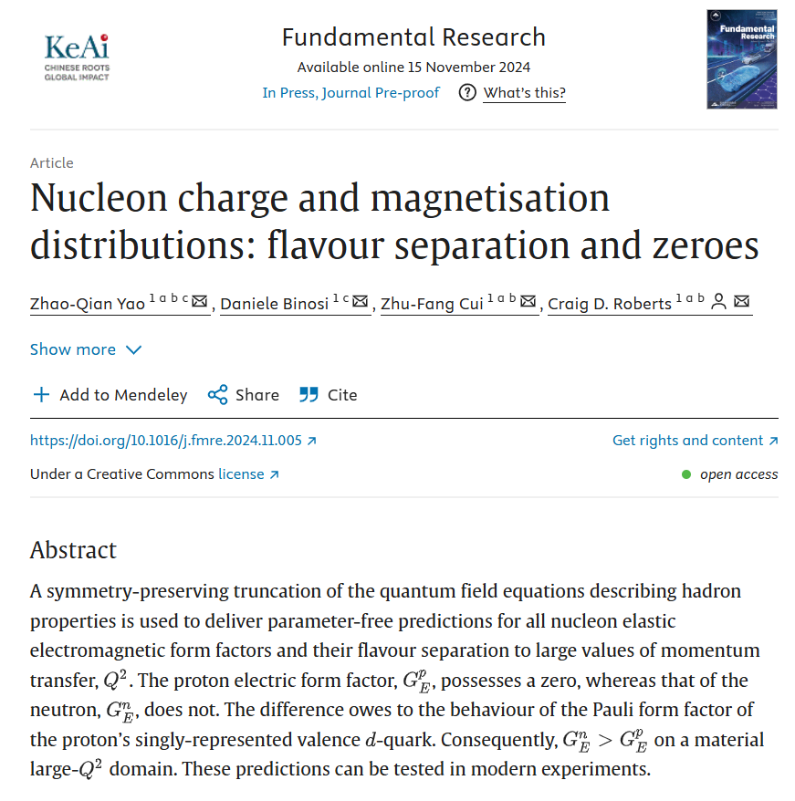
Aims & Scope
Fundamental Research is an open access, peer-reviewed, multidisciplinary journal, which is supervised by the National Natural Science Foundation of China (NSFC). Published bimonthly, it features high-calibre research covering all areas of the natural sciences and high-tech fields.

Slide 16
Nucleon as a Bound State
Nucleon charge and magnetisation distributions: flavour separation and zeroes, Zhao-Qian Yao (姚照千), Daniele Binosi, Zhu-Fang Cui (崔著钫), Craig D. Roberts, NJU-INP 085/24, e-Print: 2403.08088 [hep-ph]
Nucleon bound-state problem can be addressed
in any approach that provides access to the three-quark six-point Schwinger function
Using CSMs, one begins with the Poincaré-invariant Faddeev equation
Today, there are 3 people in the world who can solve this problem
Only one (姚照千) can handle systems with non-degenerate valence quark flavours
The analysis to be described used precisely the same approach (approximation and interaction) as that employed for pion and kaon electromagnetic form factors
Thus, one arrives at unifying set of parameter-free predictions for all pion and kaon and nucleon elastic electromagnetic form factors and their flavour separation to large values of momentum transfer
All predictions link observables directly with fundamental QCD Schwinger functions and thereby expose novel expressions of emergent phenomena in QCD.
This is the first such set of predictions and the only such set available today

Slide 17
Nucleon Electromagnetic Current
Compared with $F_{π,K}$ calculation, the only essentially new element is $Ψ$
With $Ψ$, calculation of nucleon electromagnetic form factors is a numerical exercise
To reach large $Q^{2}$, very good algorithms must be devised
They exist …
see – Fresh extraction of the proton charge radius from electron scattering, Zhu-Fang Cui, Daniele Binosi, Craig D. Roberts and Sebastian M Schmidt, NJU-INP 033/21, arXiv: 2102.01180 [hep-ph], Phys. Rev. Lett. 127 (2021) 092001
… Schlessinger point method (SPM)
and are used to deliver all modern CSM predictions

Slide 18
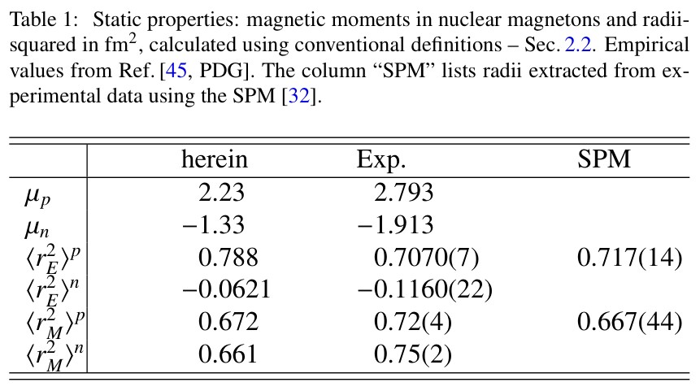
Nucleon Static Properties
In size, the magnetic moments are $∼25$% too small.
This is a failing of RL truncation, which produces a photon + quark vertex whose dressed-quark anomalous magnetic moment term is too weak.
It is corrected in higher-order truncations [Chang:2010hb].
Such corrections have been implemented in studies of mesons [Xu:2022kng].
It may be possible to adapt this approach to baryons.
Concerning the other entries, the agreement with experiment is reasonable.
In particular, the prediction ${\left\langle r_{E}^{2}\right\rangle }^{p}>{\left\langle r_{M}^{2}\right\rangle }^{p}$ accords with unbiased (SPM) analyses of existing form factor measurements.
Hadron and light nucleus radii from electron scattering, Zhu-Fang Cui (崔著钫) et al., NJU-INP 058/22, e-Print: 2204.05418 [hep-ph], Chin. Phys. C 46 (2022) 122001/1-16 - Editors' Suggestion

Slide 19
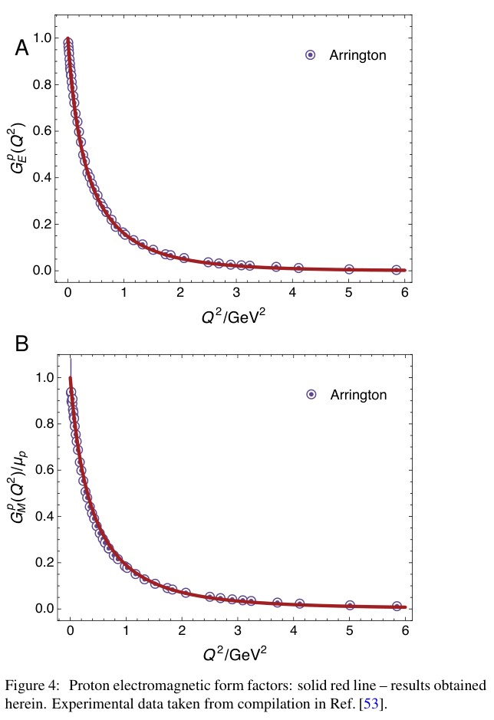
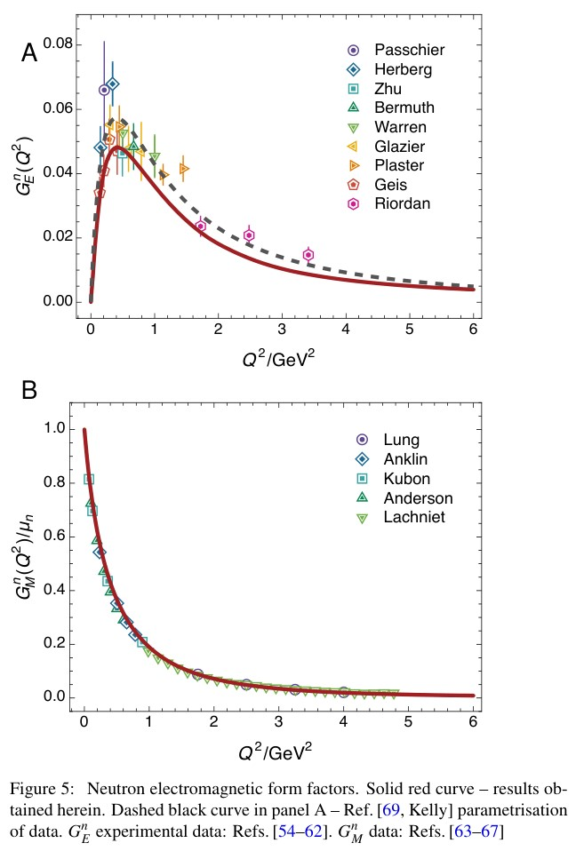
Nucleon Electromagnetic Form Factors
Predictions for $Q^{2}$ dependence of each nucleon form factor agrees well with data
Even $G_{E}^{n}\left(Q^{2}\right)$ is a fair match, despite its sensitivity to details of neutron wave function
Notably, despite underestimating $μ_{p,n}$, $Q^{2}$ dependence of proton and neutron magnetic form factors agree well with data

Slide 20
Nucleon Electromagnetic Form Factors
Comparison Kelly parametrisation
(mathematical L1 measure of
difference between two curves
domain $0<Q^{2}<10 GeV^2$)
Regarding $G_{E}^{p}, G_{M}^{p,n}/μ_{p,n}$, within line width, data parametrisations are indistinguishable from CSM predictions
$G_{E}^{n}\left(Q^{2}\right)$lies systematically below fit by $≈20$% (L1 measure)

Slide 21
Nucleon charge/magnetisation distributions
Proton electric form factor possesses a zero:
$$Q^{2}={8.86}_{−0.86}^{+1.93} GeV^{2}$$
Neutron electric form factor is positive definite
$⇒G_{E}^{n}\left(Q^{2}\right)>G_{E}^{p}\left(Q^{2}\right)$ on $Q^{2}≥4.7 GeV^{2}$
On this domain, electric form factor of charge-neutral neutron is larger than that of charge-one proton
Verification within JLab reach
… perhaps already in GEn II data?
Prediction underestimates
$G_{E}^{n}\left(Q^{2}\right)$ by 20%

Slide 22
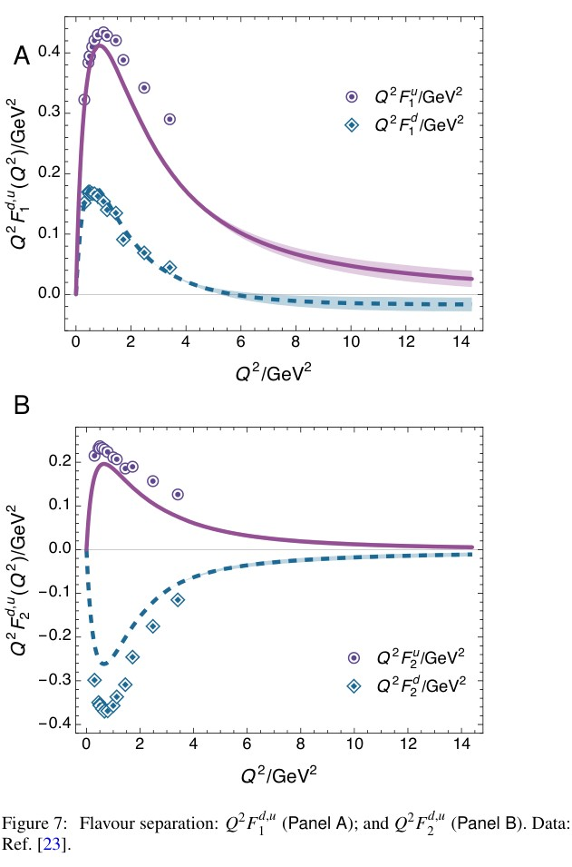
Nucleon Form Factor Flavour Separation
Suppose $s$ quark contributions negligible (very good approximation)
$F_{i=1,2}^{u}=2 F_{i}^{p}+F_{i}^{n}$ & $F_{i}^{d}=F_{i}^{p}+{2 F}_{i}^{n}$
Current conservation and valence-quark number:
$$F_{1}^{p}\left(Q^{2}=0\right)=2=2 F_{1}^{d}(Q^{2}=0)$$
Parameter-free CSM predictions … deliver good qualitative and fair quantitative agreement with available data.
Zero in $F_{1}^{d}$ at $Q^{2}={5.73}_{−0.49}^{+1.46} GeV^{2}$
Is this visible in GEn II data?

Slide 23
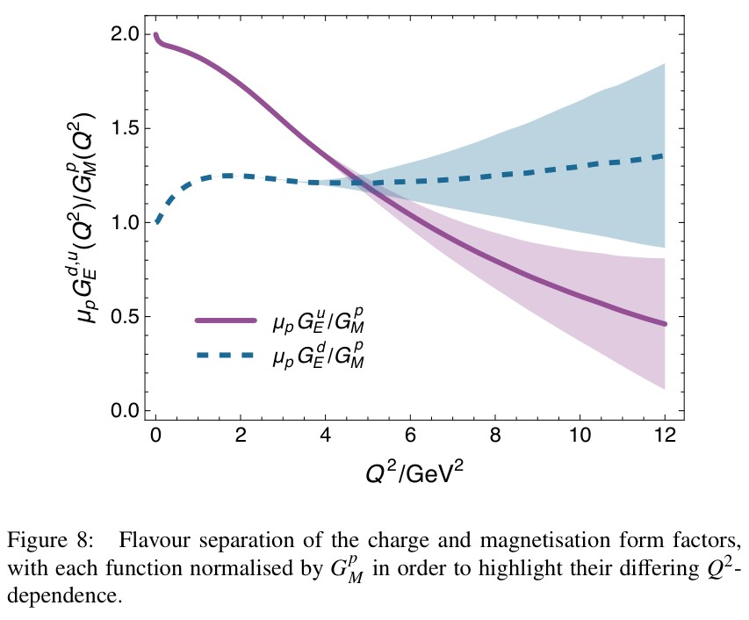
To pass through zero or not to pass through zero
Isospin symmetry limit
– behaviours of $μ_{p}G_{E}^{p}/G_{M}^{p}$ and $μ_{p}G_{E}^{n}/G_{M}^{n}$ are correlated
($e_{u}=\frac{2}{3}, e_{d}=−\frac{1}{3}$)
$G_{E}^{p}=e_{u}G_{E}^{pu}+e_{d}G_{E}^{pd}$ & $G_{E}^{n}=e_{u}G_{E}^{pd}+e_{d}G_{E}^{pu}$
Regarding these identities – see figure …
$G_{E}^{p}$ possesses a zero because
although remaining positive, $G_{E}^{pu}/G_{M}^{p}$ falls steadily with increasing $Q^{2}$
whereas $G_{E}^{pd}/G_{M}^{p}$ is positive and approximately constant
because ${∀Q^{2} F}_{2}^{d}<0$
$G_{E}^{n}$does not exhibit a zero because
$e_{u}>0$, $G_{E}^{pd}/G_{M}^{p}$ is large and positive
and ${|e}_{d}G_{E}^{pu}|$ is always less than $e_{u}G_{E}^{pd}$

Slide 24
Ab initio Faddeev cf. quark + diquark
All previous calculations used the quark + diquark picture
Most sophisticated analysis: Z.-F. Cui, C. Chen et al., Nucleon elastic form factors at accessible large spacelike momenta, Phys. Rev. D 102 (2020) 014043
Input elements are QCD-kindred but not ab initio predictions
Photon + diquark vertices are much simplified
Predicted zero in $F_{1}^{d}(Q^{2})$ at $Q^{2}={7.0}_{−0.4}^{+1.1}GeV^{2}$
Agrees with ab initio Faddeev
No material differences on $Q^{2}≤10 GeV^{2}$
Predicted zero in $F_{2}^{dp}(Q^{2})$ at $Q^{2}={12.0}_{−1.7}^{+3.9}GeV^{2}$
Disagrees with ab initio Faddeev
Predicted zero in $G_{E}^{n}(Q^{2})$ at $Q^{2}={20.1}_{−3.5}^{+10.6}GeV^{2}$
Zero in quark + diquark $F_{2}^{dp}(Q^{2})$ is responsible for this
Peng Cheng et al.
Updating quark + diquark QCD-kindred approach
What improvements are necessary to “reproduce” ab initio Faddeev results
Subsequently revisit nucleon-to-resonance transition form factor calculations
Simultaneously use ab initio Faddeev for such calculations
Testing/highlighting role of diquark correlations

Slide 25
Summary: Nucleon Form Factors
$G_{E}^{p}(Q^{2})$ predicted to possess a zero at $Q^{2}$ within reach of modern experiments
$G_{E}^{n}(Q^{2})$ does not exhibit a zero
Consequently, modern experiment (GEn II ?) predicted to see $G_{E}^{n}>G_{E}^{p}>1$
These predictions rest on behaviour of $F_{2}^{dp}$
For nucleons, discovering QCD scaling and scaling violations requires $Q^{2}>18 GeV^{2}$
Each feature is sensitive expression of emergent phenomena in QCD
No material improvement of CSM analysis can be anticipated before lattice-regularised QCD produces precise, infinite-volume, continuum-limit, carefully renormalised, physical pion mass results on a similar domain to that covered by CSM studies

Slide 26
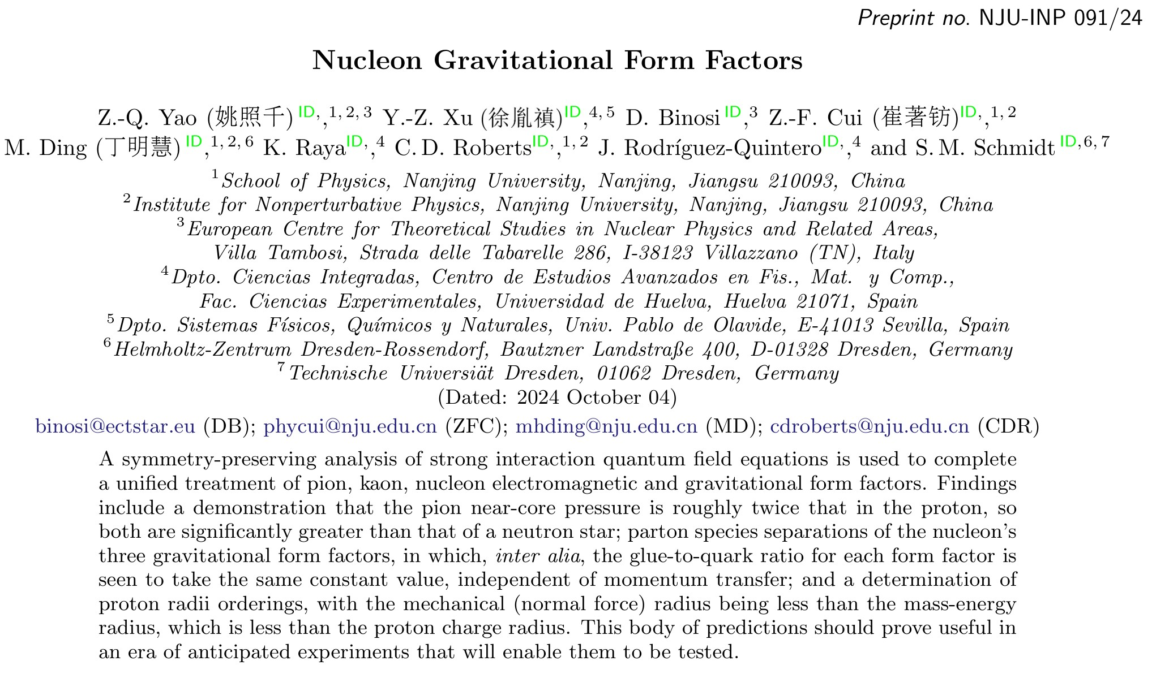

Slide 27
Nucleon Gravitational Form Factors
Current … compared with meson and baryon electromagnetic form factors, only new element is the dressed graviton + quark vertex, $Γ_{μν}^{g}$
Determined in
Pion and kaon electromagnetic and gravitational form factors, Yin-Zhen Xu (徐胤禛) et al., e-Print: 2311.14832 [hep-ph], Eur. Phys. J. C 84 (2024) 2, 191/1-13
Current …
$A(Q^{2})$ mass distribution form factor
$$A\left(Q^{2}=0\right)=1$$
$J(Q^{2})$ spin distribution form factor
$$J\left(Q^{2}=0\right)=1/2$$
$D(Q^{2})$ pressure distribution form factor
$$D\left(Q^{2}=0\right)=?$$
GFFs Accessible via GPDs
Last unknown global property of nucleon

Slide 28
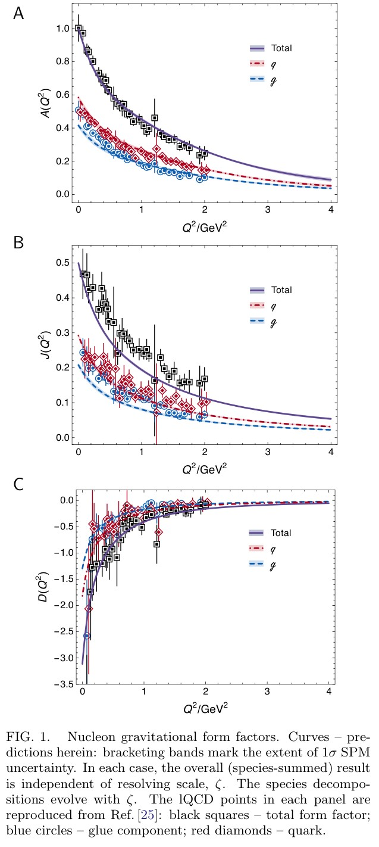
Predicted GFFs
Solid curves … CSM predicitions
Points lQCD results [Hackett:2023rif]
Agreement within (large) lattice uncertainties
Symmetry-preserving character of CSM analysis is evident in values of
$A\left(0\right)=1$
$J\left(0\right)=1/2$
With $J\left(0\right)=1/2$, confirm that the anomalous gravitomagnetic moment of a spin-$1/2$ system is zero [Kobzarev:1962wt, Teryaev:1999su, Brodsky:2000ii].
nucleon “D-term” … prediction $D\left(0\right)=−3.11(1)$

Slide 29
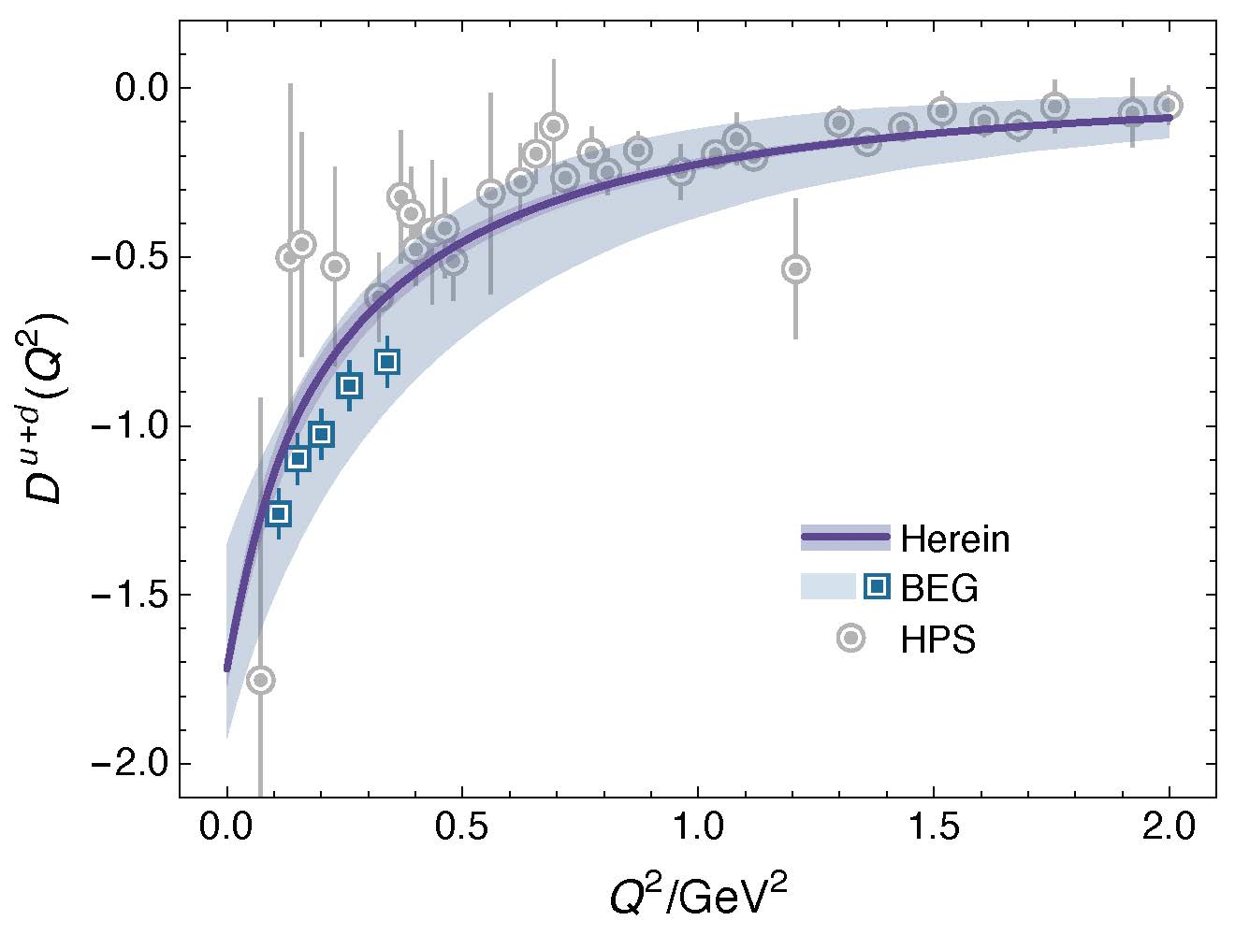
GFF Species Decomposition (scale dependent, $ζ_{2}=2GeV$)
Considering light quarks alone:
$$D^{u+d}\left(0;ζ_{2}\right)=−1.73(5)$$
Inference from available DVCS data
$$D_{DVCS}^{u+d}\left(0;ζ_{2}\right)=−1.63(29)$$
CSM prediction is also in pointwise agreement with curve inferred from that data … see figure
BEG: Inference from existing DVCS data
V. D. Burkert, L. Elouadrhiri, F.-X. Girod, The pressure
distribution inside the proton, Nature 557 (7705) (2018) pp. 396–399.

Slide 30
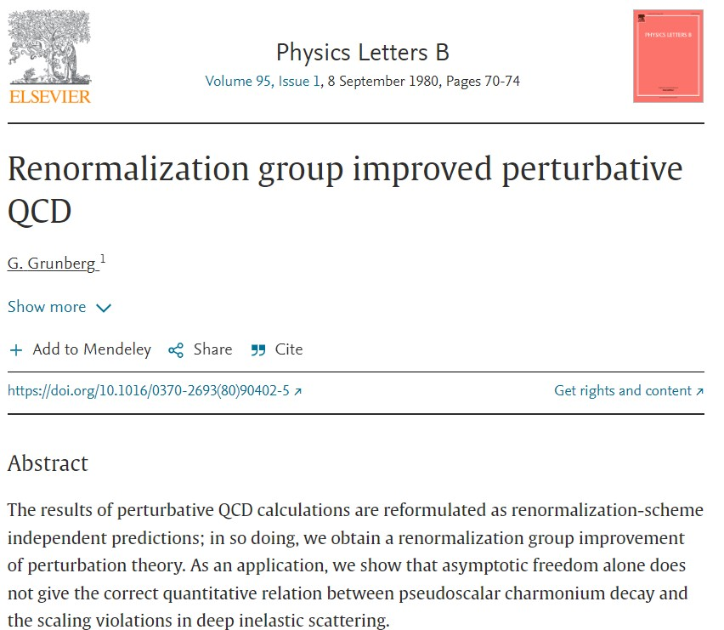
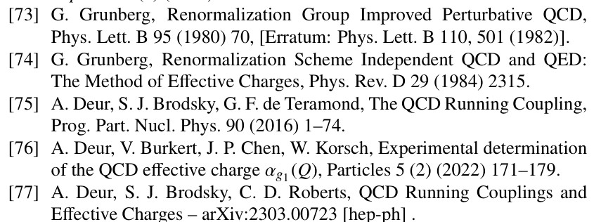
All-orders evolution
All-Orders Evolution of Parton Distributions: Principle, Practice, and Predictions
Pei-Lin Yin (尹佩林), NJU-INP 075/23, e-Print: 2306.03274 [hep-ph]
P1 – In the context of Refs. [73, 74], there exists at least one effective charge, $α_{1ℓ}(k^{2})$, which, when used to integrate the leading-order perturbative DGLAP equations, defines an evolution scheme for parton DFs that is all-orders exact.
CSM Process-Independent charge serves this purpose
Hadron scale, $ζ_{H}$
Scale at which all properties of a given hadron are carried by valence degrees-of-freedom

Slide 31
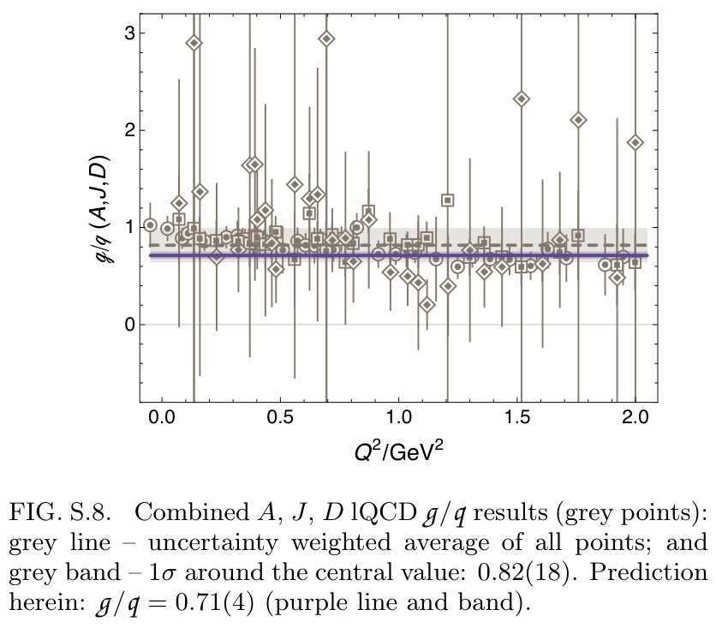
GFF Species Decomposition (scale dependent, $ζ_{2}=2GeV$)
CSM prediction – species decomposition,
for each form factor:
$$\frac{F^{glue}\left(Q^{2};ζ\right)}{F^{quark}\left(Q^{2};ζ\right)}=constant(ζ)$$
$constant\left(ζ_{2}\right)=0.71(4)$
namely, the ratio of glue:quark contributions is the same
$Q^{2}$-independent number for each form factor
lQCD results … see figure
Consistent with prediction
${constant}_{lQCD}\left(ζ_{2}\right)=0.82(18)$

Slide 32
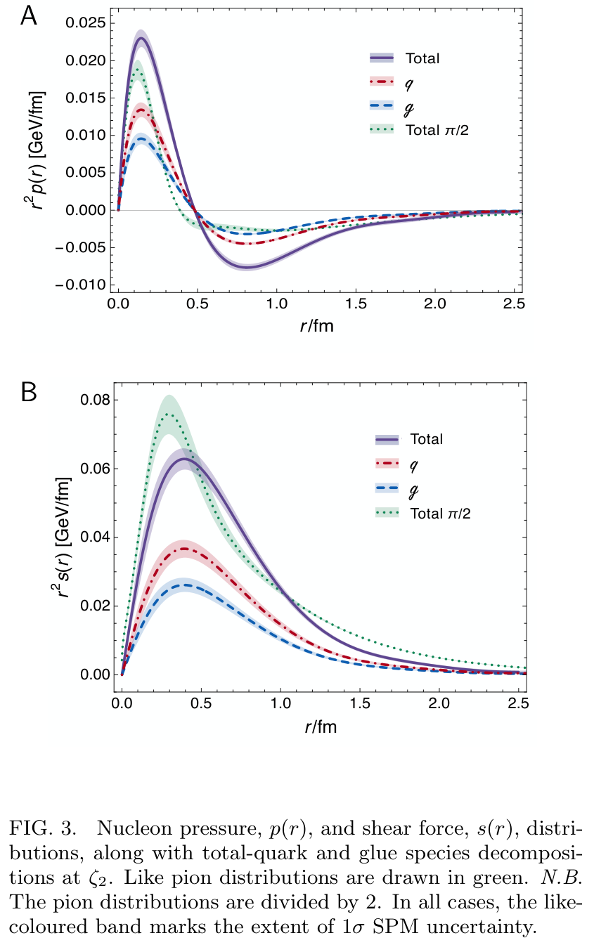
Proton Pressure Profiles
Pressure and shear-force density profiles
Pion (green) peak values are roughly twice those in the proton
Expected because
pressures $∼Ψ^{2}$
similar interior QCD dynamics + more compact object
$⇒\frac{p_{π}}{r_{π}^{2}}≈p_{p}/r_{p}^{2}$ & $r_{p}^{2}≈2{ r}_{π}^{2}$
Scale is order-of-magnitude greater than neutron star core
$r_{mass}=0.81\left(5\right)r_{ch}$ $>$ $r_{mech}=0.72\left(2\right)r_{ch}$
Species decomposition ($ζ_{2}$)
$r_{mass}^{q}=0.62\left(4\right)r_{ch}$ $>$ $r_{mass}^{g}=0.52\left(3\right)r_{ch}$
$r_{mech}^{q}=0.55\left(4\right)r_{ch}$ $>$ $r_{mech}^{g}=0.47\left(3\right)r_{ch}$
Contrary to practitioner desires … no existing experiment provides information on glue contributions to proton GFFs

Slide 33
Summary: Nucleon Gravitational Form Factors
Last unknown global property of nucleon: prediction $D\left(0\right)=−3.11(1)$
Species decompositions: CSMs predict that glue/quark ratio = constant, independent of $Q^{2}$
Near-core pressure in pion is roughly twice that in proton
so both are at least an order of magnitude greater than that of a neutron star.
Nucleon's mechanical radius is less than its mass radius, which in turn is less than its charge radius.
At standard resolving scale, glue contributions to both radii are 15% less than the total quark contributions.
Within uncertainties, CSM predictions are consistent with phenomenological inferences from available data on deeply virtual Compton scattering.
No improvement on CSM study can be anticipated before lattice-QCD analyses have simultaneously delivered infinite-volume, continuum-limit, carefully renormalised, physical pion mass studies of all physical properties discussed in this presentation, viz. pion, kaon, nucleon electromagnetic and gravitational form factors.

Slide 34
Positivity of unpolarised DFs
The overlap representation of GPDs (hence, DFs) was introduced independently
by Diehl et al. and Burkardt 24 years ago (2000): $p\left(x\right)∼∫d^{2}k_{⊥}{\left|Ψ\left(x,k_{⊥}\right)\right|}^{2}$.
In all that time, no flaw has been found in the analysis
Objectively, available rigorous theoretical considerations $⇒$ unpolarised DFs are positive definite
Discussion Forte et al. vs. Collins et al. is readily summarised
At any factorisation scale for which O$(α)$ pQCD is a valid tool for the description of cross-section data, the DF obtained is necessarily positive definite
As one lowers the factorisation scale, it cannot be
guaranteed that O$(α^{2}$) corrections will preserve
DF positivity.
Models exist in which that is not the case
An interpretation of F v. C:
Discussion does not demonstrate that QCD-connected DFs can be negative, only that attempts at a perturbative inference of DFs can yield results with domains of negative support
If O$(α^{2}$) changes physics, then O$(α^{2}$) is invalid tool and higher orders (in $α$ and other corrections) should be included and tested to see whether they can restore the balance

Slide 35
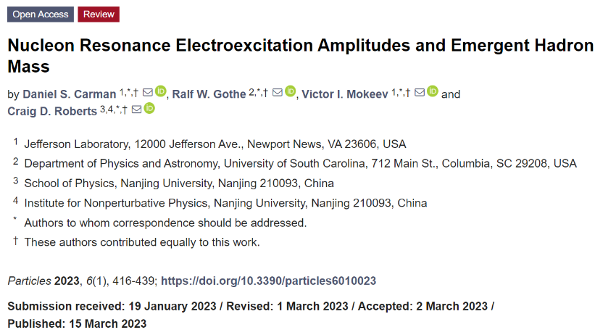
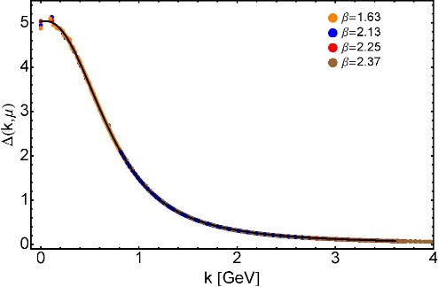
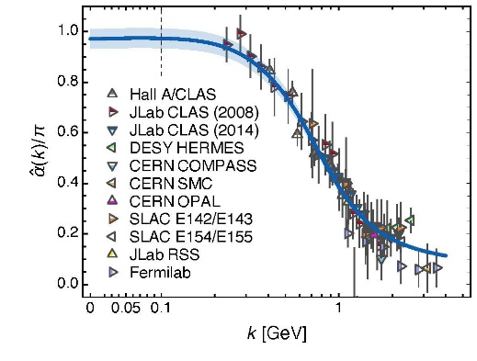
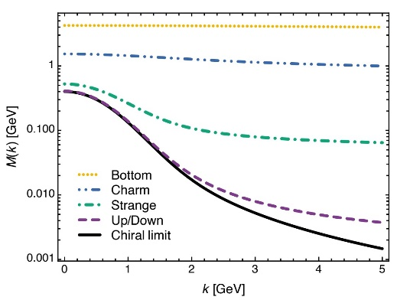
Synergy of Experiment, Phenomenology, Theory
Gather all pieces of the puzzle … Reveal the source of Nature’s basic mass-scale
Strong interaction theory is maturing
Expanding array of parameter-free predictions for the nucleon – yes
And all the other hadrons whose properties express the full meaning of QCD
Structure of Nature’s most fundamental Nambu-Goldstone bosons
Structure of baryons, e.g.,
$Q^{2}$-dependence of nucleon resonance transition form factors
Spectrum is insufficient – many models give same spectrum, but transition form factors discriminate between pictures.
Understanding how QCD’s simplicity explains the emergence of hadron mass and structure requires investment in facilities that can deliver precision data on much more than one of Nature’s hadrons.
AMBER@CERN, EIC, EicC, STCF, CEPC, JLab22, LHeC could …
Deliver precise structure data on a wide range of hadrons with distinctly different quantum numbers
Thereby move Science into a new realm of understanding.

Slide 36
Emergent Hadron Mass
Grant no. 12135007
QCD is unique amongst known fundamental theories of natural phenomena
The degrees-of-freedom used to express the scale-free Lagrangian are not directly observable
Massless gauge bosons become massive, with no “human” interference
Gluon mass ensures a stable, infrared completion of the theory through the appearance of a running coupling that saturates at infrared momenta, being everywhere finite
Massless fermions become massive, producing
Massive baryons and simultaneously Massless mesons
These emergent features of QCD are expressed in every strong interaction observable
They can also be revealed via
EHM interference with Nature’s other known source of mass = Higgs
We are capable of building facilities that can validate these concepts, proving QCD to be
the 1st well-defined four-dimensional quantum field theory ever contemplated
This may open doors that lead far beyond the Standard Model

Slide 37
$${\text{L}}_{Nature}= ?$$
There are theories of many things,
But is there a theory of everything?
Thankyou

