Slide 1
DSG NPS Contributions Status
Aaron Brown
Detector Support Group
07/09/2020

Slide 2
Contents
DSG Contributors
CAEN High Voltage Testing
High Voltage Divider Cables
EPICS Controls & Monitoring Screens
Upcoming Work
Conclusion

Slide 3
DSG Contributors
CAEN high voltage testing
Hardware
Mindy Leffel, Marc McMullen
Testing and analysis
Aaron Brown, Pablo Campero, George Jacobs, Marc McMullen
High voltage divider cables fabrication
Mindy Leffel
Environmental monitoring
Peter Bonneau, Tyler Lemon
EPICS CSS-BOY screens development and testing
Mary Ann Antonioli, Aaron Brown, Brian Eng, Tyler Lemon

Slide 4
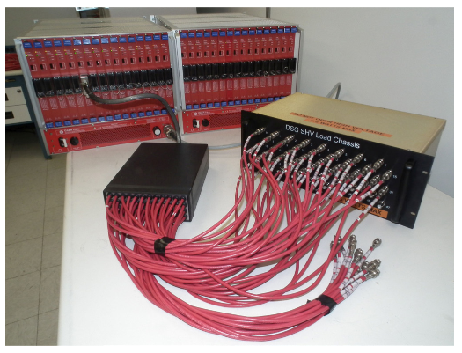
CAEN High Voltage Testing
In process of testing 34 CAEN high voltage modules and two SY4527 crates
Tests include:
Stability using GECO 2020 (in progress – 32 of 34 completed)
Stability using built-in EPICS server (planned)
Current Trip (planned)
Verify channels trip
If I_{meas.} > I_{set}
CAEN High Voltage Modules
DSG SHV Load Chassis
52-pin Radiall Connector Adapter

Slide 5
CAEN High Voltage Testing
Stability test details
1500 V
2 MΩ resistor load
24 hours
Failures found
Two firmware updates
Module firmware update fixed channel latency issues
Crate firmware update fixed EPICS communication issues

Slide 6
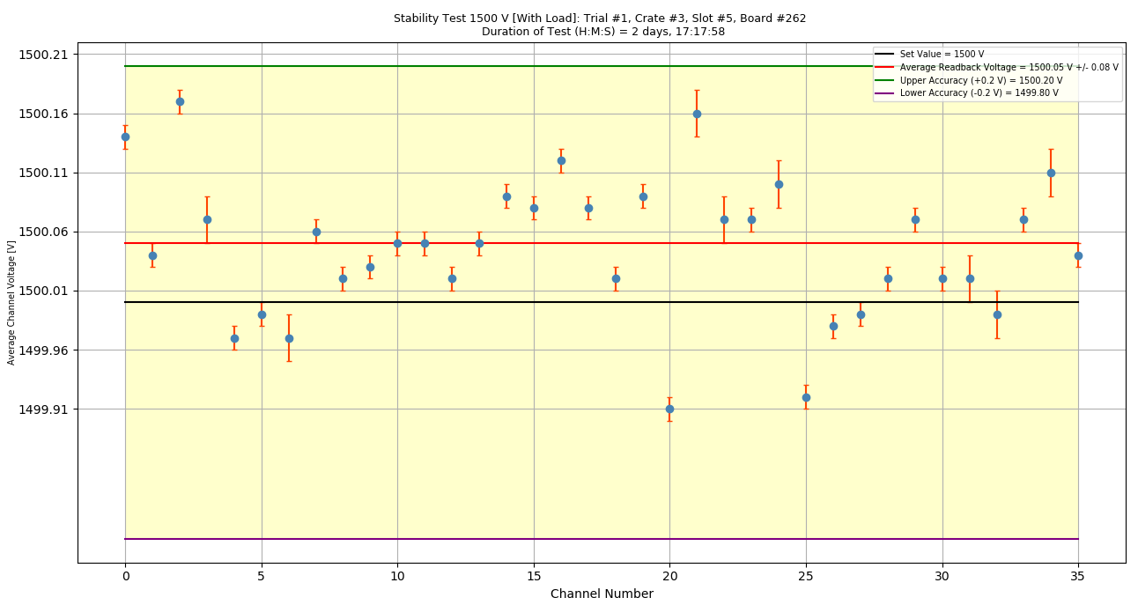
CAEN High Voltage Module Testing
Average readback voltage of each channel of module #262
All channels within manufacturer’s specifications
Voltage spread (ΔV/1500 V) ~0.02%

Slide 7
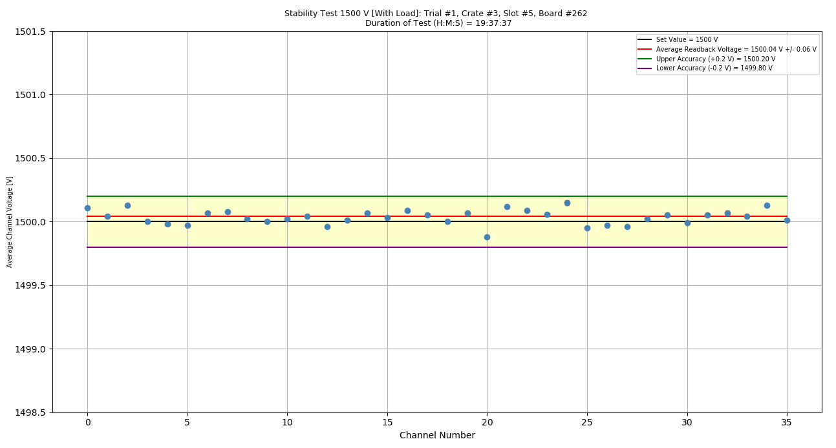
CAEN High Voltage Module Testing
Average readback voltage of each channel of module #262

Slide 8
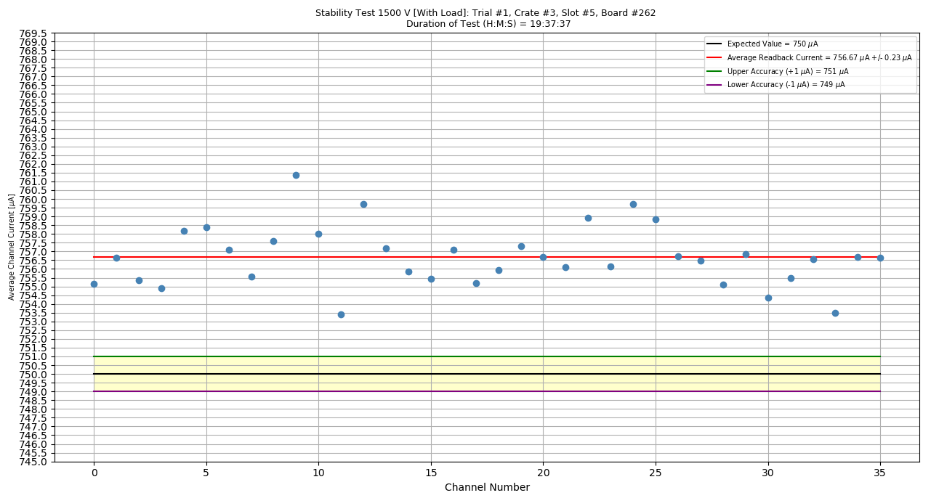
CAEN High Voltage Module Testing
Average readback current of each channel of module #262
All channels above expected current value
Offset perhaps due to lower resistor value, 1.98 MΩ instead of 2 MΩ
Current spread (ΔI/757 μA ) ~ 1%
Issue is being investigated

Slide 9
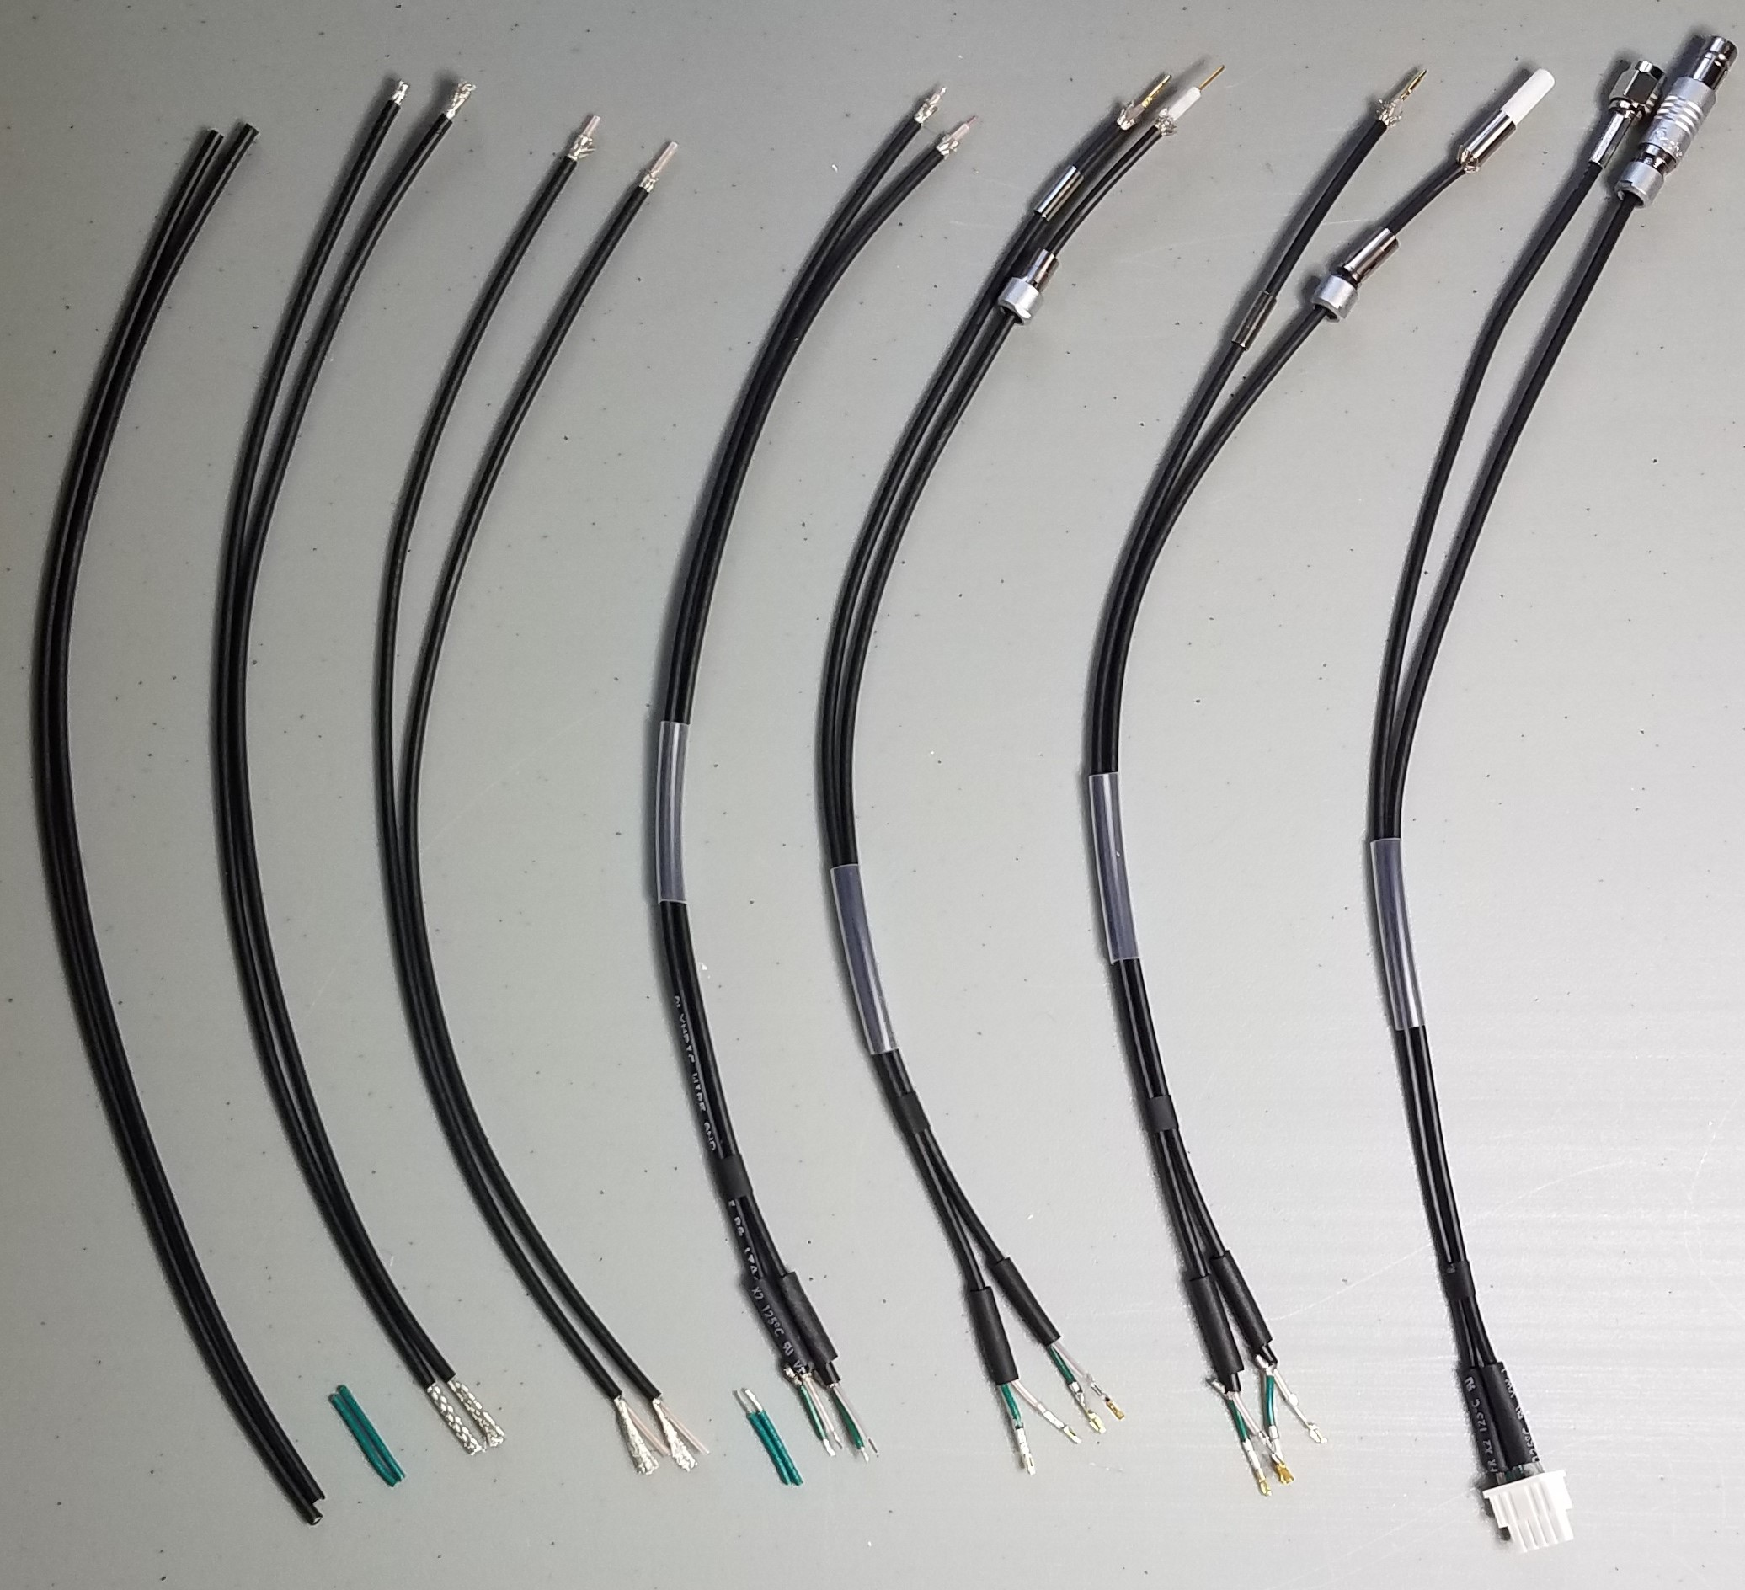
High Voltage Divider Cables
Fabricating 1100 high voltage divider cables
390 cables fabricated (35% completed)
All components on hand
Finished cable
Cable fabrication sequence: left to right

Slide 10
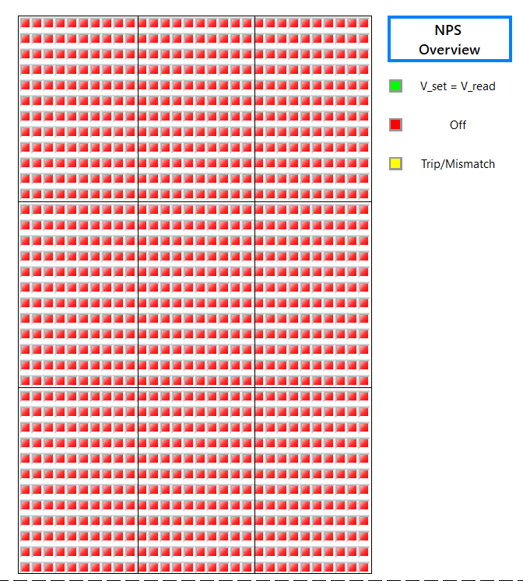
EPICS Controls & Monitoring Screens
Development of EPICS CSS-BOY screens
Screens will include
Overview Screen
Environmental Readback Screens
Chiller Temperature and Flow Screens
1080 PMT HV indicators
In a 3x3 matrix

Slide 11
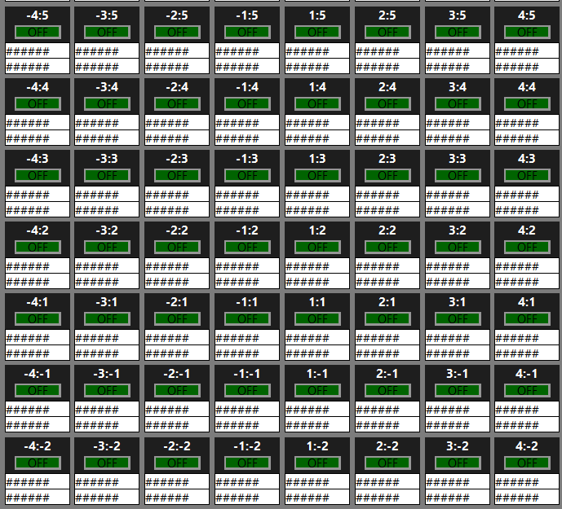
EPICS Controls & Monitoring Screens
High Voltage Readback Screen
30 x 36 grid of voltage and current readback of each PMT
PMT located in
Column -4, Row -2 from the origin

Slide 12
Upcoming Work
Continue cable fabrication
Continue CAEN high voltage system testing
Crates for EPICS interface
Verify module specifications
Investigation of sensors and instrumentation for environmental monitoring
Continue development of EPICS CSS-BOY controls & monitoring screens
Development of WEDM screens

Slide 13
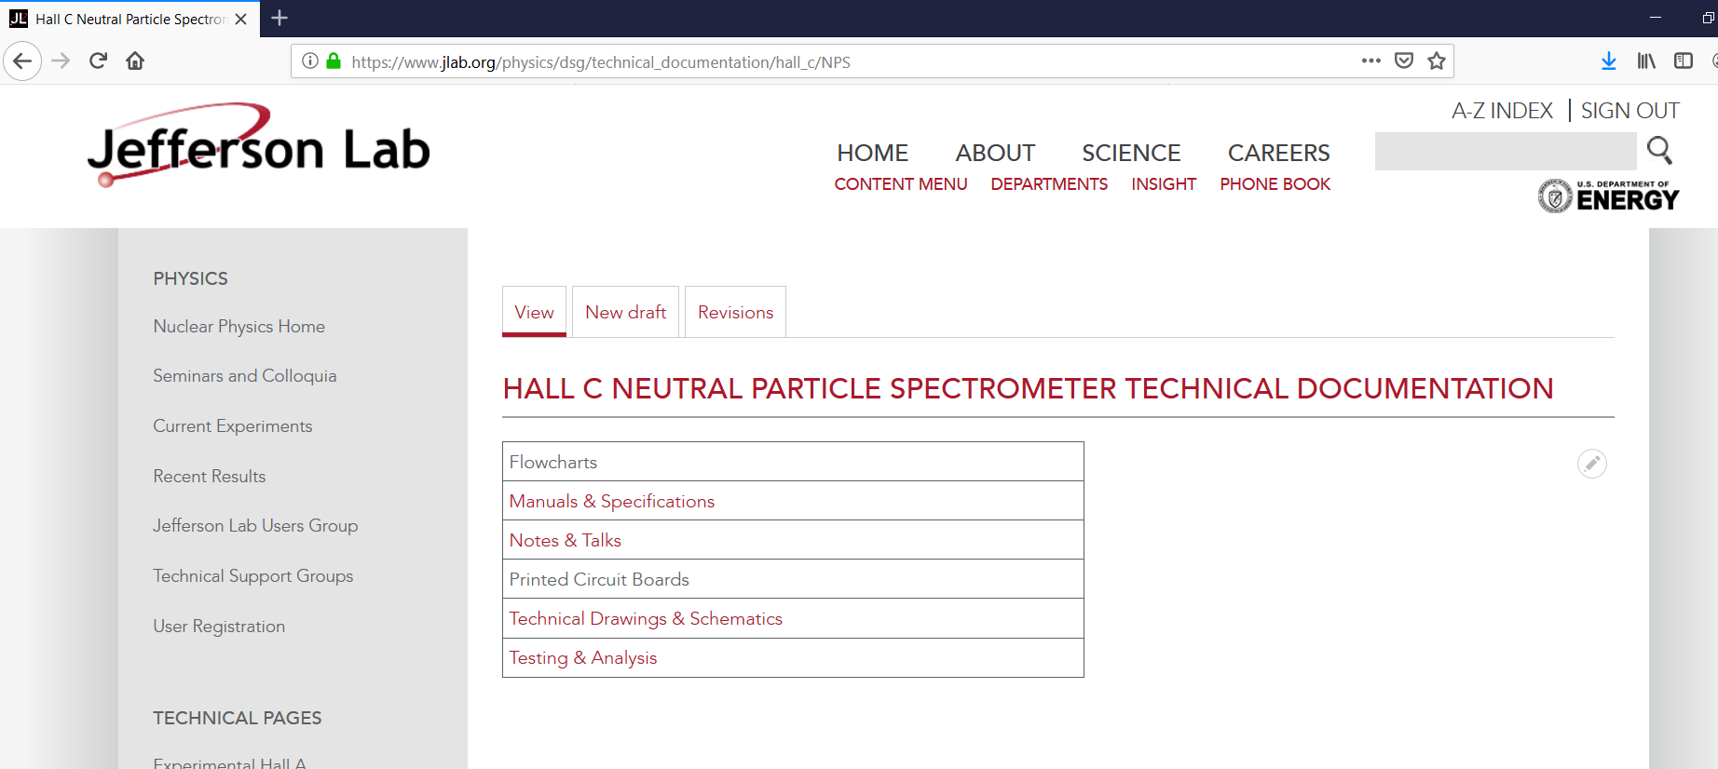
DSG Website
NPS section of DSG Hall C Technical Documentation
Page will be updated as progress is made

Slide 14
Conclusion
Contributions to NPS by DSG
Testing CAEN crates and modules
Fabricating and testing high voltage divider cables
Developing environmental monitoring
Developing EPICS controls & monitoring screens
Significant progress is being made

Slide 15
Thank You!

