Slide 1
NPS Status
Feb 01, 2019
Paulo M & Steven L

Slide 2
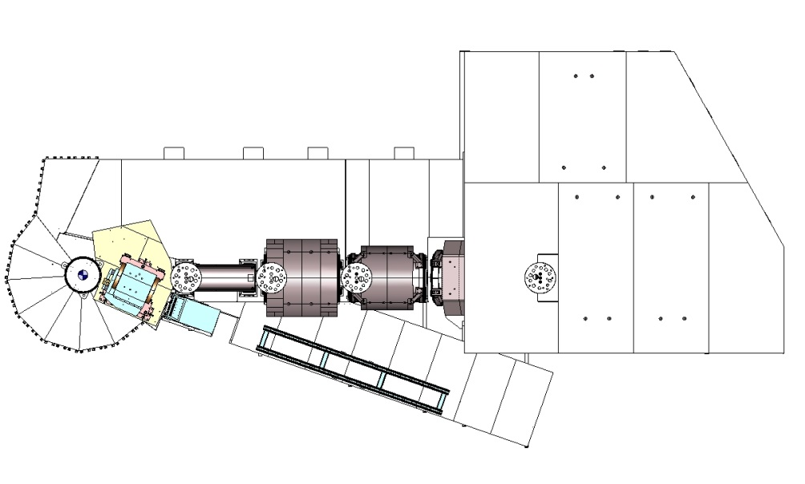
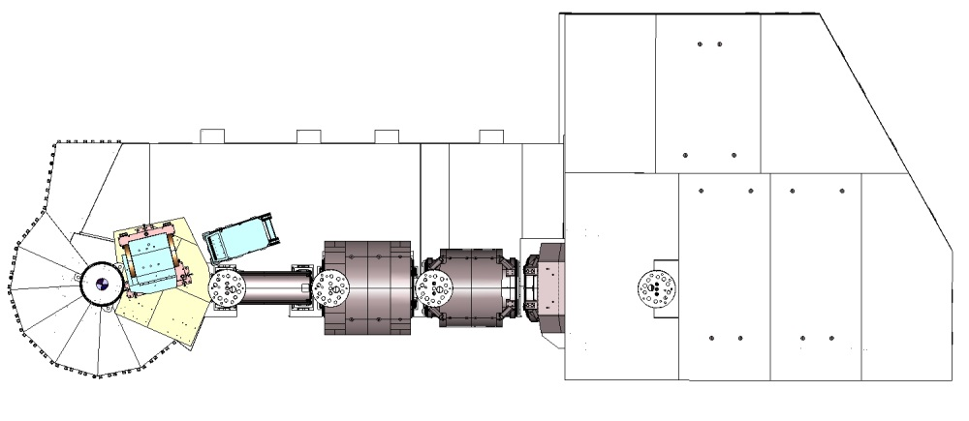
NPS Layout configurations
Experiments with Ɵγ 22.5 degrees or less will be installed on SHMS right side.
Experiments with Ɵγ greater then 22.5 degrees will be installed on SHMS left side (due to space constraints in hall structure).

Slide 3
NPS Layout configurations modifications due to space restrictions
Experiments with Dmag value:
1.10 meters is now 1.40 meters and cannot use corrector (installed SHMS left)
1.57 meters is now 1.60 meters due to interference with target window (installed SHMS right)
2.65 meters is now 1.85 meters due to interference with SHMS Q1
(installed SHMS left)
See following slides for experiment layout examples.

Slide 4
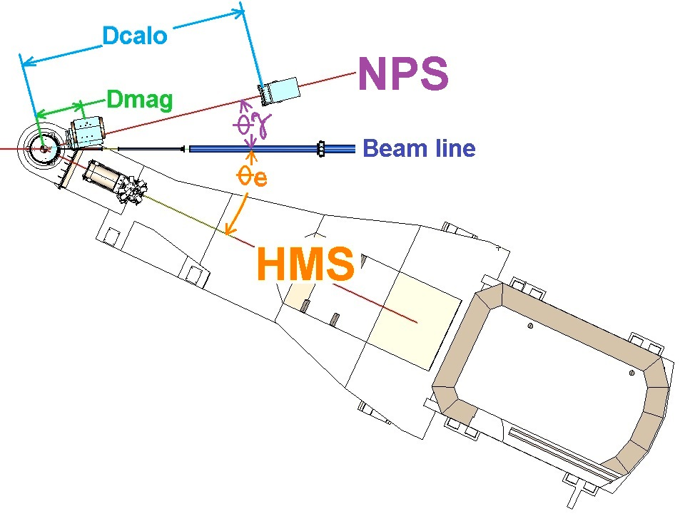
NPS Layout configurations
Ɵγ = angle between beam and NPS
Ɵe = angle between beam and HMS
Dmag = distance between target center and sweeper center
Dcalo = distance between target center and detector face

Slide 5
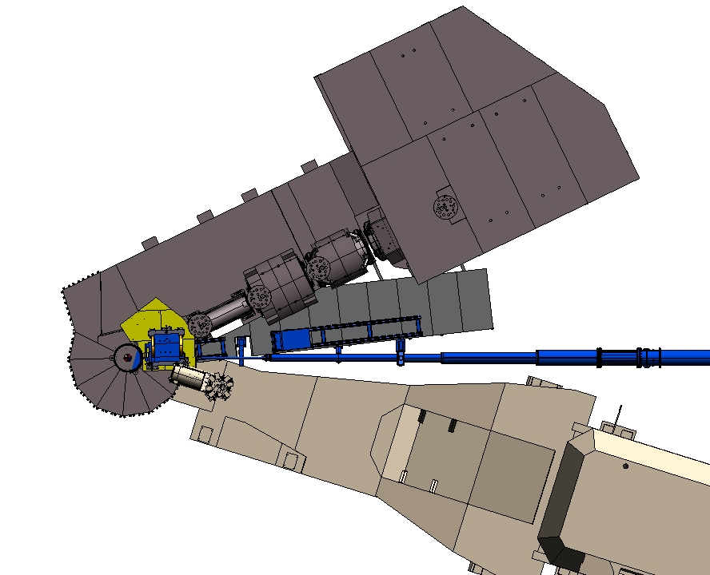
DVCS #16
Ɵγ6.3 – Ɵe17.3 – Dmag 1.6m – Dcalo 6m
Dcalo
6 m
Dmag 1.6 m
Ɵγ 6.3 deg
Ɵe 17.3 deg

Slide 6
WACS/PION #4C
Ɵγ22.5 – Ɵe27.8 – Dmag 1.85m – Dcalo 3m
WACS/PION #4D
Ɵγ26.9 – Ɵe23.7 – Dmag 1.4m – Dcalo 3.5m
Detector platform, rail and detector installed on SHMS right side.
Detector platform removed, rail and detector relocated to SHMS left side.

Slide 7
SHMS Structure Tasks
HB Magnet warmed up, disconnected from cryo and controls then removed from SHMS (2 weeks duration).
Survey, then grind off HB Magnet mount pads.
Platform needs to be re-enforced around pivot area.
Install new target deck section.
Install NPS detector platform mounts and platform.
NPS magnet and detector installed.
Eng/Design task includes, design, Engineer analysis, drawings and initial fabrication estimates.

Slide 8
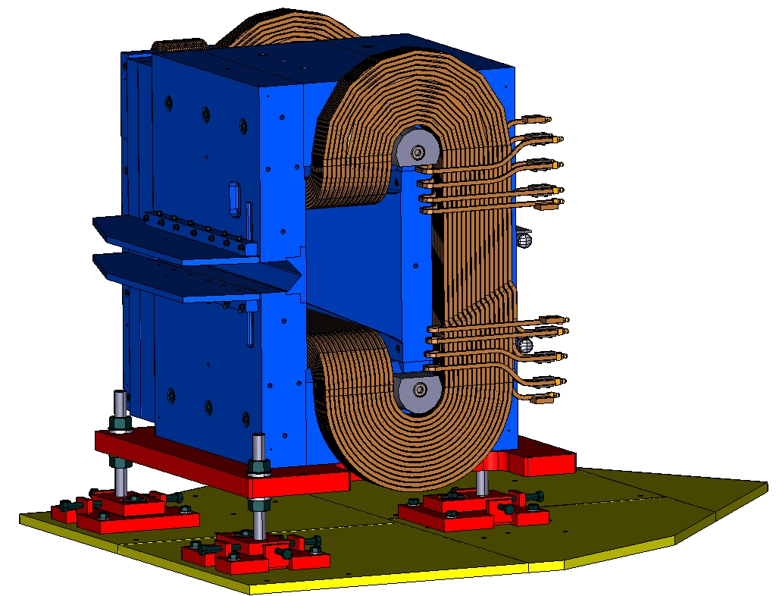
Sweeper supporting structure
Sweeper support assy in design phase
Eng/Design : 7 weeks (30% completion)
Procur/Fab : 7 weeks (0% completion)
Installation: 1 week (0% completion)
Base/slide plate assy in design phase
Eng/Design : 3 weeks (40% completion)
Procur/Fab : 6 weeks (0% completion)
Installation: 1 week (0% completion)

Slide 9
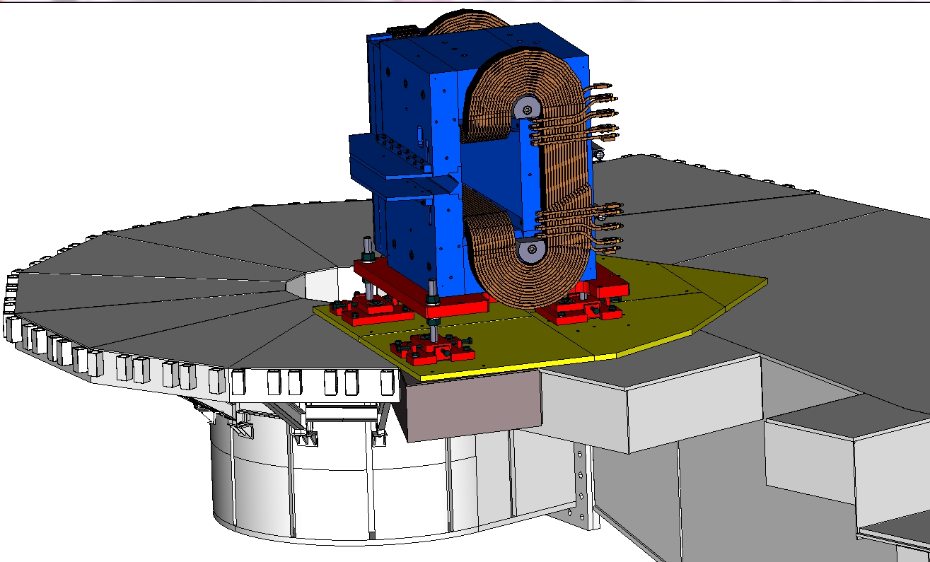
Pivot Area Reinforcement
Target access platform support needs to be replaced with larger and heavier duty section or reinforce existing.
Eng/Design : 2 weeks (40% completion)
Procur/Fab : 2 weeks (0% completion)
Installation: 1 week (0% completion)
Target access platform section to be replaced with larger and heavier duty section.
Eng/Design : 3 weeks (40% completion)
Procur/Fab : 5 weeks (0% completion)
Installation: 1 week (0% completion)

Slide 10
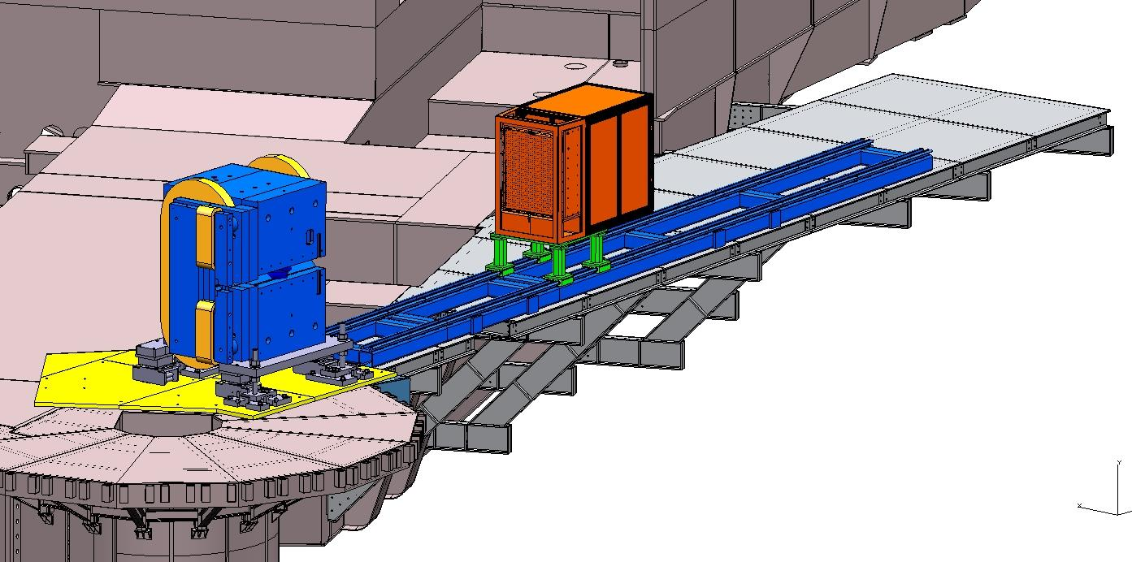
Detector Support Structures
Cable routing/support.
Waiting on detector design.
Eng/Design: 5 weeks (10%completion)
Procur/Fab: 6 weeks (0% completion)
Installation: 1 week (0% completion)
Rail assy in the design stage
Eng/Design: 5 weeks (30%completion)
Procur/Fab: 6 weeks (0% completion)
Installation: 1 week (0% completion)
Platform in design stage
Eng/Design : 6 weeks (40% completion)
Procur/Fab : 8 weeks (0% completion)
Installation: 2 week (0% completion)

Slide 11
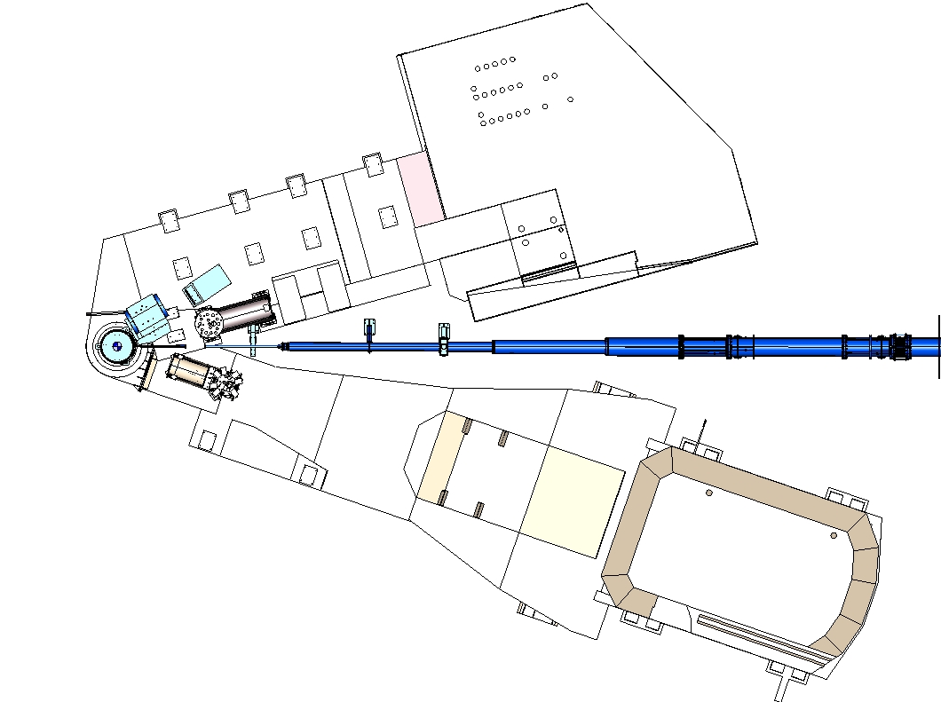
Downstream Beam Line
Beam line in design stage
Eng/Design : 6 weeks (40% completion)
Procur/Fab : 8 weeks (0% completion)
Installation: 1 week (0% completion)

Slide 12
Outstanding tasks
Design has gone through numerous changes.
Waiting on NPS layouts to be approved.
Power supply and DC bus layout not determined.

Slide 13
Conclusion
Installation for first setup (SHMS right setup) expected to take 4 weeks.
Moving detector in different setups using same side setup will take a day with Survey support.
Moving Sweeper magnet on same side setup will take 2 days with Survey support.
Removing magnet beam field clamp will take ½ day.
Installing or removing corrector will take one day.
Relocating magnet, detector, cabling, DC bus to SHMS left side setup, remove detector platform and relocate rail will take 1 week.

Slide 14
Backup slides

Slide 15
NPS Sweeper Magnet

Slide 16
NPS Sweeper Magnet Status
Sweeper magnet at JLAB and setup for low current testing in Test Lab building.

Slide 17
WACS/PION #4E
Ɵγ34.0 – Ɵe18.9 – Dmag 1.4m – Dcalo 3m
WACS/PION #5A
Ɵγ11.0 - Ɵe41.7 - Dmag1.85m - Dcalo 11m

Slide 18
WACS/PION #5B
Ɵγ13.8 – Ɵe35.3 - Dmag1.85m - Dcalo 9m
WACS/PION #5D
Ɵγ19.7 – Ɵe26.3 - Dmag1.85m - Dcalo 6m

Slide 19
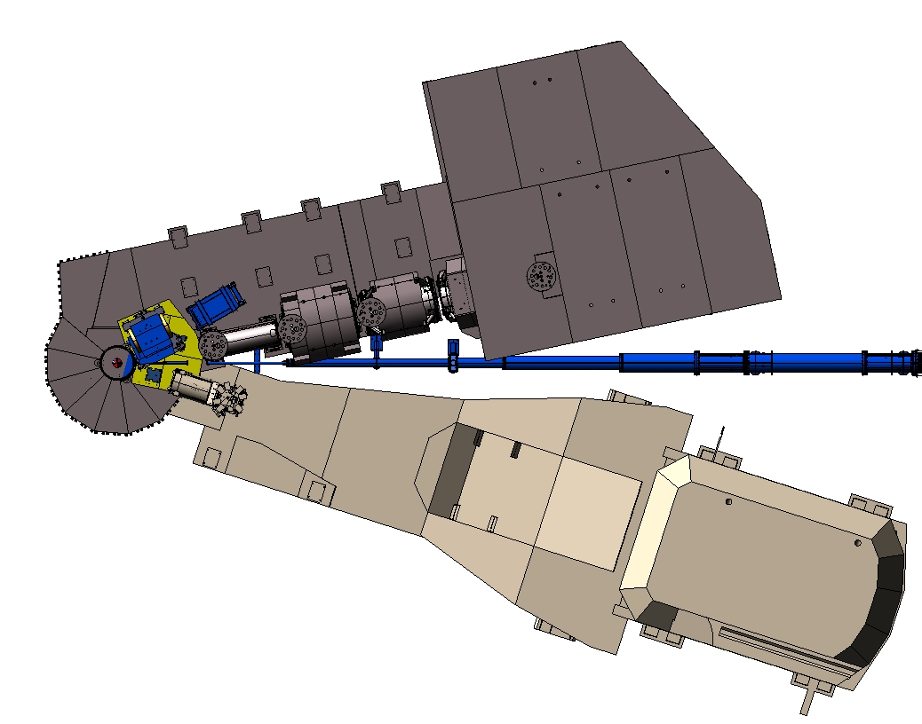
WACS/PION #5E
Ɵγ29.9 – Ɵe17.8 - Dmag1.4m - Dcalo 3m

Slide 20
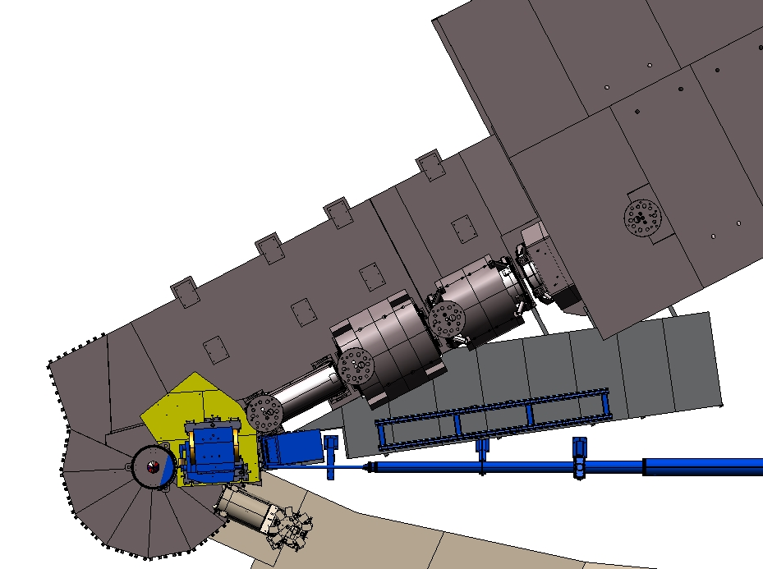
SI PION #D
Ɵγ7.93 – Ɵe24.15 - Dmag1.6m - Dcalo 3m

