Slide 1
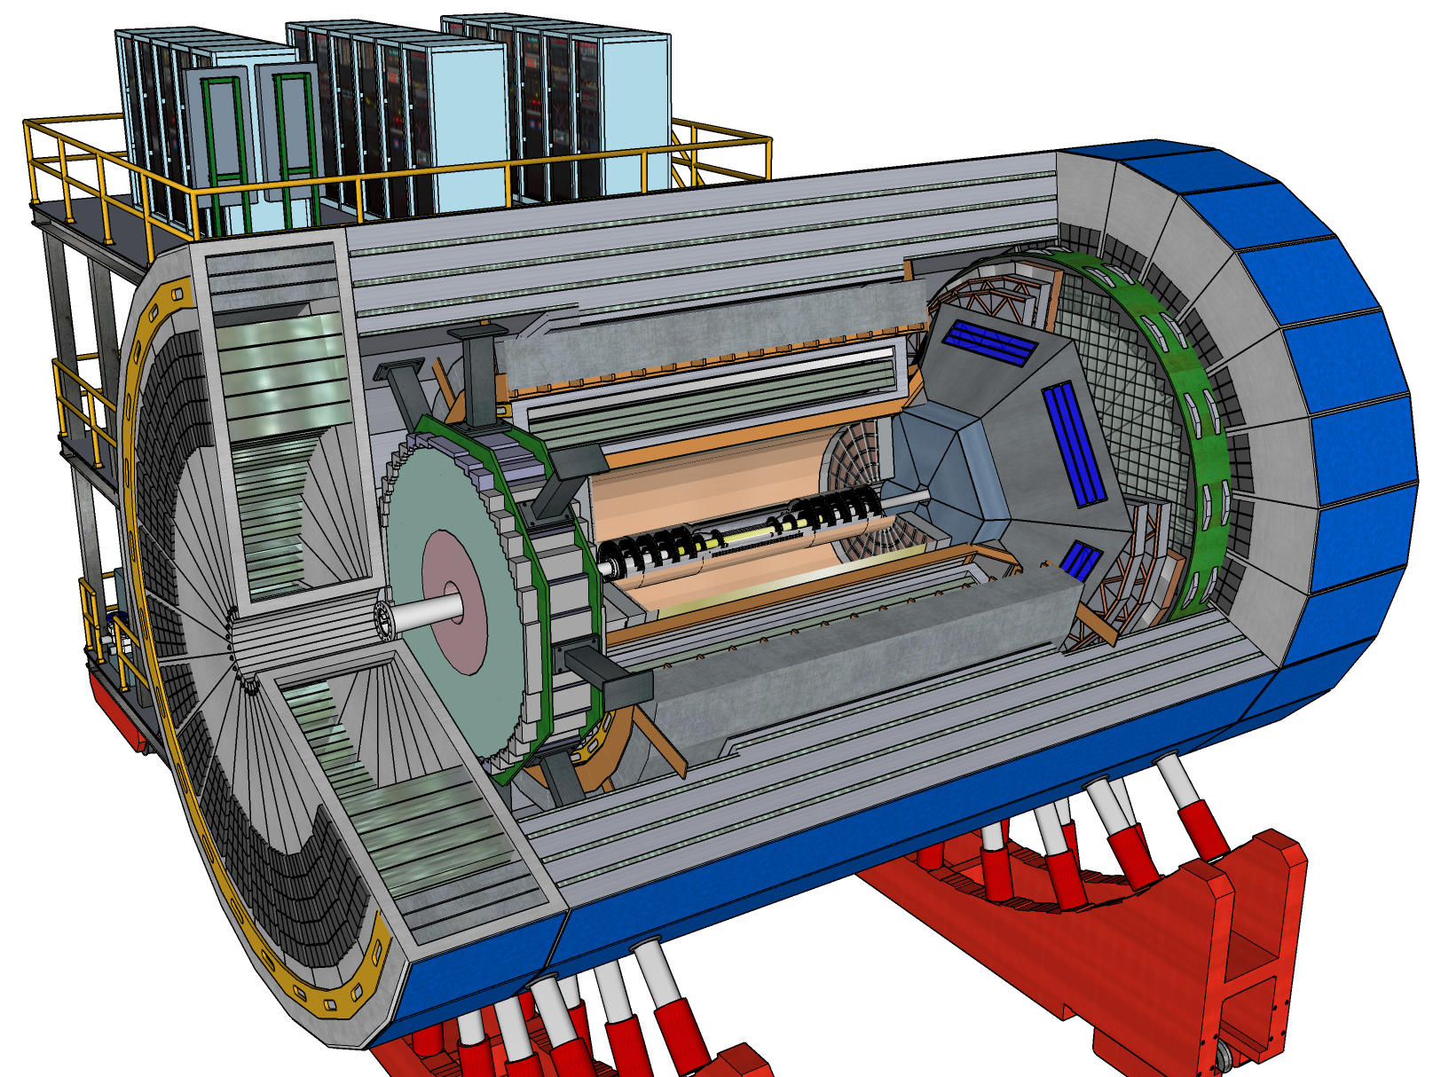
ECCE Central Detector – Original EEEMCal/DIRC Configuration
DIRC Prism on hadron side
Interference with dRICH

Slide 2
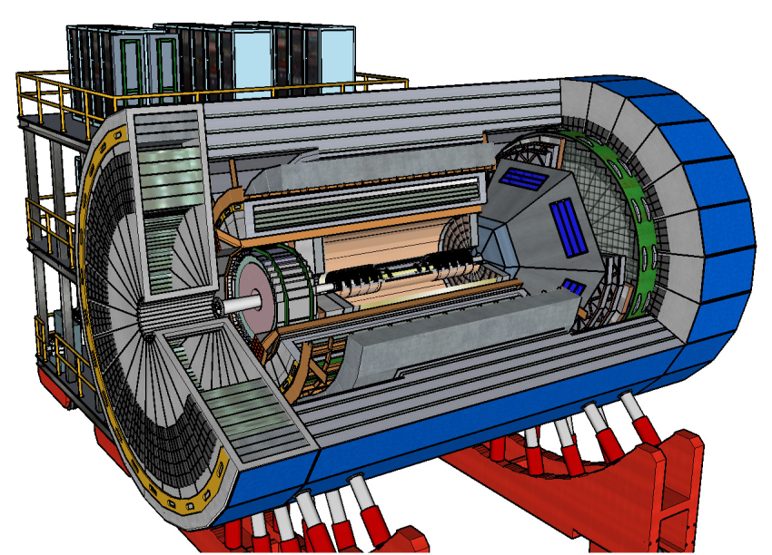
ECCE Central Detector – PRESENT EEEMCal/DIRC Configuration
DIRC Prism on electron side
Move in EEEMCal – need new frame
Prism in “shadow” of EMCal

Slide 3
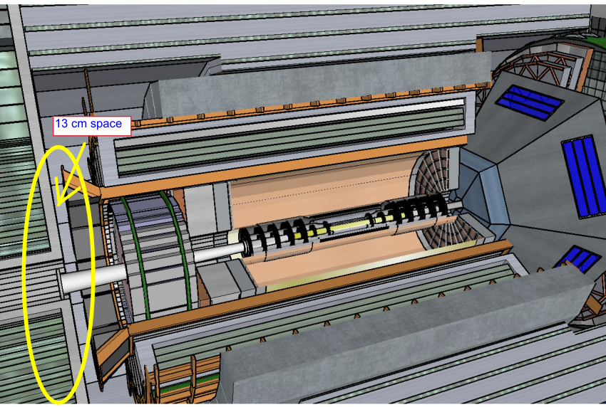
ECCE Central Detector – PRESENT EEEMCal/DIRC Configuration

Slide 4
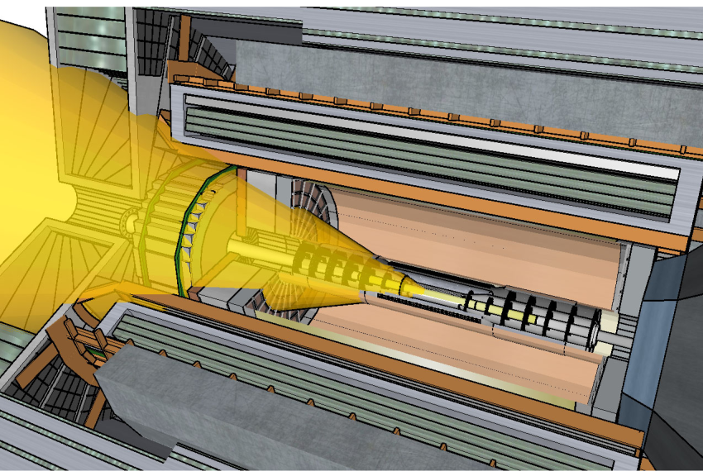
ECCE Central Detector – Particle cone

Slide 5
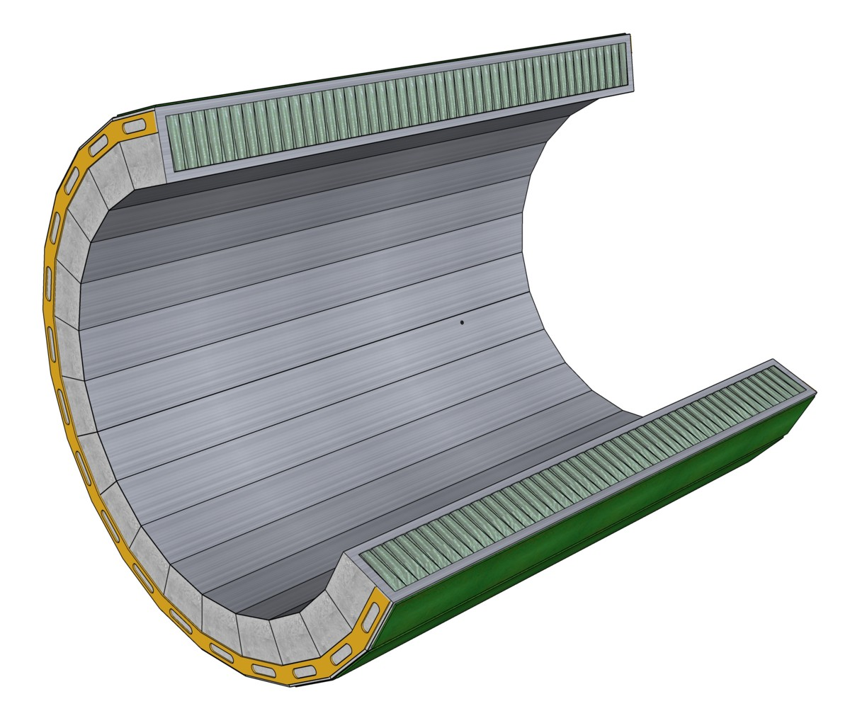
ECCE Central Detector – Barrel EMCal model
Consider adding projectivity eta (1, 2)

Slide 6
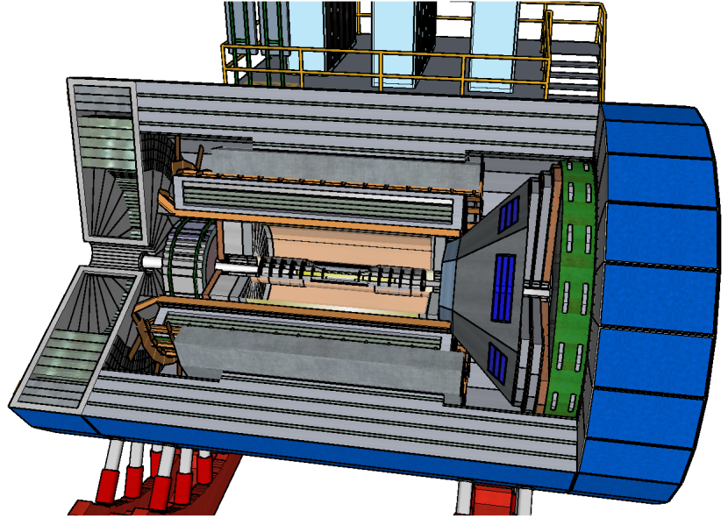
ECCE Central Detector – PRESENT EEEMCal/DIRC Configuration

