Slide 1
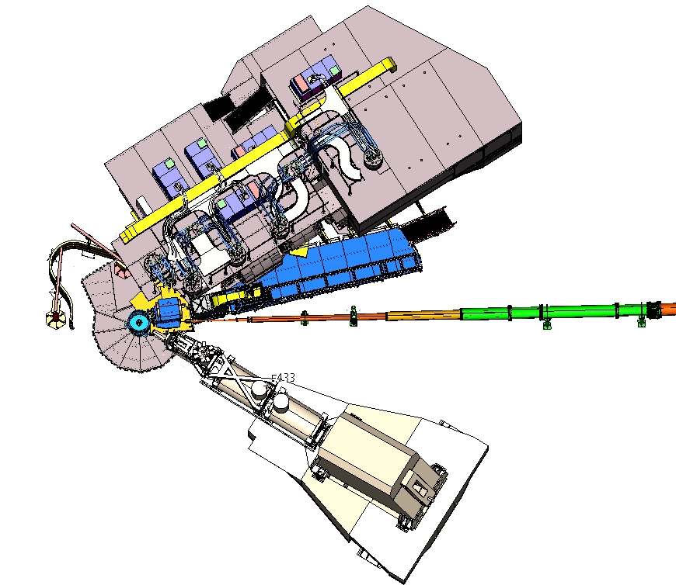
NPS assembly
06/30/2022
nDVCS with NPS
1

Slide 2
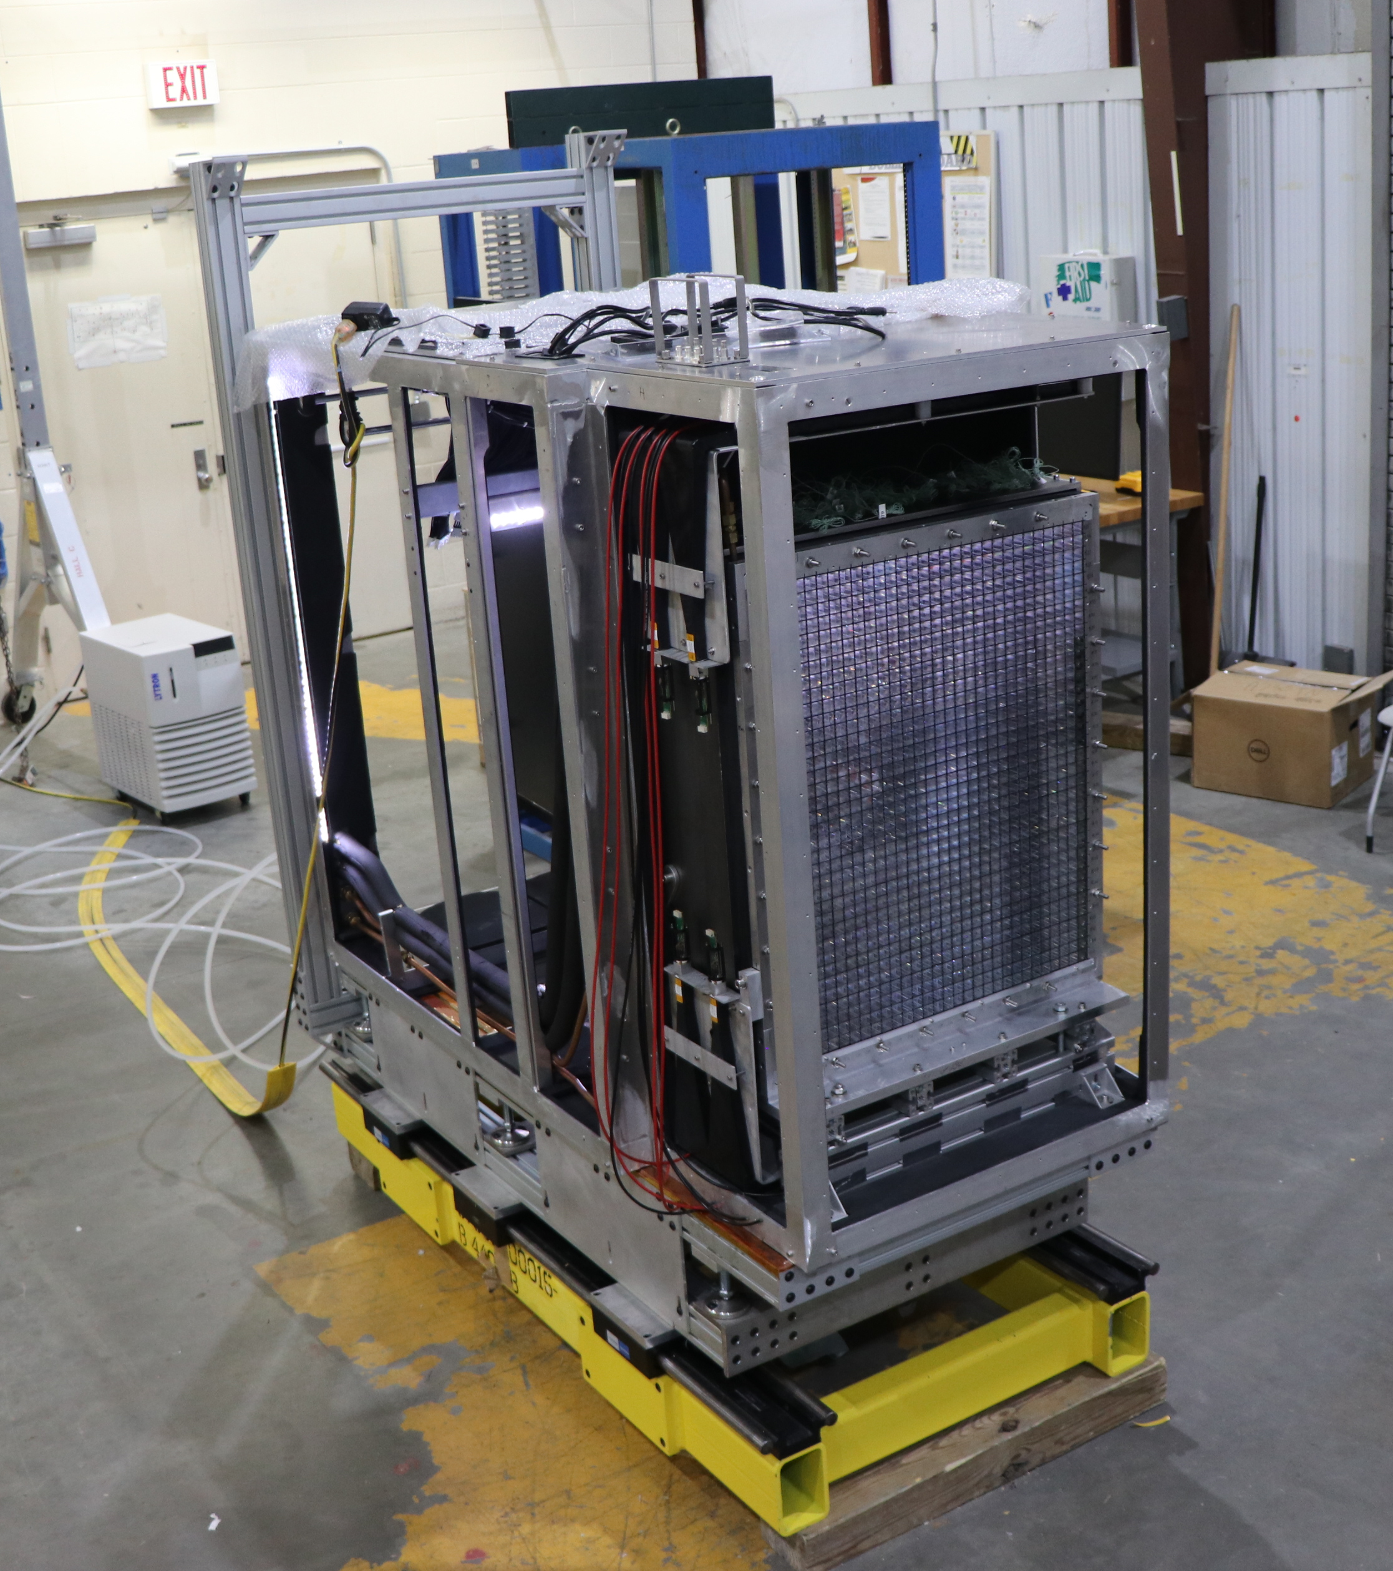
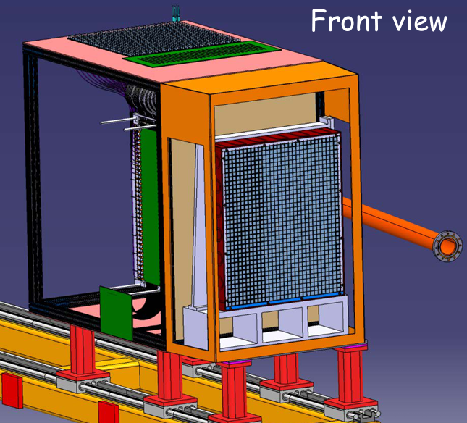
Overview
06/30/2022
NPS assembly
1

Slide 3
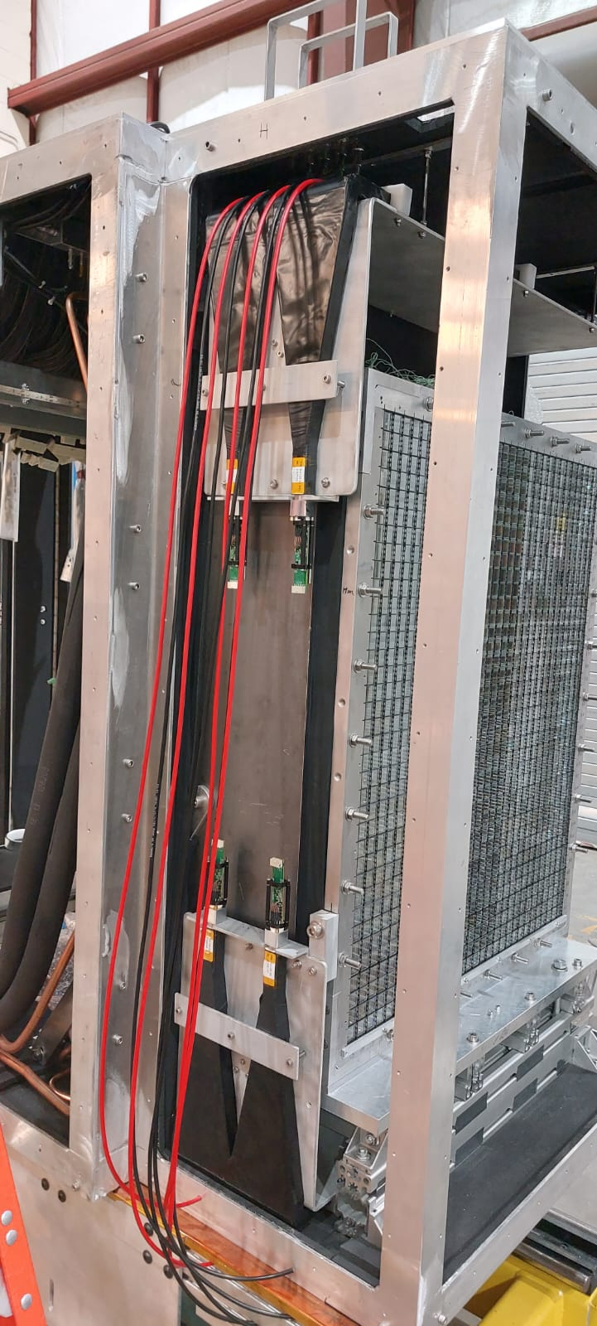
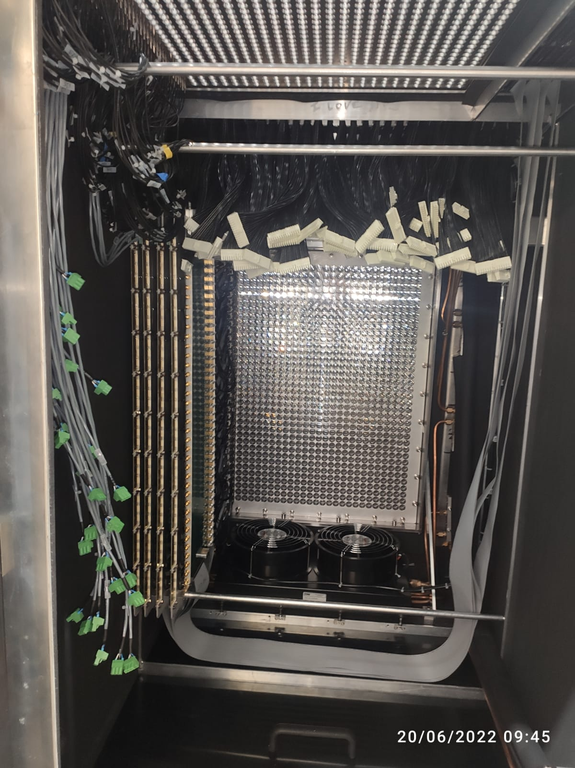
06/30/2022
NPS assembly
1

Slide 4
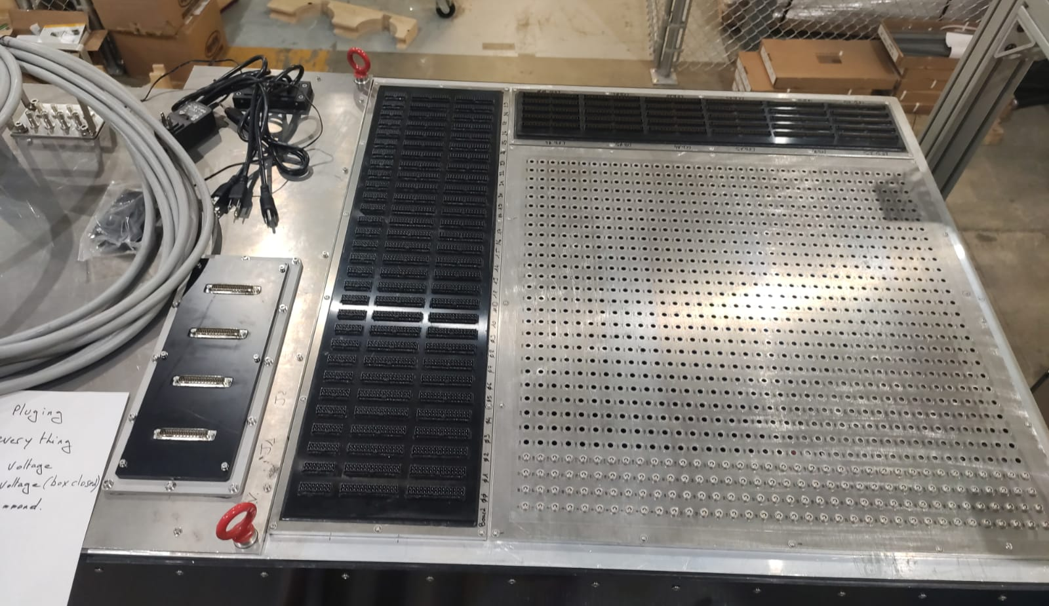
Top view
06/30/2022
NPS assembly
1

Slide 5
Title
06/30/2022
NPS assembly
1

