Slide 1
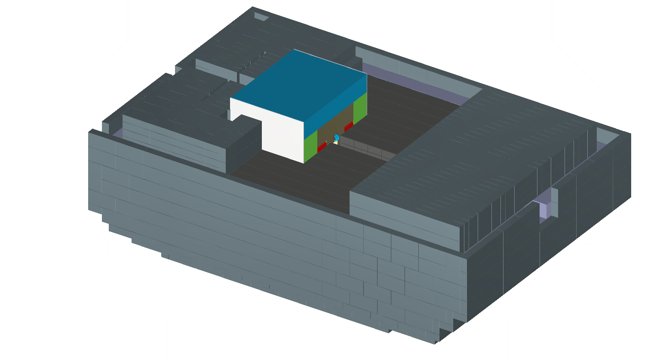
CPS Shield Stacking

Slide 2
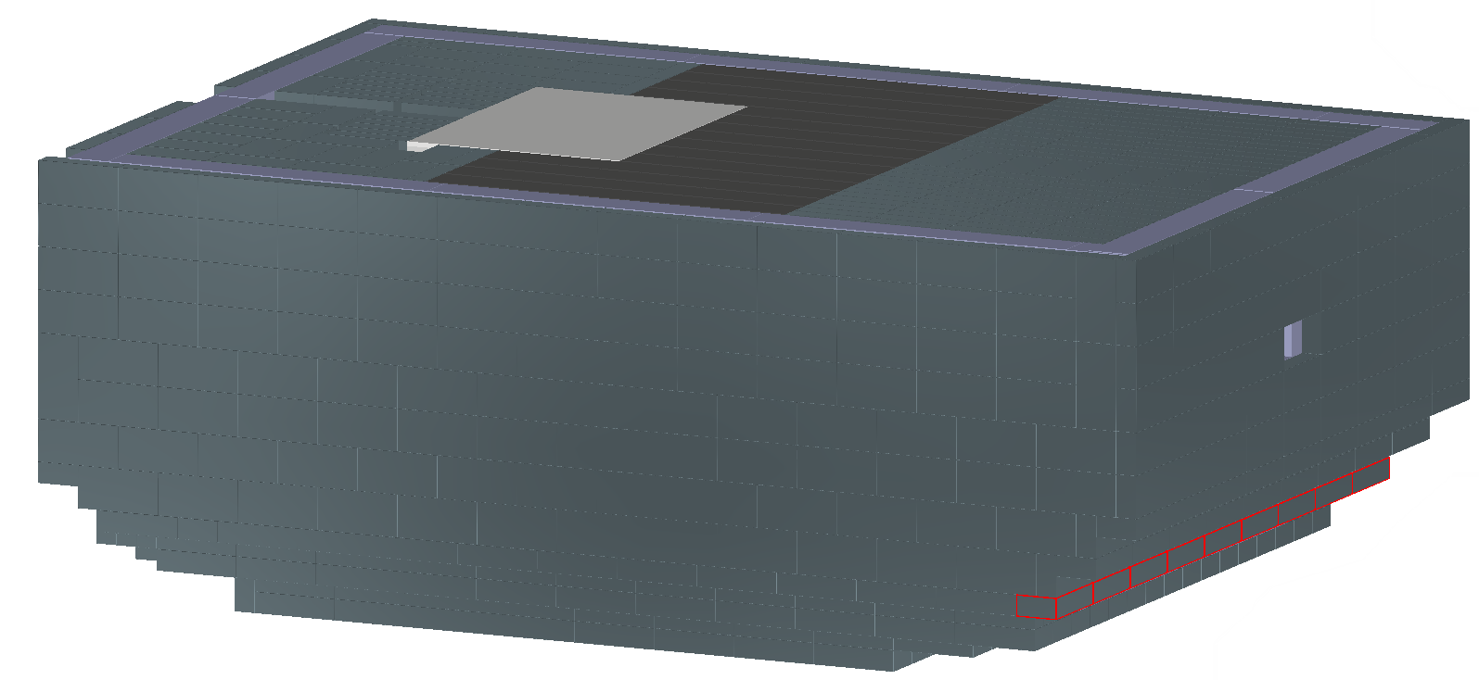
CPS Shield Stacking
Top plate added to magnet to bring the top of the magnet flush with the existing shielding.

Slide 3
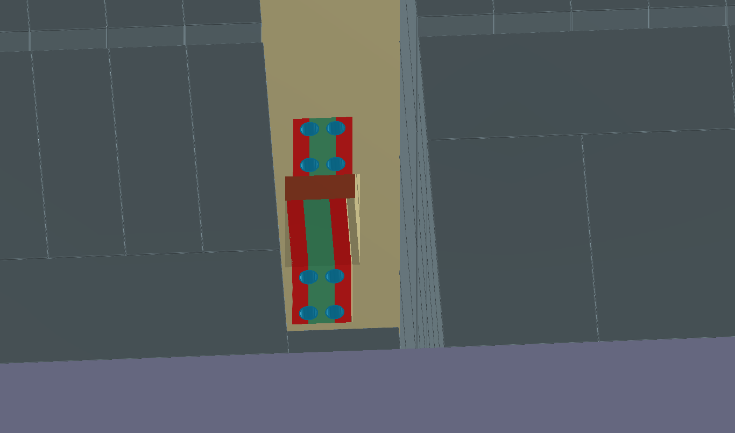
Magnet Upstream end space:
Free space behind the magnet to allow for electronics and cooling pipes.
Support structure?
Diameter of LCW feed?
Electrical cables for magnet coils.

Slide 4
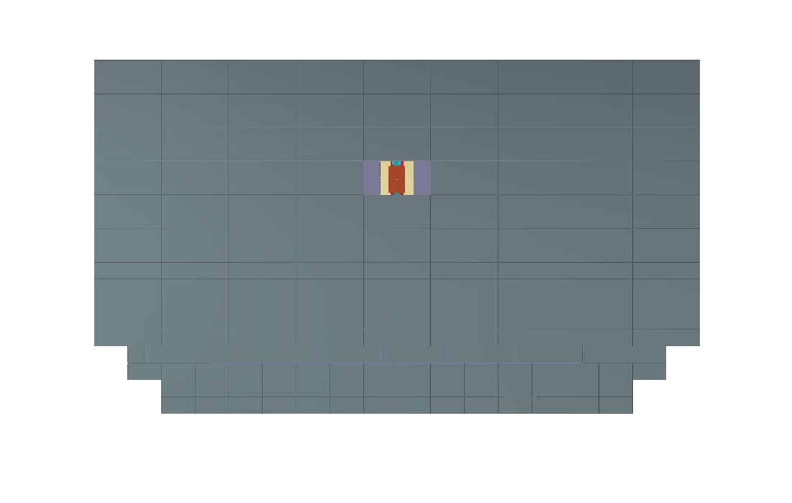
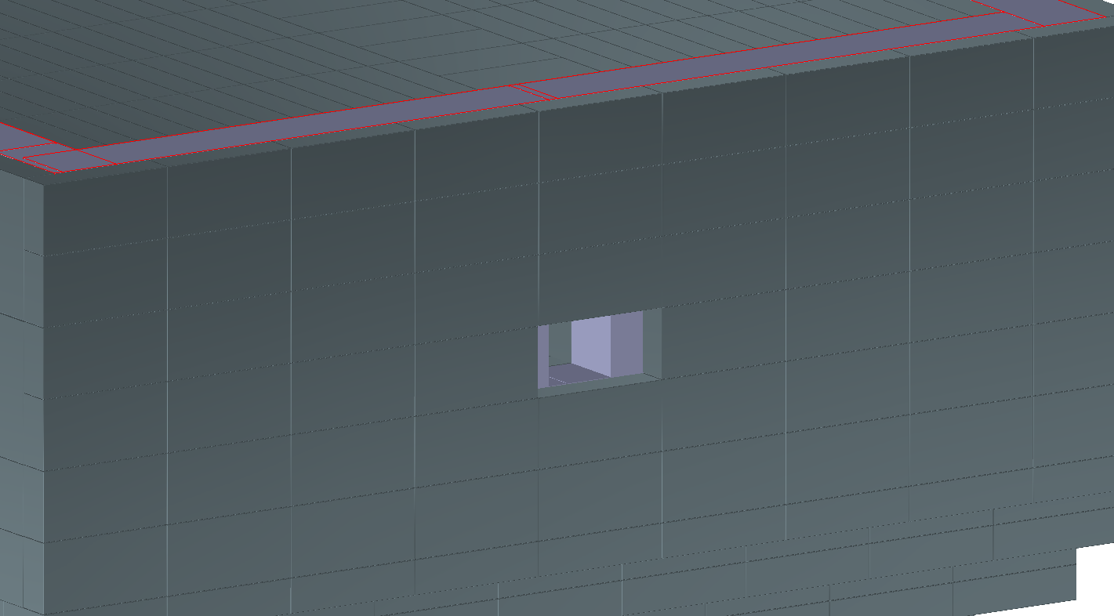
CPS downstream beam hole
Downstream end of the shield has extra lead shielding removed to provide an expanding aperture.
Beam hole has 4in X 4in square void through the shielding to the downstream face of the magnet.
One tungsten brick is removed both above and below the downstream face of the magnet to accommodate the bend in the cooling pipes.
Support structure around beam hole.

Slide 5
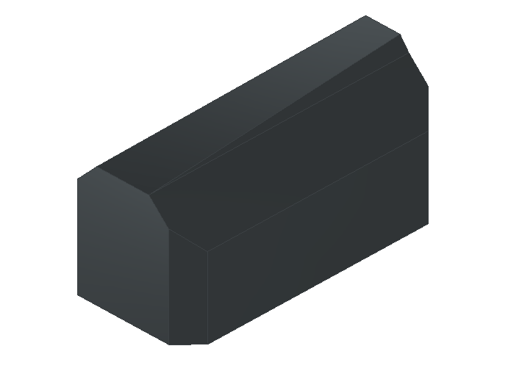
CPS Magnet Pole
Make an adjustment to the angle of the contact surface to the Cu Core to increase material

