Slide 1
Elucidating Pion and Kaon in
Continuum QCD Approach
Adnan Bashir
Institute of Physics and Mathematics
University of Michoacán, Morelia, Michoacán, Mexico
Fulbright Visiting Scientist
Jefferson Laboratory, Newport News, Virginia, USA
EIC Meson DF Meeting
May 11, 2023

Slide 2
Internal Structure of Pion and Kaon
Adnan Bashir
Luis Albino, Khépani Raya
Melany Higuera, Roger Hernández
Physics Opportunities at an Electron-Ion Collider
POETIC 10
May 5, 2023, Sao Paulo, Brazil

Slide 3
Towards Algebraic Models
Sophisticated Truncations
Numerically Demanding
QCD Predictions
QCD Green Functions
Mesons – Static, FFs, PDAs, PDFs
Baryons – Static, FF
Schwinger-Dyson Equations
Most Observables
Mesons, Baryons
Moderate Simplicity
QCD-like Predictions
Contact Interaction
Algebraic Models
Simple Implementation
Insightful - Mindful
LFWFs, GPDs, TMDs,
PDFs, FFs

Slide 4
The Algebraic Model (AM)
It retains the constant term from original models, setting it to M_{q}.
There is a term linear in w with the coefficient (M_{h}² − M_{q}²). For same flavored quarks, it ceases to contribute by construction.
There is a quadratic term w² with coefficient m_{M}². The condition
It guarantees the positivity of
The quark propagator:
Bethe-Salpeter Amplitude:

Slide 5
The Light Front Wavefunction
For a quark in pseudo-scalar meson M, the leading twist (2-particle) light front wave function, ψ_{M} , can be obtained via the light front projection of the meson’s BSWF.
Bethe-Salpeter Wavefunction:
Light Front Wavefunction:
BSA:
The Algebraic Model:

Slide 6
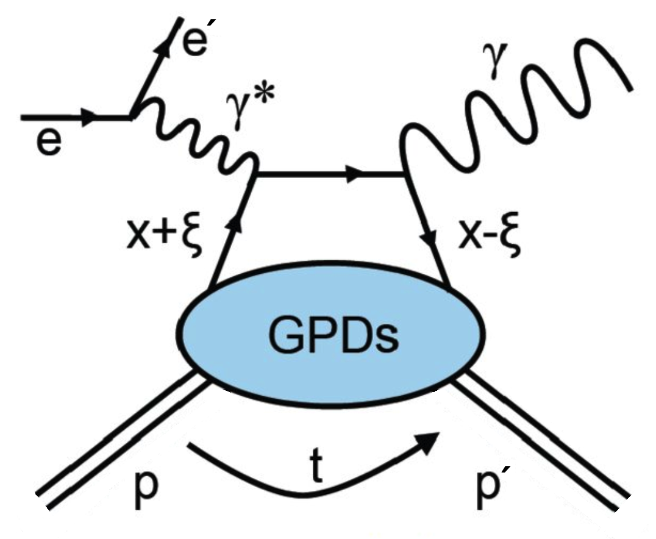
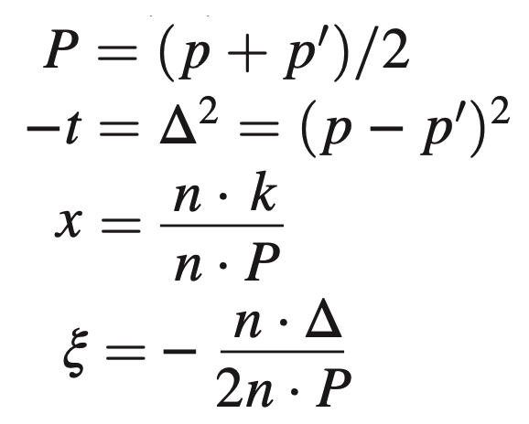
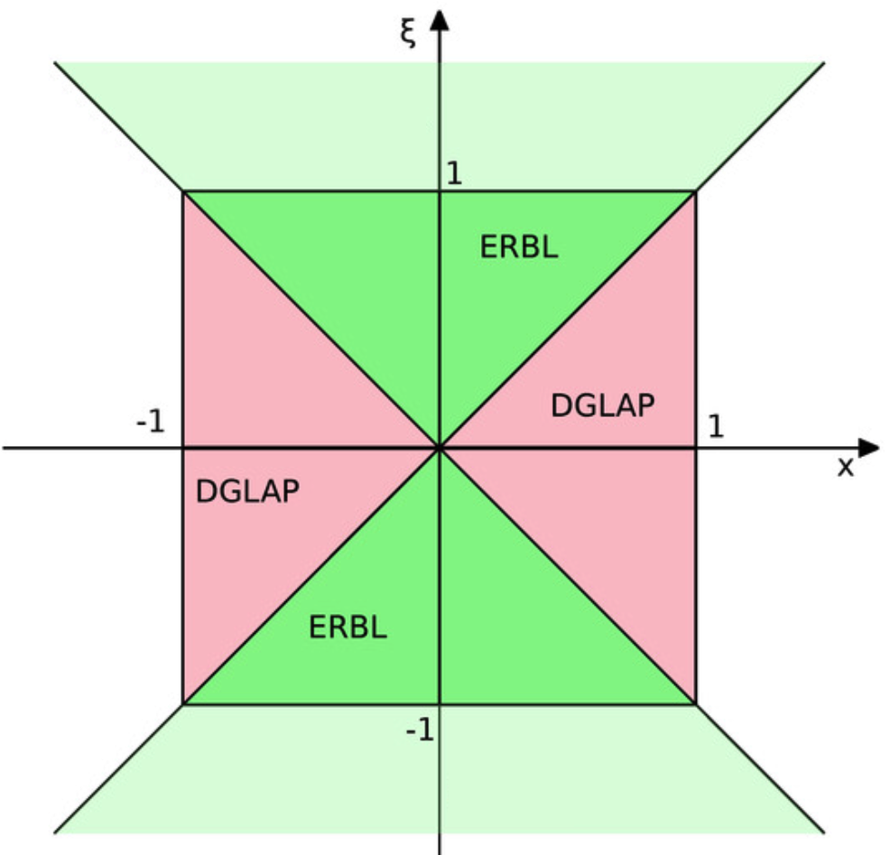
The GPDs from the overlap representation
Valence quark GPD from the overlap representation of the LFWF.
Both x and ξ have support on [−1,1].
The overlap representation is only valid in the DGLAP region, |x|>ξ.

Slide 7
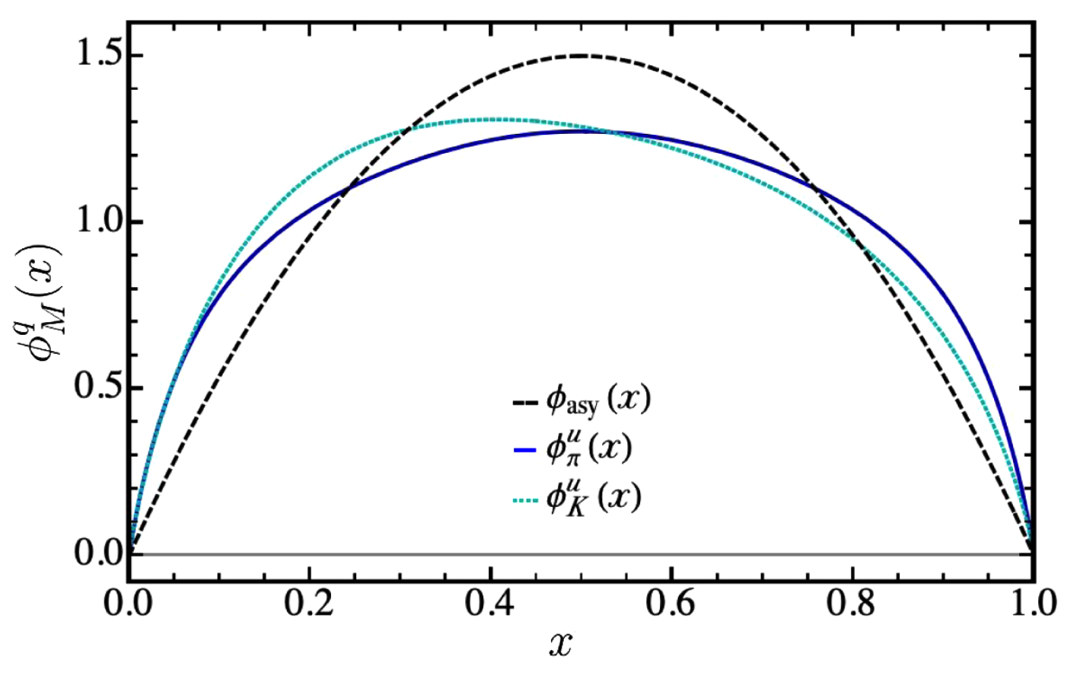
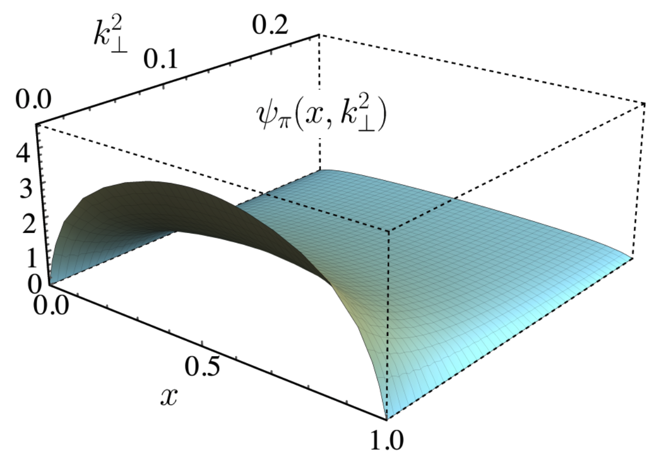
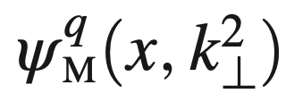
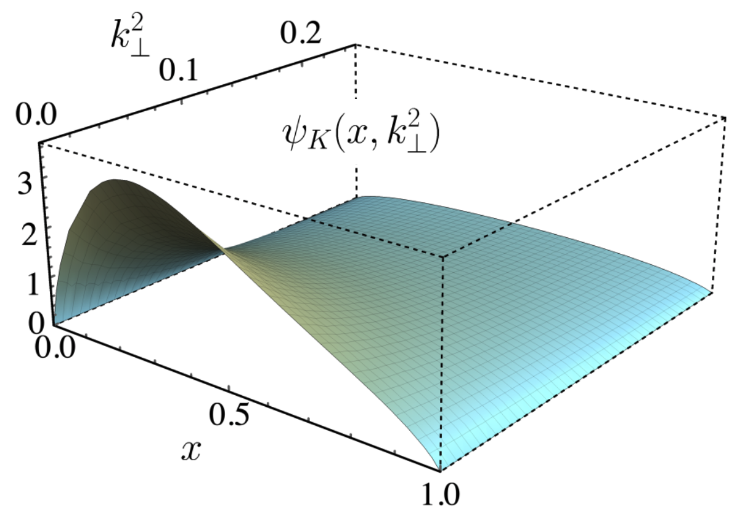
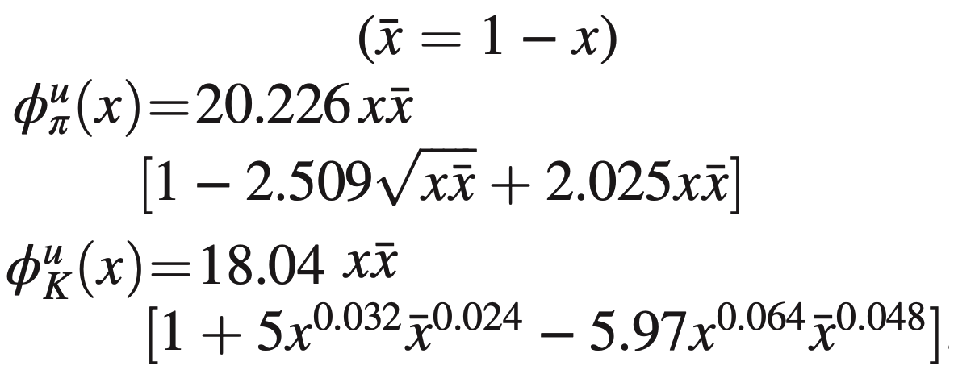
From the PDAs to the LFWFs
Drawing upon accumulated information on the PDAs of 𝜋 and K, we parameterize them as corrections to the asymptotic PDA form on the hadronic scale.
LFWF
𝜋 and K PDAs
Z.-F. Cui, et. al.,
Eur. Phys. J. C 80, 1064 (2020).
PDA

Slide 8
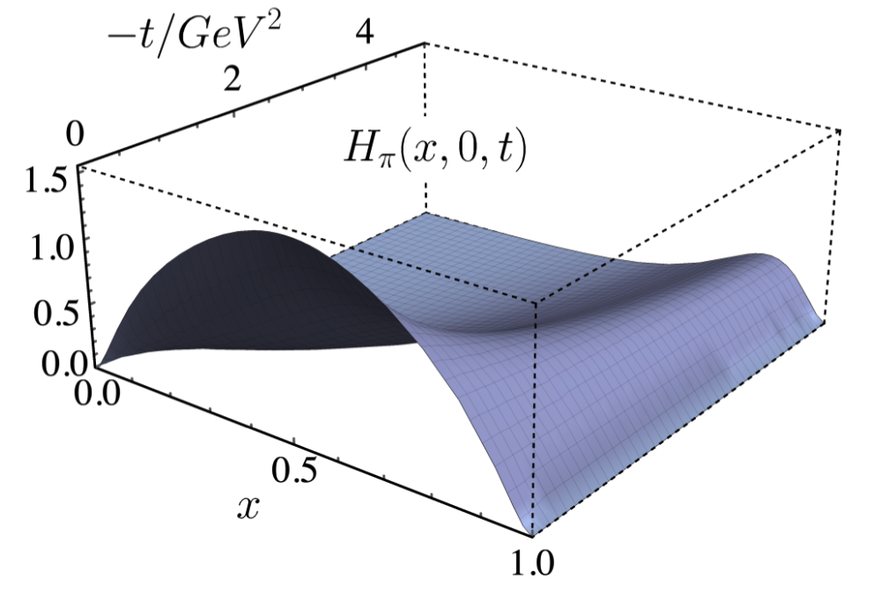
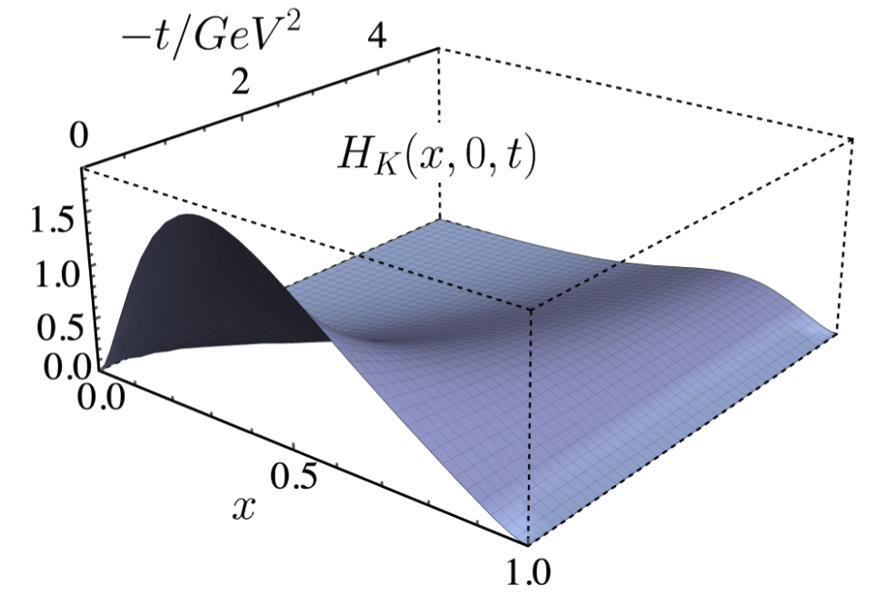
From the LFWFs to the GPDs
𝜋 LFWF
Overlap Representation of the GPDS
L. Albino, M. Higuera, K. Raya, AB
Phys. Rev. D 106 (2022) 3, 034003
K LFWF

Slide 9
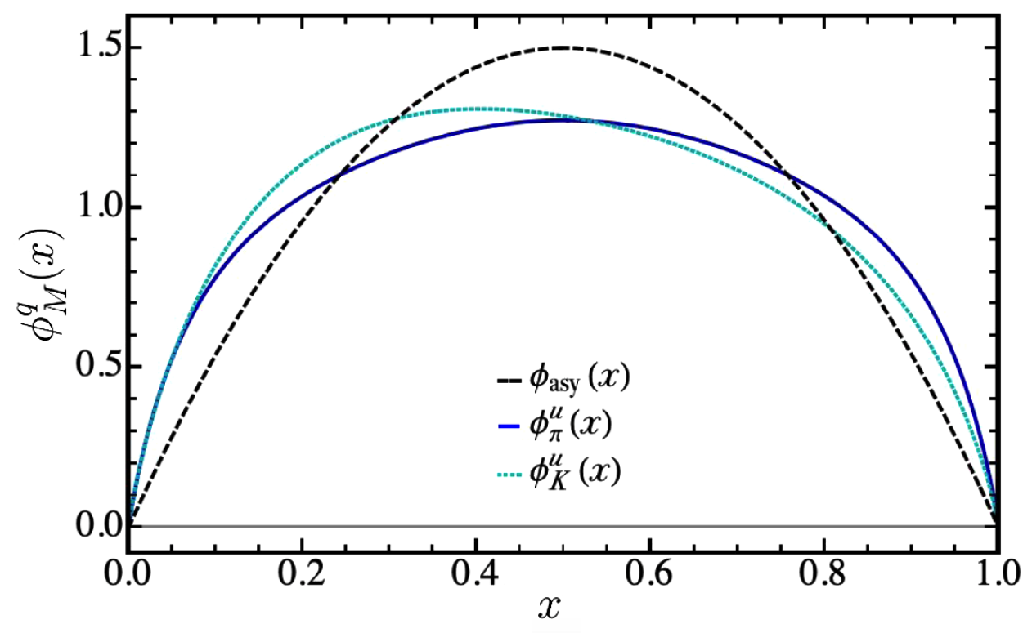
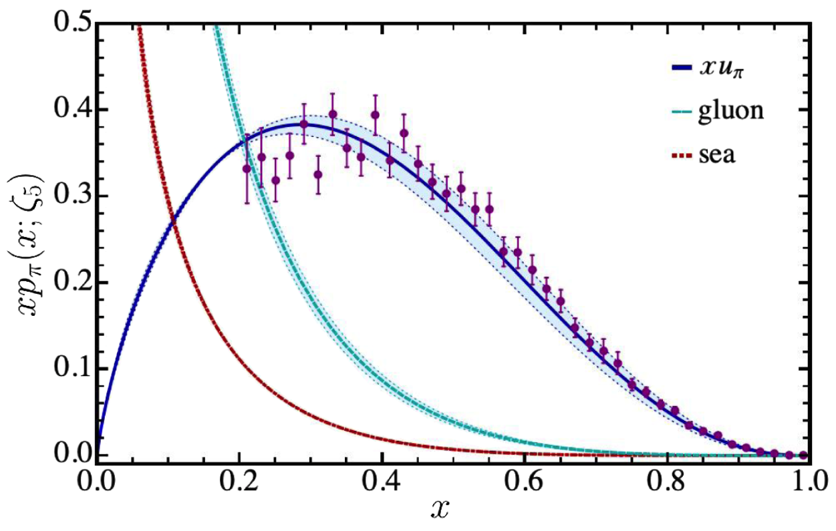
From the GPDs to the PDFs
DGLAP Evolution Equations
L. Albino, M. Higuera, K. Raya, AB
Phys. Rev. D 106 (2022) 3, 034003

Slide 10
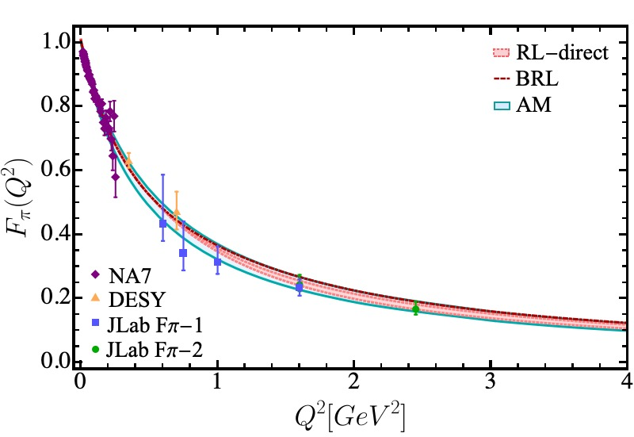
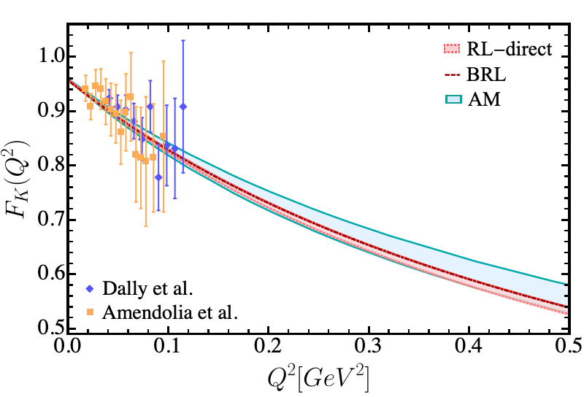
Completing the Cycle – Back to Form Factors
The electromagnetic form factors using our algebraic model can be obtained either through the knowledge of the GPDs or the direct evaluation of the triangle diagram.
Such an exercise provides stringent constraints on the efficacy of the algebraic model we have constructed by direct comparison with the refined calculation of these form factors.

