Slide 1
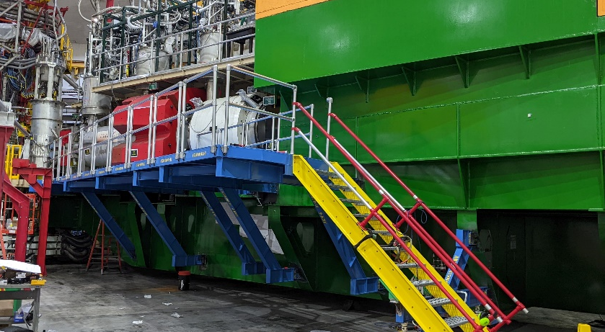
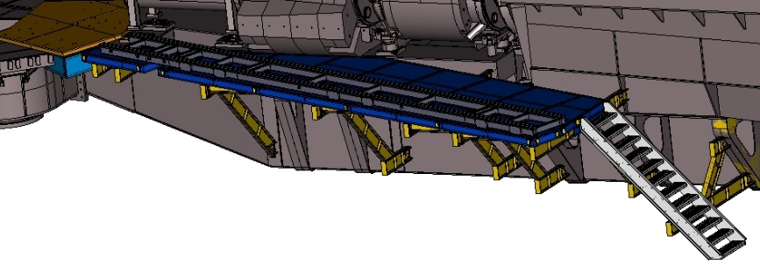
SHMS/NPS INSTALL/FITUP
Platform was completely installed and removed.
Detector rail track was 80% installed and removed.
New detector deck section is installed permanently.
NPS Engineering Status– 9 June 2022 1

Slide 2
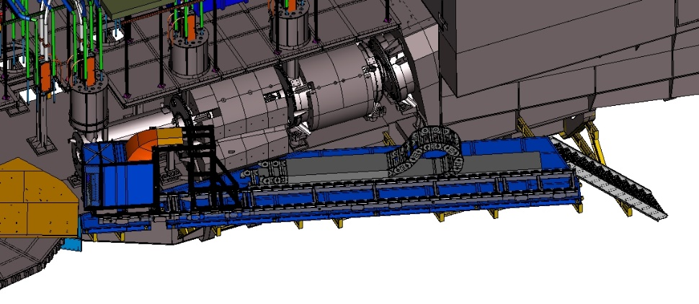
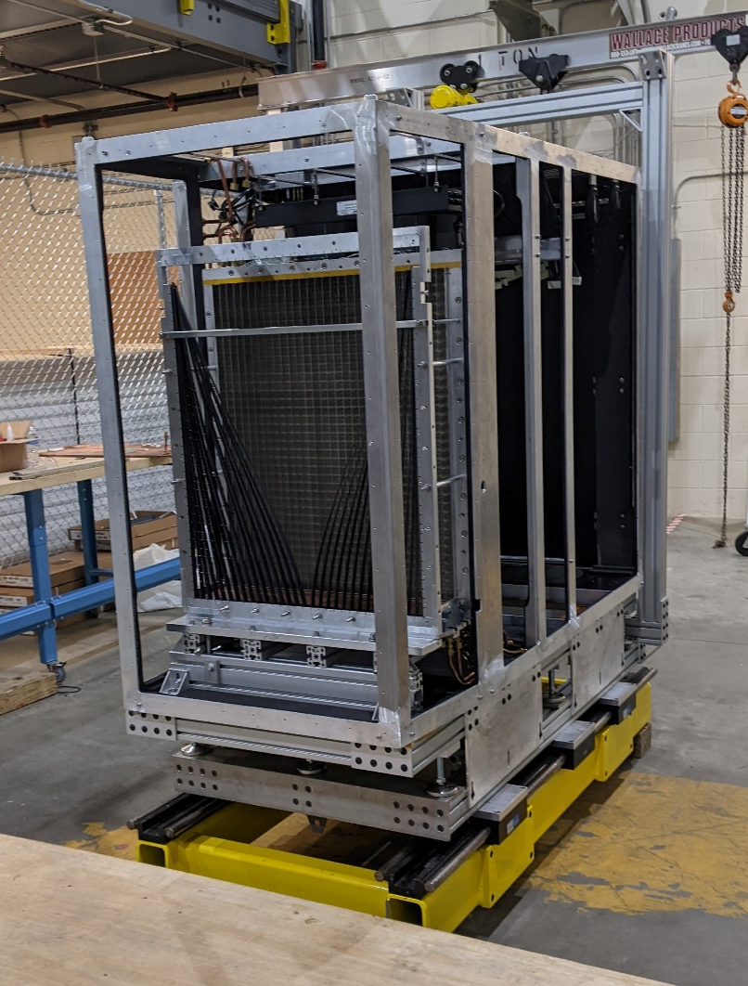
SHMS/NPS INSTALL/FITUP
Cable guide track is in design/review phase .
Detector frame is assembled .
Detector is installed unto detector frame and detector assembly is ongoing by a lively crew.
NPS Engineering Status– 9 June 2022 2

Slide 3
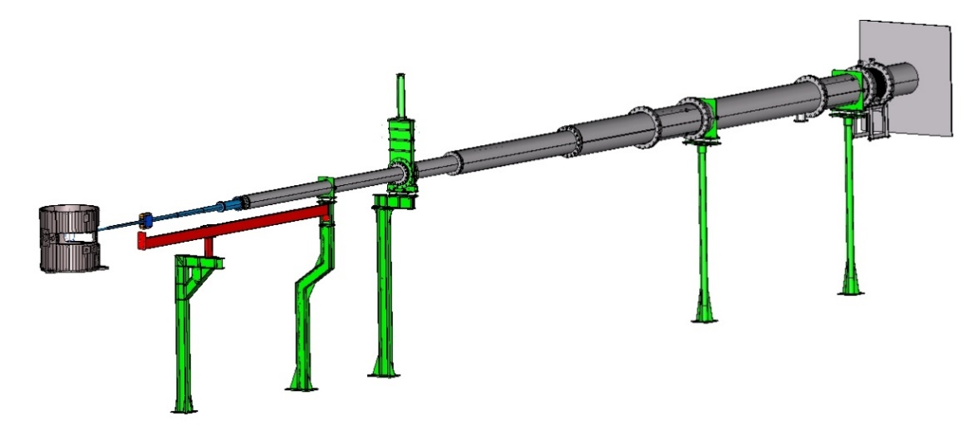
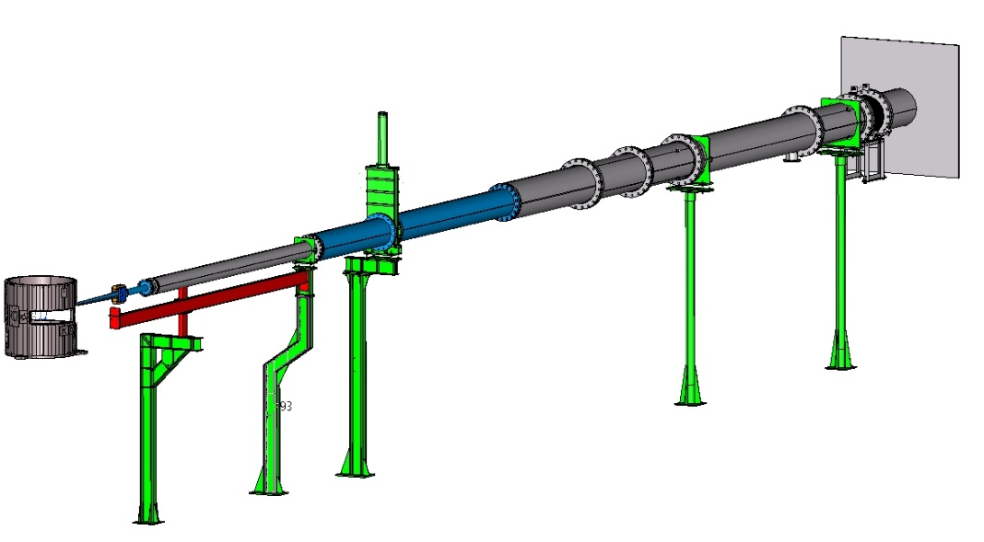
NPS BEAMLINE
Beam line-1 is under physics review and ready for fabrication once signed off.
Beam line setup-1
NEW CORRECTOR TO BE DESIGN AND DETAILED FOR WACS
Beam line-2 is under physics review. Some changes requested and ready for fabrication once signed off.
Beam line setup-2
NPS Engineering Status– 9 June 2022 3

