Slide 1
Energy Calibration of the NPS Calorimeter
Jacob Murphy
Graduate Student with Julie Roche
Ohio University

Slide 2
NPS Calorimeter Calibration Method As done before with DVCS in Hall A
DVCS
Elastic
e’
HMS
$$p_{elastic}$$
HMS
e
e
$$γ$$
NPS
$${e′}_{elastic}$$
NPS
p’
HMS will require polarity change
Calorimeter will need to be moved back

Slide 3
NPS Elastic Kinematics
Out-going photon used to represent elastic electron energy, while keeping the same beam energy
PAC 40 DVCS and π0 kinematics for Hall C
Calorimeter angles : 6⁰ - 23⁰ and 23⁰ - 57.30⁰
HMS Momentum: 0.5 GeV/c – 7.5 GeV/c (Larger than 7.5 GeV/c)
HMS Magnet Saturation at: 5 GeV/c (Larger than 5 GeV/c)
Calorimeter distance: 3m – 11m
HMS - NPS angle larger than 23.5⁰

Slide 4
Elastic Kinematic Simulation
Using proposed kinematics on previous page:
Beam energy fixed
Electron kinematic is uniformly generated about a region centered on the Calo angle in kinematic
Solid angle chosen to be slightly larger than accepted angle of calorimeter
Vertex is uniformly generated from -0.05 to 0.05 m
Proton is calculated from k and theta e
1 million events generated for a given calorimeter distance and kinematic

Slide 5
Hits on Detector Faces
Particle Angles
Electron side
Kinematic 16
Calo-target distance 6m
Proton side
Notes:
Explain Plots and layouts
Vertical coverage
Adjust angle of a detector to reach horizontal

Slide 6
3m 6m 9m 11m
Electron side
Kinematic 16
Proton side
Notes:
Same kinematic, different distances
Only faces of detectors
Note change in horizontal coverage
That at 6m every kinematic, full vertical coverage
Not all kinematic allow us to calibrate calo in one-shot

Slide 7
Notes:
Add to table from slide 3
For 6m and 11m
Rate for 1 microamp beam per block
Same for whole calo
Time for 1000 events per block
% calo covered (NAB/NAC
Conclusion : are kinematics and distances where we can cover whole calo (not surprising given distance of 11m back)

Slide 8
Thank You!

Slide 9
Extra Slides

Slide 10
Distance Calo = 6m

Slide 11
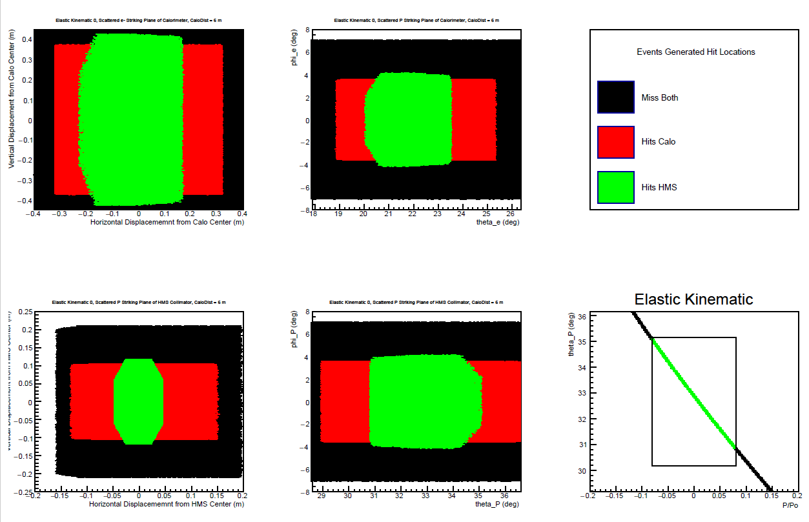
Kinematic 0

Slide 12
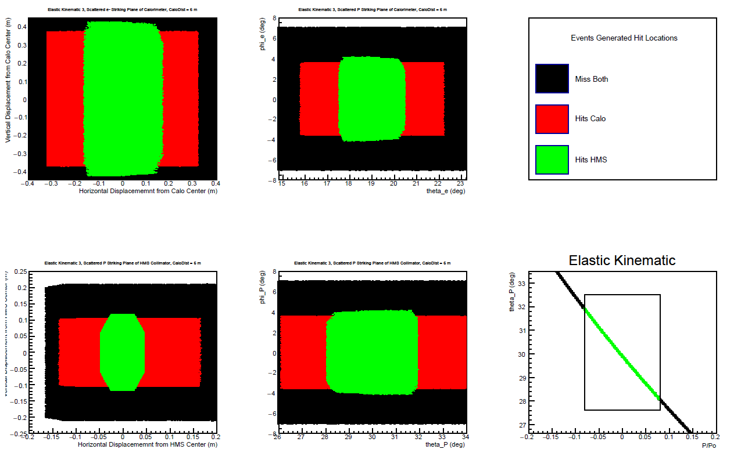
Kinematic 3

Slide 13
Kinematic 4

Slide 14
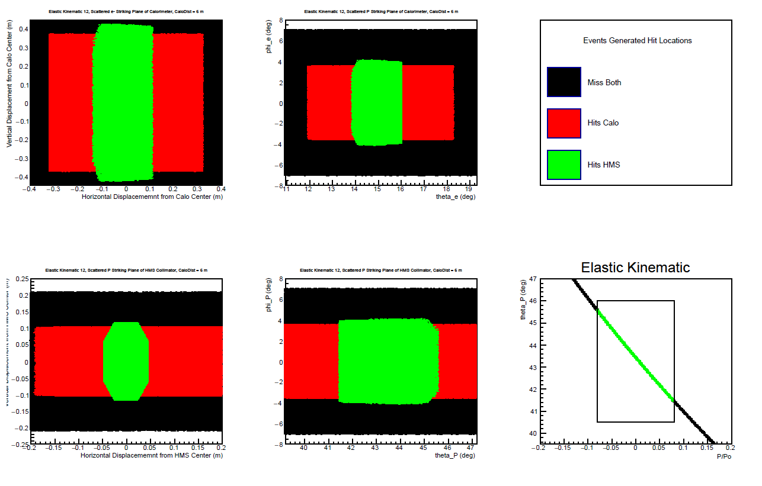
Kinematic 12

Slide 15
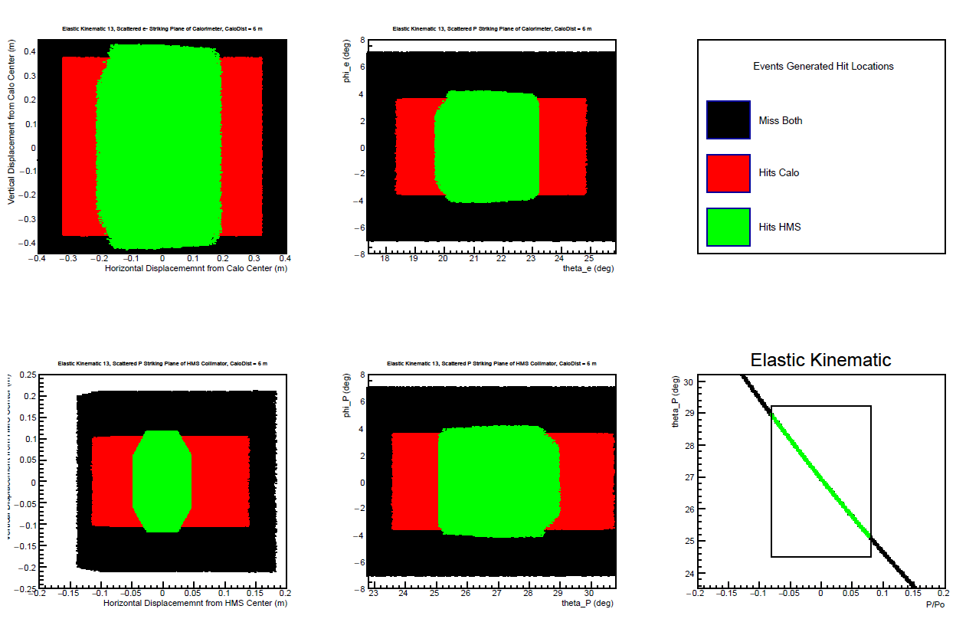
Kinematic 13

Slide 16
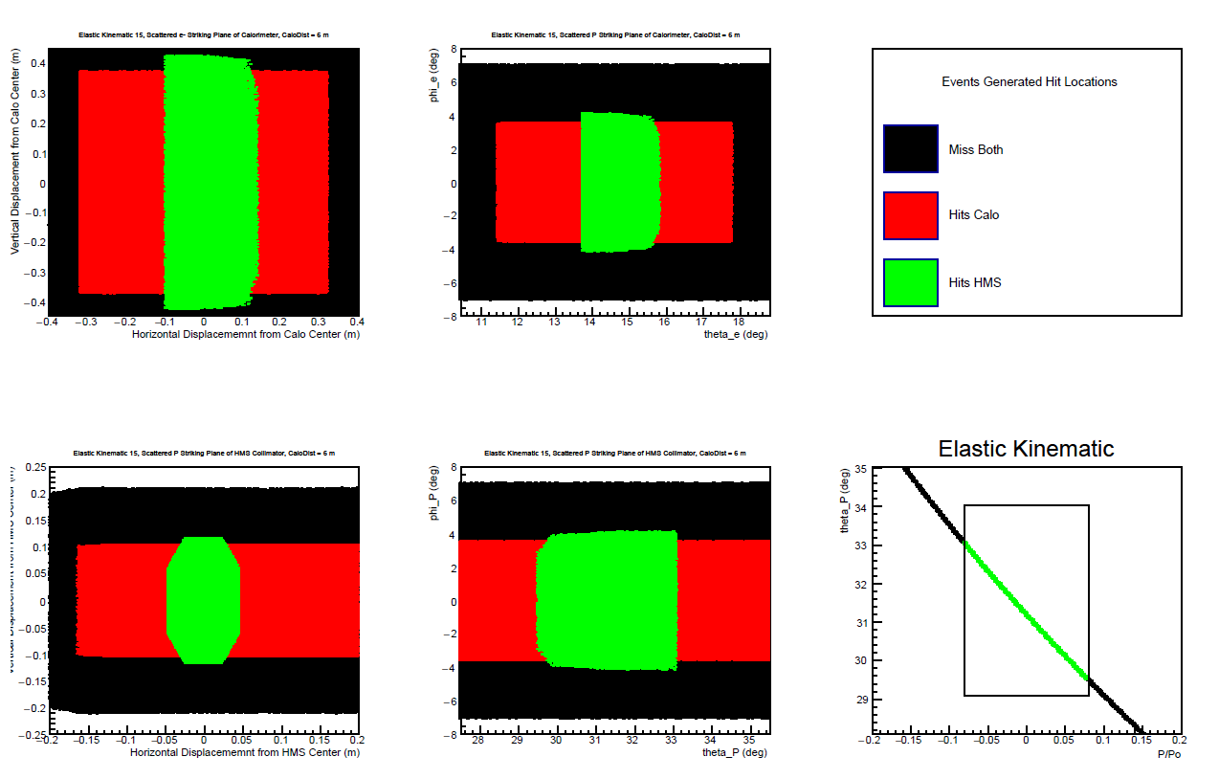
Kinematic 15

Slide 17
Kinematic 16

Slide 18
Kinematic 17

Slide 19
Kinematic 18

Slide 20
Distance Calo = 11m

Slide 21
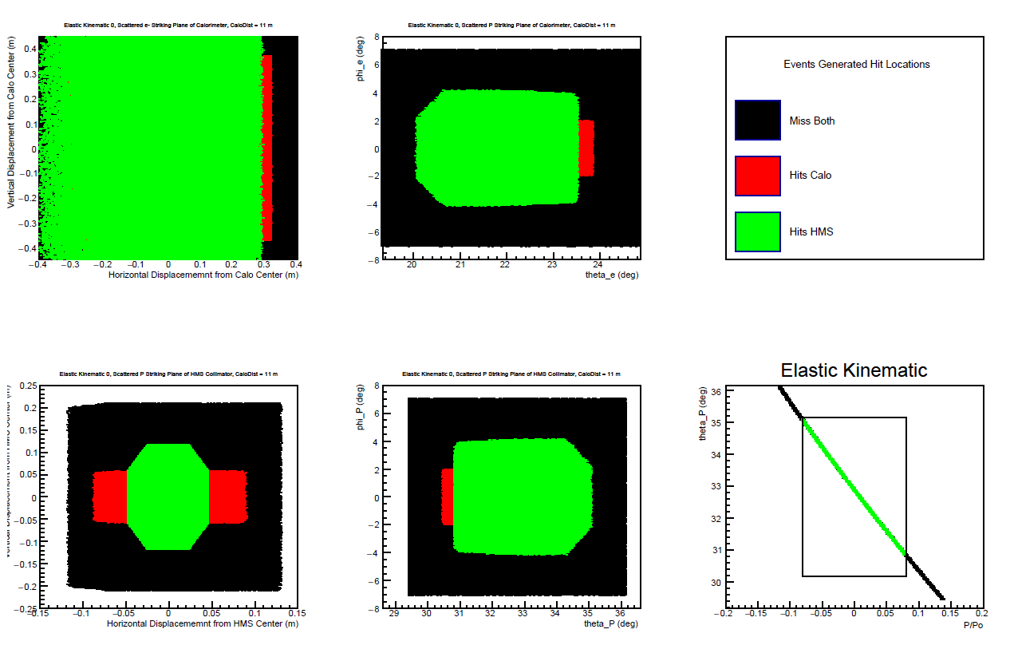
Kinematic 0

Slide 22
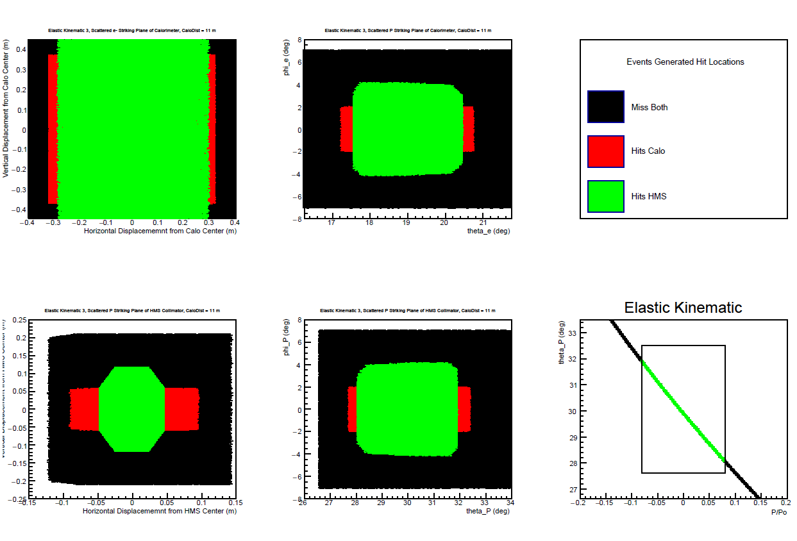
Kinematic 3

Slide 23
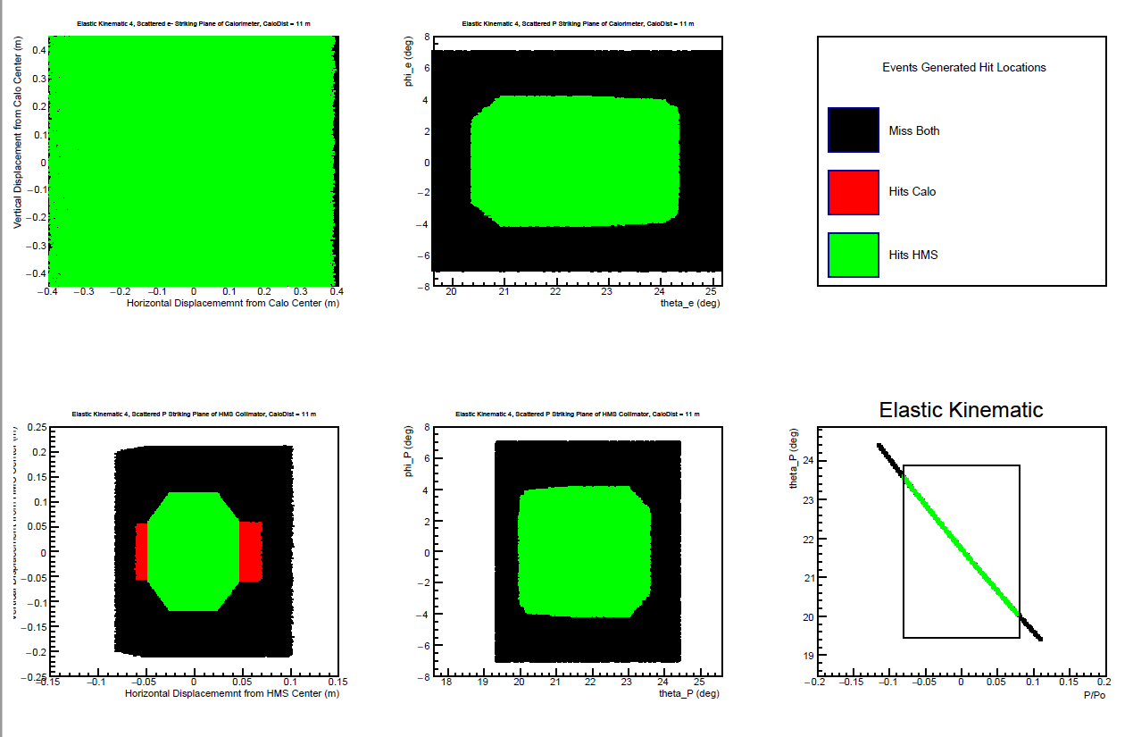
Kinematic 4

Slide 24
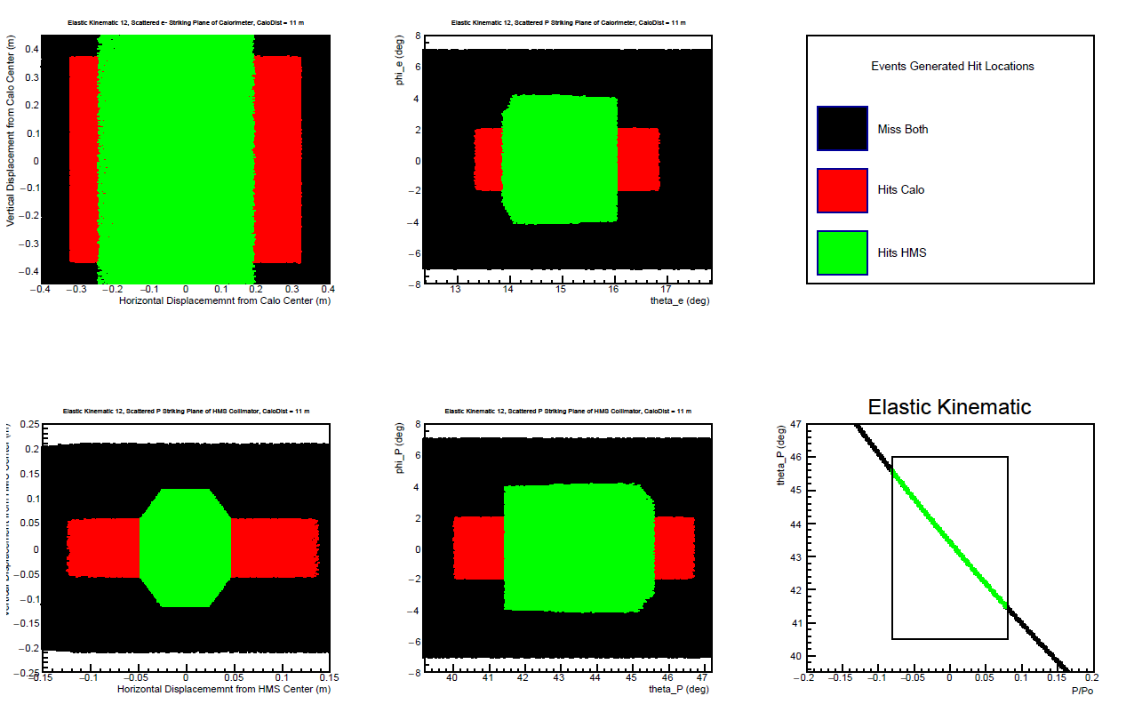
Kinematic 12

Slide 25
Kinematic 13

Slide 26
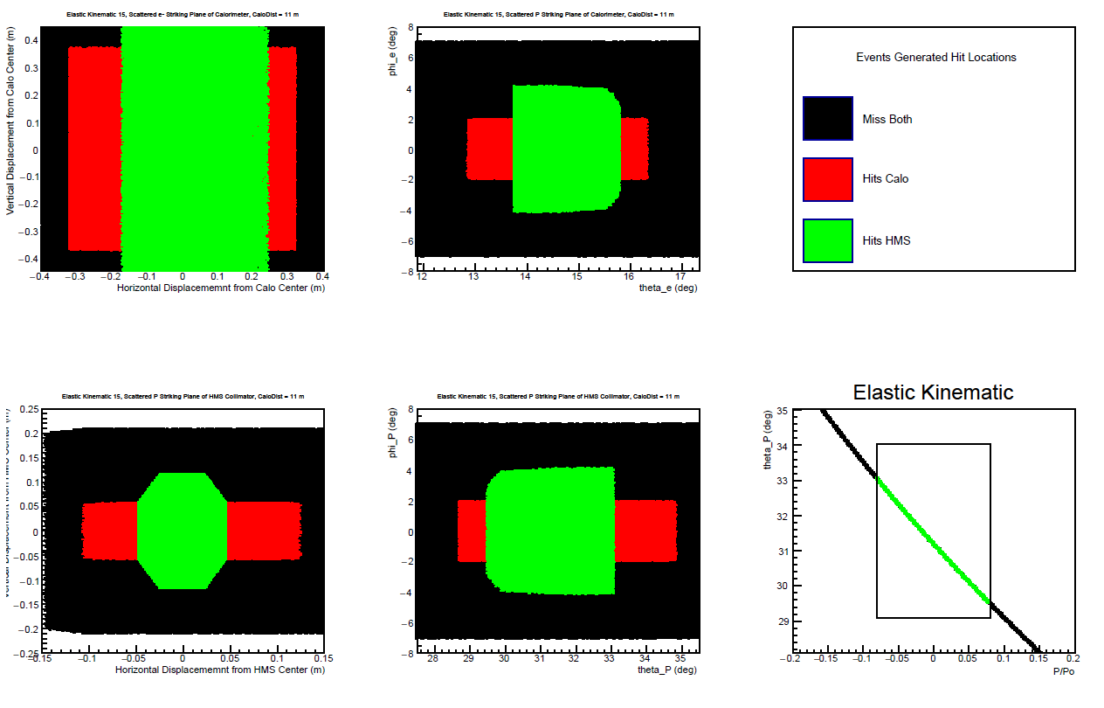
Kinematic 15

Slide 27
Kinematic 16

Slide 28
Kinematic 17

Slide 29
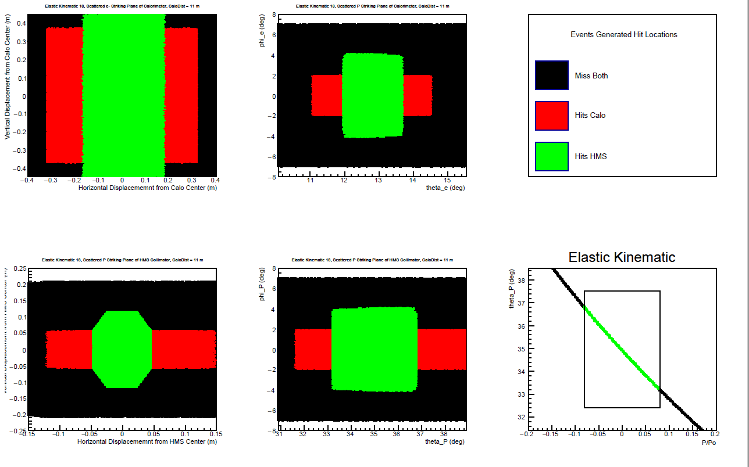
Kinematic 18

