Slide 1
Pion Boer-Mulders function using a contact interaction
Dan-Dan Cheng (程丹丹)
Supervisors: Craig Roberts,
Zhu-Fang Cui (崔著钫)
October 17, 2024

Slide 2
Mass in nature
The character of mass and its consequences in the Standard Model (SM) is a key question in modern physics
When considering the origin of mass in the SM thoughts typically turn to explicit mass generation through the Higgs mechanism
Notion behind Higgs mechanism for mass generation was introduced more than fifty years ago; and it became an essential piece of the SM
2012 – Discovery of something possessing all anticipated properties of the Higgs boson
SM became complete
Nobel Prize in physics awarded to Englert and Higgs
“. . . for the theoretical discovery of a mechanism that contributes to our understanding of the origin of mass of subatomic particles . . . ”
NOT the complete story. Far from it …

Slide 3
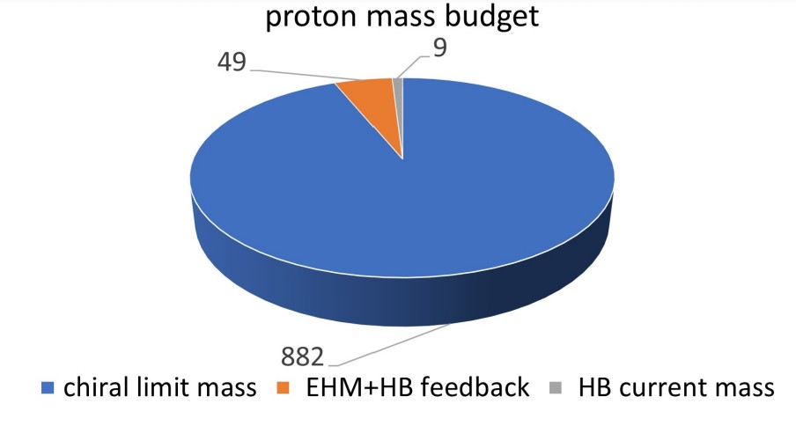
Emergence of hadron mass
The Higgs boson only gives mass to very simple particles. It is alone responsible for just $\sim 1\%$ of the visible mass in the Universe
Proton mass budget
Only 9 MeV/939 MeV is directly from Higgs
Evidently, there is another phenomenon in Nature that is extremely effective in producing mass:
Emergent Hadron Mass (EHM)
Craig D. Roberts, David G. Richards, Tanja Horn, Lei Chang
Prog. Part. Nucl. Phys. 120 (2021) 103883
Alone, it produces 94% of the proton’s mass
Remaining 5% is generated by constructive interference between EHM and Higgs-boson

Slide 4
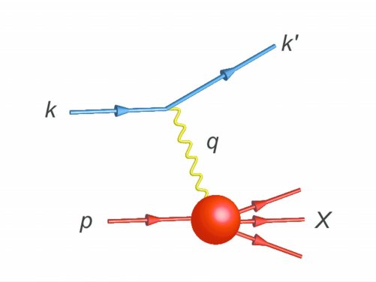
Parton distribution function
EHM is expressed in EVERY strong interaction observable.
Challenge to theory =
Elucidate all observable consequences of these phenomena
and highlight the paths to measuring them.
Parton distribution functions (DFs) = preeminent source of hadron structure information.
Experiments interpretable in terms of DFs have long been a priority.
Hadron physics has focused on one dimensional (1D) imaging of hadrons in the past 50 years.
Facilities have given high priority to experiments that can yield data that may be used to draw three-dimensional (3D) images of hadrons.
JLAb, CERN, Eic, EIcC, etc

Slide 5
Gauge invariant correlation function
The gauge-invariant quark-quark correlation function is defined as
$$Φ_{ij}(k;P,S)=\int{d^{4}ξe^{ik∙ξ}\left\langle P\left.S\right|\right.{\overline{ψ}}_{j}\left(0\right)U_{[0,ξ]}ψ_{i}\left(ξ\right)\left|\left.PS\right\rangle \right.}$$
Path ordered exponentials
$$\left({−∞}^{−}\text{,}∞_{⊥}\right)$$
$$\left(∞^{−}\text{,}∞_{T}\right)$$
$$ξ_{⊥}$$
$$ξ^{−}$$
$$\left(−∞^{−}\text{,}ξ_{⊥}\right)$$
$$\left(ξ^{−}\text{,}ξ_{⊥}\right)$$
$$\left(ξ^{−}\text{,}ξ_{⊥}\right)$$
$$\left(ξ^{−}\text{,}∞_{T}\right)$$
$$\left({−∞}^{−}\text{,}0_{⊥}\right)$$
$$\left(0^{−}\text{,}0_{⊥}\right)$$
$$\left(0^{−}\text{,}0_{T}\right)$$
$$\left(∞^{−}\text{,}0_{T}\right)$$
Initial state interaction in Drell-Yan
Final state interaction in SIDIS
Initial/final state interaction to past/future in Drell-Yan/SIDIS process.
The light-cone disappears in light cone gauge; the transverse vanishes in Feynman gauge.

Slide 6
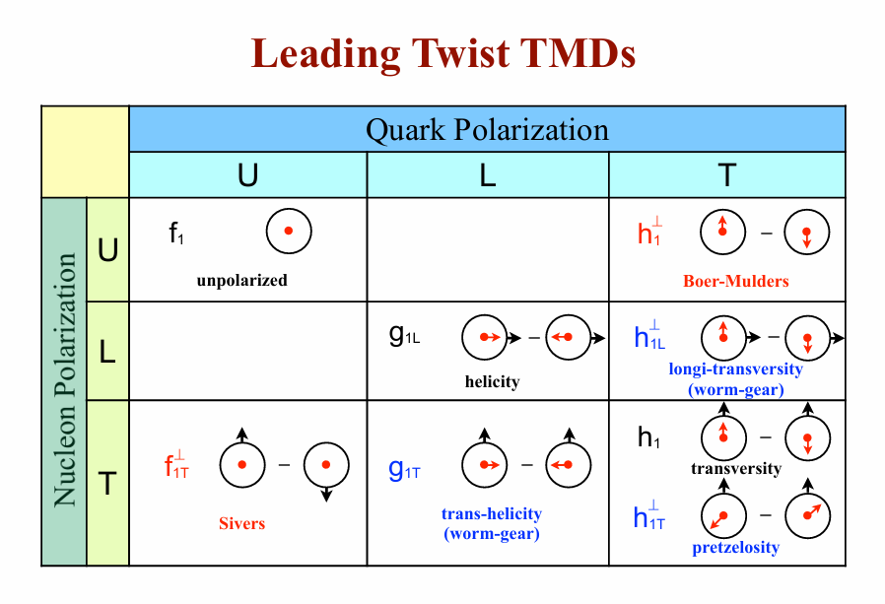
Leading twist TMDs
Decompose the correlation function on a basis of Dirac structure
Hermiticity, parity invariance, and time reversal invariance
$$f_{1}\left(x\right),g_{1}\left(x\right),h_{1}\left(x\right)$$
Considering quark transverse momentum
Hermiticity, parity invariance, and time reversal invariance
$$f_{1}\left(x,k_{⊥}\right),g_{1L}\left(x,k_{⊥}\right),g_{1T}\left(x,k_{⊥}\right),h_{1}\left(x,k_{⊥}\right),h_{1L}\left(x,k_{⊥}\right),h_{1T}\left(x,k_{⊥}\right)$$
Without time reversal invariance
$$f_{1T}^{⊥}\left(x,k_{⊥}\right),h_{1}^{⊥}\left(x,k_{⊥}\right)$$
(Naive) T-odd TMDs

Slide 7
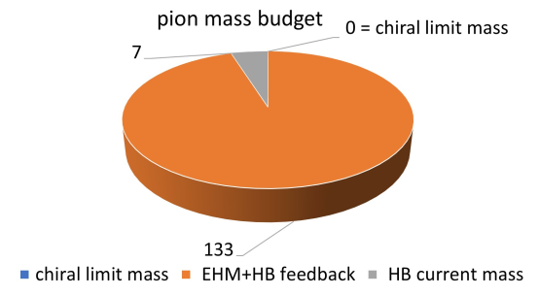
Pion leading twist TMDs
Craig D. Roberts, David G. Richards, Tanja Horn, Lei Chang
Prog. Part. Nucl. Phys. 120 (2021) 103883
The most direct expression of EHM in the SM
Massless in the chiral limit (Nambu-Goldstone boson)
Simplest bound state
The leading twist pion TMDs
$$Φ^{\left[{iγ}^{+}\right]}\left(x,k_{⊥}\right)=f_{1}(x,k_{⊥})$$
$$Φ^{\left[iσ^{i+}γ^{5}\right]}\left(x,k_{⊥}\right)=−\frac{ε_{T}^{ij}k_{⊥j}}{M}h_{1}^{⊥}\left(x,k_{⊥}\right)$$
$$\frac{ε_{T}^{ij}k_{Tj}}{m_{π}}h_{1}^{⊥}\left(x,k_{T}\right)→\frac{ε_{T}^{ij}k_{Tj}}{M}h_{1}^{⊥}\left(x,k_{T}\right)$$
$f_{1}$ and $h_{1}^{⊥}$ are constrained by positivity bound relation
$$\left|k_{T}h_{1}^{⊥}\left(x,k_{⊥}^{2}\right)\right|/M≤f_{1}(x,k_{T})$$
$h_{1}^{⊥}$ can not vanish in chiral limit

Slide 8
Number density interpretation
The distribution of transversely polarized quarks in an unpolarized hadron
$$f_{{q^{↑}}/p}\left(x,k_{⊥}\right)=\frac{1}{2}\left[f_{1}^{q}\left(x,k_{⊥}^{2}\right)−\frac{\left(\hat{P}×k_{⊥}\right)∙S_{q}}{M}h_{1}^{⊥}\left(x,k_{⊥}^{2}\right)\right]$$
A. Bacchetta, U. DAlesio, M. Diehl, C. A. Miller, Phys. Rev. D 70 (2004) 117504
Unpolarized distribution function
Quark transverse polarisation
$$f_{{q^{↑}}/N}\left(x,k_{⊥}\right)+f_{{q^{↓}}/N}\left(x,k_{⊥}\right)=f_{1}^{q}\left(x,k_{⊥}^{2}\right)$$
$$+$$
The Boer-Mulders function arises from the correlation of the quark spin and the quark transverse momentum
Quark transverse momentum vector
$$f_{{q^{↑}}/N}\left(x,k_{⊥}\right)−f_{{q^{↓}}/N}\left(x,k_{⊥}\right)=−\frac{\left|k_{T}\right|h_{1}^{⊥}\left(x,k_{⊥}^{2}\right)}{M}sin\left(φ_{k_{⊥}}−φ_{S}\right)$$

Slide 9
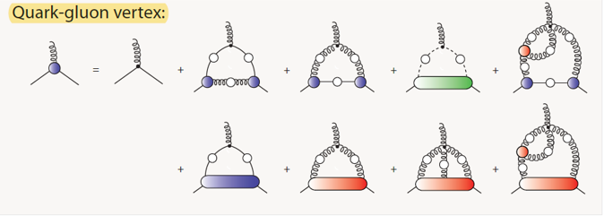
Dyson-Schwinger equation
The dressed quark propagator (Gap equation)
Continuum Schwinger function methods
nonperturbative
$${S(p)}^{−1}=iγ∙p+m+\int{\frac{d^{4}q}{{\left(2π\right)}^{4}}g^{2}D_{μν}\left(p−q\right)\frac{λ^{a}}{2}γ_{μ}S\left(q\right)\frac{λ^{a}}{2}Γ_{ν}\left(q,p\right)}$$
symmetry-preserving
Owing to the infinite coupling feature, It is necessary to truncate the Dyson-Schwinger equations at a certain level for practical calculations
The two body system is described by Bethe-Salpeter equation
$$Γ_{ν}^{a}\left(q,p\right)=\frac{λ^{a}}{2}γ_{ν}$$
Rainbow-ladder truncation
$$Γ\left(k;P\right)=−\int{\frac{d^{4}q}{{\left(2π\right)}^{4}}g^{2}D_{μν}\left(p−q\right)γ_{μ}\frac{λ^{a}}{2}S\left(q+P\right)Γ\left(q;P\right)S\left(q\right)\frac{λ^{a}}{2}γ_{ν}}$$

Slide 10
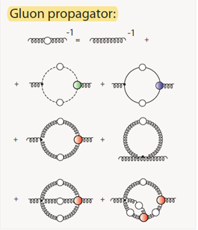
Contact interaction
Contact interaction (SCI)
$$g^{2}D_{μν}\left(p−q\right)=δ_{μν}\frac{4πα_{IR}}{m_{G}^{2}}$$
algebraic simplicity
Parameter free
applicable to a wide variety of systems and processes
potential for revealing insights that connect and explain numerous phenomena
capacity to serve as a means of checking the validity of algorithms employed in calculations that depend upon high performance computing
where $m_{G}≈0.5GeV$ is a gluon mass-scale and the $α_{IR}≈π$ is the zero-momentum value of a running-coupling constant in QCD.
Gap equation
$${S(p)}^{−1}=iγ∙p+M$$
Bethe-Salpeter amplitude
$$Γ_{P}\left(Q\right)=γ_{5}\left[iE_{P}\left(Q\right)+\frac{1}{2M_{fg}}γ∙QF_{P}\left(Q\right)\right]$$

Slide 11
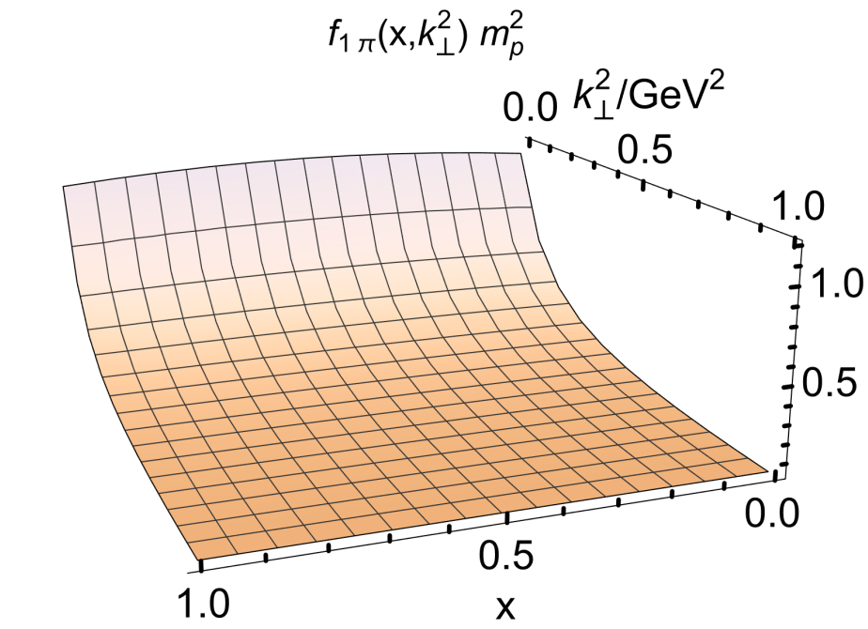
Unpolarized distribution function
Ignoring the gauge link in correlation function
$$f_{1π}\left(x,k_{⊥}^{2}\right)=\frac{N_{c}}{{2π}^{3}}\left[E_{π}\left(E_{π}−2F_{π}\right){\overline{C}}_{2}\left(ω_{1}\right)+3{\left(E_{π}−2F_{π}\right)}^{2}x\left(1−x\right)M_{π}^{2}{\overline{C}}_{3}\left(ω_{1}\right)\right]$$
J.-L. Zhang, et al. Eur. Phys. J. C 81 (2021).
The result at hadron scale (valence degrees-of-freedom carries all pion properties)
The light-front momentum sum rule is saturated by the pion’s valence degrees-of-freedom
$$\int_{0}^{1}{dx\int{d^{2}k_{⊥}}}2xf_{1π}\left(x,k_{⊥}^{2}\right)=1$$
Symmetric around $x=1/2$. The $k_{⊥}^{2}$ profile is almost independent of $x$
$$m_{π}^{2}/M^{2}≪1$$
$f_{1π}\left(x,k_{⊥}^{2}\right)≠0$ on $x≃0,1$ at any finite $k_{⊥}^{2}$
artefact of the momentum independent quark + quark interaction

Slide 12
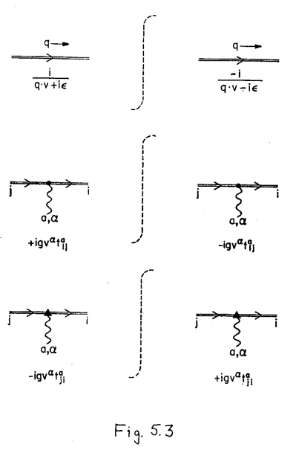
Eikonal approximation
Non-zero BM function requires valence quark involved in the forward scattering event subsequently/ initially interacts with the spectator via (multiple) gluon exchanges
C. J. Bomhof, Other thesis, Vrije U., 2007.
Gluon interactions with the struck quark can be approximated by the double line propagator after eikonal approximation
eikonal approximation
J. C. Collins, D. E. Soper, G. F. Sterman, Adv. Ser. Direct. High Energy Phys. 5 (1989) 1–91

Slide 13
Diagrammatic calculation of BMF
The relative negative sign expresses the sign-change between initial- and final- state eikonal-quark interactions
The second diagram can be mapped into the first by time reversal invariance
$$h_{1}^{⊥}\left(x,k_{⊥}\right)\frac{{\vec{k}}_{⊥α}}{M}=N_{c}{tr}_{D}\int{\frac{d^{4}q}{{\left(2π\right)}^{4}}δ_{n}^{x}\left(k\right)S\left(k−P_{π}\right)Γ\left(−P_{π}\right)S\left(k\right)σ_{α+}\frac{\left[−gn_{μ}\right]}{n∙q}S\left(k+q\right)Γ\left(P_{π}\right)S\left(k+q−P_{π}\right)\left[−gγ_{υ}\right]D_{μν}}$$
The on shell condition of double line is represented by $1/n∙q→∓πδ\left(n∙q\right)$
$${h_{1}^{⊥}\left(x,k_{⊥}\right)}_{SIDIS}=−{h_{1}^{⊥}\left(x,k_{⊥}\right)}_{DY}$$

Slide 14
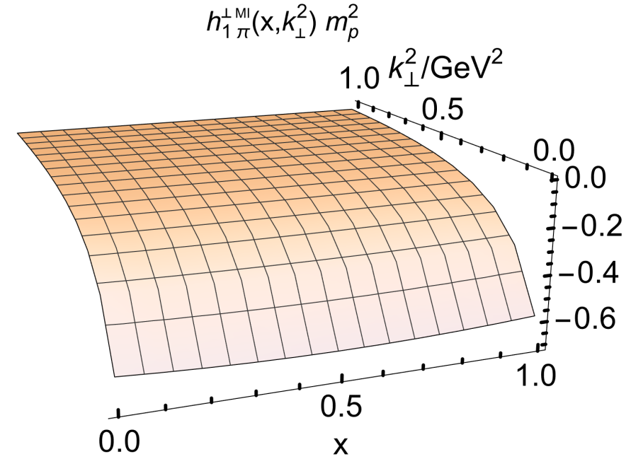
SCI gauge link
Symmetry preserving contact interaction
$$g^{2}D_{μν}\left(q\right)=δ_{μν}\frac{4πα_{IR}}{m_{G}^{2}}$$
$$h_{1}^{⊥}\left(x,k_{⊥}^{2}\right)=−\frac{α_{IR}}{m_{G}^{2}}\frac{N_{c}}{4π^{3}}𝒩_{EF}\frac{{\overline{C}}_{2}\left(ς\right)}{ς}\left\{\left[\left(E_{π}−F_{π}\right)M^{2}−x\left(1−x\right)m_{π}^{2}F_{π}\right]{\overline{C}}_{1}\left(ς_{0}\right)+F_{π}C_{0}\left(ς_{0}\right)\right\}$$
Result at hadron scale
Non-zero in the chiral limit
Only non-zero because of the interaction between the eikonalized quark and the spectator
The magnitude of the effect reflects the scale of EHM
$$ς=k_{⊥}^{2}+M^{2}−x\left(1−x\right)m_{π}^{2}$$
The similar profile compared to $f_{1π}$
Practically undamped

Slide 15
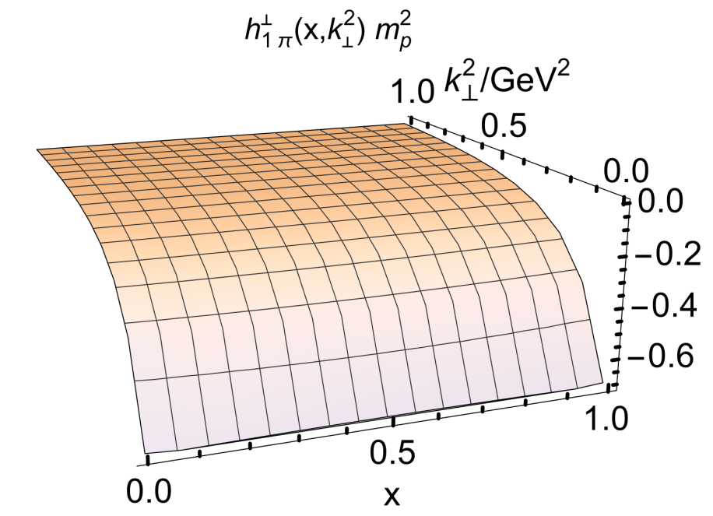
Momentum-dependent link completion
$$g^{2}D_{μν}\left(q\right)=δ_{μν}\frac{4πα_{ℒ}}{{q^{2}+m}_{G}^{2}}$$
More realistic interaction
It is SCI form at infrared momenta when $α_{ℒ}=α_{IR}$
Provides damping in the ultraviolet for any value of $α_{ℒ}$
$$h_{1π}^{⊥}=−α_{ℒ}\frac{N_{c}}{4π^{3}}𝒩_{EF}\frac{{\overline{C}}_{2}\left(ς\right)}{ς}\int_{0}^{1}{dυ\left\{2\left(1−υ\right)\left(E_{π}M^{2}−F_{π}\left[M^{2}+x\left(x−1\right)m_{π}^{2}+υk_{⊥}^{2}\right]\right)\frac{{\overline{C}}_{2}\left(\tilde{ς}\right)}{\tilde{ς}}+F_{π}{\overline{C}}_{1}\left(\tilde{ς}\right)\right\}}$$
Other model calculations also considered a momentum-dependent gauge-link
M. Ahmady, et, al. Phys. Rev. D, 100 (2019) 5, 054005
Wei Kou, Chao Shi, Xu-Rong Chen, et, al. Phys. Rev. D 108 (2023) 3, 036021
A mismatch between the bound state kernel and the gauge link completion

Slide 16
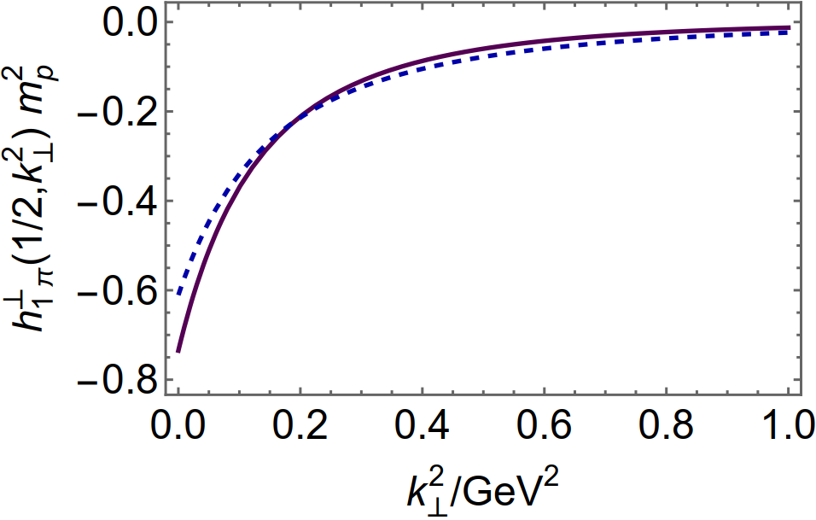
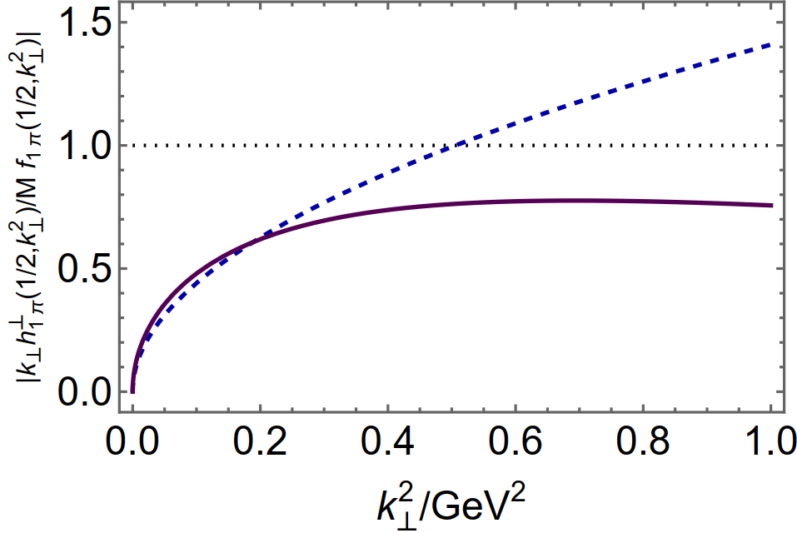
Comparison of two gauge links
$$\left|k_{T}h_{1}^{⊥}\left(x,k_{⊥}^{2}\right)\right|/\left(Mf_{1}(x,k_{T})\right)≤1$$
BMF decays quicker with the momentum-dependent gauge link interaction
MI
MI
MD
MD
The positivity bound is violated in SCI gauge link
B. Pasquini, P. Schweitzer, Phys. Rev. D 90 (2014) 014050
provide greater support to the gauge link contribution than it do to the usual quark loop
Z. Wang, X. Wang, Z. Lu, Phys. Rev. D 95 (2017) 094004
M. Ahmady, et, al. Phys. Rev. D, 100 (2019) 5, 054005
Z. Lu, B.-Q. Ma, Phys. Rev. D 70 (2004) 094044
Wei Kou, Chao Shi, Xu-Rong Chen, et, al. Phys. Rev. D 108 (2023) 3, 036021
Z. Lu, B.-Q. Ma, Phys. Lett. B 615 (2005) 200–206

Slide 17
Comparison of two gauge links
$$\left|k_{T}h_{1}^{⊥}\left(x,k_{⊥}^{2}\right)\right|/\left(Mf_{1}(x,k_{T})\right)≤1$$
MI
MI
MD
MD
The positivity bound is satisfied in momentum-dependent gauge link
quark and gluon propagators used throughout possess an ultraviolet momentum dependence that matches QCD expectations
the support of the usual quark loop is not curtailed without at least commensurate and consistent suppression of the gauge link range

Slide 18
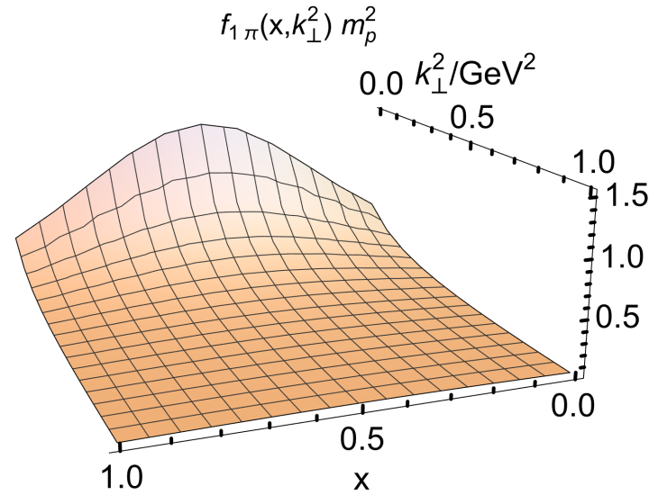
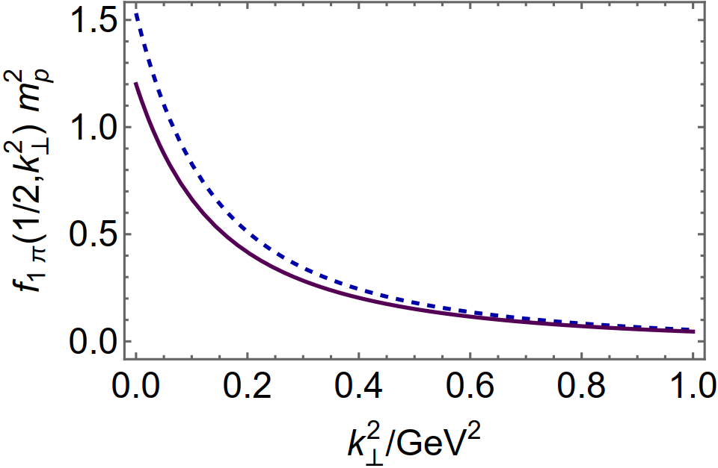
Current mass dependence
Considering a (fictitious) pion composed of a quark $s$ and antiquark $\overline{s}$
$π_{s}$ result
$π$ result
The $x$ profile is far less dilated, with greater concertation around $x=1/2$
The increased magnitude of the $π_{s}$ at its global maximum with respect to that of the $π$
More rapid decrease with increasing $k_{⊥}^{2}$ on the infrared domain

Slide 19
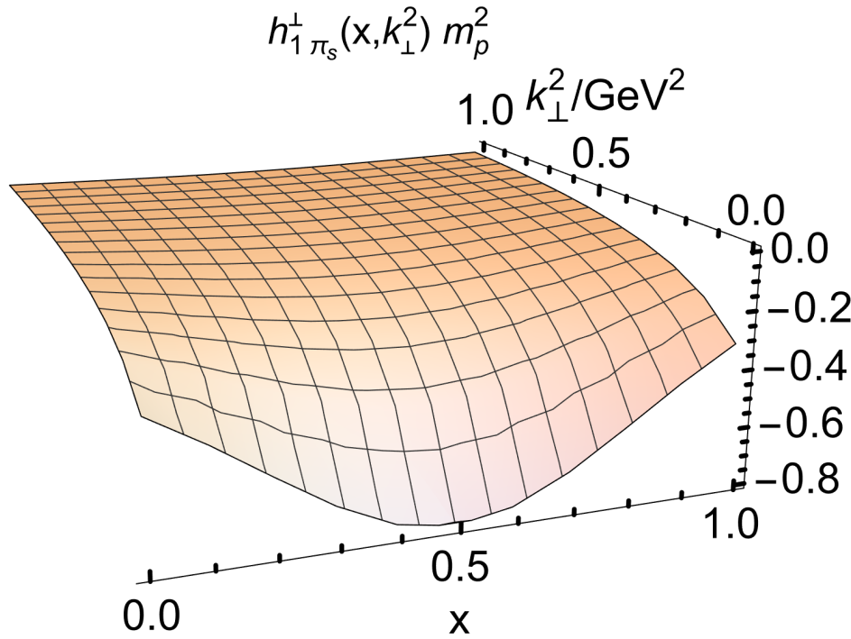
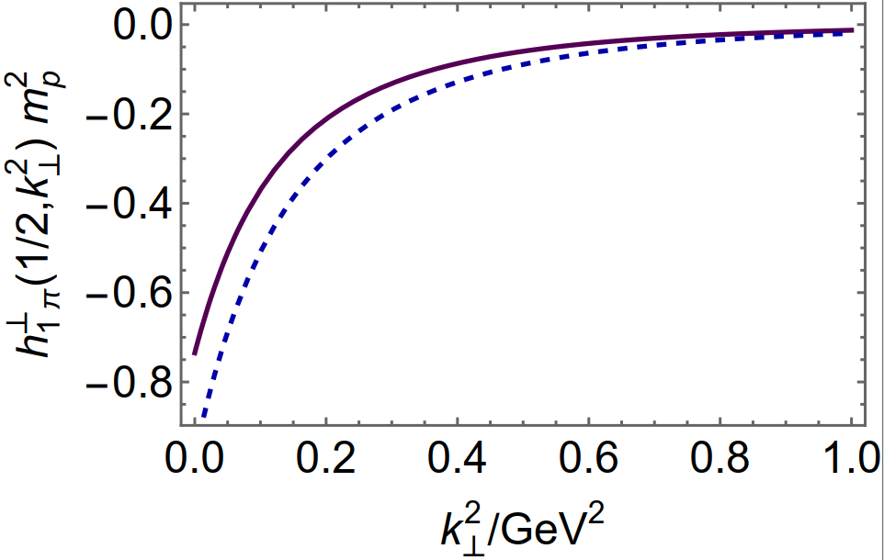
Current mass dependence
Considering a (fictitious) pion composed of a quark $s$ and antiquark $\overline{s}$
$π$ result
$π_{s}$ result
The response is qualitatively equivalent to that of $f_{1}$

Slide 20
Pion Light Front Wave Function
The pion light front wave function associated with the leading term in the operator expansion of the Fock space is the pion’s RL LFWF
Projecting the SCI Bethe-Salpeter wave function onto the light-front
$$Ψ\left(x,k_{⊥};λ_{1},λ_{2}\right)=ψ\left(x,k_{⊥}^{2}\right)S_{λ_{1},λ_{2}}\left(x,k_{⊥}\right)$$
$$S_{↑↑ }=−𝒩_{EF}\left(k_{1}−ik_{2}\right)$$
$$ψ\left(x,k_{⊥}^{2}\right)=\frac{\sqrt{2N_{c}}}{k_{⊥}^{2}+M^{2}−x(1−x)m_{π}^{2}}$$
$$S_{↑↓ }=\frac{E_{π}M^{2}+F_{π}\left[\left(k_{⊥}^{2}−M^{2}\right)−x\left(1−x\right)m_{π}^{2}\right]}{M}$$
$$S_{λ_{1},λ_{2}}\left(x,k_{⊥}\right)=\left[\begin{matrix}S_{↑↑ } & S_{↑↓ } \\ S_{↓↑ } & S_{↓↓ }\end{matrix}\right]$$
$$S_{↓↓ }=S_{↑↑}^{∗},S_{↓↑ }=−S_{↓↑ }$$
The correlation function can be expressed by LFWFs
$$Φ^{[ℊ]}\left(x,k_{⊥}\right)=\sum_{λ_{1},λ_{1}^{′},λ_{2}}{\int{\frac{d^{2}k_{⊥}^{′}}{16π^{3}\sqrt{n∙kn∙k′}}𝒢\left(x,k_{⊥},k_{⊥}^{′}\right)ψ\left(x,k_{⊥}^{′2}\right)ψ\left(x,k_{⊥}^{2}\right){\left[S_{λ_{1}^{′},λ_{2}}\left(x,k_{⊥}^{′}\right)\right]}^{†}S_{λ_{1},λ_{2}}\left(x,k_{⊥}\right)\overline{u}\left(k^{′},λ_{1}^{′}\right)\frac{ℊ}{2}}}u\left(k,λ_{1}\right)$$

Slide 21
Pion TMDs in Contact Interaction
Unpolarized distribution function
$$f_{1}\left(x,k_{⊥}^{2}\right)=\frac{N_{c}}{{2π}^{3}}\left[E_{π}\left(E_{π}−2F_{π}\right){\overline{C}}_{2}\left(ω_{1}\right)+3{\left(E_{π}−2F_{π}\right)}^{2}x\left(1−x\right)M_{π}^{2}{\overline{C}}_{3}\left(ω_{1}\right)\right]$$
Boer-Mulders function
SCI gauge link
$$h_{1}^{⊥}\left(x,k_{⊥}^{2}\right)=−\frac{α_{IR}}{m_{G}^{2}}\frac{N_{c}}{4π^{3}}𝒩_{EF}\frac{{\overline{C}}_{2}\left(ς\right)}{ς}\left\{\left[\left(E_{π}−F_{π}\right)M^{2}−x\left(1−x\right)m_{π}^{2}F_{π}\right]{\overline{C}}_{1}\left(ς_{0}\right)+F_{π}C_{0}\left(ς_{0}\right)\right\}$$
Momentum dependent gauge link completion
$$h_{1π}^{⊥}=−α_{ℒ}\frac{N_{c}}{4π^{3}}𝒩_{EF}\frac{{\overline{C}}_{2}\left(ς\right)}{ς}\int_{0}^{1}{dυ\left\{2\left(1−υ\right)\left(E_{π}M^{2}−F_{π}\left[M^{2}+x\left(x−1\right)m_{π}^{2}+υk_{⊥}^{2}\right]\right)\frac{{\overline{C}}_{2}\left(\tilde{ς}\right)}{\tilde{ς}}+F_{π}{\overline{C}}_{1}\left(\tilde{ς}\right)\right\}}$$

Slide 22
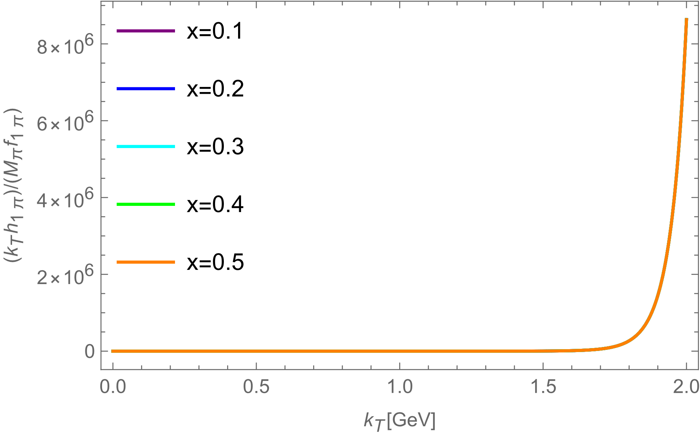
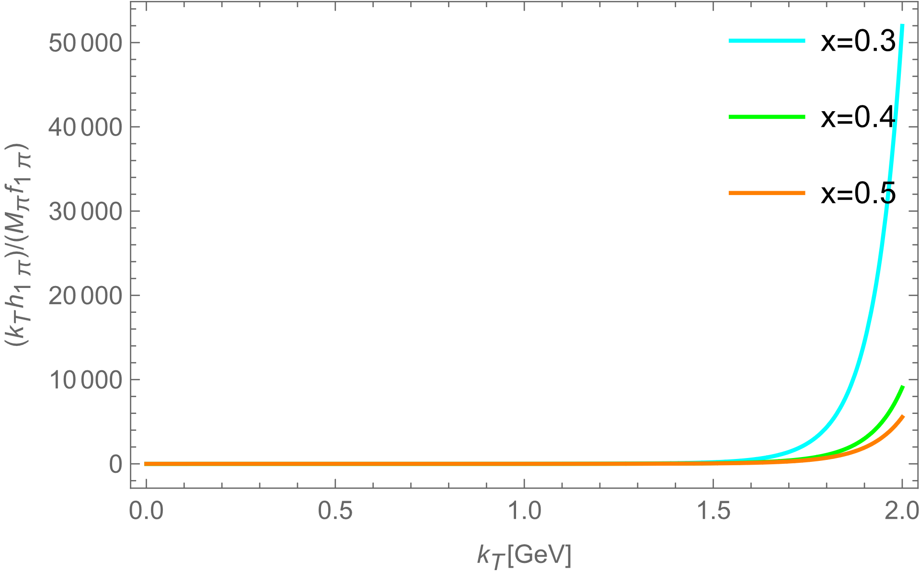
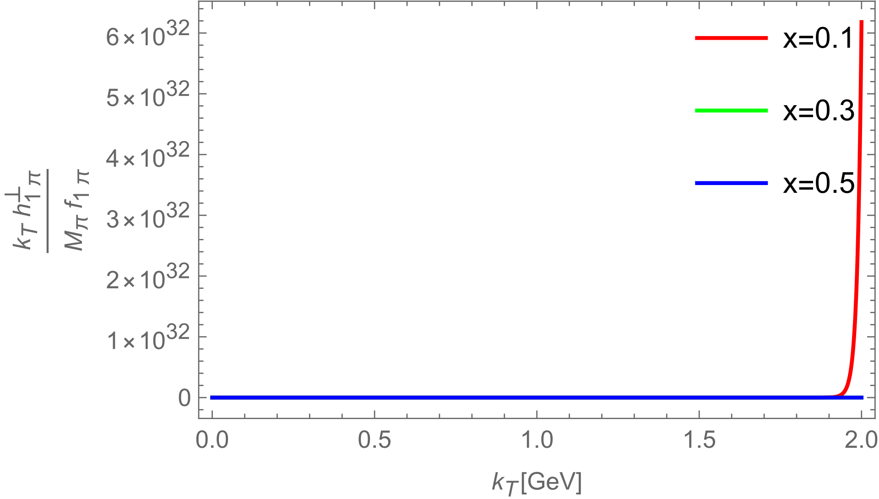
Positivity bound
$$ψ\left(x,k_{⊥}^{2}\right)=\frac{\sqrt{2N_{c}}}{{\left[k_{⊥}^{2}+M^{2}−x(1−x)m_{π}^{2}\right]}^{2}}$$
Considering the other form of LFWFs
Positivity bound is violated. Support in the quark loop is too compact in comparison with the range of the gauge link
$$g^{2}D_{μν}\left(q\right)=δ_{μν}\frac{4πα_{ℒ}}{{q^{2}+m}_{G}^{2}}$$
Similar violations appear when using other momentum components of LFWFs
Gaussian type
Holographic wave function
BHL description
Positivity can be restored by replacing the re-scattering kernel by some more rapidly damping form
Further weakens the connection between any such model and QCD

Slide 23
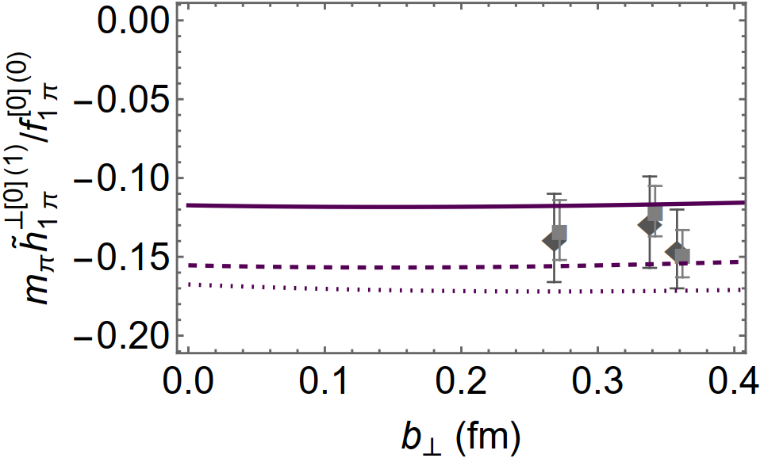
Generalized Boer-Mulders shift
$ζ_{2}=2$ GeV scale heavy pion
The so called “generalized Boer-Mulders shift” is defined in an appropriate way to be safely evaluated on the lattice
Hadron scale heavy pion (0.518GeV)
$${〈k_{y}〉}_{UT}\left(b_{T}^{2};ζ_{2}\right)≡m_{π}\frac{{\tilde{h}}_{1}^{⊥\left[0\right]\left(1\right)}\left(b_{T}^{2};ζ_{2}\right)}{{\tilde{f}}_{1}^{\left[0\right]\left(0\right)}\left(b_{T}^{2};ζ_{2}\right)}$$
Hadron scale pion mass (0.14GeV)
The denominator is unity, independent of the resolving scale
The numerator is directly related to the first $k_{⊥}$ moment of BM function
$$H_{0}\left(ζ_{2}^{2}\right)=H_{0}\left(ζ_{1}^{2}\right){\left[\frac{α_{LO}\left(ζ_{2}^{2}\right)}{α_{LO}\left(ζ_{1}^{2}\right)}\right]}^{\frac{1}{4}\left(C_{F}−2𝒮\right)γ_{m}}$$
The magnitude of the shift decreases slowly with increasing meson mass
The impact of evolution is noticeable, but not dramatic

Slide 24
Summary
The two nonzero pion TMDs have been predicted by using a symmetry preserving contact interaction.
The two models between spectator and eikonalized quark have been considered to generate non-zero BM function. One is SCI based; and the other involves momentum-dependent gluon exchange.
The positivity constraint is satisfied in momentum dependent gauge link completion.
The consistent results and analyses can be obtained by using light front wave functions.
The SCI-based prediction for the generalized Boer-Mulders shift is consistent with existing results obtained using Lattice-regularized QCD.
Thankyou

