Slide 1
CPS at pivot

Slide 2
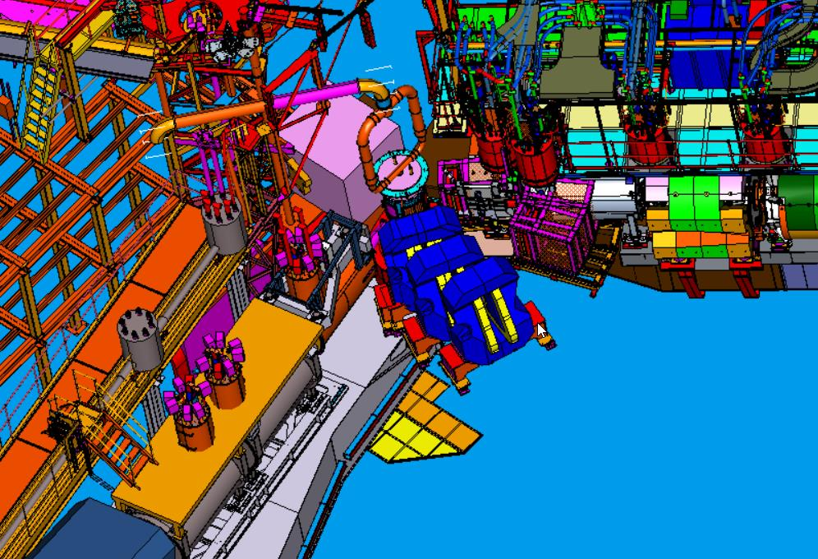
CPS
Pump Line to auxiliary platform upper deck
SHMS @ 40 deg.
Target
NPS detector positions
BigBite positions
HMS @ 80 deg.

Slide 3
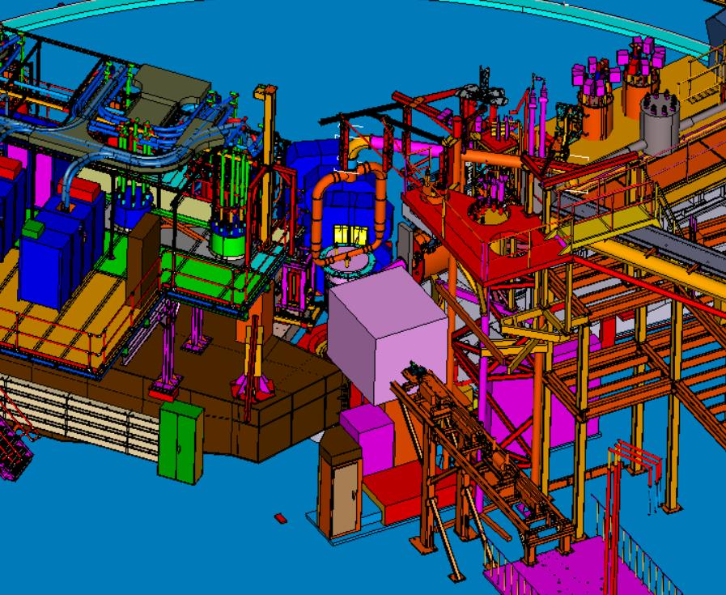
Birdseye view from upstream
Cryo platform
CPS
Auxiliary platform
Utility enclosures
Beamline

Slide 4
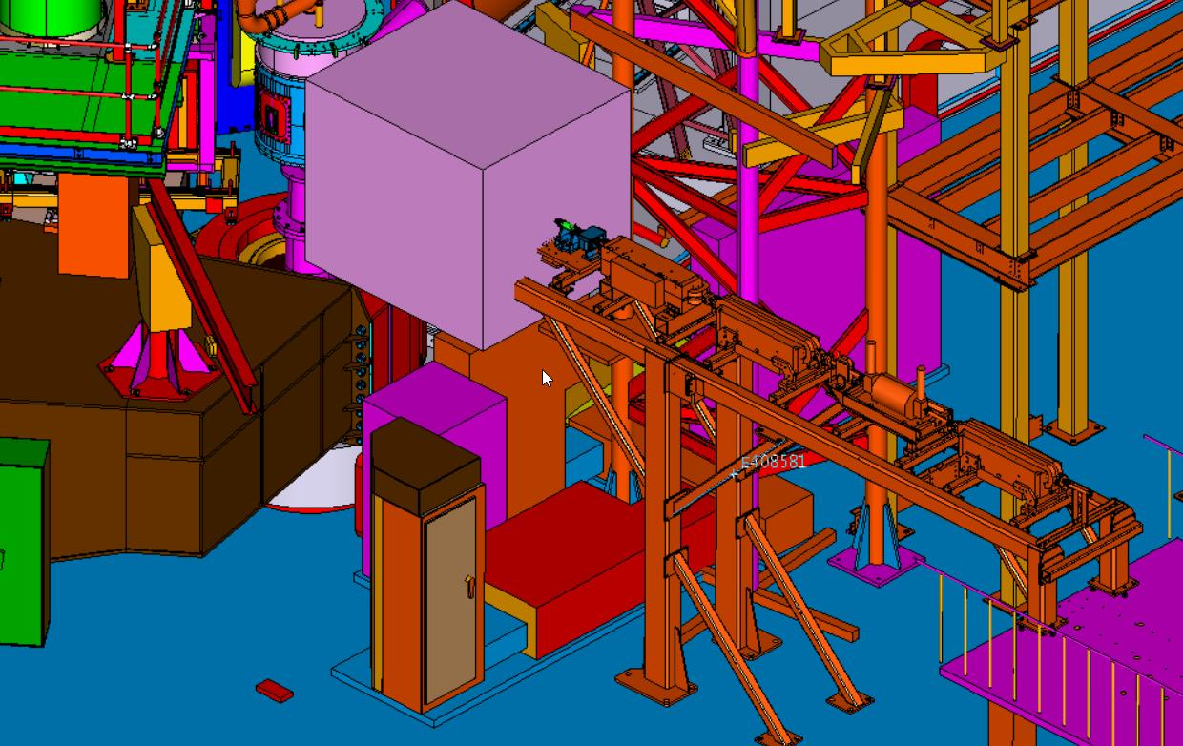
Birdseye view from upstream, close-up

Slide 5
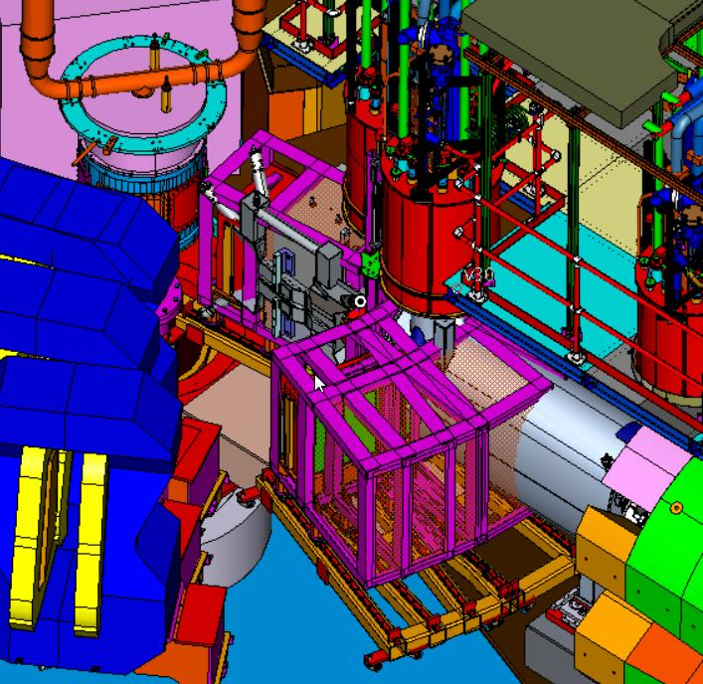
Birdseye view from down stream
SHMS HB
SHMS Q1
NPS positions

Slide 6
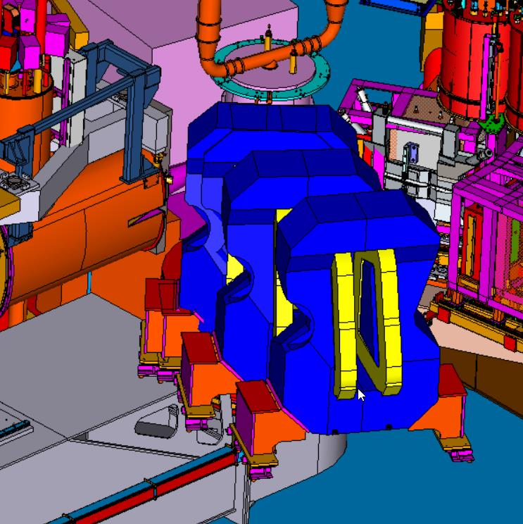
BigBite positions
HMS Q1
BigBite over structure
HMS Structure

Slide 7
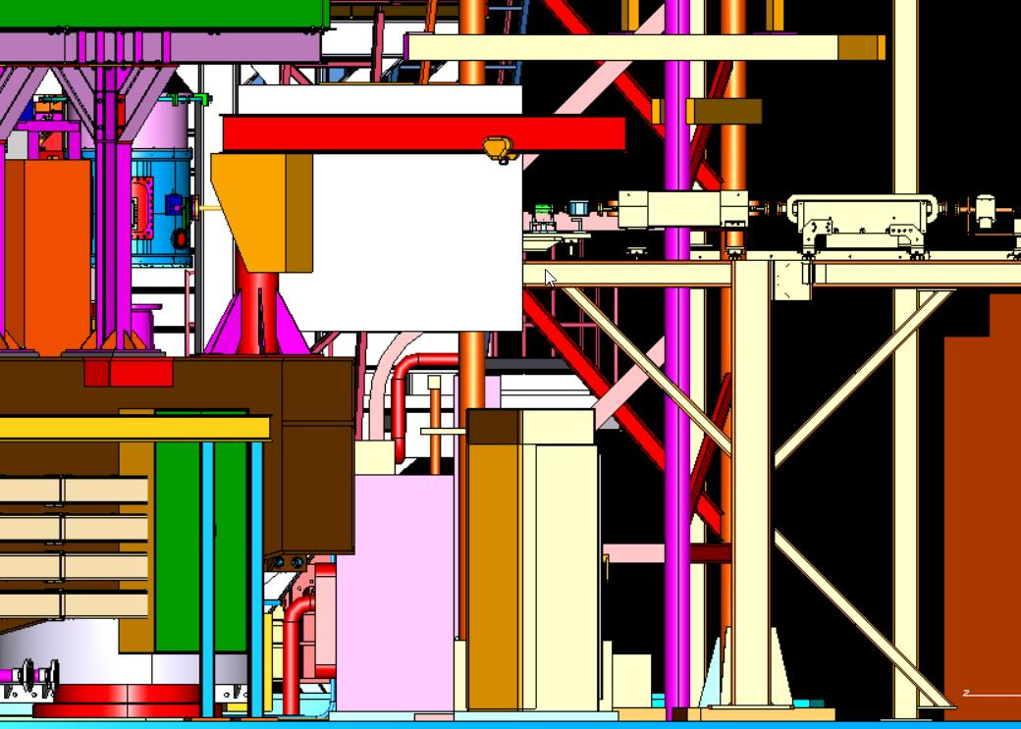
Beam left view
CPS
Beamline
SHMS Structure

Slide 8
CPS downstream

Slide 9
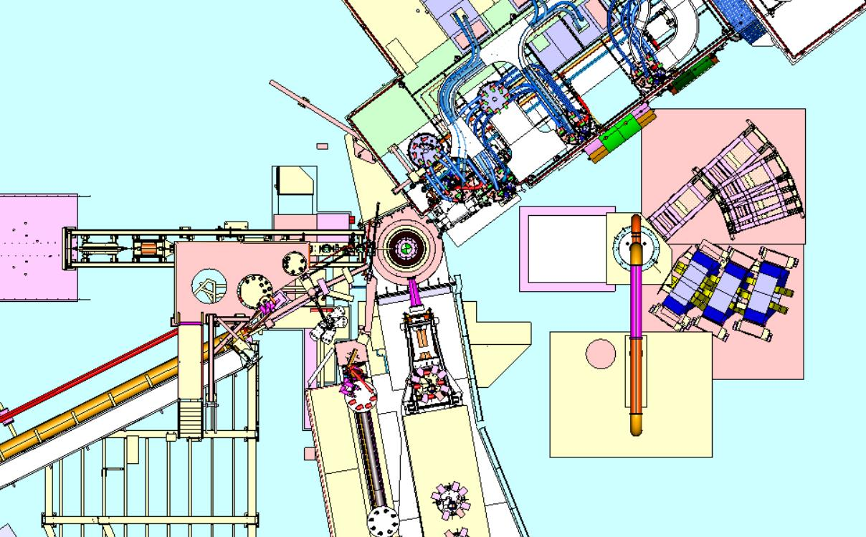
CPS Downstream
NPS Positions
Target
CPS
BigBite Positions
Dewar
Vacuum pump
Reconfigured pump line

Slide 10
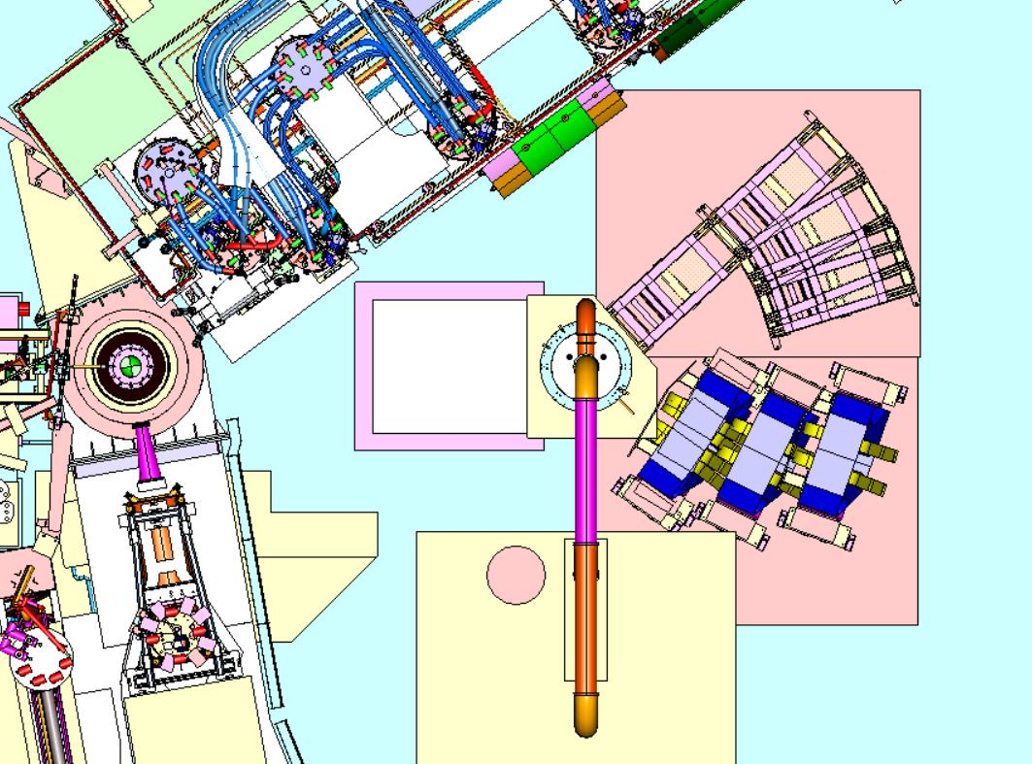
CPS Downstream, larger view
SHMS @ 40 deg.
HMS @ 80 deg.

Slide 11
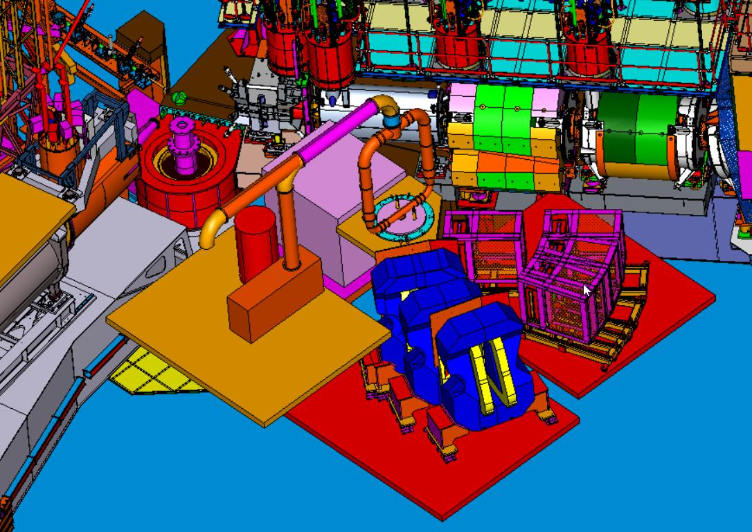
Birdseye downstream view
CPS
Reconfigured pump line
NPS
Pump
BigBite

Slide 12
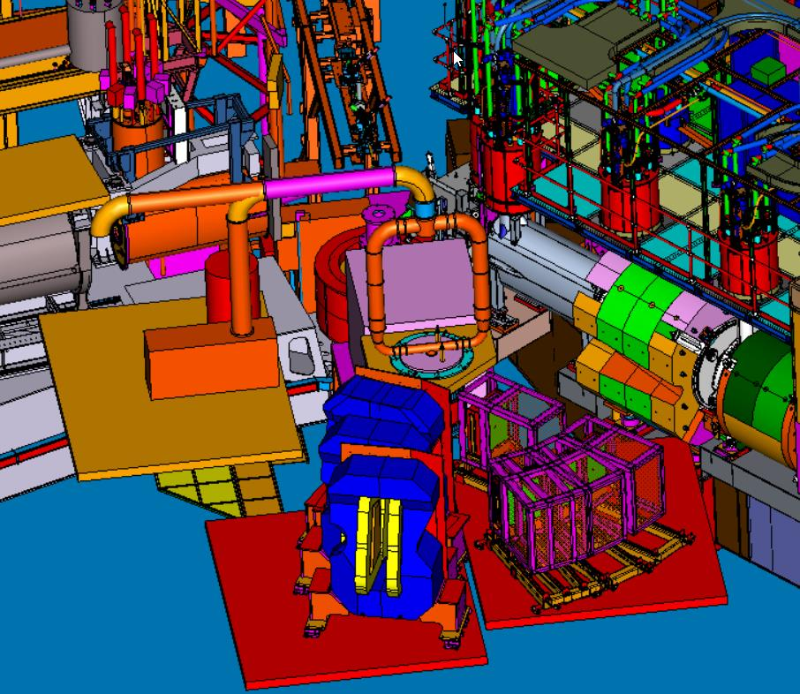
Upstream beamline
Birdseye view

Slide 13
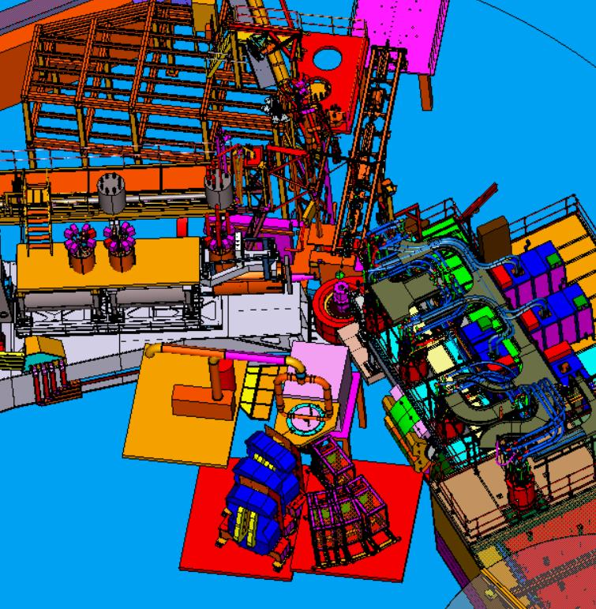
Birdseye view

