Slide 1
NPS Wrapping procedure
2021/02/02

Slide 2
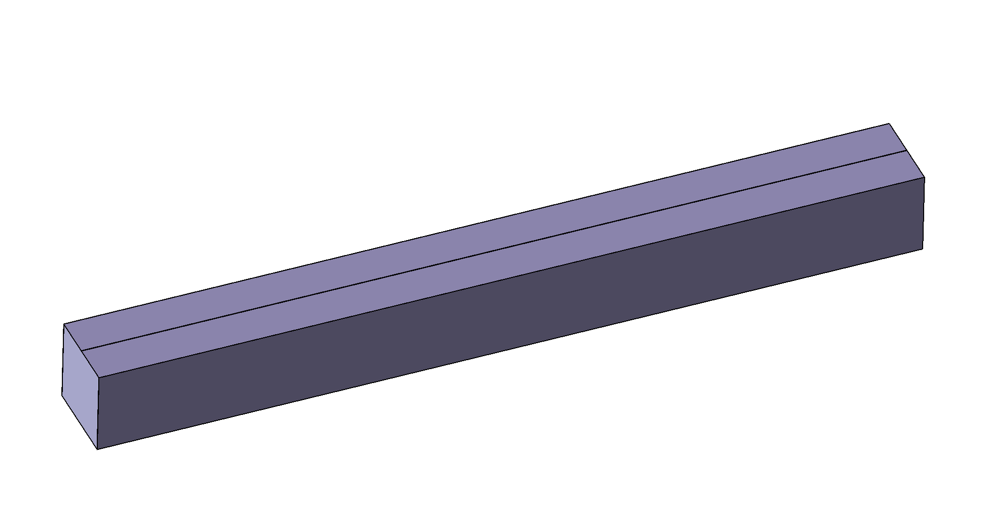
Reflective sheet 70 µ
No overlap (gap 0,5mm to be adapted for all crystals sizes
Reflective sheet 200 mm length
No reflective sheet on both extremities (will be glued on the plastic block part for front side and no reflective sheet side PMt)

Slide 3
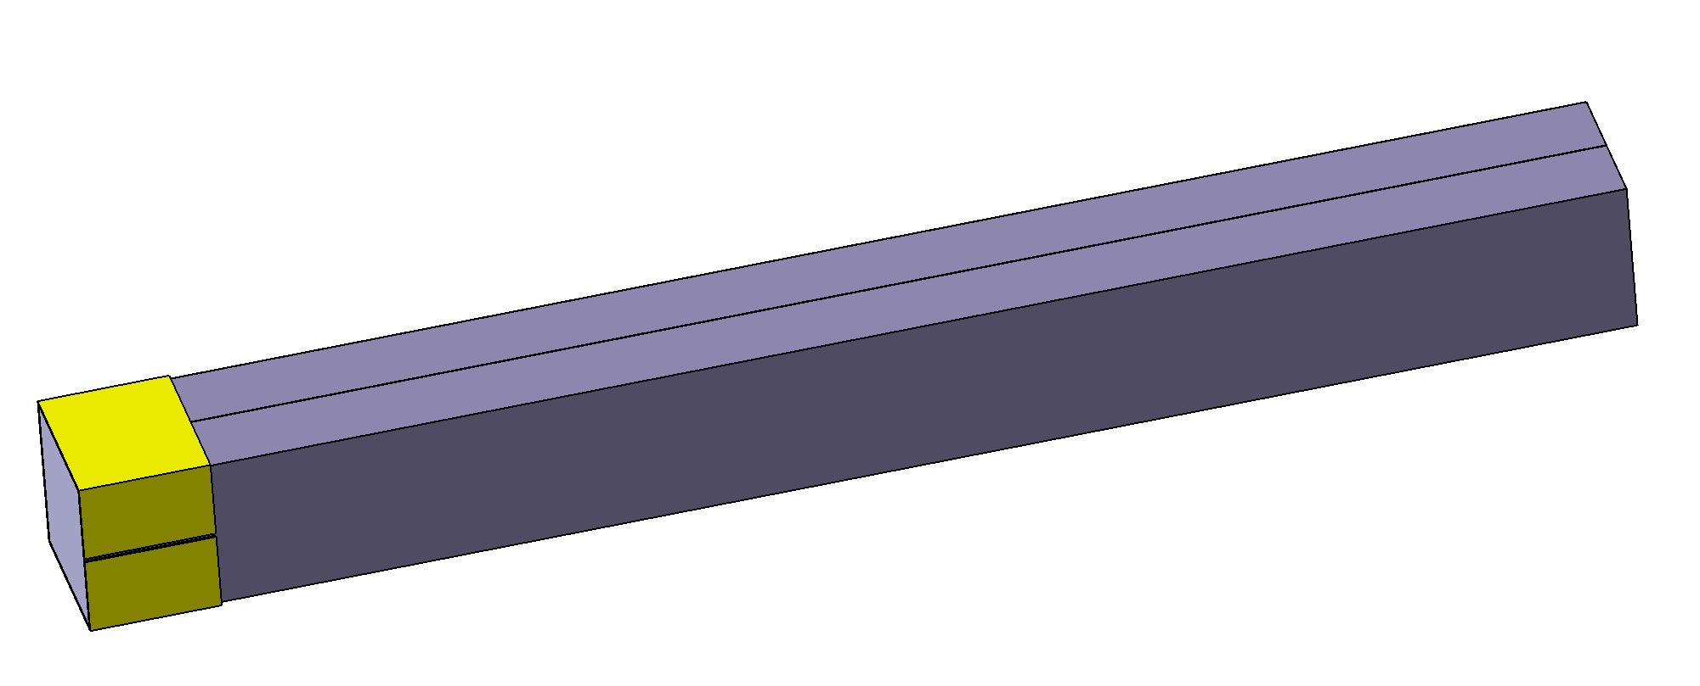
Wrapping tape Crystal side PMt : tape 60 µ
Mylar aluminised tape 60µ (17 mm width)
17 mm
No overlap for tape
Side PMt
Cutting tape 90°/ cutting reflective sheet

Slide 4
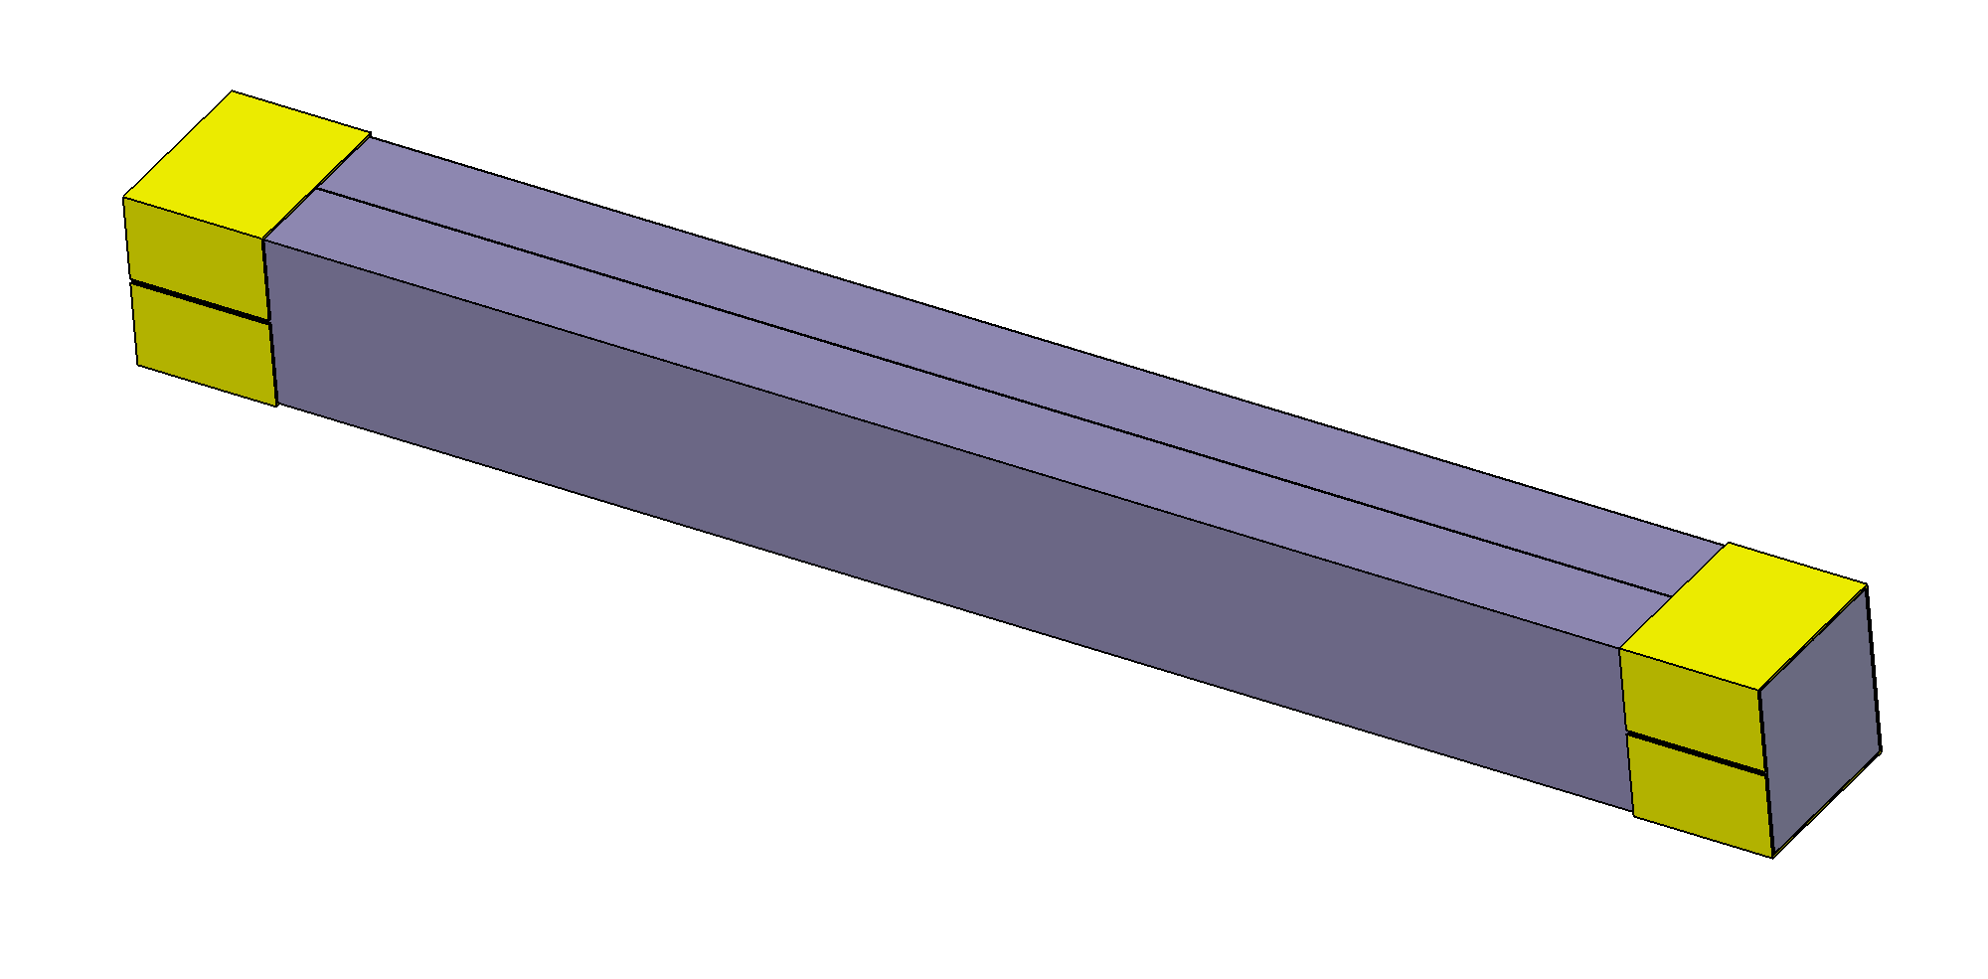
Wrapping tape crystal side reflective sheet :tape 60 µ
17 mm
17 mm
Mylar aluminised tape 60µ (17 mm width)
(no overlap)
Cutting tape 90°/ cutting reflective sheet

Slide 5
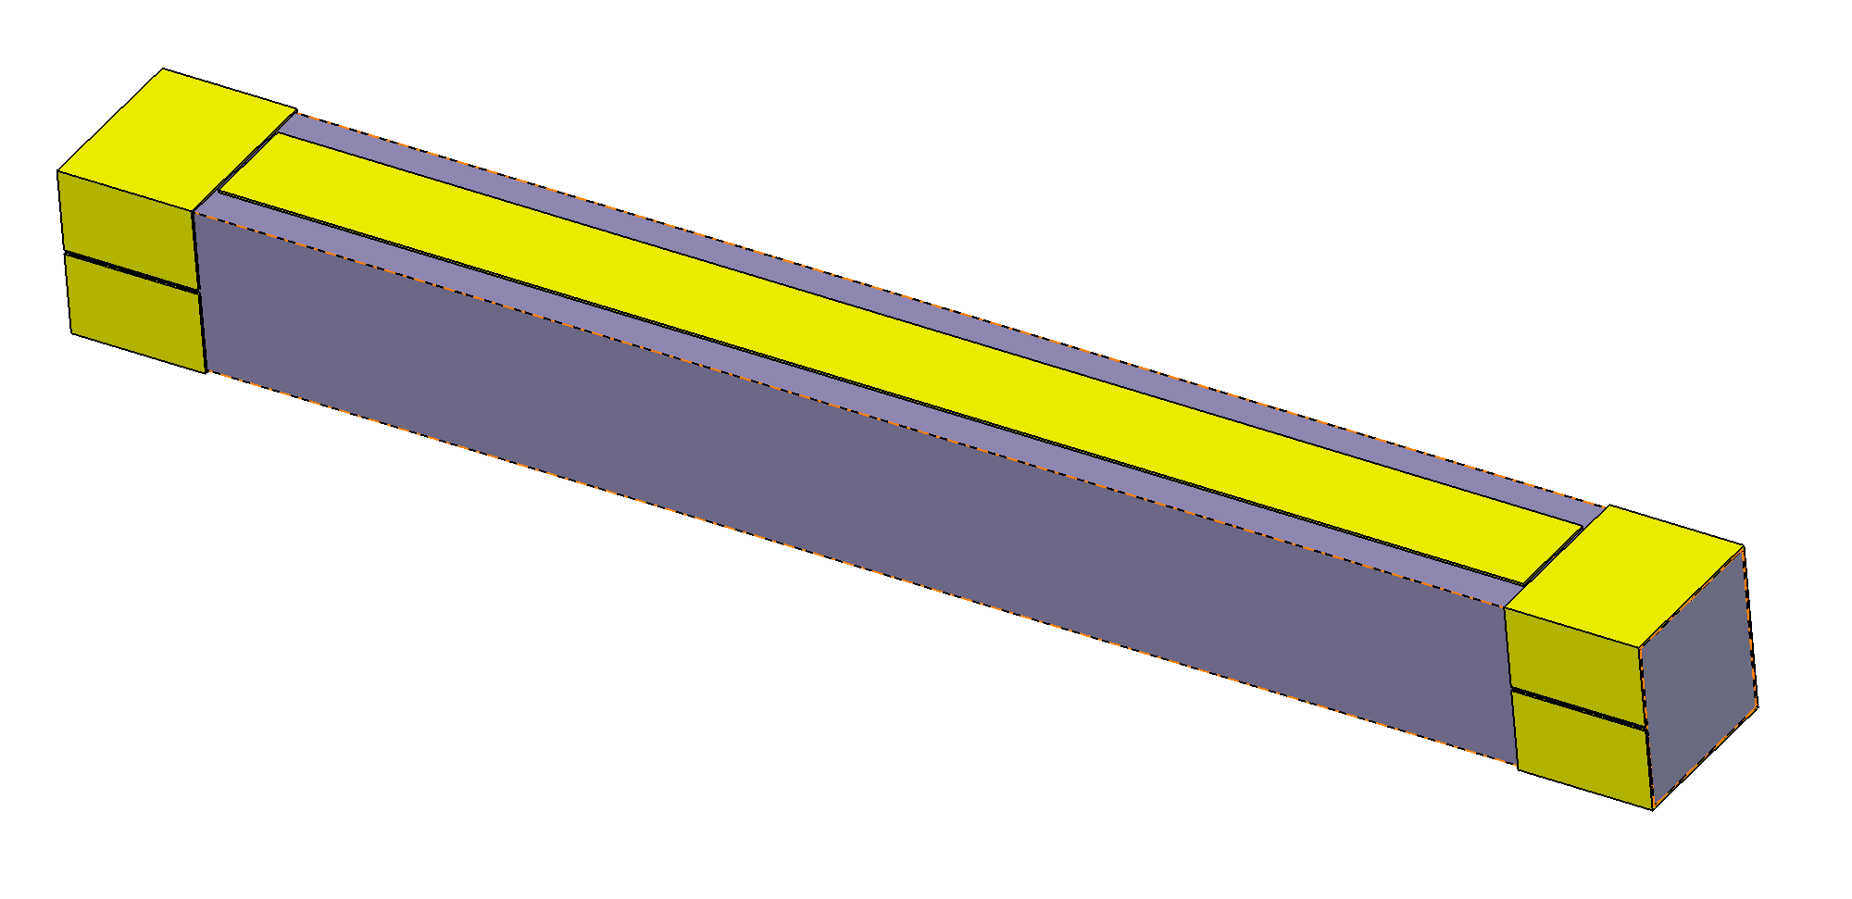
Wrapping Longitudinal tape 60µ
12 mm
Longitudinal Tape mylar aluminised 60µ 12 mm width
No overlap for tape gap 1 mm reasonable

Slide 6
Total wrapping thickness
Total horizontal wrapping thickness = 260µ (2x70 + 2x60)
Total vertical wrapping thickness = 260 µ (2x70 + 2x60)

Slide 7
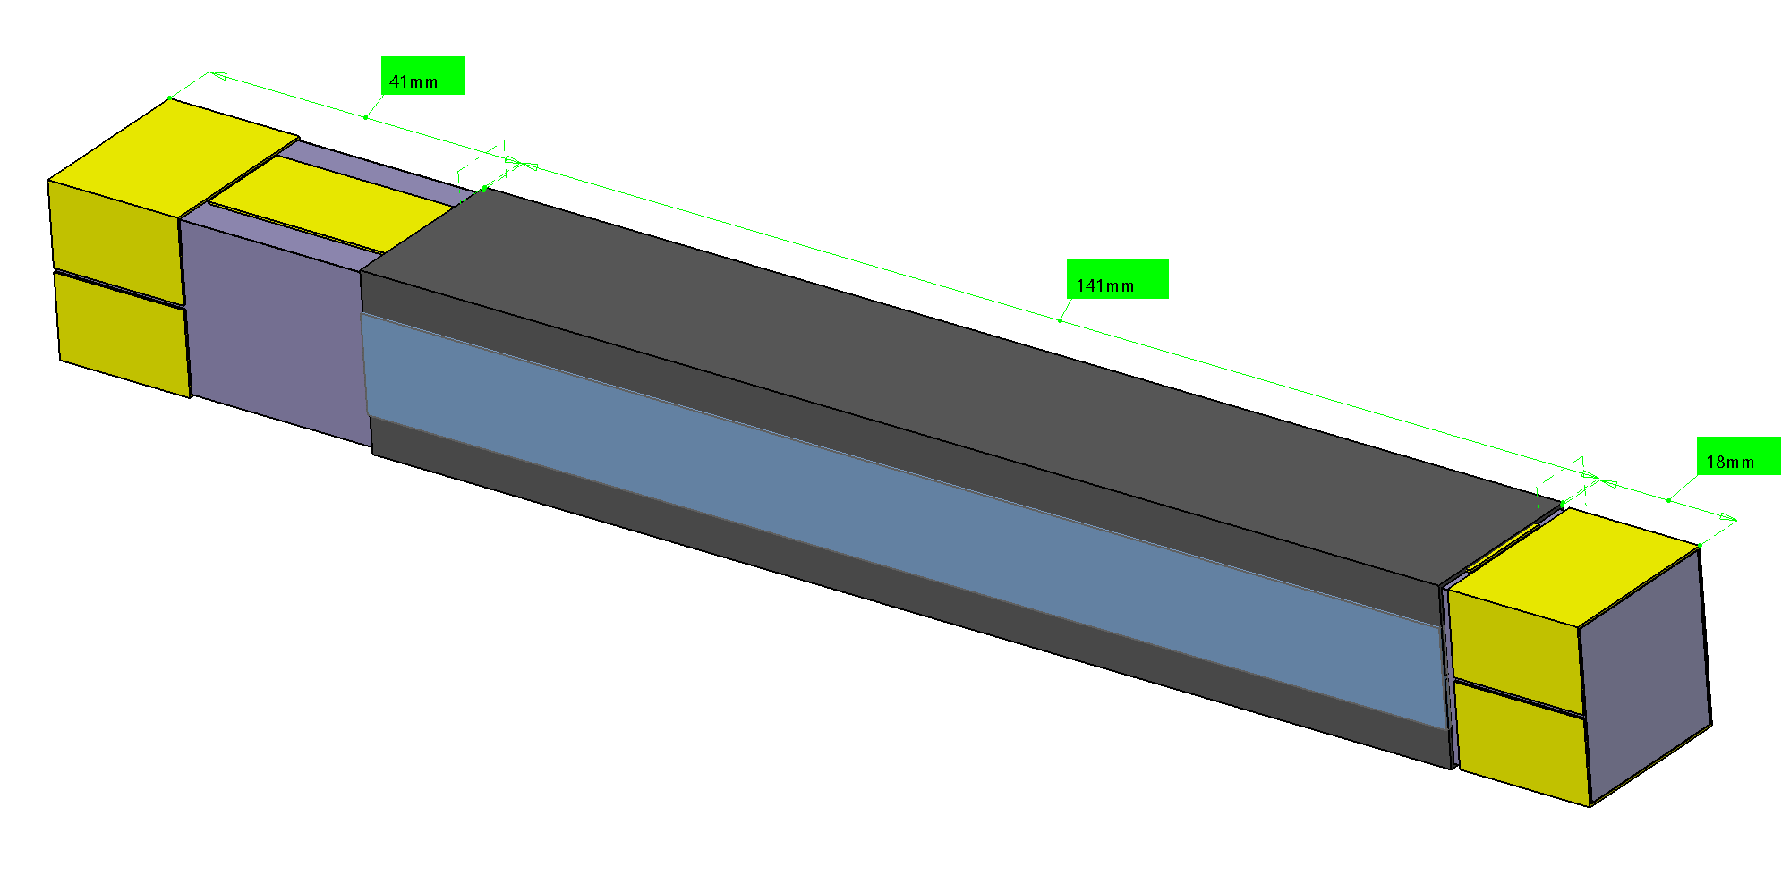
TEDLAR wrapping
1 mm gap between Mu metal area and Tedlar (no overlap for good stacking)
Wrapping tape
1 mm gap between stacking area and Tedlar (no overlap for good stacking)
Tedlar Wrapping
Rear stacking area 17 mm
Mu metal area 40 mm
Mylar aluminised tape 12 mm width:
@ 90 ° / wrapping tape
Front stacking area 17 mm

Slide 8
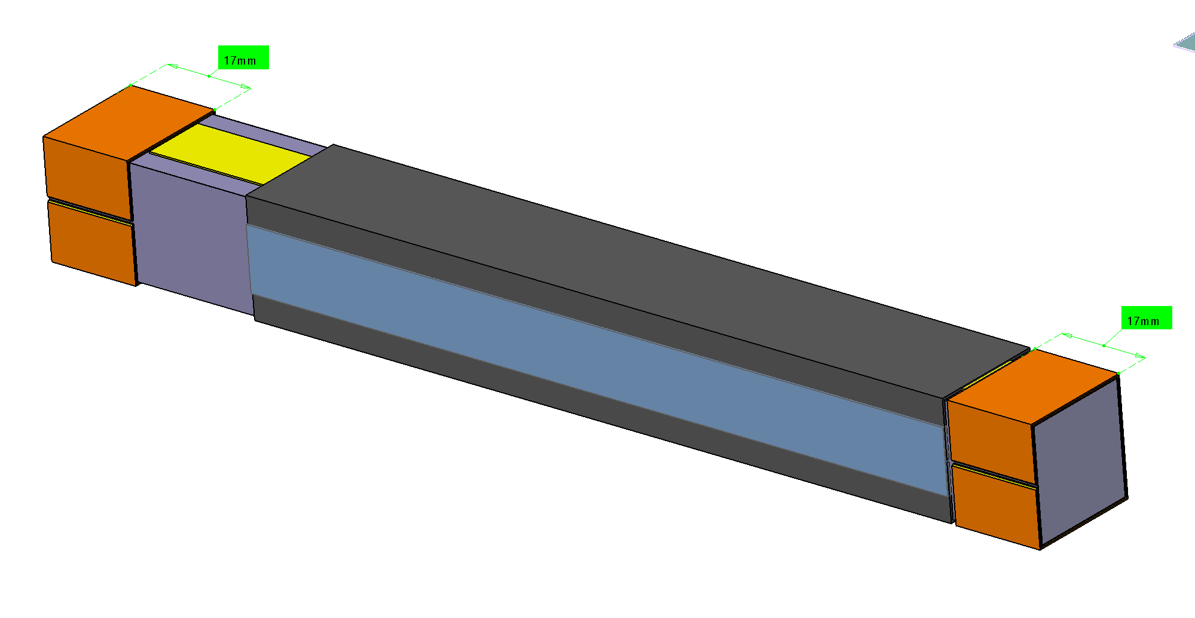
Adjustment tape : mylar 60µ 17mm width
Mylar 60µ 17mm width for adjustment
Mylar 60µ 17mm width for adjustment
Number of layers variable ; no overlap on both Top and bottom sides

Slide 9
Adjustment Tape : mylar 60µ 17mm width
These gaps are based from Jlab measurement values
See next slide for calculations
For a alveoli 21mm inner dimension (nominal dimension) : the Gap is (between alveoli and crystal wrapped)
Gap min (21- 20,86=0,14mm)
Gap Max (21- 20,69=0,31mm)
Mean Gap Siccas ( 21-20,80 = 0,20mm)
Mean Gap Crytur ( 21-20,72 = 0,28mm)
60µ
Mean gap :
Siccas 0,20 ≈ 3 x 0,06 = 18µ 1 turn +1/4 turn of tape 60 microns
Crytur 0,28 ≈ 4 x 0,06 = 24µ 1 turn + ½ turn of tape 60 microns

Slide 10
Gap between alveoli and crystal (theorical value)
The measurement for CRYTUR gives :
mean value : 20,46mm (20,72 with wrapping)
Max value : (20,46 + 3σ) = 20,46+ 3*0,01 =20,49mm (20,75 with wrapping)
min Value : (20,46-3 σ) = 20,46-3*0,01 = 20,43 mm (20,69 with wrapping)
The measurement for SICCAS gives :
mean value : 20,54mm (20,80 with wrapping)
Max value : (20,54 + 3σ) = 20,54+ 3*0,02 =20,60mm (20,86 with wrapping)
min Value : (20,54 -3 σ) = 20,54 - 3*0,02 = 20,48 mm (20,74 with wrapping)
Measurement values from Jlab
The extrema gives with wrapping :
Max value : Siccas 20,86mm
min Value : Crytur 20,69mm
For a alveoli 21mm inner dimension (nominal dimension) : pitch 21,5 mm the Gap is
Gap min (21- 20,86=0,14mm)
Gap Max (21- 20,69=0,31mm)
Mean Gap Siccas ( 21-20,80 = 0,20mm)
Mean Gap Crytur ( 21-20,72 = 0,28mm)

