Slide 1
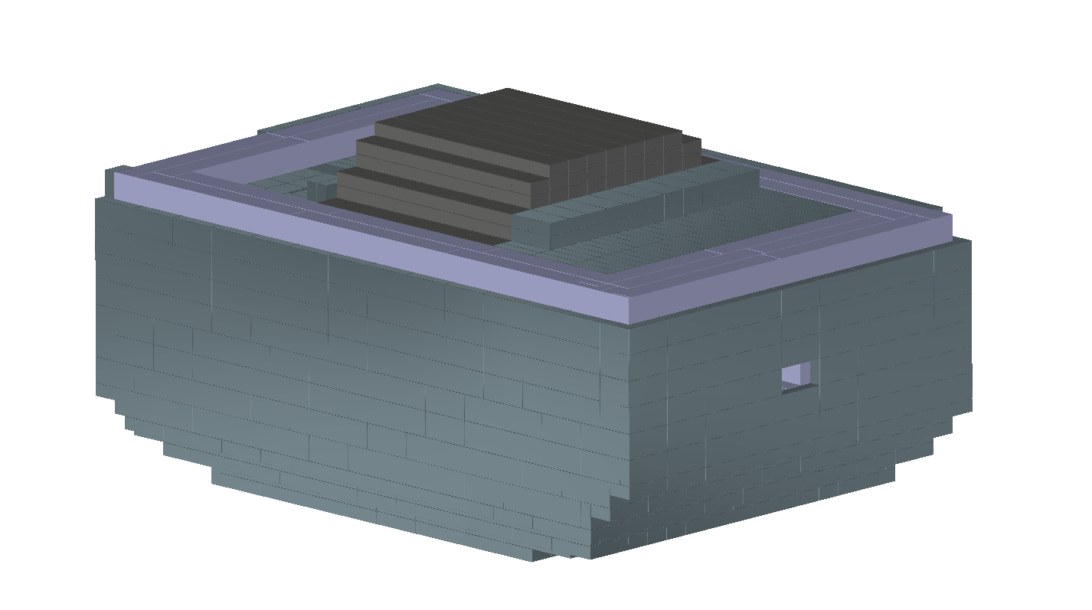
CPS Shield Stacking

Slide 2
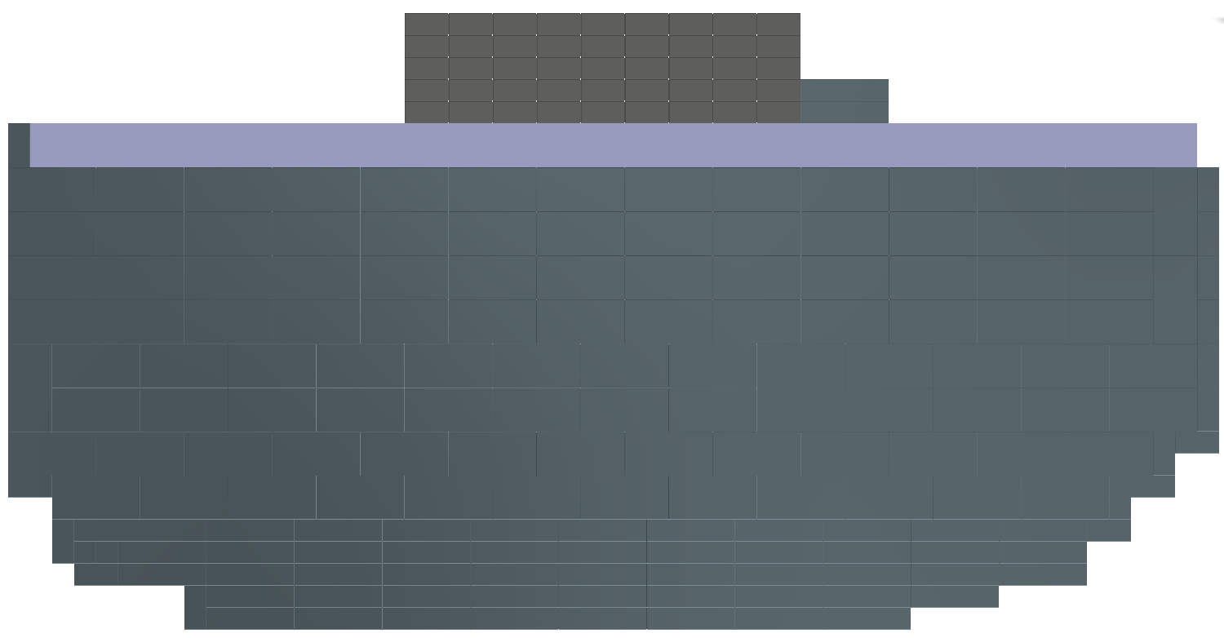
CPS Shield Stacking (side view)

Slide 3
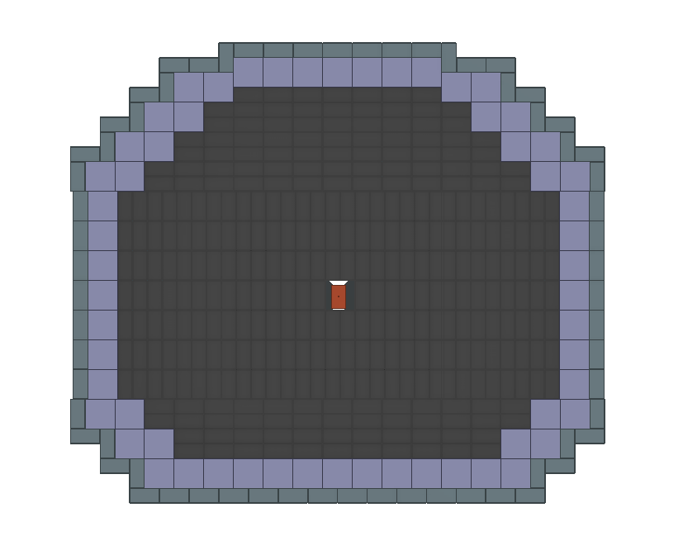
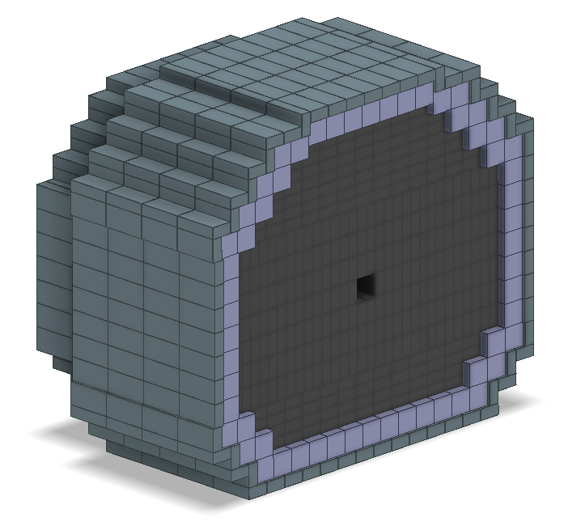
CPS Shielding Cross Section

Slide 4
CPS Magnet Coil Cooling Feeds
What feeds for this hardware will be necessary?
Upstream end of the CPS magnet has two areas where the magnet coils are easily accessed.
Material could be removed from the W-Cu shield to provide more access to the coils.

Slide 5
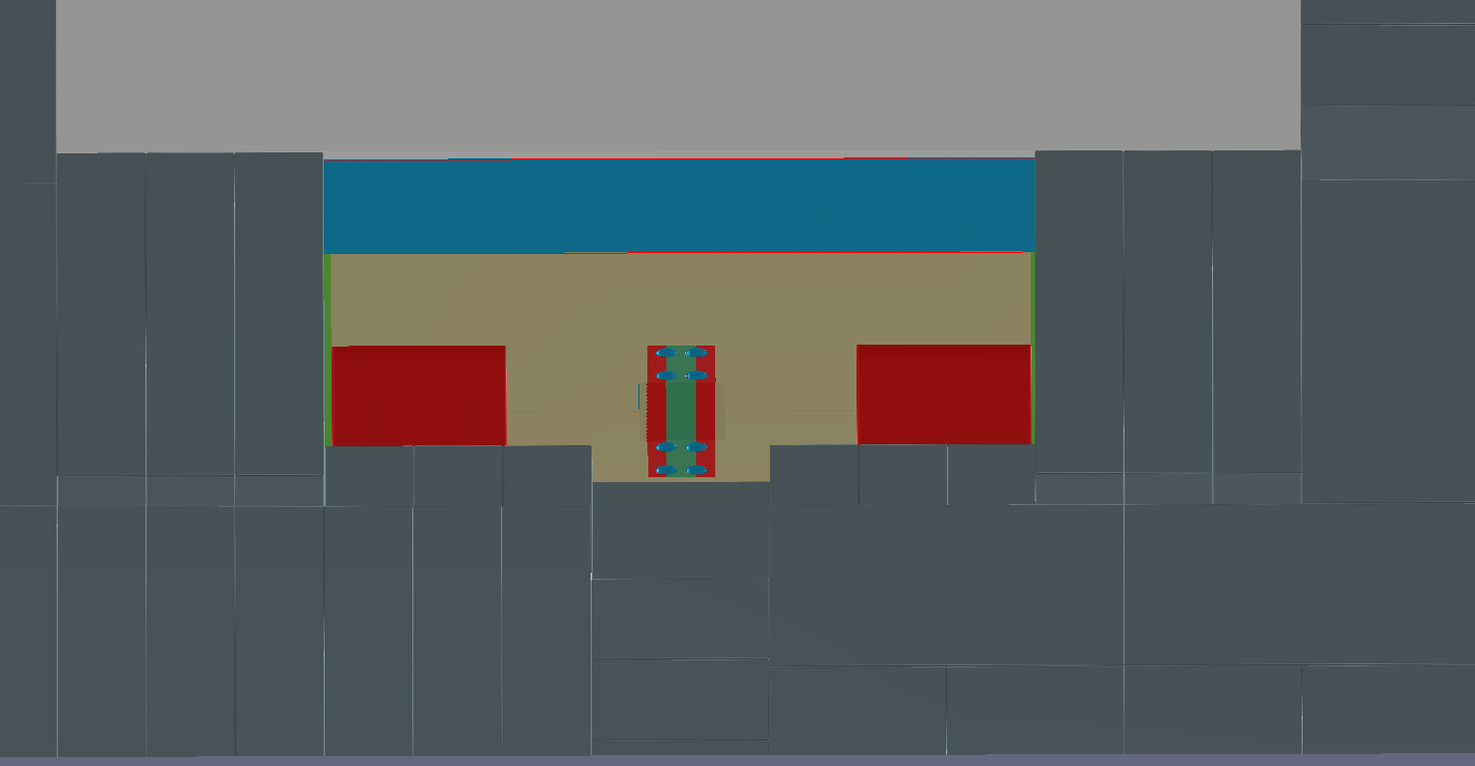

Slide 6
