Slide 1
NPS mechanical design
06/20/2019 Jlab meeting

Slide 2
Design presentation
Wrapping crystals
Pitch alveolis
Mechanical tests and simulations for carbon alveolis
Fiber tests and mounting
Cables and PCB adjustement (Moke up )
Cooling

Slide 3
Design presentation

Slide 4
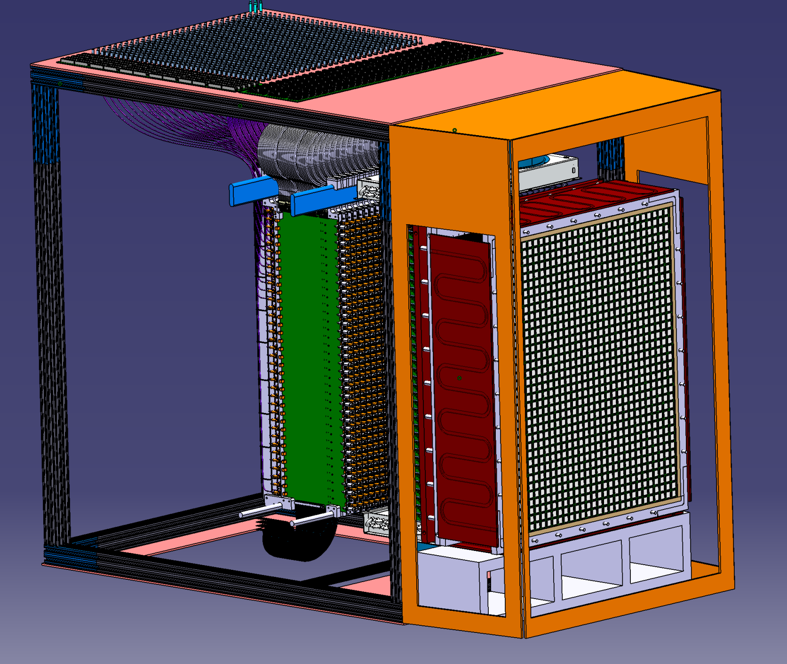
General front Axio view
Calorimeter

Slide 5
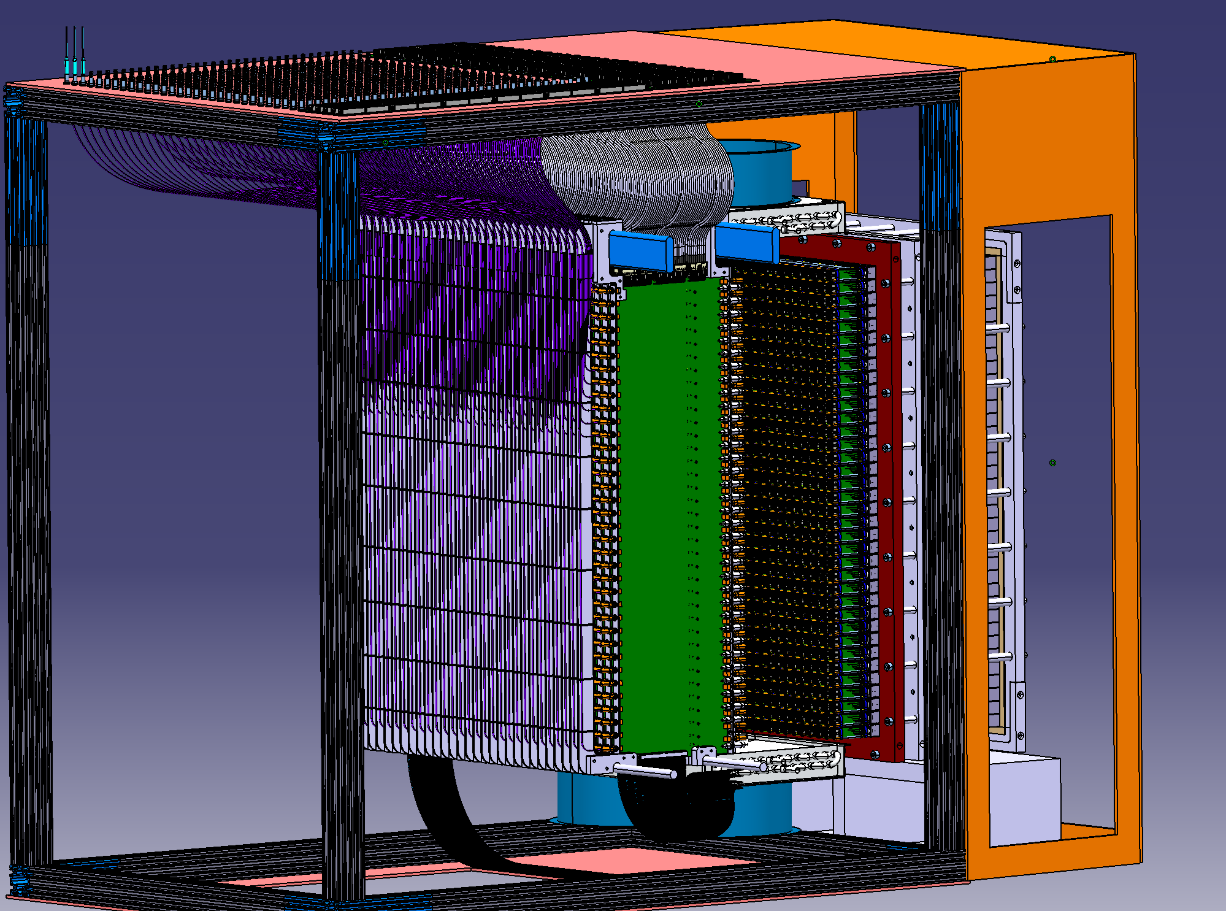
General back axo view
30 Interface PCB and cables

Slide 6
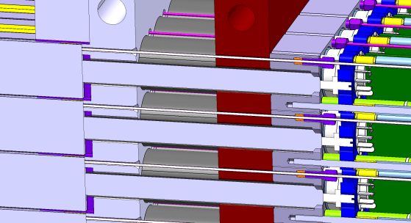
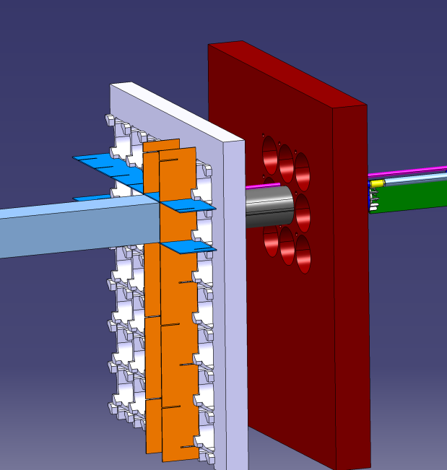
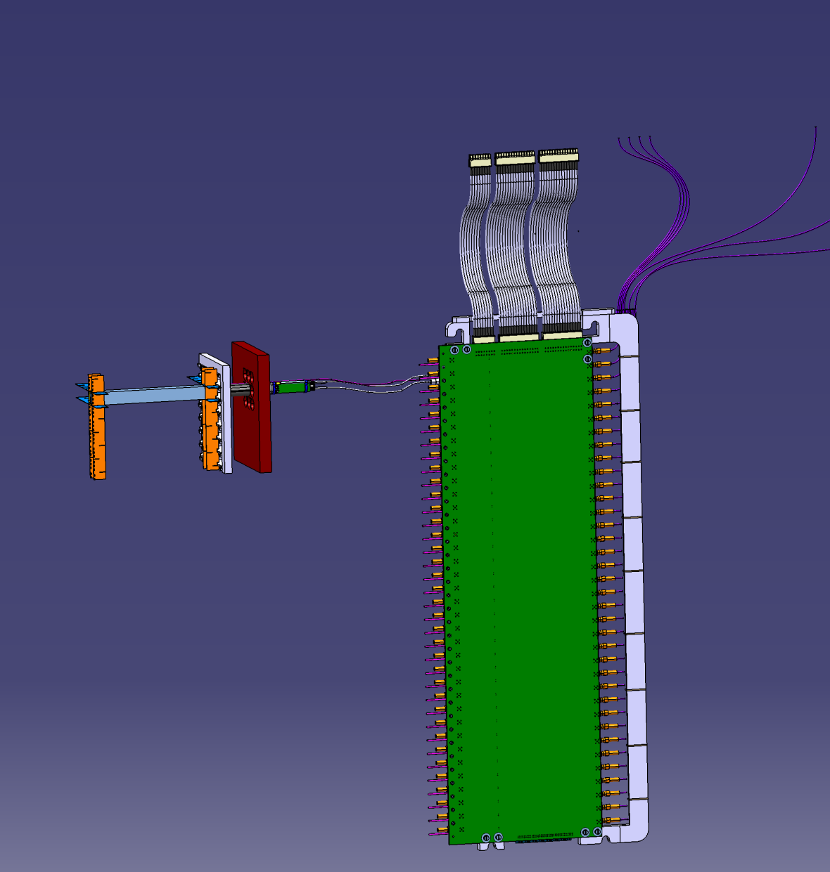
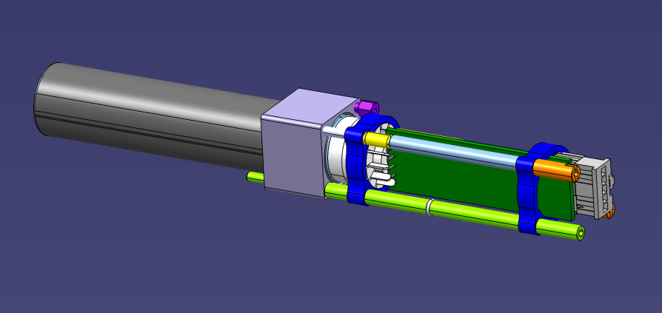
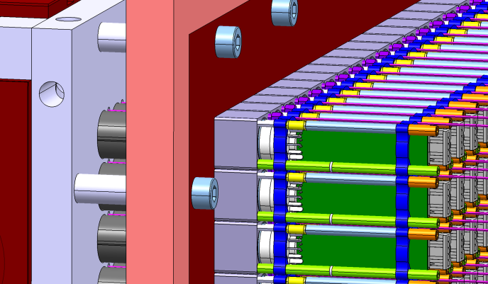

Crystal +PMt+cabling channel
Reference plate
Fiber Cut view
PMt support plate
Carbon plates honeycomb structure
Interface Pcb (HV,Anode and LED)
independant PMt assembly

Slide 7

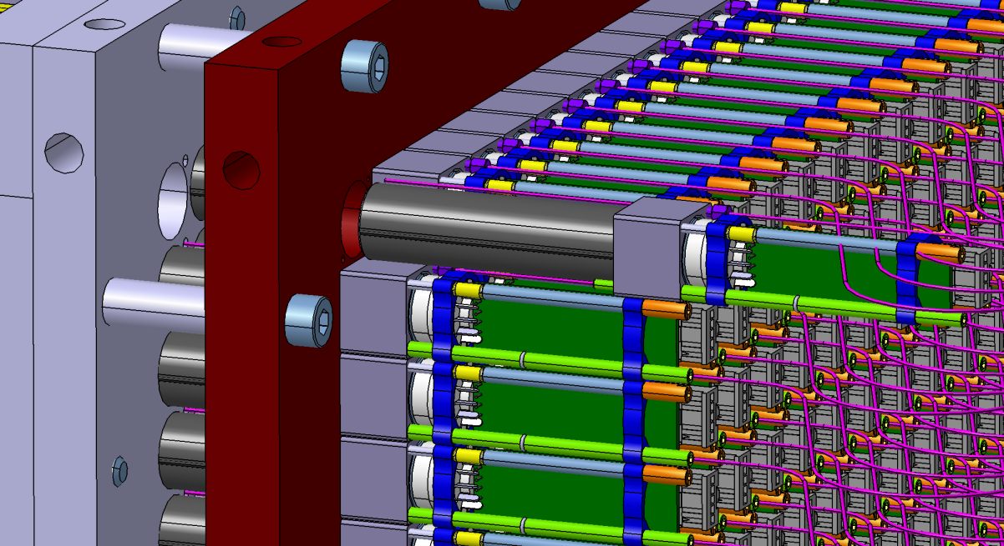
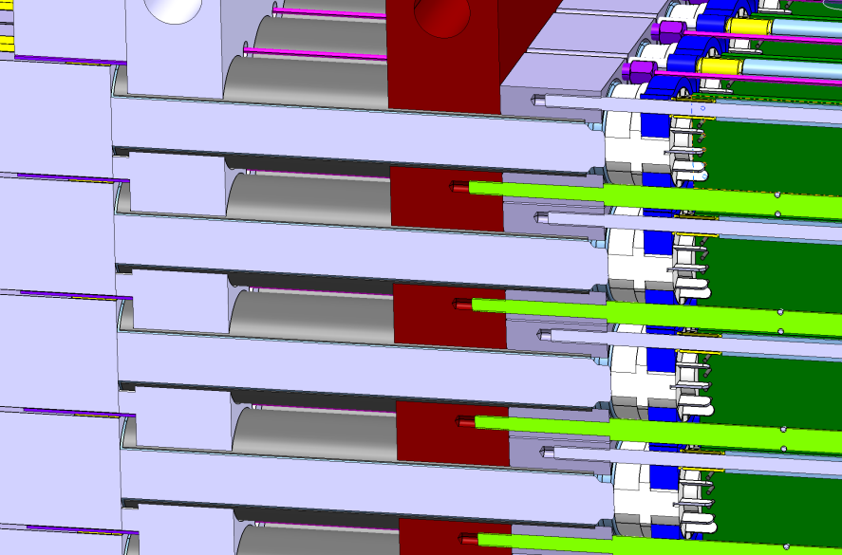
Independent PMt assembly
Long Captive screw
Unscrewing of 1 alone screw
Cut view dismounting Screw
Then pull The Block

Slide 8

Calorimeter
36 raws of 30 crystals =1080 crystals 20,5 x 20,5 x 200 mm
Pitch between 2 crystals = 21,5 mm in each direction (gap between 2 crystals without Wrapping = 1mm)
Cooling copper plates around the calorimeter + insulation with Foam in order to maintain the T° @ 18°=/- 0,1 °(Study in progress)

Slide 9
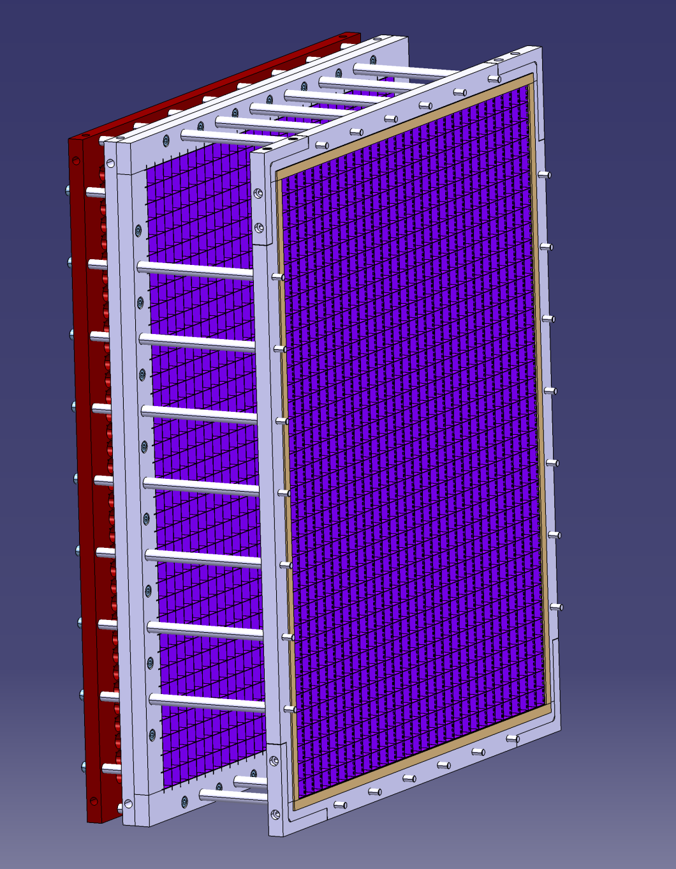
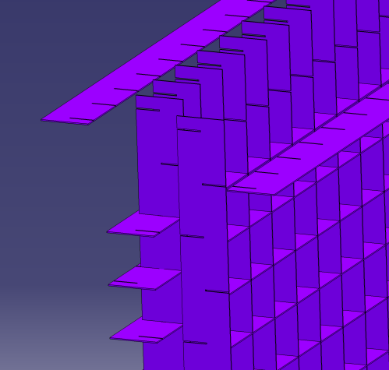
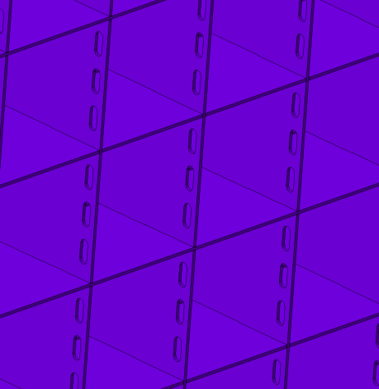
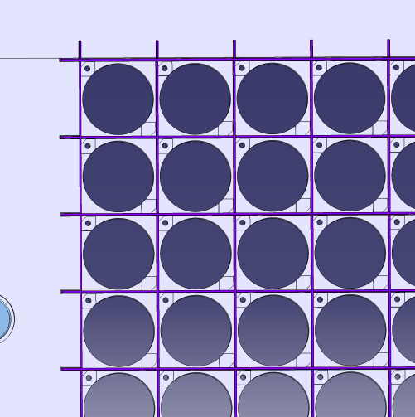
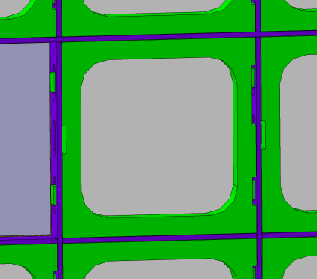
Calorimeter support
Spacers and threaded rods between the 2 frames
Aluminum frames (20 mm width)
Back side alveolis
Front side alveolis
Holes for plastic stop parts
Carbon alveolis (20 mm width)

Slide 10
Wrapping crystals

Slide 11
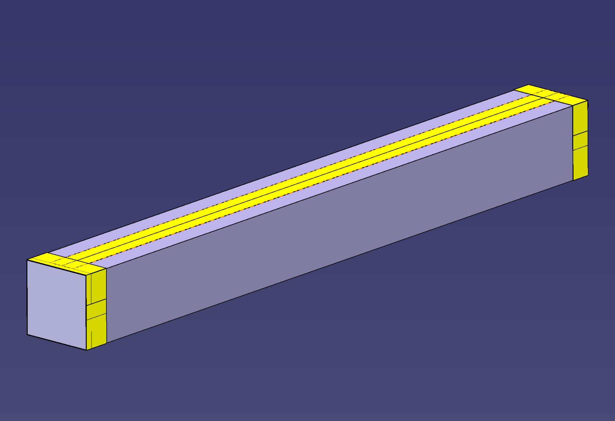
Total wrapping thickness
Total horizontal wrapping thickness = 260µ (2x70 + 2x60)
Hypothesis : no air between crystal and reflective sheet
Total vertical wrapping thickness = 260 µ (2x70 + 2x60)

Slide 12
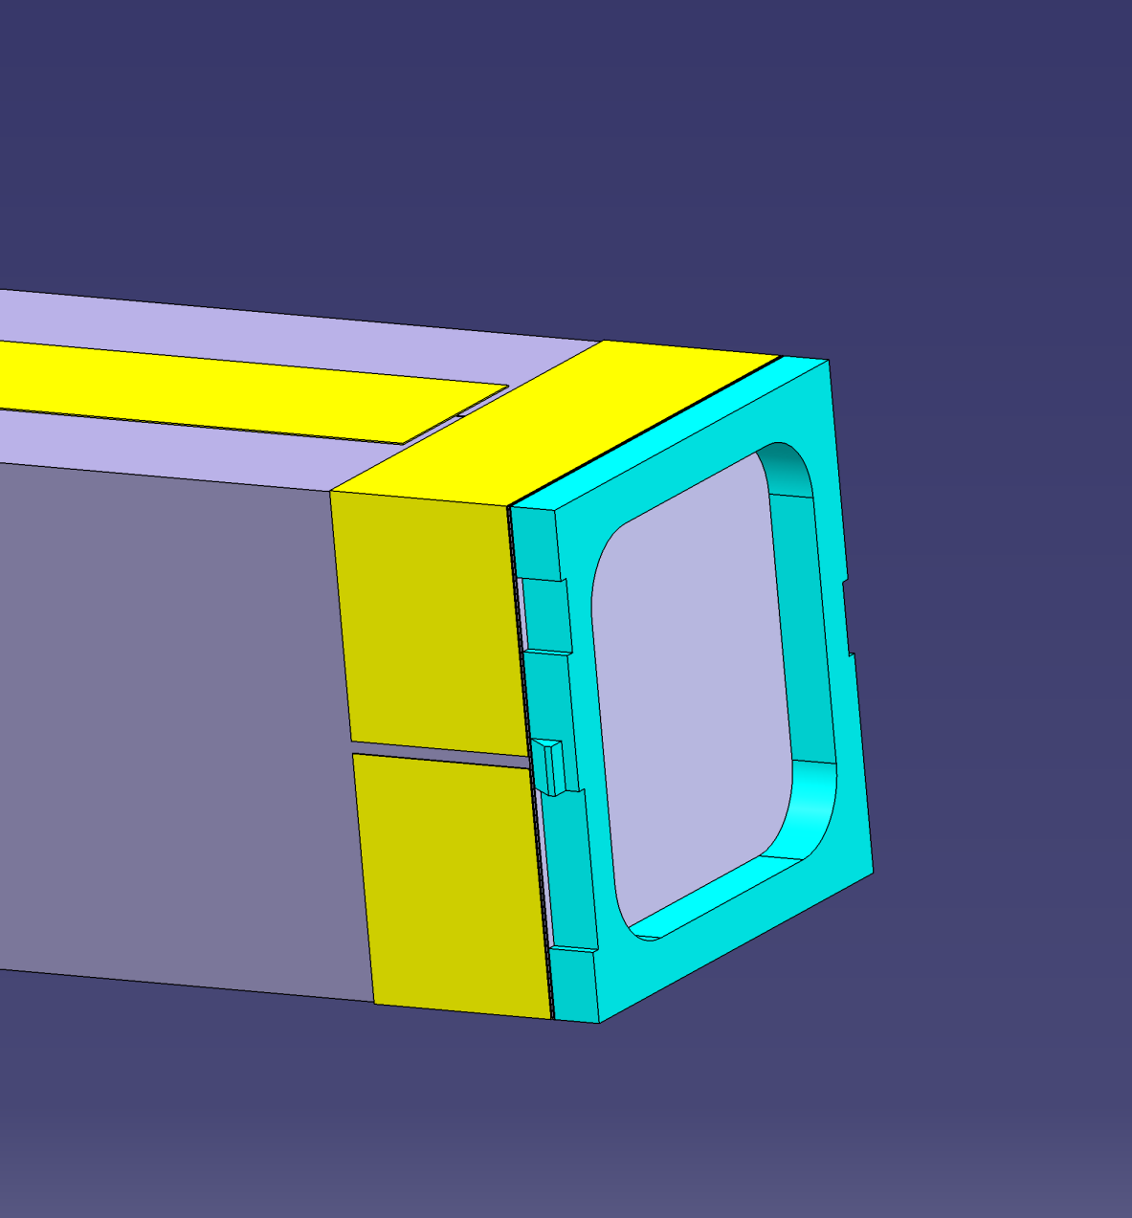
Front reflective sheet
Front reflective sheet glued on the plastic block part

Slide 13
Pitch alveoli

Slide 14
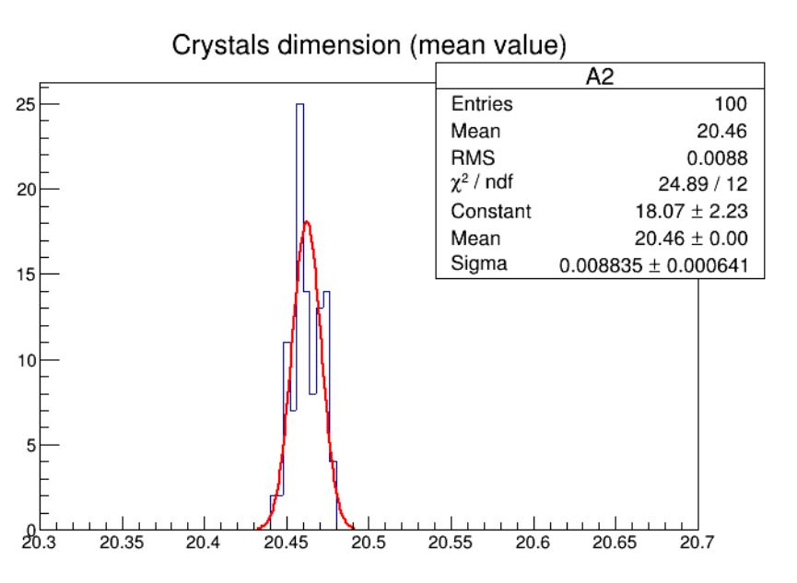
Crytur dimensions

Slide 15
Siccas dimensions

Slide 16
Gap between alveoli and crystal (practical value)
The final value of the crystals with 260µ for wrapping +50µ (du to air and corners of wrapping) is:
Max value : Siccas = 20,91 mm
mean Value : Siccas = 20,85 mm
Min Value : Siccas = 20,79 mm
max Value : Crytur= 20,80 mm
mean Value :Crytur= 20,77 mm
min Value : Crytur= 20,74 mm
We choose an alveoli 21mm inner dimensions: so the pitch is 21,5 mm (gap between 2 crystals : 1mm)
Gap min (21- 20,91 =0,09mm)
Gap Max (21- 20,74=0,26mm)
Mean Gap Siccas ( 21-20,85 = 0,15mm)
Mean Gap Crytur ( 21-20,77 = 0,23mm)

Slide 17
Mechanical tests and simulations on carbon honeycomb structure

Slide 18
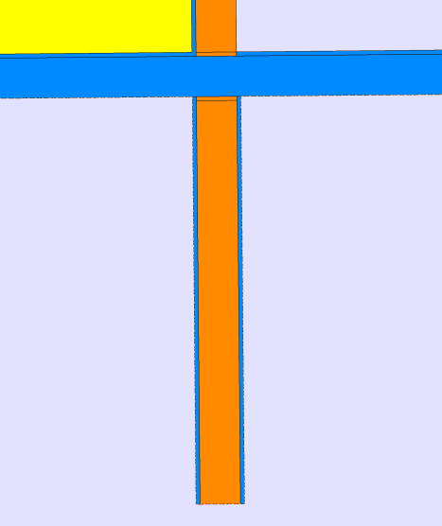
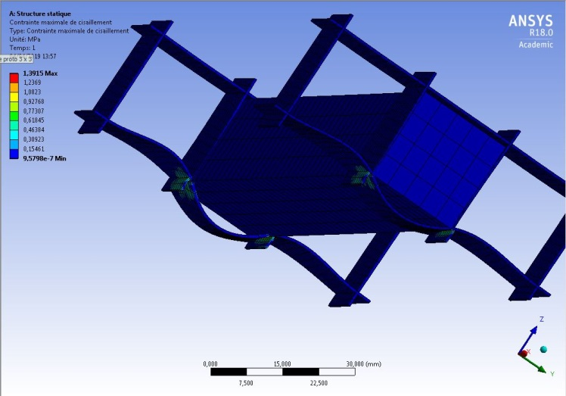
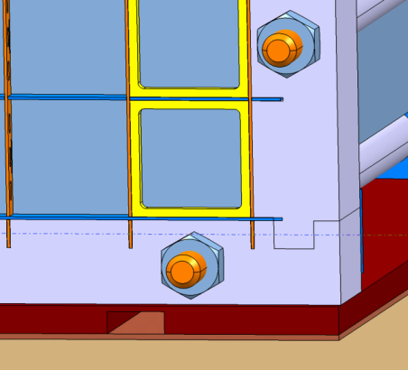
Shearing simulation on 1 pillar with no gap under the pillar
X 36
P/2 = 7 N
P/2
P/2
Shearing Max = 1,4Mpa
NO GAP
Max stress = 1,4 Mpa
Shear resistance carbon plate = 90Mpa (Good Fellow value) security coeff =64
Very secure
1,4 Mpa @ each stage
For each horizontal plate (even the bottom one) the stress will be the result of 1 crystal weight only = 1,4 Mpa
No gap

Slide 19
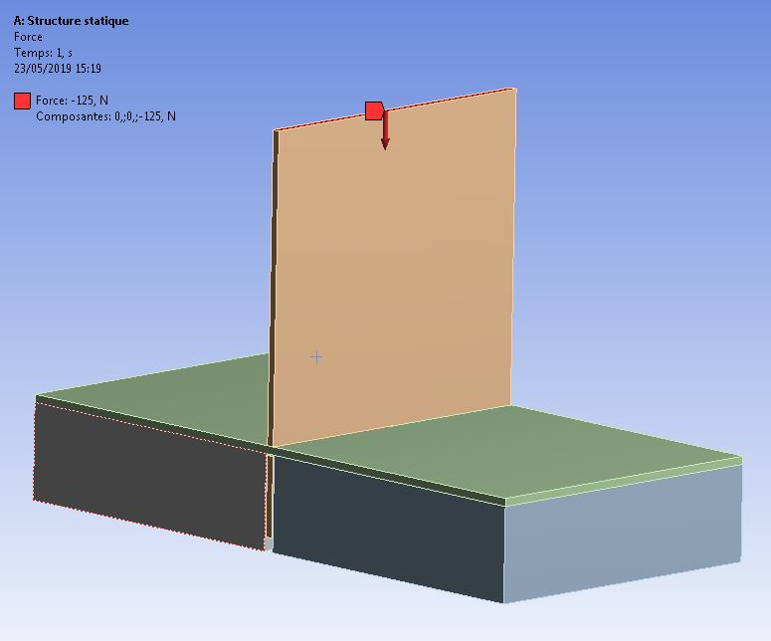
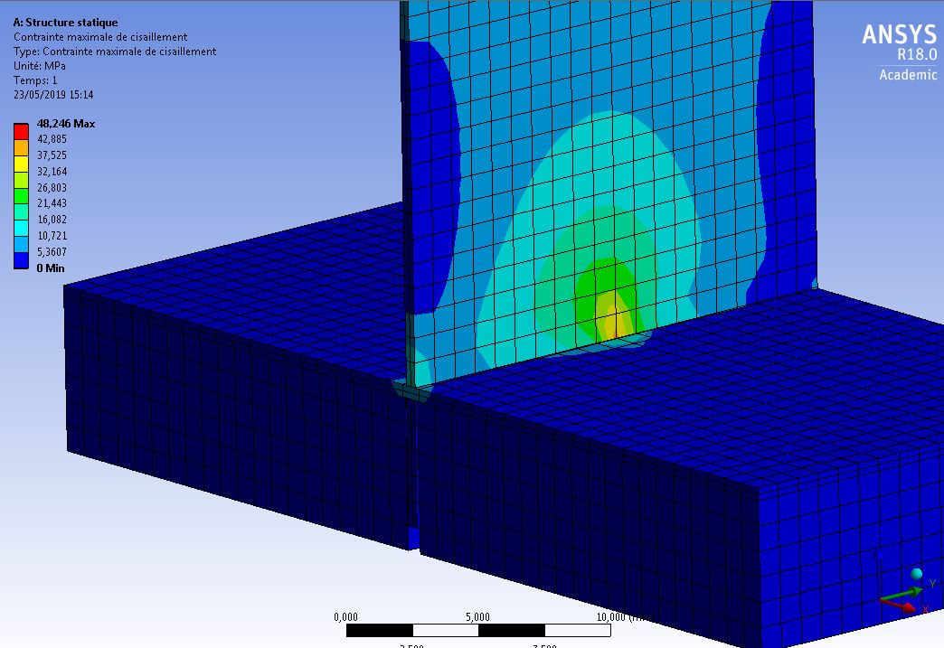
Shearing simulation on 1 pillar
In this simulation we want to see what would happen if we have gap under the vertical carbon plates :All the load will be supported by the bottom horizontal plate.
125 N
pillars
36P/2
Shearing
Shearing
contact
Max stress = 48Mpa
Shear resistance carbon plate = 90Mpa (Good Fellow value) security coeff =2
Safe but not secure enouth
In reality its necessary to have no gap under the Vertical plates in order to reduce the stress

Slide 20
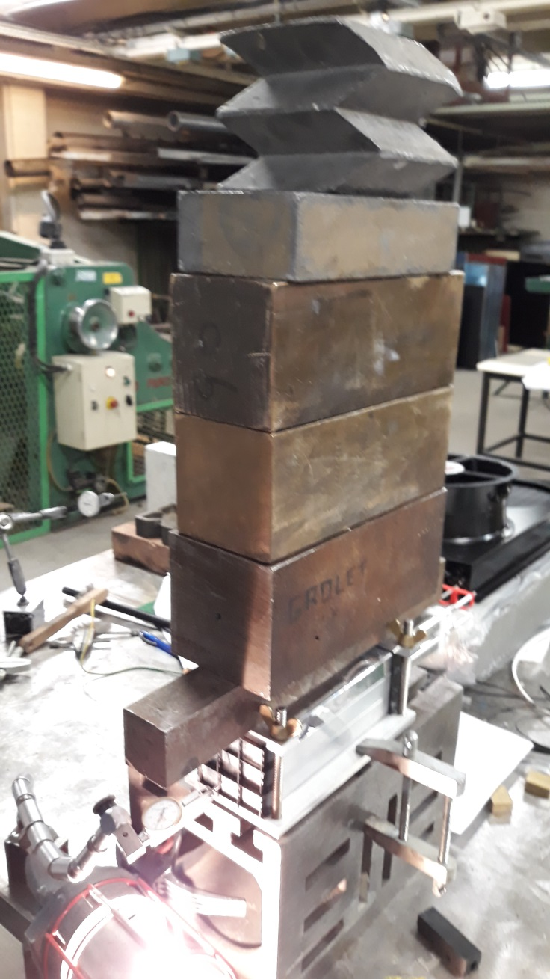
Test in workshop: schearing in case of gap under the vertical carbon plates
additionnal weight to obtain 76 Kg (3 columns weight)
Conclusion : No damage; it confirm the very good Shearing resistance of these carbon plates
Gap

Slide 21
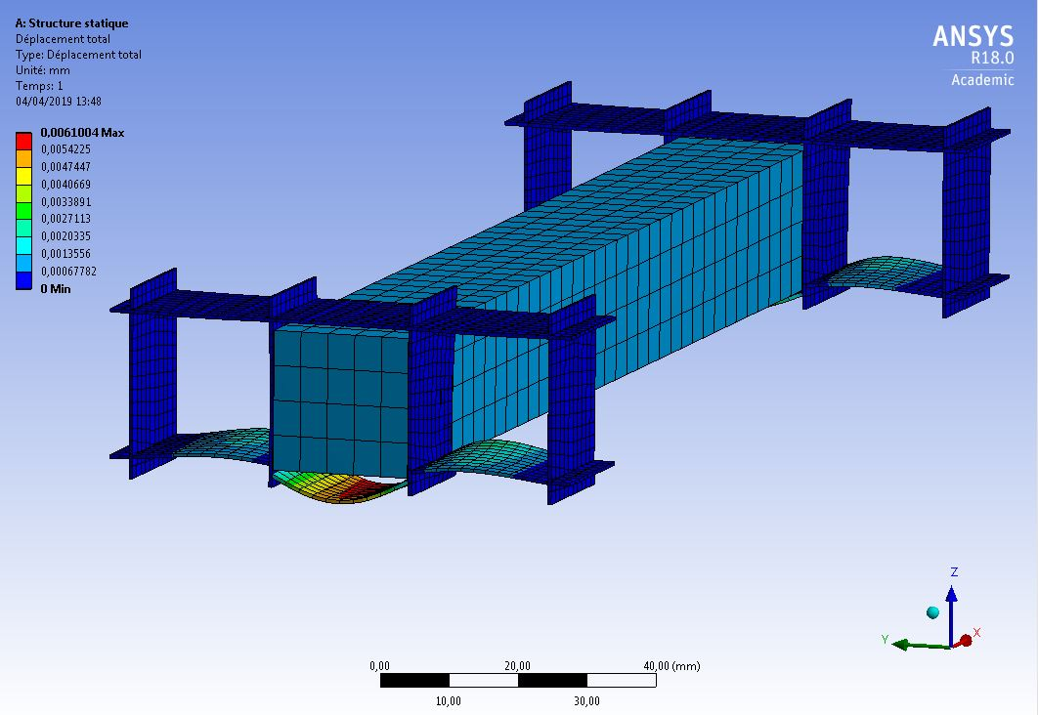
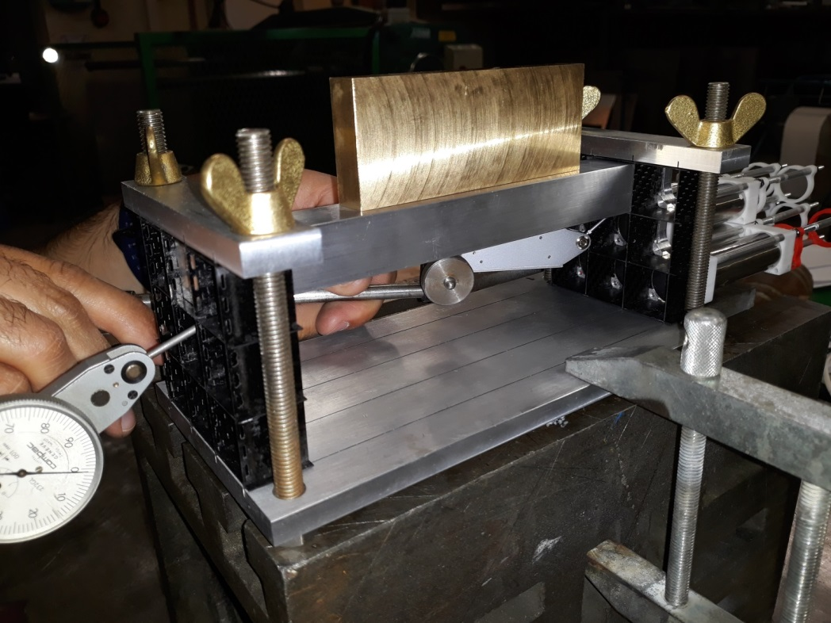
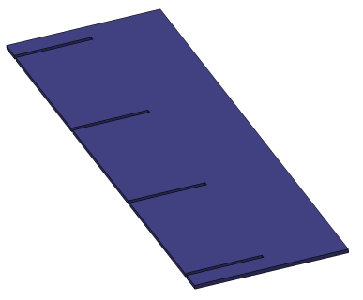

Test in workshop: deformation alveoli with 1 crystal
Bending : 4 measurement points : A=0,05mm ; B0,02mm ; C=0,05mm ; D=0,04mm
additionnal weight to obtain 0,7 Kg (PBWo4)
Aluminum part
C
D
A
B
Conclusion: The deformation is very small

Slide 22
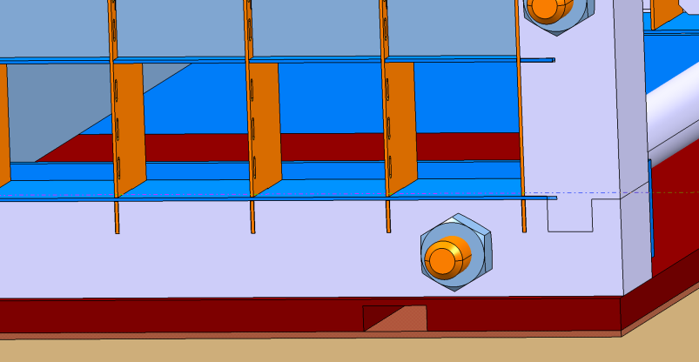
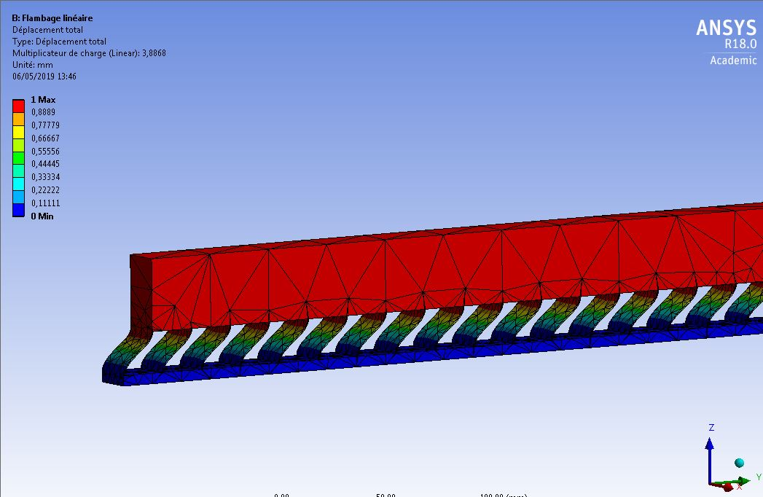
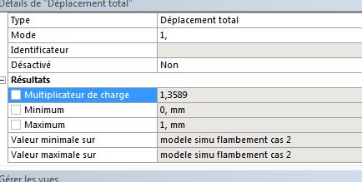
Buckling
Hypothesis : first raw without crystal (no real scenario)
We consider that all the stages above the first raw are compact
The vertical plates are blocked strongly at the bottom
F=125x30 =3750N
Buckling factor = 1,36 (> 1 ) Ok
With the moke up under load we tried to remove the 3 bottom crystals:
1st conclusion : it was possible to remove them
2nd conclusion: after a small time we have seen a movement of the vertical plates : buckling. Probably the load was not exactly centered so
It is evident not to remove one bottom or intermediate raw when crystals above !

Slide 23
Fiber tests and mounting

Slide 24
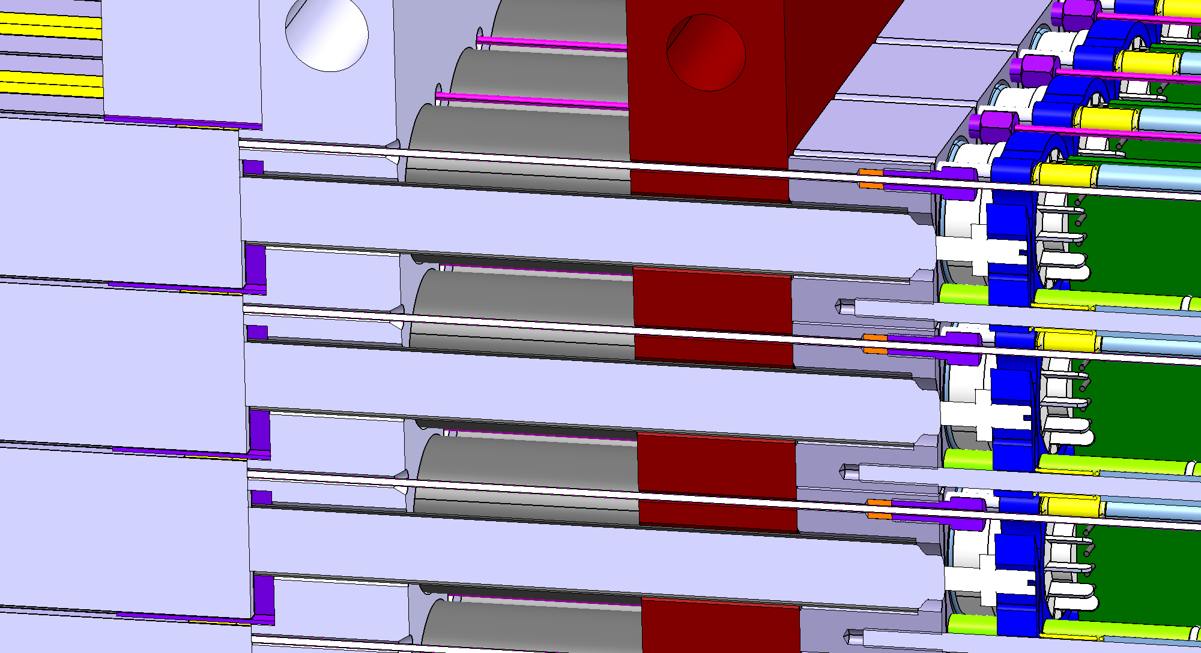
Fiber side crystal
Metal ferrule screwded in aluminum support
Silicon Cable gland in order to block the fiber

Slide 25
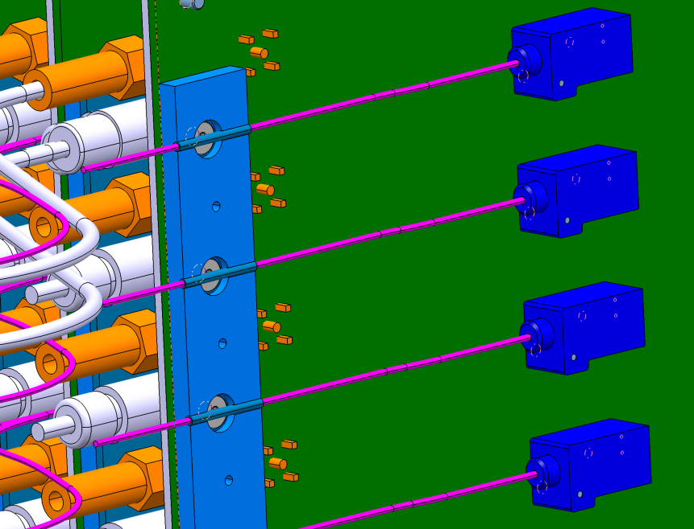
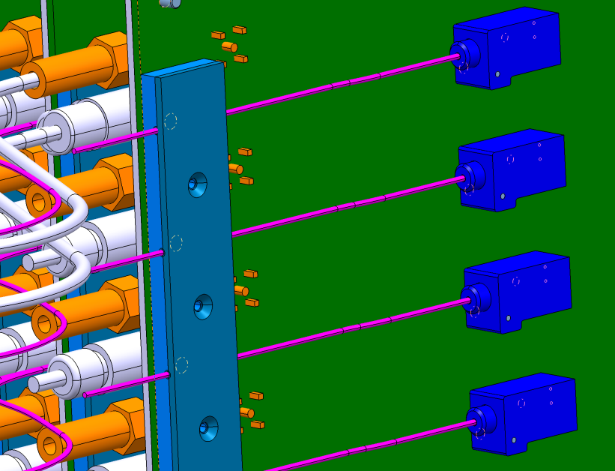
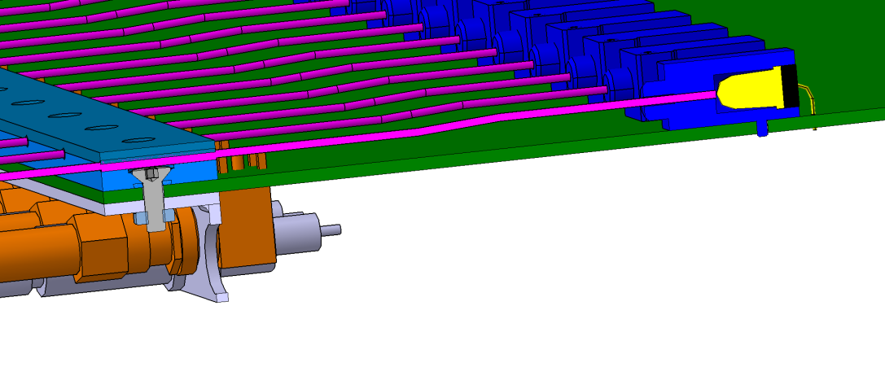
Fiber side PCB
Pinched between 2 aluminum plates
Protected with plastic tube
inserted and no glued in the plastic Ferrule
Length fiber = 51cm (has to be adjusted with the PCB prototype)
Advantage:
1) The fibers can be dismounted if necessary
2) The PCB can be dismounted separately if necessary

Slide 26
Cables and PCB adjustement (Moke up )

Slide 27
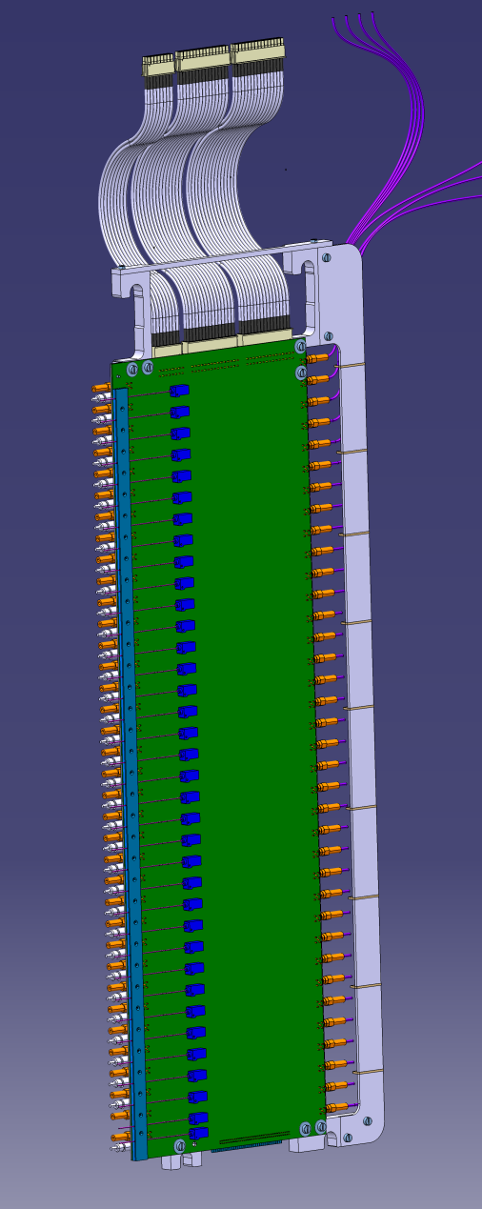
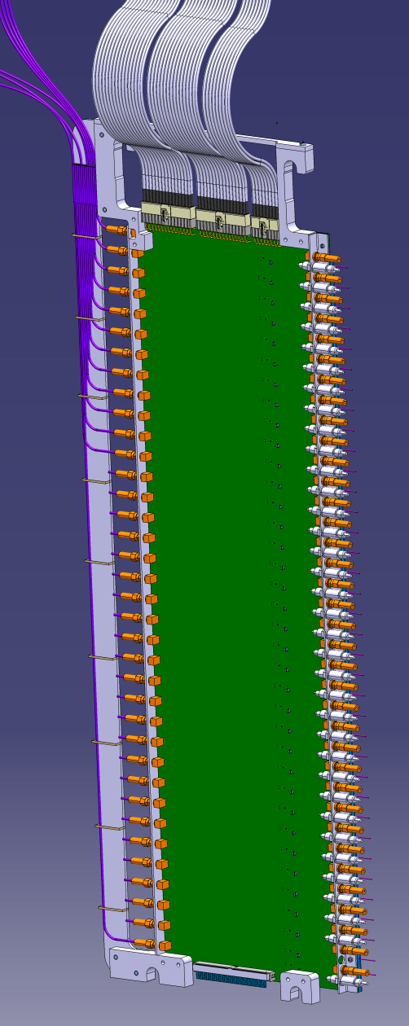
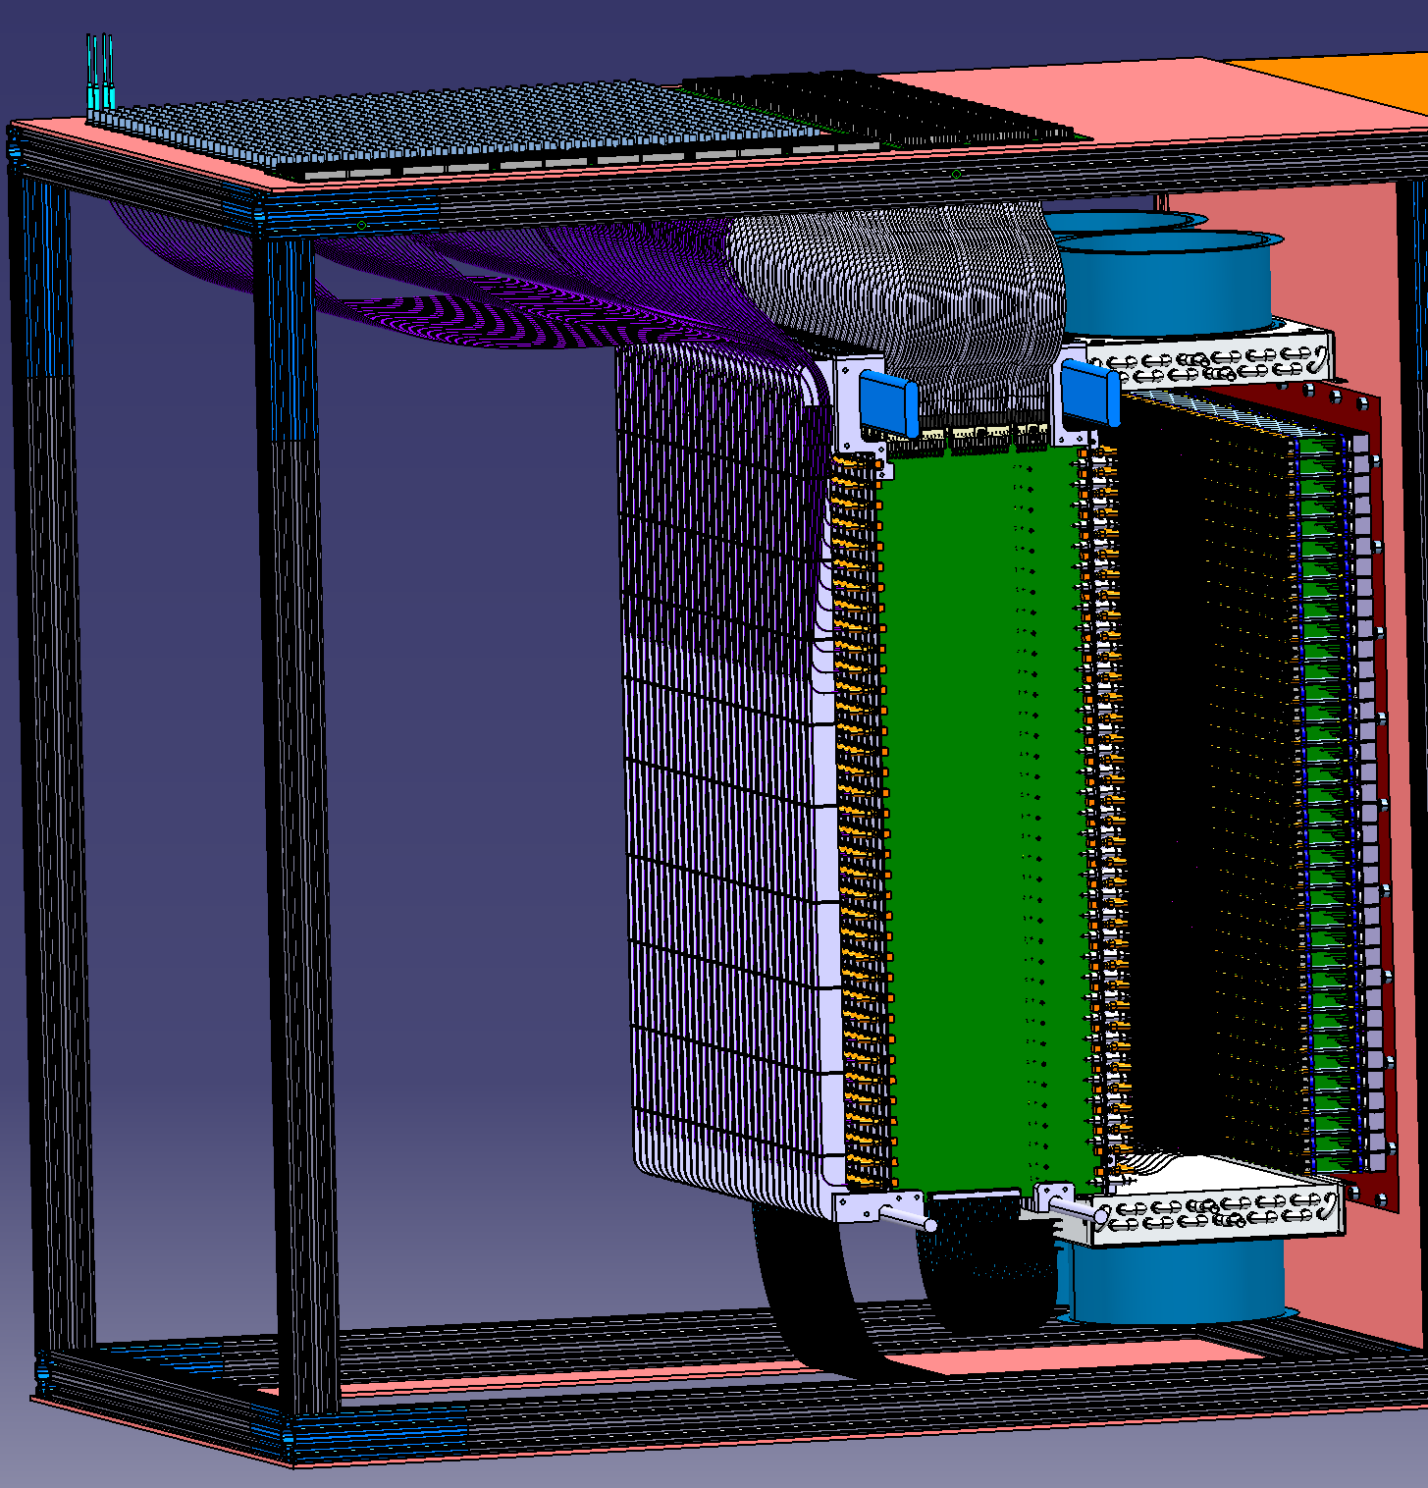
Interface PCB

Slide 28
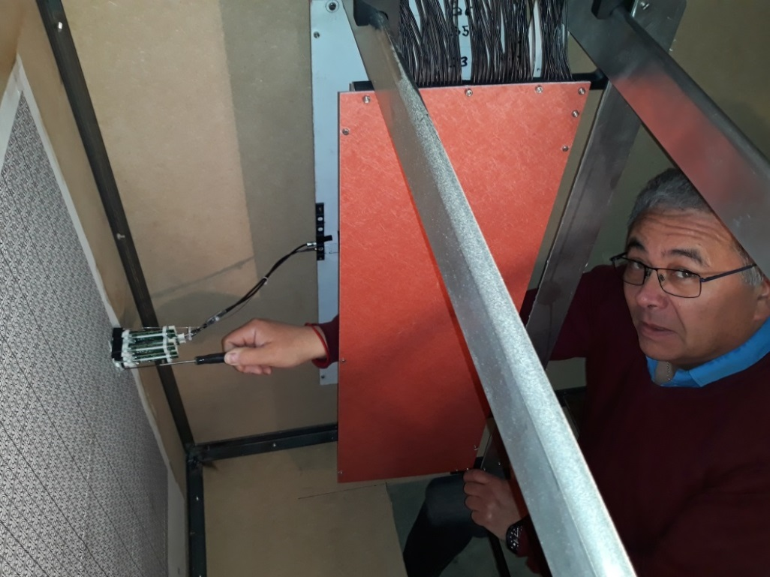
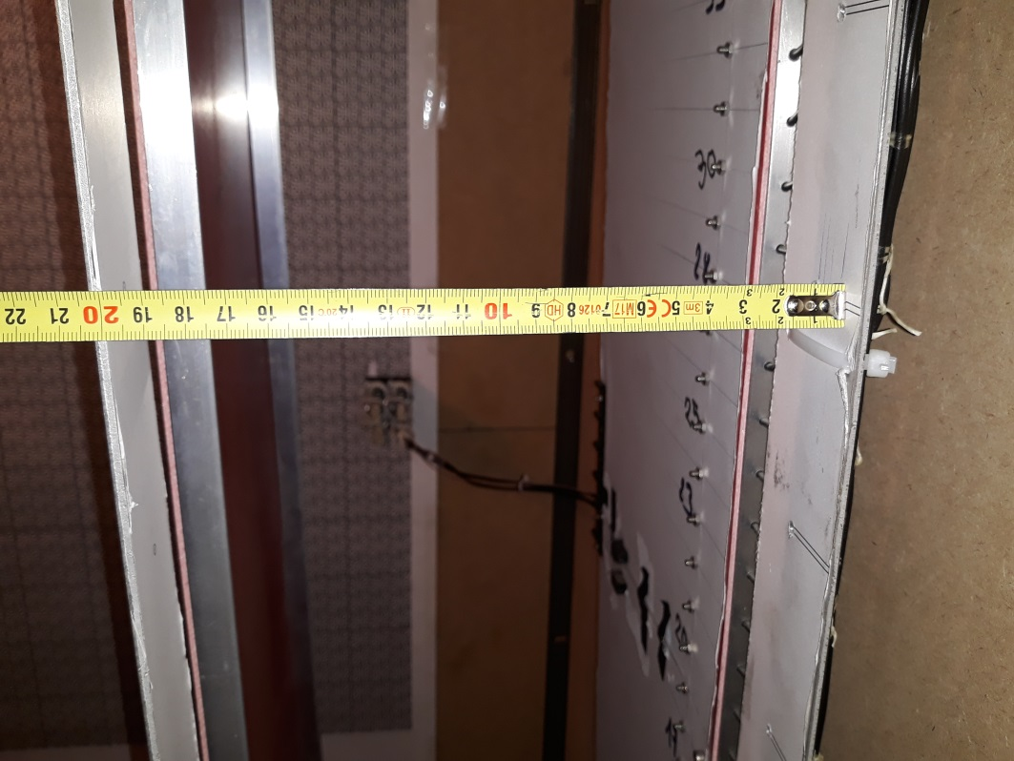
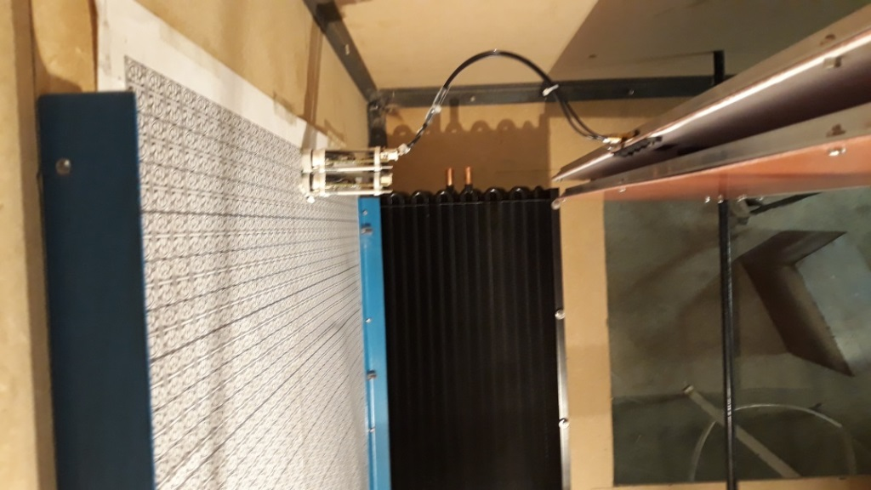
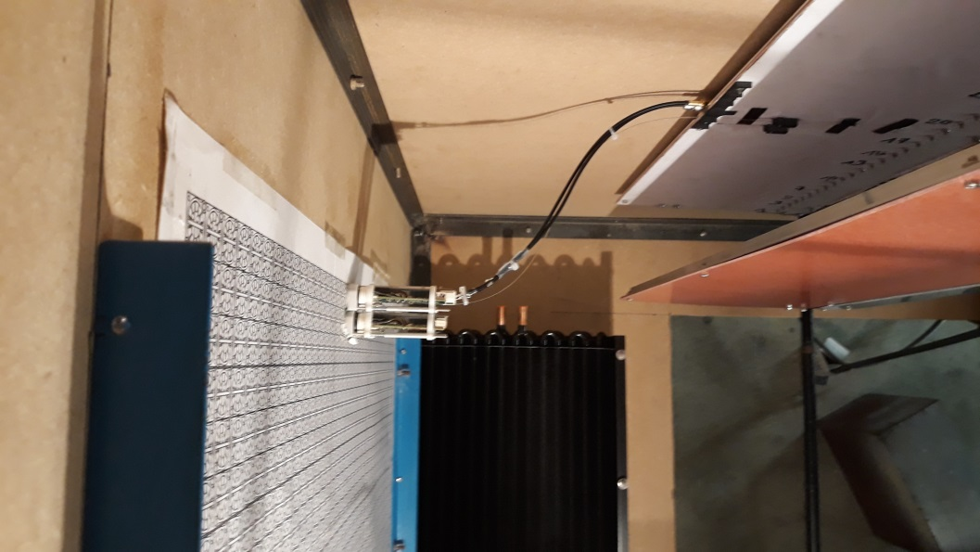
Interface PCB
Access for PMt assembly exchange
15 cm
PCB in front of its PMt column (Top view)
PCB shifted 15 cm of its PMt column (Top view)

Slide 29
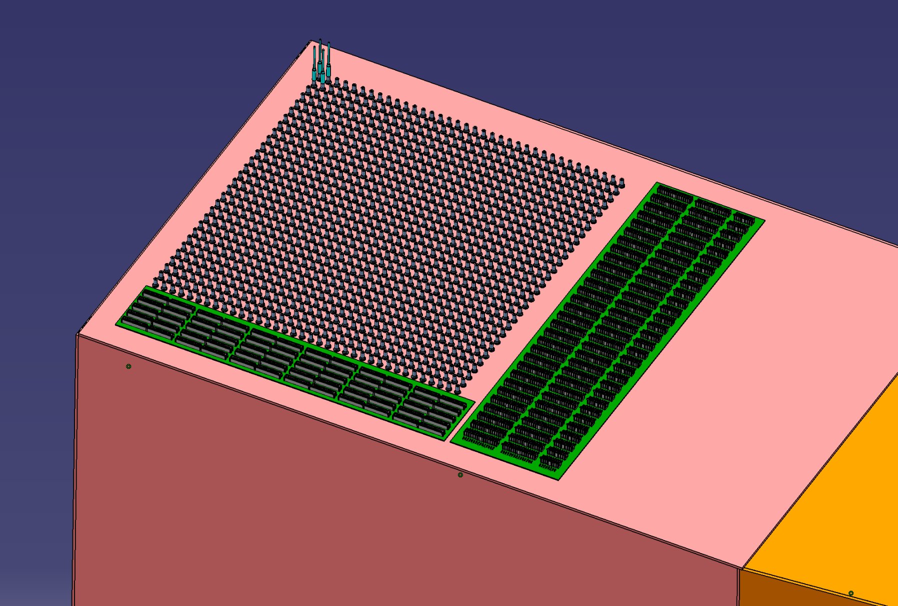
Electronique Input/Output
108O Lemo connectors for signal
HV PCB
LED distribution

Slide 30
Cooling

Slide 31
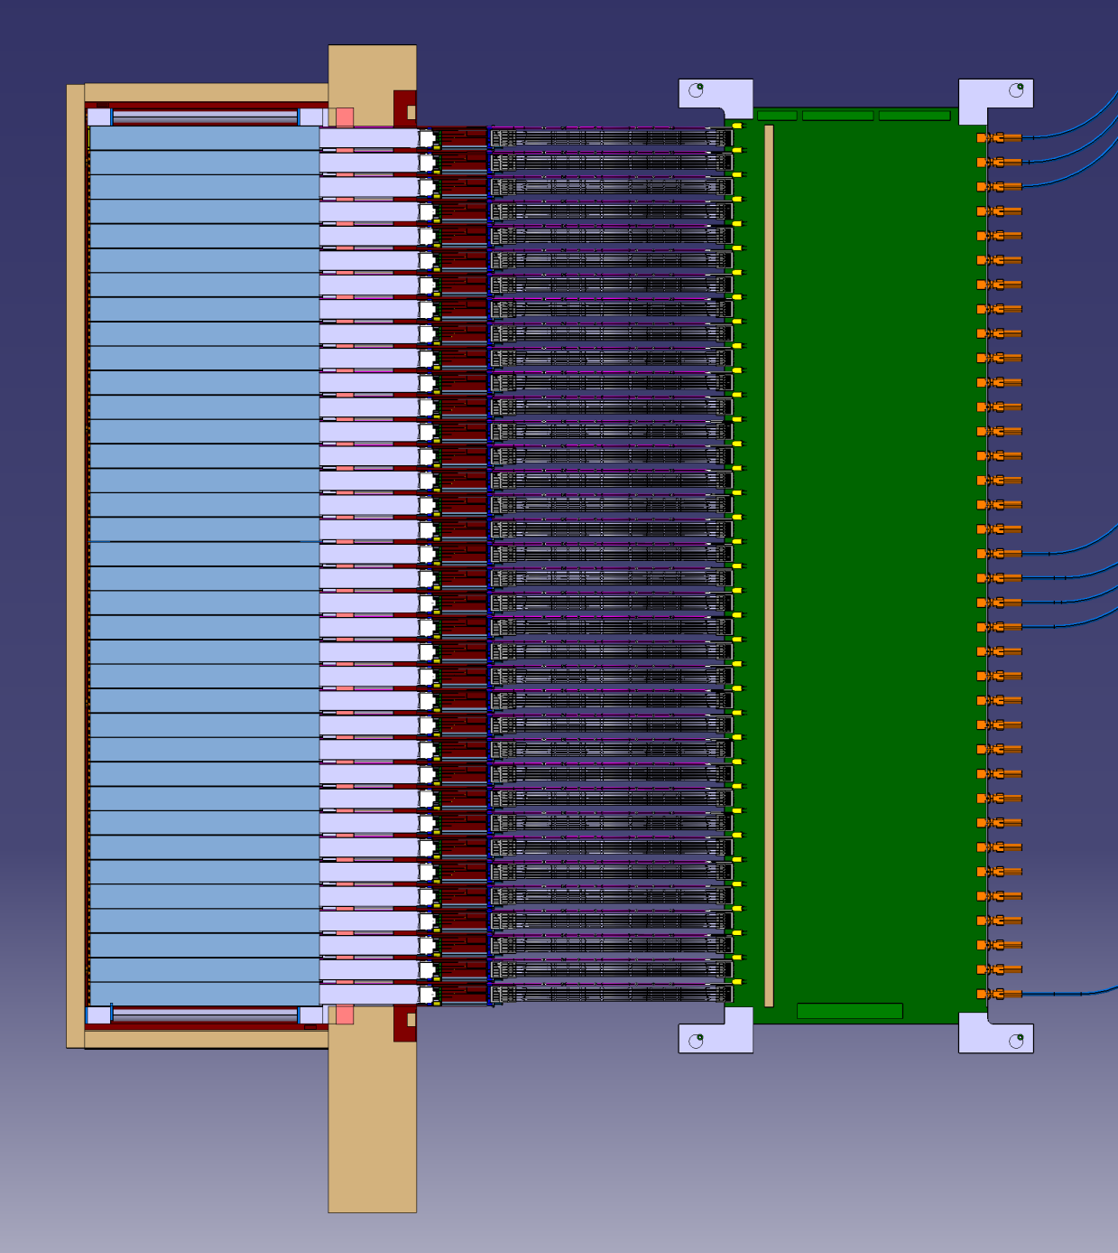
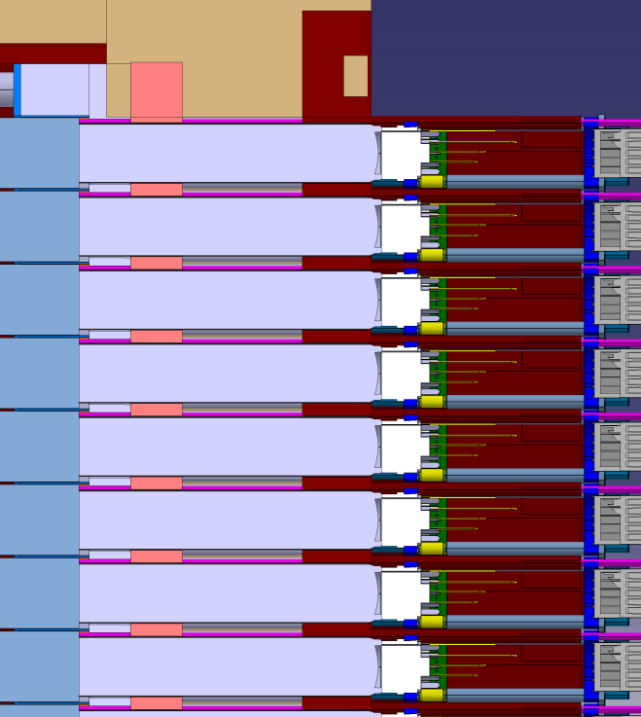
Thermical aspect
Intermediate Zone : Thermical Resistance
inserted and no glued in the plastic Ferrule
Crystals Zone : @ 18°+/-0,1°
Heating Zone : 500mW/channel = 540 W
Intermediate Zone : Made of Glass , Vacuum (PMt)
Depron (Thermal insulator)
+ cold Copper plate
External Zone : T° = 22°c

Slide 32
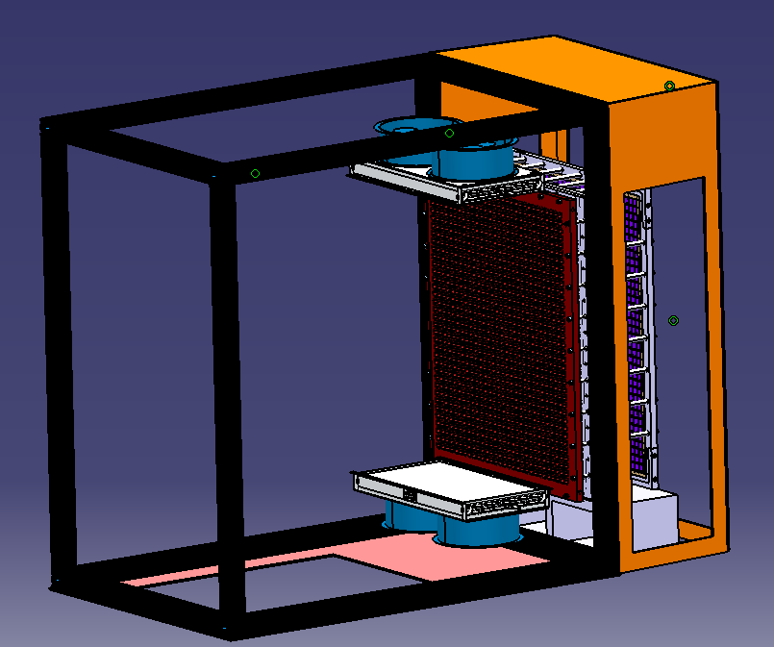
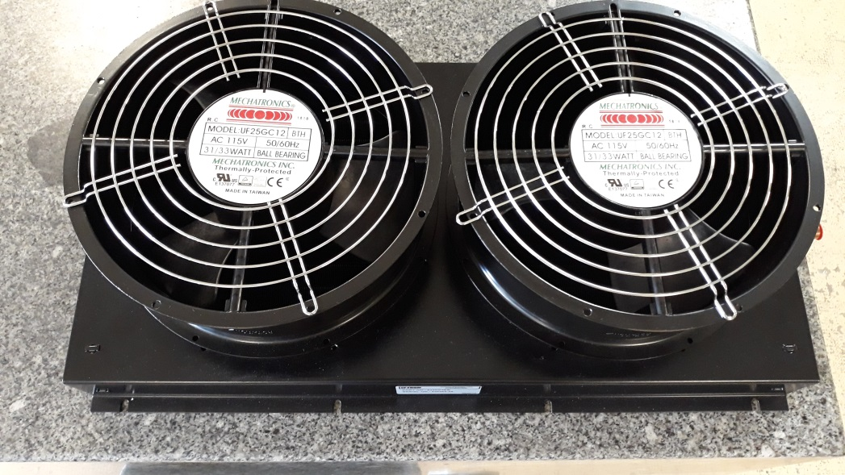
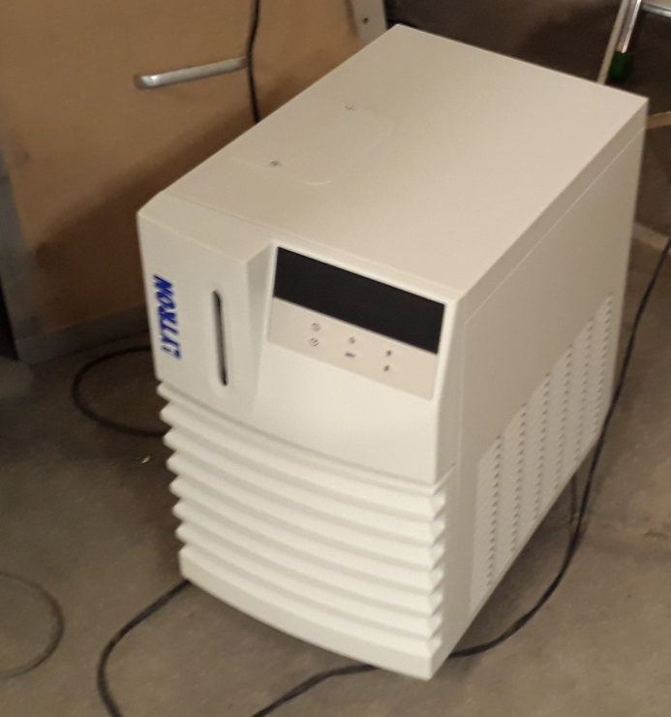

Cooling
Electronic cooling ; Device delivered
Test in progress with the moke-up
Crystals cooling ; Study in progress
Test will be done with the moke-up

