Slide 1
DSG NPS Collaborators’ Meeting Update
Aaron Brown and the Detector Support Group
02/25/2021

Slide 2
Contents
Radiall-to-SAMTEC High Voltage (HV) Cables
Fabrication
Testing
HV Schematic
Hardware Interlock System Development
Tentative signal list
Dew point interlock
CSS-BOY Screen Development
Conclusion

Slide 3
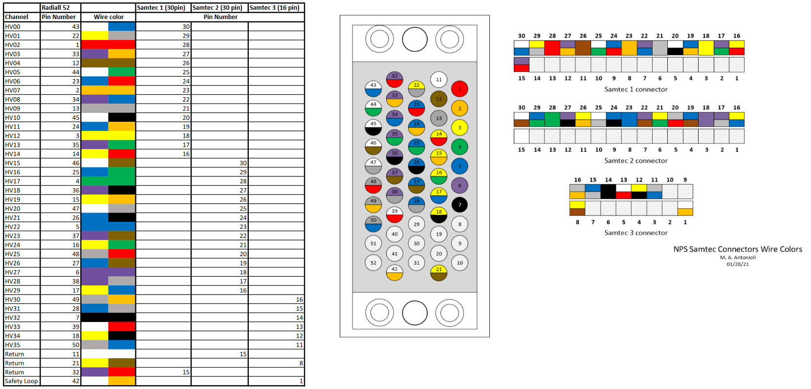
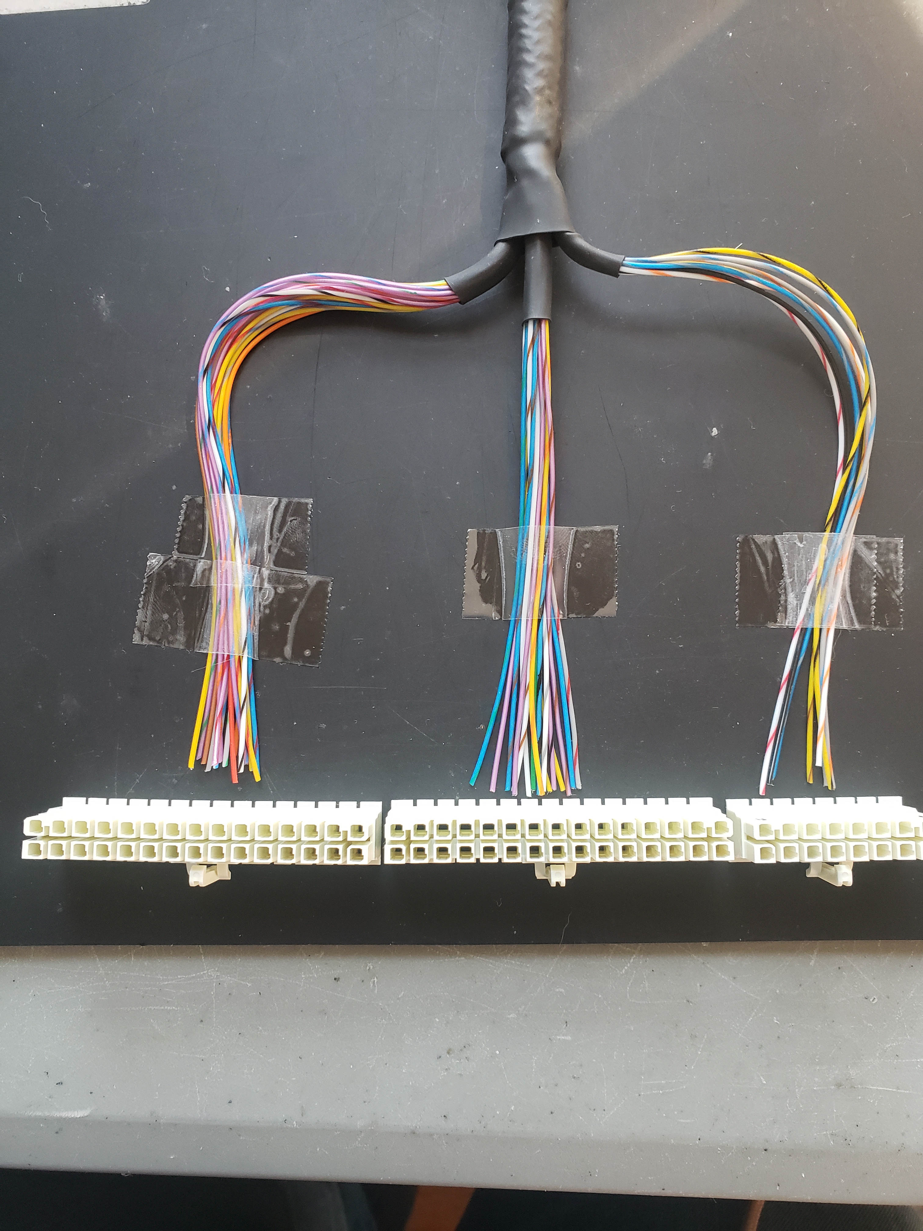
Radiall-to-SAMTEC HV Cables: Fabrication
Cables being fabricated by Mindy Leffel – five of 40 complete
Grounding wire connected to each braided shield at Radiall connector end
SAMTEC connectors (labeled 1,2, and 3) have 15, 15, and 6 HV channels, respectively

Slide 4
HV Schematic
Mindy Leffel is fabricating the high voltage cables

Slide 5
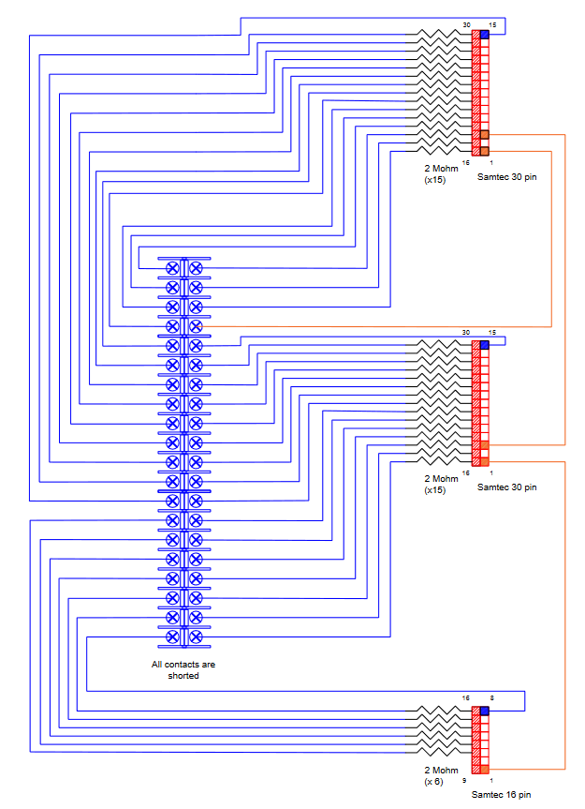
Radiall-to-SAMTEC HV Cables: Testing
Testing goals
Observe cables’ SAMTEC connectors at 1100 V
Verify neighboring channels don’t change voltage or current if a channel, or adjacent channel, is turned off
Marc McMullen is developing the Test Chassis
Test chassis internal schematic developed in AutoCAD

Slide 6
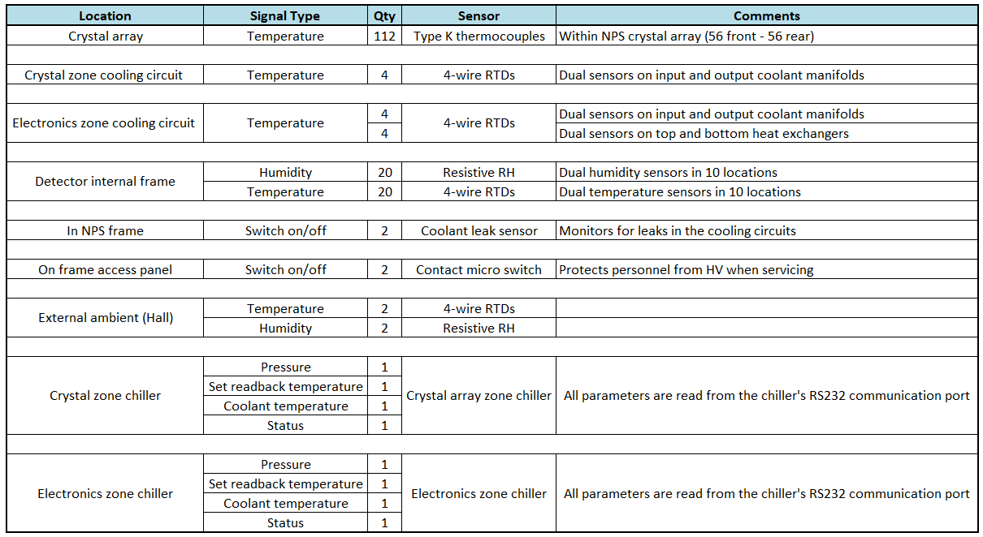
Hardware Interlock System Development
Tentative signal list: ~180 monitored signals
Signal readout from sensors
To Keysight → cRIO → EPICS
To cRIO → EPICS

Slide 7
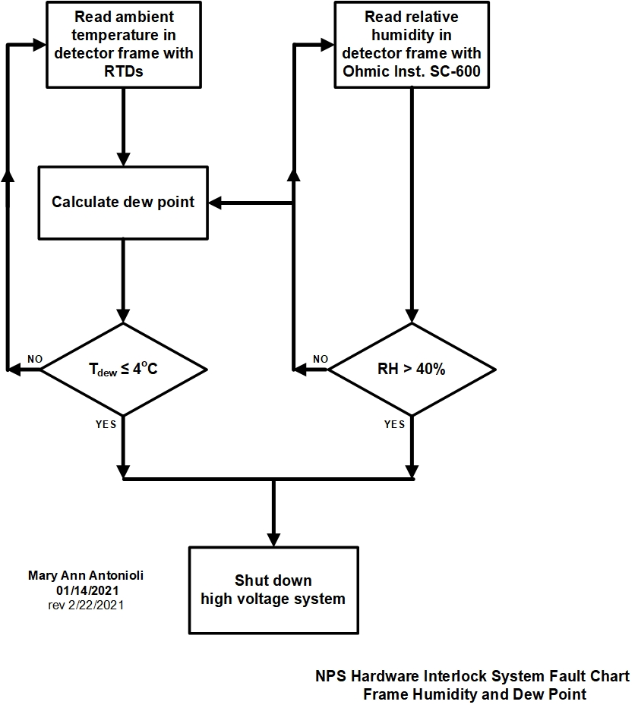
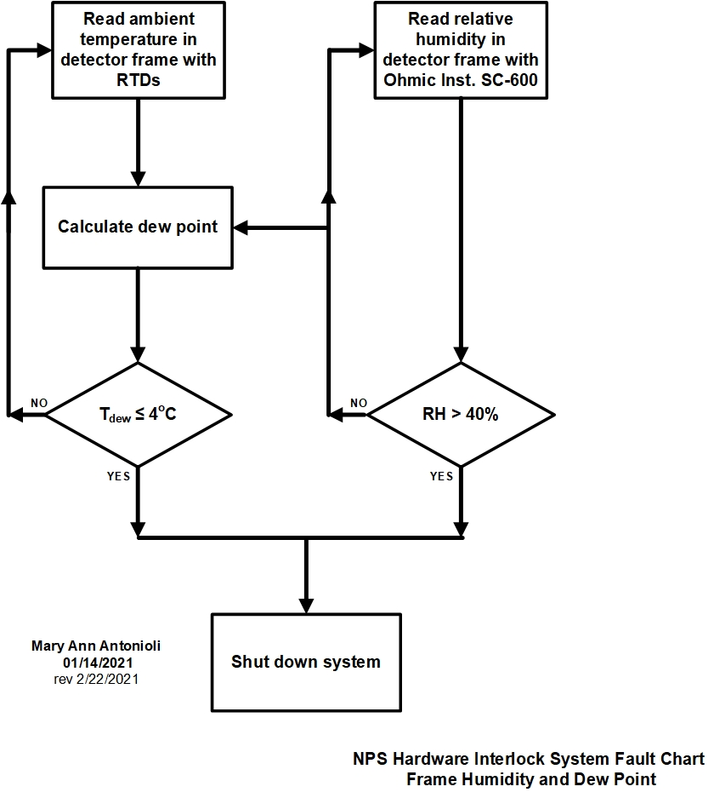
Hardware Interlock System Development
Minimum coolant temperature of chiller is 5°C
→ Dew point should be interlocked at ≤ 4°C
→ For operational temperature of 18ºC, max RH ≤ 40%
Providing margins for humidity and temperature sensors accuracies

Slide 8
CSS-BOY Screens Development
Screen enables user to turn off channels individually
Buttons to be added:
Turn off slot
Turn off crate
Turn off both crates
Snippet of Module/Channel Power CSS-BOY screen

Slide 9
Conclusion
Work is progressing smoothly

Slide 10
Thank You

