Slide 1
CPS Prototype Testing
100 to 300 Watts
June 29, 2023

Slide 2
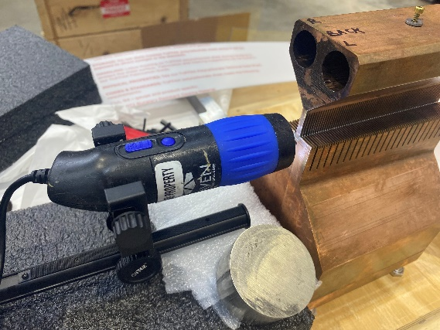
Brazing - End View Initial
Back End
Front End
Cusil 72%Ag 28%Cu Braze
Melting point 780C
K= 371W/m-K Modeled in Ideas thermal solution

Slide 3
Setup

Slide 4
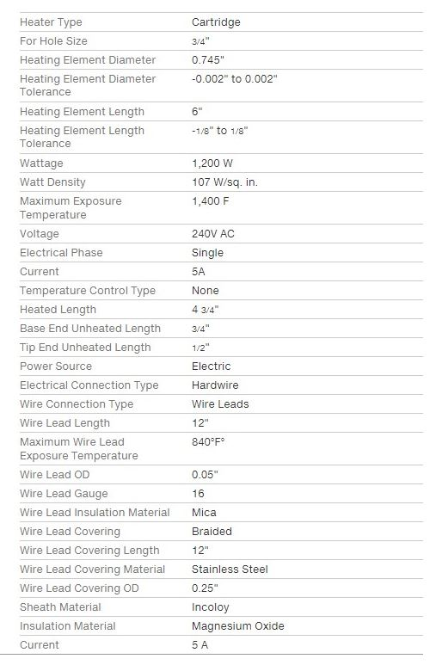
Test Setup
Cartridge Heater Resistance 28 and 28.3 ohms

Slide 5
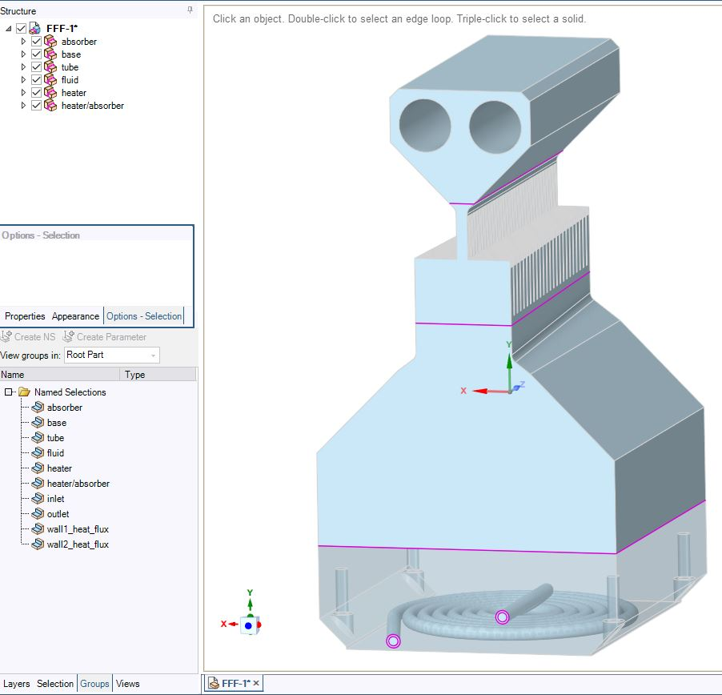
A thermal analysis was performed using both Ideas and Fluent software. Both agreed well with each other on temperature profiles
 | Surface area of a heating tube |  | m^2 | 7.200E-03
 | Diameter of Heater |  | m | 1.905E-02
 | Diameter of H20 tube |  | m | 3.200E-03
 | Area of Tube |  | m^2 | 8.040E-06
 | Mesh element Size |  | m | 6.350E-03
 | Density of Water |  | kg/m^3 | 9.982E+02
 | Cp of H20 |  | J/kg-K | 4.182E+03
 | Conductivity H20 |  | W/m.K | 6.000E-01
 | Density of Cu |  | kg/m^3 | 8.978E+03
 | Cp of Cu |  | J/kg-K | 3.810E+02
 | Conductivity Cu |  | W/m.K | 2.876E+02
 | Fluent model -Tube conditions were prefect - no roughness factor
Heating elements
Top section
Absorber
Base
Materials: C1020 OFHC Copper
water tube
outlet
inlet

Slide 6
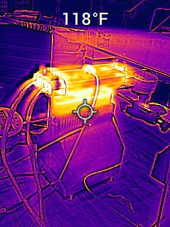
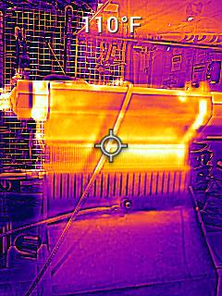
Thermal Camera Captures

Slide 7
Measured vs Model
Top
End
Side

Slide 8
Measured vs Model

Slide 9
Steady State reached ~ 30 minutes

Slide 10
Water Flow
Pressure measured values:
Flow 0.625GPM
Static Pressure ~50psig
Flowing inlet pressure 42psig.
Flowing outlet pressure 0 psig
Fluent Model:
Pressure drop 22psig for all 0.625GPM cases (No surface roughness used in model.)
Temperatures:
Inlet 22.2C
Outlet 22.2C (did not increase for the low power test - up to 300W)
Fluent Model:
Inlet 23.3C
Outlet Increased by 2.1C for 300W and 4.1C for 600W

Slide 12
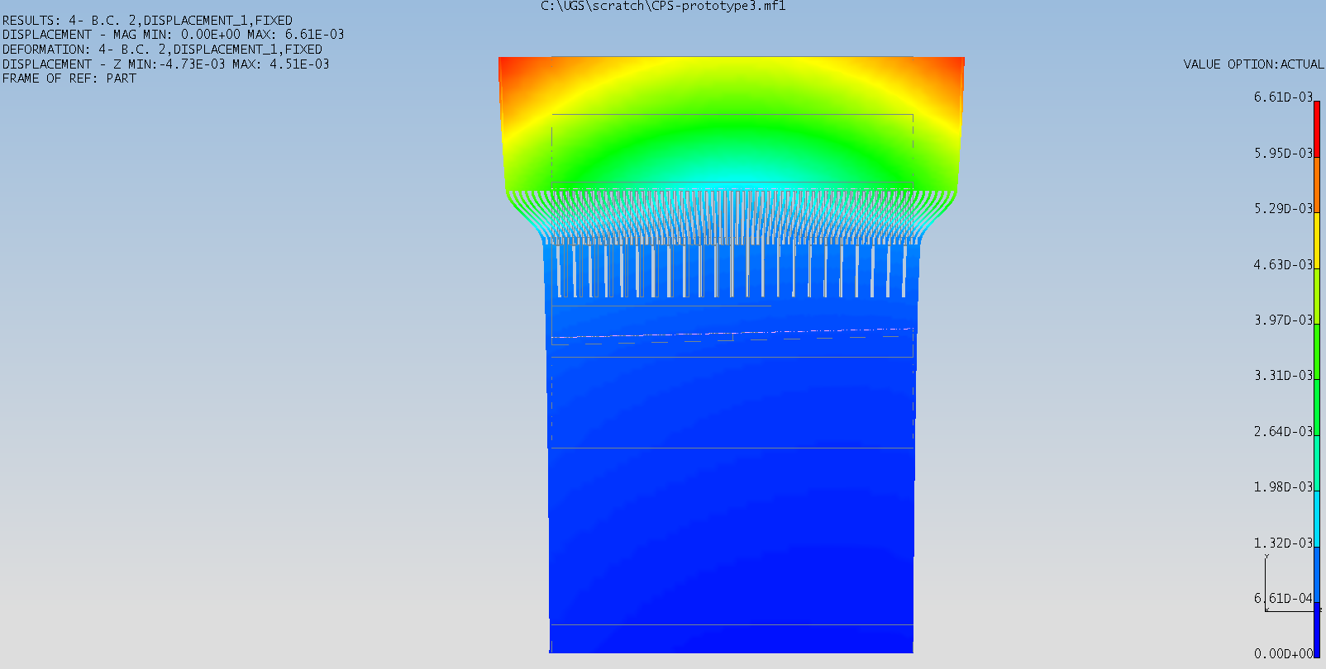
Thermal Expansion
B
A
Setup of dial indicators needs improvement
A mil is 0.001”

Slide 13
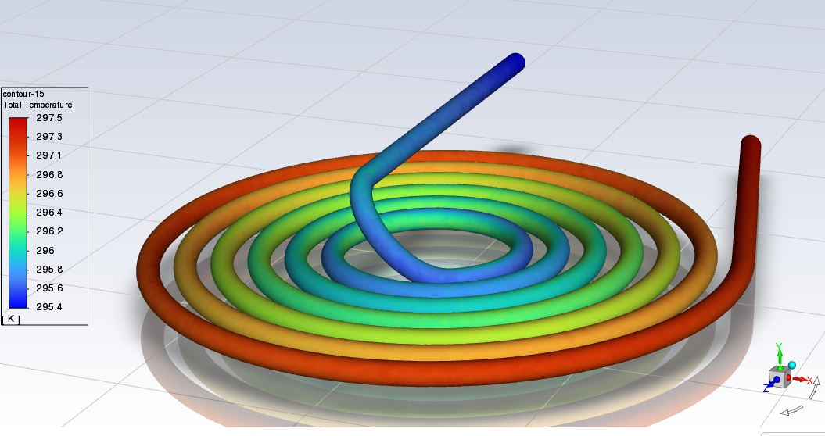
Resulting temperature profile of the fluid.
Power 300W
The maximum temperature of the fluid was 297.5K (24.4ºC).
The ΔT between the inlet and outlet was 297.5K – 295.4K = 2.1K

Slide 14
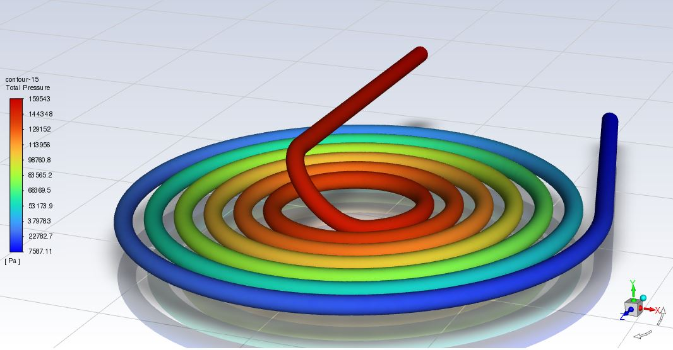
Resulting profile of the water pressure
Power = 590W The pressure of the fluid at the outlet was 7587Pa (1.1psi).
The pressure of the fluid at the inlet was 159543Pa (23.1psi).
ΔP = 23.1 – 1.1 = 22.0 psi.

Slide 15
Thermal Contact Paste
Thermal Paste was used around Heater elements to provide better contact surface.
At higher heat loads approaching 600W, The paste stared to flow and give off an odor.
This concerned people nearby and further testing at higher heat loads was halted.

Slide 16
Notes
Testing is still in the infancy stage.
Test setup and measurement devices could be improved.
Higher heat loads should be tested for thermal deflections, solder integrity, water cooling effects and model proofing.
Fluent model needs to be fine tuned for flow parameters to match test case.

Slide 17
Extra Slides

Slide 18
Heaters

