Slide 1
NPS Calorimeter
ERR, May 15 (2019)
Carlos Munoz Camacho, IPN-Orsay
for the NPS Collaboration
IPN-Orsay NPS group:
E. Rindel, T. Nguyen Trung, G. Hull, J. Bettane
C. Domingues, M. Imre, B. Mathon, L. Seminor, L. Vatrinet, B. Geoffroy
H. S. Ko, C. Munoz

Slide 2
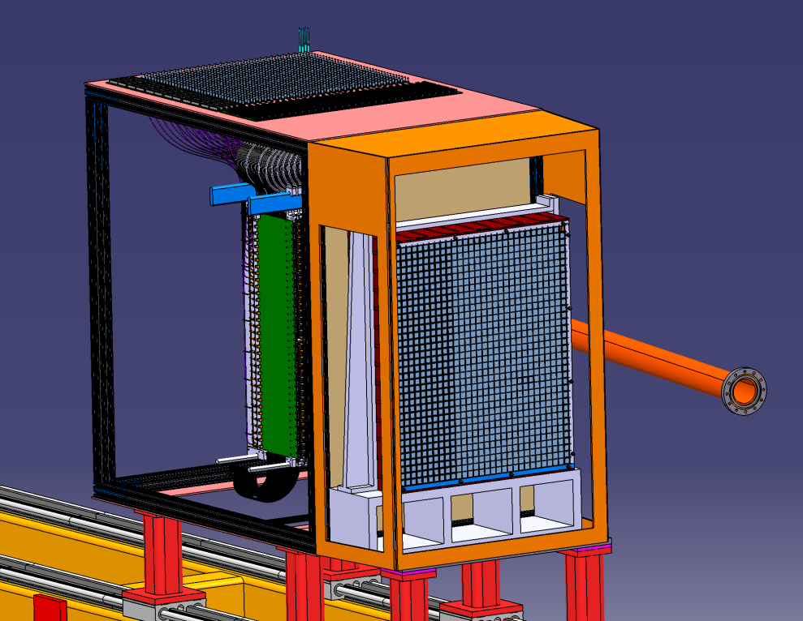
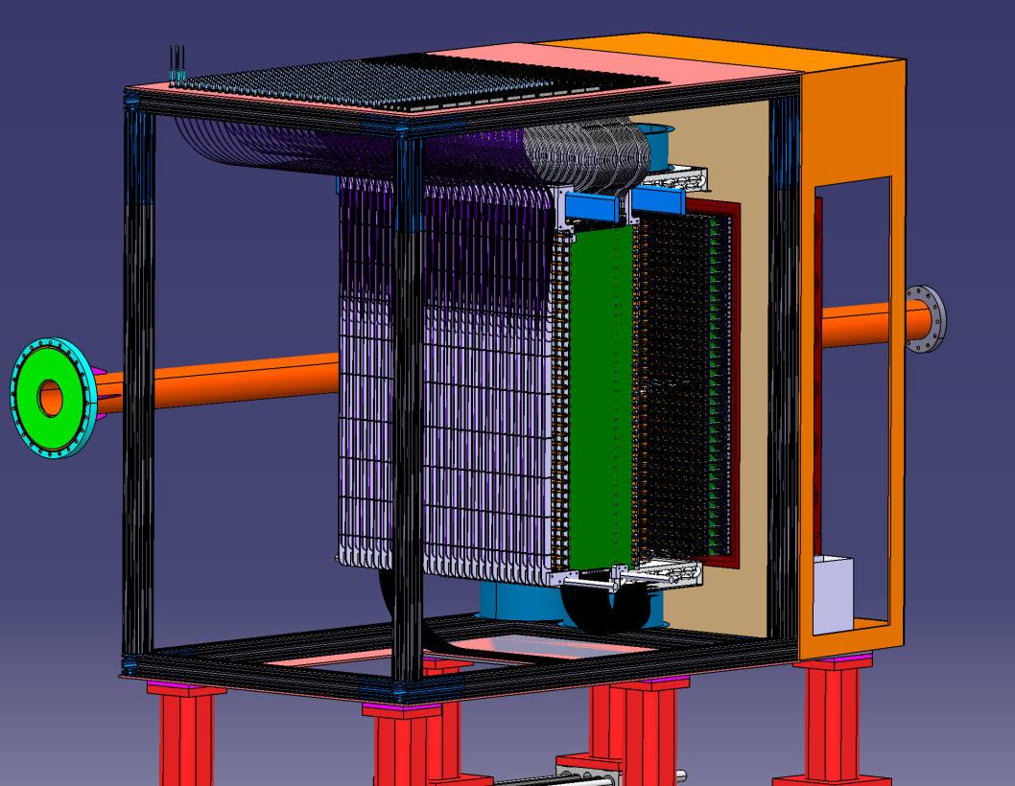
Overview: conceptual design
Front view
JLAB, CUA
30x36 (1080) PbWO₄ crystals (2x2x20 cm³)
Hamamatsu R4125 PMTs JLAB, YEREVAN
Custom-made active bases
OHIO, YEREVAN
Survey & alignment requirements: ~1mm
Back view
Calorimeter frame:
ORSAY
Crystals placed in a 0.5 mm-thick carbon frame to ensure good positioning
PMTs accessible from the back side to allow maintenance
Calibration and radiation curing with blue LED light though quartz optical fiber
Back view
Design 100% completed

Slide 3
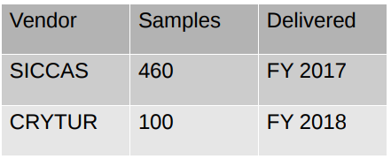
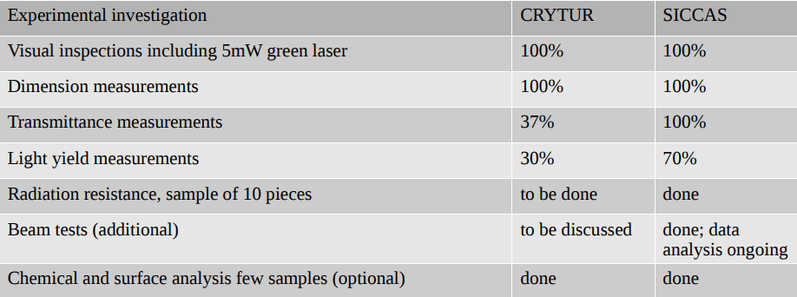
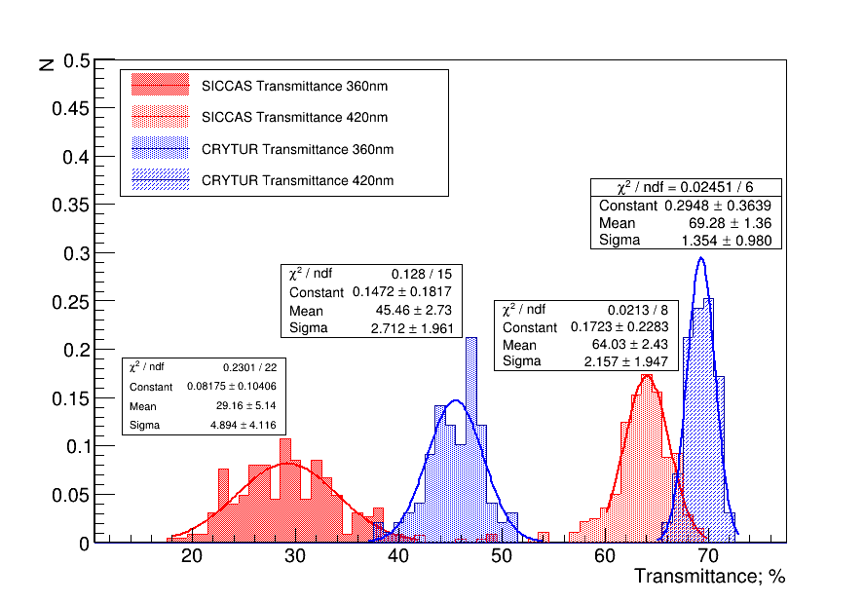
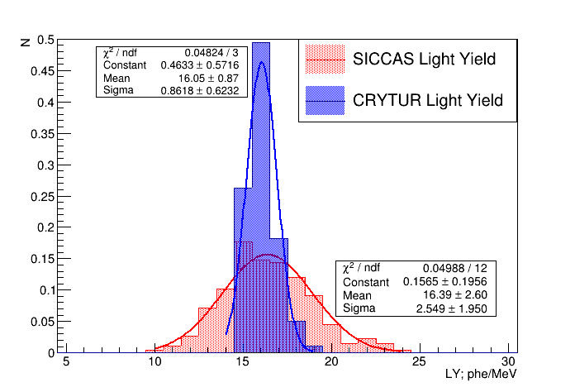
Crystals status
Quality analysis:

Slide 4
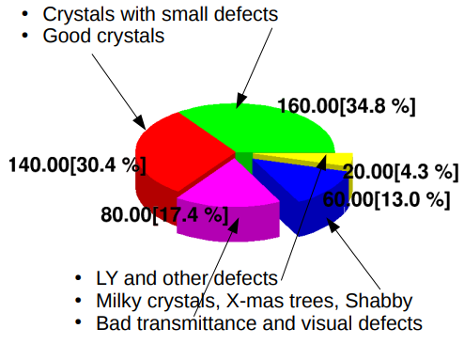
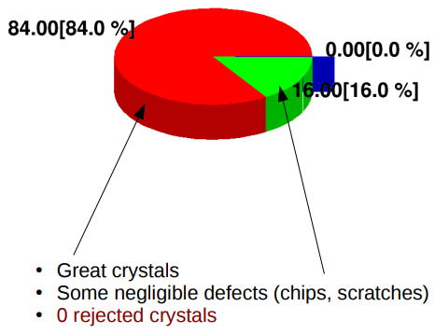
Crystals status
SICCAS
CRYTUR
160 rejected crystals
Crystal procurement:
CRYTUR:
100 (2018) onsite
250 (ordered 2019)
300 (ordered 2019 - replacing an order to SICCAS)
=======
650
SICCAS:
460 (2017-18) onsite
All crystals will be onsite by Summer 2020

Slide 5
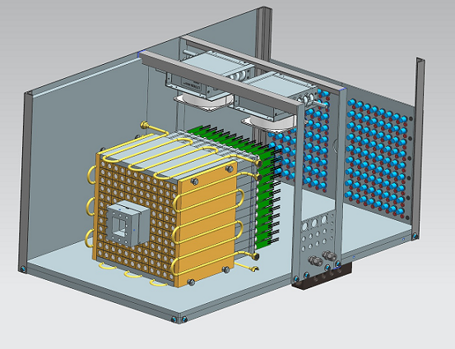
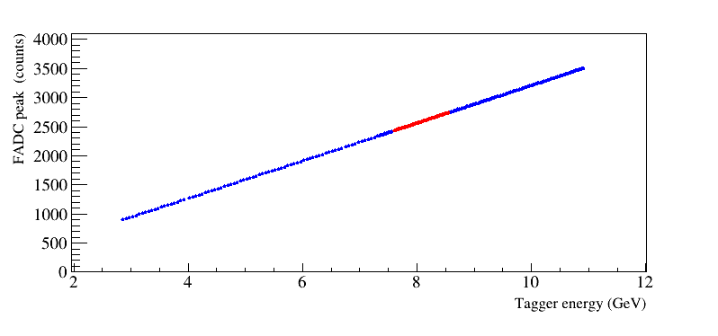
PMT and voltage dividers
PMT (Hamamatsu R4125 ):
340 onsite, 1000 more ordered (delivery by Summer 2019)
Voltage dividers:
80% of them (865) assembled. Completion expected by Summer 2019
Array of 12x12 PbWO₄ crystals
Voltage dividers tested in the Hall D ComCal prototype:
FADC amplitude as a function of the beam energy
FADC amplitude (count)
10 GeV : 3200 FADC channels
FADC range: 2 V (maximum range)
Typical HV: 700 – 750 V
5

Slide 6
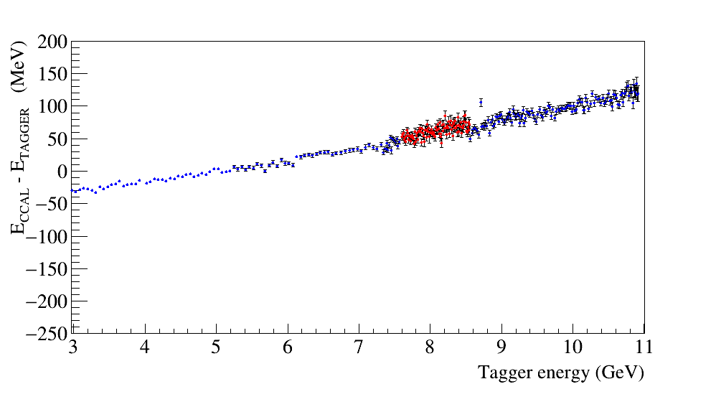
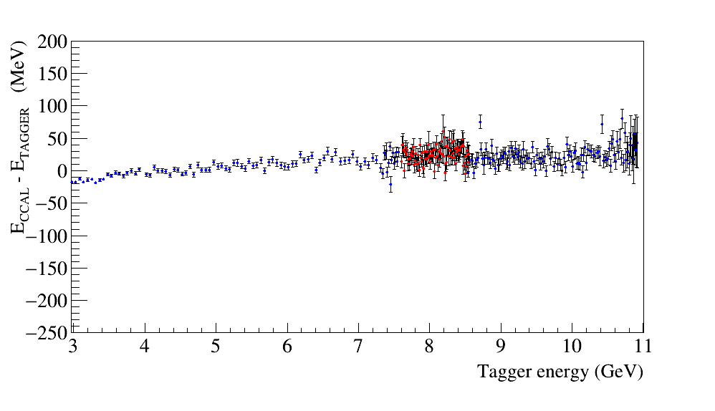
Linearity of the FADC peak amplitude
Original PMT base, gain ∼25
Modified base, gain 3
750 V
2 V FADC range
850 V
2 V FADC range
Some non-linearities on the level of 2 – 3 % were observed for the original PMT base
(PMT was operated at relatively small HV, recommended HV is about 1 kV)
The linearity can be improved by reducing the amplifier gain and increasing HV:
change of 1 resistor in the base needed
Anode current will be evaluated and gain adjusted as needed

Slide 7
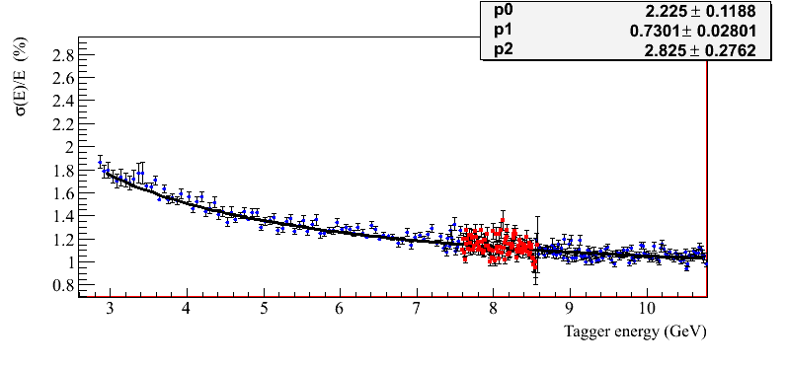
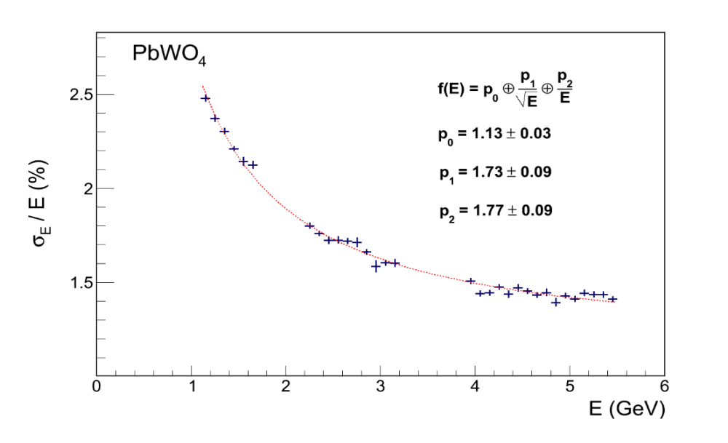
Energy resolution of prototype
NPS Prototype
3x3 array
bypassed amplifier
$\frac{σ(E)}{E}=p1⊕\frac{p0}{\sqrt{E}}⊕\frac{p2}{E}$
HyCal
HyCal (Hall B)
NPS prototype
Relatively good energy resolution.
Consistent with Hall B HyCal, constructed with SICCAS crystals
•
•
•
More details can be found in GlueX-doc-3590, GlueX-doc-3998, V. Berdnikov, A.Somov, J. Crafts

Slide 8
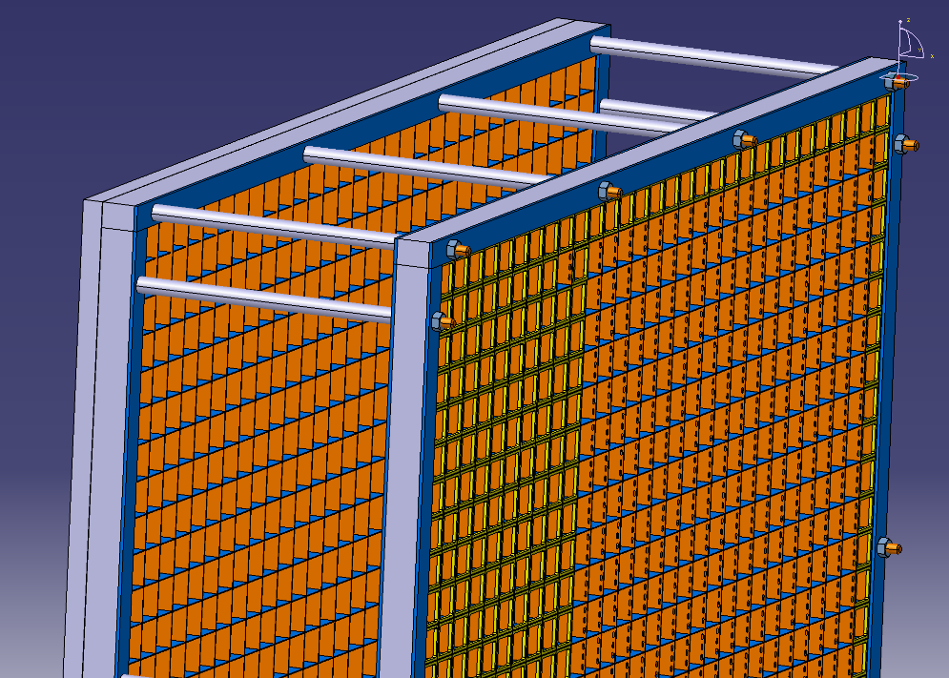
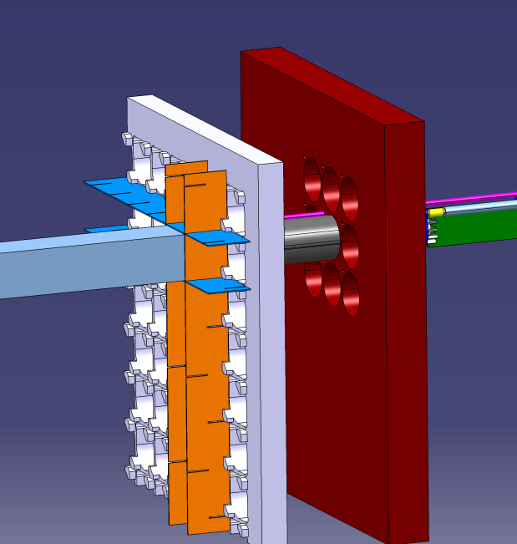
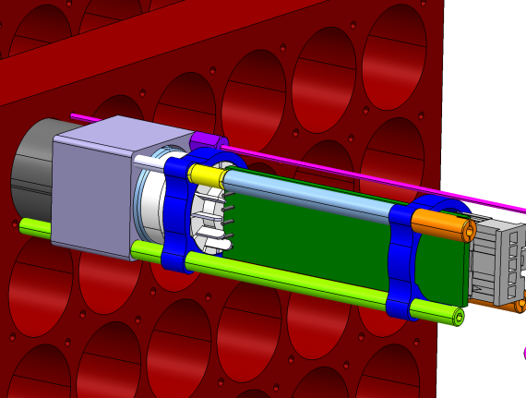
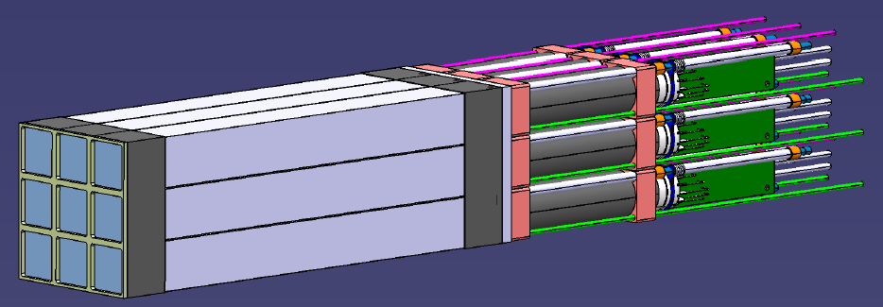
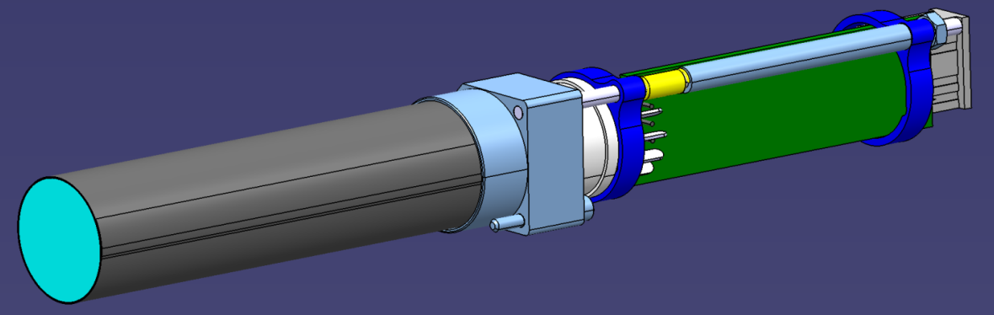
Calorimeter carbon frame
Easy disassembly of PMT block
with one long single captive screw
2-cm of C (0.5 mm thick) at the front and
back of the crystals
PMT assembly
HV divider
μ-metal shield
PMT

Slide 9
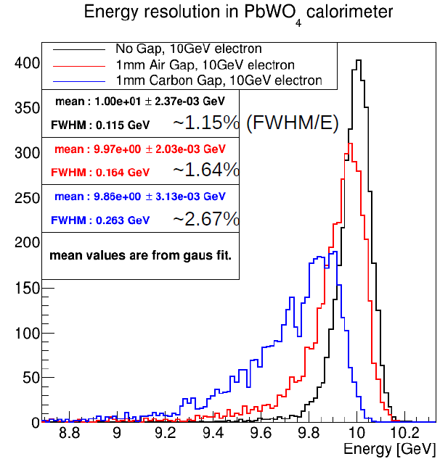
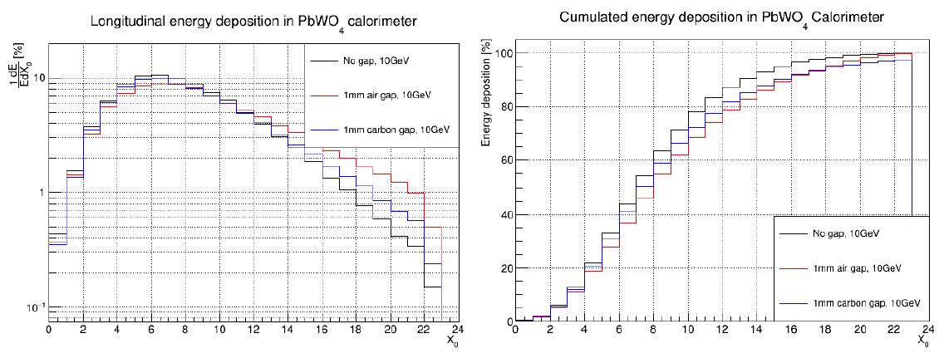
Carbon frame: impact on energy resolution & efficiency
1.2% (ideal case) to 1.6% at 10 GeV
with 1mm of air between crystals
More than 97% of energy collected after 22 X₀

Slide 10
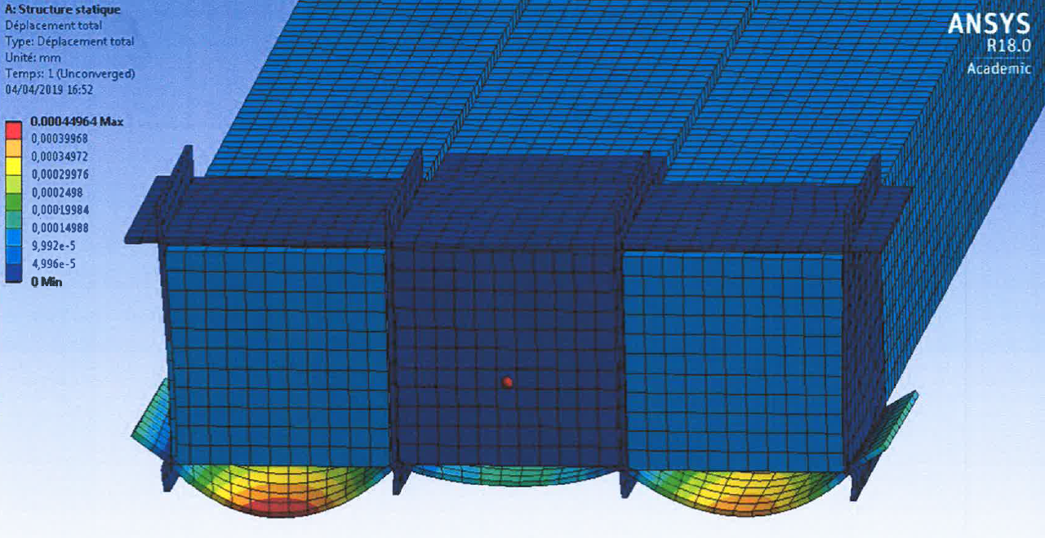
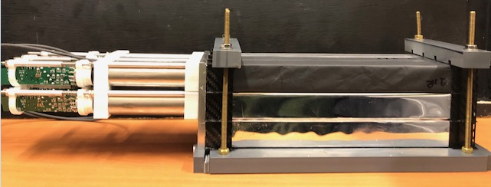
Carbon frame: mechanical simulations and tests
Simulations:
Less than 0.2 μm deformation at the center
0.4 μm deformation on external layer
Effect of 1 crystal
in each cell
Very resistant structure
Real tests on the bench ongoing:

Slide 11
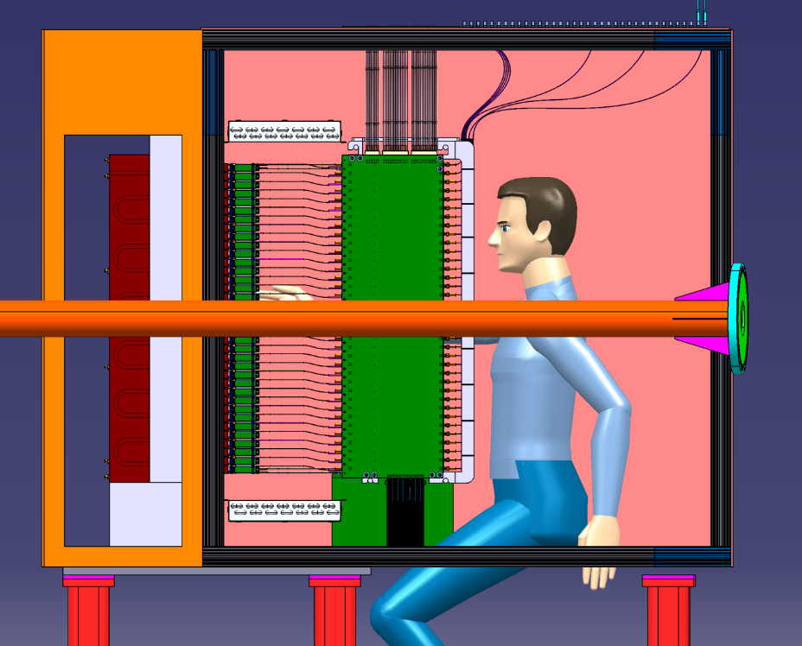
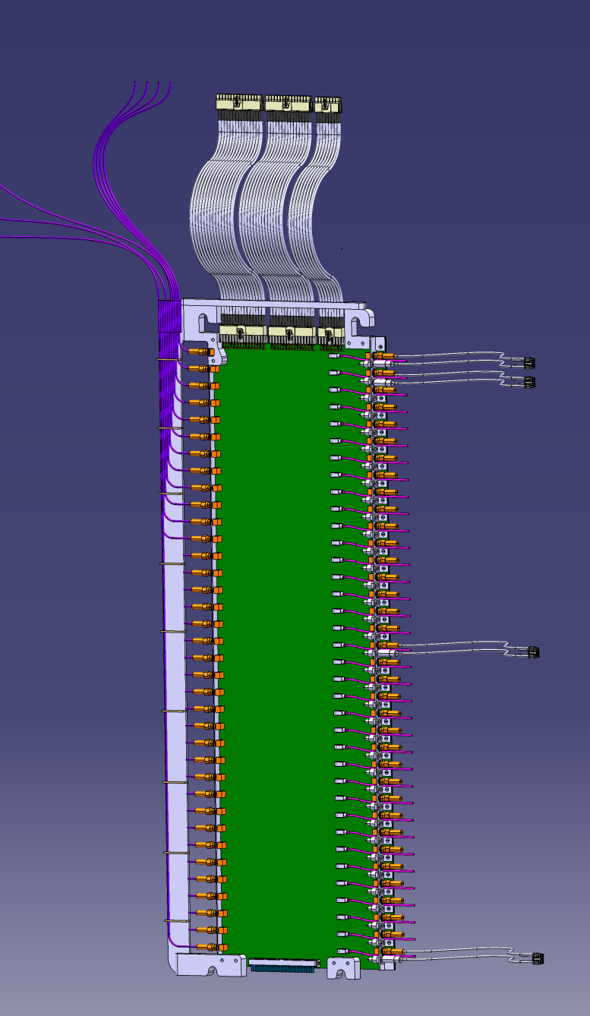
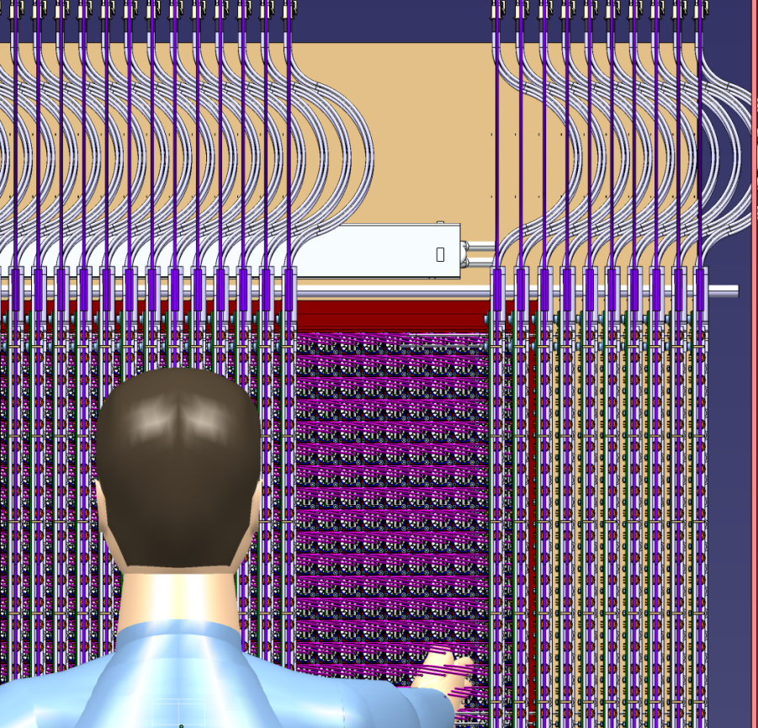
Cables and fibers
180mm

Slide 12
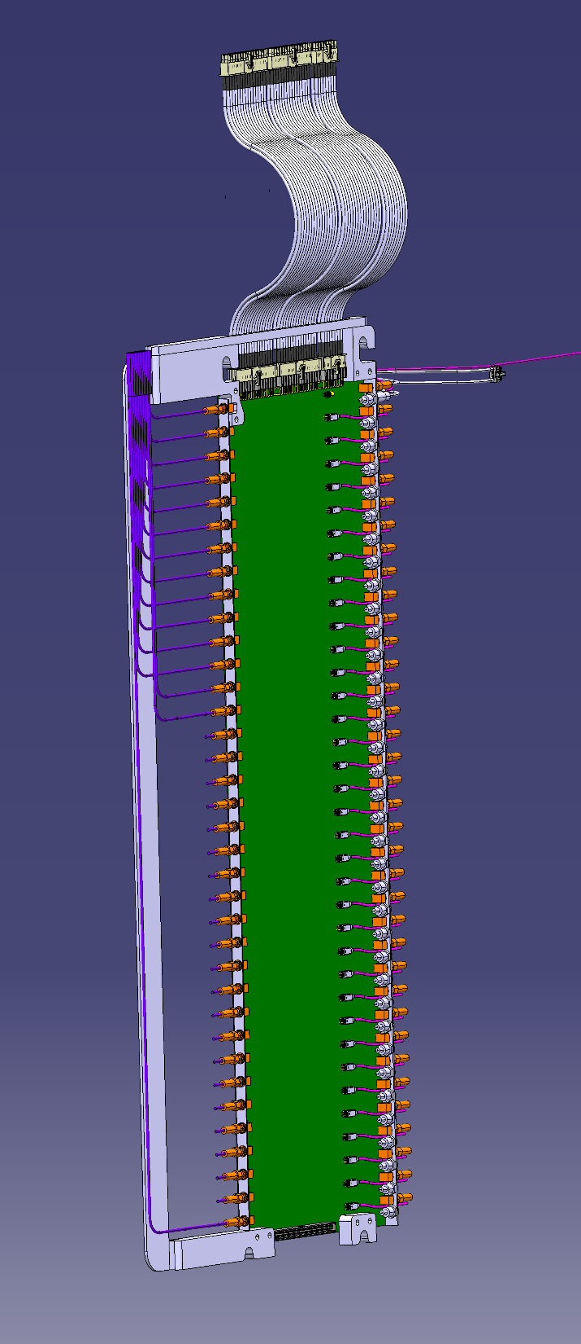
PCB design (HV, signal, LED)
Routing of the board completed
HV input
Slots for rails
Signal outputs
PMT
LEDs
Ficher conector for HV (smaller than regular SHV)
SMA connectors (signal)
LED control
Design 100% completed
1st board being manufactured (delivery by end of May)

Slide 13
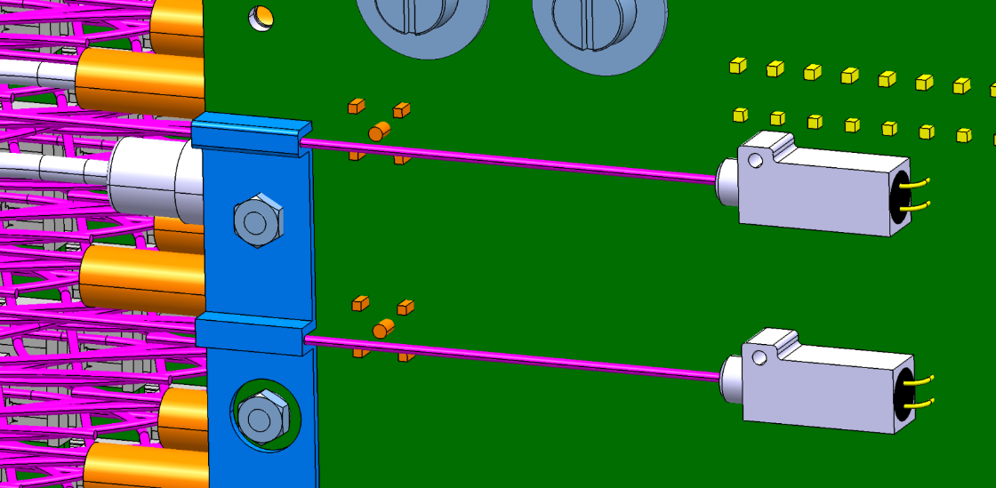
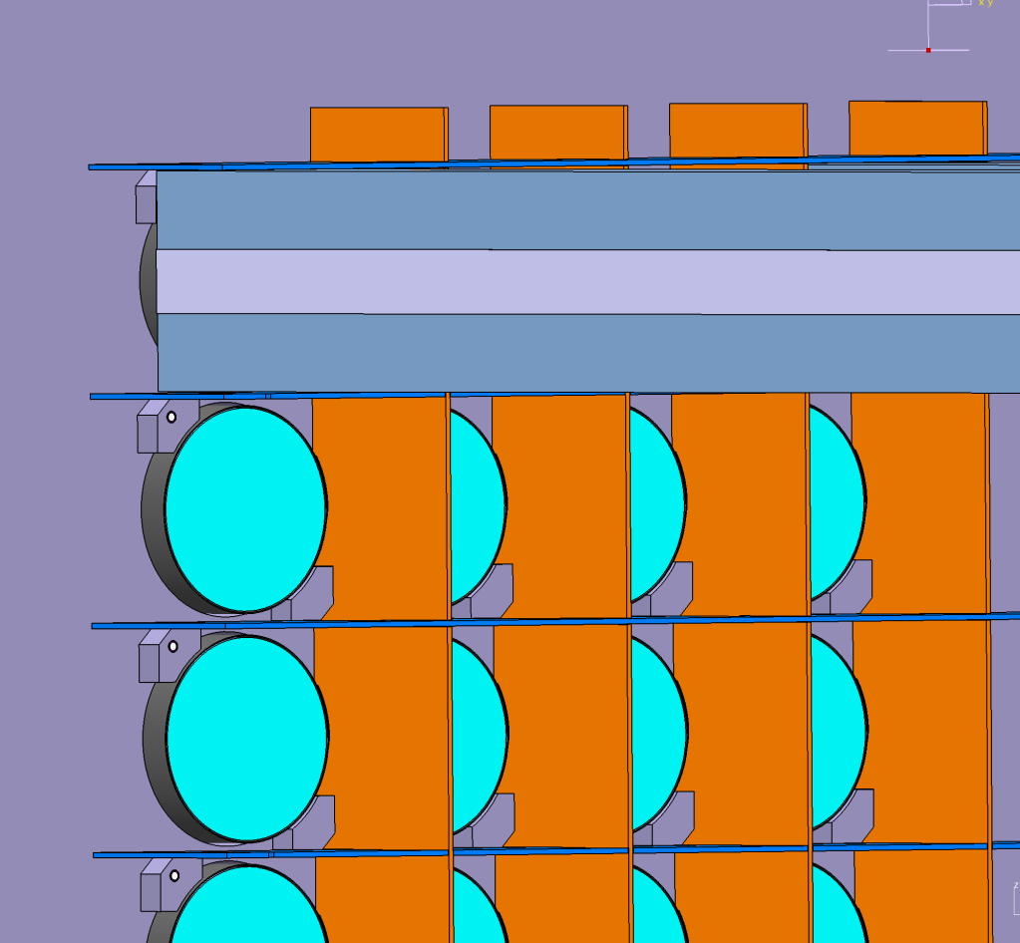
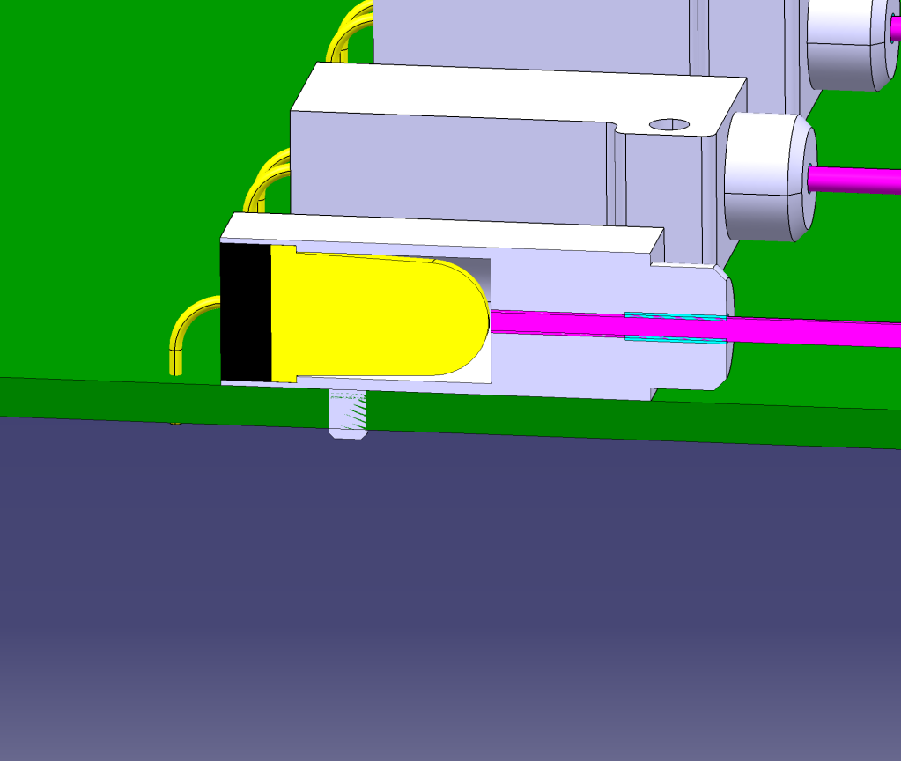
Calibration and curing
1 blue LED per channel (onto the PCB board)
Pulsed mode for calibration
Continuous mode for curing
Light through 800 μm diameter silicate fiber (radiation hard)
TO DO:
LED control board (JLAB)
grease
glue

Slide 14
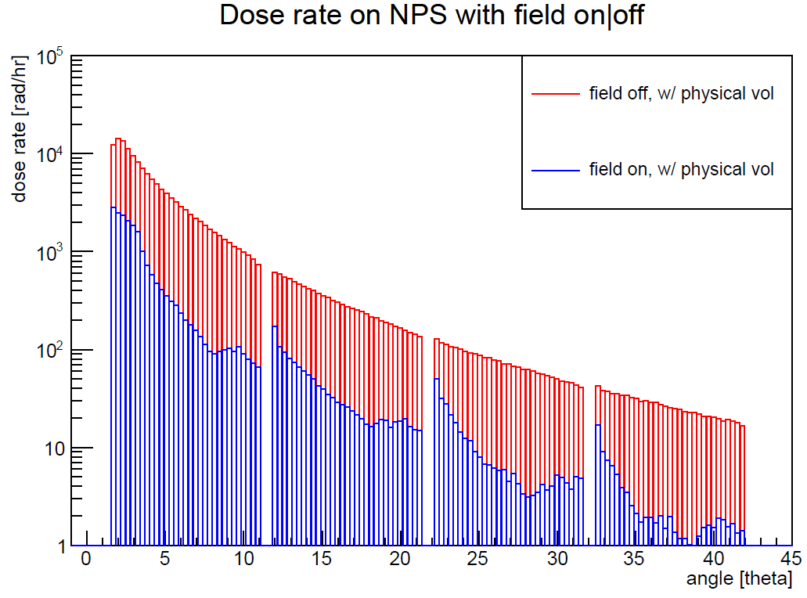
Radiation environment
1 μA, 15 cm LH2
Curing expected to be needed
every few days or few weeks, depending on the kinematics setting
30 Gy/h
Irradiation and curing tests made with 30 Gy at 1Gy/min rate
Geant4 simulation, cross-checked with RadCon estimates

Slide 15
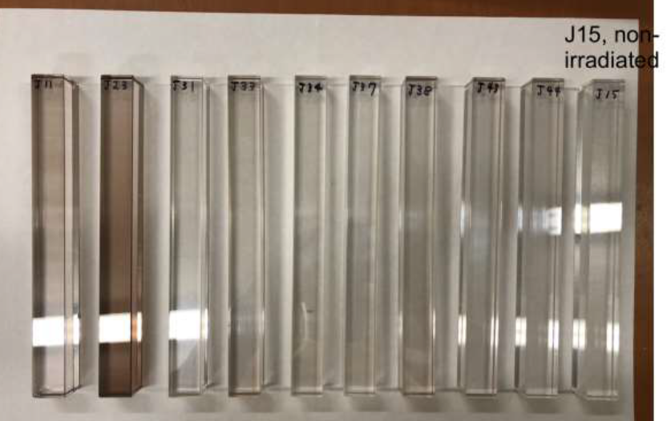
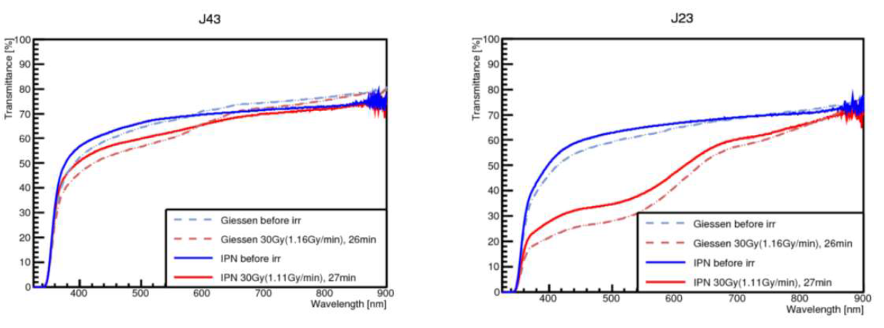
Irradiation and curing tests
Radiation hardness measurements
Strong ⁶⁰Co source (3000 Cu)

Slide 16
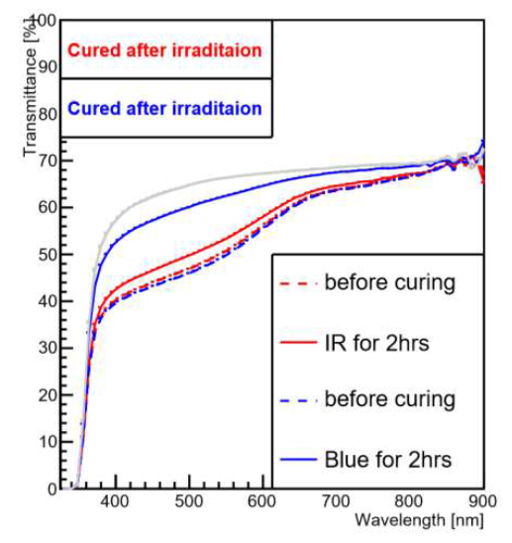
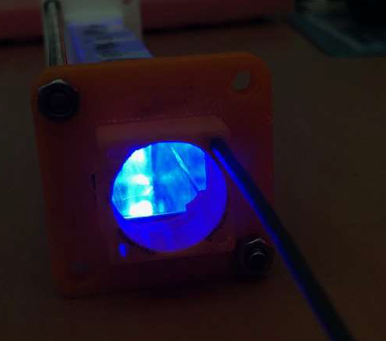
Irradiation and curing tests
30 Gy
(at ~1Gy/min)
Radiation damage recovered with a few hours of blue light curing
Blue LED optical bleaching

Slide 17
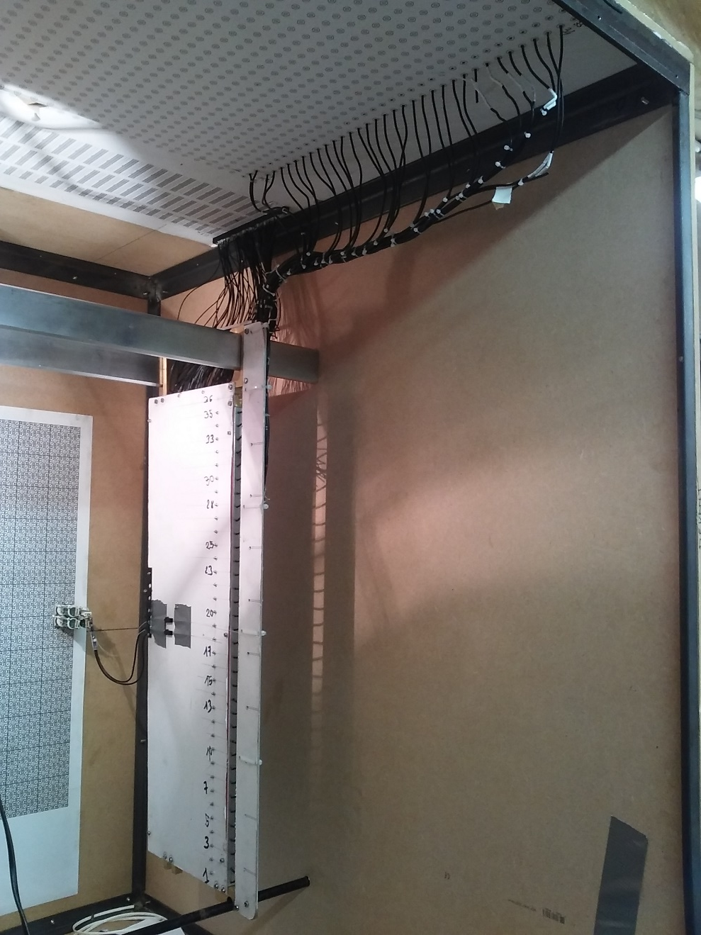
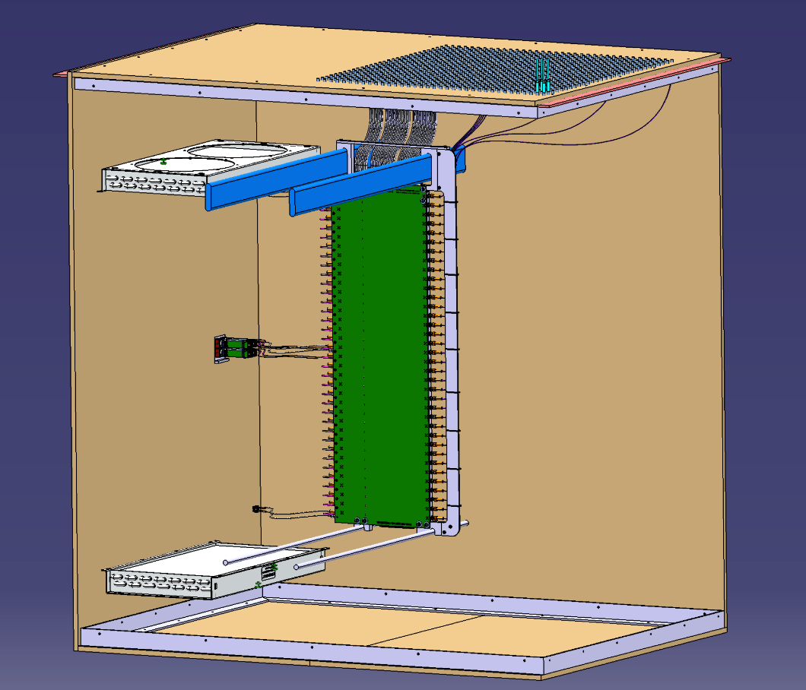
Full scale mock-up of NPS frame
Cable lengths defined:
32 cm PMT->PCB (HV+signal)
Signal PCB-> top of box: 0.5-1.5 m

Slide 18
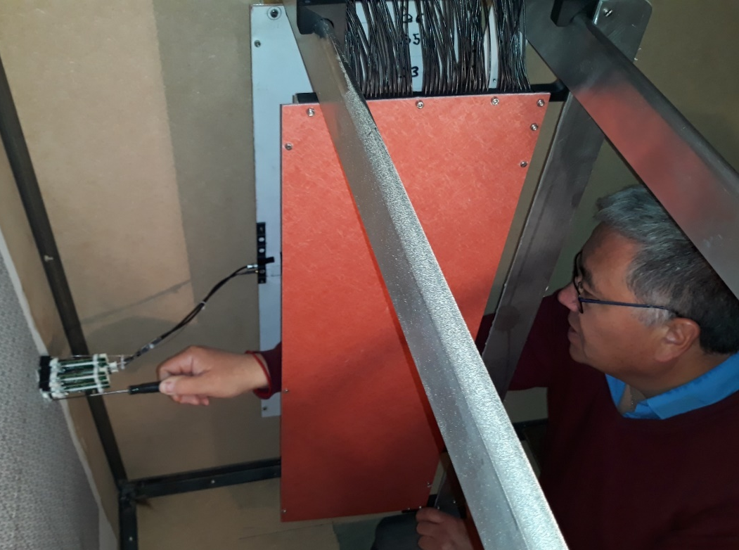
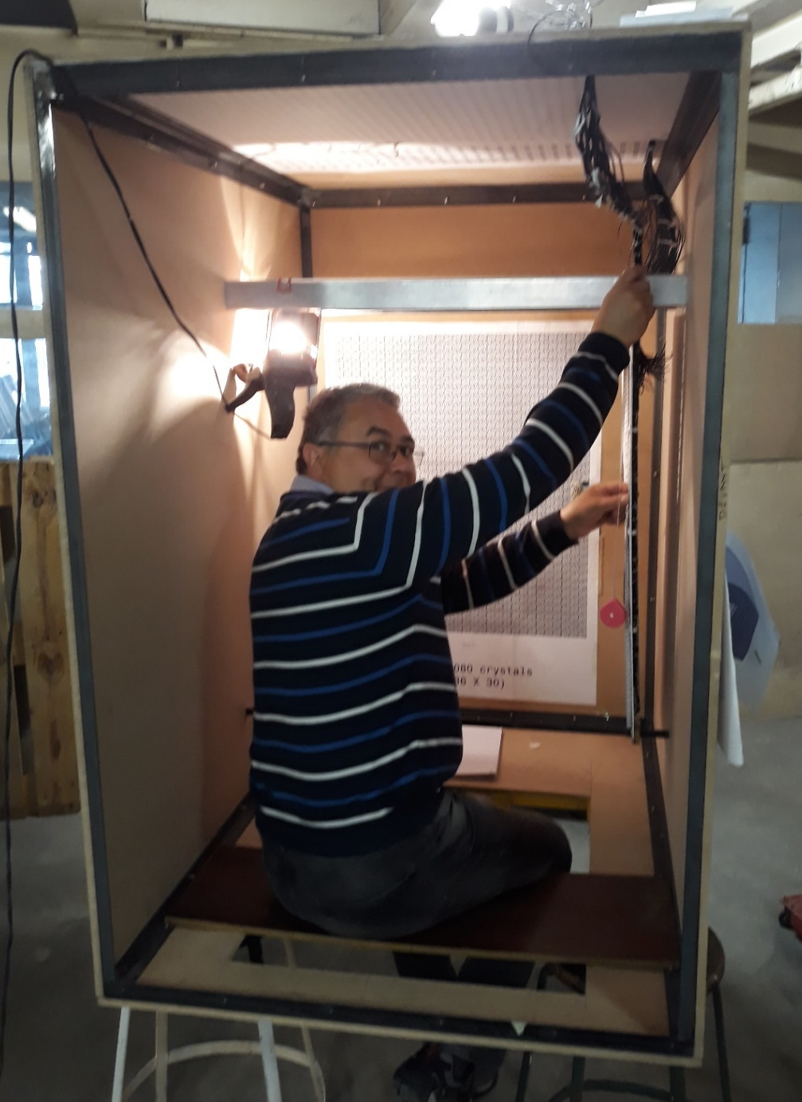
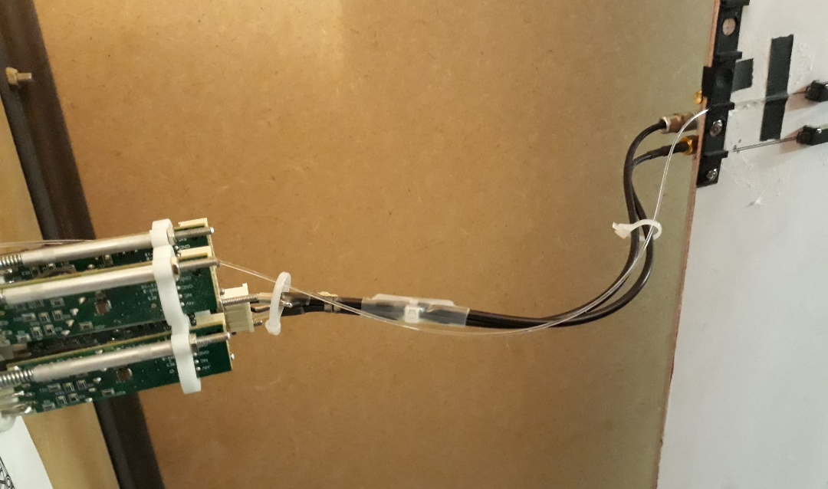
Full scale mock-up of NPS frame
18 cm
Easy PMT maintenance
Fiber
Human sized detector
HV+signal

Slide 19
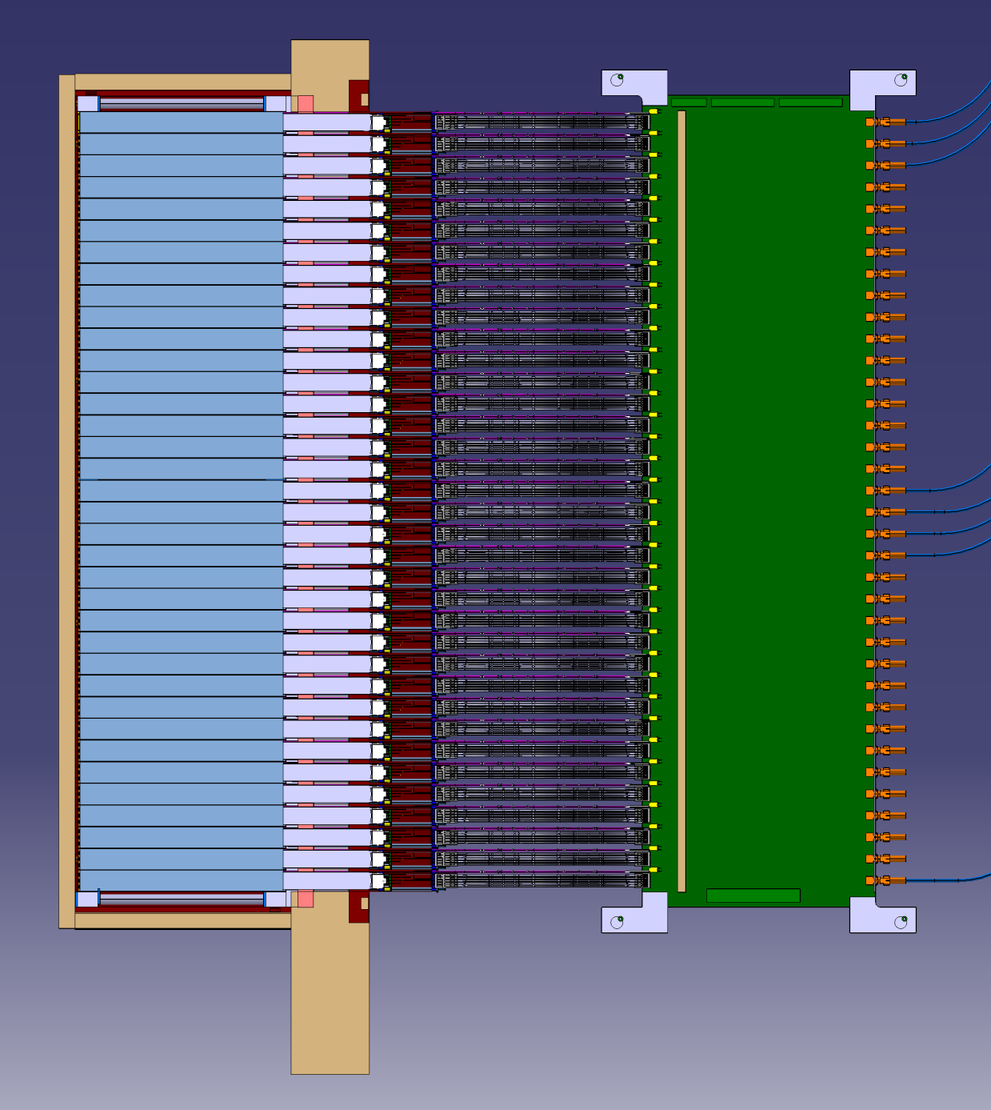
Temperature zones
Crystals Zone : @ 18°+/-0,1°
Heating Zone : 500mW/channel = 540 W
External Zone : T° = 22°c

Slide 20
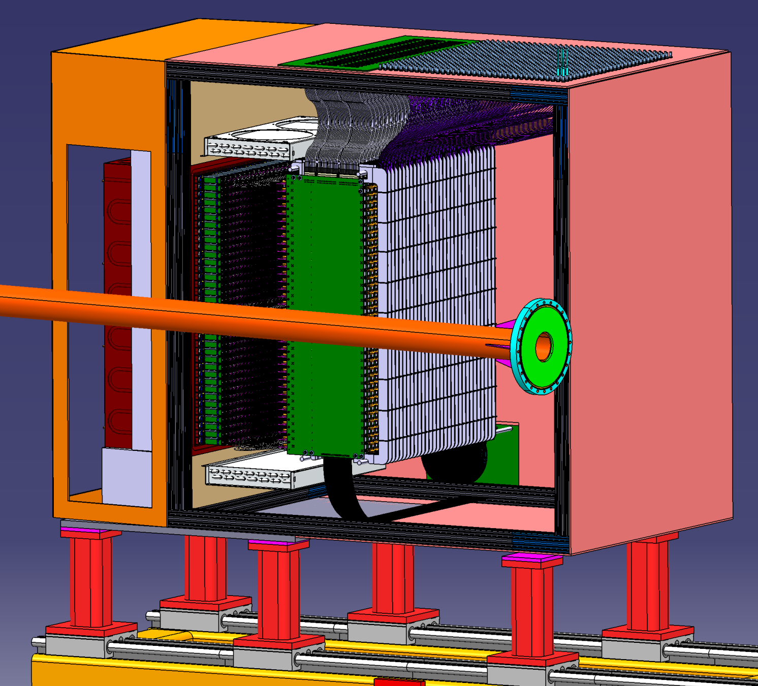
Temperature control: back side
Crystals Zone : @ 18°+/-0,1°
Heat exchangers & chiller procured
Heating electronic Zone : 500mW/channel = 540 W
Heating zone cooled with 2 heat exchangers 6320G3SB (Lytron)
+ funs + 1 chiller Kodiac RC006G03BG3
Same manufacturer than the ones used for HyCal
Higher heat load specification

Slide 21
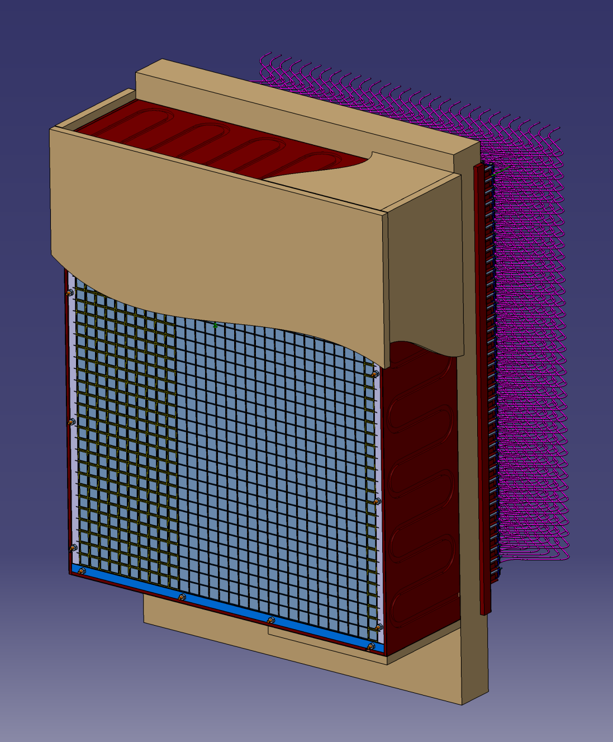
Temperature control: crystals
Crystals Zone : @ 18°+/-0,1°
4 copper plates around + 1 intermediate copper plate + 1 other chiller ( cooling separated from backward zone)
Foam : thermal insulator

Slide 22
Summary
NPS calorimeter construction in progress:
All crystals and PMT/bases will be onsite by Summer 2020
Calorimeter frame components will be shipped (from Orsay) early 2020
Assembly (+tests) at JLab can start from September 2020
No show-stoppers anticipated

Slide 23
Back-up

Slide 24
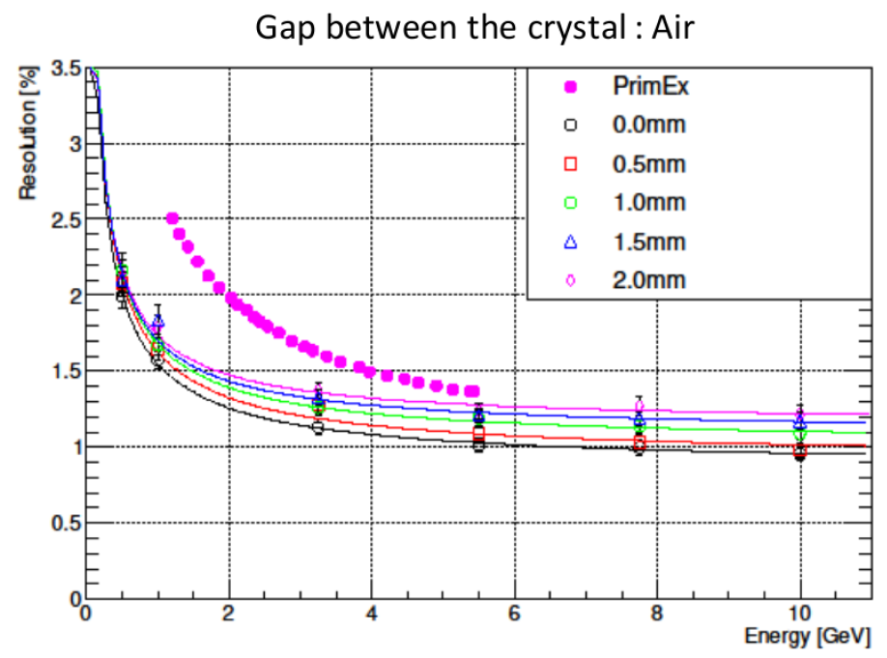
1% constant term added to
simulation (miscalibration, etc)

Slide 25
Beam Test of the Calorimeter Prototype
Installed in the experimental Hall D. Used to detect Compton events in the PrimEx D experiment
- successfully operated during PrimEx D production run in the Spring of 2019
Array of 12x12 PbWO₄ crystals
Beam hole: 2 x 2 crystals
Tungsten absorber covers the inner
most layer (taken from HyCal)
Water cooling (minimum 5° C),
nitrogen purge
LED-based gain monitoring system
Positioned on X-Y movable platform

Slide 26
Calibration
Move each calorimeter module to the photon beam
- Calibration runs at small luminosity (rate in the module 30 kHz at 30 MeV threshold)
Use beam energy provided by the Hall D tagger counters to equalize gains
FADC amplitude as a function of the beam energy
10 GeV : 3200 FADC channels
FADC range: 2 V (maximum range)
Typical HV: 700 – 750 V
FADC amplitude (count)

Slide 27
Linearity
Linearity of the FADC peak amplitude
Original PMT base, gain ∼25
Modified base, gain 3
750 V
2 V FADC range
850 V
2 V FADC range
Some non-linearities on the level of 2 – 3 % in the calorimeter response were observed for the original
PMT base for both the peak amplitude and pulse integral
- PMT was operated at relatively small HV, recommended HV is about 1 kV
The linearity can be improved by reducing the amplifier gain and increasing HV. Some tuning of the
PMT base may be required

Slide 28
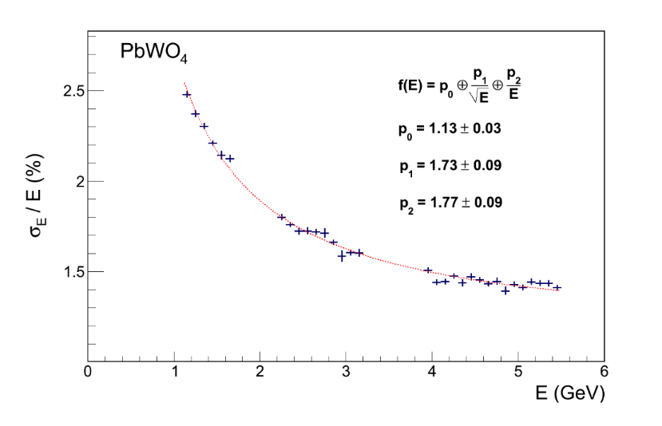
Energy Resolution
This plot will be updated
NPS Prototype
HyCal (Hall B)
3x3 array
bypassed amplifier
NPS prototype
$\frac{σ(E)}{E}=p1⊕\frac{p0}{\sqrt{E}}⊕\frac{p2}{E}$
•
•
•
Relatively good energy resolution, which is consistent with the resolution of the
Hall B HyCal calorimeter (which was constructed using SICCAS crystals)
More details can be found in
GlueX-doc-3590, GlueX-doc-3998, V. Berdnikov, A.Somov, J. Crafts

Slide 29
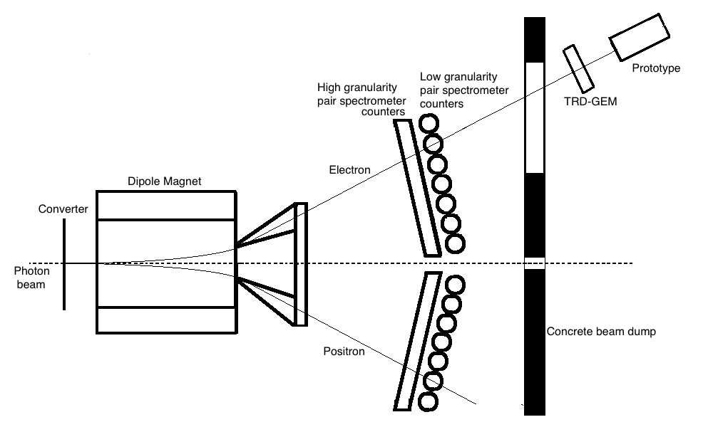
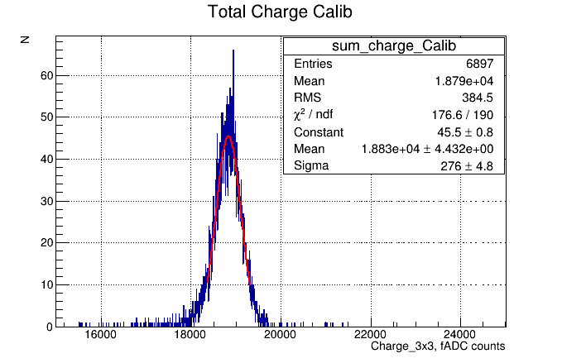
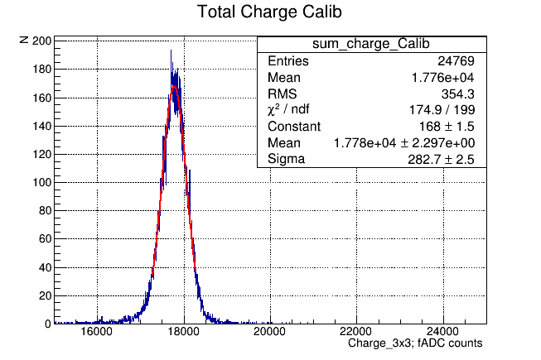
Energy Resolution
3x3 SICCAS crystals
3x3 CRYTUR crystals

