Slide 1
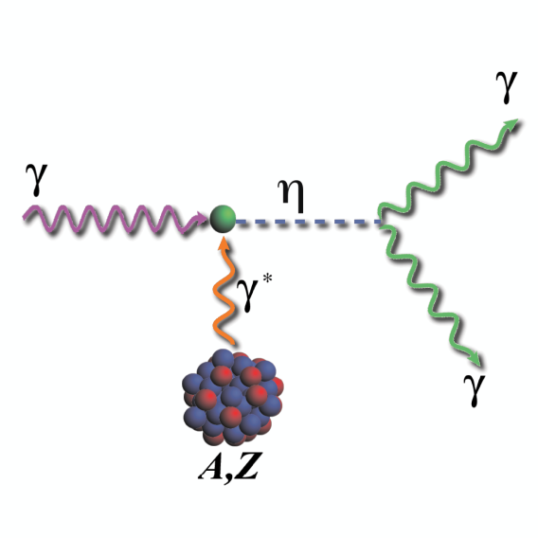
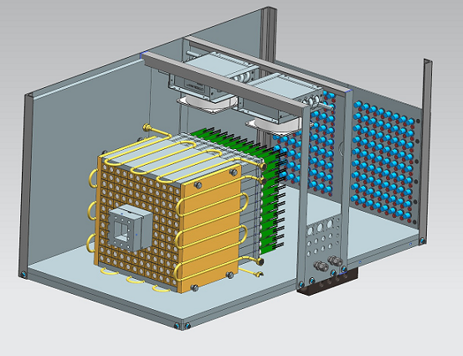
Status of the Calorimeter Prototype
A. Somov
Collaboration between Hall C and Hall D
Tanya Horn, Vlad Berdnikov, Hakob Voskonyan, Hamlette Mkrtchyan
Ashot Gasparan, Liping Gan, Iliya Larin, Joshua Crafts, Hovanes Egiyan, Vanik Kakoyan, Tim Whitlatch, Fernando Barbosa
NPS Collaboration Meeting, February 1, 2019

Slide 2
Introduction
Prototype of the NPS calorimeter
It will be used as a Compton Calorimeter for the PrimEx D
experiment in Hall D
Prototype of the Hall D forward calorimeter upgrade FCAL II

Slide 3
NPS prototype (Hall D Compton Calorimeter)
Array of 12x12 PbWO₄ crystals
Beam hole: 2 x 2 crystals
Tungsten absorber covers the inner
most layer (taken from HyCal)
Water cooling, colled to 5° C,
nitroger purge
LED-based gain monitoring system
Positioned on X-Y movable platform
Hamamatsu R4125 PMT
HV dividers with amplifiers, designed by Vlad Popov

Slide 4
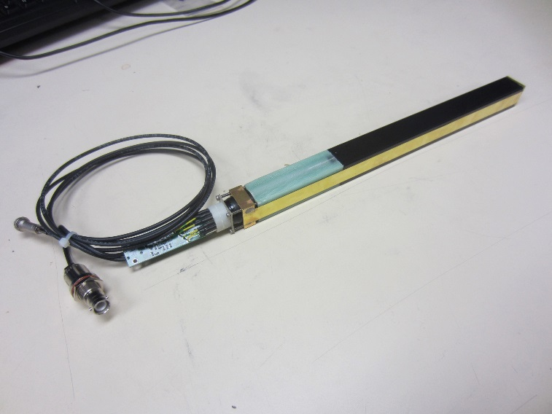
Module Assembly
Design from HyCal
(Hall B)
PbWO₄ crystal
PMT housing
Brass strip
PMT divider & Amplifier
PbWO₄ crystal wrapped with a ESR reflective foil (60 μm) and Tedlar (35 μm)
Brass tension strips (25 μm) are brazed to flanges and hold pieces together
PMT is placed inside G-10 housing with mu-metal

Slide 5
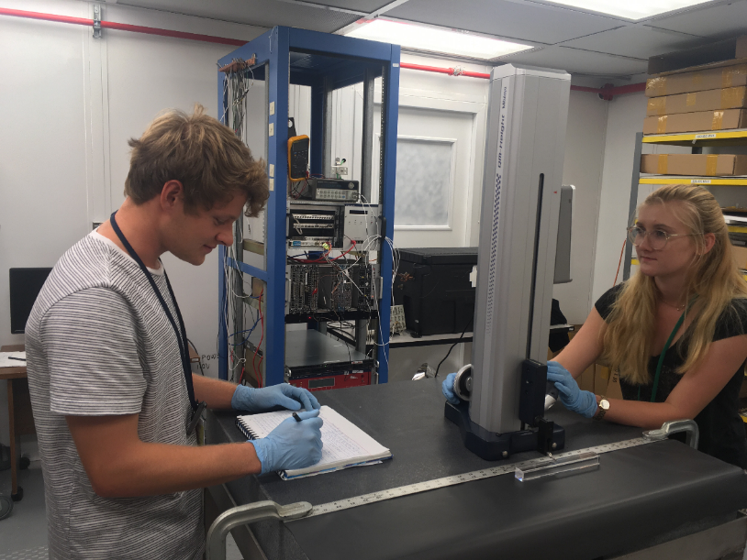
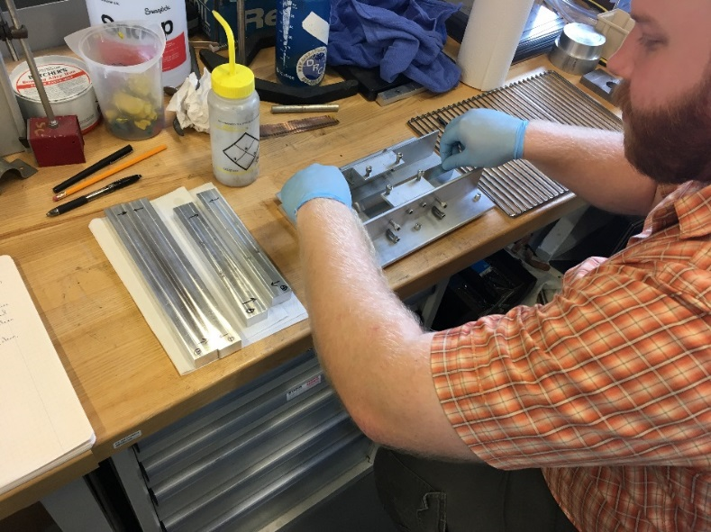
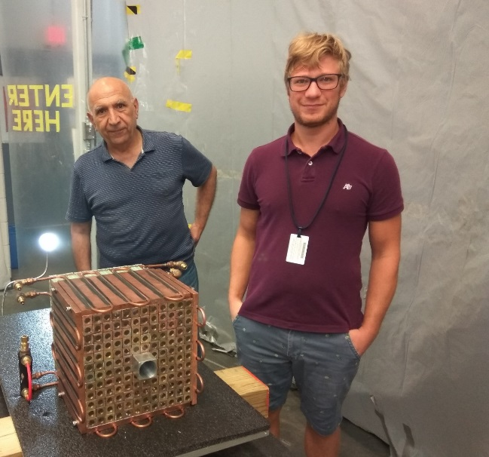
Calorimeter Fabrication
Crystals QA
Shaping ESR reflective foil
https://halldweb.jlab.org/wiki-private/index.php
/CompCal_Construction
The page contains a lot of fabricaton details
and proceedures

Slide 6
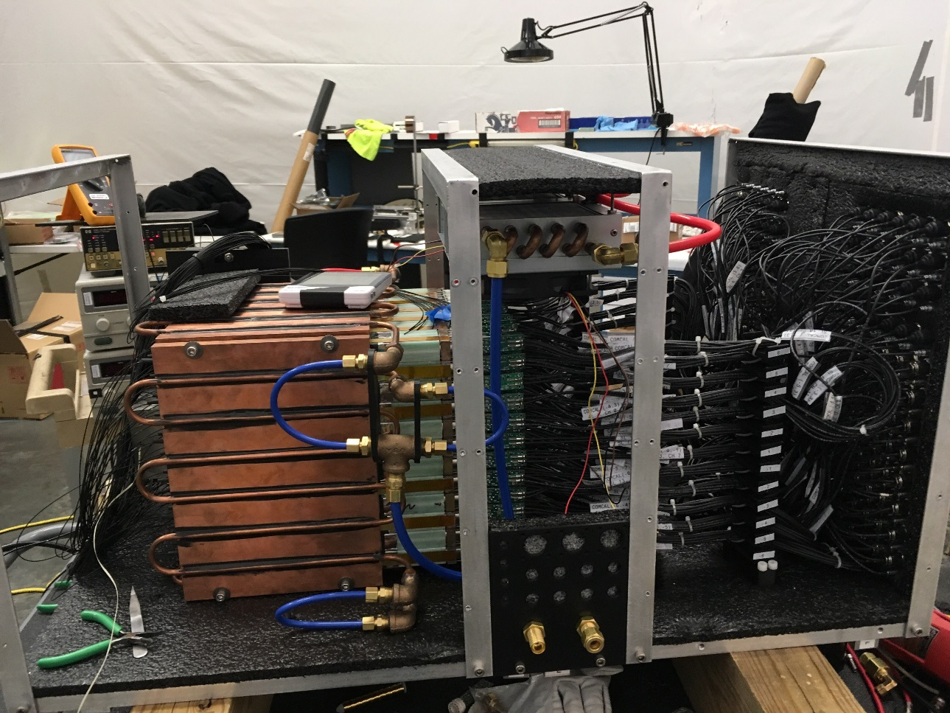
Calorimeter Fabrication

Slide 7
Light Monitoring System
LED pulser provided by Frenando
Light from an LED is distributed to the face of each crystal using optical fibers
FADC waveforms

Slide 8
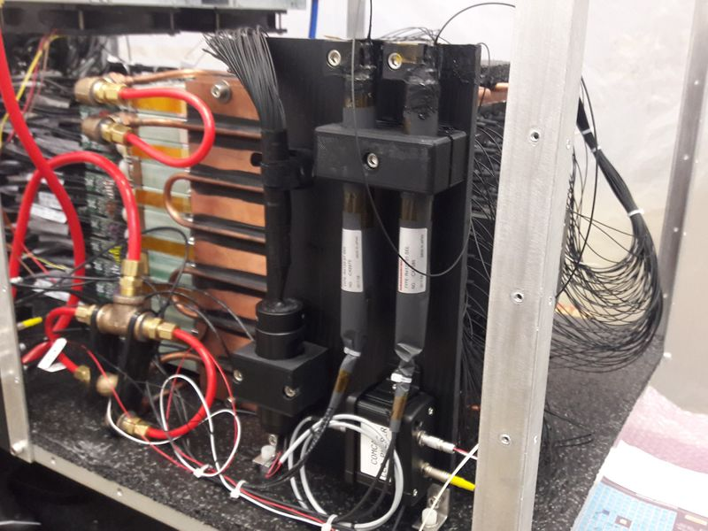
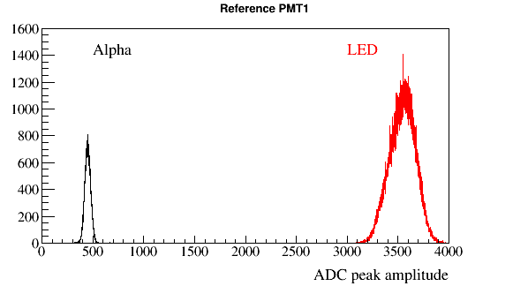
Light Monitoring System
Two reference PMTs are installed to monitor LED stability
Each PMT receives light from the LED fiber and YAP:CE Am light source
LED and Alpha-source triggers are used during data taking (special trigger types)
Reference PMT FADC amplitudes
PMT1
PMT2

Slide 9
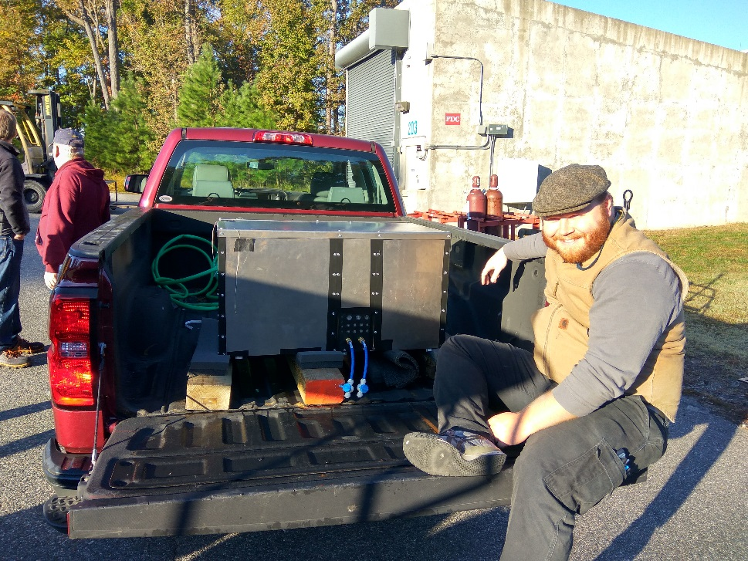
Installation in Hall D

Slide 10
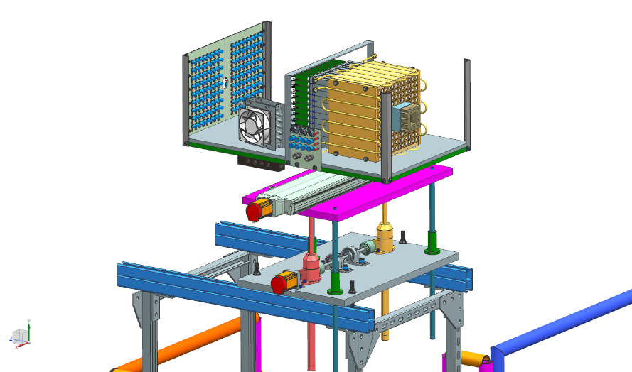
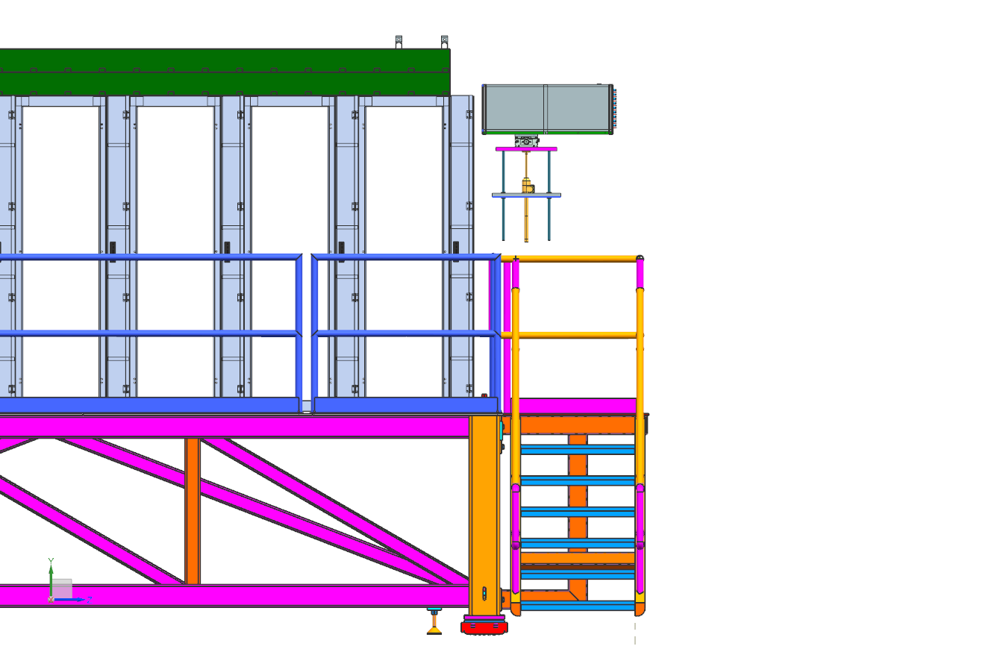
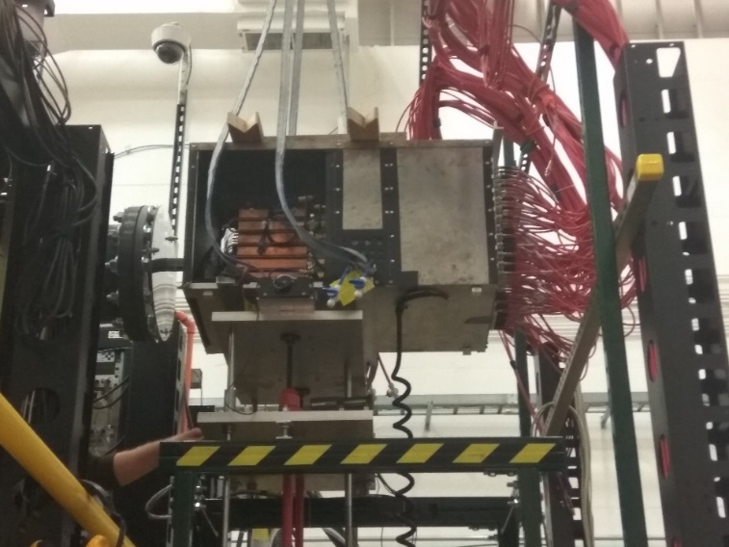
Position in Hall D
CompCal on the movable platform
CompCal
Beam
FCAL

Slide 11
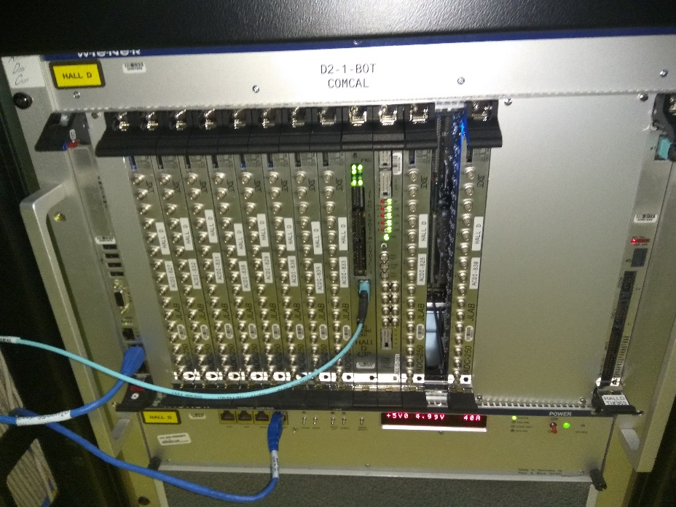
Trigger and Readout Electronics
VXS crate with 10 fadcs and trigger
modules installed in the Hall
The crate is connected to the global
trigger crates
Integrated to the GlueX DAQ system
Integrated to the GlueX trigger
- PrimEx D trigger is based on energy
depositions in FCAL & CCAL
- SSP module installed in the
trigger crate
- new GTP firmware installed and testes
- tested using a Play Back mode
An LED trigger is handled by the CAEN
1495 module (installed), which is connected
to the TS

Slide 12
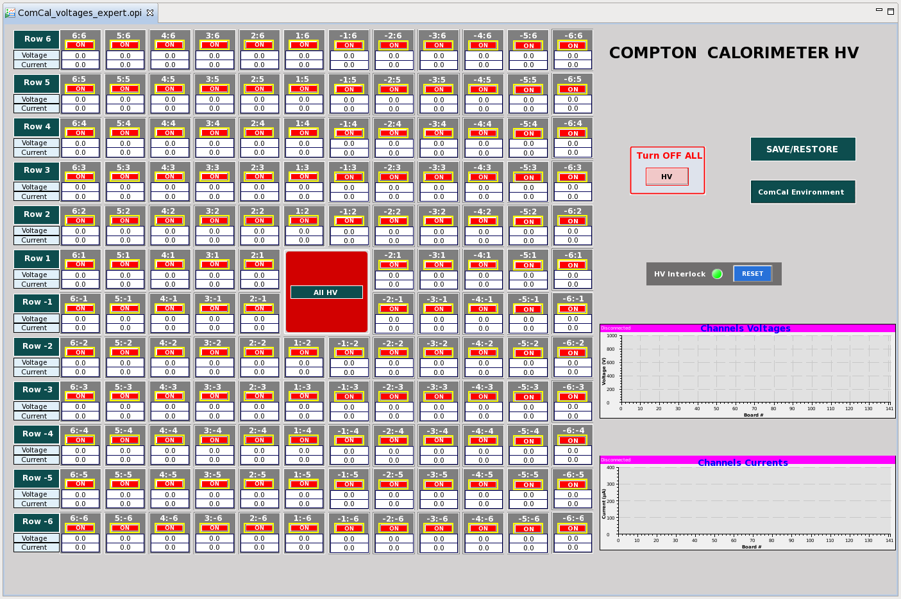
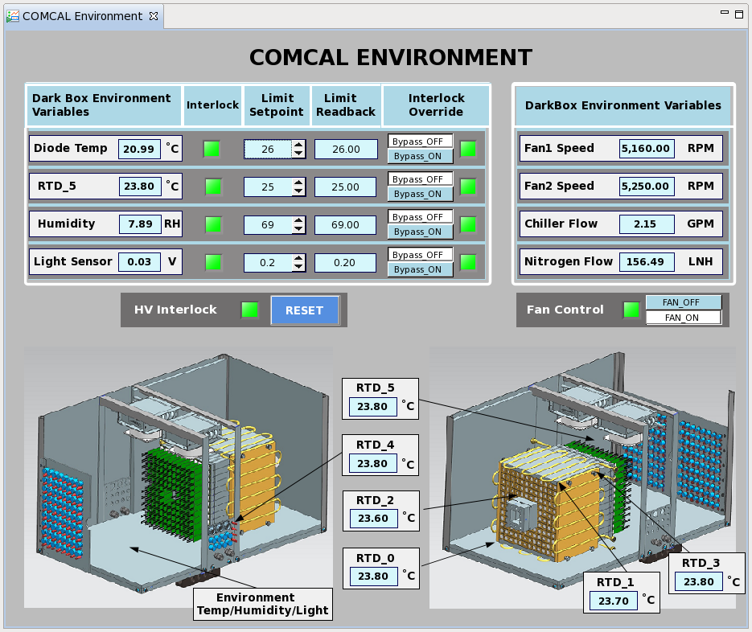
Calorimeter Slow Control
Hovanes E., Vanik K. (see Hovane’s talk)
HV control
Environmental control

Slide 13
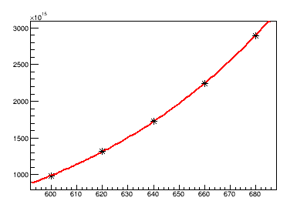
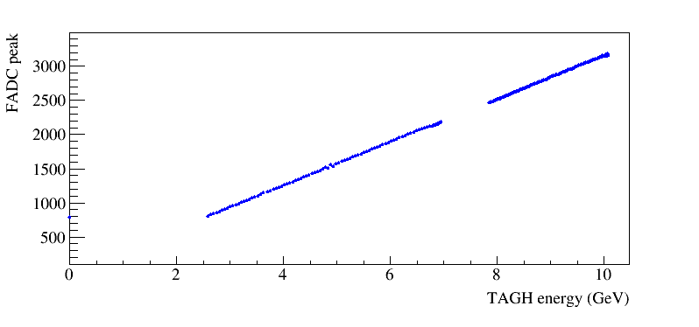
Calibration
Move each calorimeter cell to
the beam
HV scan for all channels
(automatic preceedure)
Use beam energy provided by the
tagger hodoscope to equalize gains
10 GeV – 3200 fadc channel

Slide 14
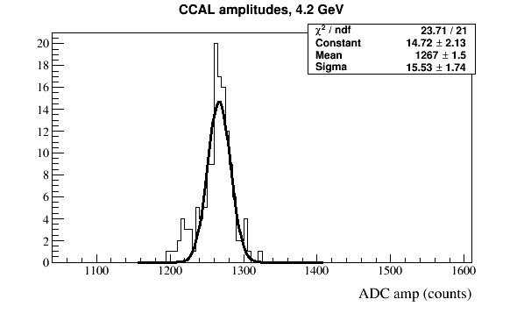
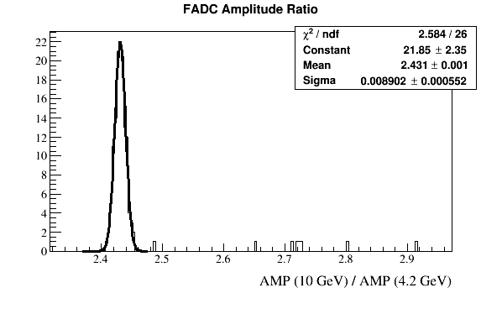
Calibration
fadc amplitudes
at 4.2 GeV
Amplitude ratio
A(10 GeV)/A(4.2 GeV)
Δσ/σ ∼ 0.5 %
- good module-to-module stability
observed 7 channels with larger amplitude deviation
(the PMT pulses look Ok)

Slide 15
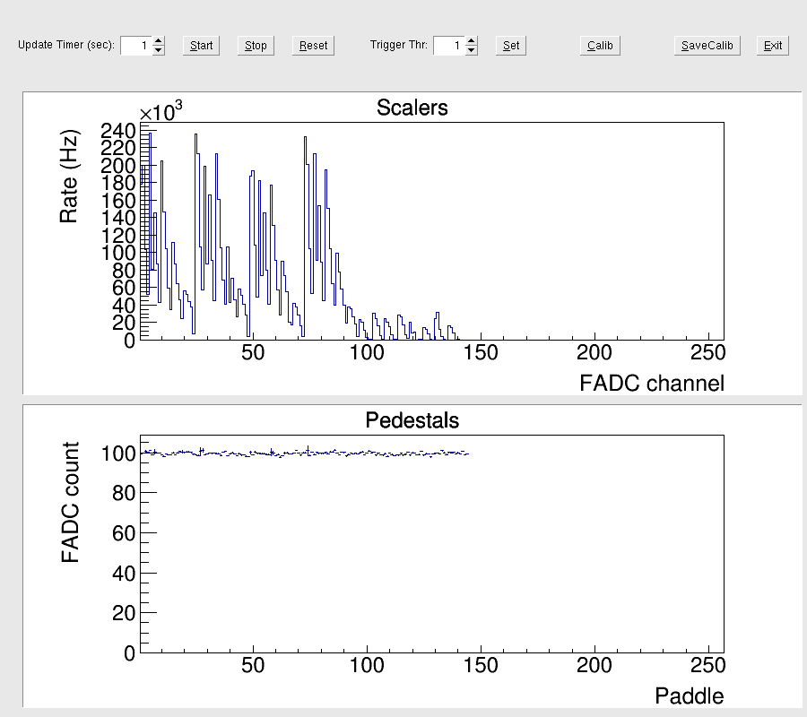
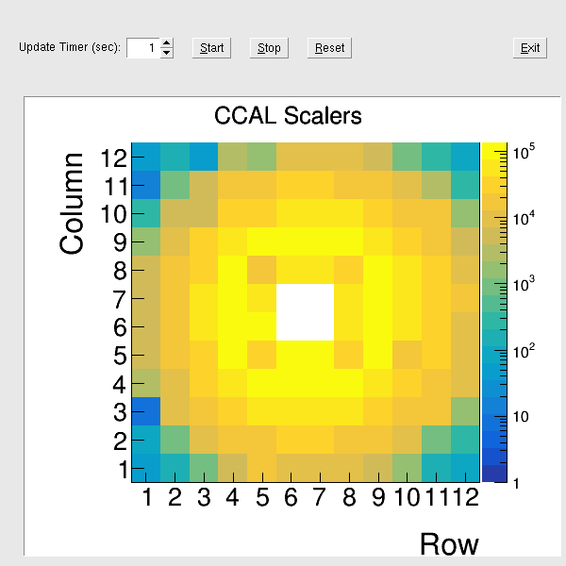
Rate per Counter (PrimEx D Conditions)
Maximum rate per counter
is 250 kHz
(at ∼30 MeV threshold)
In a good agreement with the
simulation for PrimEx D
250 kHz
FADC scalers

Slide 16
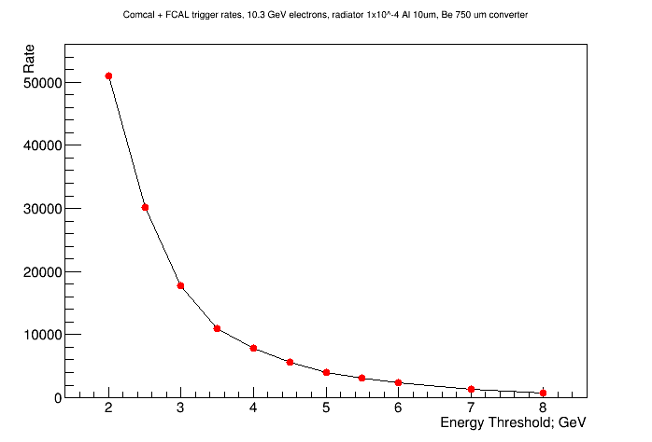
Trigger Rate for PrimEx D
Trigger is based on the energy sum deposited in two forward calorimeters (FCAL and CCAL)
Trigger rate as a function of the total energy
(FCAL + CCAL) threshold
Trigger rate at 4 GeV
threshold is about 8 kHz
(DAQ livetime is ∼100 %)
- consistent with MC
predictions
4 GeV

Slide 17
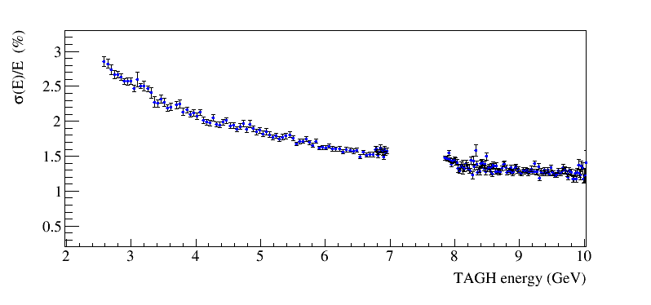
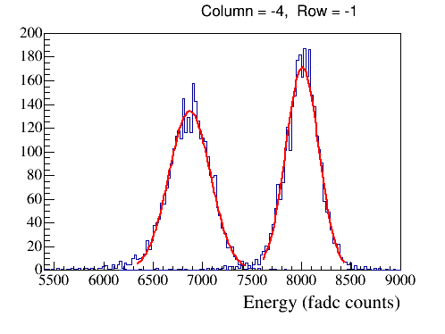
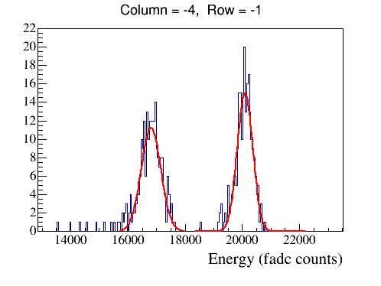
Energy Resolution
Slightly worse resolution than expected
- amplifier performance (?)
(operating as small voltages,
non linearities)
Energy deposition in the central cell:
- 85 % of the total energy in
the cluster (expect ∼ 80%)
•
HyCal
ADC pulse integral
4.2 GeV
10 GeV

Slide 18
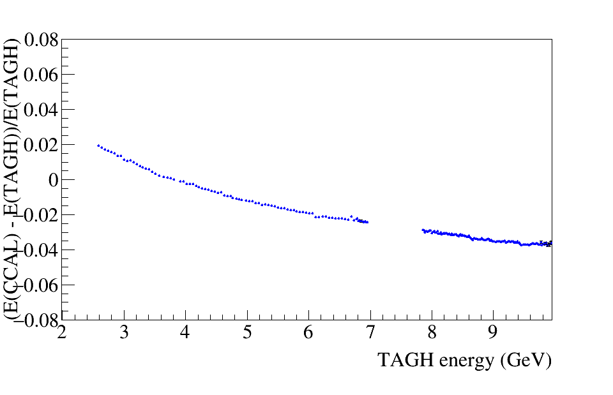
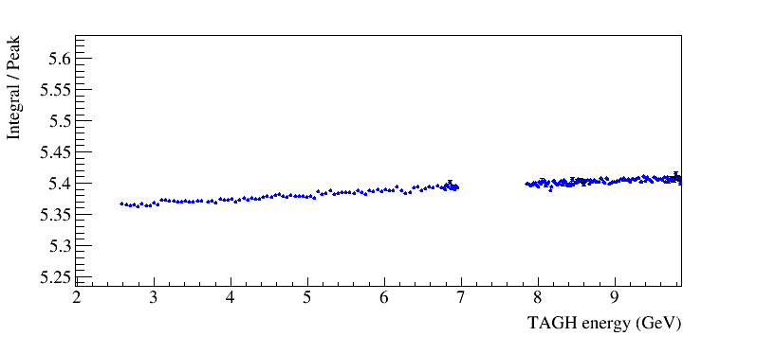
Energy Resolution (non linearities)
Relative Pulse integral
Non linearity of the fadc peak amplitude
between 2 GeV and 10 GeV ∼2 %
(note, the energy scale of the tagger
is slightly non-liner
large non-linearity of the pulse integral,
> 5 %
Integral / Peak

Slide 19
PMT Operation Condition (discussion)
The maximum rate per module in the PrimEx experiment is 250 kHz
We operated PMTs as small voltages of about 620 – 650 V which provided
the pulse amplitude of about 1 V (recommended Hamamatsu voltage is
above 1 kV).
The anode current for this conditions is about 10 μA
Without an amplifier (factor ∼10), the current will be 100 μA, which corresponds
to the maximum averaged current for this PMT, i.e., the amplifier is need at
this rates (though the amplification can be reduced)
(operating at the maximum current results in about 15 % gain drop after 100 hours
of operation, to be checked)
For a new run, we switched fadc to a 2 V range and increased voltages by
about 60 V

Slide 20
Next Steps
The calorimeter prototype has been successfully tested during
PrimEx D commissioning run in the Fall of 2018 and will be used in the
Spring run of 2019
Reconstruction of the calorimeter (Hits, Clusters) has been integrated to the Hall D reconstruction framework. For the cluster reconstruction we use “Island Algorithm” inherited from Hall B HyCal
We are working on the calorimeter calibration and trying to understand the energy resolution (light yield in units of photo electrons) and observed non-linearities in the reconstructed energy
- we are planning to check/study divider performance

Slide 21
Backup Slides

