Slide 1
CPS Prototype
Simulation of low temperature heating using Heat stick
Version D
Sept 15, 2021

Slide 2
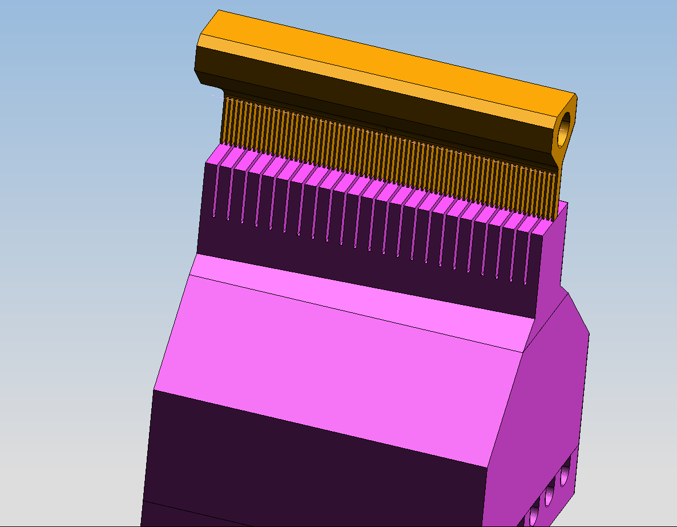
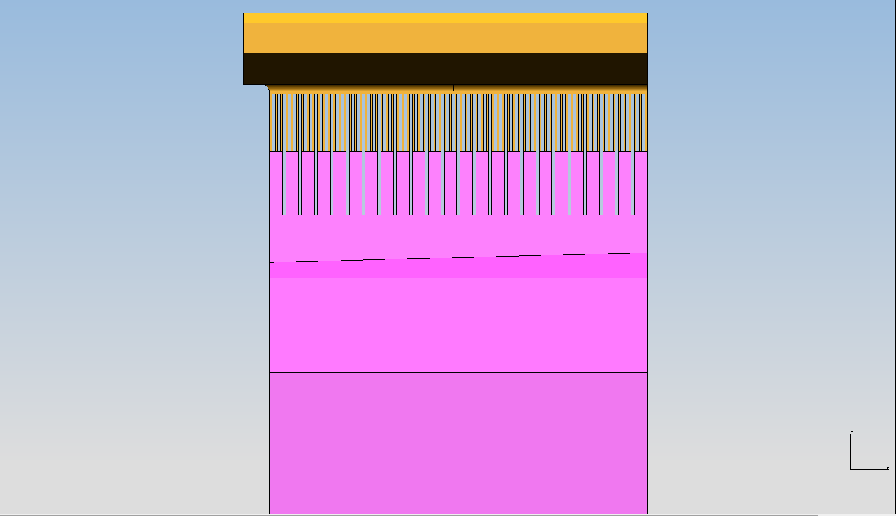
Thinner and longer Heater Tines
Three heater tines to each Absorber block

Slide 3
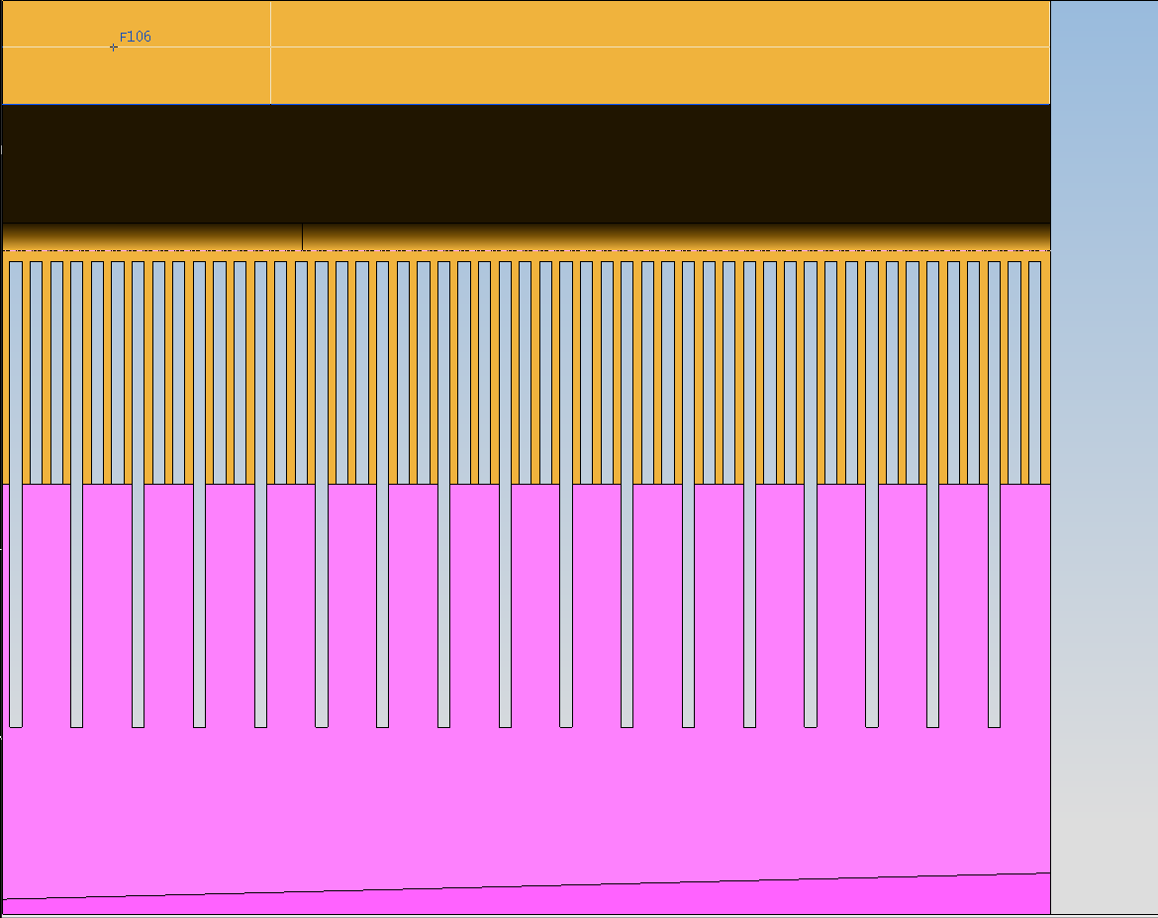
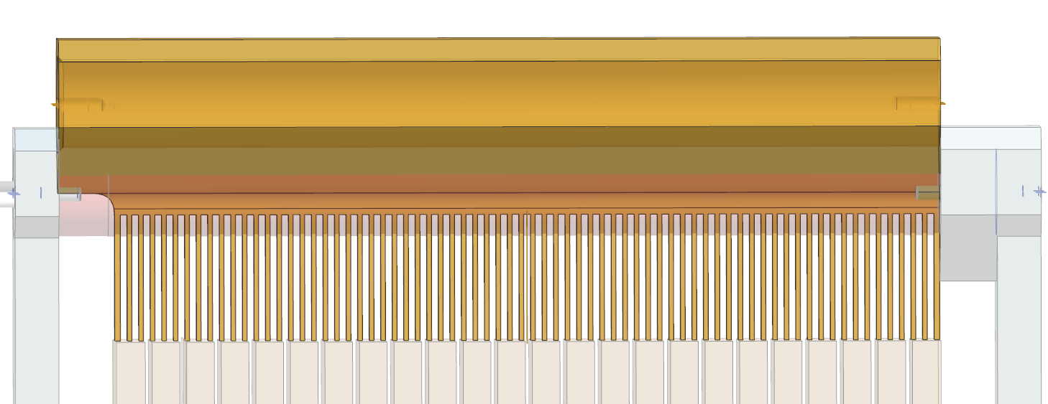
Close up and Pre-Brazing setup

Slide 4
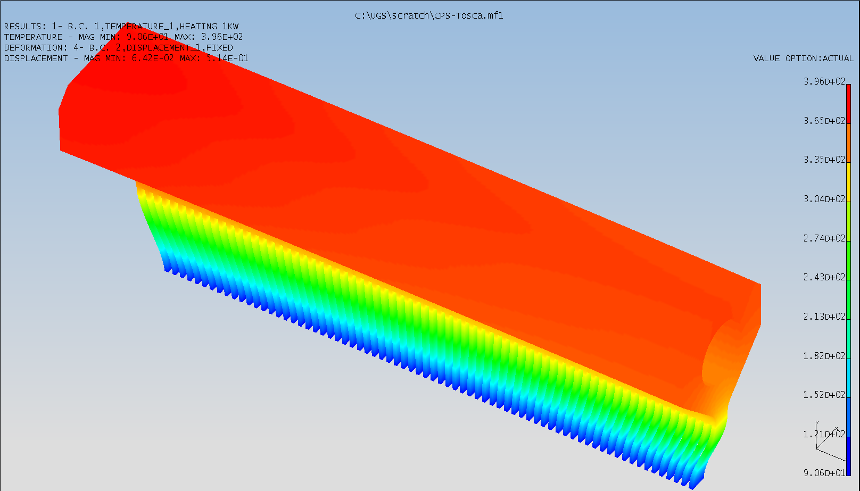
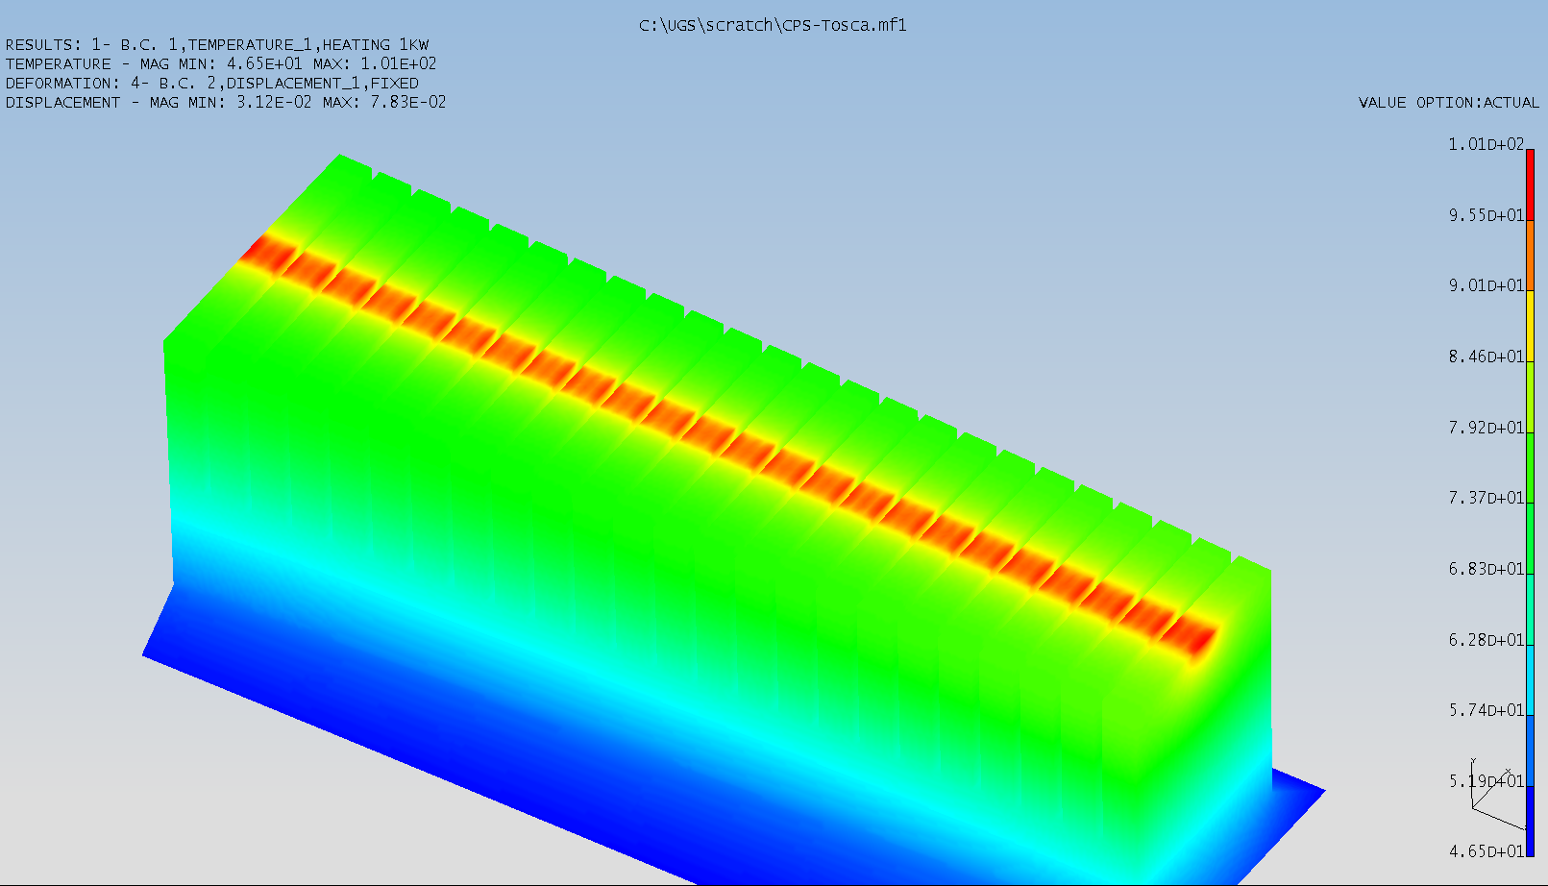
Temperature Profile
1kW heater applied to inner surface area of heater
Units mm, C

Slide 5
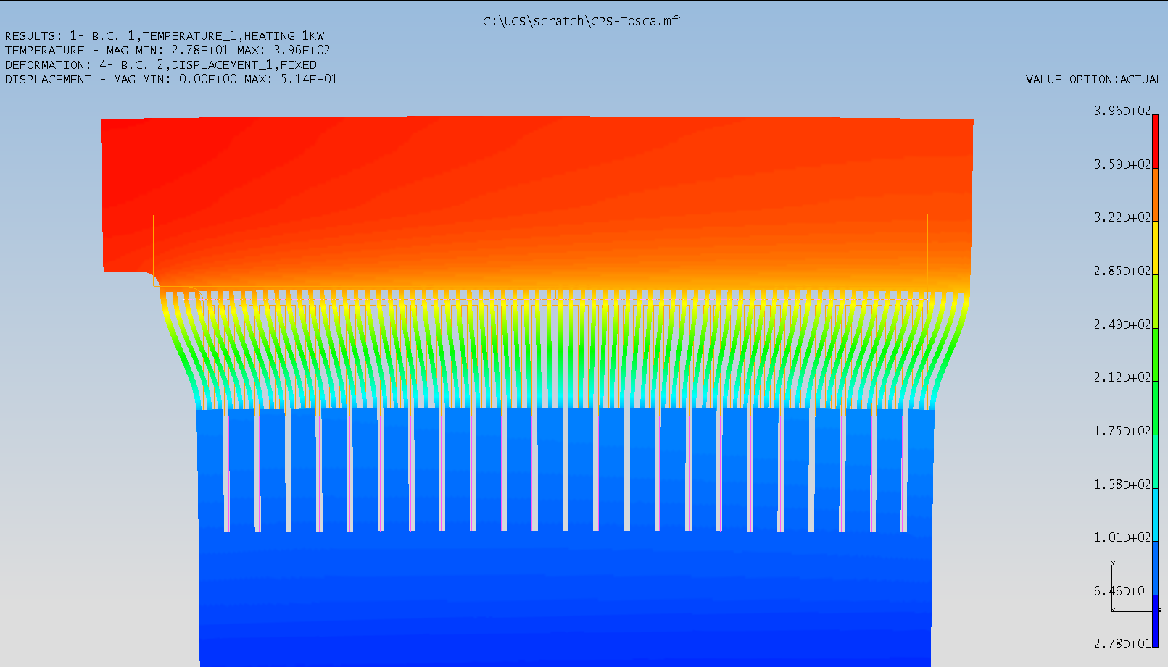
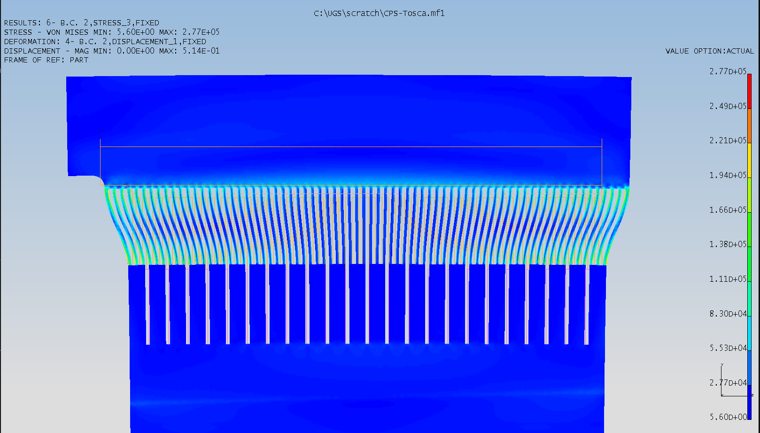
Temperature Profile Stress and Deflection
Units C Units mPa, mm

Slide 6

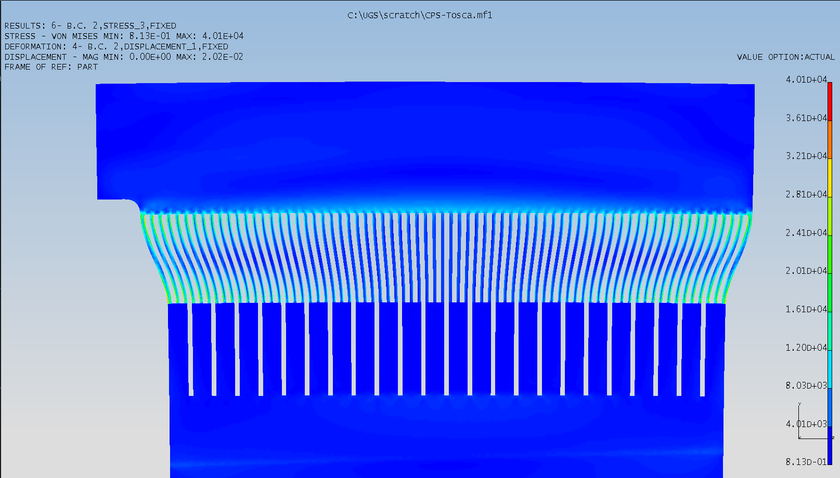
Temperature Profile Stress and Deflection
Units F Units psi, inch

Slide 7
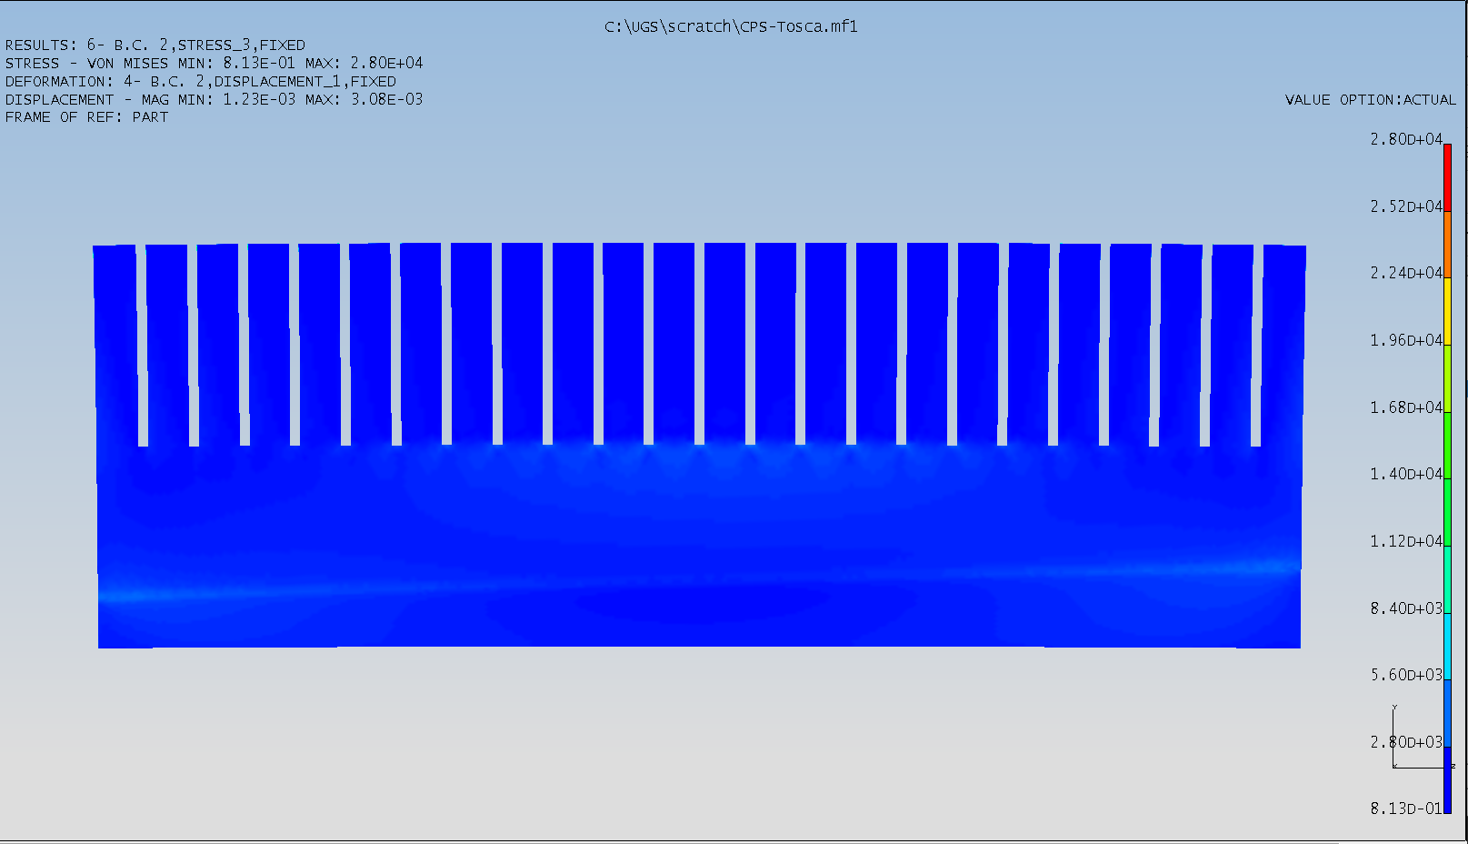
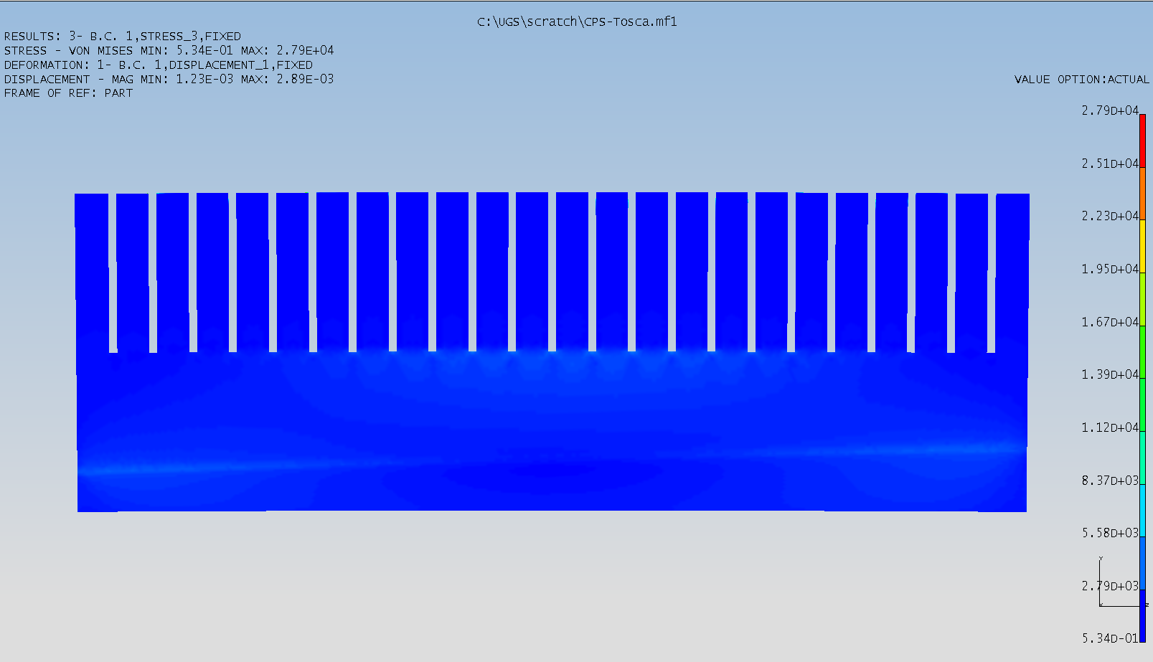
Heater attached vs No heater
Units psi and inches
Very little Difference between the two.
Looks like this is the best option to go with

