Slide 1
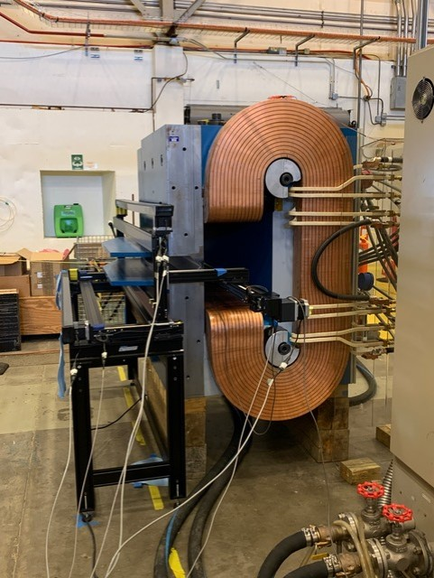
Sweep Magnet Mapping Data
NPS/CPS Meeting
16 January 2020
Charles Hyde
Old Dominion University
Mitch Kerver, Software
Tom Hartlove, Mechanical

Slide 2
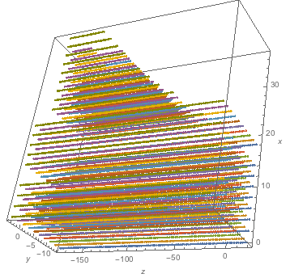
Magnet Mapper
Gammas and background
3-D Coverage
+z towards target
+y down
+x horizontal away from beamline
View from below
Beam

Slide 3
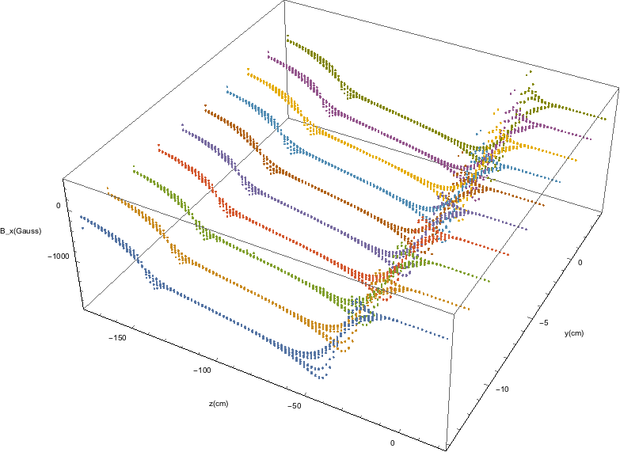
Horizontal Field at 250 A
Front trim coil off
Field uniform in x and y at center of z-range
B_{x}(Gauss)
y (cm)
z (cm)

Slide 4
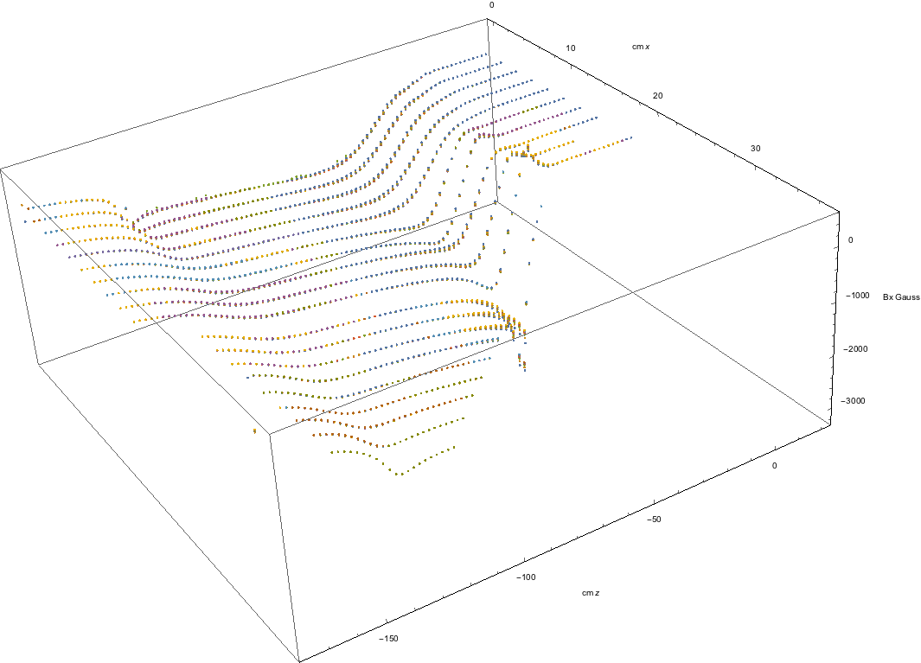
B_{x} (Gauss)
10
20
x (cm)
B_{x}
30
Central Field ≈–1100 Gauss
Color = various y-values
0
–1000
–2000
0
–50
–100
z (cm)
–150

Slide 5
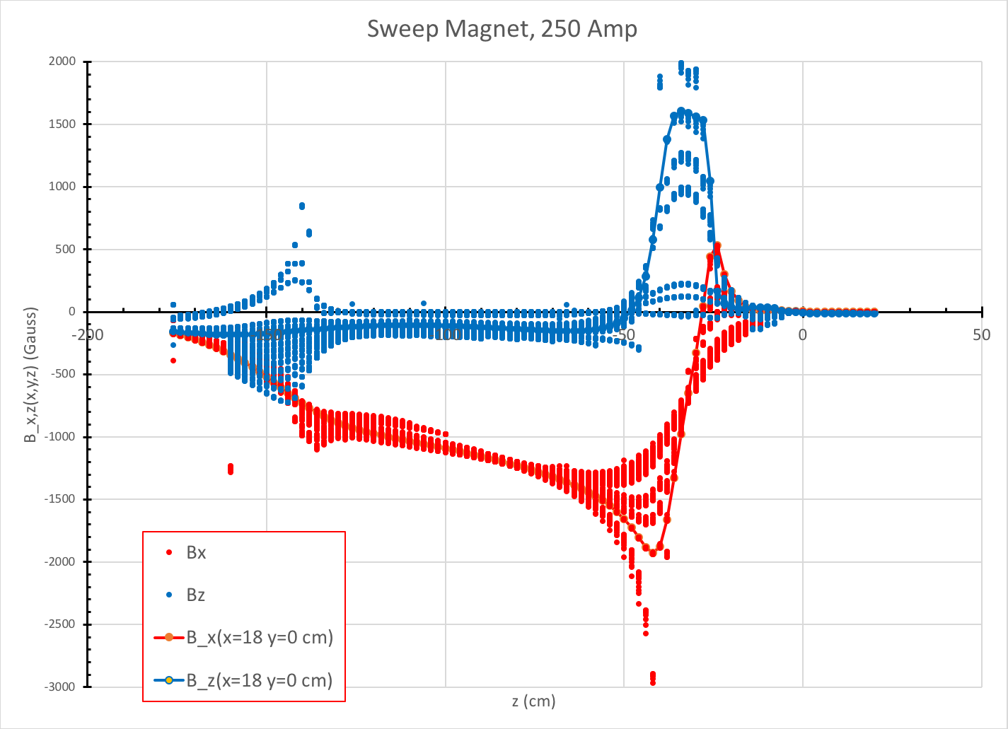
B_{x}, B_{z}
Various x,y values

Slide 6
Summary
B_{x} , B_{y} , B_{z} data available in full magnet volume
Beamline data available
Future work: Local Interpolation to test consistency
$∇∙B=0$?
$∇×B=0$?

