Slide 1
NPS mechanical design
11/13/2018 Jlab meeting

Slide 2
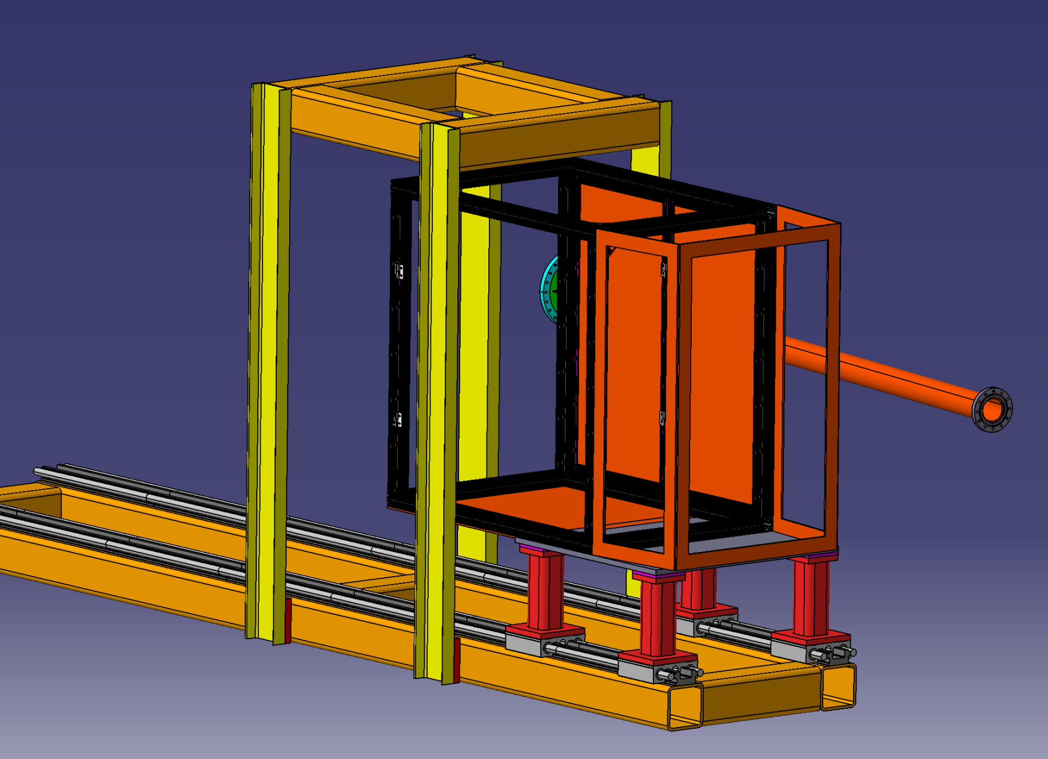
General view
Lifting frame
Mike Fowler structure design
Black box
Base with rails

Slide 3
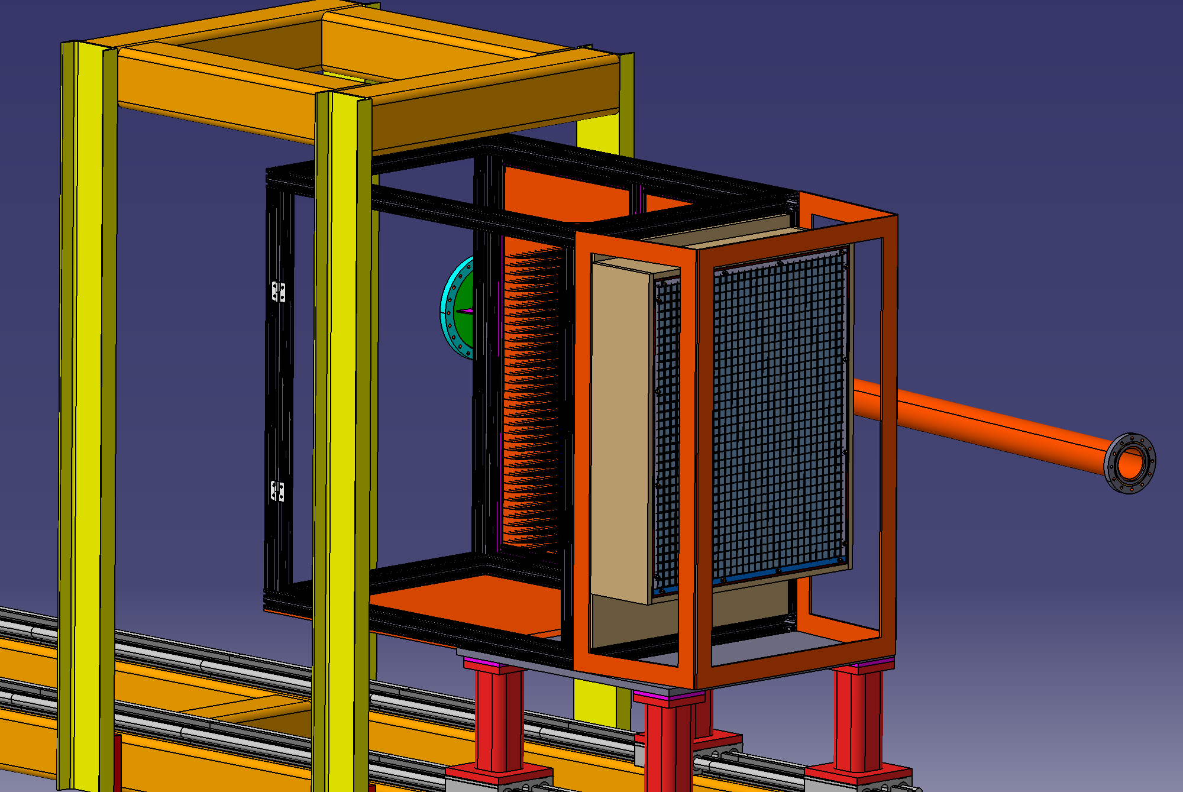
General view
structure design + calorimeter
Calorimeter

Slide 4
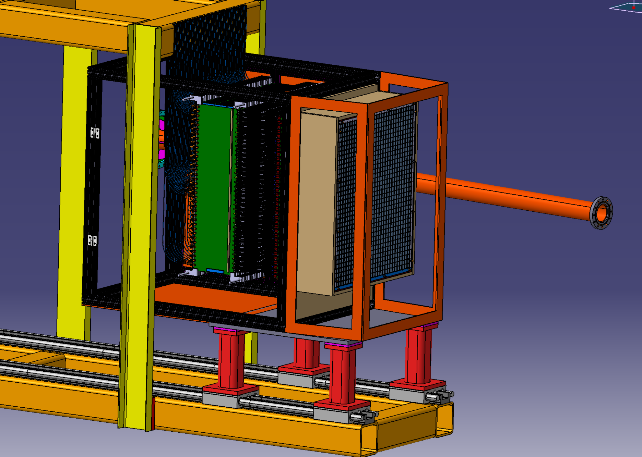
General view
structure design + calorimeter
+ connectic
PCB cards and cables

Slide 5
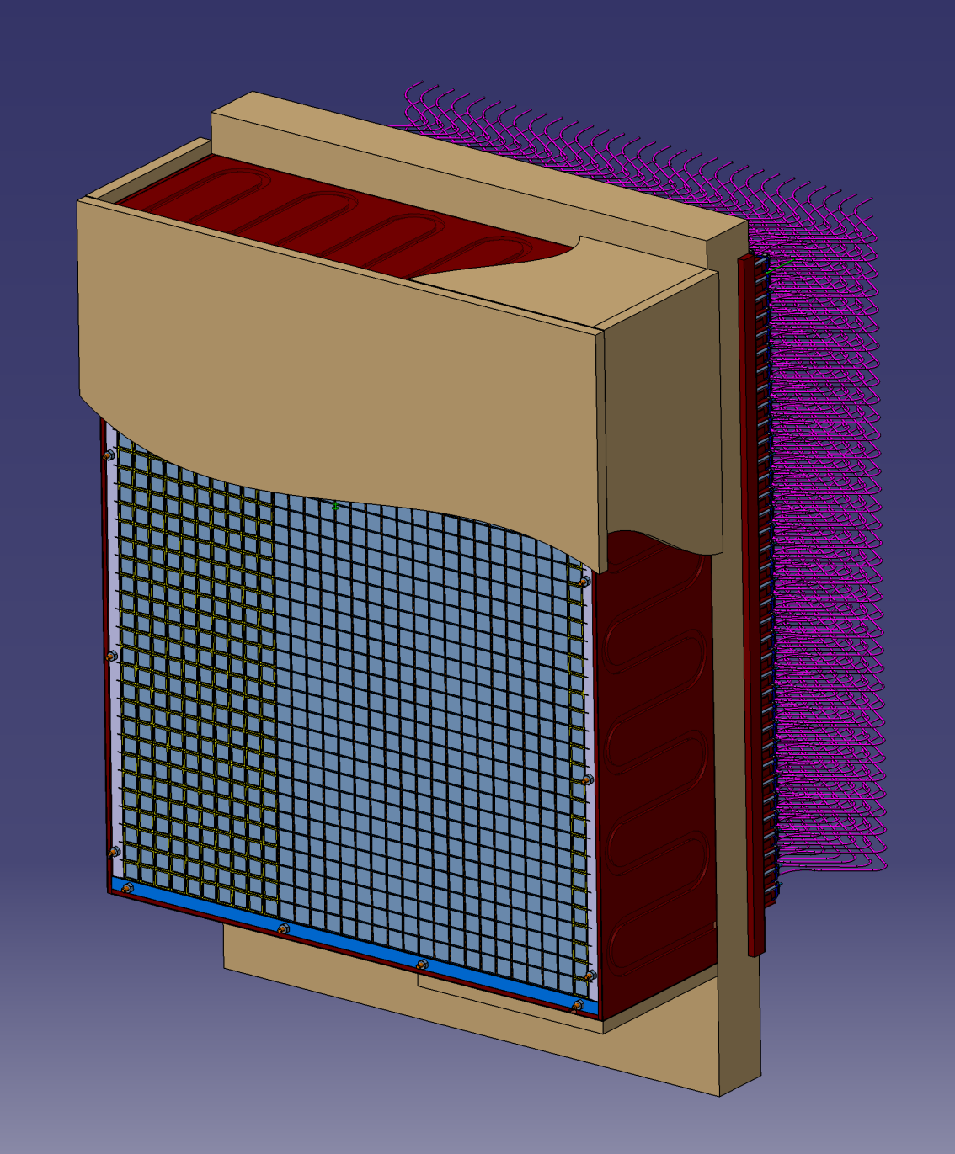
Calorimeter
36 raws of 30 crystals =1080 crystals 0,5 x 20,5 x 200 mm
Pitch between 2 crystals = 21,35 mm in each direction (gap between 2 crystals = 0,8mm
Each crystal is wrapped of reflective sheet on each side except the back side toward the PMt (Reflecteurs, Enhanced Specular Reflector 3M S+ESR 65µ thickness)
Cooling copper plates around the calorimeter + insulation with Depron in order to maintain the T° @ 18°=/- 0,1 °(Study in progress)

Slide 6
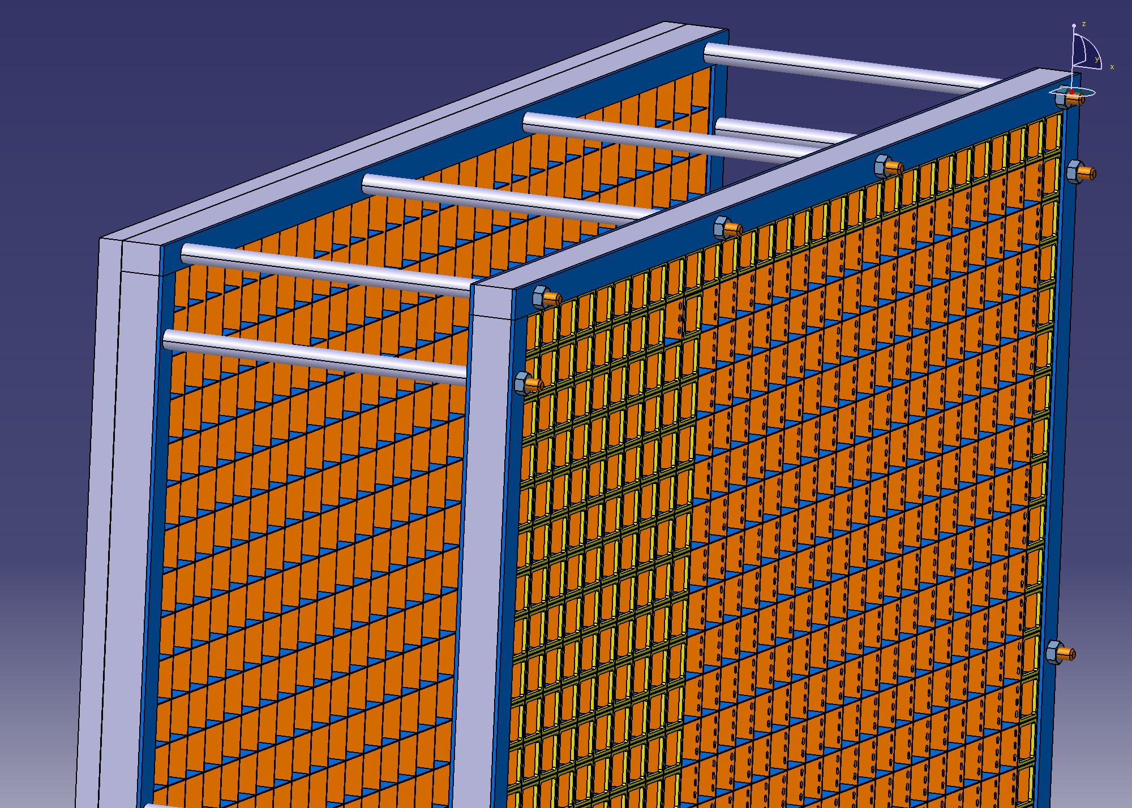
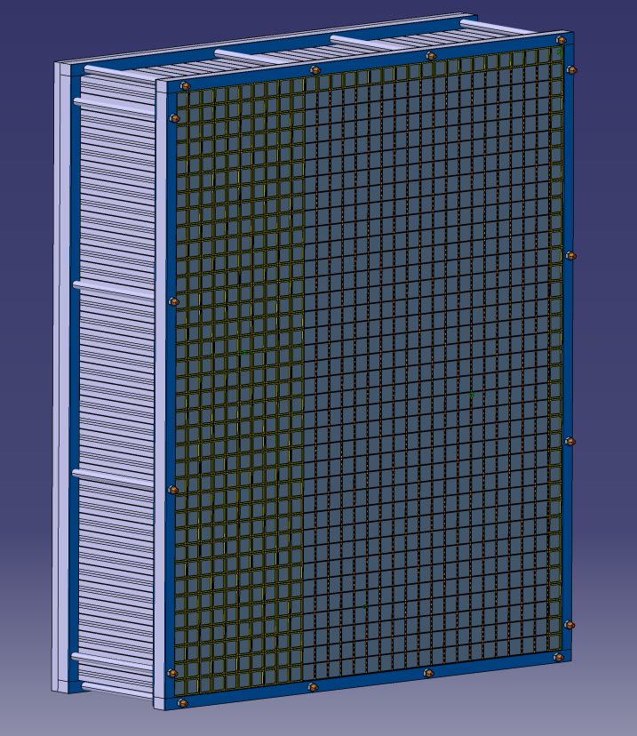
Calorimeter support
Spacers and threaded rods between the 2 frames
Back side alveoles (20 mm width)
Aluminum frame (20 mm width)
Front side alveoles (20 mm width)

Slide 7
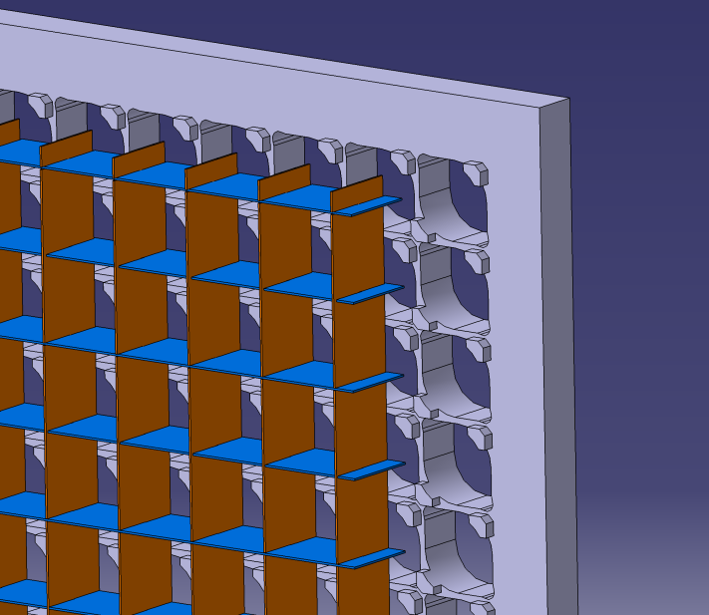
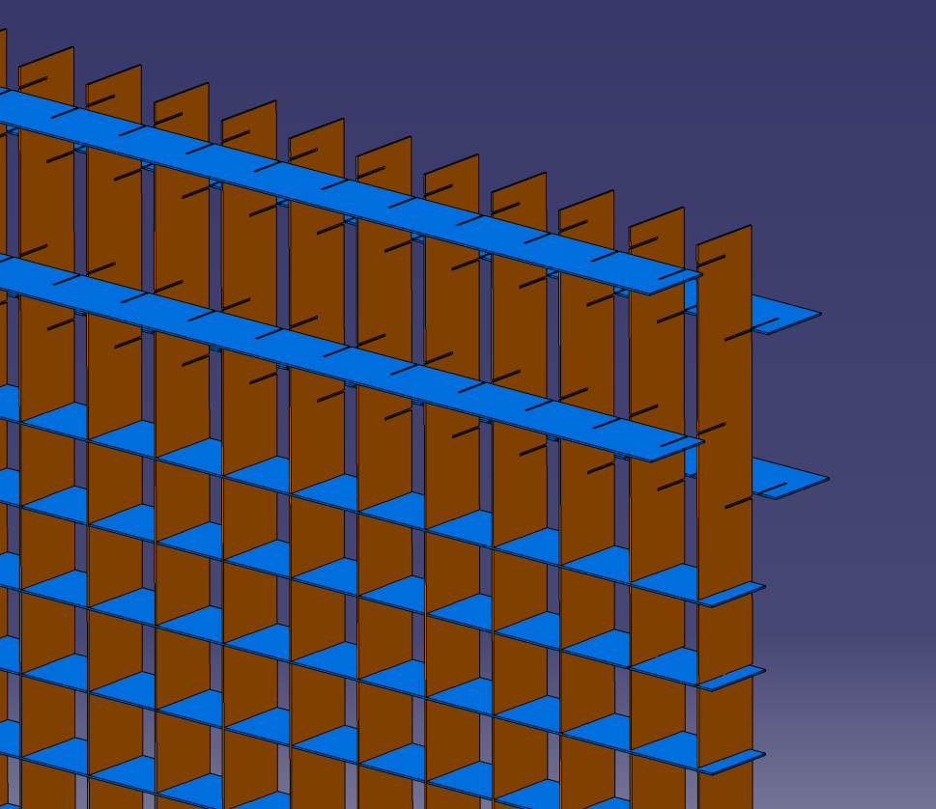
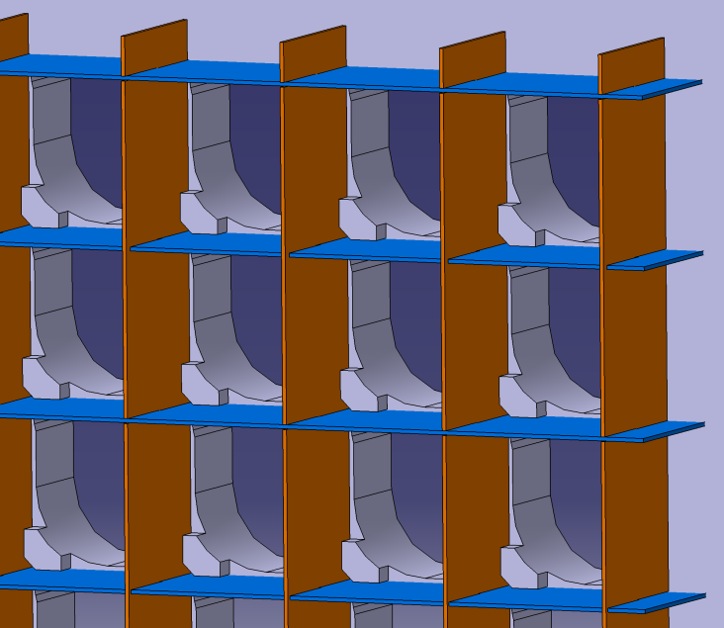
Calorimeter support: Back side alveoles details
Reference Aluminum plate
(on which are fixed the PMts)
Carbon plates 0,5 mm thickness crossed
Carbon plates glued on the ref. plate

Slide 8
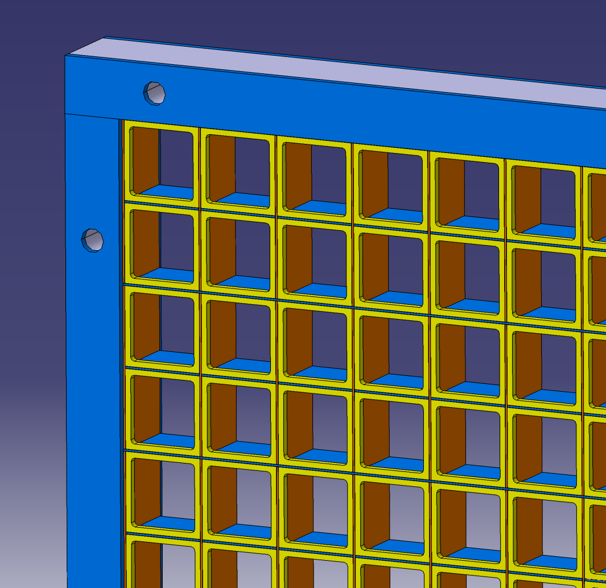
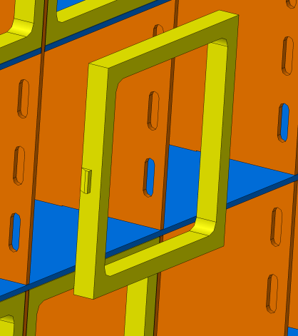
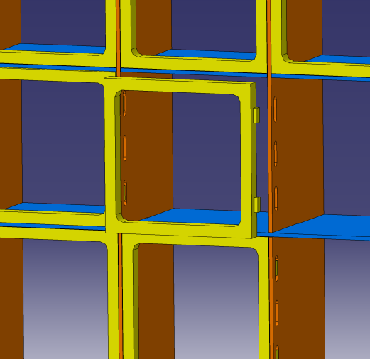
Calorimeter support: Front side alveoles details
Carbon plates 0,5 mm thickness crossed
Blocking plastic parts for an axial maintain of the crystals
Insert plastic part inside each alveole
(after insertion of the crystal)

Slide 9
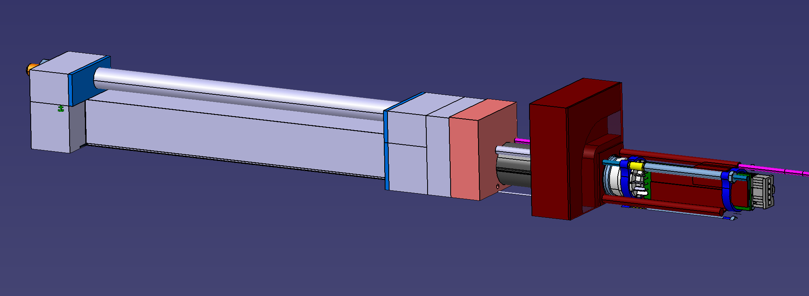
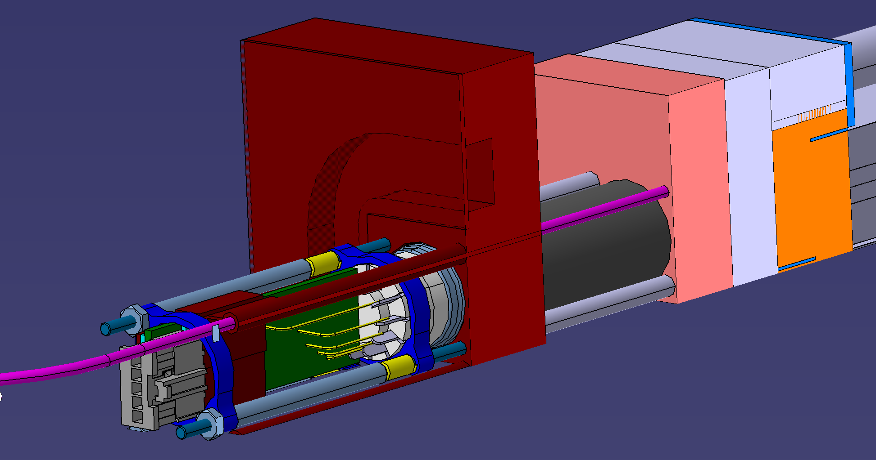
PMt assembly
Copper plate for cooling
Optic fiber for monitoring and curing
Mu metal shielding
PMt
PCB

Slide 10
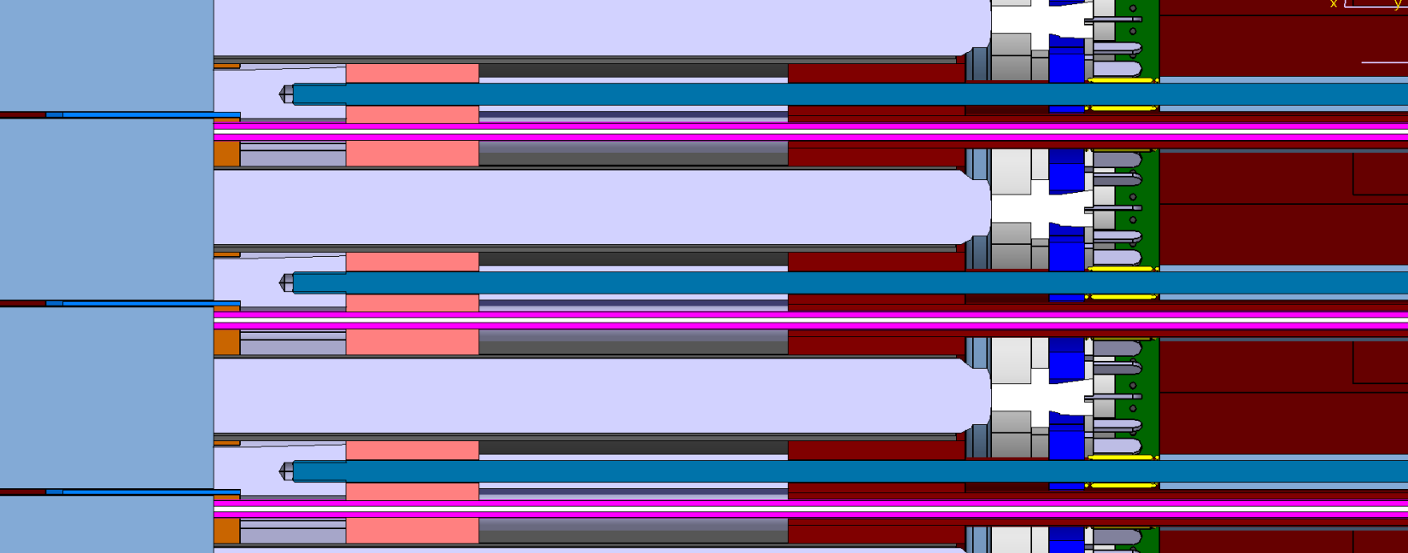
PMt and crystal assembly cut view
PMt
Optic fiber for monitoring and curing

Slide 11
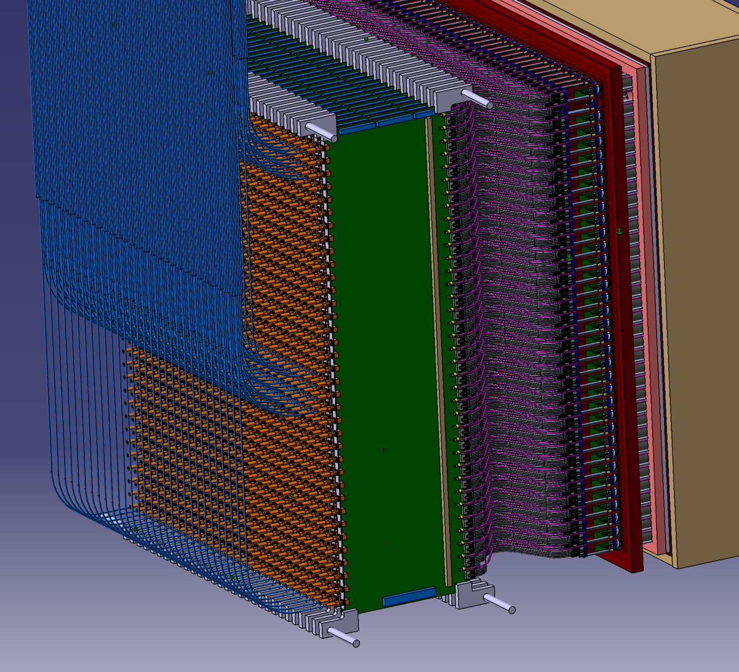
Cables , PCB cards and connectors
5 Cables for HT ,signal and ground
Optic fiber for monitoring and curing
1 Pcb card per column
800 x 230 x1,6 mm

Slide 12
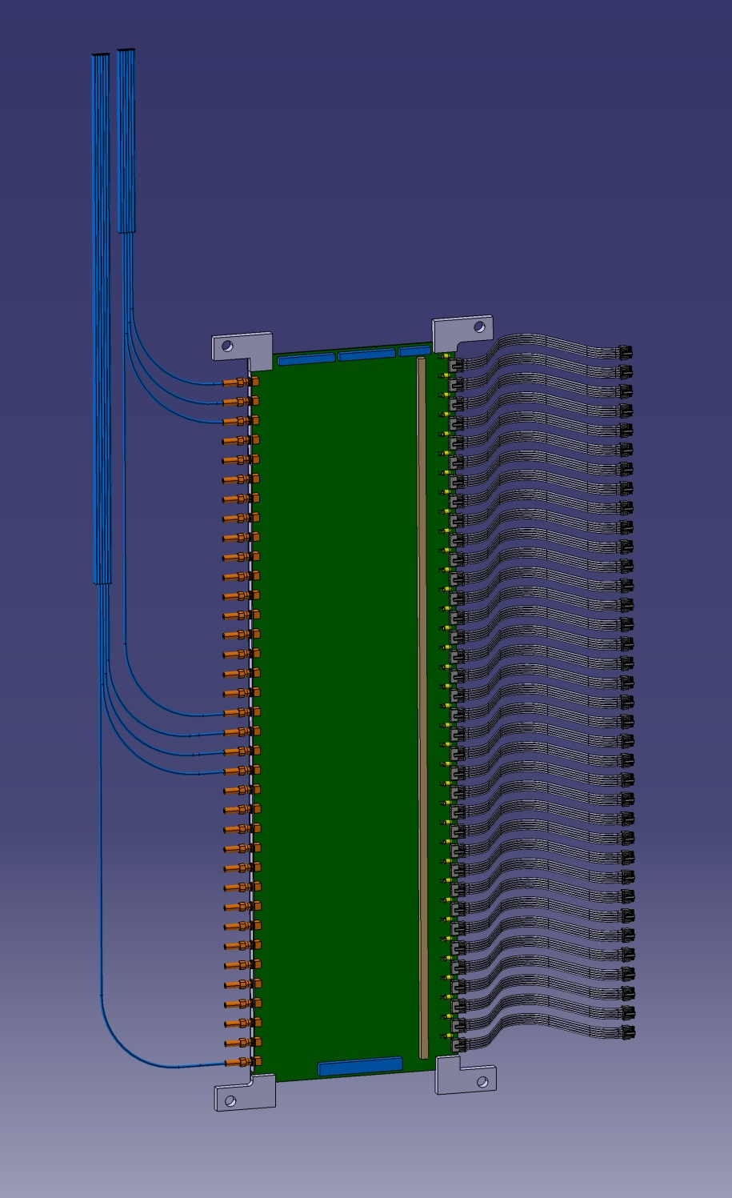
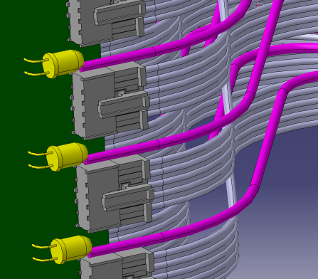
Cables , PCB cards and connectors
3 HV connectors
5 Cables for HT ,signal and ground /chanel
Sma connector
Optic fiber for monitoring and curing
Detail : 1 LED/channel connected to optic fiber
LED connector
Translation system

Slide 13
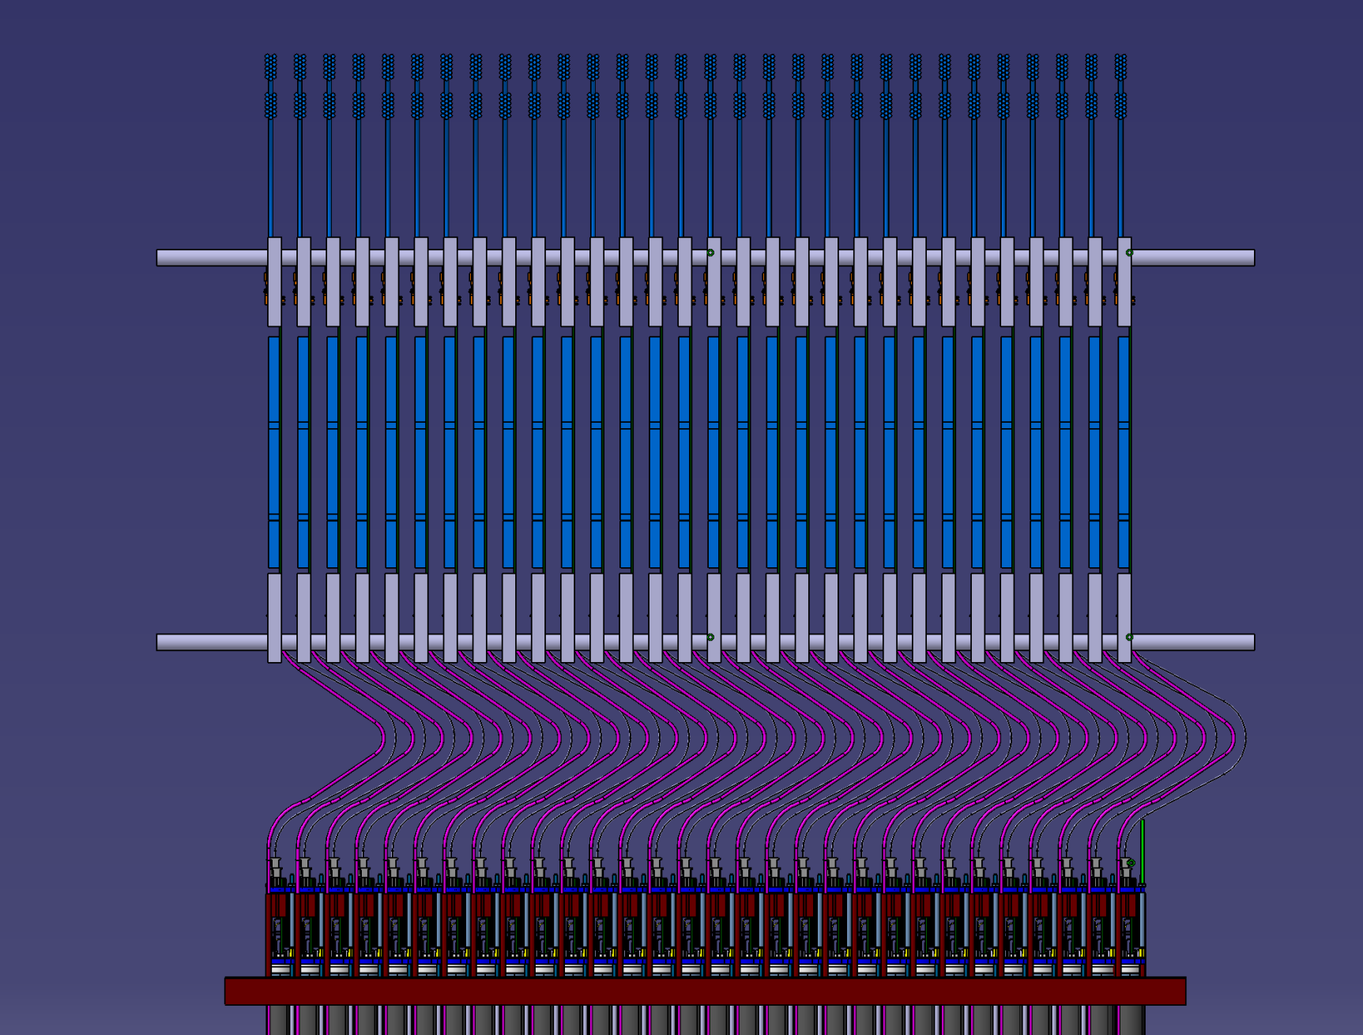
Cables , PCB cards Translation
Slide the PCB in order to permit the acces to the PMTs
25 cm seems ok : test in orsay with a moke up

Slide 14
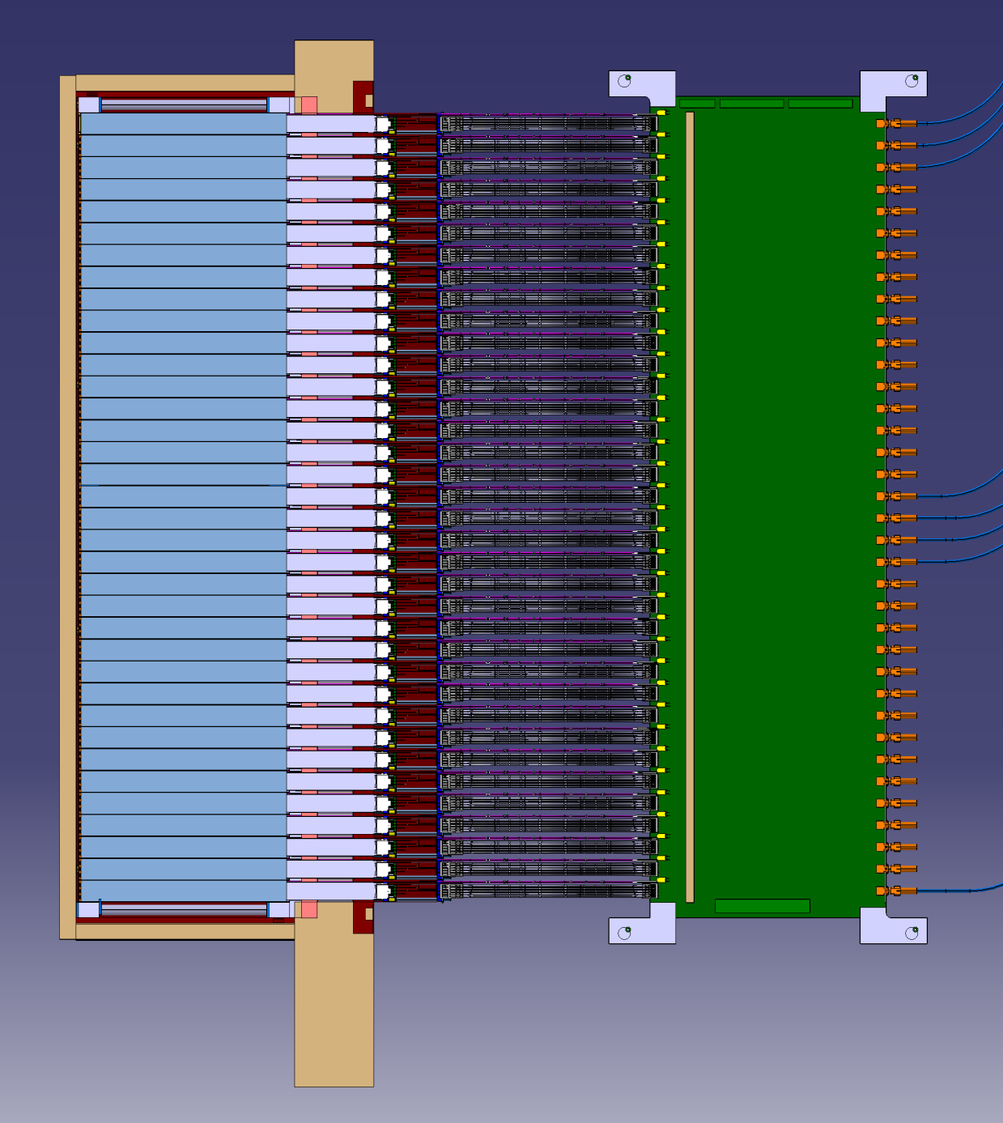
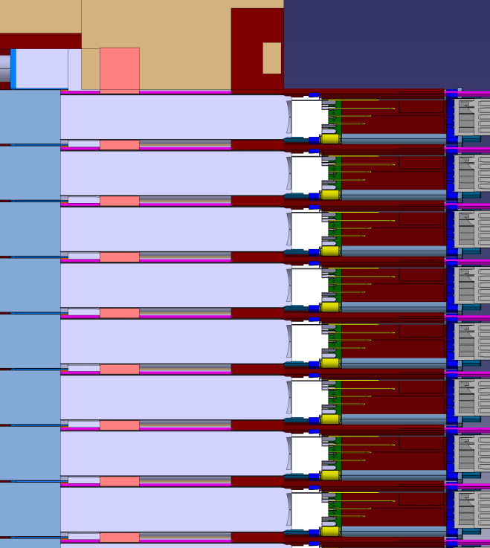
Thermical aspect
Intermediate Zone : Thermical Resistance
Crystals Zone : @ 18°+/-0,1°
Heating Zone : 500mW/channel = 540 W
Intermediate Zone : Made of Glass , Vacuum (PMt)
Depron (Thermal insulator)
External Zone : T°?

Slide 15
Thermical aspect: Crystal zone
Crystals Zone : @ 18°+/-0,1°
Copper plate with cooling system
Depron: thermal insulator

Slide 16
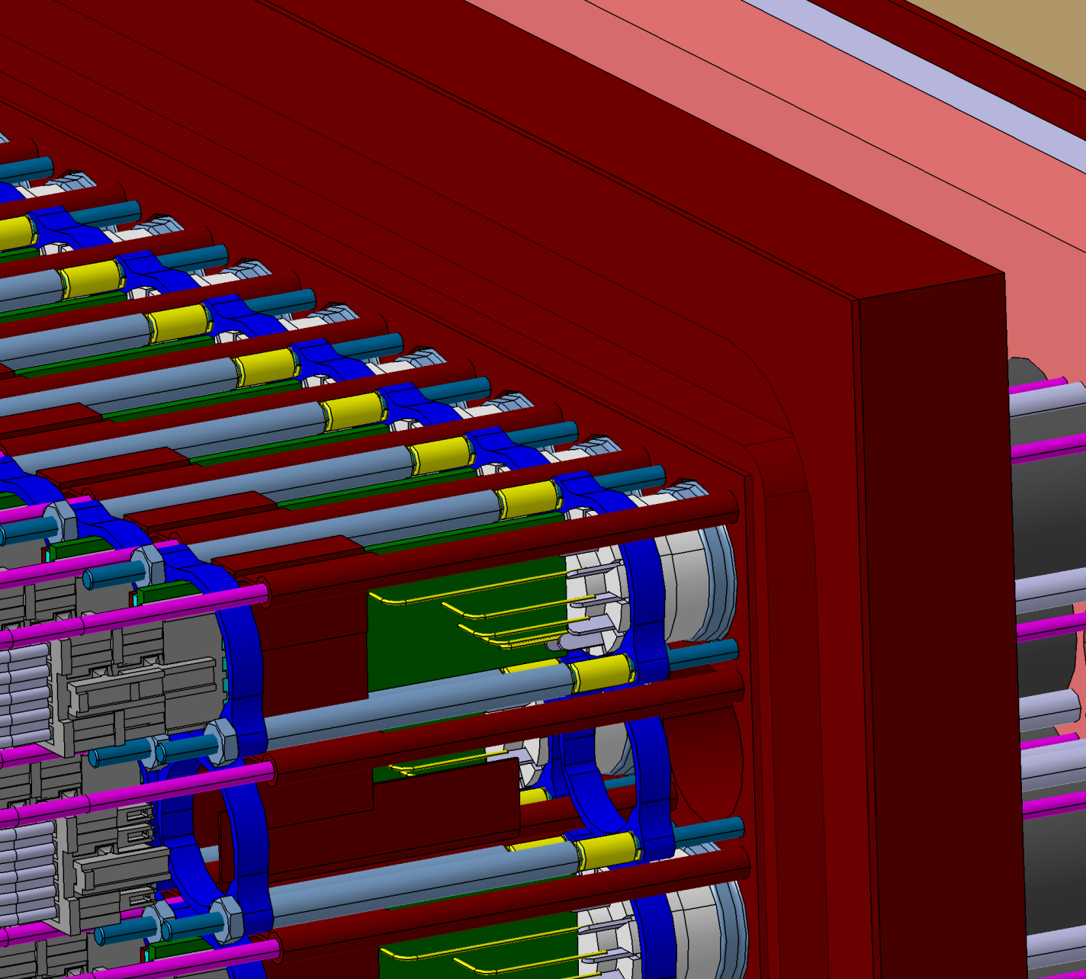
Thermical aspect: Heating zone
Copper plate with cooling system
Copper for Heating conduction (via gap pad)

Slide 17
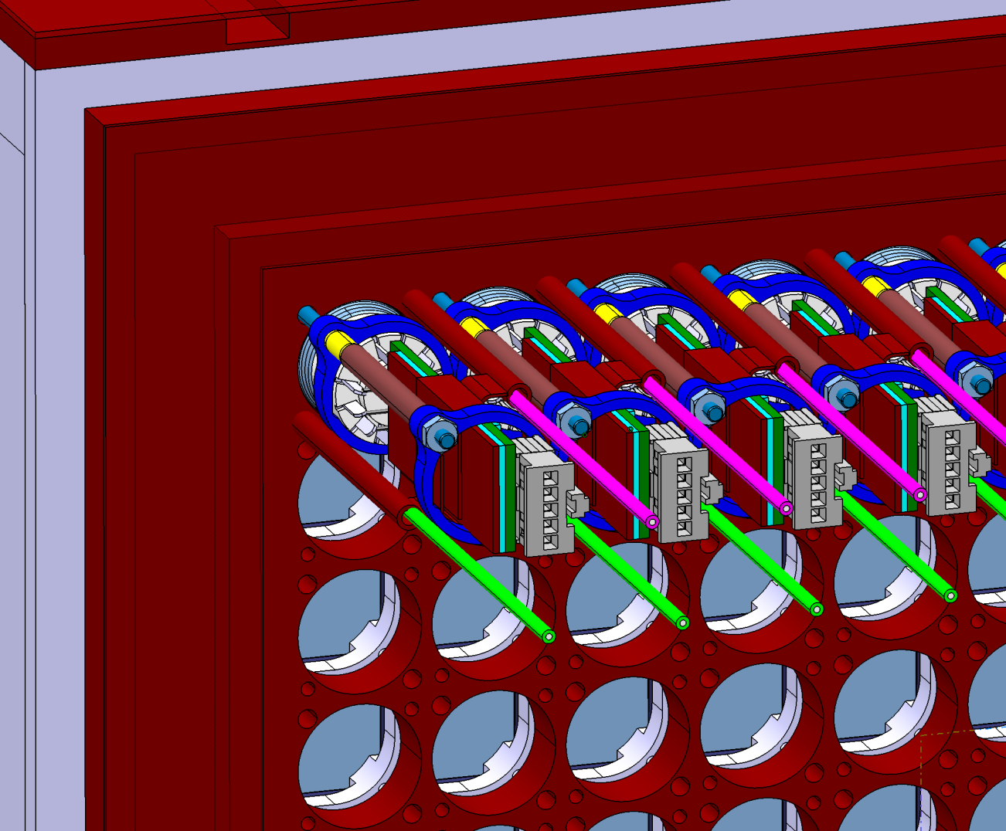
Thermical aspect: Heating zone

Slide 18
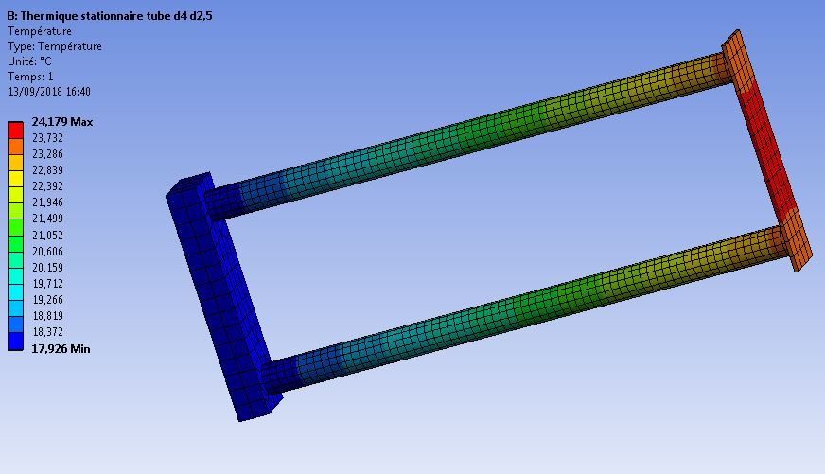
Thermical aspect: Heating zone
Refroidissement interne 18°
500mWatts sur une plaque en cuivre
Plaque froide à 18°

Slide 19
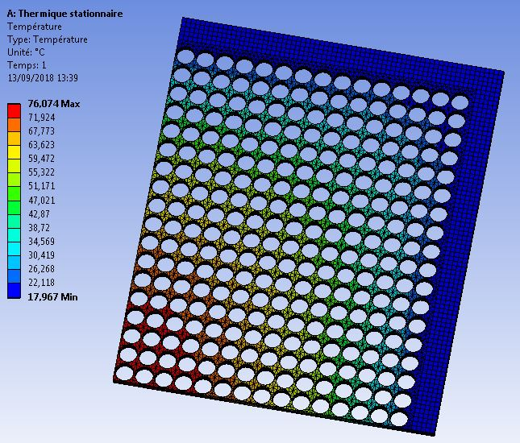
Thermical aspect: Copper plate 10 mm thickness cooling
Cooling 18°
500mWatts applied on each PMt zone
This approximative calculation show the difficulty to cool the plate in the center

Slide 20
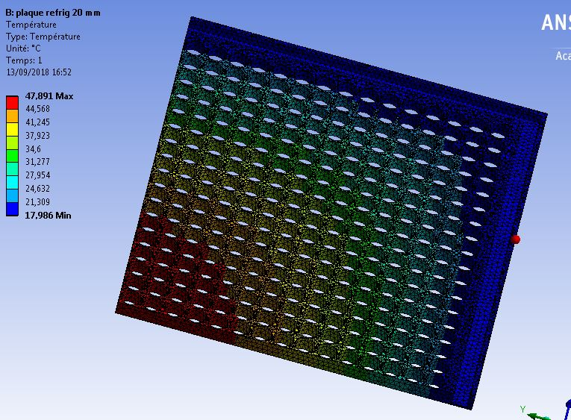
Thermical aspect: Copper plate 20 mm thickness cooling
Cooling 18°
500mWatts applied on each PMt zone
This model show an improvement for T° but difficulty to cool the center

