Slide 1
Hall C’s CPS Magnet
Steven Lassiter Sept 19,2022

Slide 2
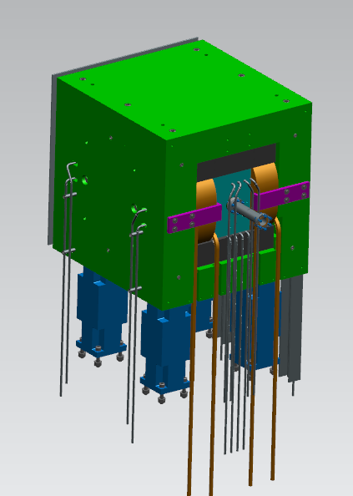
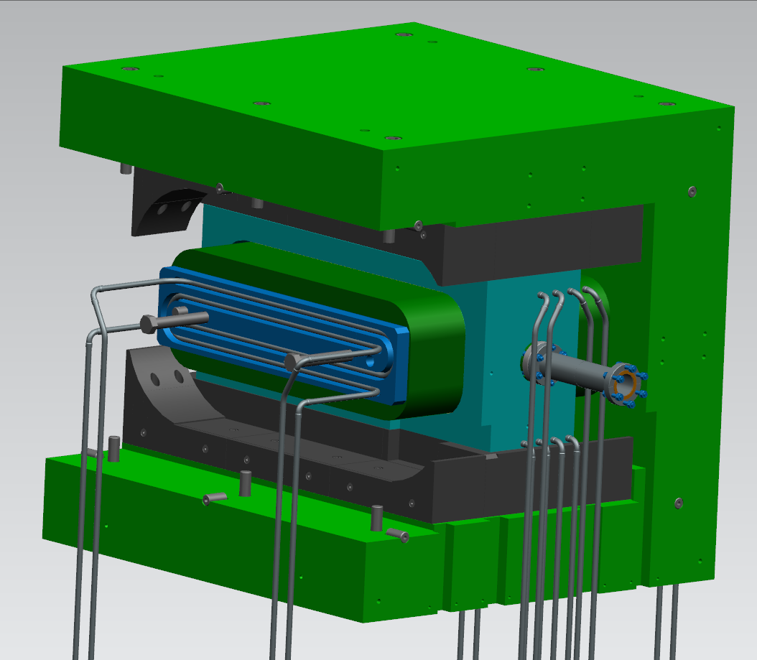
CPS Magnet Steel : Width = 75cm
Height = 77.8cm
Length = 79cm
Magnet steel is 1006 Poles are Permendur-V2 Water cooling of poles Water cooled coils Luvata #6801 conductor
Internal Shielding is Heavy Met Tungsten (90W,7Ni,3Fe)

Slide 3
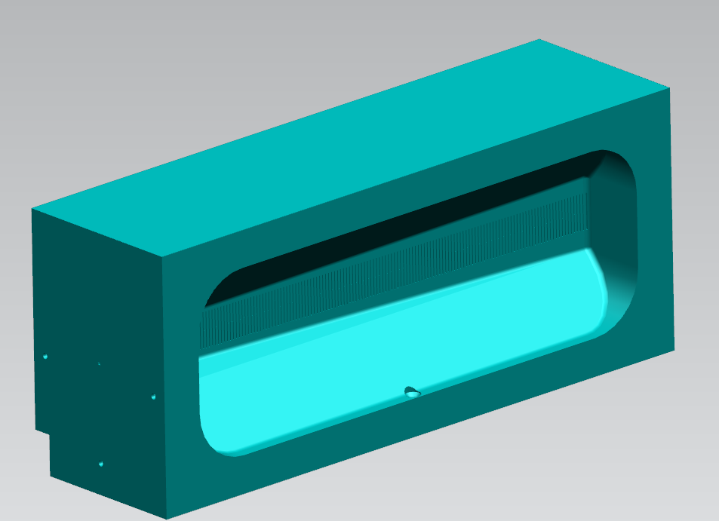
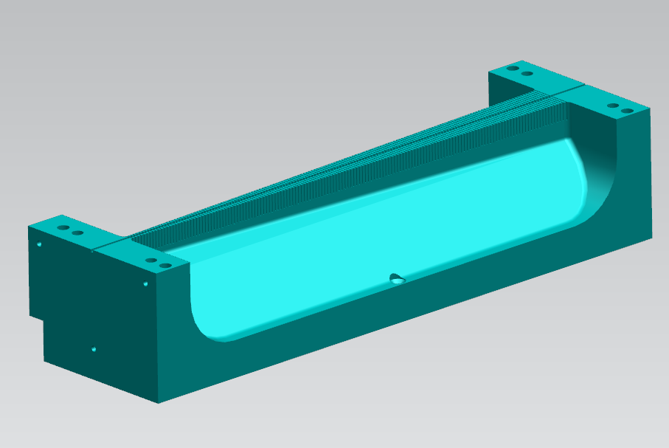
Coils, Absorber & Pole Cooling Plates
Coils 55 turns/pole
Cu Absorber Center Channel 3mm x 3mm
Poles and embedded Cooling Plate

Slide 4
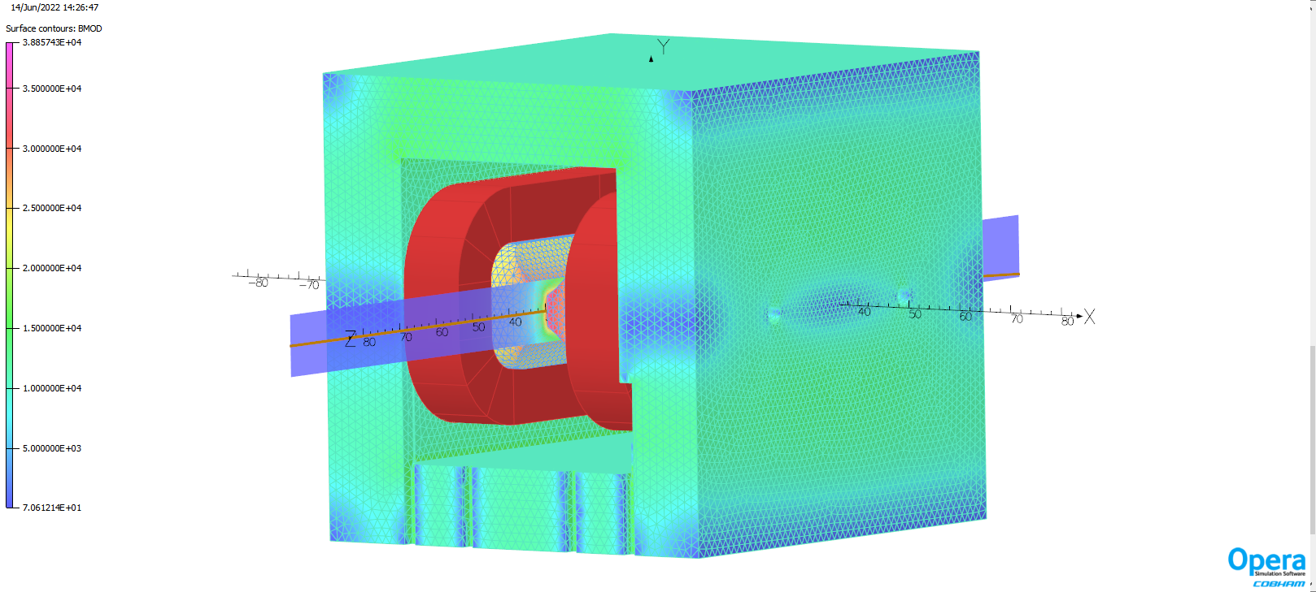
CPS Tosca model updated to include bolts holes, cutouts and pole cooling plate J=500A/cm^2, Yoke = 1010*, Pole= Supermendur Max Pole field 3.89T, tracks: electrons 11 Gev @ 2.7uA
*Yoke has been upgraded to 1006

Slide 5
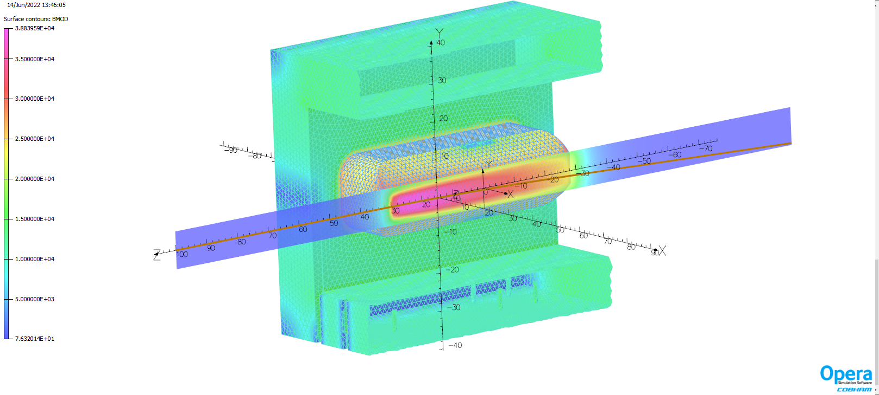
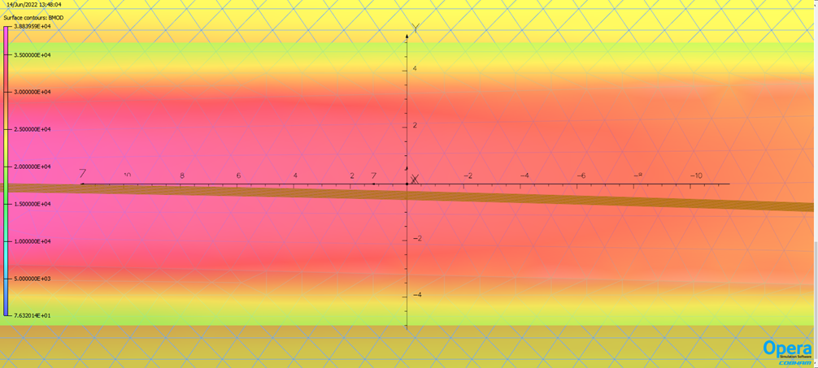
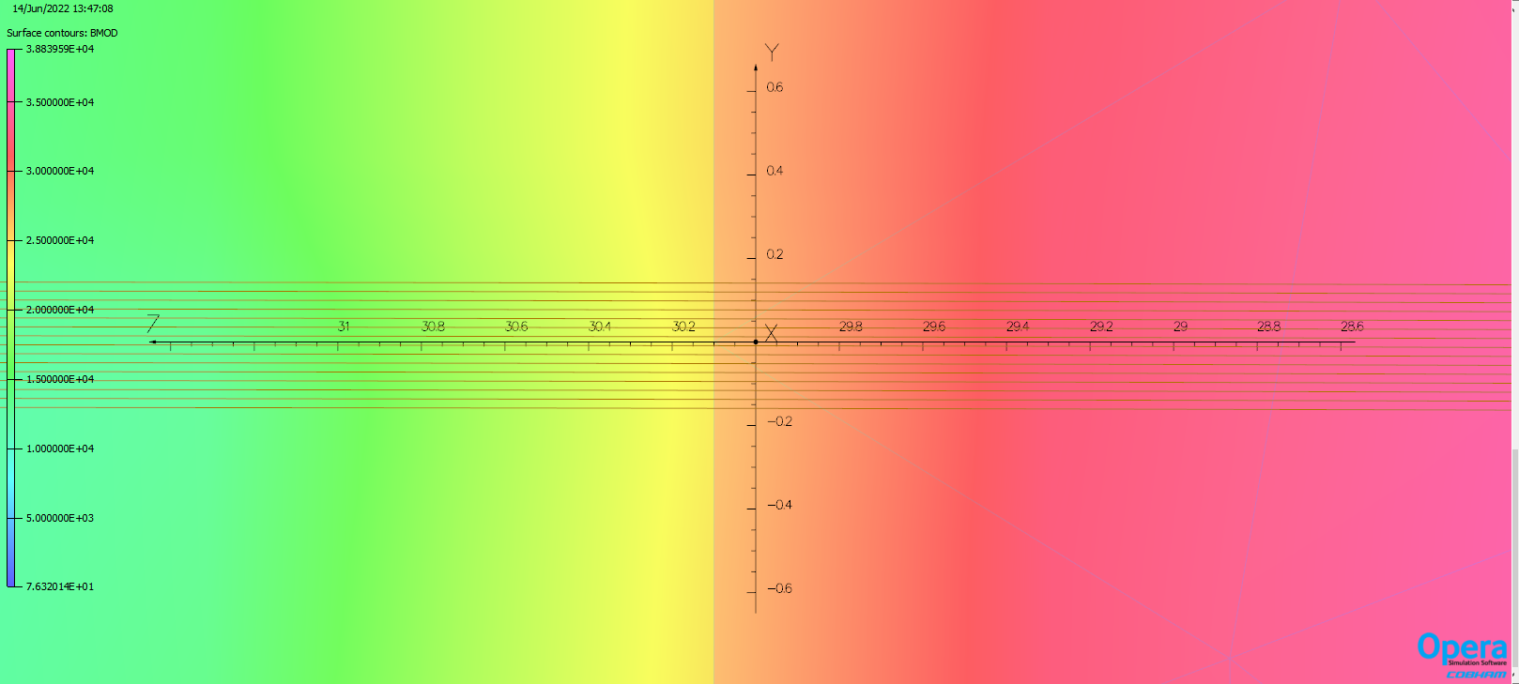
30 electrons tracks shown at the front of the magnet and at the center.

Slide 6
Yoke and Pole Magnetization Coils suppressed for visual clarity Peak field is 3.8T

Slide 7
Stray Fields 10 Gauss fields extends out to ~80cm from ends
10 Gauss lines

Slide 8
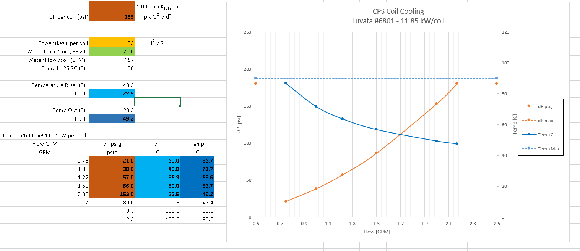
Coils : Based on Vendors Coil Length & Turns
Plenty of overhead – We spec’d a 12.5kW heat load to the coil

Slide 9
High Radiation considerations (~20 MRad)
Use OFHC copper to minimize radiation swelling of copper.
Use BT Polyimide resin with Boron free glass tape insulation for coil fabrication. Good for GRad.
Design for all LCW, Power and I/O connections to be outside the shielding box.

Slide 10
CPS Copper Absorber To minimized Thermal expansion effects along the z axis, center sections was sliced into 3mm thick blocks with a 1mm gap between them

Slide 11
Heating Profile Along Absorber Heat Flux is applied uniformly over the surface area of each block Group of 4 blocks have the same heat flux
30kW of Heat applied as surface flux to bottom surface of the channel

Slide 12
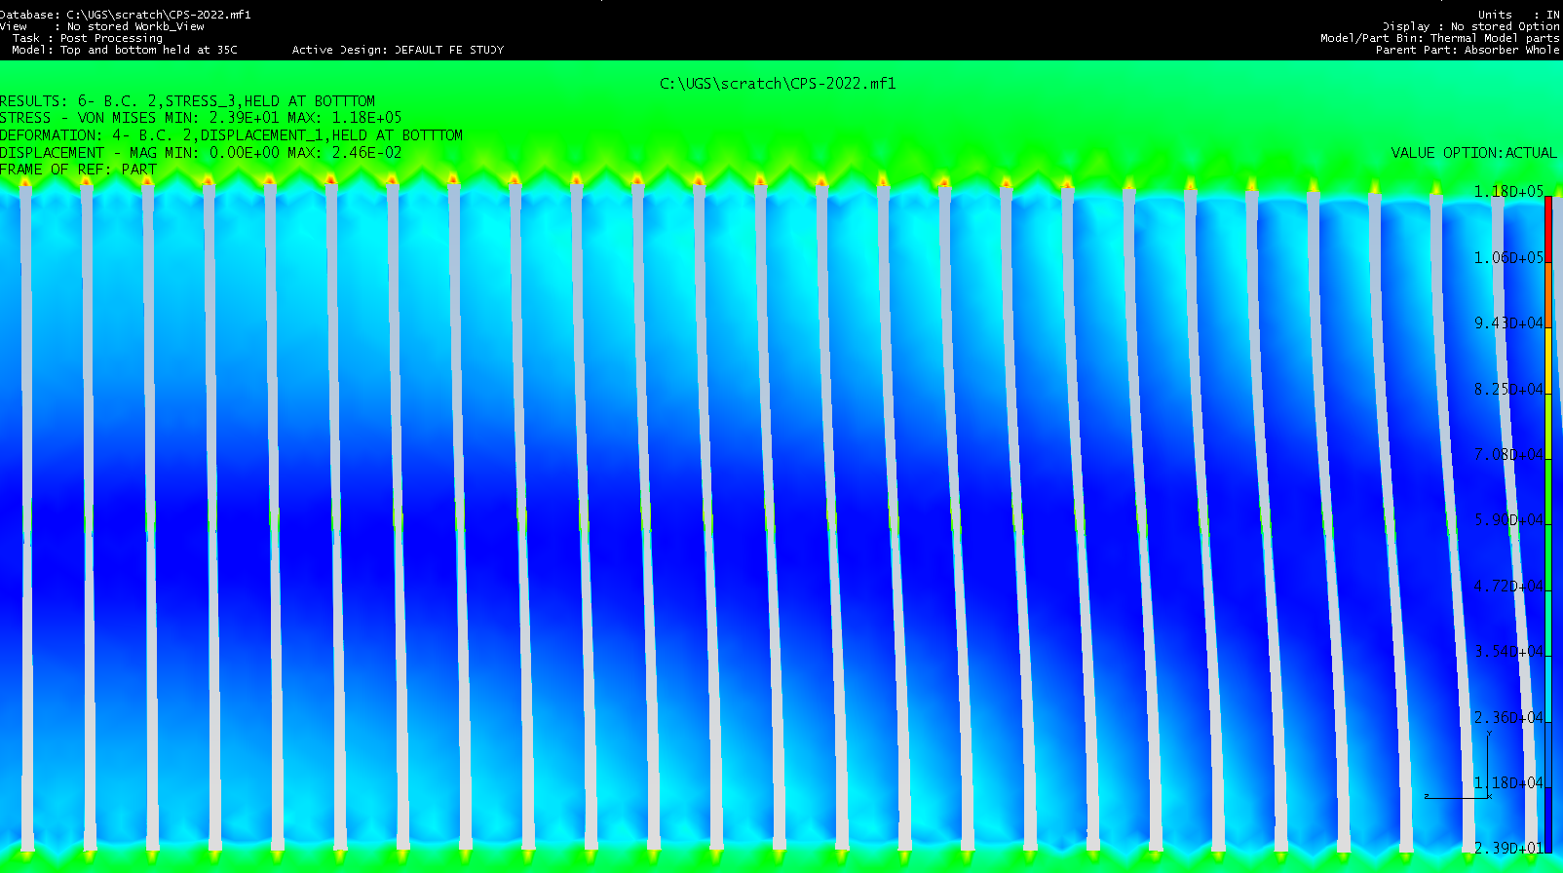
Stress and Thermal Expansion BC: Bottom Surface fixed, Top surface is free
Tmax = 720°C Stress (vm) = 118 ksi (814MPa)
Deflection (in) = 0.025 (0.64mm)
Yield Stress: C10200 OFHC 4.3E3 psi C11000 ETP 1.04E4 psi
Highest stresses are due meshing size and sharp corners Still stresses in main body are above yielding for the majority of absorber

Slide 13
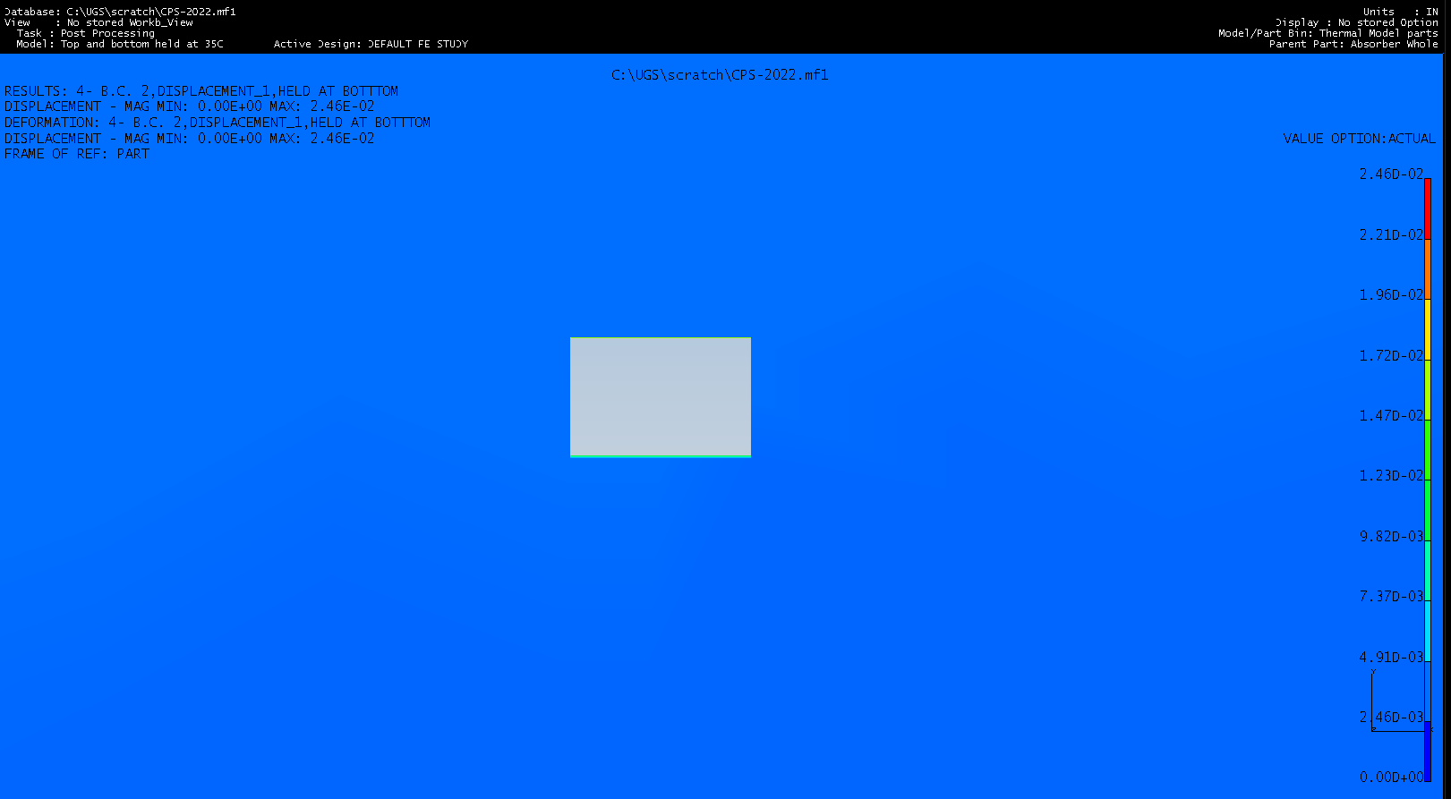
Close up of Highest Temperature Region Tmax = 720C
Top Half
Bottom Half
If a gap forms between top and bottom half of the absorber, then Tmax climbs to 1,140C
Thermal expansion of bottom aperture is of the order of 0.4mm or 13% of the opening. Does not impinge upon beam acceptance.

Slide 14
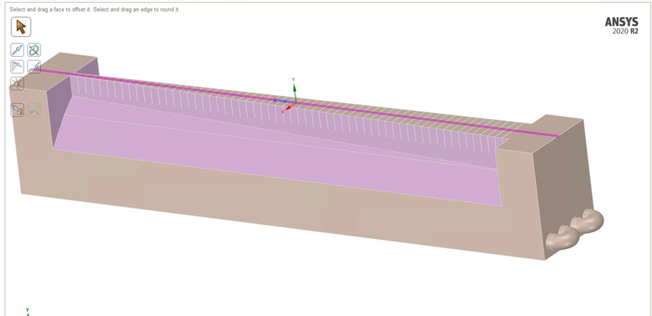
Initial Fluent modeling Uniform heat deposit along inner channel just bottom half of absorber modeled
Total amount of heat source applied to the copper absorber was 30kW.
There are 58 individual heat source blocks.
Therefore 30kW/58 = 0.5172 kW was applied for each block.
Volume of each block is 29.1 mm³ or 2.91 x 10⁻⁸ m³ [3mm x 1.0mm x 9.7mm]
Energy source for each block was then 517.2 W/2.91 x 10⁻⁸ m³ = 1.78 x 10¹⁰ W/m³
Boundary Conditions for the inlet were the following:
Velocity of fluid 1.8 m/s (6 ft/s) in order to prevent corrosion
Temperature of the fluid at the inlet 303.2K (30⁰ C)
Boundary Conditions for the outlet were the following:
Gauge pressure 206,843 pascals (30psig)
Backflow total temperature 303.2K (30⁰ C)

Slide 15
Solution converged and results look physically ok Max Temp of 617°C .

Slide 16
LCW Temperature profile Temp rise ~28°C
Cooling of LCW at the closed ends has since been resolved in Model
LCW Pressure Profile Delta P <1psig

Slide 17
CPS Energy Deposition Plots

Slide 18
Fluka Data: grid overlaid on cross section of Absorber Spacing is 1mm x 1mm in XY plane XY planes are spaced 10mm apart in Z
Fluka data: heat load sum was only 25kW. Each data point was scaled by 30/25 to reach a sum total heat load of 30kW

Slide 19
Bottom half of the absorber with the Grid map overlaid

Slide 20
Grid Points vs Absorber Geometry
X= +2.5mm
X= +1.5mm
X= -0.5mm
X= +0.5mm
Data points are at the center of 1mm x1mm x10mm long volume
Each plane is 1mm spaced in X and Y

Slide 21
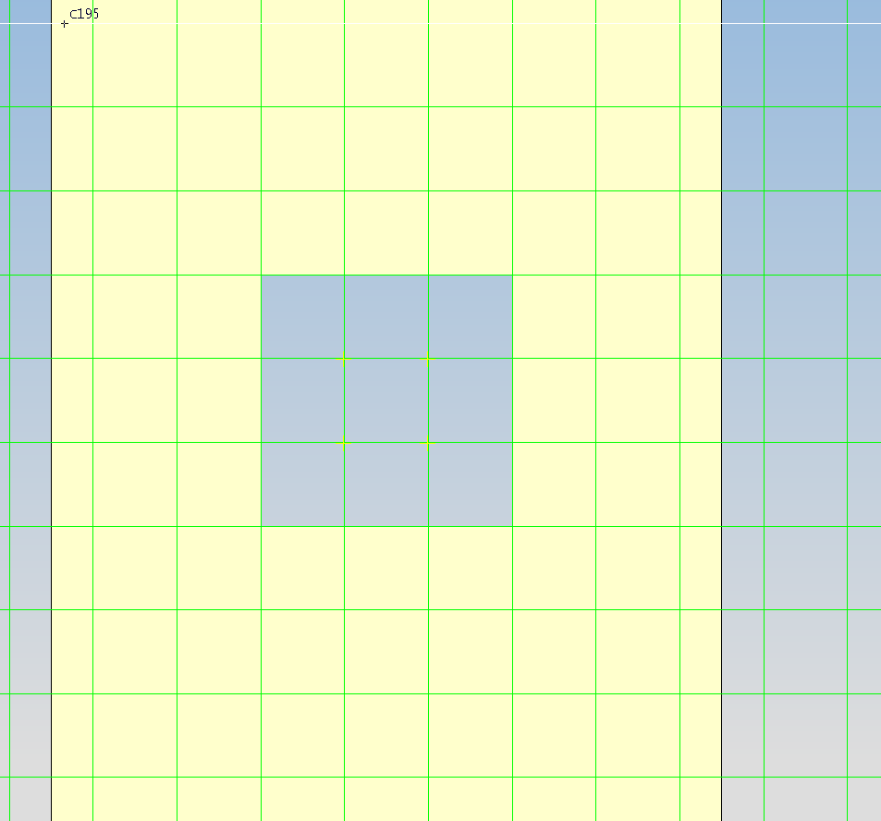
YZ Plane cuts of Heat deposited [W] at x=0.5mm
Max Q=203W Sum of heat in this plane 4.90kW
Center section of absorber
Bottom of absorber
X= +0.5mm
Top of absorber
Z Axis
Y axis

Slide 22
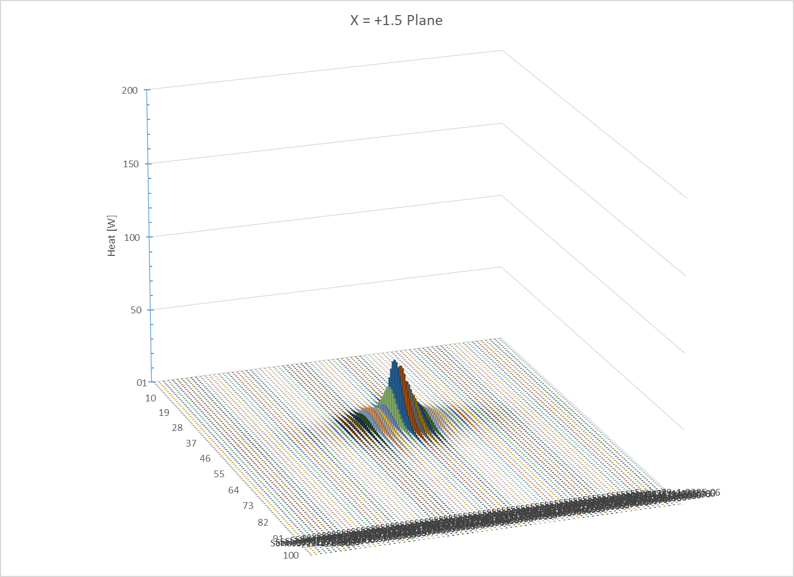
YZ Plane cuts of Heat deposited [W] at x=1.5mm
Max Q=38.3W Sum of heat in this plane 2.61kW
X= +1.5mm

Slide 23
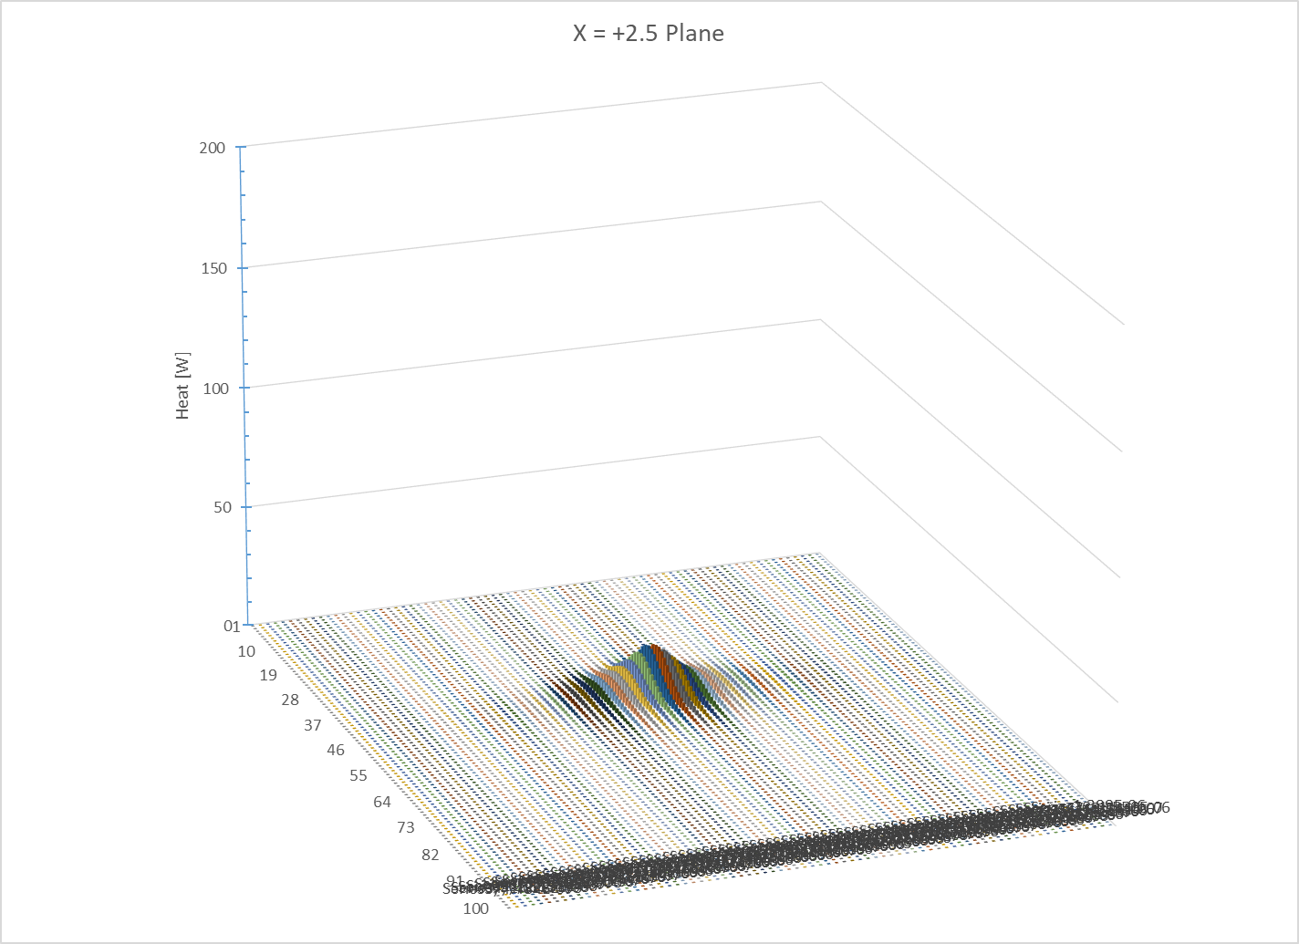
YZ Plane cuts of Heat deposited [W] at x=2.5mm
Max Q=16W Sum of heat in this plane 1.82kW
X= +2.5mm

Slide 24
CPS Prototype
Central section of the lower absorber, where beam heating will be at the maximum, is prototype for testing of:
A: fabrication of cutting slits and brazing of copper sections.
B: test various cooling channels options and to verify against Fluent modeling.
C: Temperature and thermal expansion verification to test FEA modeling.

Slide 25
Temperature Profile with two 1.2kW heaters
Tmax=893°C of Heating rods holder
T(absorber)=212°C at base of cooling channel

Slide 26
Displacement and Stresses for two 1.2kW heaters 0.26mm and 515MPa (75.ksi) Temperature along top Absorber is 212°C.

Slide 27
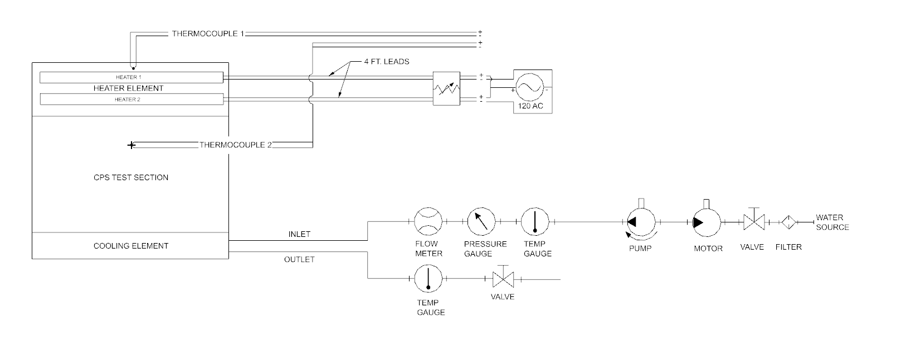
CPS Prototype
Testing hardware is being acquired.
Power connections and components have been requested from Spectrometer support group.
Testing will hopefully begin in the late fall.

Slide 28
Prototype Cooling Circuit Design 1

Slide 29
Conclusion
CPS magnet and coils are a straight forward & basic design but uses expensive high mu material. Procurements are under way.
Estimates of the Absorber heating and cooling have been used in the design of the magnet – addition of pole cooling plates, providing clearances between coil/pole and the Absorber.
A complete 3D thermal modeling of the Absorber and the magnet, using Fluent, is ongoing. The 3D heating profile data from Fluka is being read directly into Fluent.
Prototype of the Absorber has been built and is being prepared for testing to validate FEA models and options for the LCW cooling profile.

