Slide 1
DSG NPS Update
Aaron Brown
Detector Support Group
8/26/2020

Slide 2
Contents
Fabrication, Procurement, and Testing
HV Rating Concerns and Research
HV Schematic
HV Connection Parts List
Conclusion

Slide 3
DSG NPS Work Update
HV divider cables fabrication status
700 of1100 fabricated
Procurement status for HV multi-conductor cable fabrication
From CAEN: 40 Radiall 52-pin connectors, insertion/extraction tool, and crimper tool
PR submitted and signed, lead time: ~12 weeks
Assigned buyer: Albert DeChristopher
From General Wire Products: Forty-two 42-conductor cables
Cut to 142’
PR submitted, lead time: 4-5 weeks
Assigned buyer: Jami Anthony
CAEN voltage stability testing
All 34 modules tested with GECO 2020
All channels of 12 modules passed testing
Four modules have major problems
Eighteen modules have at least one problem channel
22 of 34 modules tested with EPICS
Analyzing data

Slide 4
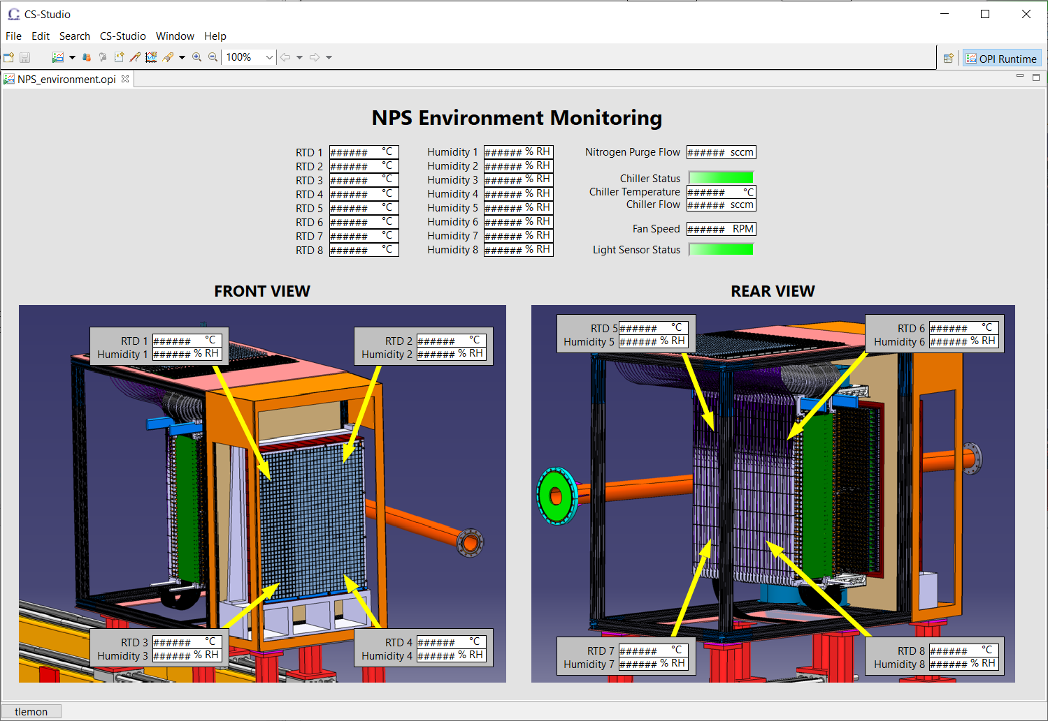
DSG NPS Work Update (cont’d)
EPICS Controls & Monitoring screens development
Environment monitoring screens
Voltage and current readback screen
Researching sensors and related instrumentation for environment monitoring

Slide 5
HV Connection Schematic
HV board
Interface card
PMT HV/Signal Y cable
IPBT-108-H1-T-D-K
IPBT-108-H1-T-D-K
(424 V)
(565 V)
SMA
IPBD-108-H1-T-D-K
PMT Signal
(424 V)
SMA
Radiall A996 52 pin
RG-174
PMT
(12.5 kV)
CAEN 7030TN
HV supply cable
RG-174
(30 V)
IPD1-05-S-K
140’ GPW 42 cond. 030-23904
(5 kV)
Fischer D 102 A 018
(387 V)
IPBD-115-H1-T-D-K
(8 kV)
(424 V)
Fischer S 102 A 018
IPBT-115-H1-T-D-K
(8 kV)
(565 V)
PMSD-08-206-K-15.40-D-LUS
(600 V)
HV rating concerns
Researching alternates
PMSD-15-206-K-15.40-D-LUS
(600 V)

Slide 6
NPS Cable Components
NPS Assembly/Board | Component | Part Number | Voltage Rating (V)
HV supply cable | CAEN HV connector | Radiall A996 52 pin | 12.5 kV
 | HV multiconductor - 42 cond. | GWP 030-23904 | 5 kV
 | Samtec 8 pin (male cable mount) | IPBD-08-D-K | 424 V
 | Samtec 15 pin (male cable mount) | IPBD-15-D-K (x2) | 424 V
HV board | Samtec 8 pin (female pcb mount) | IPBT-108-H1-T-D-K (1 per side of patch panel) | 565 V
 | Samtec 15 pin (female pcb mount) | IPBT-115-H1-T-D-K (x2 per side of patch panel) | 565 V
Samtec ribbon cables | Samtec 8 conductor ribbon cable | PMSD-08-206-K-15.40-D-LUS | 600 V
 | Samtec 15 conductor ribbon cable | PMSD-15-206-K-15.40-D-LUS (x2) | 600 V
Interface Card | Samtec 8 pin (female pcb mount) | IPBT-108-H1-T-D-K | 565 V
 | Samtec 15 pin (female pcb mount) | IPBT-115-H1-T-D-K (x2) | 565 V
 | Fischer jack connector | D 102 A018 | 8 kV
 | SMA right angle jack | 142-0701-501 (1 per side of patch panel) | 335 V
PMT HV/Signal Y cable | Fischer plug connector | S 102 A018 | 8 kV
 | SMA female cable mount | R19-003-04-032611011 (1 per side of patch panel) | 335 V
 | Coax cable | RG-174u | 30 V
 | Samtec 5 pin male connector | IPD1-05-S-K | 387 V

Slide 7
Conclusion
HV divider cable fabrication ongoing
Procurement of HV cable components underway
Controls & Monitoring screens development progressing

Slide 8
Thank You

