Slide 1
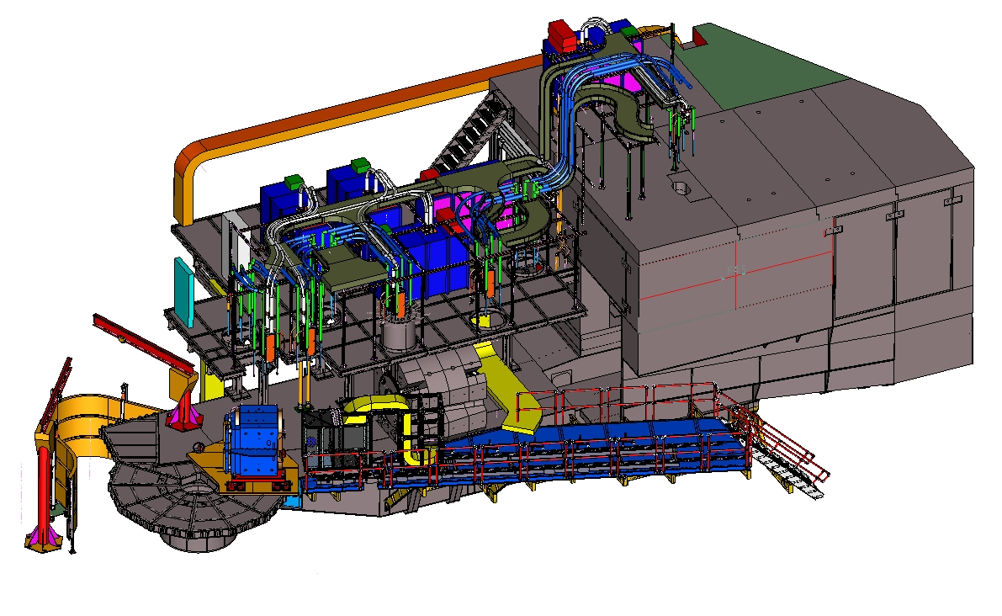
NPS outstanding items
CABLE TRAYS AND SUPPORTS
$10K
ROOF BLOCK
$6K
CABLE DOLLEYS
$2K
RAILING
$2.5K
BRAKE SLIDES
$1K
CABLE CART
$5K
STAIRCASE
$6.5K
PLATE-MAG SPRT
$10K
TARGET DECK REINFORCEMENT
$5K
NPS outstanding items– 26 August 20211

Slide 2
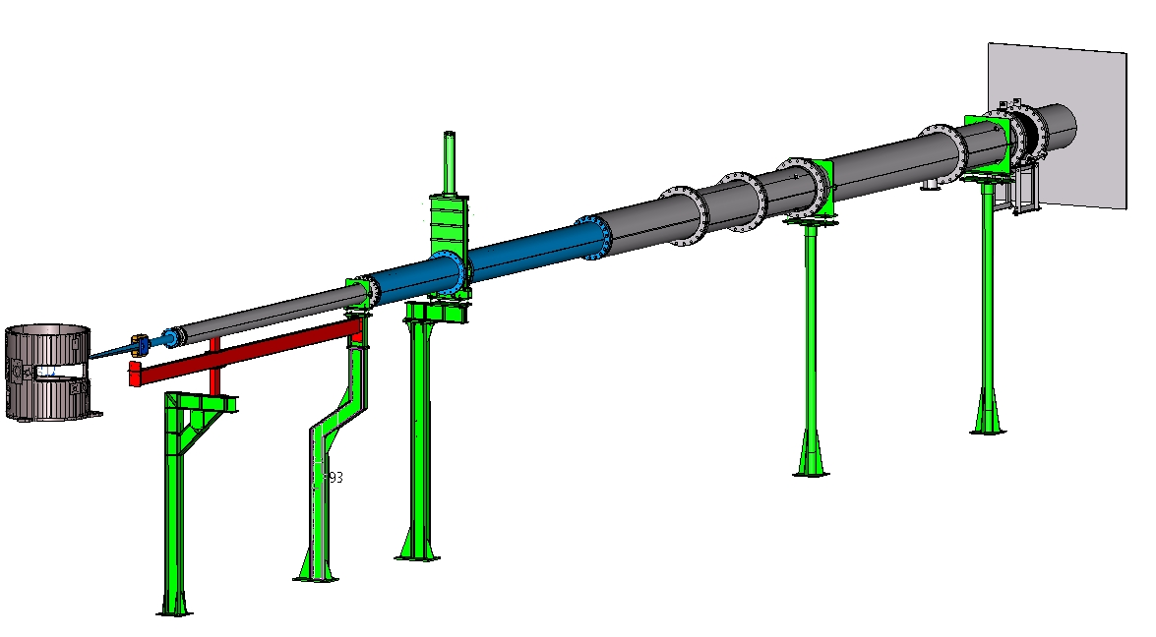
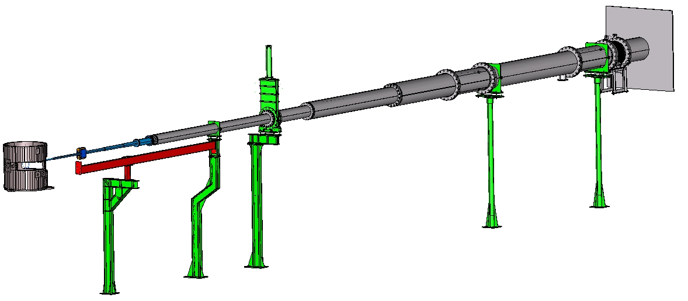
NPS outstanding items
BEAM LINE-1
BEAM LINE-2
SUPPORTS IN GREEN ARE EXISTING
SUPPORTS IN RED ARE NEW
$3K
BEAM LINE SPOOLS IN SILVER ARE EXISTING
SPOOLS IN BLUE ARE NEW
$10K
NPS outstanding items– 26 August 20212

Slide 3
NPS outstanding items
CABLE TRAYS AND SUPPORTS - $10K
CABLE DOLLEYS - $2K
CABLE CART - $5K
CART SLIDE BRAKES - $1K
BEAM LINE SPOOLS - $10K
BEAM LINE SUPPORTS - $3K
PLATE MAGNET SUPPORT - $10K
RAILING - $2.5K
ROOF BLOCK - $10K
STAIRCASE - $6.5K
TARGET DECK REINFORCEMENT - $5K
TOTAL = $65K
NPS outstanding items– 26 August 20213

