Slide 1
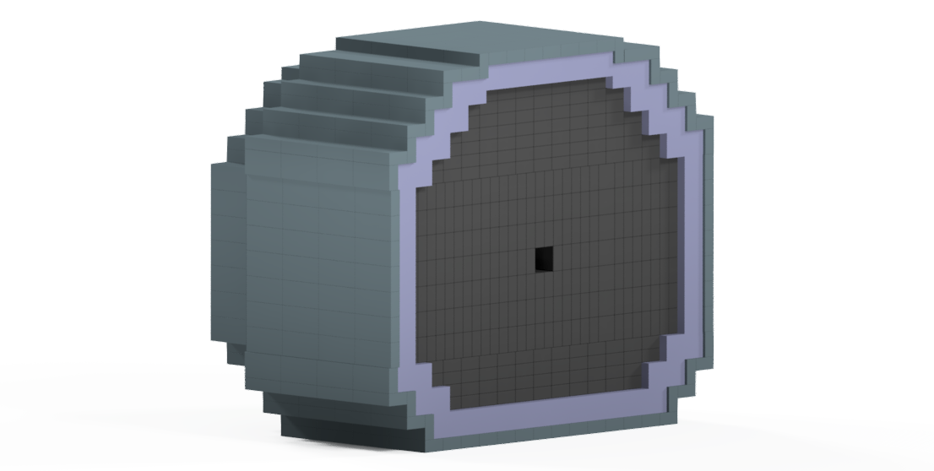
CPS Initial Design Model
Image of Total CPS
Joshua Crafts
Catholic University Of America

Slide 2
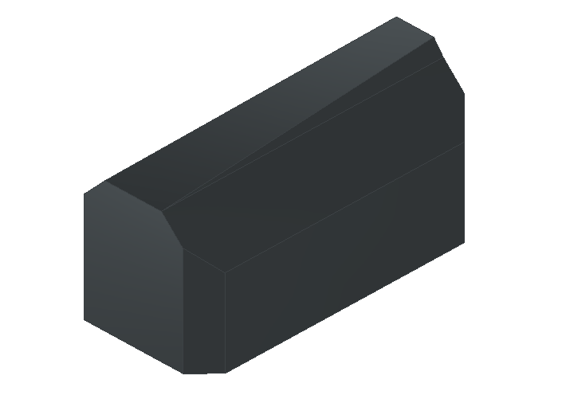
CPS Magnet Pole
Iron Pole
40 cm long
20 cm wide
Angled surface connecting to Cu core

Slide 3
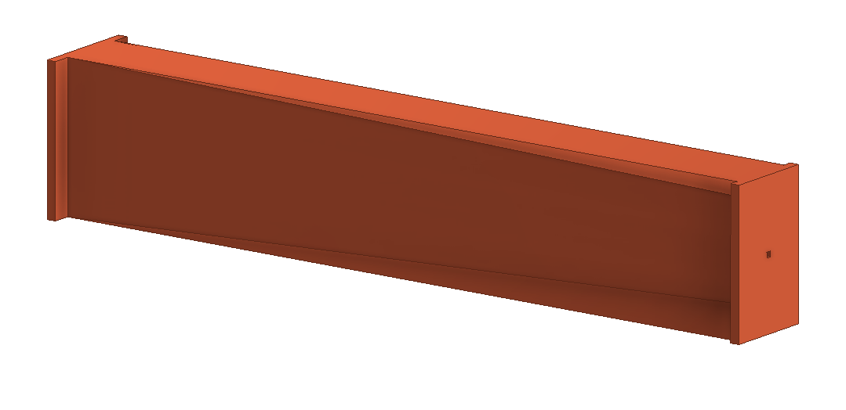
CPS Cu Core
41cm
5.895cm
8cm

Slide 4
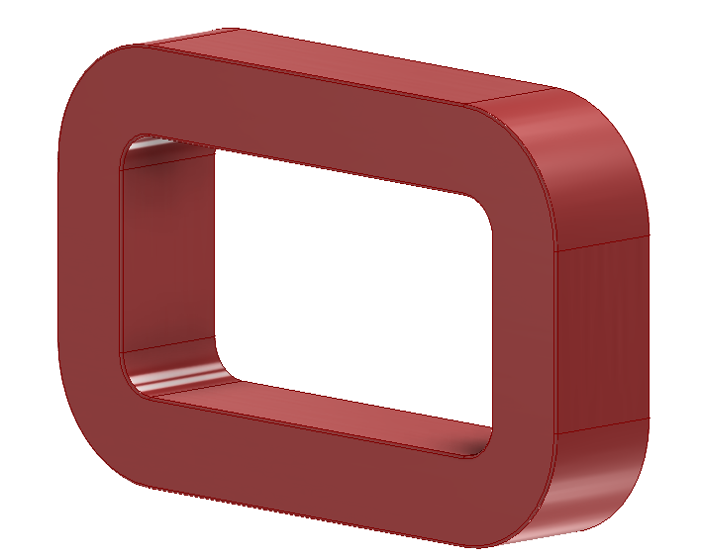
CPS Magnet Coil
54cm
10cm Thick
34cm

Slide 5
CPS Magnet Yoke
70cm
70cm
44cm
40cm
54cm

Slide 6
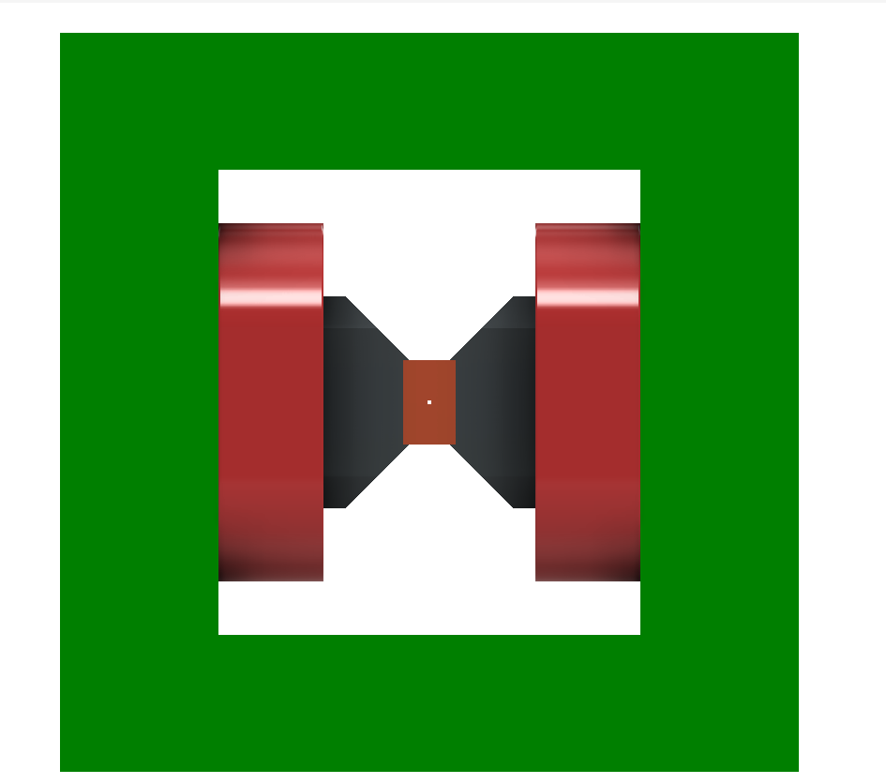
CPS Magnet Assembled

Slide 7
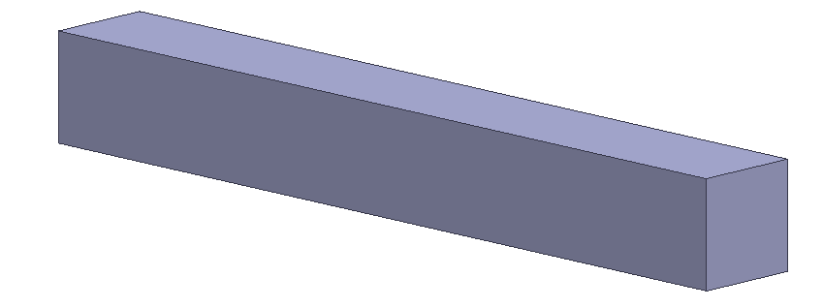
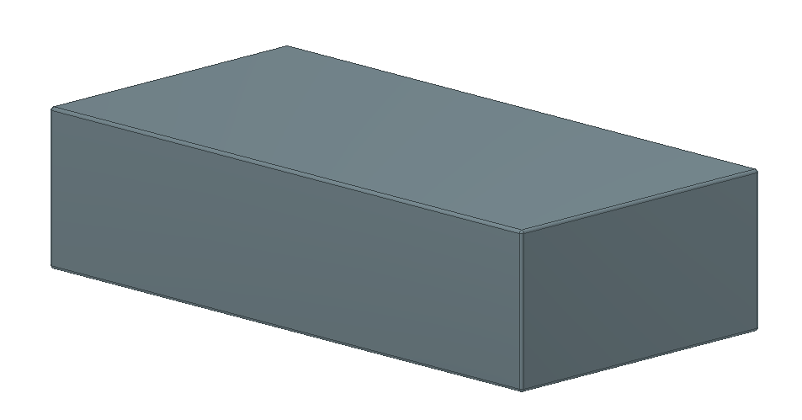
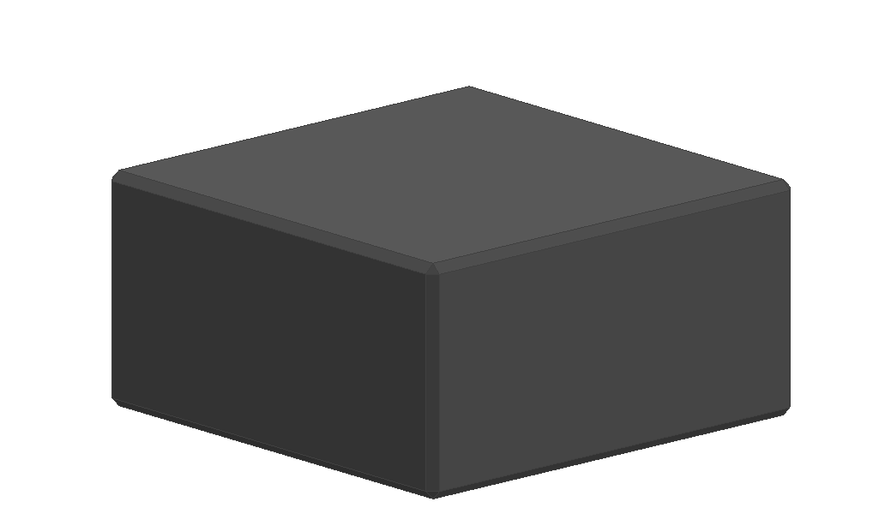
CPS Magnet Shielding
Borated Polyethylene
4”x4”x80cm
Lead Brick
8”x4”x2”
Tungsten Powder Block
4”x4”x2”

Slide 8
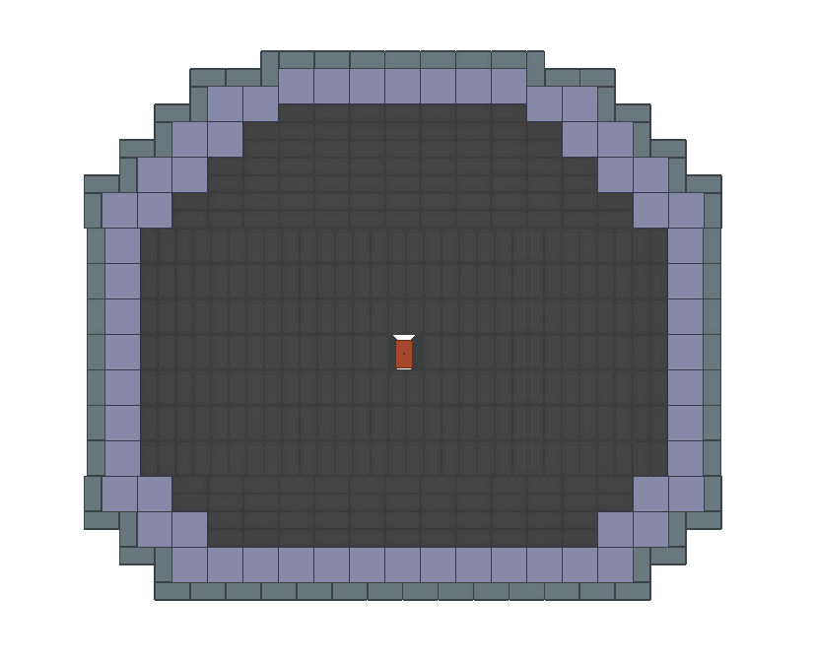
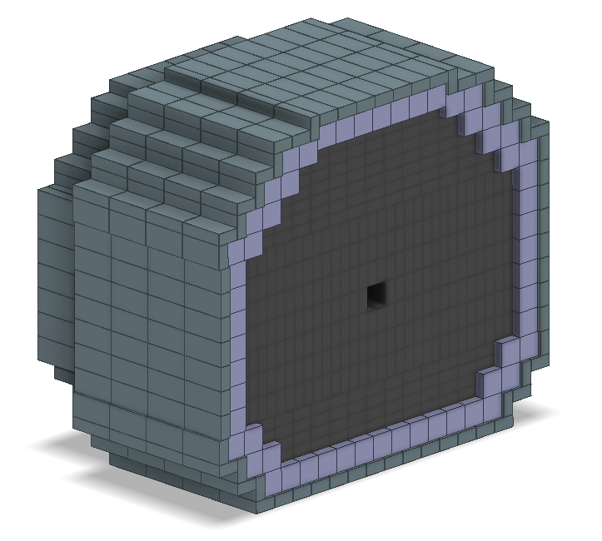
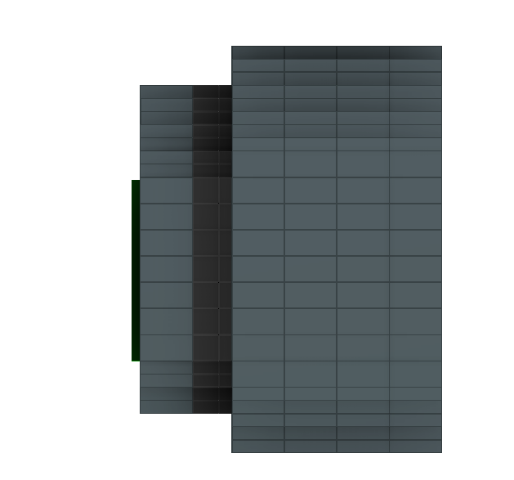
CPS Shielding Initial Stacking Concept
CPS inner segment: 182.88cm wide, 152.48cm tall

Slide 9
