Slide 1
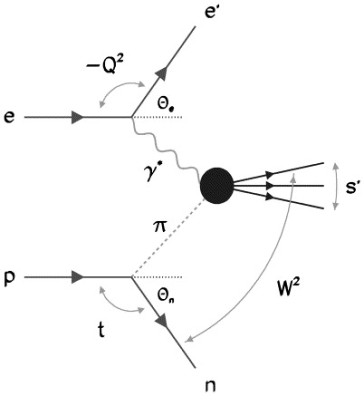
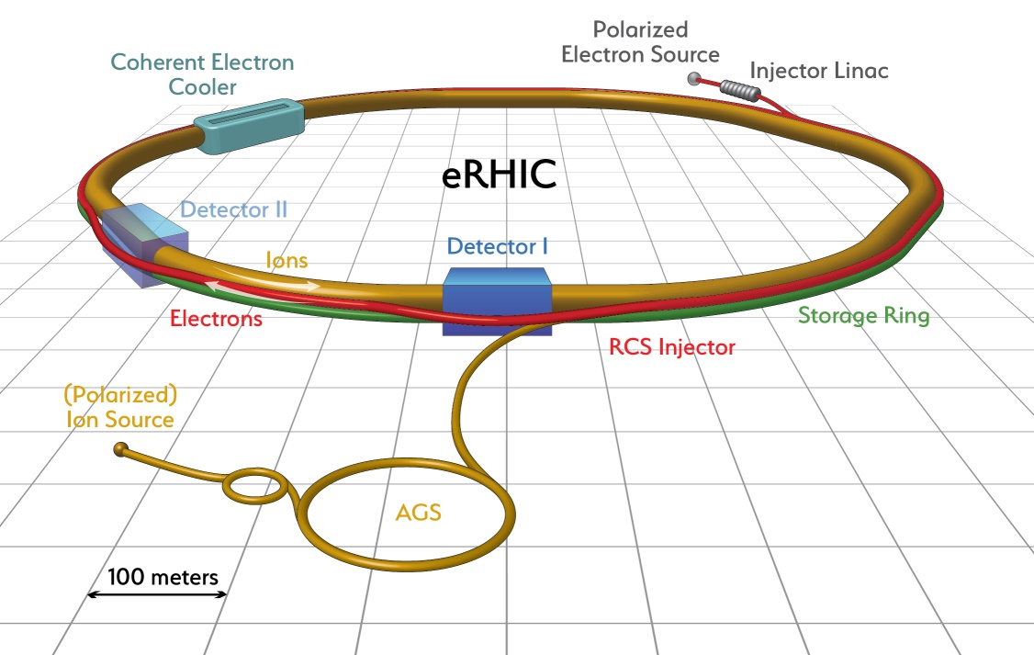
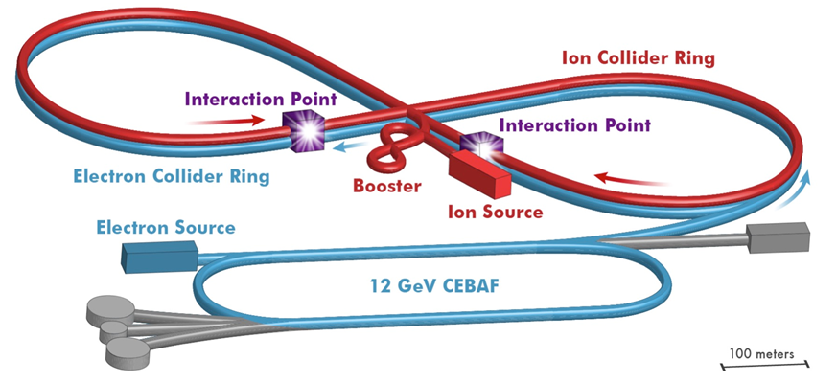
Pion and Kaon Structure from DIS: HERA to EIC
Rik Yoshida

Slide 2
Outline
Pion Measurements from HERA
What was measured
How is was measured
How pion structure was extracted
Pion and Kaon structure measurements at EIC
Forward particle measurements
Reaching high-x
Final remarks

Slide 3
HERA Experiments
DESY laboratory in Hamburg, Germany
H1
HERMES
ZEUS
electrons
2 collider experiments
→ ZEUS and H1
2 fixed target experiments
→ HERMES and HERA-b
protons
HERA-b
HERA Data taking 1991-2007
Mission: Explore QCD at highest scale (Q²). Search for new phenomena.

Slide 4
Sullivan Processes
DIS on kaon
DIS on pion
K
Λ
Need to measure these, so “Tagged DIS” (t is small)

Slide 5
HERA Publication connected to pion structure
H1 “Exclusive rho0 Meson Photoproduction with a Leading Neutron at HERA” Eur.Phys.J.C77 (2017) 4, 215
H1 ✔ “Measurement of Leading Neutron Production in Deep-Inelastic Scattering at HERA” Eur.Phys.J.C68 (2010) 381
H1 “Measurement of Dijet Cross Sections in ep Interactions with a Leading Neutron at HERA” Eur.Phys.J.C41 (2005) 273-286
ZEUS: ✔ “Study of pion trajectory in the photoptoduction of leading neutrons at HERA” Phys. Lett. B 610 (2005) 199-211
ZEUS: “Photoproduction of D*^\pm Mesons Associated with a Leading Neutron”Phys. Lett. B 590 (2004) 143-160
ZEUS: ✔“Leading Neutron production in e+p Collisions at HERA” Nucl. Phys. B 637 (2002) 3-56
ZEUS: “Measurement of dijet cross sections for events with a leading neutron in photoproduction at HERA “ Nucl. Phys. B 596 (2001) 3-29
H1: “Measurement of Leading Proton and Neutron Production in Deep Inelastic Scattering at HERA” Eur.Phys.J.C6 (1999) 587-602
ZEUS: “Observation of Events with an Energetic Forward Neutron in Deep Inelastic Scattering at HERA” Phys. Lett. B 384 (1996) 388-400

Slide 6
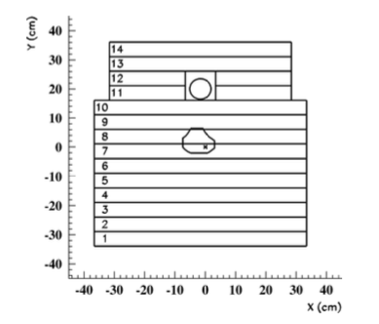
Measuring the Forward Neutron (FNC) at ZEUS
~110m from ZEUS central detector
Lead-Scintillator (compensating) calorimeter
7 interaction-length
Had resolution of 65%/√E
500 GeV Neutron → 3% Energy Resolution

Slide 7
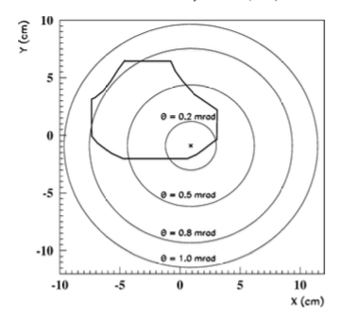
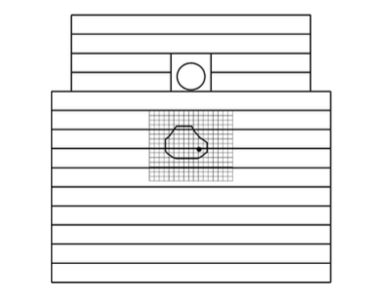
Forward Neutron “Tracker”
FNC acceptance was ~20% of 2π up to about 0.8 mr
(limited by beam elements)
Forward Neutron “Tracker”
Scintillating fingers—1.5 cm wide was
installed to measure t (P_{t})

Slide 8
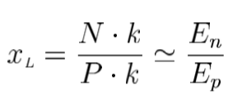
Defining the measurement
ep DIS Cross-Section
Quark Parton Model
Proton PDF
Now with a leading neutron
FROM
Nucl. Phys. B 637 (2002) 3-56

Slide 9
Forward Neutron Deep Inelastic Scattering
DIS Cross-Section with a leading neutron
Conditional (or Tagged) Proton Structure Function
So far no model dependence

Slide 10
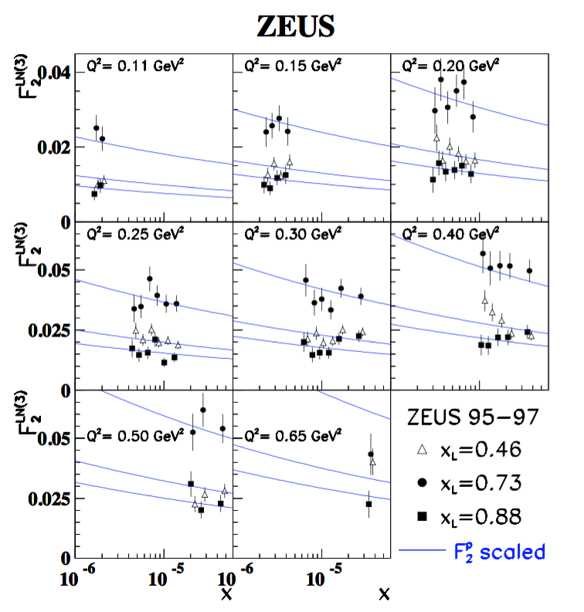
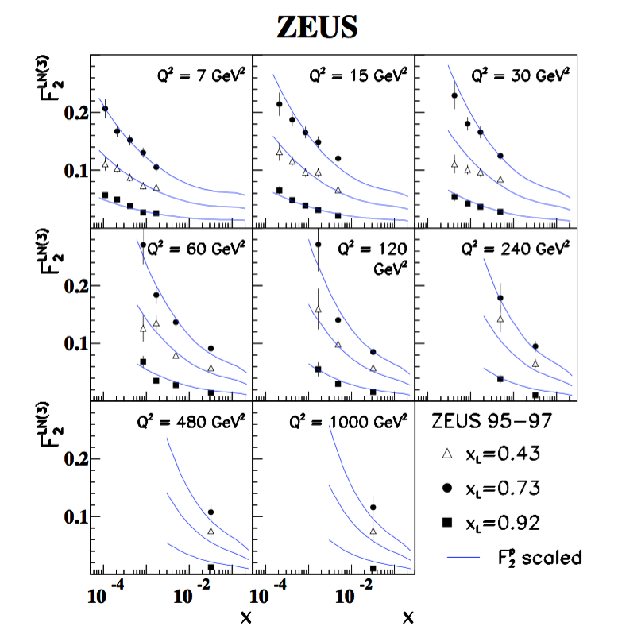
Measurements of Leading Neutron F₂
Looks just like protons at low x (scaled down)

Slide 11
Going towards a Pion Structure: Flux factor
Pion Flux Factor

Slide 12
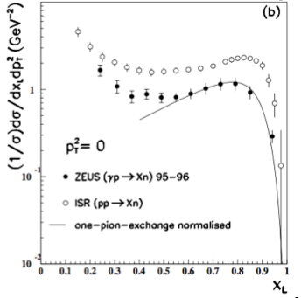
Determining the Flux Factor
Taken from One Pion Exchange Model for CX Hadroproduction
ISR and Fermilab experiments from the 70s well described
Also looks consistent with CX photoproduction data from ZEUS
Note factor 2
difference
“takes care of” all other effects incl. off-shellness
“Bishari” flux (F=1)
Something is not right with this flux
(at least normalization)

Slide 13
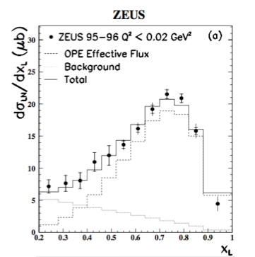
Neutron Energy Distribution and the Flux Factor
“Bishari” flux (F=1)
The Bishari flux can be fit to HERA data with a background linear in (1-x_{L})
What about the pion trajectory?

Slide 14
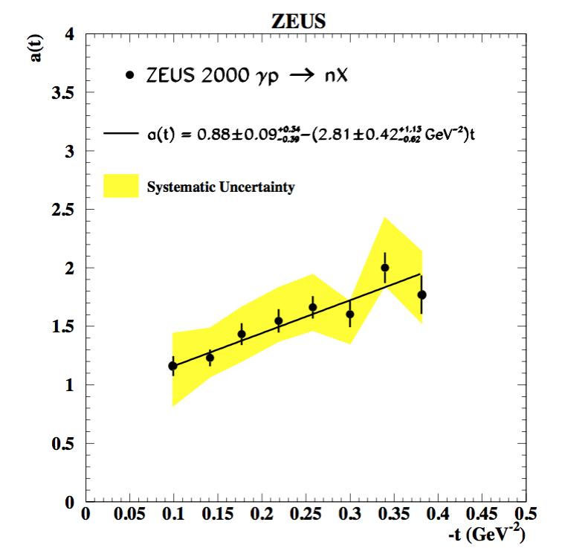
Pion Trajectory (t dependence)
HERA x_{L} and t dependences are consistent with one pion exchange shape

Slide 15
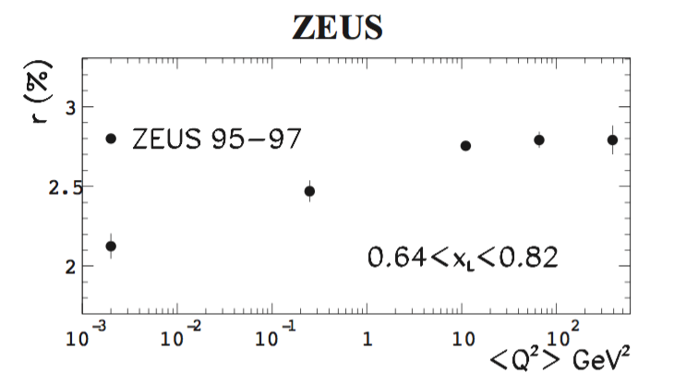
Final State Interactions?
r = (Neutron Tagged “DIS”)/ (Total “DIS”)
HERA data consistent with absorptive
effects (i.e. interaction of hadronic part of
the photon)
Photoproduction = real photon (hadronic size)
DIS = virtual photon (more point-like)
DIS
Photoproduction

Slide 16
Defining the absorptive effects
Less than 10% effect at high Q²? : D’Alessio and Pirner Eur. Phys. J. A7 (2000) 109

Slide 17
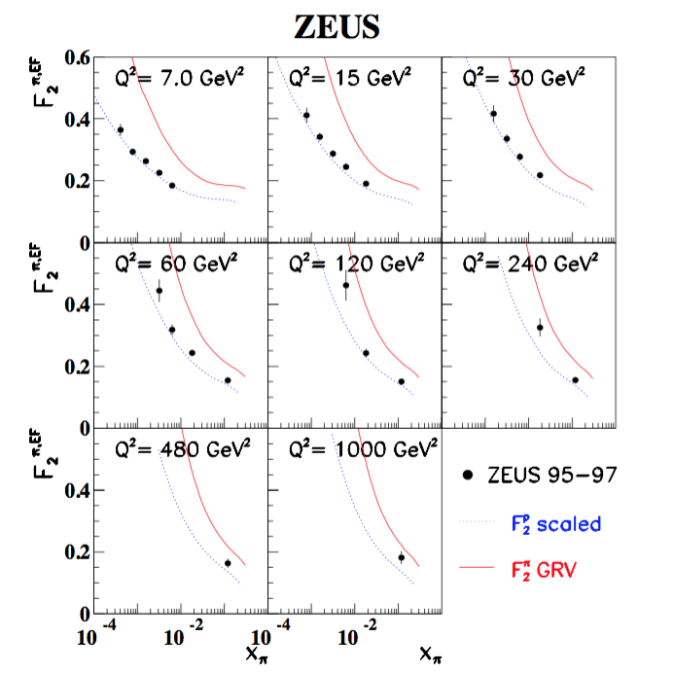
“Pion F₂” as measured by ZEUS
So now just using the “effective flux” (Bishari) and ignoring
our normalization problems…
Looks like a scaled down proton F₂
Doesn’t match expectation from DY data at higher x
(“GRV”) as expected from the normalization issues.

Slide 18
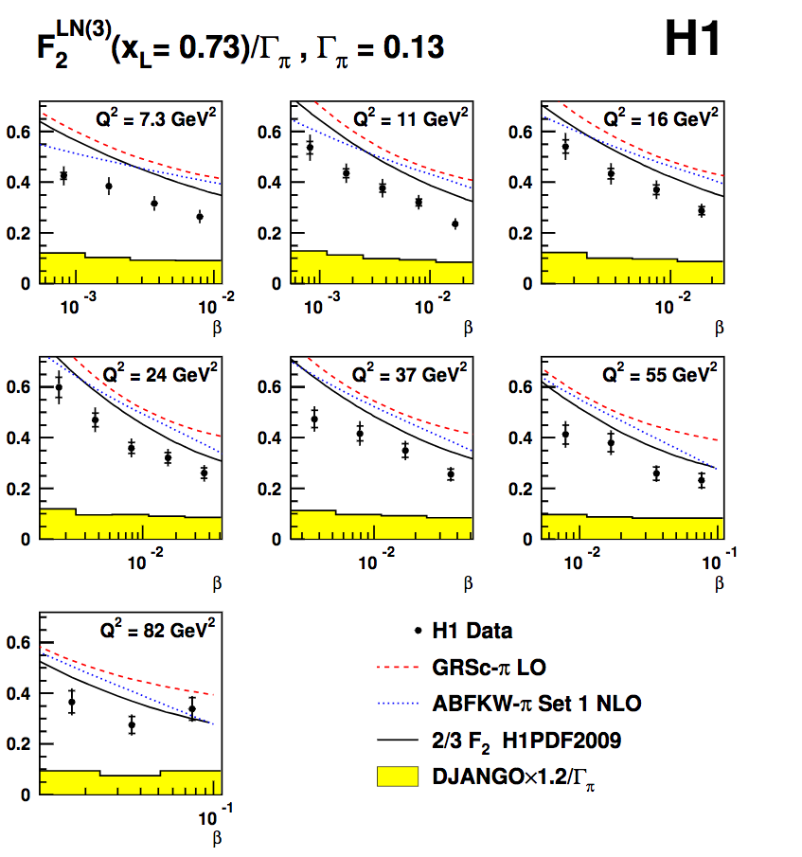
Results from H1
Light Cone Flux
Similar conclusion from H1
Hope of further data from DIS, maybe at high x?
What about CEBAF 12 GeV?
Difficult at fixed target but….
Eur.Phys.J.C68 (2010) 381

Slide 19
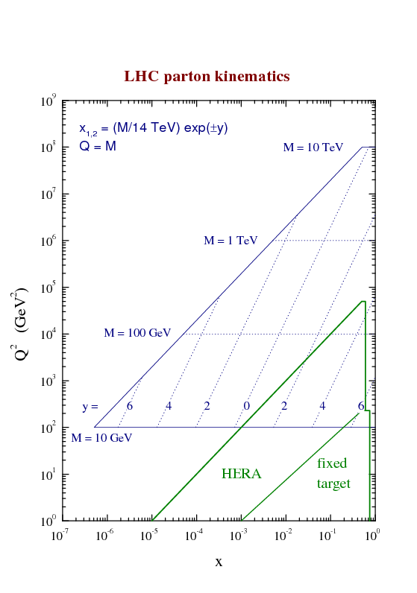
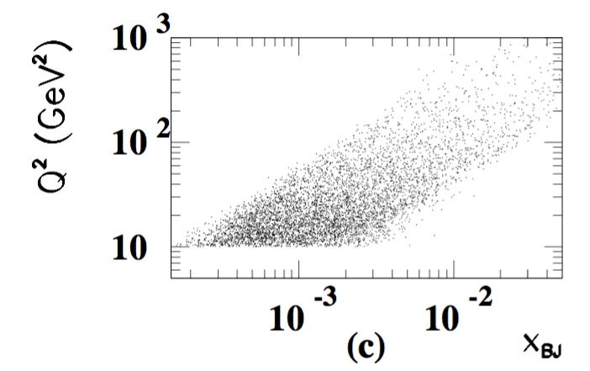
Measurement Possibilities at EIC
Events at HERA
HERA did not plan on doing forward physics:
FNC came as an after-thought (poor acceptance, limited space)
HERA had difficulty reaching higher-x
Luminosity was relatively low
Detectors were not designed for high-x measurements at lower Q²
EIC

Slide 20
Measuring Forward Particles
Extended detector: 80+ m
JLEIC
eRHIC
EIC detectors must be extremely well integrated with the accelerator

Slide 21
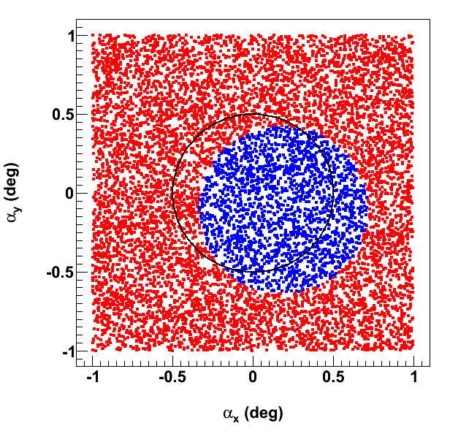
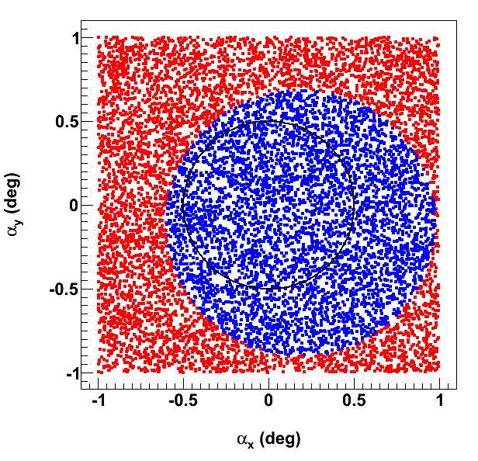
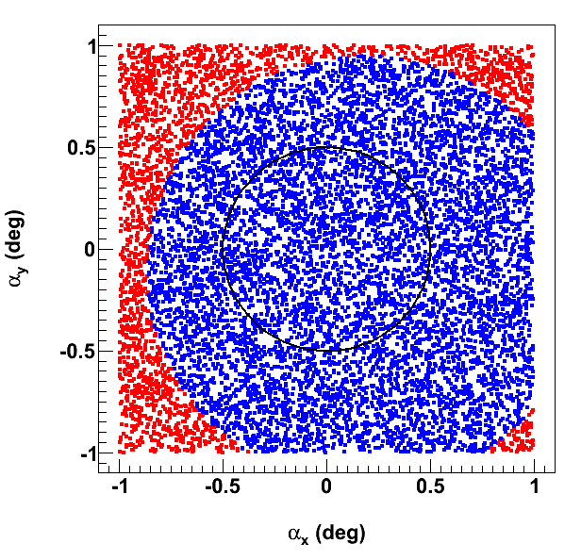
Neutron Acceptance
Neutrons uniformly distributed within ±1° horizontal & vertical angles around proton beam
Each quad aperture = B max / (field gradient @ 100 GeV/c)
6 T max
9 T max
12 T max
← electron beam

Slide 23
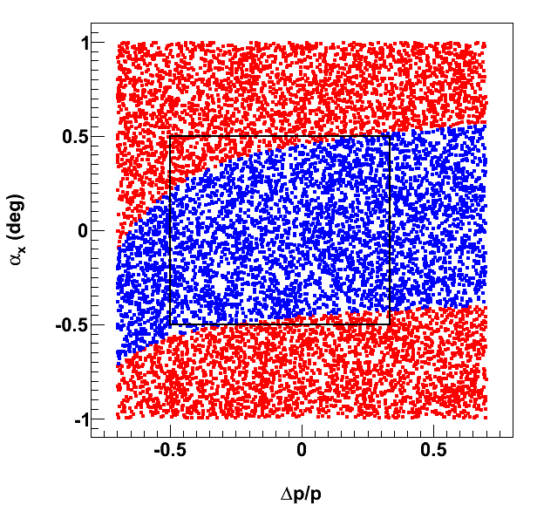
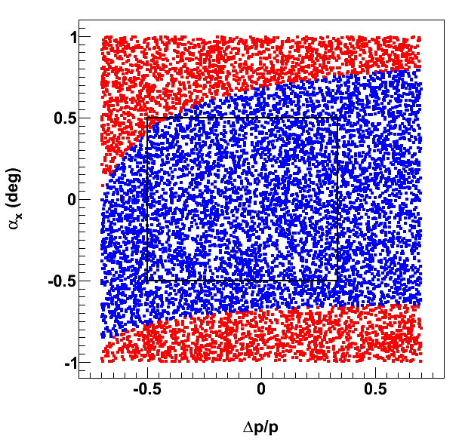
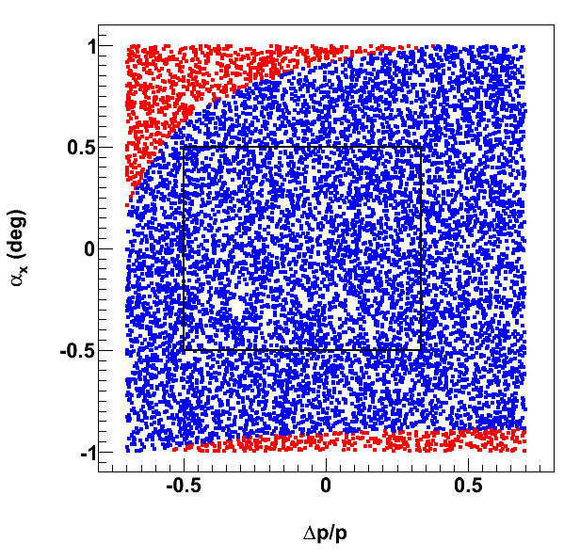
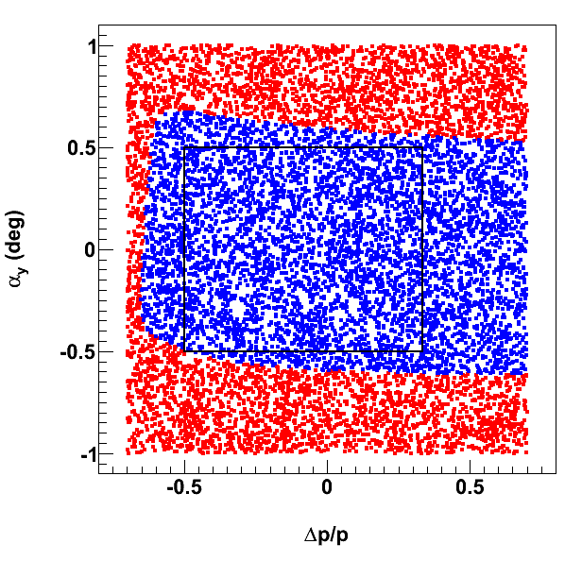
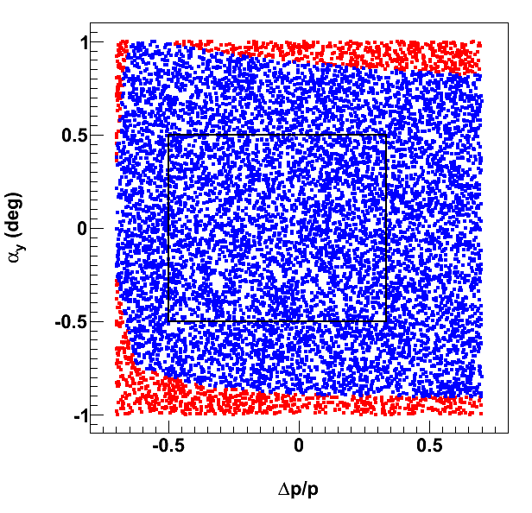
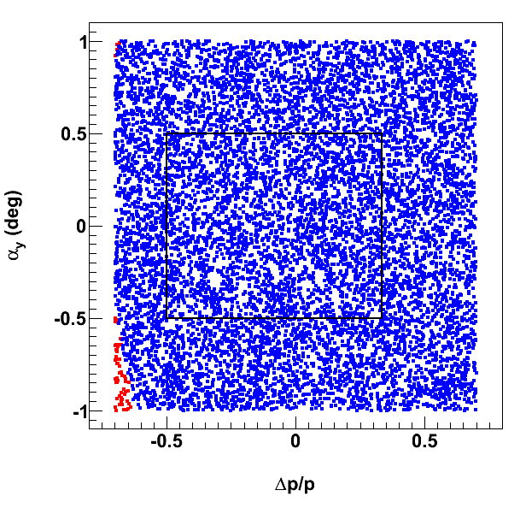
Charged Particle Acceptance
Quad apertures = B max / (field gradient @ 100 GeV/c)
6 T max
9 T max
12 T max
← electron beam

Slide 24
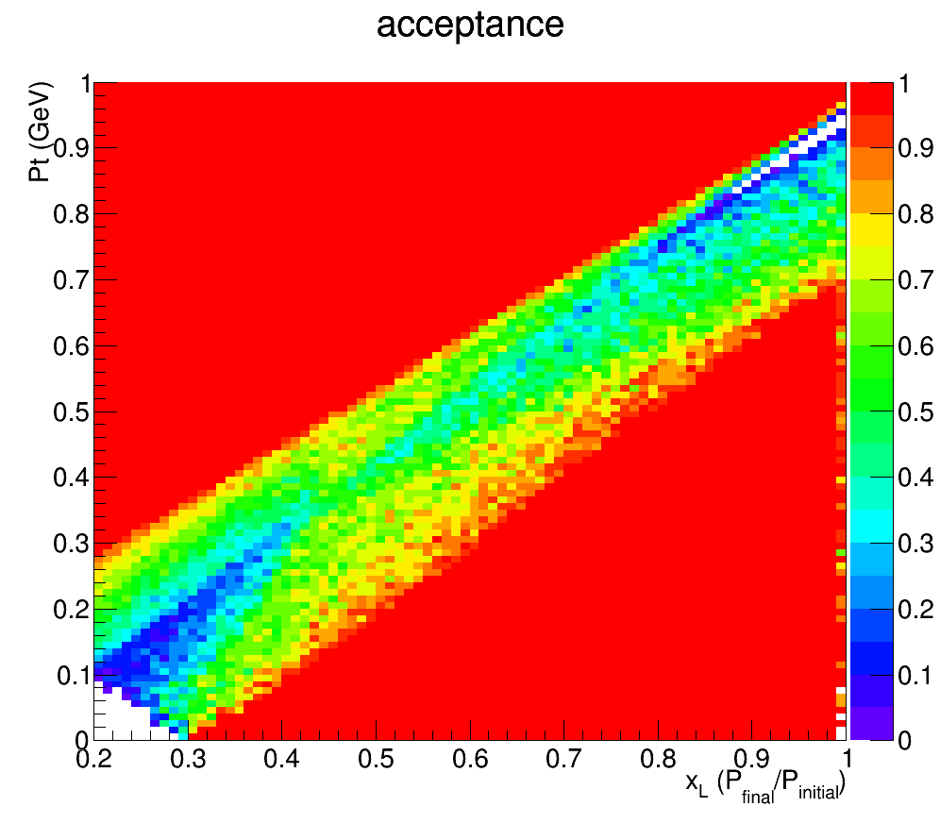
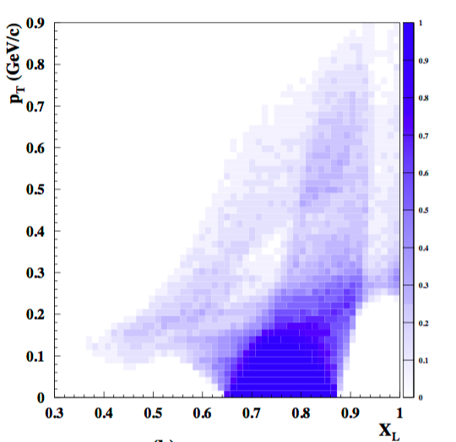
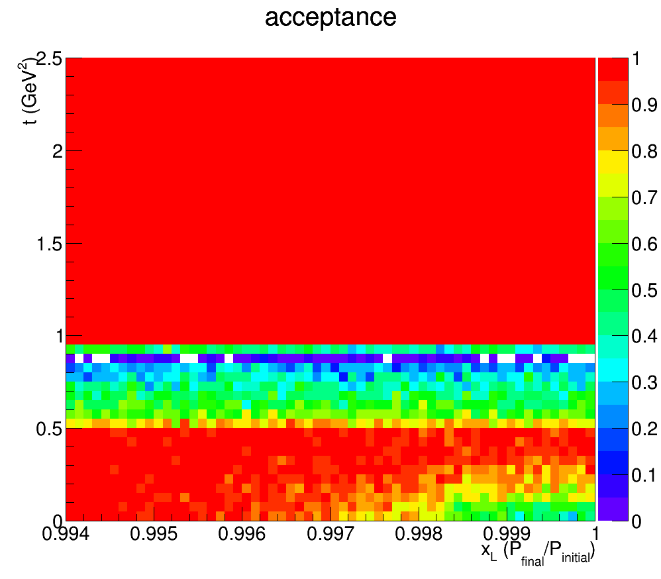
Acceptance for ep->e’Xp’
JLEIC
ZEUS
Leading Proton Spectrometer
P_{t}
1
(GeV)
Region 1
Region 2 (Hi. Res)
0
0.2
1
X_{L}
t
2.5
(GeV²)
Acceptance in diffractive peak (X_{L}>~.98)
ZEUS: ~2%
JLEIC: ~100%
0.994
1
X_{L}

Slide 25
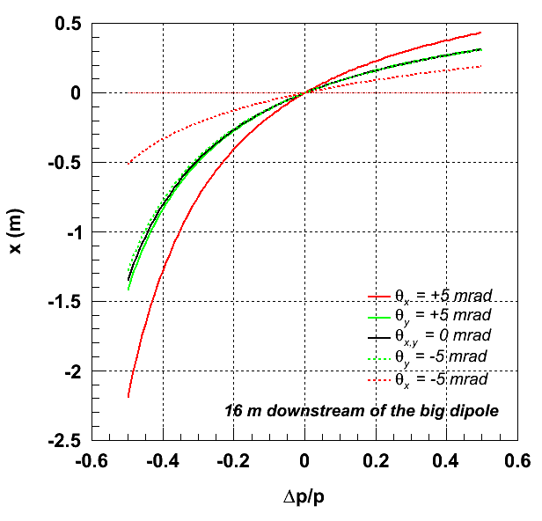
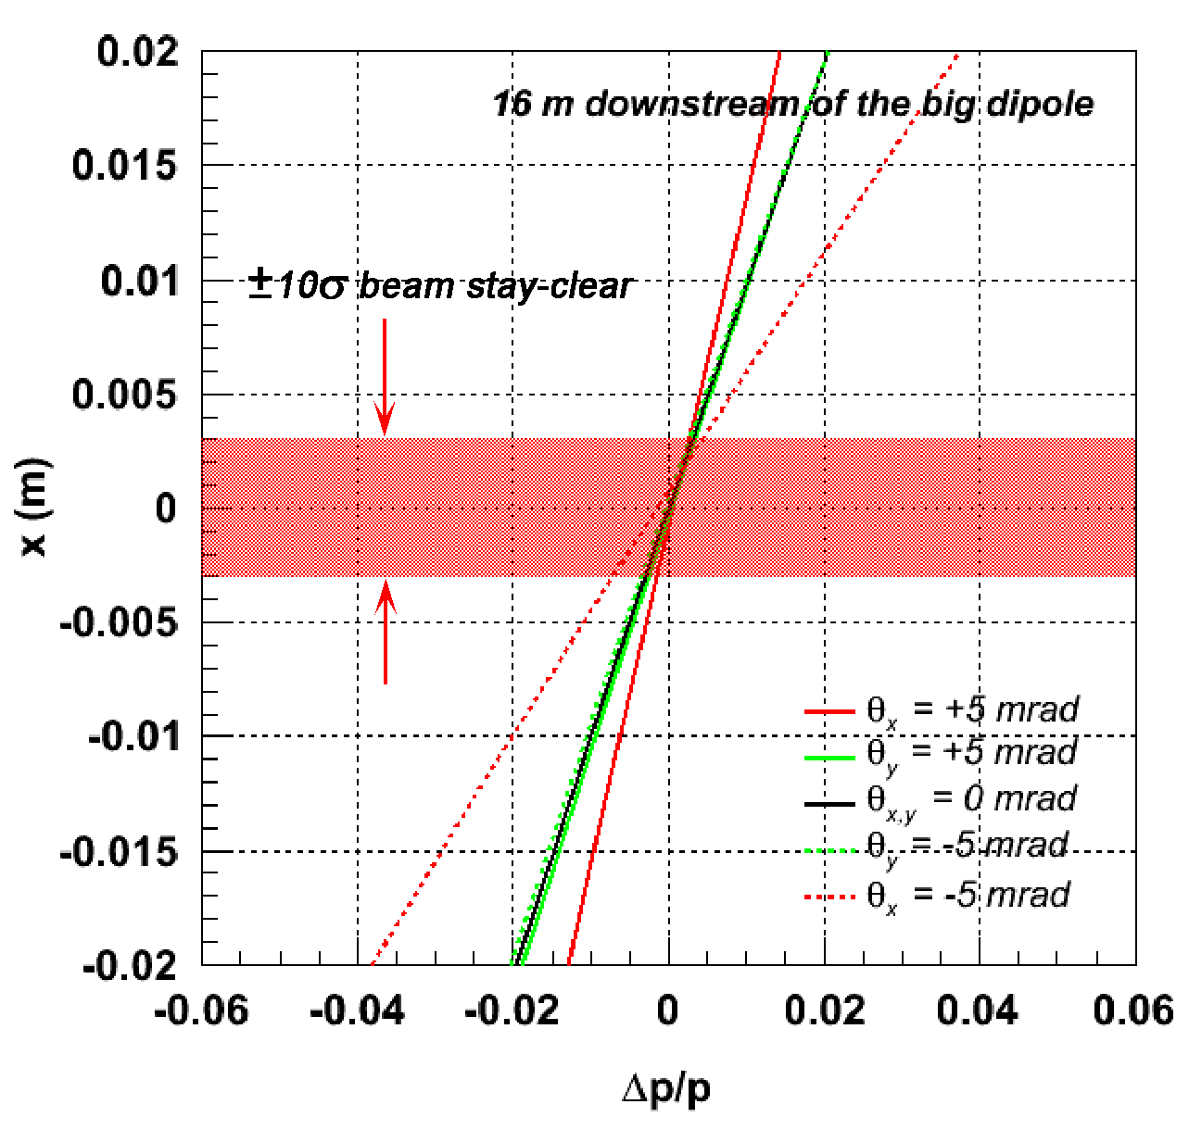
Resolution for Charged Particles
Protons with Δp/p spread launched at different angles to nominal trajectory
|Δp/p| > 0.005 @ θ_{x,y} = 0
±10σ @ 60 GeV/c
← electron beam
For ZEUS LPS: resolution in X_{L} was about 0.5% and Pt resolution was 5 MeV

Slide 26
Resolution for Neutral Particles
E_{EIC} = E_{HERA}/10, so now neutrons are ~50 GeV
65%/√E →9% resolution
ZEUS Uranium-Scintillator Calorimeter was 35%/√E so 5% resolution.
Is this good enough? Do we need something better? What is the position
resolution we need?
What about Λ -> n pi ? 36% br. Is it possible? Better acceptance than p pi?
Can we reconstruct this?

Slide 27
Tagging Lambda’s

Slide 28
What High-x Interaction looks like
Highly asymmetric collision at the parton level (the other way)
parton carrying ~x*0.5*E_{proton_beam}
E_{electron_beam}
Since x ->1, this is like the 0.5*beam energy
Parton energy ~50 GeV
Electron Beam ~10 GeV
Where does the final state go?

Slide 29
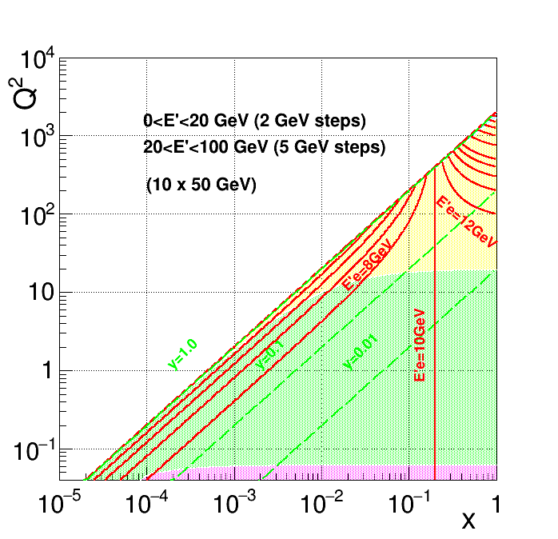
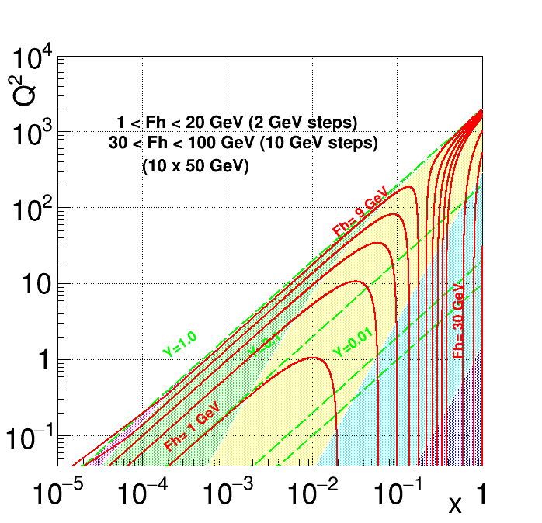
Final State for 50 GeV pion vs. 10 GeV electron
Electron energy isolines
Quark energy isolines

Slide 30
High-X kinematics
Need a very precise measurement to get x
Most of the time:
E_{electron} ≅ E_{electron_beam}
θ ~ Q²
beamline
E _{jet}
E_{pion}
= X
This is hard to measure: a jet close to beam pipe

Slide 31
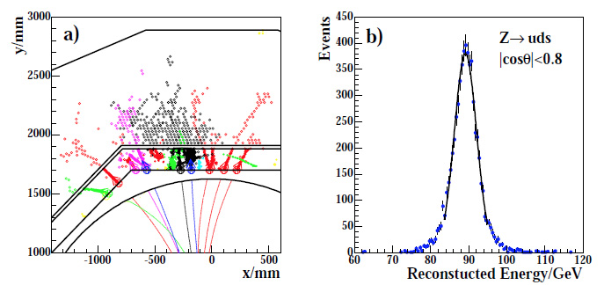
High-x Detector
High Granularity Particle-flow Calorimeter
No Field
Dipole
Field
Pb-Sci calorimeter
electron
Θ
electron beam
Proton beam
E_{jet}
Tracker/TRD
Electron is “always” 10 GeV: use TRD to ID, use conventional calorimeter. Measure
angle to get Q².
Jet energy needs to be measured as well as possible for x: use particle flow.
30%/root(E)? If so 3-5% resolution on x (0.5 to 1)

Slide 32
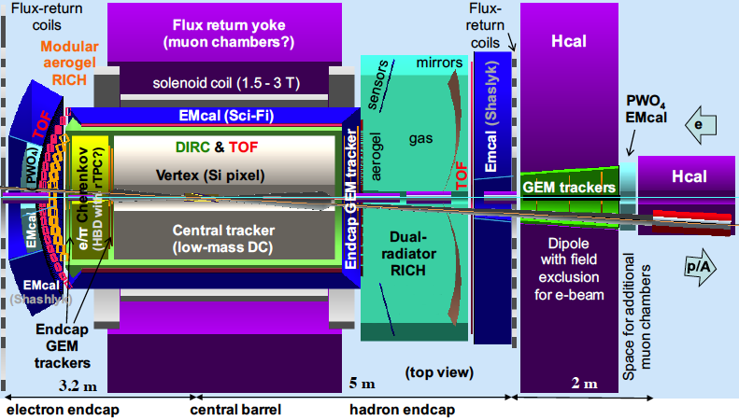
Modified EIC Detector
HCAL
dipole
dipole
solenoid
EM
VTX
+Tracking
TOP
EM
GEM Tracker
HCAL

Slide 33
Final Remarks
Discussed the pion structure measurement made at HERA.
Didn’t understand the normalization.. Better understood now?
Measuring pion (and kaon) structure at EIC.
Can do better in the forward particle measurement
Can do better in high-x measurement.
But it’s not for free. Pretty challenging detector questions need to be answered.

