Slide 1
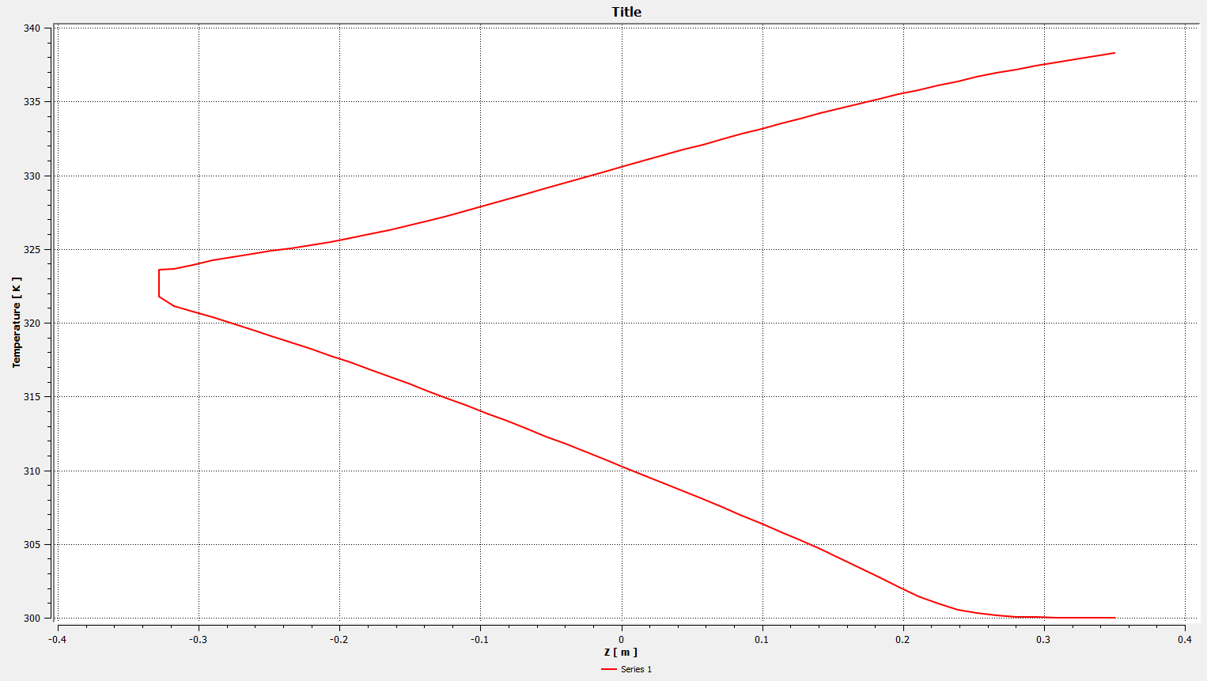
Thermal balance
Roughly a temperature delta of 38K of each flow channel showing each channel takes half the heat load.
Flat line at inlet not realistic!! Flow needs to be given time to develop outside the cu absorber since temperature does not increase linearly for the 1st 0.1 m of channel.
outlet
180 bend
There should be no heating (or cooling) at the far end where the piping exits the absorber makes a 180 degree bend and then re-enters the absorber. Should be nearly constant temperature.
Inlet
Temperature at center of fluid channel : Z COORDINATE VS TEMPERATURE

Slide 2
Exit
5cm no heating occurs.
Section at start of absorber.
Entrance
60cm of heating.
Lower amount of heating occurs. Tube near sides of absorber.
Tube bend region. No heating/cooling.
Just more mixing occurring?

Slide 3
