Slide 1
VME LED Driver (VLD) design
1080 (30x36) LEDs, through long ribbon cables.
Calibration: individually controllable, up to 110 mA, ~ns pulses
Bleaching: All ON, 35 mA, many hours
Design in progress
VME_64
Switch ADG1611
CHmonitor
ADCs
monitor
Switch ADG1611
CH1
2x80ft ribbon cable
JTAG
engine
FPGA
Switch ADG1611
CH2
Channel_En(108:1) /(180:1)
Switch ADG1611
CH3
Config
memory
Bleach_En(6:1) /(10:1)
Trigger
Clock
In/Out
Switch ADG1611
CH108
AC or DC coupling
To be determined
DAC_D(5:0)
Switch ADG1611
CH180
No protection
FPGA_DAC
500 MSPS
Amplifier AD8021
LDOs
Vout adj.
‘Serial termination’,
Cable reflection suppression
VME +5V
Bleaching current limit
William GU

Slide 2
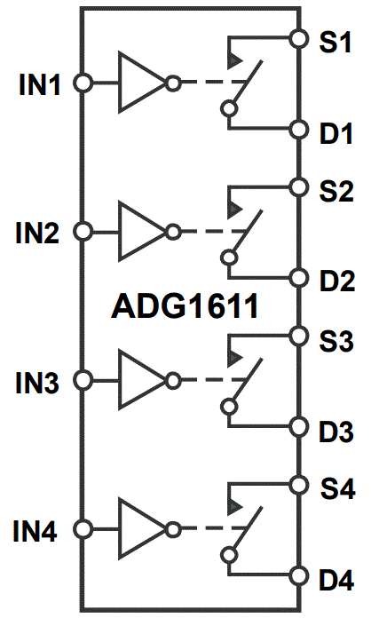
VLD design
LED(1)
FPGA_enable(1)
FPGA_DAC
6-bit
500 MSPS
LED(2)
FPGA_enable(2)
DAC_D(0)
LED(…)
DAC_D(1)
FPGA_enable(…)
DAC_D(2)
DAC_D(3)
LED(180)
FPGA_enable(180)
DAC_D(4)
DAC_D(5)
DAC_OUT
FPGA
1, 0, Z
LED Cal pulse
ADG1611:
1 Ohm typical on resistance
+3.3V enable control
+12V single supply.
DAC_D: width adjustable with steps of 2ns
Amplitude: 3.3V, 0V, or high impedance (each bit)
William GU

Slide 3
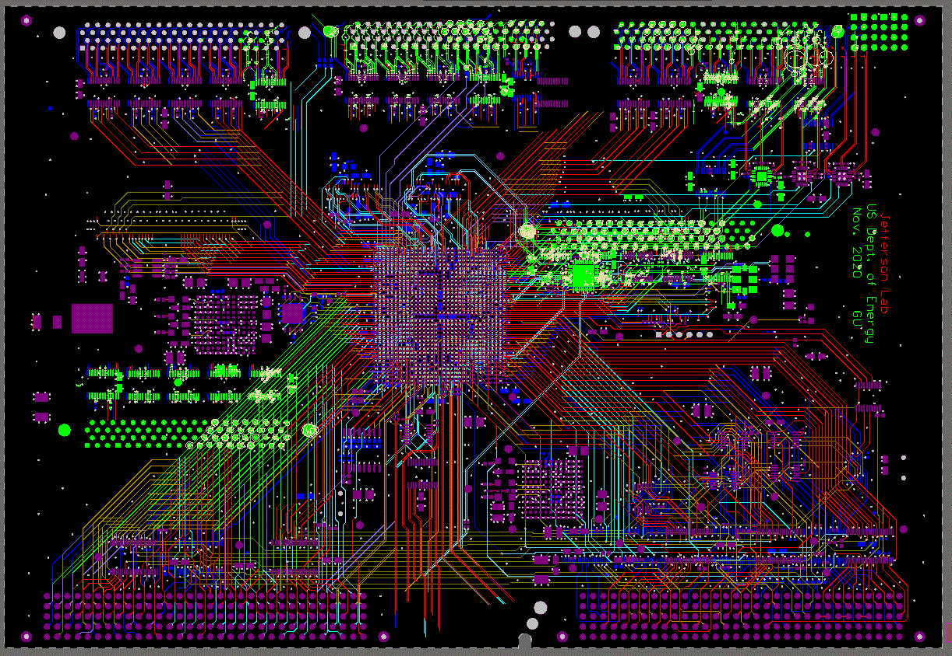
VLD PCB
80-pin 3M P5E
36-LEDs #3
80-pin 3M P5E
36-LEDs #2
80-pin 3M P5E
36-LEDs #1
LEMO I/O
Trigger Clock
1080 channels:
* 10 VLDs: the front panel
* 6 VLDs: the front panel and on-board
XC7A200T
FPGA
On-board (?)
80-pin 3M P5E
36-LEDs
On-board (?)
80-pin 3M P5E
36-LEDs
VME64x

Slide 4
Trigger Interface for NPS
Fiber
#1
Fiber
#5
#6
#7
#8
Short fibers inside HUT
TI_master
TI
Long fiber from CH to HUT
TI_DC
NPS#2
Existing trigger/Clock/Sync distribution system
(SHMS/HMS)
TI
NPS#1
NPS#3
TI
TI_DC: TI New mode of operations:
When the TI_DC is set to master mode, these five crates behaves like an independent (DAQ) system.
When the TI_DC is set to Daisy Chain mode, it receives Trigger/Sync/Clock from, and sends BUSY to the SHMS/HMS master TI via fiber#1 (as a salve TI); fans out the Trigger/Sync/Clock to, and accepts BUSY from fiber#5, #6, #7, and #8 as a TD (or master TI).
NPS#4
TI
NPS#5
TI_DC FPGA firmware is being developed/tested
Minimum fiber route (addition), minimum existing (SHMS/HMS) trigger interface change.

