Slide 1
EIC Meson Structure Working Group
Meeting 02/22/2021
  History
  Where we are
  Next steps and goals for CY2021

Slide 2
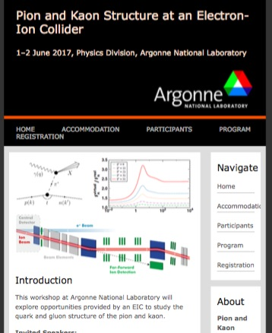
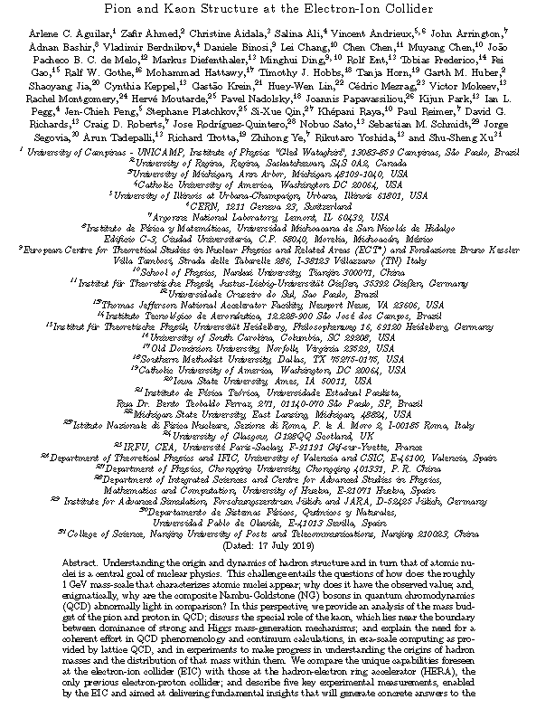
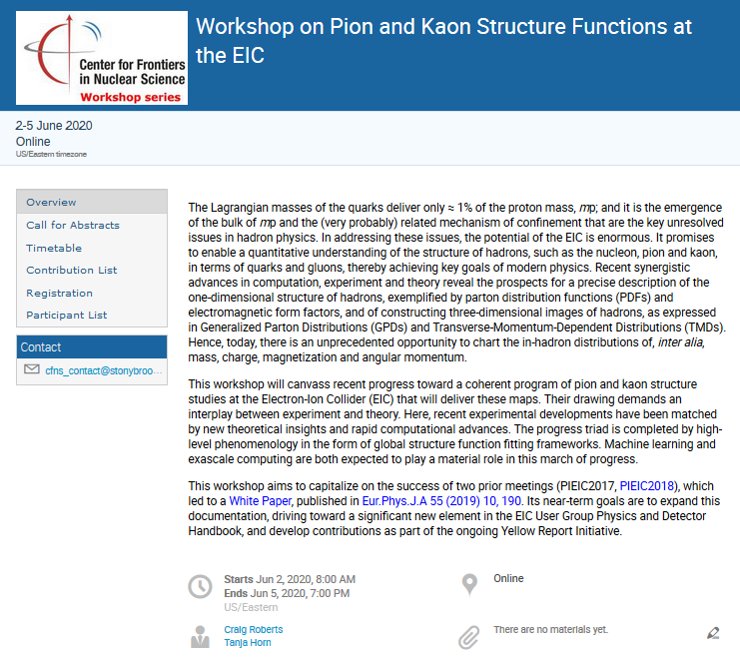
Pion and Kaon Structure at the EIC – History
PIEIC Workshops hosted at ANL (2017) and CUA (2018)
ECT* Workshops: Emergent Mass and its Consequences (2018)
Mapping Parton Distribution Amplitudes and Functions,(2018).
Pion and Kaon Structure at an EIC
Eur. Phys. J. A 55 (2019) 10, 190
AMBER/CERN Workshop (2020)
CFNS Workshop (2020)
2
ECT* Workshops (2021): Mass in the Standard Model and Consequences of its Emergence

Slide 3
EIC Meson Structure WG – Where We Are
Main progress over the last year:
Synergy between Lattice QCD, QCD Phenomenology, and Global QCD Fits more refined
Much theory progress – interplay emergent- and Higgs-mass mechanisms, gluon pdfs in lattice, global pion structure pdf fits, pressure distributions in pions and kaons, etc., etc.
Tagged meson structure capabilities drove forward-detection definition at EIC. Community realization growing of importance and need to make beam line compatible with detection of n, Λ (decay), etc.
Projections of pion structure functions and pion form factor at EIC shows unique opportunities at EIC.
Prominent appearance in EIC Yellow Report.
Results documented and article submitted: “Revealing the structure of light pseudoscalar mesons at the Electron-Ion Collider”

Slide 4
EIC Meson Structure WG – Next Steps
Goals CY2021
Make progress on defining mass sum rules for pion (and kaon) at physical-mass scale
Similar, make progress on major parts of theory interface as written in 2.4: direct lattice calculation of contributions, inclusion of lattice in global data analysis, benchmarking calculations with QCD fits and phenomenology, relating Euclidean lattice QCD and continuum methods, mapping the pion light-front wave function.
Similar, make progress on documenting gluon pdfs in pion and kaon from LQCD, pion and kaon pressure distributions, impact of emergent- and Higgs-mass interference on physical observables, and quantifying connections to understanding of the pion and kaon mass.
Document Λ/Σ ratios from published and new L/T separated kaon electroproduction cross sections and make initial estimate if these can allow kaon form factor measurements at EIC.
Drive the forward beam line design and detector choice and placement for an alternate second detector/IR optics, and document science gain – this can directly feed into the call for detector proposals.
Project tagged kaon structure function data as possible at an EIC and their possible impact as determined from a global QCD fit.
Study if tagged pion data at low –t can produce sufficient quality data for a pion pressure distribution measurement.
Correlated, make theoretical progress on QCD backgrounds to ensure one can obtain clean physical pion data for tagged structure function measurements and beyond (pion pressure distribution, pion TMDs) at EIC.

Slide 5
EIC Meson Structure WG – Next Steps
Points to add from 2/21/2021 Meeting
Impact of off-shellness on structure functions
Investigate dependence of impact studies on, e.g. pion flux model
Add background to analysis to validate event selection criteria
Points to add 3/30/2021 – discussion with Garth
Forward beamline design: investigate forward angle charged particle momentum resolution – how does it impact t-reconstruction

