Slide 1
NPS Calorimeter
ERR, May 15 (2019)
Carlos Munoz Camacho, IPN-Orsay
for the NPS Collaboration
IPN-Orsay NPS group:
E. Rindel, T. Nguyen Trung, G. Hull, J. Bettane
M. Imre, B. Mathon, L. Seminor, L. Vatrinet, B. Geoffroy
H. S. Ko, C. Munoz

Slide 2
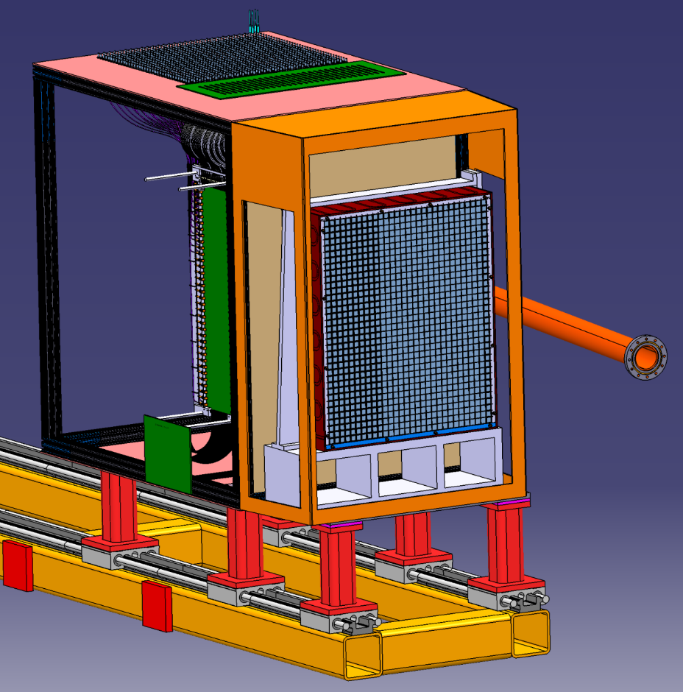
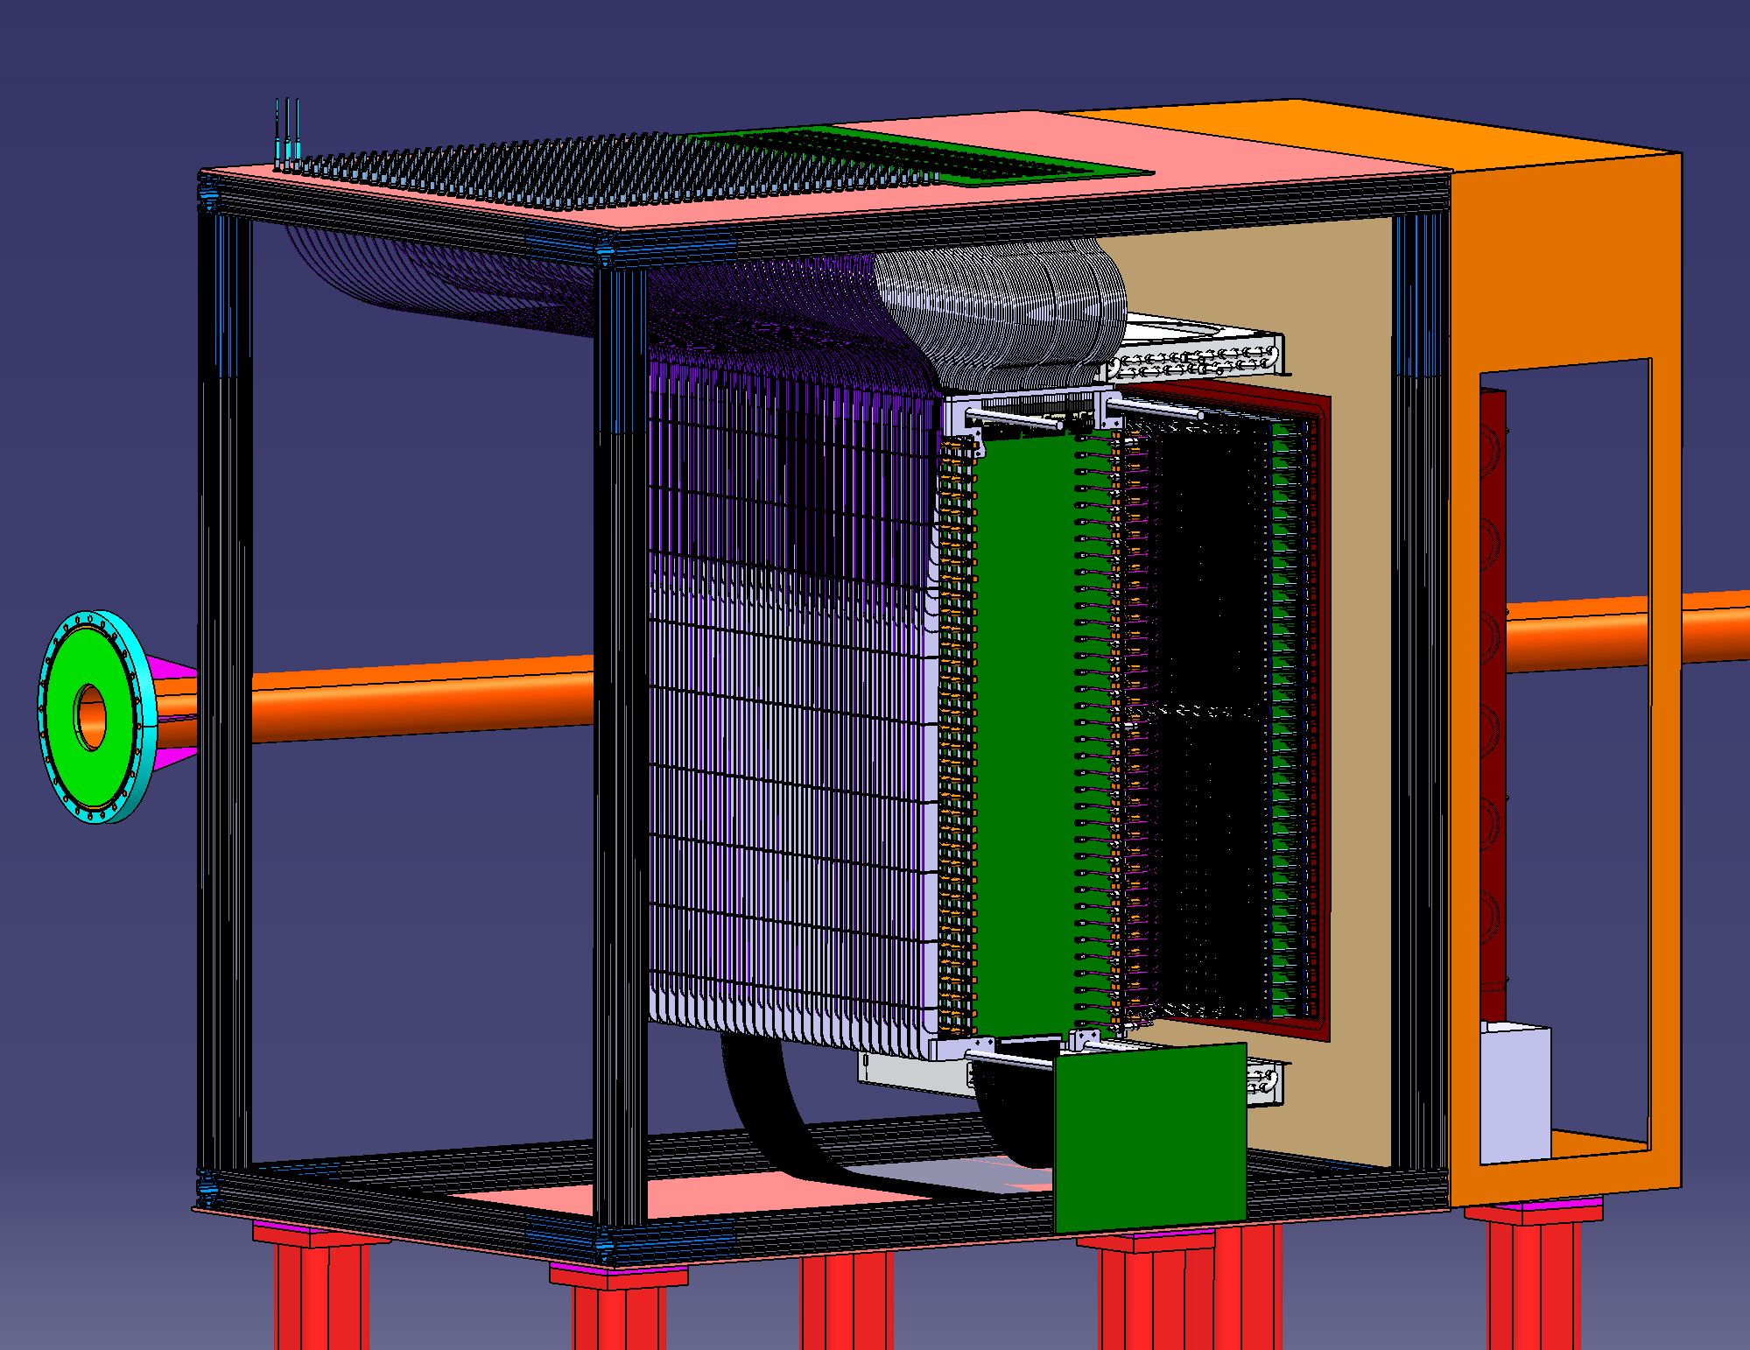
Conceptual design
Front view
30x36 (1080) PbWO₄ crystals (2x2x20 cm³)
Hamamatsu R4125 PMTs
Custom-made active bases (covered in some other talk?)
Back view
Crystals placed in a 0.5 mm-thick carbon frame to ensure good positioning
PMTs accessible from the back side to allow maintenance
Calibration and radiation curing with blue LED light though quartz optical fiber
100% completed

Slide 3
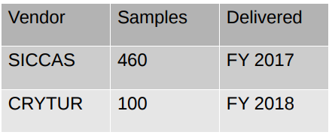
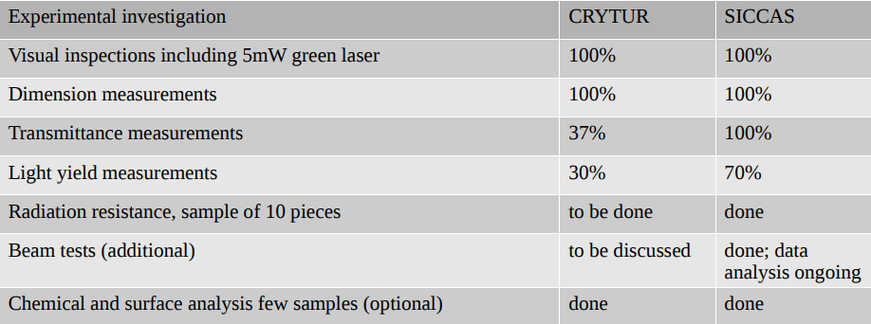
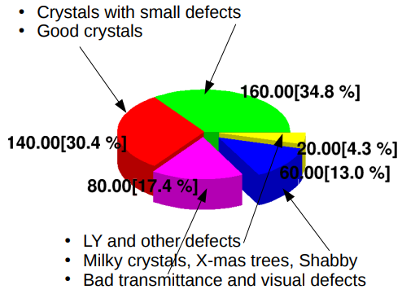
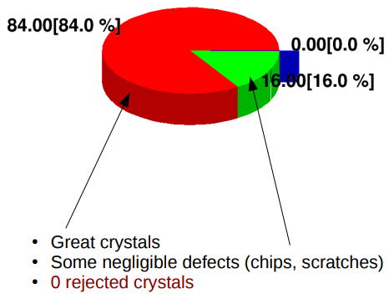
Crystals status
Quality analysis:
SICCAS
CRYTUR
will request update from Vladimir/Tanja
?% crystals onsite
Procurement timeline…
160 rejected crystals

Slide 4
PMT and voltage dividers
PMT: all ordered (?% onsite) ?
Bases: % produced? (Details on potential modifications, etc) ?
will request update from Julie

Slide 5
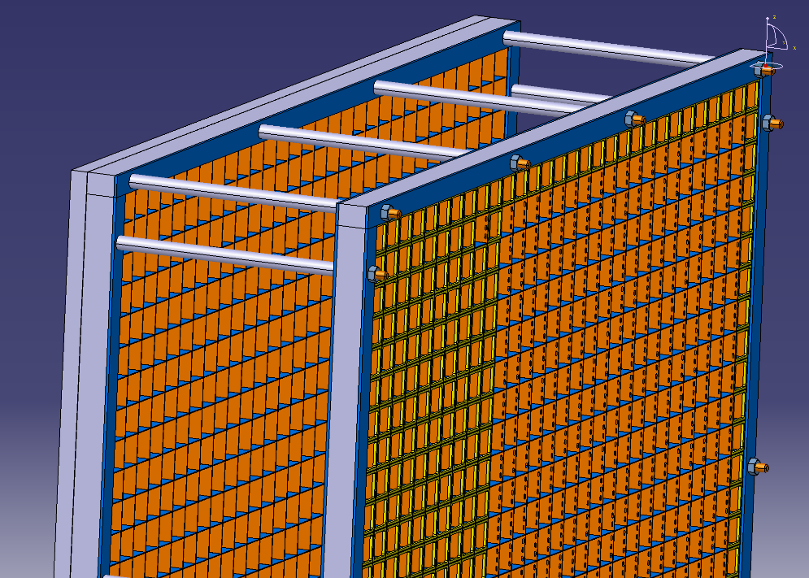
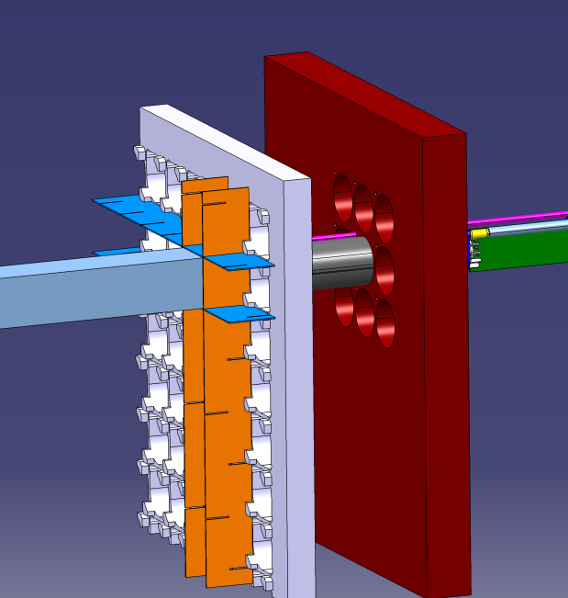
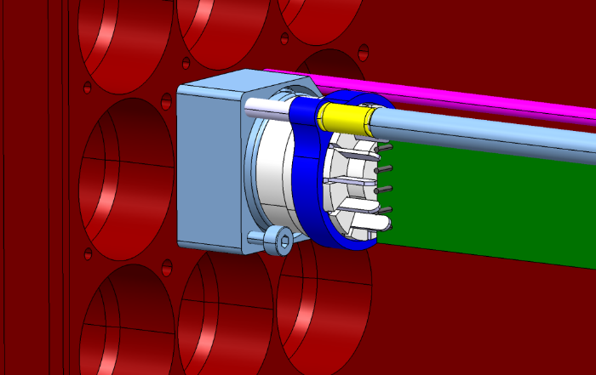
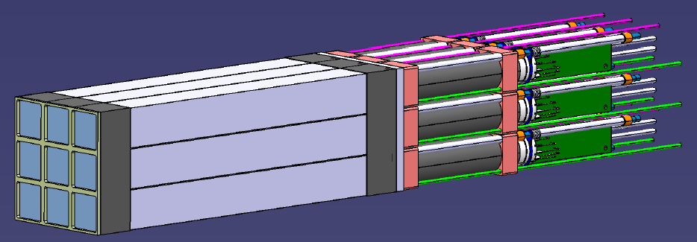
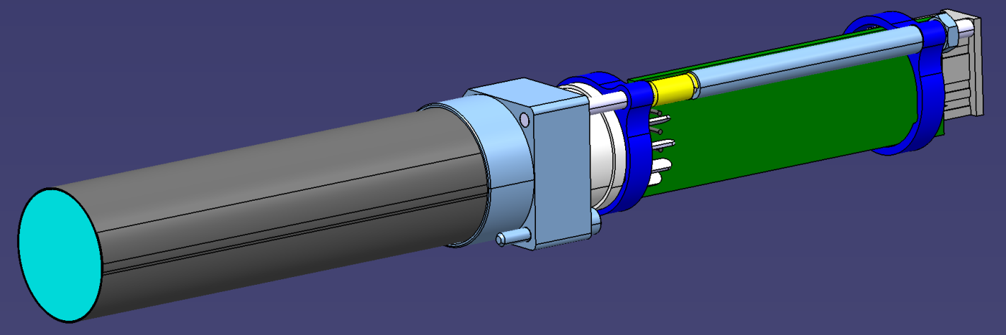
Calorimeter carbon frame
Easy disassembly of PMT block
with one single captive screw
2-cm of C (0.5 mm thick) at the front and
back of the crystals
PMT assembly
HV divider
μ-metal shield
PMT

Slide 6
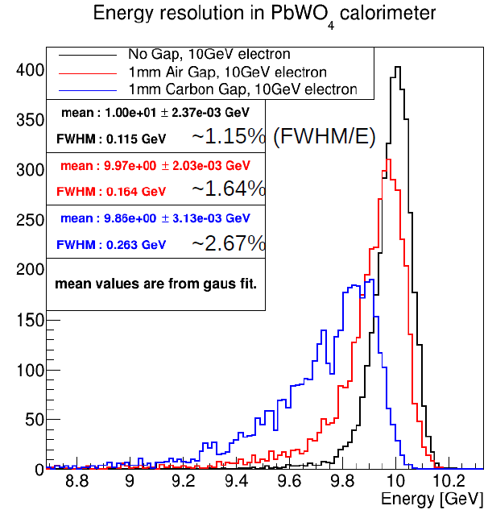
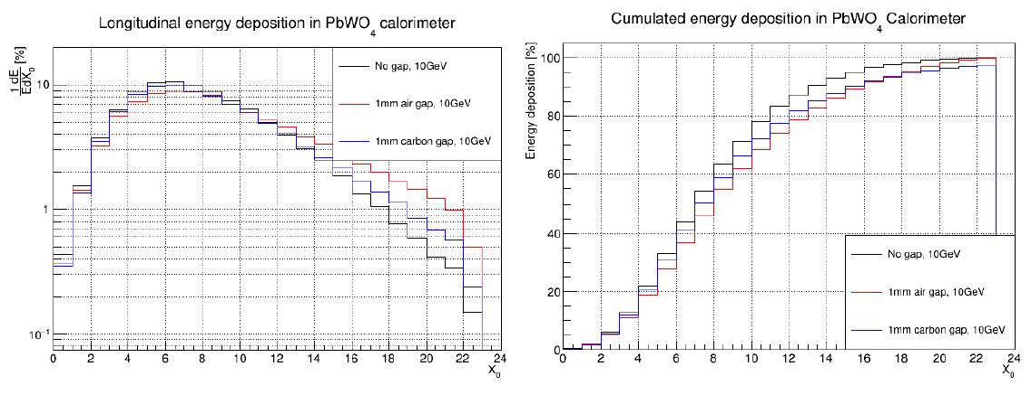
Carbon frame: impact on energy resolution & efficiency
1.2% (ideal case) to 1.6% at 10 GeV
with 1mm of air between crystals
More than 97% of energy collected after 22 X₀

Slide 7
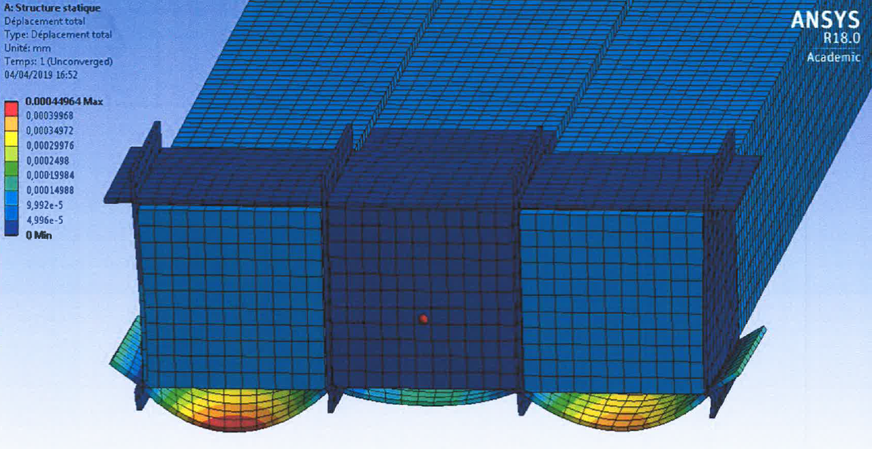
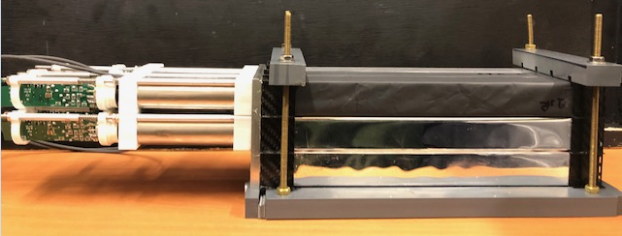
Carbon frame: mechanical simulations and tests
Simulations:
Less than 0.2 μm deformation at the center
0.4 μm deformation on external layer
Very resistant structure
Real tests on the bench ongoing:

Slide 8
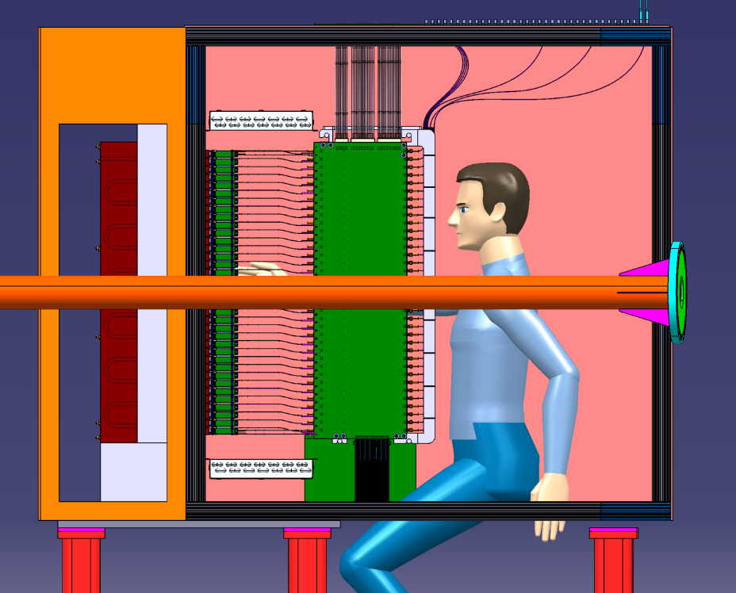
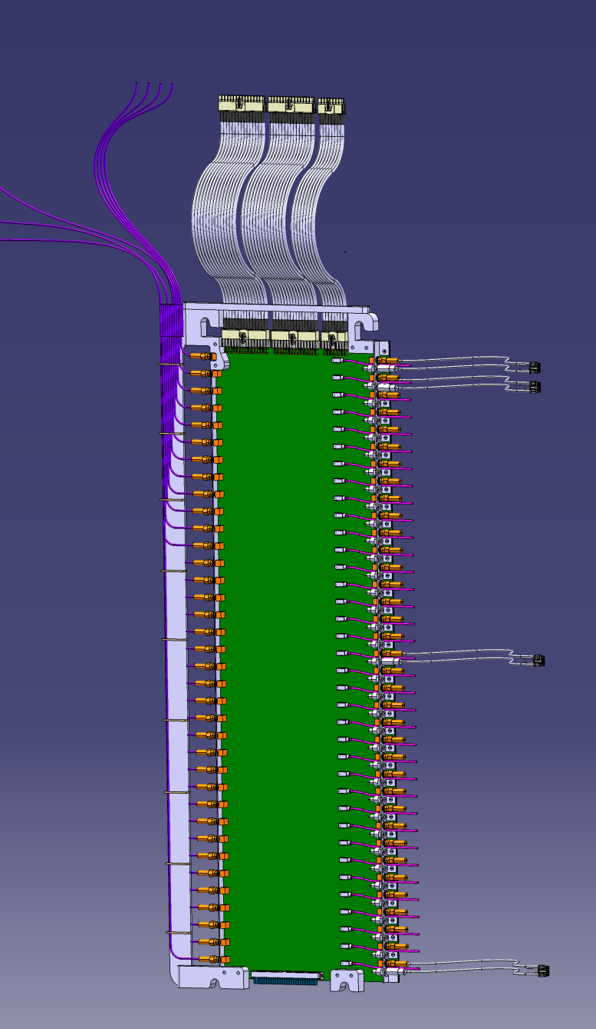
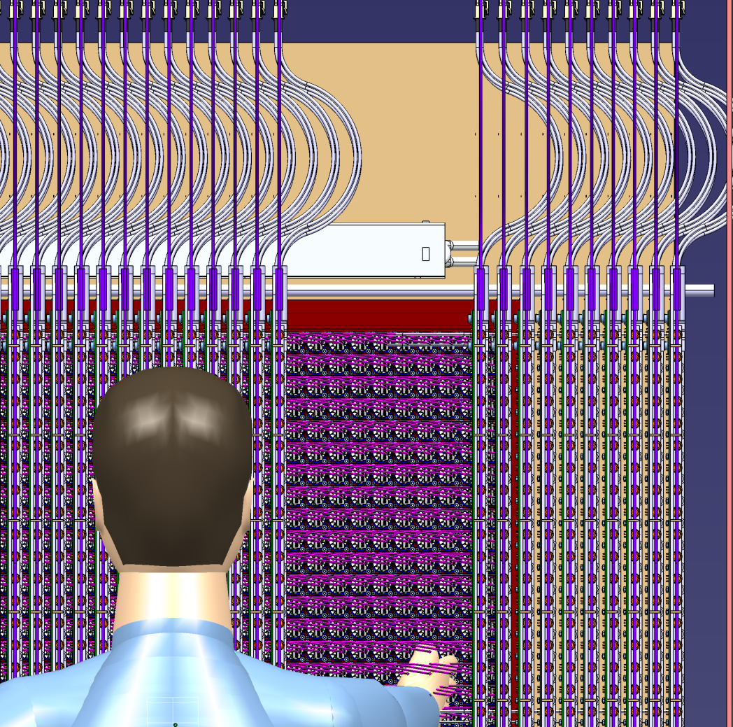
Cables and fibers
180mm

Slide 9
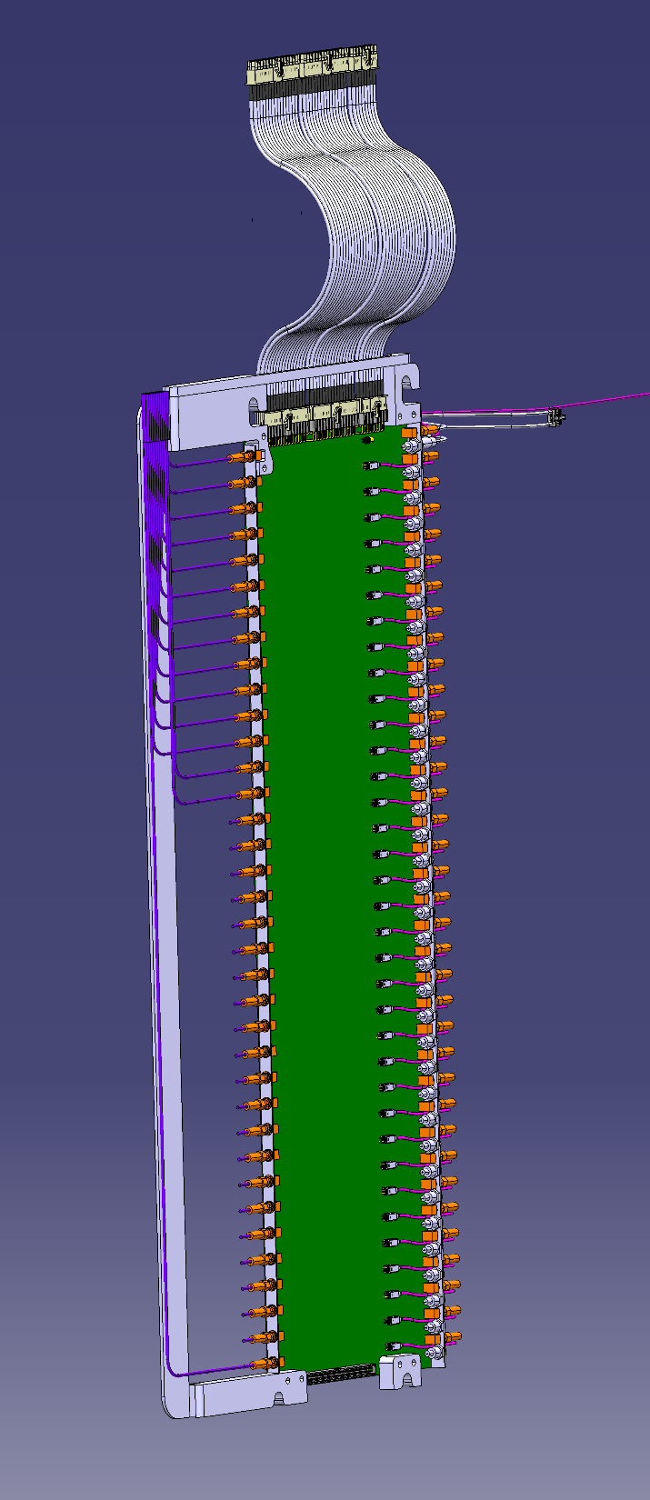
PCB design (HV, signal, LED)
Routing of the board completed
HV input
Slots for rails
Signal outputs
PMT
LEDs
Ficher conector for HV (smaller than regular SHV)
SMA connectors (signal)
LED control
Design 100% completed
1st board being manufactured (delivery by end of May)

Slide 10
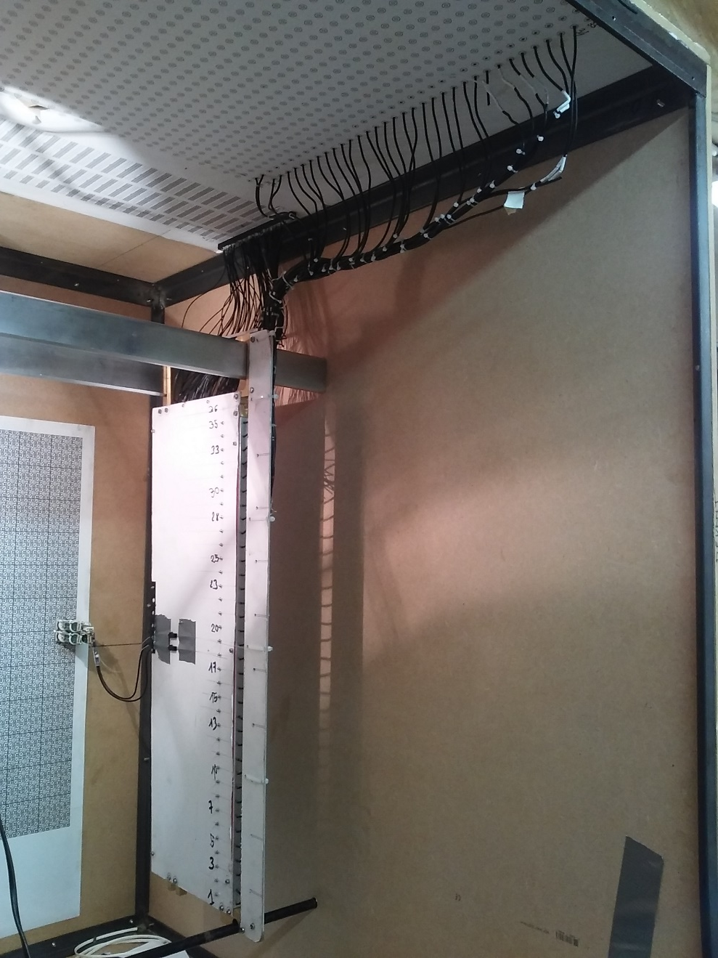
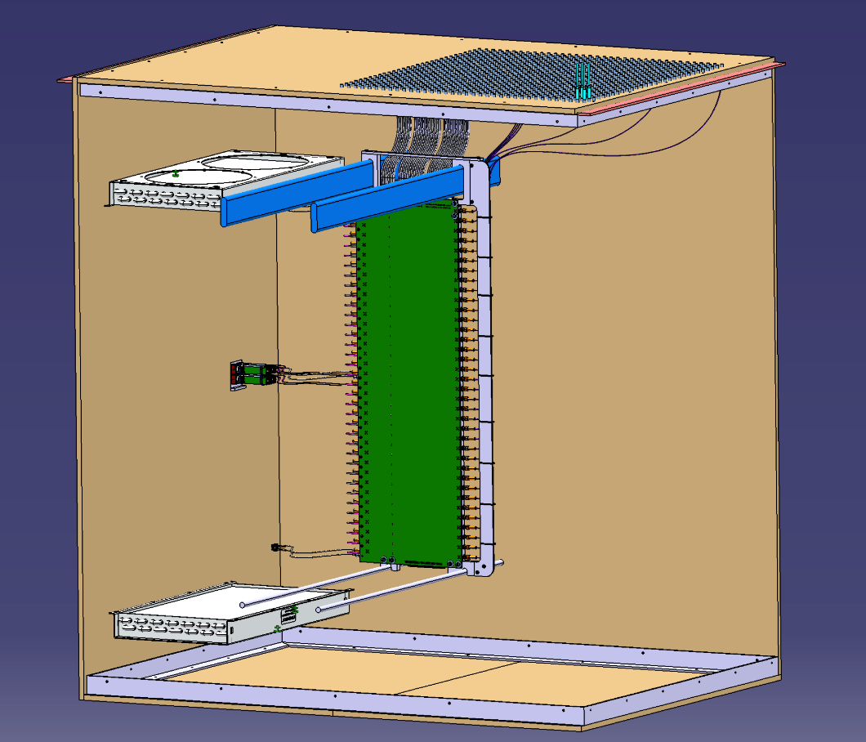
Full scale mock-up of NPS frame
Cable lengths defined:
32 cm PMT->PCB (HV+signal)
Signal PCB-> top of box: 0.5-1.5 m

Slide 11
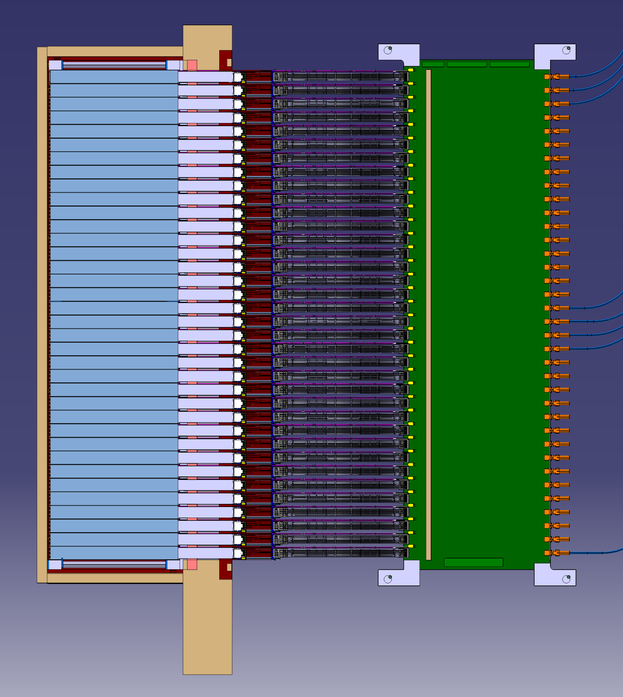
Temperature zones
Crystals Zone : @ 18°+/-0,1°
Heating Zone : 500mW/channel = 540 W
External Zone : T° = 22°c

Slide 12
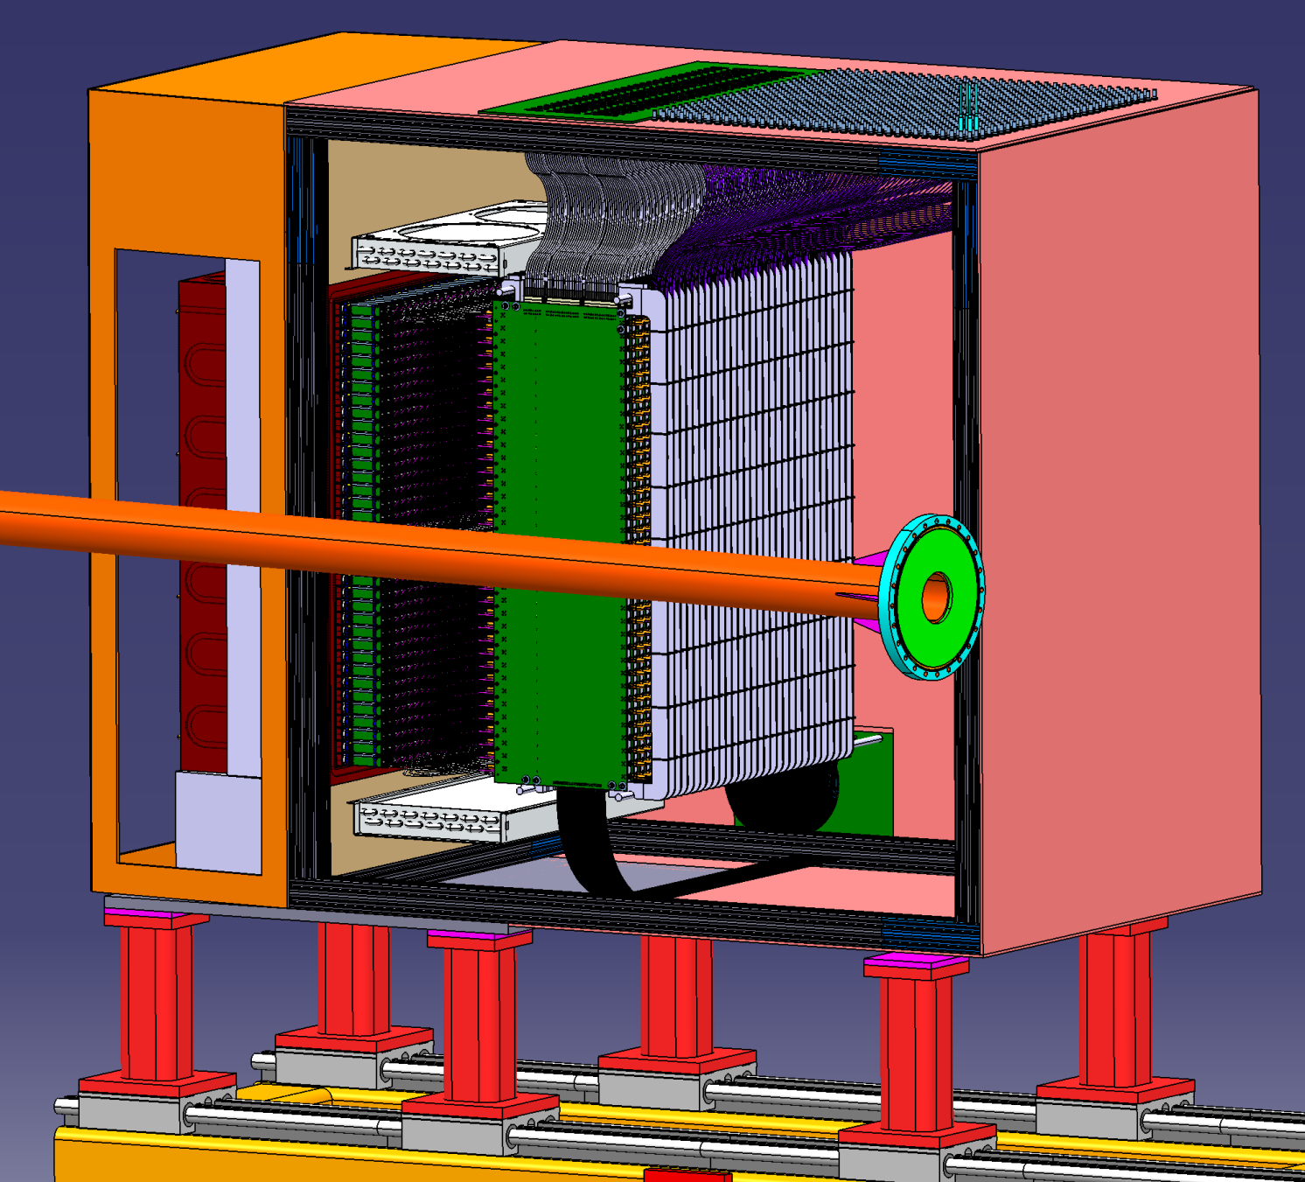
Temperature control: back side
Crystals Zone : @ 18°+/-0,1°
Heat exchangers & chiller procured
Heating electronic Zone : 500mW/channel = 540 W
Heating zone cooled with 2 heat exchangers 6320G3SB (Lytron)
+ funs + 1 chiller Kodiac RC006G03BG3
Same manufacturer than the ones used for HyCal
Higher heat load specification

Slide 13
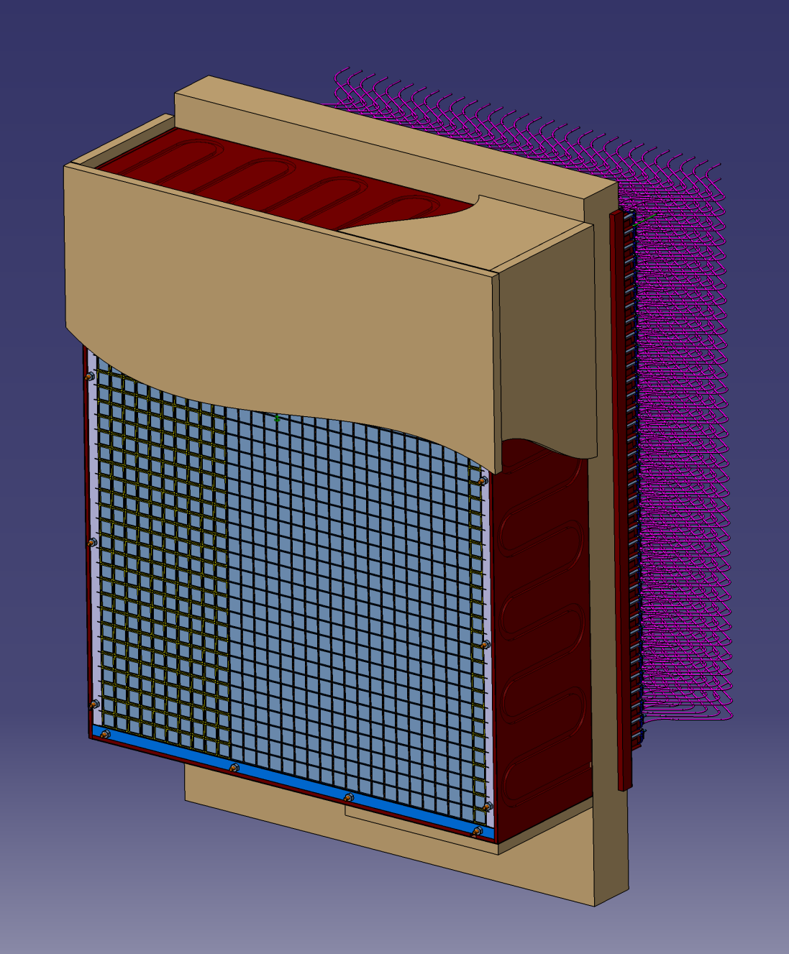
Temperature control: crystals
Crystals Zone : @ 18°+/-0,1°
4 copper plates around + 1 intermediate copper plate + 1 other chiller ( cooling separated from backward zone)
Foam : thermal insulator

Slide 14
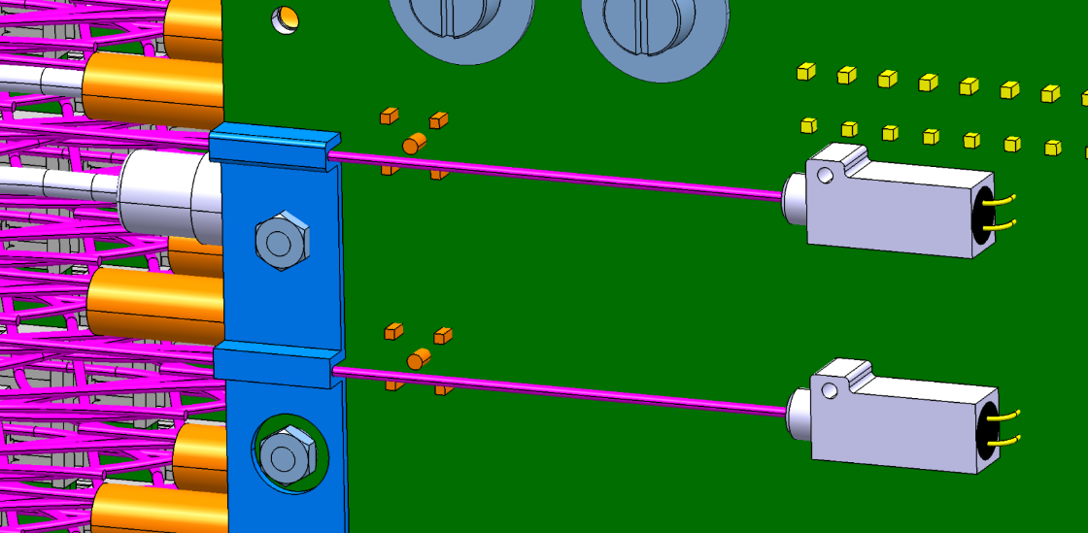
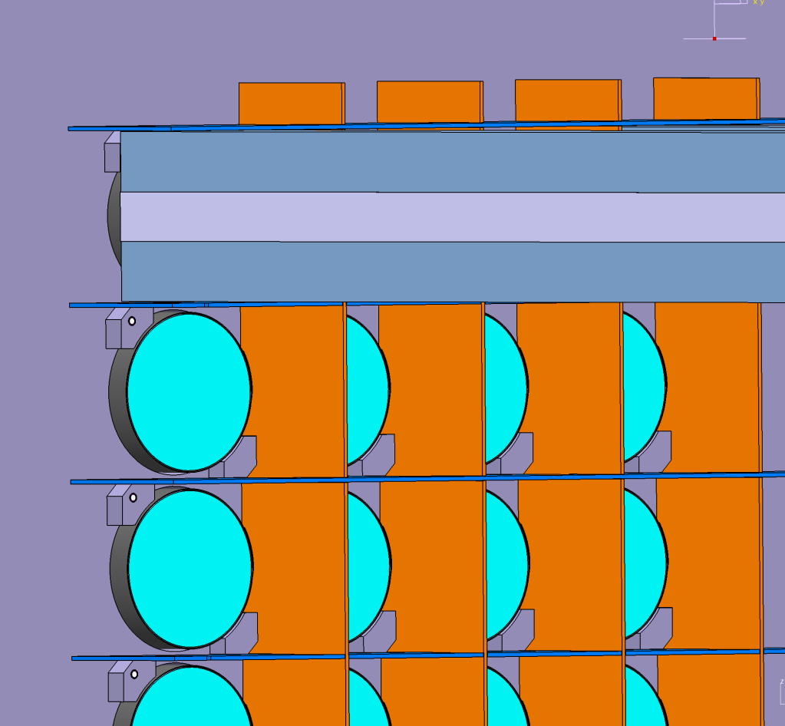
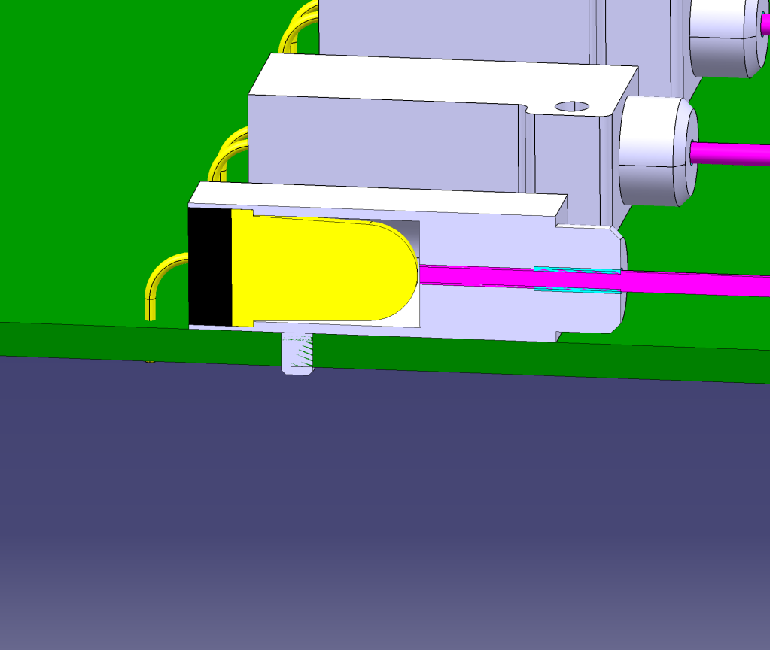
Calibration and curing
1 blue LED per channel (onto the PCB board)
Pulsed mode for calibration
Continuous mode for curing
Light through 800 μm diameter silicate fiber (radiation hard)
grease
glue

Slide 15
Irradiation and curing tests

Slide 16
Summary and outlook

Slide 17
Back-up

Slide 18
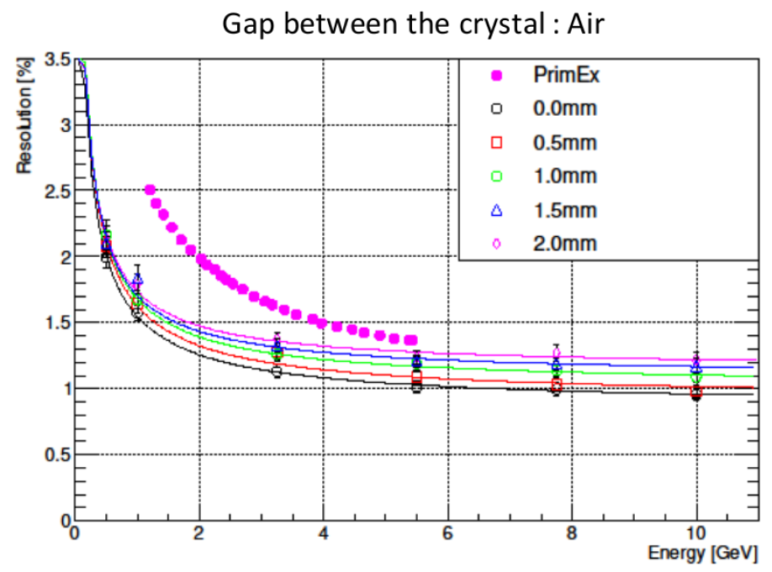
1% constant term added to
simulation (miscalibration, etc)

