Slide 1
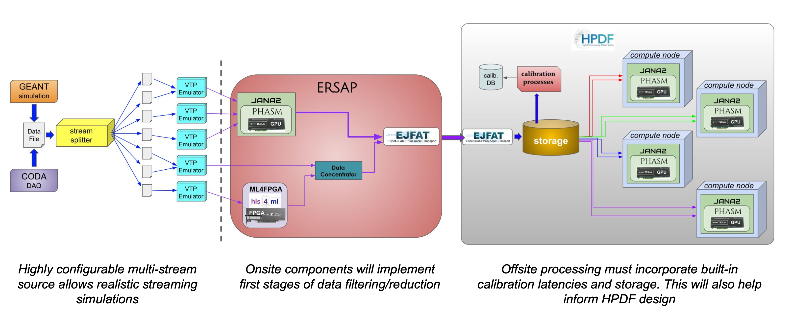
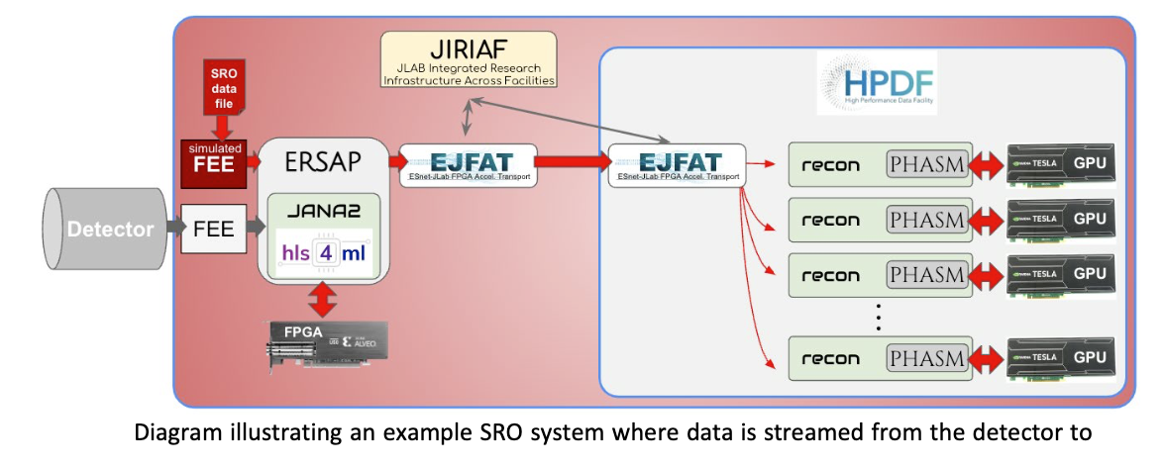
RTDP: Streaming Readout Real-Time Development and Testing Platform
Authors: Ayan Roy, David Lawrence, Jeng-Yuan Tsai, Marco Battaglieri, Markus Diefenthaler, Vardan Gyurjyan, Xinxin (Cissie) Mei
motivation
Objective
Experimental Nuclear Physics is moving towards a Streaming Readout (SRO) paradigm
Complex pipelines integrating heterogeneous hardware and varied software may have interference effects
Simulation and testing of complex SRO systems is needed to assist in their design and validation
Testing of complete, integrated SRO systems at scale for future experiments requires new tooling
Deployment of a distributed (quasi) real-time SRO data processing model includes data calibration and full traditional off-line reconstruction.
Framework optimization using GEANT-generated and archived beam-on data.
Optimized framework validation with beam-on tests.
Assessment of needed network and computing resources.
Assessment of the performance for different hardware platforms.
Identify potential issues relevant to a future HPDF in receiving and processing SRO data.
Application
SRO Experiments requiring intricate configurations can be defined with user-friendly YAML
Individual components such as calibration or data transport can be represented by software simulation modules
Full simulation can include mixture of real and simulated components
Scale from fully simulated on single PC to full use of hardware in distributed system
Measure of success
Specific milestones and objectives of the project include:
Ability to launch synchronized processes across multiple nodes
Integrated monitoring of all components in the system
Ability to configure and simulate an experiment similar in size to the planned SoLID experiment at JLab
Test with 400Gbps transfer speed, at least one FPGA and at least 1 GPU component
Goal
Create a platform to seamlessly process data from SRO to analysis on compute centers in various configurations
Fully developed software platform that is capable of monitoring the components in a fully developed streaming system.
Tools for fully simulating a real-time SRO data processing network from Front End Electronics to large compute.
Acknowledgement
progress
Future works
This project is funded through the Thomas Jefferson National Accelerator Facility LDRD program. This material is based upon work supported by the U.S. Department of Energy, Office of Science, Office of Nuclear Physics under contract DE-AC05-06OR23177.
RTDP is at the early stages of development. Here are some out of many things we have worked on:
Captured CLAS12 data, streamed across the Jlab campus using a 100Gbps high-speed NIC featuring hardware timestamps.
Captured data using synchronized streams from multiple network sources.
Create stream splitter program for EVIO or HIPO data formatted files
Create stream splitter program for simulated data in PODIO for ePIC
Create VTP emulator using files produced by stream splitter
Integrate Hydra as monitoring component.

