Slide 1
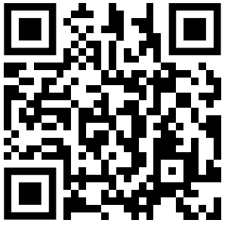
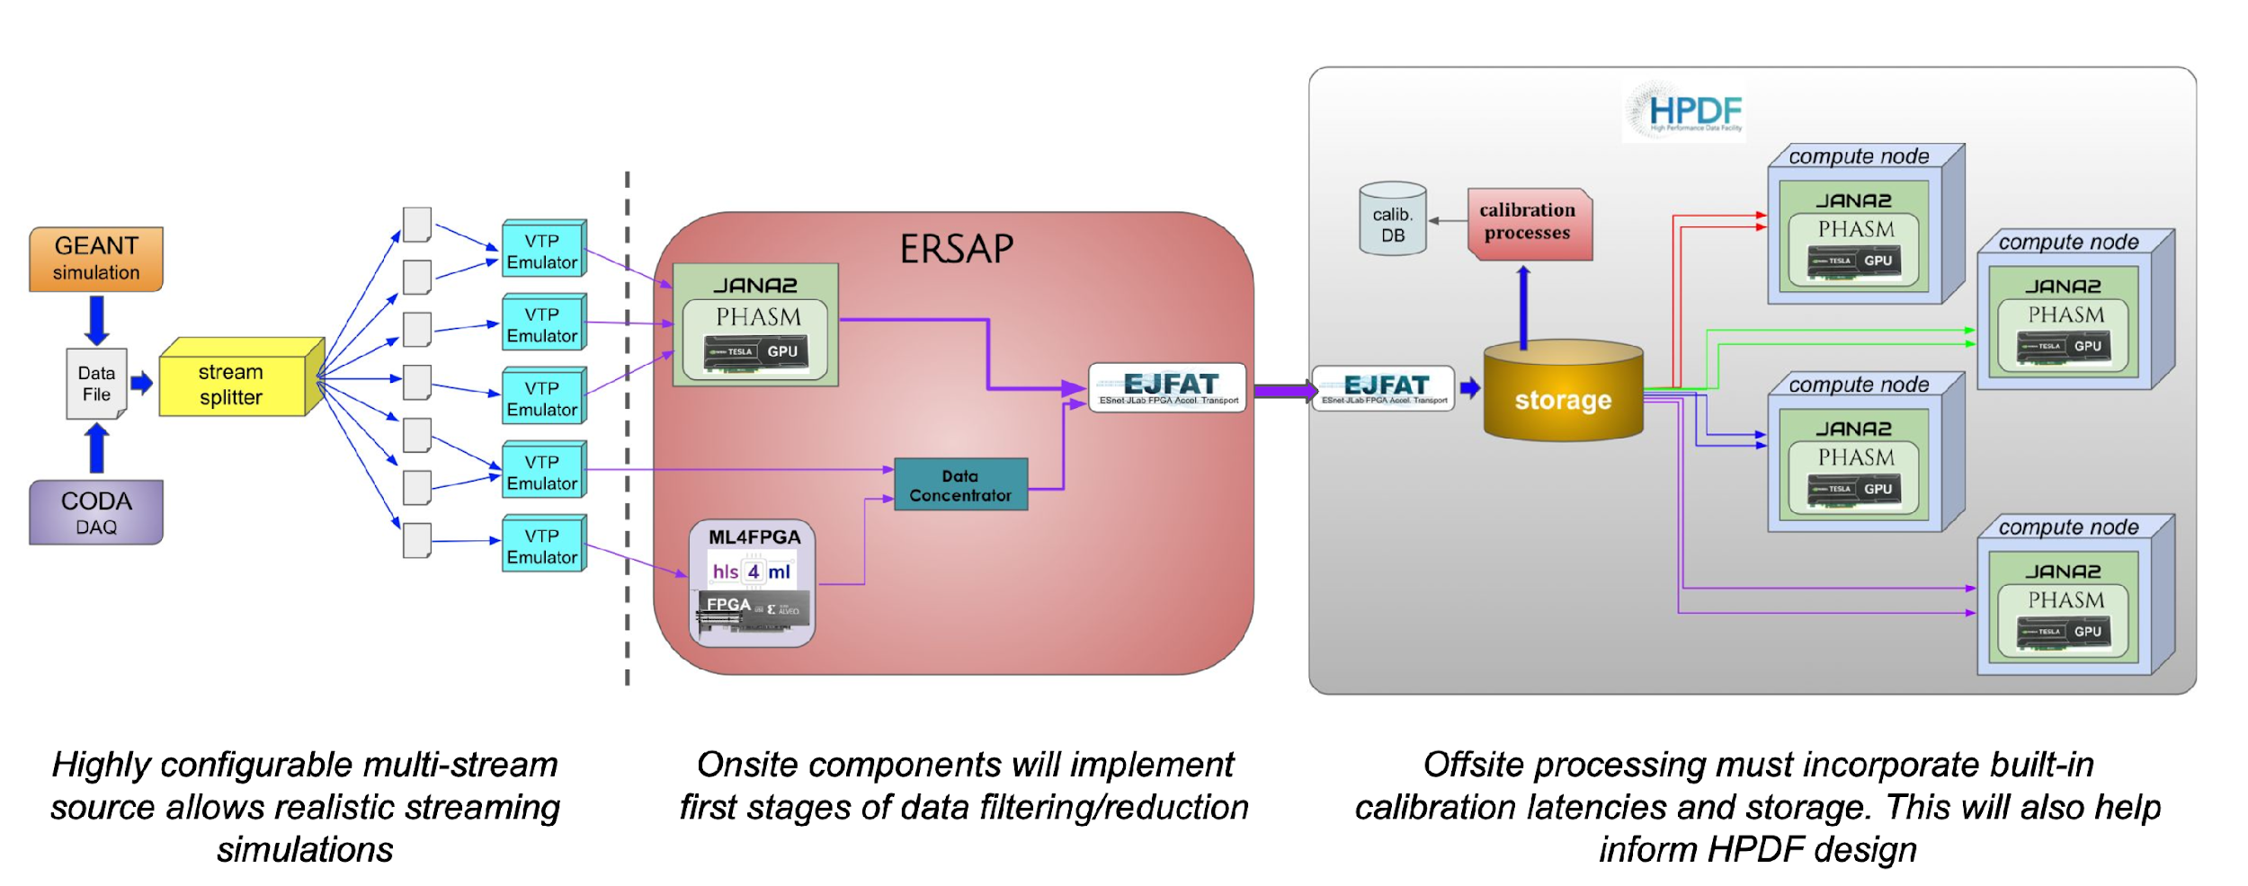
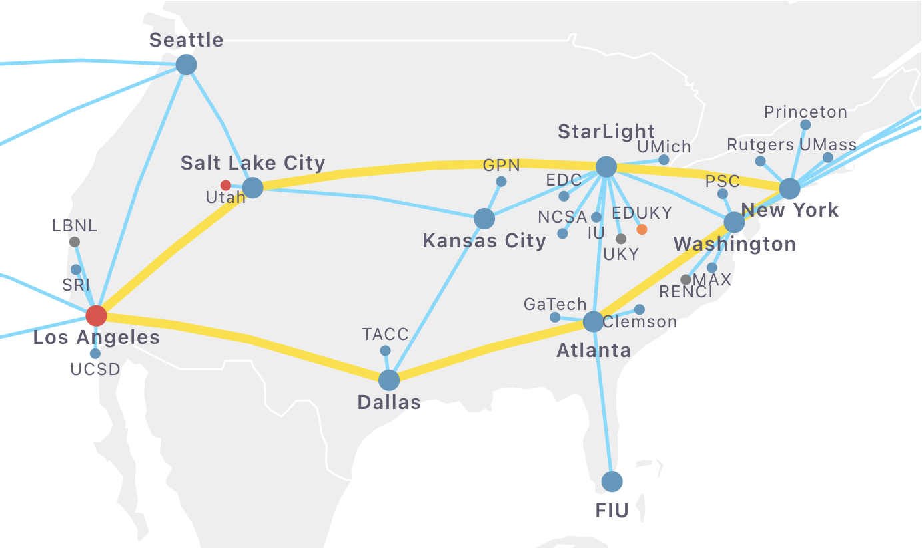
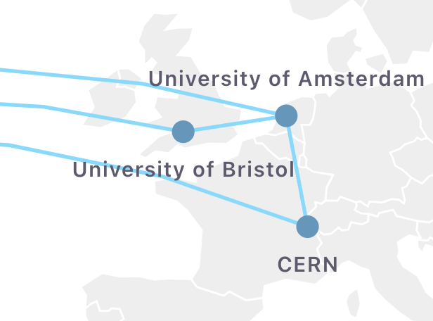
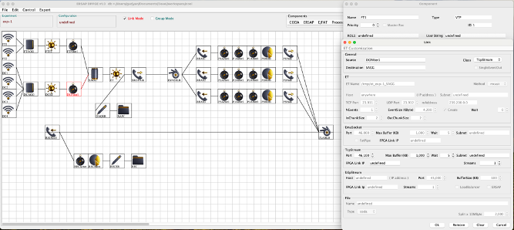
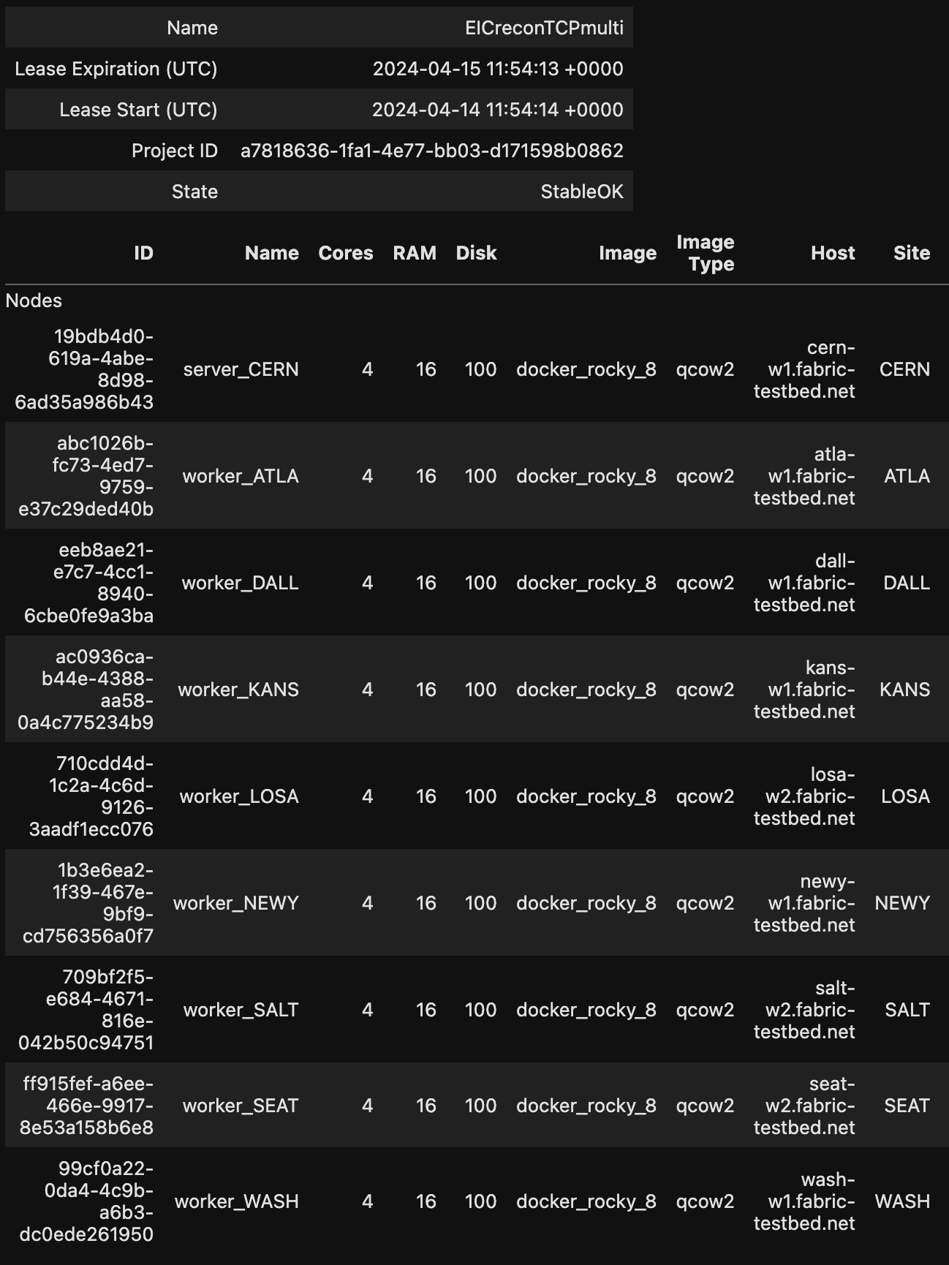
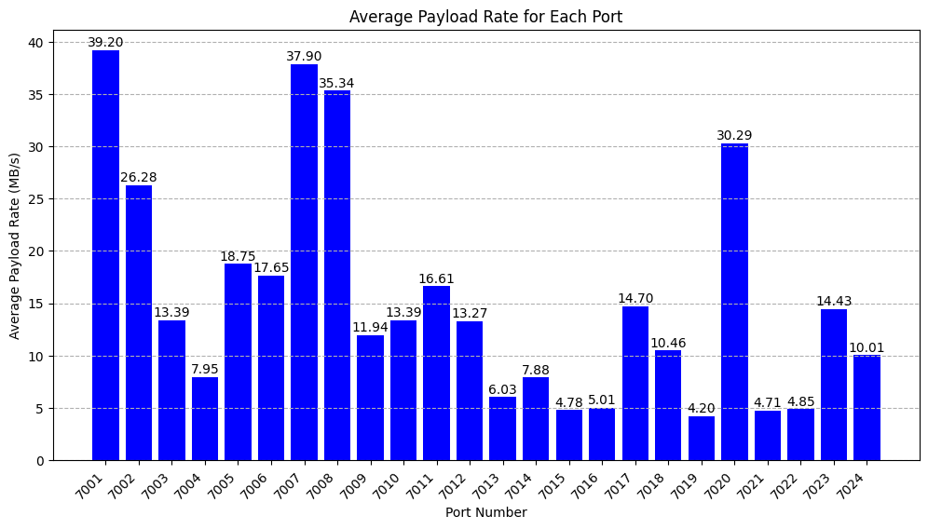
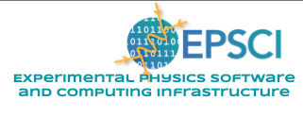
RTDP: Streaming Readout Real-Time Development and Testing Platform
Authors: Ayan Roy, David Lawrence, Jeng-Yuan Tsai, Marco Battaglieri, Markus Diefenthaler, Vardan Gyurjyan, Xinxin (Cissie) Mei, Nathan Brei, Sergey Boiarinov
MOTIVATION
RTDP OBJECTIVES
Streaming Readout (SRO) Data Acquisition is a new paradigm in which data read from a detector is streamed directly into a large, High Throughput Computing (HTC) farm. This enables things like triggerless DAQ, sophisticated event filtering, and fast calibrations which lead to shorter delays in producing reconstructed data that is ready for physics analysis.
The RTDP project aims to build a software platform that can be used to simulate the many components of complex SRO systems to aid in the prototyping and design of such systems. The ability to swap real components such as GPUs and FPGAs in for their simulated counterparts will add a level of hardware testing that improves the realism of such simulations.
Process Launcher: The software that will be used to configure and launch each component
Monitoring System: Advanced monitoring for continuous data validation (this will include Hydra, among other tools)
Proxy Components: Allow effects-based simulations to be developed using a performant language such as C++
Multi-stream Event Source: Read data from file(s) and stream into system as though coming from a DAQ system.
High Bandwidth Test: Stream data from an experimental hall that saturates the available bandwidth to the Data Center in CEBAF Center and process on heterogeneous hardware using the RTDP system.
Insights for HPDF: The platform will be a tool for developing, testing, and validating SRO systems that utilize remote compute facilities similar to what HPDF will do..
Example of an SRO system showing various components. RTDP is being designed to simulate such a system.
STREAMING ePIC DATA FROM CERN TO US
STREAMING DATA FROM CLAS12 TO DATA CENTER
GRAPHICAL CONFIGURATION + ONTOLOGY
In Dec. 2023 and then again in May 2024 beam data was taken with the CLAS12 detector and streamed directly to CEBAF Center. The TCP data packets were captured into industry standard .pcap files using a high speed NIC with hardware timestamps. This allowed the capture of data at various beam intensities that could
Configuring a RTDP workflow can become quite complex due to the number of components. Extending the CODA graphical interface to support RTDP will allow users to more easily build and visualize very complex configurations in a format already familiar to them.
Simulated
data for the
ePIC detector
being designed
for the EIC was modified into a stream form that could be distributed to multiple sites. The graphics on the left show an exercise where the FABRIC testbed was used to send events from CERN to 8 different sites across the US. RTDP is a general tool that will support designs using the ePIC/SoLID software stack as well as ones using software stacks from CLAS12 or GlueX.
Payload Rate and Beam Current vs. time
be played back with exactly the same network time structure and TCP packets as it had when the beam was on. In the top plot on the left, the payload rate vs. time in green plotted against the left hand axis. The red indicates the beam current for this same time period plotted against the right hand axis.
The bottom plot on the left (blue) shows the payload rates for individual streams. The CLAS12 drift chambers are the bins on the left half of the plot while the right half corresponds to F250 ADC modules used for calorimeters.
ACKNOWLEDGEMENT
This project is funded through the Thomas Jefferson National Accelerator Facitlity LDRD program. This material is based upon work supported by the U.S. Department of Energy, Office of Science, Office of Nuclear Physics under contract DE-AC05-06OR23177.

