Slide 1
FPGA
The Event Transport or ET system, based on shared memory, can be used as a data storage FIFO, decoupling the reading thread from data users.
Since we’re reading UDP packets, only 1 reading thread can be used. In this scheme, it does not have to allocate memory but can use pre-allocated ET system buffers. These buffers are reused.
When initially configured, the ET system needs to know how many data sources max will be used.
If there are no (or slow) consumers, the reader may be unable to obtain more buffers and will dump the incoming data.
ET code can be C, C++ or Java.
UDP socket reader
Get array of empty ET buffers
Put array of full ET buffers (one tick)
GC
ET system
Users
Get array of full buffers (one tick)
Put array of used buffers
Data Consumer

Slide 2
ET System as FIFO
et_start_fifo –n N –e 4
Station Input Lists
1 2 … N
FIFO Entry =
1 - N buffers =
1 tick
Data Source 1
GC
1 2 … N
Data Source 2
Little Box =
1 buffer
1 2 … N
UDP socket reader
ET
.
.
.
1 2 … N
FPGA
Data Source N
Users
Can be blocking or non-blocking
Data Consumer:
getFifoEntry, putFifoEntry

Slide 3
There is one reading thread which disentangles incoming packets. It can handle:
  data from multiple sources
  out-of-order packets
  overlapping ticks
The reading thread gets a single fifo entry – which is an array of buffers. These buffers exist in shared memory. This fifo entry corresponds to 1 tick.
Thread places reconstructed data from one data source into a single buffer. If there are multiple sources, each source will have its own buffer in a single fifo entry.
When the data from each source is reconstructed, then the entire fifo entry is returned to the ET system and made available for back-end users, through the “Users” station.
The fifo is by default non-blocking. So if the data users are slow, all incoming packets are read, placed into buffers, then dumped.
Data users can get metadata from each buffer. Among other things, the metadata tells the user if a buffer has data and what the data source id is.
In the previous diagram, “GC” just stands for GrandCentral station and contains a list of available fifo entries/buffers for placing new data in. The “Users” station contains a list of available fifo entries/buffers with valid data.

Slide 4
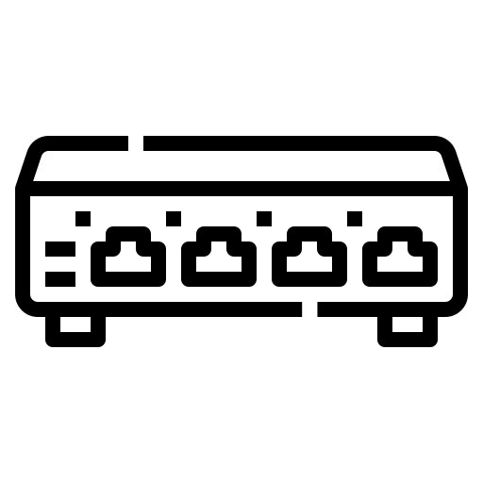
EJFAT System Architecture
Load Balancer
Control Plane
Source sends latest event #
Set schedule density (proportion of slots allocated to host)
From host feedback, create new schedule density
From source feedback, set epoch boundary for change to new schedule
Update behavior of data plane
Host
Control Plane
FPGA
Data Plane
Host registers &
sends metrics
port 1
Host 1
Src 1
Switch
Event 1 Src 1
port 2
Event Building
Src 2
Event 1 Src 2
Reassembly
Analysis
Colors → Events
Shapes → Data Sources

Slide 5
EJFAT System Architecture
Control Plane
Load Balancer
Source sends latest event #
Select data plane
Set schedule density (proportion of slots allocated to host)
From host feedback, create new schedule density
From source feedback, set epoch boundary for change to new schedule
Update behavior of data plane
Host
Control Plane
FPGA
Data Plane 2
FPGA
Data Plane 1
Host registers &
sends metrics
port 1
Host 1
Event 1 Src 1
Src 1
Switch
port 2
Event Building
Event 1 Src 2
Src 2
Reassembly
Analysis
Colors → Events
Shapes → Data Sources

Slide 6
EJFAT CP Communications
Load Balancer
Backend
Returned Values
Commands to CP
1) (instanceToken, lLB_id , syncIpAddr, syncUdpPort, dataIpv4Addr , dataIpv6Addr)
2) (timestamp, currentEpoch,
currentPredictedEventNumber,
for each worker:
(name, fillPercent, controlSignal,
slotsAssigned, lastUpdated) )
4) (sessionToken, sessionId)
1) ReserveLB (adminToken, LBname, timeout)
2) LBstatus (adminToken, LB_id)
3) FreeLB (adminToken, LB_id)
4) Register (adminToken, LB_Id, name, weight, ipAddr, udpPort, portRange)
5) SendState (sessionToken, sessionID, LB_Id, timestamp, fillPercent, controlSignal, isReady)
6) Deregister (sessionToken, LB_id, sessionID)
Src
Last event #N
Control Plane
Data
Data Plane
Reassembly

Slide 7
Load Balancer
EJFAT Event Reassembly
Switch
port 1
Linux IP Stack
NIC
Driver
XDP Socket / Stack Bypass
port 2
Kernel
User Space
UDP packet Reassembly into events / Src 2
UDP packet Reassembly into events / Src 1
Packetize
Src 1
Packetize
Src 2
Combine event fragments
Colors → Events
Shapes → Data Sources
Analyze events
Host

