Slide 1
Field Programmable Gate Array
(FPGA)
Michael S. Goodrich, Ph.D.
Staff Scientist
Experimental Physics Scientific Compute Infrastructure
November 5, 2021

Slide 2
Overview
What’s an FPGA?
Under The Hood
Programming an FPGA
What’s an FPGA Good For?

Slide 3
What’s an FPGA?
Field → In-Service; “Fielded”
Programmable → Configurable Digital Circuit
Gates
Configurable Logic Blocks (CLBs)
AND, OR, LATCHs, FlipFlops, etc
Memories, DSPs, CPUs, AI/ML, …
Programmable Switch Matrices (PSMs)
Array→ Regular Arrangement of Logic Gates

Slide 4
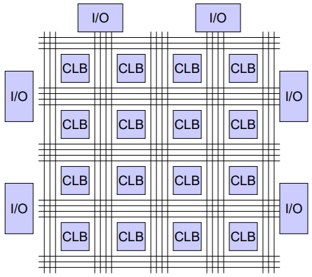
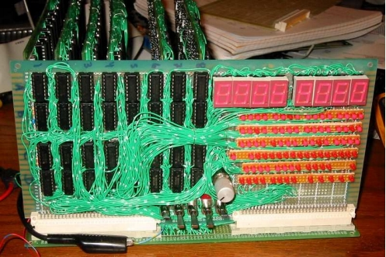
What’s an FPGA?
→
FPGA = CLBs + PSMs

Slide 5
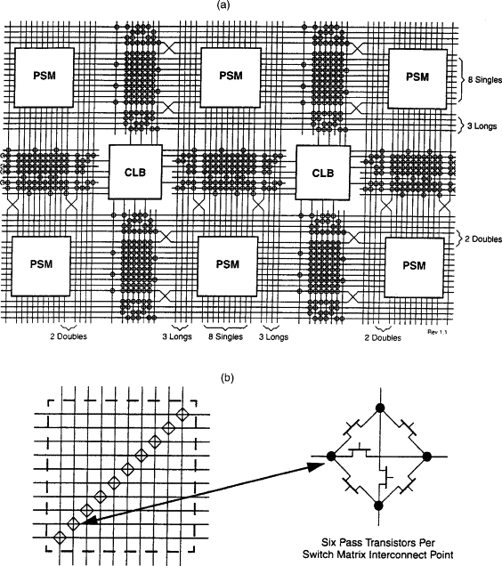
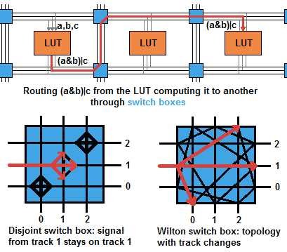
Programmable Switch Matrices (PSMs):
Dynamic Configurations – special memory loaded with bit patterns that control inputs to CLBs via PSMs.

Slide 6
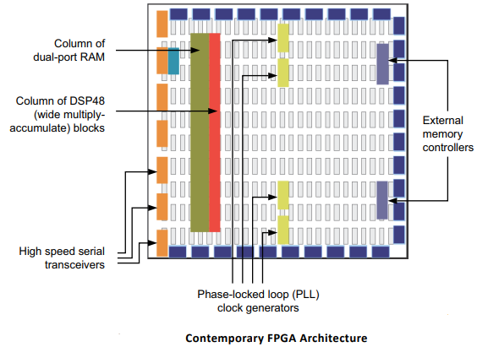
FPGA Architecture
I/O Cont
RAMs: Multiported, FIFOs,
DMA
PUs: ARM, DSP, NPU, ALUs
Clocks: PLLs
AI/ML

Slide 7
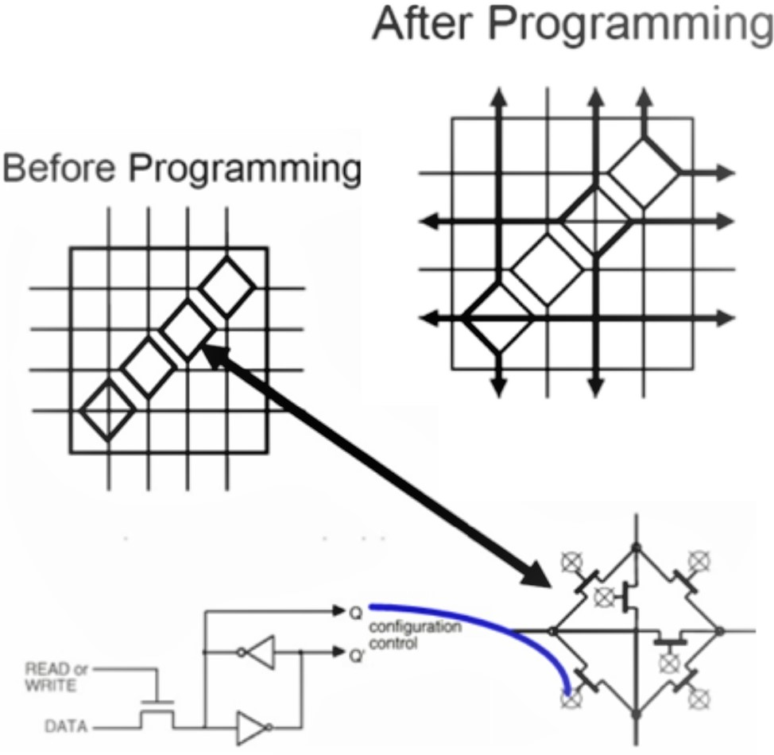
Programming (RTL)
Design Circuit
Verilog Simulation – validate logic design
Synthesis – Translate design to bit patterns that program PSMs for connections to CLBs in a Resource Efficient Manner.
Verilog module:
Module smpl_crct(A,B,C,x,y);
input A,B,C;
output x,y;
wire e;
and g1(e,A,B);
not g2(y,C);
or g3(x,e,Y);
Endmodule;

Slide 8
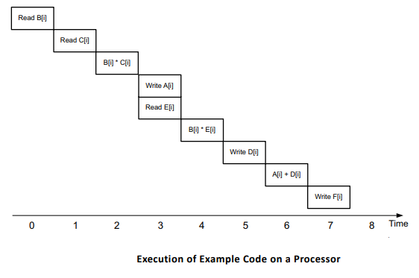
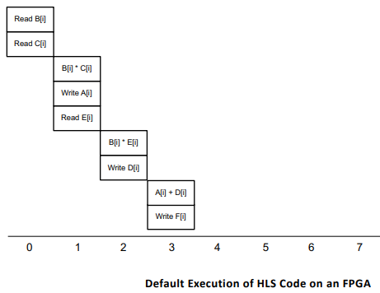
High Level Synthesis (HLS):
C like syntax:
A[i] = B[i] * C[i];
D[i] = B[i] * E[i];
F[i] = A[i] + D[i];
Pipelining
Parallelization
Interval
Latency
Parallelization
Parallelization
Interval, Latency
Interval
Pipelining?
Latency

Slide 9
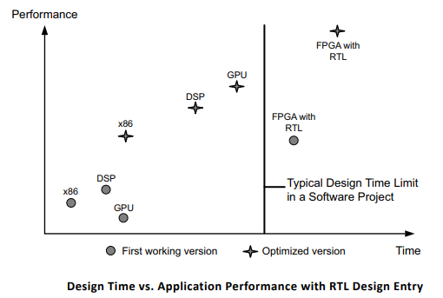
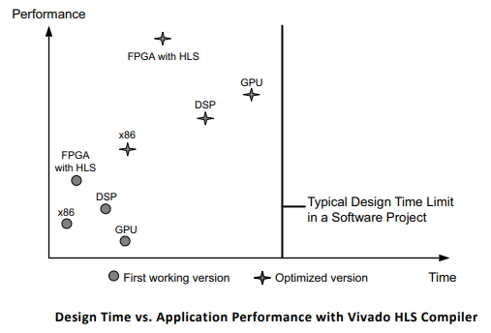
High Level Synthesis (HLS):
Verilog Design:
HLS Design:

Slide 10
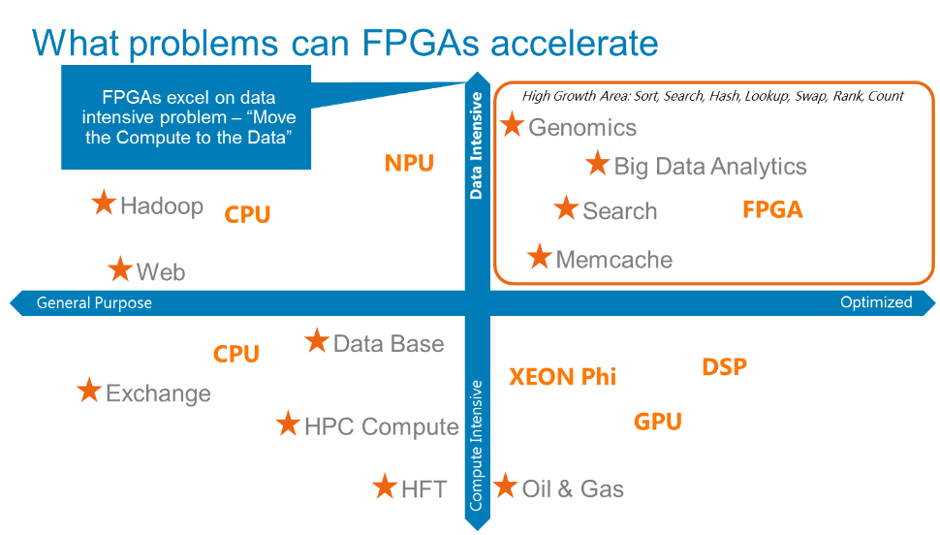
FPGA Use Cases

Slide 11
Current Project
Telemetry
Experiment Edge Compute
Data Center
FPGA
Data
Center
Traffic
Shaper
AI
Steering
System
FPGA
Edge
Data
Shaper
Telemetry
Edge
Data
Source
Steering

Slide 12
Questions?

Slide 13
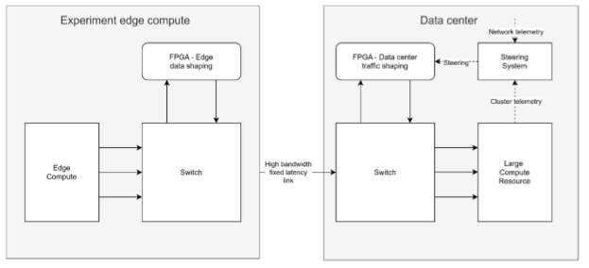
Current Project

Slide 14
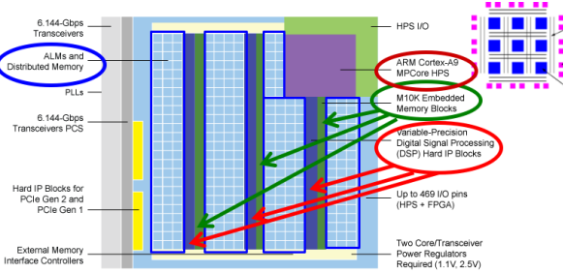
FPGA Architecture
I/O Cont
RAMs: Multiported, FIFOs,
DMA
PUs: ARM, DSP, NPU, ALUs
Clocks: PLLs
AI/ML

Slide 15
Current Project
100 GBS streaming UDP data from Accelerator
Destination = FPGA

Slide 16
FPGA Benefits
Integration: I/O, Proc, Rams, DSPs, ARMs, ...
Flexibility: Digital Chameleon
Time To Market: COTS
Low Obsolescence: Components
Less Power Than CPU based Solution
Parallel Execution at Hardware Speeds

Slide 17
FPGA Use Cases
Excel at Simple Data Intensive Problems
Move Compute to Data
Flexibility > Custom Circuit or ASIC
No Economies of Scale (otherwise ASIC)

Slide 18
FPGA Pro / Con
Engineering Costs < Custom Circuit
Flexibility > Custom Circuit or ASIC
No Economies of Scale (otherwise ASIC)
Less Power Than CPU

Slide 19
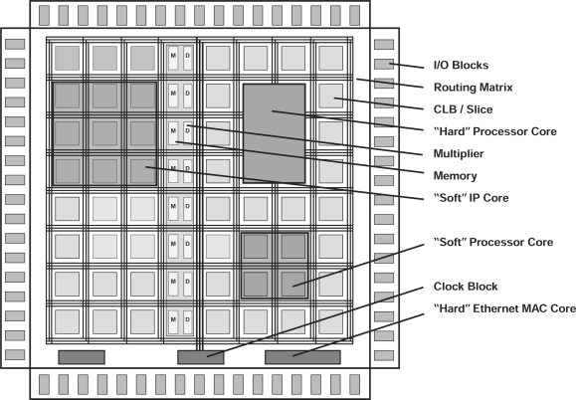
FPGA Architecture

Slide 20
Dynamic Configuration
Programming – special memory loaded with bit patterns that control inputs to CLBs via PSMs.

Slide 21
More on Programming

Slide 22
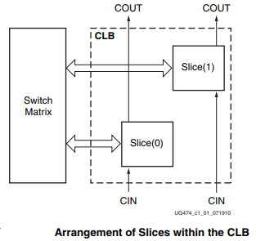
More on CLBs

Slide 23
Configurable Logic Blocks (CLBs)
• Real 6-input look-up table (LUT)
• Dual LUT5 (5-input LUT) option
• Distributed Memory and Shift Registers
• carry logic for arithmetic functions
• Wide multiplexers for efficient utilization

Slide 24
Under the Hood
Logic → MUXs, LUTs
Static Memory → Flip-Flops (D-FF)
‘Wires’ → Gates Connecting Logic/Memories
Programming→ bit patterns that setup inputs to LUTs and ‘wire’ connections

Slide 25
FPGA Use Cases
Cost
Energy
Data Base Accelerator
Generic Device

Slide 26
FPGA Use Cases
Custom H/W (Versus S/W) → FW
Network Accelerator
Data Base Accelerator
Generic Device

Slide 27
FPGA Use Cases
Compute Accelerator
Network Accelerator
Data Base Accelerator
Generic Device

Slide 28
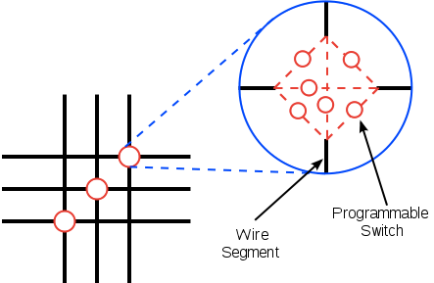
More on ‘Wires’
Programming – special memory loaded with bit patterns that construct and control inputs to CLBs via ‘Wires’.

Slide 29
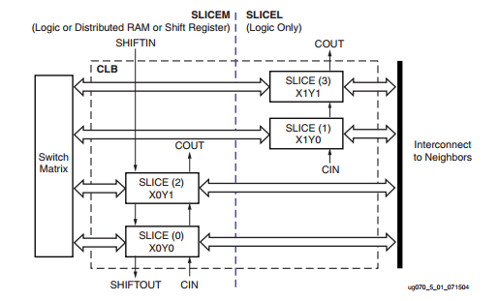
More on CLBs

Slide 30
Parallel / Pipelined Design
Module1 → Read Inputs (Parallel)
Module2 → Buffer Inputs (Parallel)
Module3 → Process Inputs (Parallel)
Module4 → Format Display Inputs (Parallel)
The only delay comes from the switching delays of the transistors in the chip, which are incredibly small

Slide 31
More on Gates
Gates → Combined Transistors (N/P Types)
“Wires” →
Primitive → AND, OR, XOR, NAND, NOR, XNOR, Latch
Mid → FF, LUT, MUX
High→ LUT

Slide 32
Summary
COTS: more flexible than legacy hardware
data processing now on commodity servers
common Sub system for FE electronics
meets ATLAS requirements with margin
performance tests show ready for deployment

