Slide 1
SRO with Raspberry
OFFLINE Training of AUTOENCODER
C code on Raspberry
C code on Raspberry
Weights.h
Model.h5
Read Signal from file
Receive Signal
Compress
(Encoder)
Python on PC
Transmission
Receive
Transmission
Decompression
(Decoder)
LAN
(TCP/IP)
LAN
(TCP/IP)
Histogram

Slide 2
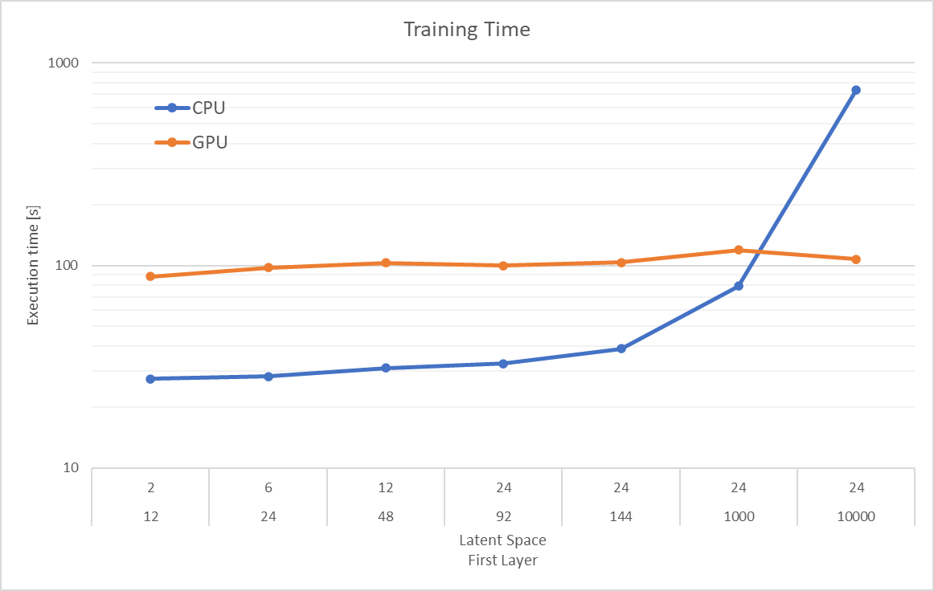
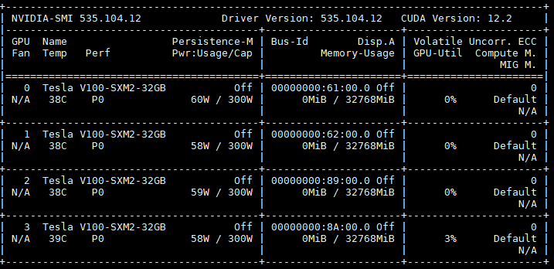
Training Execution on GPU VS CPU
CPU
AMD Ryzen 5 5600U
6 core, 12 Logic processor
GPU
Used Model

Slide 3
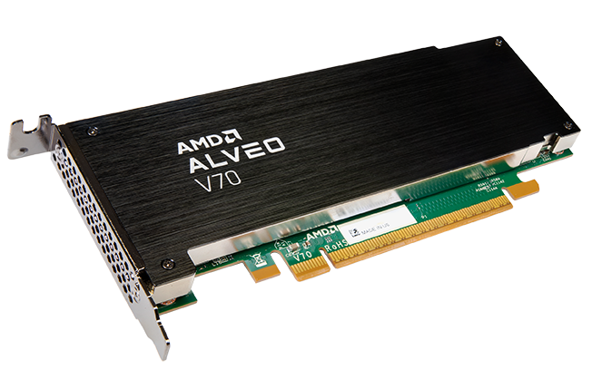
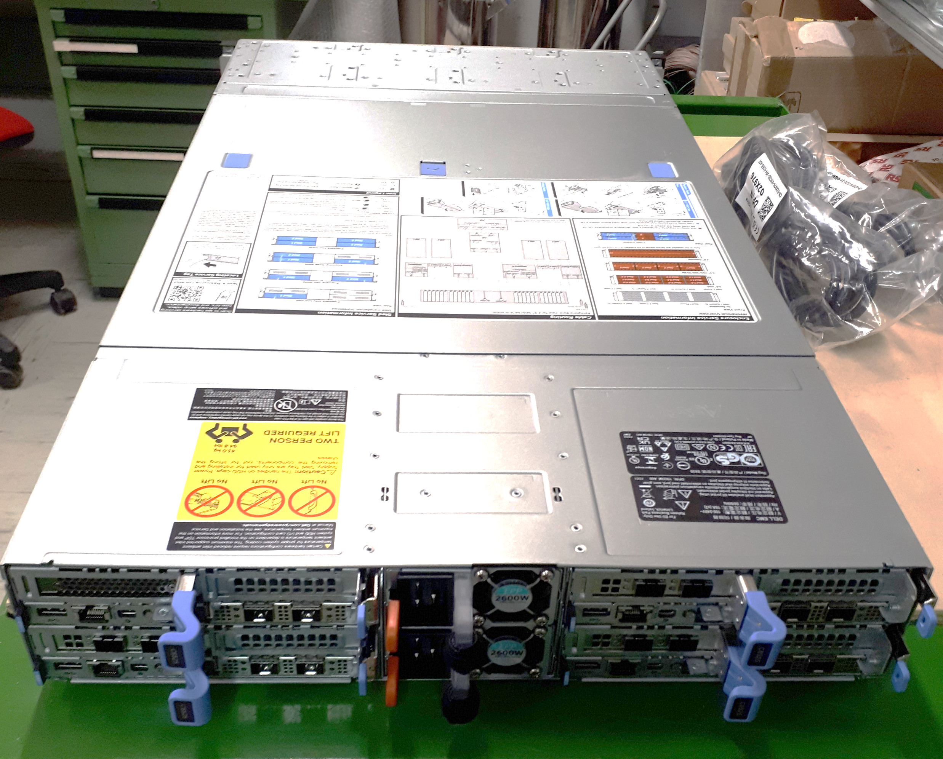
More Realistic Scenario
what we're looking for developing.
Available hardware
2 ALVEO V70 FPGA
Board
Server 1
Server 2
Server 3
Data Generation
Compression
Frame Router
Server 4
Decompression
&
Analisys
4 Server DELL C6400
Data Generation
Compression

