Slide 1
SRO RTDP
Streaming Readout Real-Time Development and Testing Platform
D. Lawrence (PI), V. Gyurjyan, C, May, A. Roy, J. Tsai

Slide 2
Why SRO?
Optimize experimental equipment to minimize the need for delay cables.
Enable full integration of all detector components for comprehensive event identification.
Implement real-time data processing to minimize costly IO latencies.
Facilitate future event identification processes to support verifying and validating new physics theories.

Slide 3
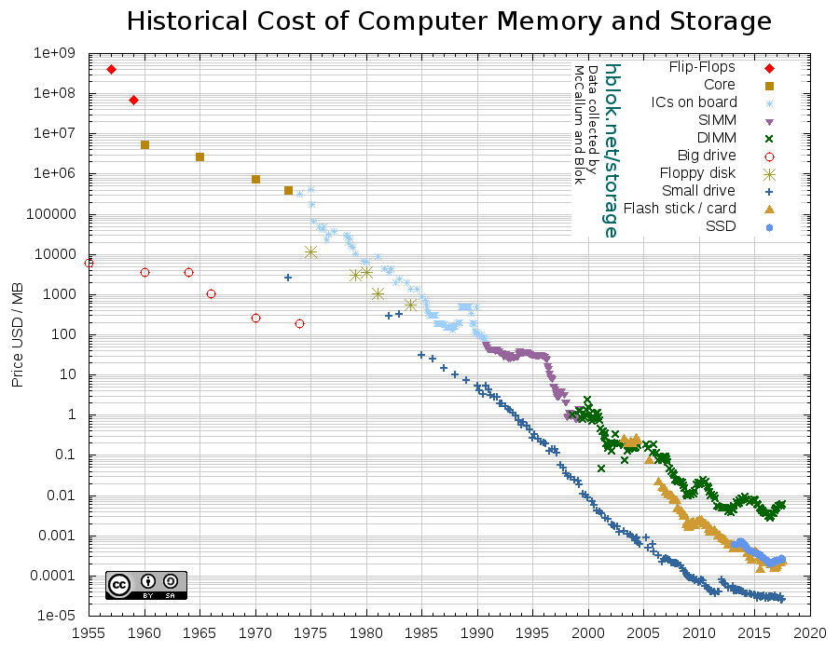
Why Now?
Network speeds have grown 10X every five years since 1990

Slide 4
Why RTDP?

Slide 5
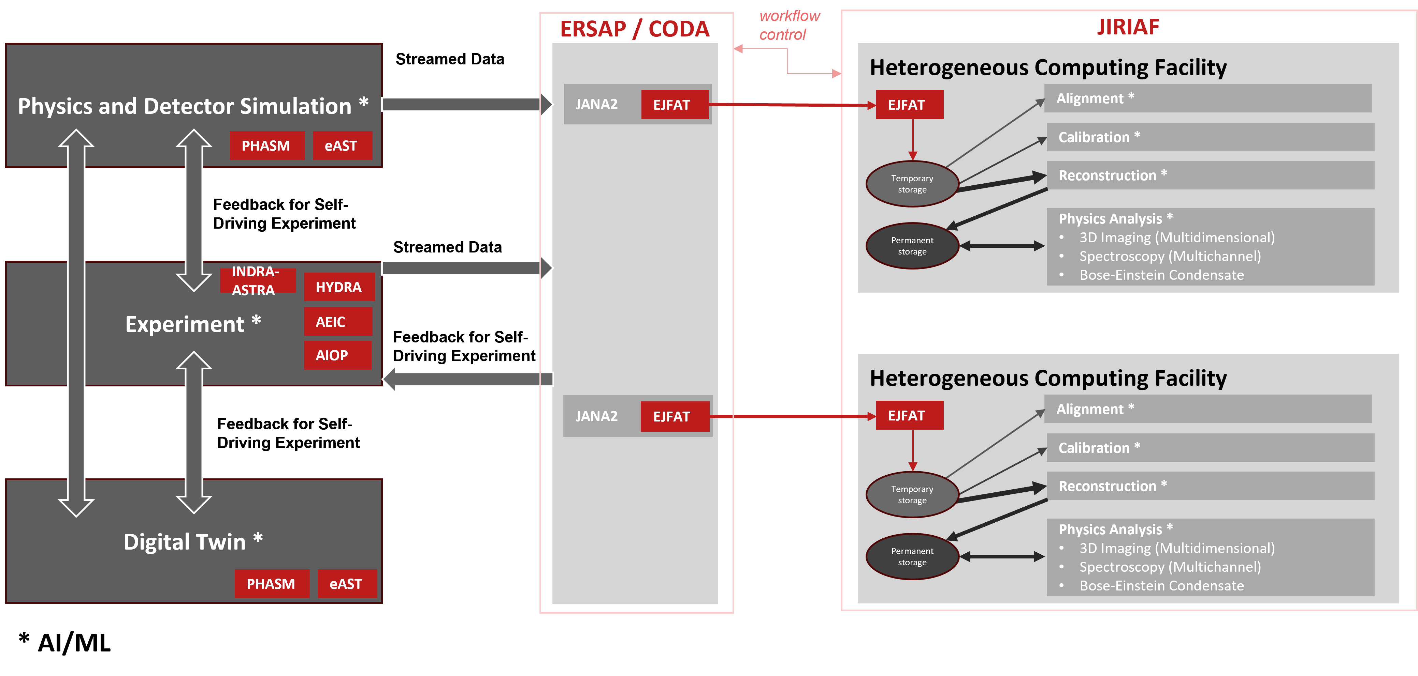
GC Related Projects

Slide 6
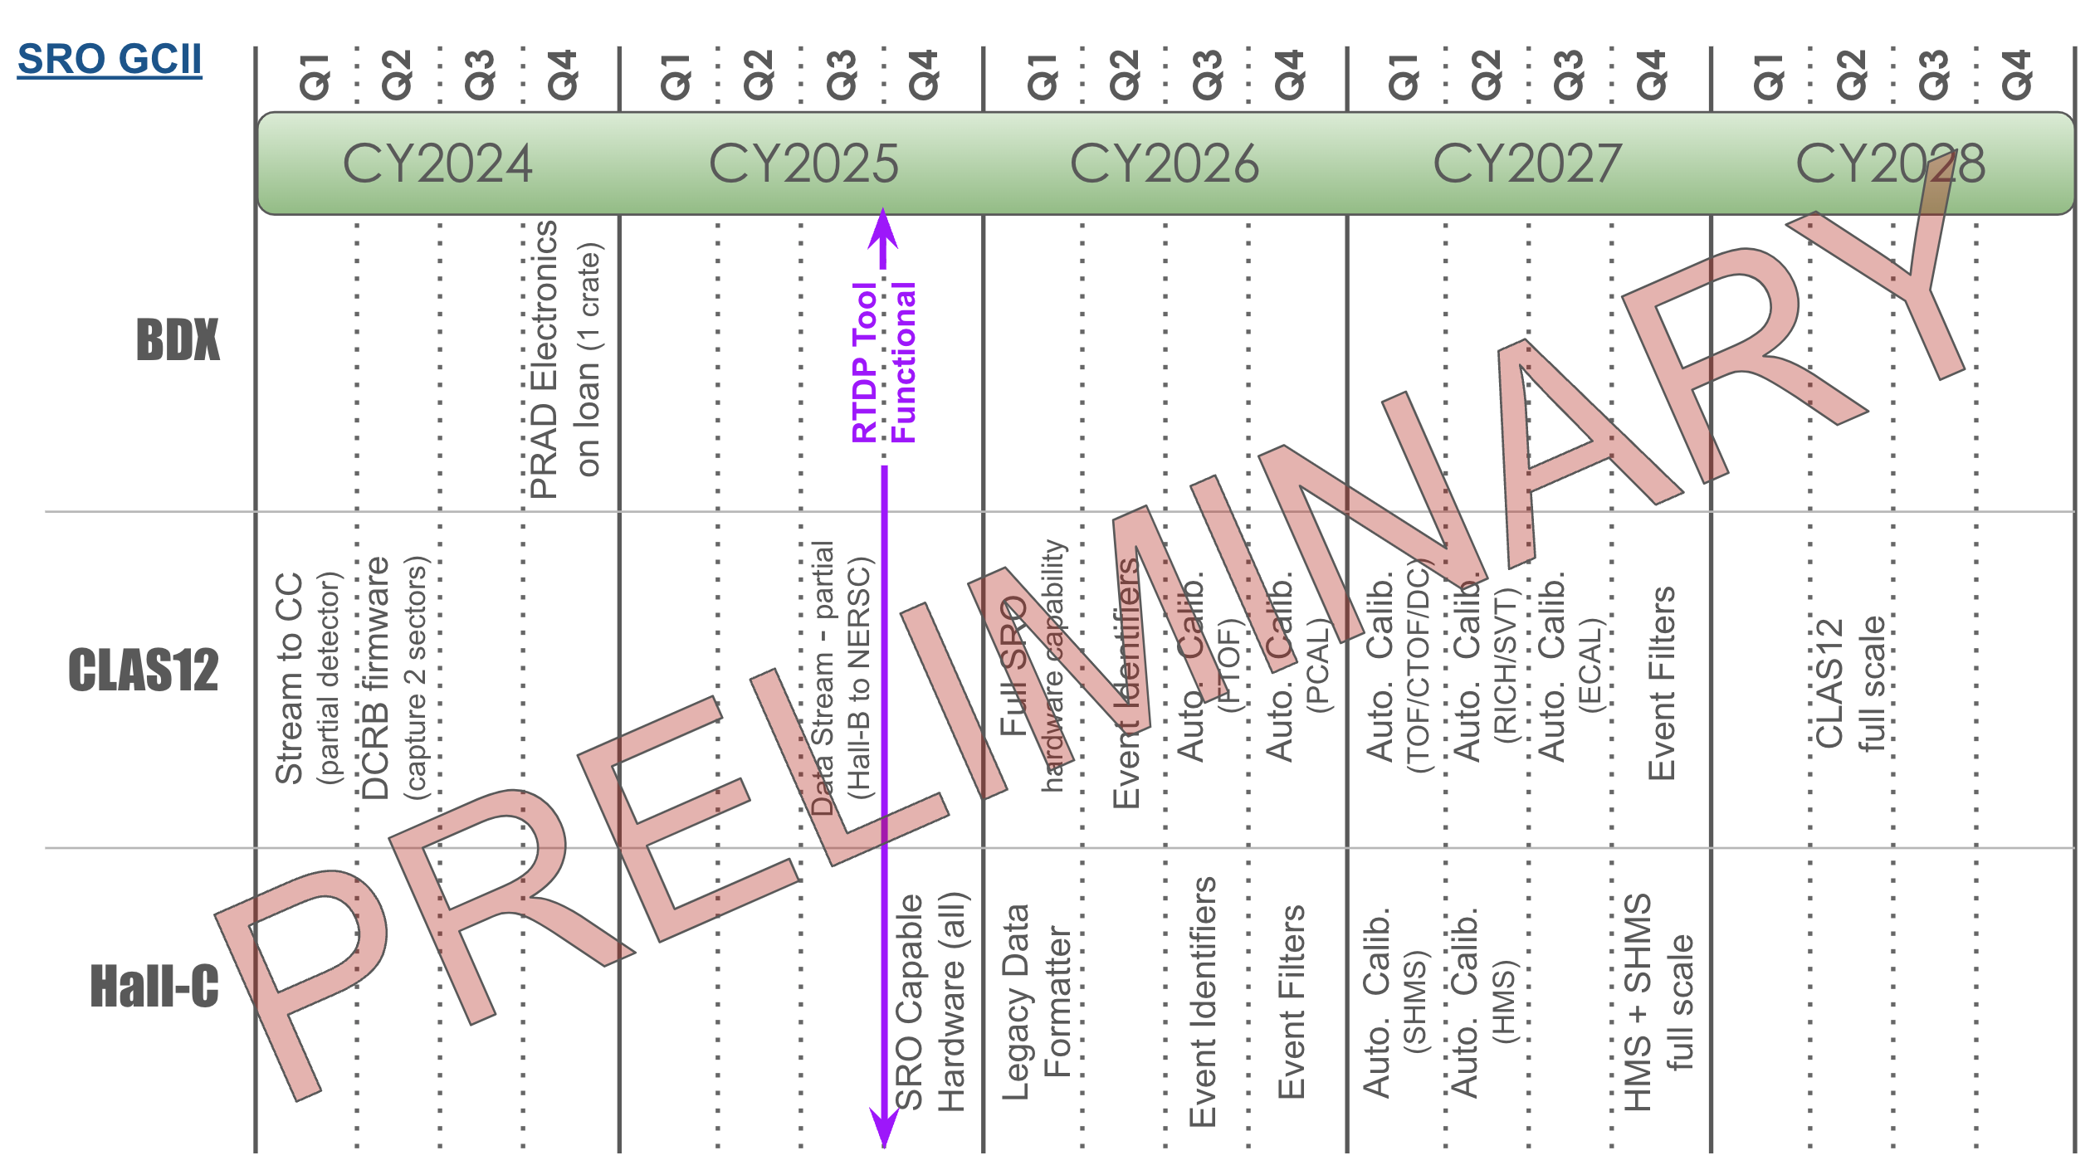
GC Timetable

Slide 7
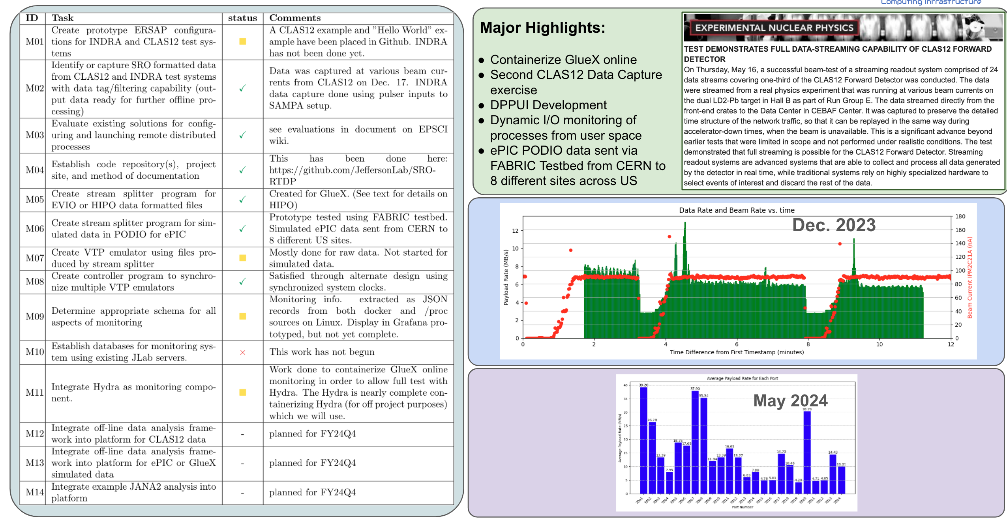
Milestones Achieved

Slide 8
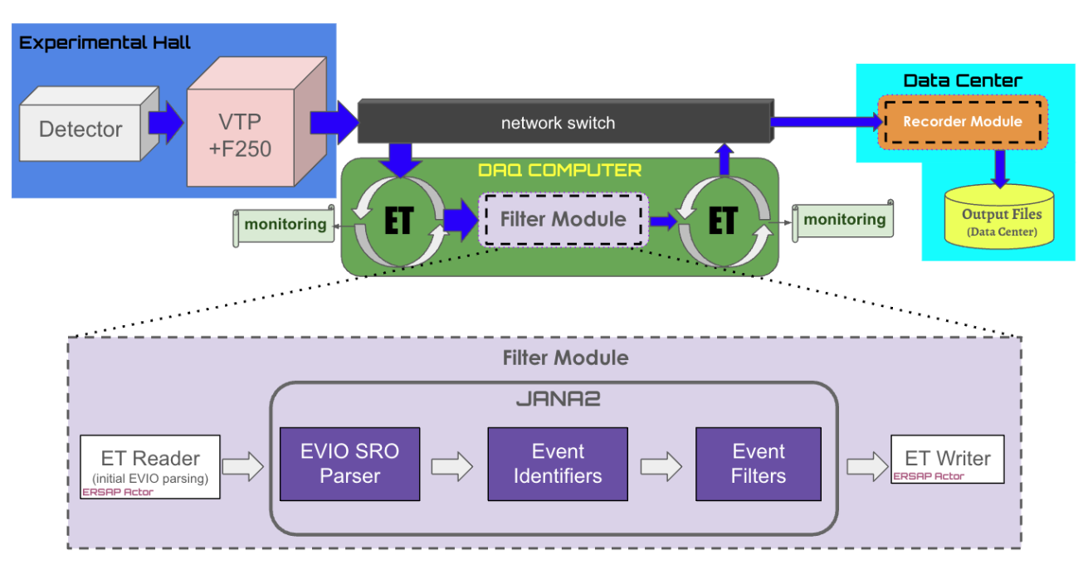
Current State

Slide 9
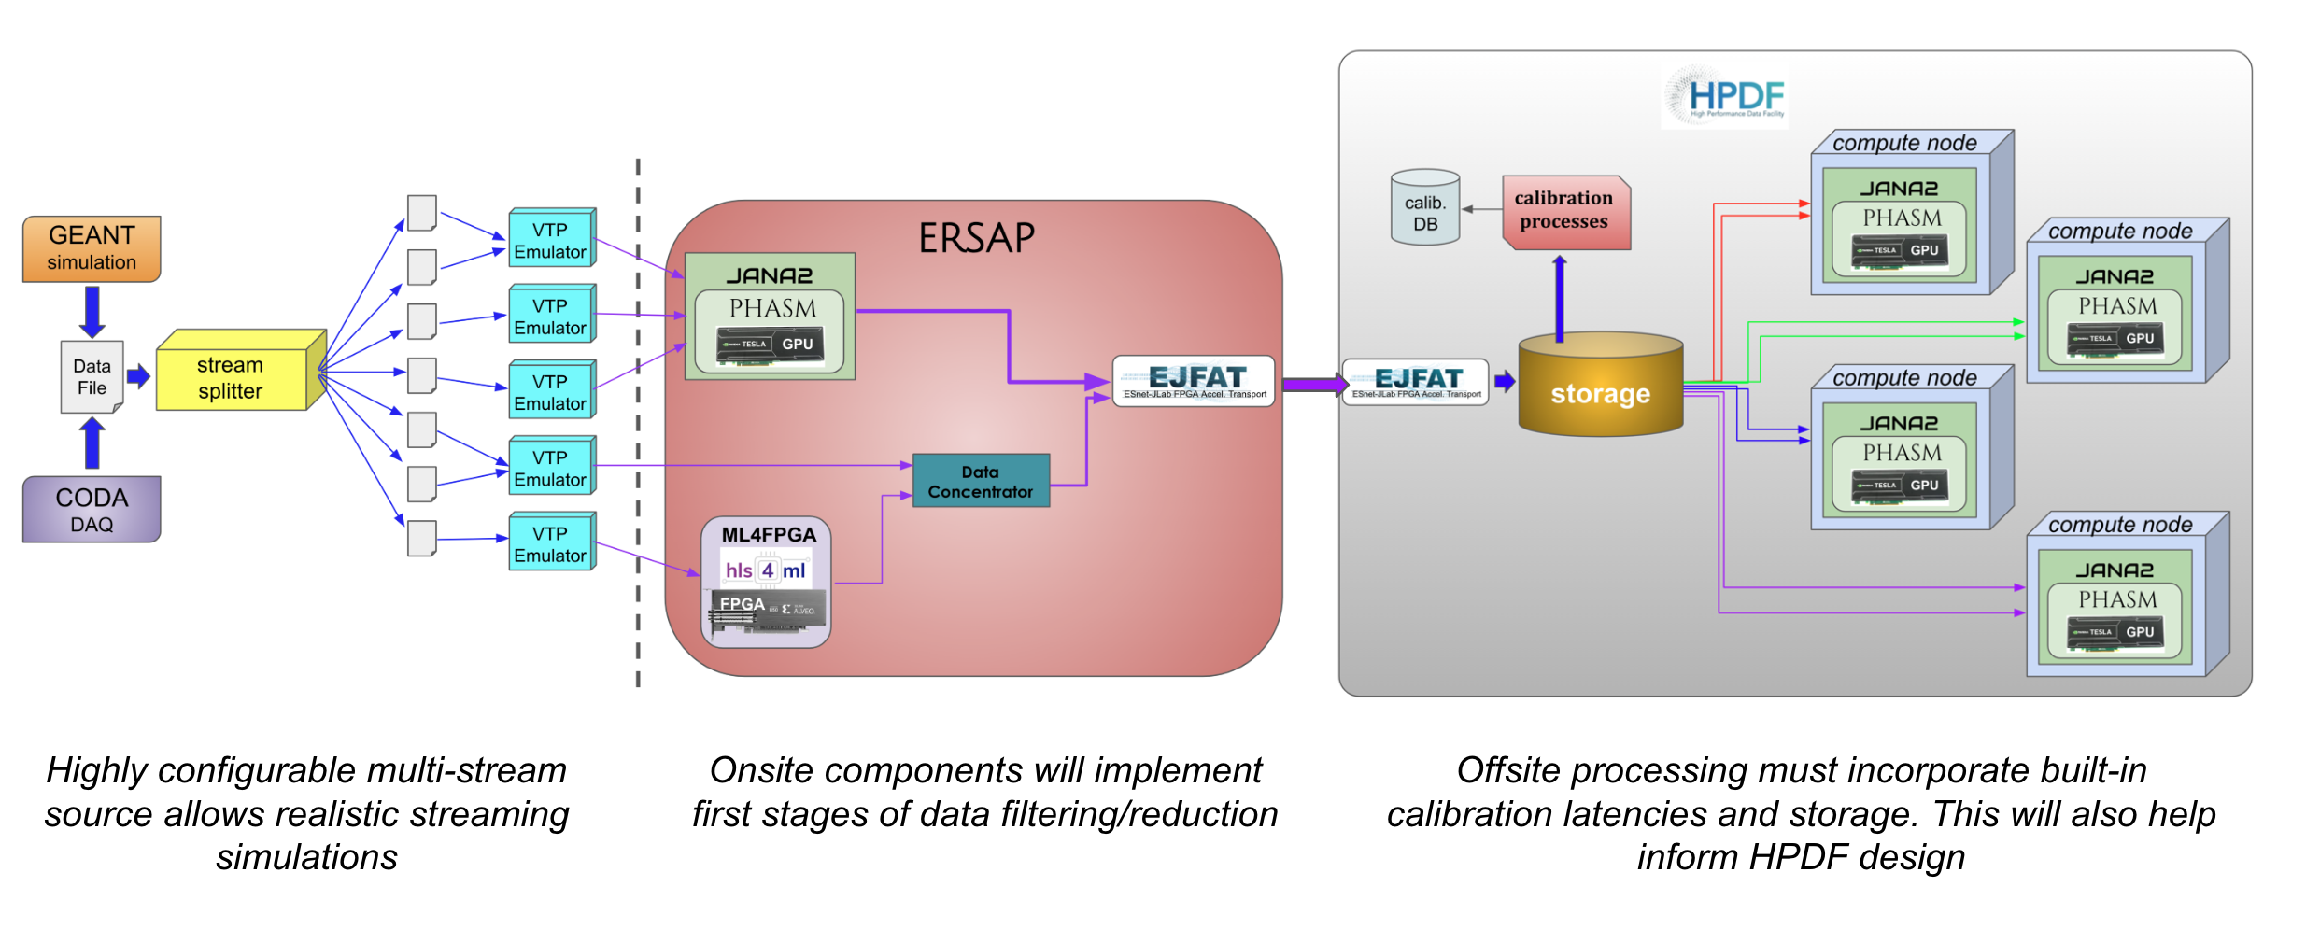
Final Deliverable

Slide 10
RTDP FE

Slide 11
Budget and Summary
SRO experiments will have a diversity and complexity of components beyond that of traditional DAQ systems.
A Real-Time Development and Testing Platform for Streaming Readout DAQ is a tool that will help develop the technical aspects of future JLAB experiments
This platform will benefit the HPDF in being flexible enough to provide streaming profiles for even non-NP experiments
Budget | FY24 | FY25 | Total
($K) | $271K | $285k | $556k*
*increase of $11k from original
David Lawrence (PI) | SSCS | 25%
Vardan Gyurjyan | SSIII | 15%
Cissie Mei | SCSII | 20%
Jeng-Yuan Tsai | Postdoc | 50%
Michael Goodrich | SSIII | 20%

Slide 12
Thank You

Slide 13
Reviewer Questions
Are additional in-beam SRO tests with CLAS12 or GlueX anticipated during FY25 given the issues with the Hall B test carried out to date? There are no specific plans at this time. Much of the work for RTDP itself can be done using the existing captured data. The late schedule start for FY25 beam (end of Jan.) will put additional pressure on the schedule so we will want to show show a significant benefit will be gained from the exercise being done now as opposed to the post-LDRD era (e.g. Fall 2025) when RTDP as a tool can be used.
What are your plans for reconstructing the collected SRO data to demonstrate integrity and offline SRO data “assembly”? The most viable path is likely to work with Hall-B to couple this into the AI/ML based fast recon L3 trigger system they are already developing. This will require less time from the RTDP developers who can focus more on stream integrity monitoring.
How will SRO tests be integrated with level-3 testing to develop a complete SRO system? From the RTDP standpoint, L3 is treated as a filter for L1 data so can use existing L1 data sets. We will focus first on GlueX data and then CLAS12 to ensure generality. The plan is to make use of Hall compute resources during beam down periods for some testing of longer data flows.

