Slide 1
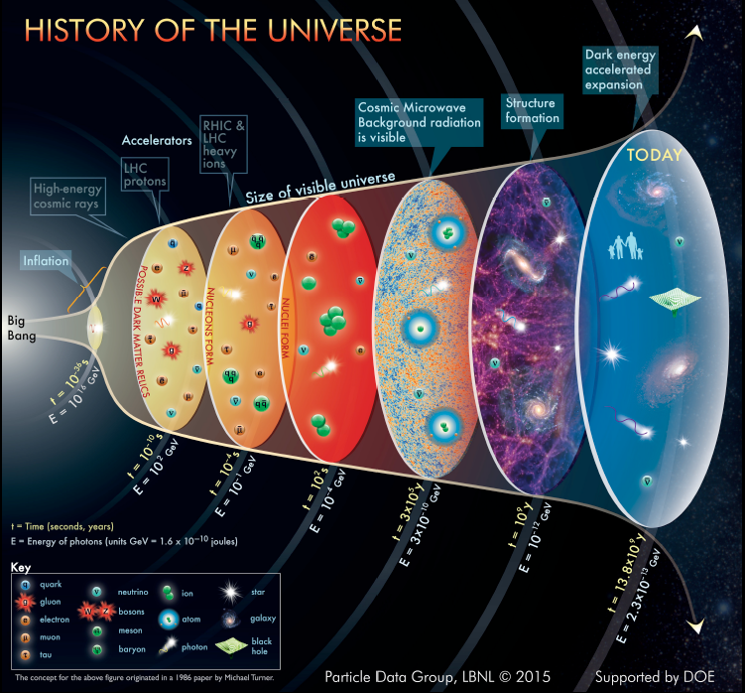
Nucleon Resonances in the Emergence of Hadronic Matter and Strong QCD
Studies of N* electroexcitation amplitudes (γ_{v}pN* electrocouplings) from exclusive electroproduction data of 6,12, 22 GeV eras @JLab for Q²<30 GeV² will offer unique opportunities to explore the full range of distances where N* states emerge.
Provide insight into many facets of the strong interaction in the regime of α_{s}/π~1 (strong QCD) seen in the generation of the full spectrum of N* states of different structure
Pave the way towards understanding strong QCD dynamics that underlie the generation of both meson and baryon structure including their ground and excited states
Shed light on the emergence of the dominant part of hadron mass (EHM)
The Higgs mechanism only generates the masses of bare quarks relevant to the perturbative QCD regime, contributing < 2% to the measured proton/neutron masses.
N*
The transition from the weakly bound quark/gluon to the hadron phases in the μs-old Universe
Quark-gluon confinement emerges
Chiral symmetry of QCD is broken
Quarks and gluons acquire mass
Baryon resonances form
Nucleons/N*s are the most fundamental 3-body systems. If we don’t understand how QCD builds each state in the N* spectrum, our understanding of sQCD is incomplete
The wealth of experimental data on N/N* and pion structure allows us to check any concept on EHM
1
2

Slide 2
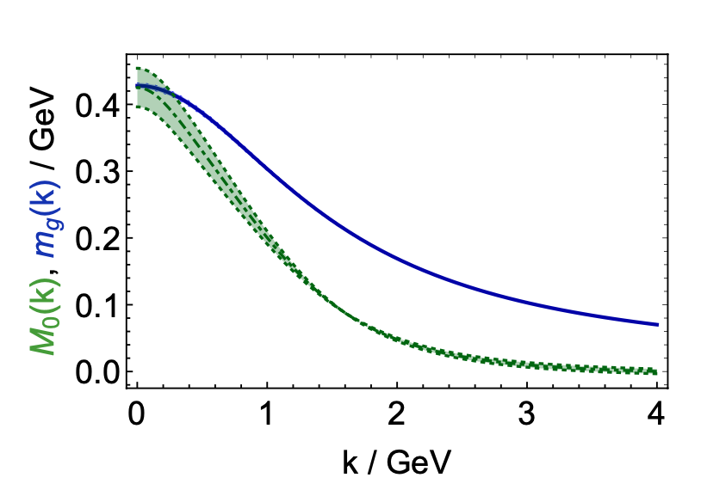
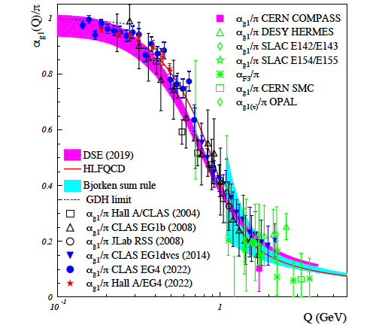
EHM Concept within Continuum Schwinger Method
Dressed Quark/Gluon Masses (continuum QCD)
C.D. Roberts, Symmetry 12, 1468 (2020)
Gluon self-interaction encoded in QCD Lagrangian represents a seed for EHM, producing the dressed gluon running mass via the Schwinger mechanism
Dynamically generated gluon mass shapes the evolution of the QCD running coupling α_{s}(Q) with distance/momentum
Dressed quarks with momentum- (distance-) dependent masses emerge from QCD, as follows from the equations of the motion for the QCD fields within CSM
Expresses the fundamental feature: emergence of the quark and gluon masses even in the case of massless quarks in chiral limit and massless QCD gluons.
The bound states of three dressed quarks generate the quark cores for the N/N* at a 1-2 GeV mass scale - M.Ding et al., Particles 6, 57 (2023)
The sensitivity of N* electroexcitation amplitudes to the dressed quark propagator allows us to map out the quark mass function - D.S. Carman et al., Particles 6, 416 (2023)
Dressed
gluons
Dressed
quarks
QCD Running Coupling α(Q)
Zh-F. Cui et al., Chin. Phys. C44, 083102 (2020)
A. Deur et al., Particles 5, 171 (2022)
2

Slide 3
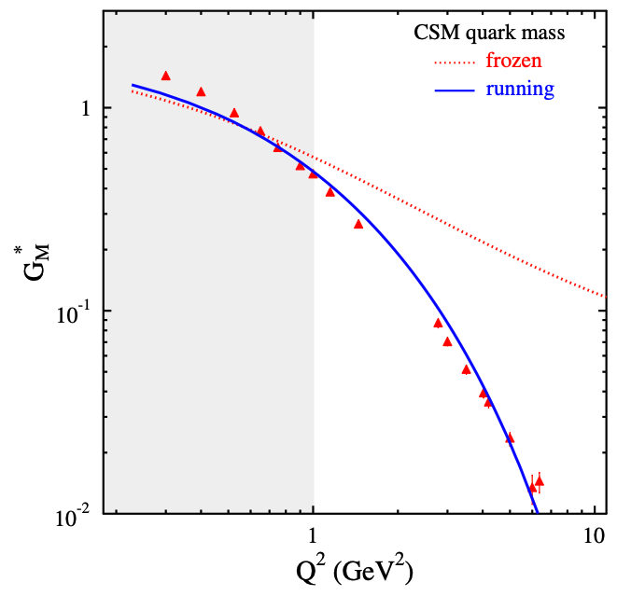
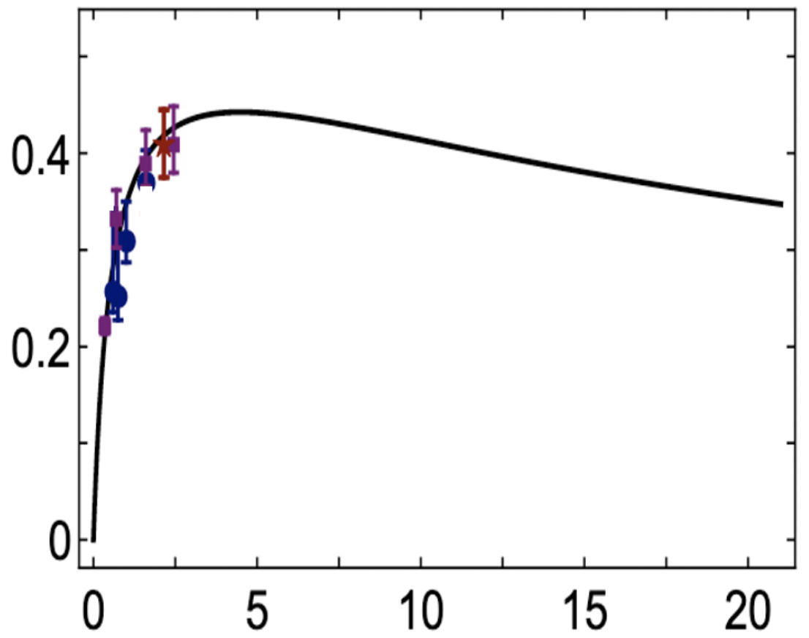
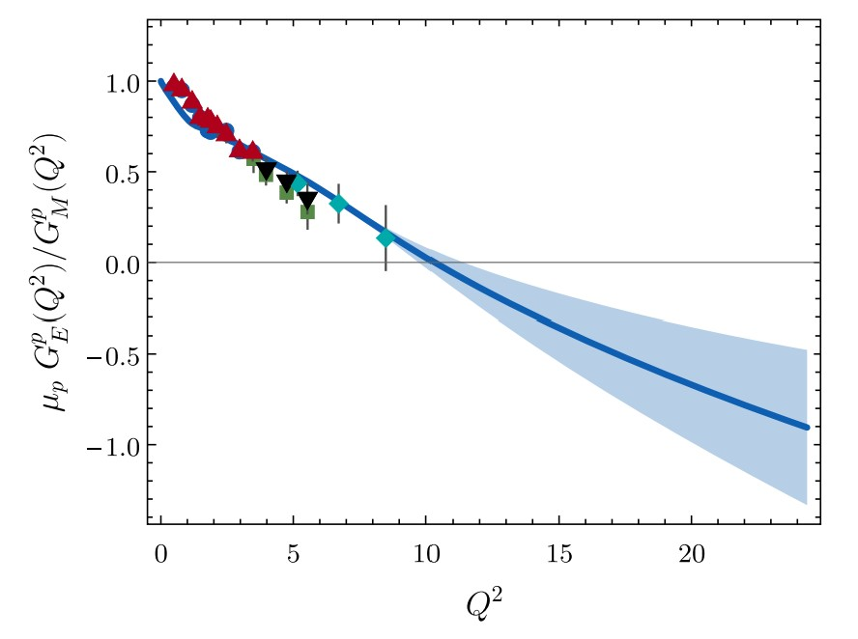


Validation of EHM Concept from CSM via Experimental Results
A successful description of the pion and nucleon elastic FFs and the electrocouplings of the Δ(1232)3/2⁺ and N(1440)1/2⁺ has been achieved with the same dressed quark/gluon mass function.
CLAS/Hall A/C results vs. CSM expectations
N→Δ(1232)3/2⁺ magnetic FF
N(1440)1/2⁺
Substantial contributions from M-B cloud
J. Segovia et al., FBS 55, 1185 (2014)
J. Segovia et al., PRL 115, 171801 (2015)
Pion Elastic FF
C.D. Roberts et al., Prog. Part. Nucl. Phys. 120, 103883 (2021)
Nucleon Elastic FF
M. Barabanov et al., Prog. Part. Nucl. Phys. 103835 (2021)
A_{1/2} Δ(1600)3/2⁺
Predicted electrocouplings of Δ(1600)3/2⁺ [Y. Lu et al., PRD 100, 034001 (2019)] were confirmed by the CLAS results [V.I. Mokeev et al., PRC 108, 025204 (2023)].
⇒ Strong evidence for insight into the momentum dependence of the dressed quark mass
Q² F_{π} / GeV²
μ_{p}G_{E}^{p}(Q²)/G_{M}^{p}(Q²)
Data points: JLab F_{π} Collaboration
Hall A/C data
Q² (GeV²)
Q² (GeV²)
One of the most important achievements in hadron physics of the last decade
from synergistic efforts between experimentalists, phenomenologists, and theorists
3
Notes:
- The picture of a quark inside of a hadron is a dynamical picture - what we effectively see depends on the quark momentum - review the picture and the importance of scale
- Model calculations of form factors and electrocouplings are sensitive to the evolution of the dressed quark mass function.
- Review the model calculations
- The data from CLAS12 will cover for the first time the range of Q2 where the dominant part of the hadron mass is generated addressing the key open problems of what is the nature of confinement and how is more than 98% of the visible mass in the Universe generated?

Slide 4
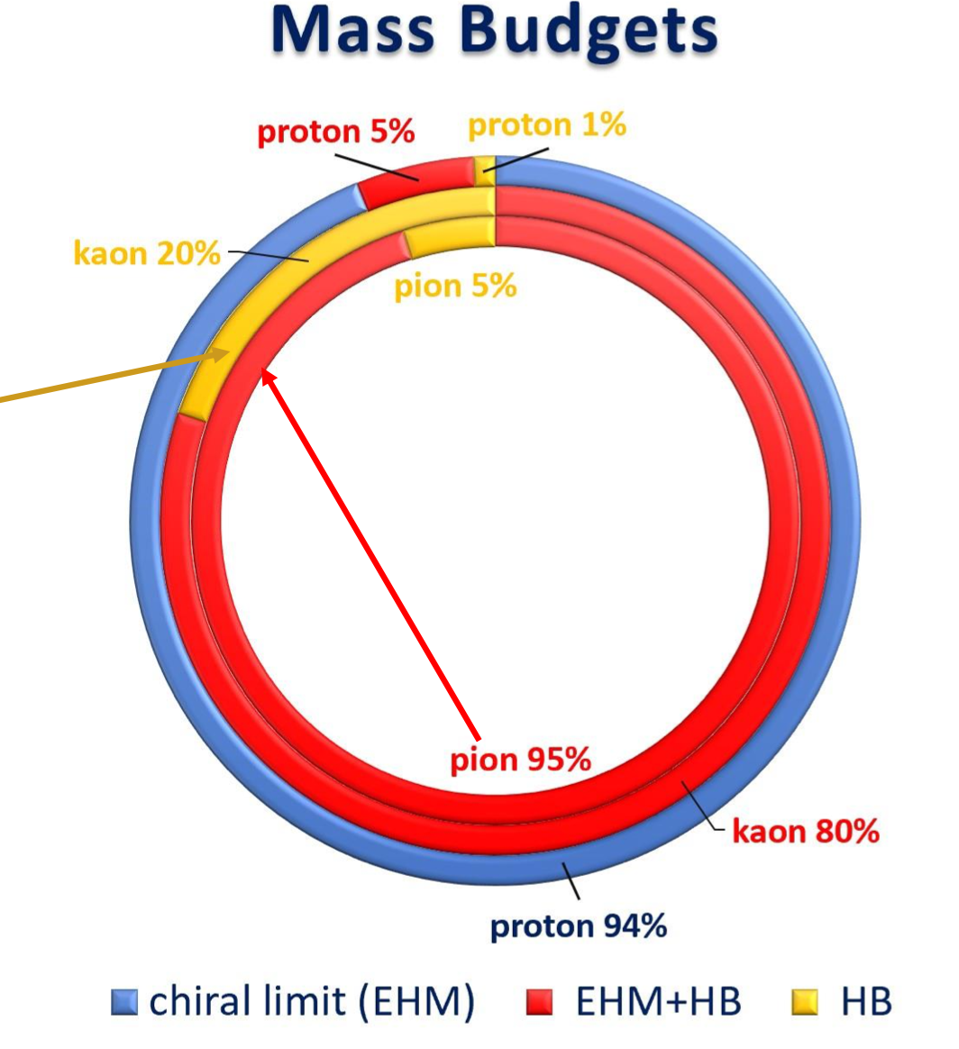
Bridging Efforts to Understand EHM from Studies of Meson and N/N* Structure
The results on the structure of pseudoscalar mesons and N/N* states from the experiments with electro-magnetic probes will allow for:
Studies of π/K structure to elucidate the interference between emergent and Higgs mechanisms in EHM
Studies of ground/excited state nucleon structure to explore the dressed quark mass function in a different environment where the sum of dressed quark masses is the dominant contribution to the physical masses of these states, offering insight into emergent mechanisms
The successful description of the π/K elastic FFs and PDFs, nucleon elastic FFs, and γ_{v}pN* electrocouplings of N*s of different structure achieved with the same dressed quark mass function is of particular importance for the validation of insight into EHM.
4

Slide 5
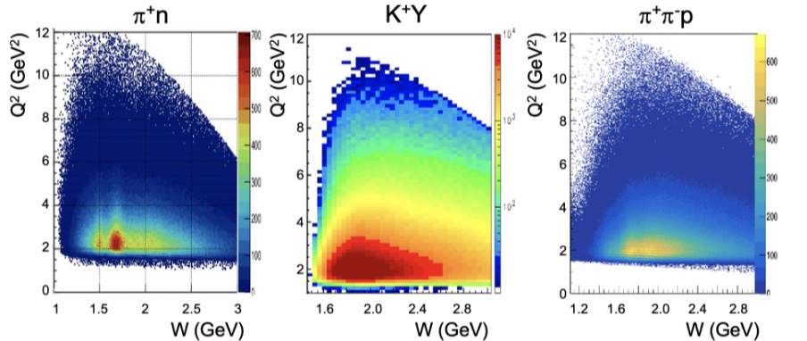
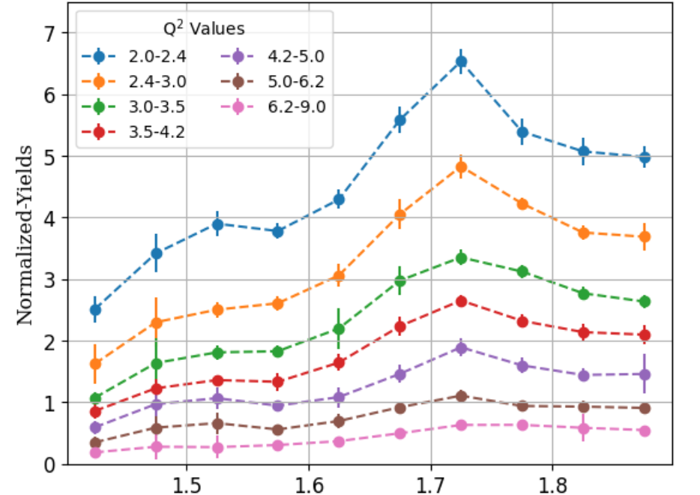
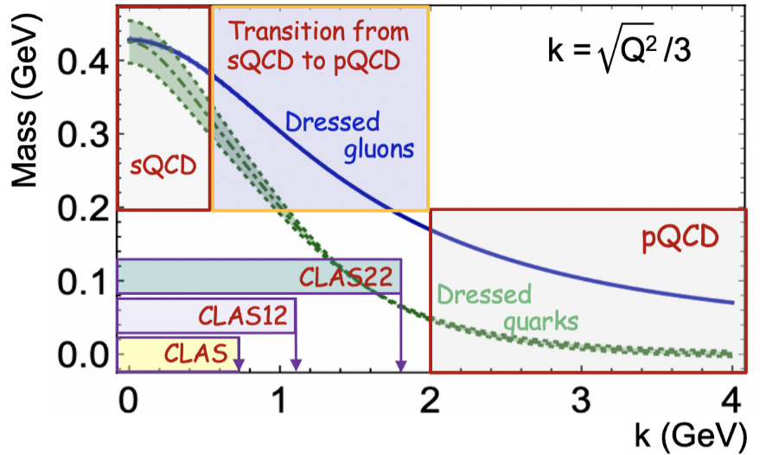
Measurements with CLAS12 and “CLAS22”
Meson electroproduction yields measured with the CLAS12
CLAS12: Extension of the results on N* electrocouplings for W < 2.5 GeV and Q² to 10 GeV² from exclusive channels, πN, ππN, KY, K*Y, KY*, allows us to map out the range of quark momenta where ~50% of dressed quark mass is generated
Efficiency corrected π⁺π⁻p yields binned over W/Q² from RG-A data
A. Accardi et al., arXiv:2306.09360 [nucl-ex]
W, GeV
5

Slide 6
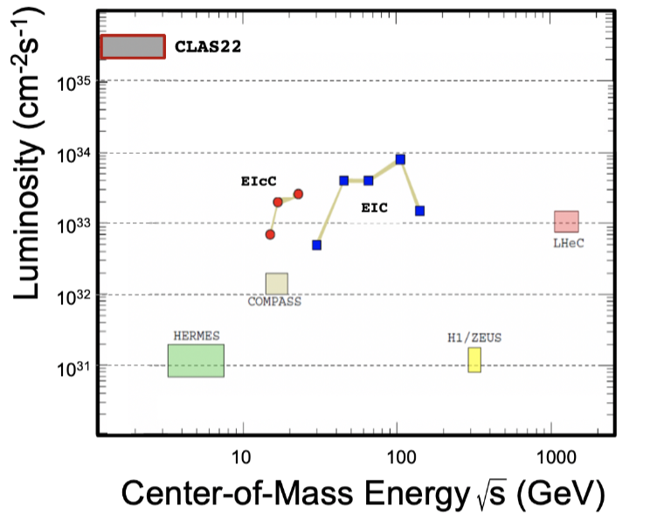
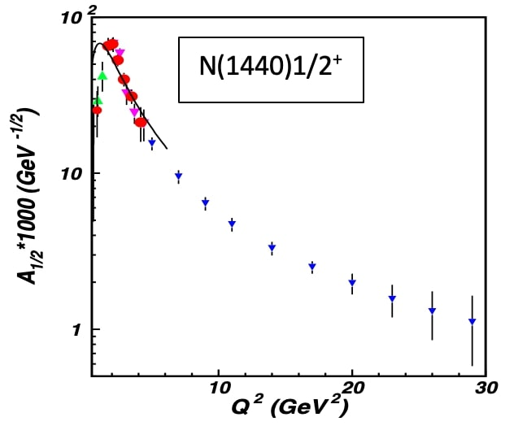
Unique Opportunities to Study EHM from N* Structure @ 22 GeV CEBAF
Simulations of πN, KY, and π⁺π⁻p electroproduction with CEBAF@22 GeV show:
γ_{v}pN* electrocouplings can be determined to Q² ~ 30 GeV² for 𝓛 ~ 2 - 5 ⨉ 10³⁵ cm⁻²s⁻¹
Both EIC and EIcC would need much higher luminosity to carry out such a program ⇒ the luminosity “frontier” is a unique advantage of CEBAF@22GeV
x→1
x→0
Extending the results to Q²~30 GeV² with CEBAF@22 GeV (and pushing the CLAS12 capabilities to the highest possible luminosity for exclusive studies), will offer the only opportunity to explore how the dominant part of the hadron mass and N* structure emerge from QCD to make CEBAF@22 GeV the ultimate QCD-facility at the luminosity frontier.
6

Slide 7
Back-Up
Can be of interest for discussion after the presentation

Slide 8
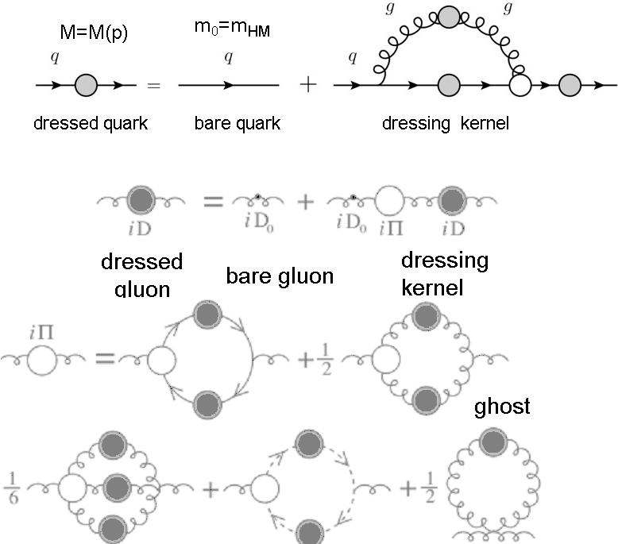
EHM Concept Developed within Continuum Schwinger Method
Emergence of Dressed Quarks and Gluons
D. Binosi et al., Phys. Rev. D 95, 031501 (2017)
QCD Running Coupling α(Q)
Zh-F. Cui et al., Chin. Phys. C44, 083102 (2020)
A. Deur et al., Particles 5, 171 (2022)
Owing to non-zero gluon running mass, α(Q) becomes finite at Q<0.5 GeV, making QCD a well-defined theory without divergences in the infrared/ultraviolet
Gluon self-interaction encoded in QCD Lagrangian represents a seed for the emergent part of hadron masses, producing dressed gluon running mass via the Schwinger mechanism.
In the regime of QCD running coupling comparable with unity, dressed quarks and gluons with momentum (distance) dependent masses emerge from QCD, as follows from the equations of the motion for the QCD fields depicted above. The bound states of three dressed quarks generate the quark cores for the ground and excited states of the nucleon at a 1-2 GeV mass scale.
8

Slide 9
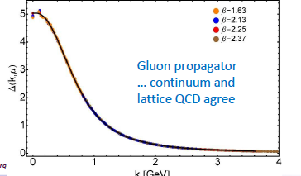
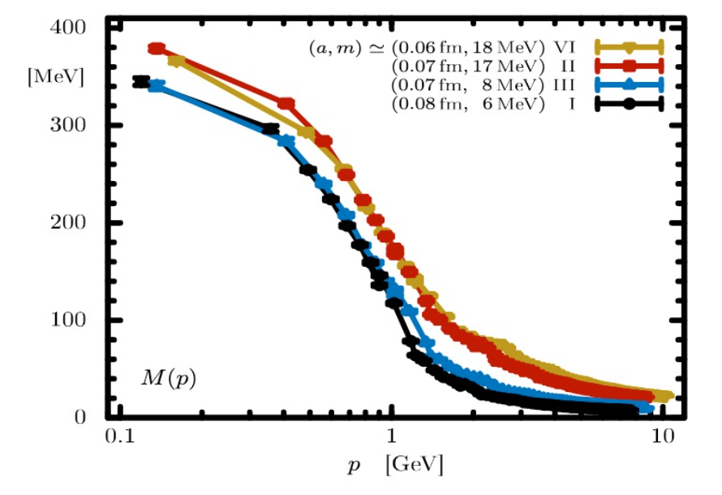
Continuum/Lattice QCD and Experiment Synergy for Insight into EHM
Dressed Quark/Gluon Masses (continuum QCD)
C.D. Roberts, Symmetry 12, 1468 (2020)
Dressed quark/gluon masses converge at the complete QCD mass scale of 0.43(1) GeV.
Express the fundamental feature: emergence of the quark and gluon masses even in the case of massless quarks in chiral limit and massless QCD gluons.
LQCD confirms continuum QCD results.
The sensitivity of N* electroexcitation amplitudes to the dressed quark propagator allows us to map out the quark mass function.
Dressed
gluons
Dressed
quarks
Inferred from QCD Lagrangian with only the Λ_{QCD} parameter
Dressed Quark Mass (lattice QCD)
O. Olivera et al., Phys. Rev. D 99, 094506 (2019)
k [GeV]
9

Slide 10
Nucleon Resonance Electrocouplings from Data on Exclusive Meson Electroproduction of 6 GeV Era with CLAS
Exclusive meson electroproduction channels | Excited proton states | Q²-ranges for extracted γ_{v}pN* electrocouplings, GeV²
π⁰p, π⁺n | Δ(1232)3/2⁺ N(1440)1/2⁺,N(1520)3/2⁻, N(1535)1/2⁻ | 0.16-6.0 0.30-4.16
π⁺n | N(1675)5/2⁻, N(1680)5/2⁺,N(1710)1/2⁺ | 1.6-4.5
ηp | N(1535)1/2⁻ | 0.2-2.9
π⁺π⁻p | N(1440)1/2⁺, N(1520)3/2⁻ N(1440)1/2⁺, N(1520)3/2⁻, Δ(1600)3/2⁺ Δ(1620)1/2⁻, N(1650)1/2⁻, N(1680)5/2⁺, Δ(1700)3/2⁻, N(1720)3/2⁺, N’(1720)3/2⁺ | 0.25-1.50 2.0-5.0 0.5-1.5
The γ_{v}pN* electrocouplings have become available from analysis of CLAS data for most N* states in the mass range <1.8 GeV and in the range of Q² < 5 GeV².
Numerical results can be found at https://userweb.jlab.org/~mokeev/resonance_electrocouplings23/ - A.N. Hiller Blin et al, PRC100, 035201 (2019)
The experiments in Halls A/C extended the results on γ_{v}pN* electrocouplings of Δ(1232)3/2⁺ and N(1535)1/2⁻ for Q² < 7.5 GeV².

Slide 11
EHM from γ_{v}pN* Electrocouplings Determined from the CLAS Data
The γ_{v}pN* electrocouplings of most N* within the mass range up to 1.8 GeV for Q²<5 GeV² will become available by 2024. In a few years, this information will be extended for most N* states within the mass range up to 2 GeV for Q²<5 GeV².
Recently, electroexcitation amplitudes for N* within the mass range up to 1.8 GeV were determined for Q²<5 GeV² at the pole positions within coupled channel analysis of Nπ Nη, KY photo-/electro- and hadroproduction data in Y-F. Wang et al., arXiv:2404v2 [nucl-th]. The authors conclude “…. qualitative comparisons with Breit-Wigner determinations of other studies show no obvious disagreement.”
Bonn-Gatchina coupled channel approach provided preliminary results on electroexcitation amplitudes for N* within the mass range up to 1.8 GeV for Q²<1 GeV² at the pole positions
Analyses of these results within CSM will allow us:
to establish either universality or environmental sensitivity of dressed quark mass function by comparing the CSM expectation and the electrocouplings of resonances of distinctively different structures extracted from the data;
shed light on DCSB manifestation in comparative studies of the chiral partner electrocouplings;
Explore di-quark correlations of different spin-parities/isospins.
Comprehensive treatment by other strong QCD theory tools is highly desirable.
11

Slide 12
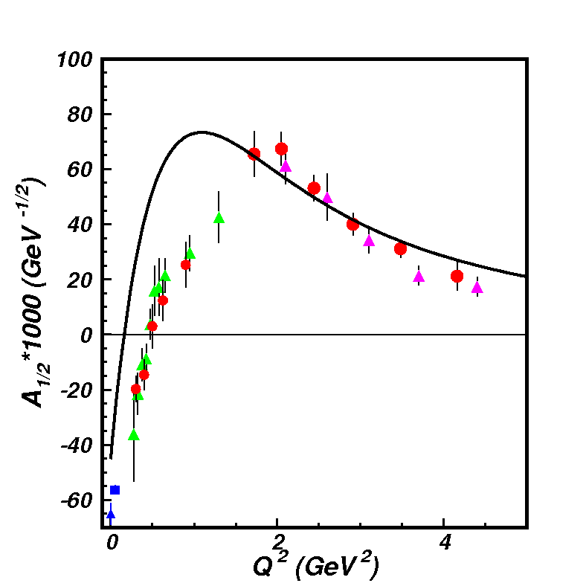
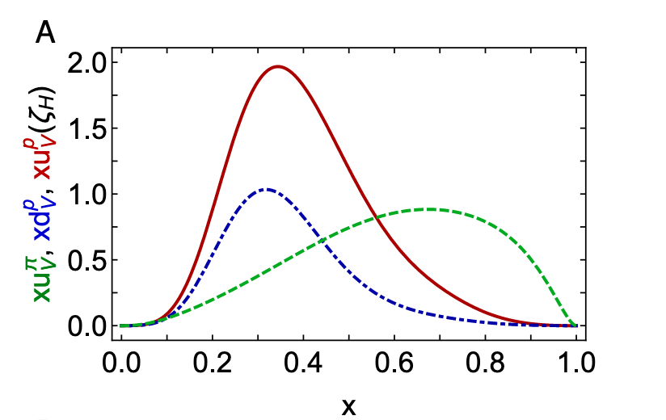
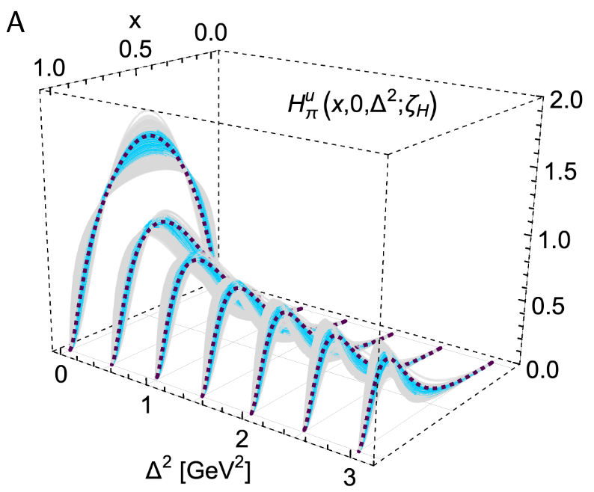
EHM from Global Hadron Structure Analysis within CSM
This will be extended by the future data on γ_{v}pN* electrocouplings from CLAS12 in the 12 GeV era
Nucleon Elastic FF
γ_{v}pN* Electrocouplings
Proton and pion PDF for valence quarks
N(1440)1/2⁺
μ_{p}G_{E}/G_{M} (Q²)
in DSEQCD
Pion GPDs
New data from studies of D-Y at AMBER and Sullivan processes at JLab
Pion Elastic FF
Pion PDF
CSM is currently the only approach that offers insight into EHM from combined studies of meson/baryon structure with connection to QCD. Ref. C.D. Roberts, FBS 64, 51 (2023).
12

